Slide 1
ENVIRONMENTAL HEALTH, OCCUPATIONAL HEALTH AND SAFETY QUESTIONS
KIMAIGA H.O
MBChB (University of Nairobi)

Slide 2
ENVIRONMENTAL HEALTH
Differentiate between global warming and ozone depletion:
Global warming:
Is the increase in temperature in the trophosphere which is due to green house gases such as CO₂, water vapour, methane, CFCs, N₂O and O₃ accumulating in the atmosphere and preventing heat from escaping to the latter. This leads to:
Melting of ice caps and glaziers
Allterations in agriculture or animal husbandry
Fecundity of diseases
Increase in population of pests that destroy crops
Heat strokes
Ozone depletion is the destruction of the ozone layer (O₃) in the stratosphere into O˟ + O₂ by other gases such as CFCs and HODS. This leads to:
Increased skin cancers
Increased cataracts
Increase immunosuppressive statuses

Slide 3
Outline two ways by which urbanization increases the prevalence of respiratory illness among urban dwellers

Slide 4
Outline 5 features that describe adequate housing:
Structure of shelter (i.e. protection from resting and breeding sites of vectors plus plastering)
Adequate water provision (quantitatively i.e. waterborne diseases and qualitatively i.e. water washed diseases)
Adequate waste disposal services
Safe housing structure (safe from landslides, floods, collapses etc.)
Overcrowding (to avoid TB, meningococcal meningitis...)
Absence of indoor air pollution from domestic fuel use
Food safety standards (storing food appropriately to avoid spoilage and contamination)
Absence of vectors and hosts of diseases
Home as a workplace (occupational health issues e.g. toxic substance storage)
Other features i.e. cost of housing, home tenure (the conditions under which land or buildings are held or occupied) e.g. stress caused by home tenure and social aspects

Slide 5
From the public health perspective, briefly discuss the merits and demerits of use of DDT pesticide.
a) What is a sanitary landfill?
b) Name 4 standard requirements for a sanitary landfill.

Slide 6
a) State 2 environmental adverse effects that can result from indiscriminate disposal of agrochemicals.
b) Name 2 methods of disposing off leftover agrochemicals and their empty containers in an environmentally sound manner.
c) Provide a toxicological interpretation given that one pesticide has a lethal dose (LD50) of 6750mg/Kg body weight and the other one has a LD50 of 350mg/Kg body weight.
a)What does the acronym “HACCP” stand for ?
b) State how HACCP processes can be applied to eliminate/control the following contaminants before food is consumed:
Biological contaminants
Chemical contaminants
Physical contaminants

Slide 7
a) What is acid rain?
b) How does acid rain affect food security?
c) Name one (1) negative environmental impact caused by acid rain
d) Name one(1) economic negative impact caused by same
A water body like Lake Victoria continues to receive affluent containing persistent organic pollutants (POPs) and heavy metals.
Name two types of POPs likely to be found in this particular lake or other water causeways in the country (Kenya).
Name two heavy metals likely to be found in this lake or other water courses in the country.
The concentration of one of the POPs in the smallest type of fish is 5X ppm What would be the concentration of the same POP in the water?
Elaborate briefly on managerial and political constraints in improving the situation of waste water and excreta disposal in Kenya.

Slide 8
Differentiate citing examples between unintentional persistent organic pollutants (POPs) and POPs pesticides.
Discuss how each type of the POPs can affect the environment and ultimately human health.

Slide 9
Describe how child mortality may be influenced by at least four environmental factors
What is a Port Health Office and where in a country should it be located?
What are the functions of a Port Health Office
Name Four diseases of which a Port Health Office is concerned with in Kenya

Slide 10
Name two heavy metals and describe how each can contaminate food/water
State the effect of each on human health.
Name 2 types of non invasive samples that should be taken from human population for analysis in the laboratory to establish the levels of heavy metals in that populatio

Slide 11
SHORT ESSAY QUESTIONS
1. Using five environmental health indicators explain the how environment impacts on health.

Slide 12
Cite five (5) major differences between persistent organic pesticides and organophosphate pesticides on the basis of their impact on the environment and human health.
From the public health perspective, briefly discuss the merits and demerits of chlorination of drinking water.

Slide 13
In the Daily Nation of 23rd July 2009 page 59, it was reported that “Kenya is facing a severe shortage of food and water with more than 10 million people requiring urgent assistance”. Select two Millennium Development Goals and outline how their achievement in Kenya may be influenced by this food and water crises.

Slide 14
Outline 5 major principles of adequate housing?
Fundamental physiological needs
Fundamental psychological needs
Protection against contagion
Protection against accidents
Residential neighbourhood

Slide 15
What is meant by sanitary land fill?
Also known as controlled pitting this is the effective and hygienic method of solid waste disposal wherever land is available. It is an engineered method, where land is excavated in known dimensions for long term disposal of solid waste

Slide 16
From public health point of view, state 2 advantages of having a ventilated improved pit latrine (VIPL) over ordinary pit latrine
State the merits and demerits of chlorination of drinking water

Slide 17
Outline 4 elements that reflect urban poverty and vulnerability
Informal settlement
Overcrowding
Poverty and resource
Social deviance – Crime, Humility, Early pregnancy
Unemployment

Slide 18
OCCUPATIONAL HEALTH AND SAFETY
Name 2 occupational hazards with potential to cause diseases or abnormal health conditions in a rural setting like where you carried out your community diagnosis exercise in weeks 8 and 9
Extremes of temperature:
Heat: heat edema, heat rashes, heat cramps, heat exhaustion, heat syncopy and heat stroke
Cold: frost nip, frost bite and hypothermia
Ergonomics: air pollution, infertility and accidents

Slide 19
Name 3 chronic health conditions that are associated with long term exposure to pesticides.
Congenital
Skin
Respiratory
Eye
Cancers

Slide 20
List 3 functions of occupational health and safety committees
Establish a schedule of inspection of the workplace for each calendar year
Conduct inspection at least once in 3 months
Establish adequate communication between management and workers on matters of health and safety
Identify occupational hazards and cases of ill health and make appropriate recommendations
Compile statistics of accidents, dangerous occurrences and cases of ill health at workplace for remedial measures, planning and resource allocation
Advise of adequacy or otherwise of safety and health measures for particular hazardous work or activities
Investigate complaints relating to workers health, welfare and safety at workplace and make representations employer
Conduct seminars and workers’ education programme; safety, health and welfare information

Slide 21
State 4 key stakeholders who should be involved in fire safety; in managing (putting off) a work place fire outbreak including managing the victims
County and private fire brigades
Nearest health facilities plus health care proffessionals
County and private ambulance services
County and national police
Relevant NGOs and Red Cross
County staff
City council
What is the mandate of the Directorate of Occupational Health and Safety Services in Kenya?
Is a department under the ministry of labour in charge of implementing the occupational health act

Slide 22
Name all the classes of fire and state the type of fire extinguishers corresponding to each class of fire.
CLASS/TYPE OF FIRE | EXTINGUISHER USED
Class A Fires involving the burning of ordinary material | Large quantities of water Sand
Class B Fires that occur in vapour mixture of flammable material | Foam, Carbon dioxide or Dry powder
Class C Fires caused by energized electrical equipment | Carbon dioxide or Dry powder
Class D Fires that involve burning of metals ( potassium, sodium, lithium,titanium) | Special extinguishing powder which covers the surface or CO₂, water or dry powder

Slide 23
Describe two types of medical examinations other than the pre-medical examination of which workers are subjected to.
Name 2 major approaches recommended for the control of occupational dermatoses
What FIVE major categories /types of occupational hazards are we concerned with at work place environment?
Give an example of each hazard you list in (a)
State how each of the hazard can be prevented or minimized

Slide 24
Define the concept of occupational accidents
Describe two worker related and two work environment related causes of accidents
What FIVE major categories /types of occupational hazards are we concerned with at work place environment?
Give an example of each hazard you list in (a)
State how each of the hazard can be prevented or minimized

Slide 25
a) Differentiate between Environmental Management & Coordination Act 1999 and Occupational Safety & Health Act Cap 514 of Laws of Kenya.
b) State four purposes of accident investigation at work place.

Slide 26
List five major causes of occupational dermatoses and state how each can be controlled.
Name 3 specific ergonomic hazards and the associated health outcomes. Briefly state how each hazard can be prevented or minimized.
Describe briefly 5 methods recommended for the control of pneumoconiosis.
Describe 5 problems that may affect the work place/environment due to use of alcohol and illicit drugs by the workers.
Work load may cause job related stress. Briefly explain .
Accidents are caused, they do not just happen! Explain two worker-related and three working environment factors that may lead to accidents at places of work.
Explain the AREC concept.

Slide 27
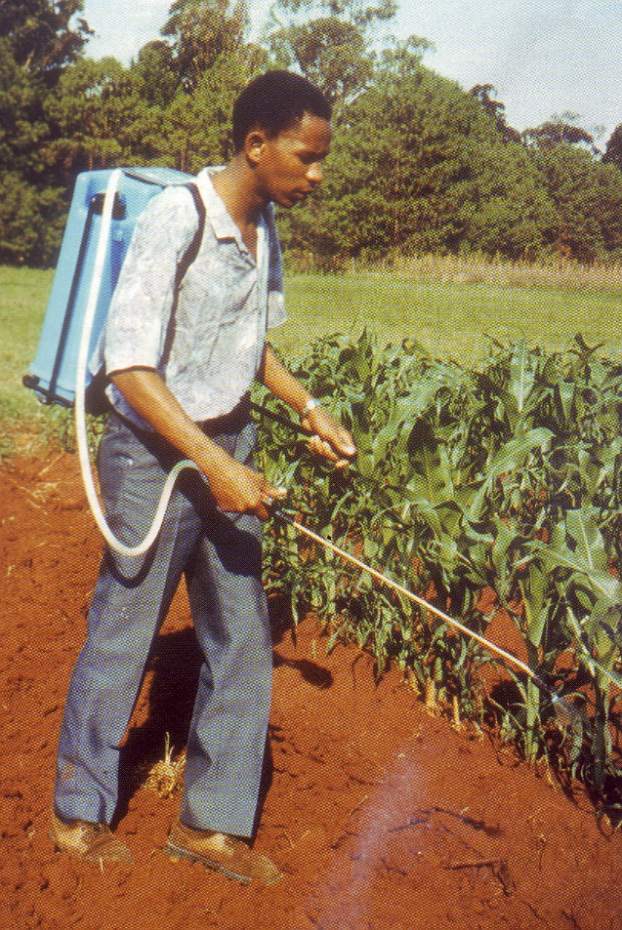
In order to answer this question, refer to Figure I
Name 5 major types of potential health hazards to which this particular worker is exposed.
Briefly describe 2 acute and 3 chronic health out come which may result from the hazards named in (i).

Slide 28
Name and describe three blood borne pathogens that health care workers
may be exposed to at their work place. Propose the control measured to these risks.
List five (5) methods or practices other than use of personal protective clothing which should be practiced in order to minimize the health hazards in the work environment.

Slide 29
1b) An epidemiologic occupational survey revealed that 75 workers were suffering from white lung disease . Past information showed that 100 of them had been working in a plant for 30 years . The survey further showed that another group of 100 subjects did not work there but 25 of them had the same kind of health outcome. The 2x2 table below provides a descriptive summary of the survey.
What name would you give to this kind of survey?
Calculate the odds ratio (OR) for this group
Interpret the OR
What was this group of workers exposed to?
How would the exposure be minimized?
 | Developed dx | Did not develop dx | Total
Exposed | 50 | 50 | 100
Not exposed | 25 | 75 | 100

Slide 30
Some of the accidents at work places are due to human factors. State 5 ways/methods that ought to be exercised to prevent or substantially reduce human related accidents.

Slide 31
Mr. Kenya wishes to expand his textile manufacturing factory. Cotton farmers are very excited because the factory will be receiving raw cotton from farmers thus boosting their income. The government is also very pleased because Mr Kenya will create some jobs as part of the projected 500,000 jobs/year. Mr Kenya though an entrepreneur is aware of potential trouble pertaining to occupational health issues. He wishes to hire you to assist.
Using examples, explain to Mr. Kenya about four occupational hazards associated with this kind of factory and how he can protect the workers health from each hazard.
Explain to him how to obtain data that he can use to determine whether the working environment is healthy once operations start.
Putting up an occupational health and safety management system will not only protect workers health and well being but may also increase his profits and corporate image of his organization. Outline to Mr. Kenya the elements of an effective occupational health and safety management system.

Slide 32
Material Safety Data Sheet (MSDS) is a very important document in specific work places.
Name 3 types of information contained in MSDS
State two important sets of information provided in MSDS useful to the health care workers at times of disaster/ incident.

Slide 33
Describe what you understand by the term Port Health Office?
Where in a country should it be located?
What are the functions of a Port Health Office
Name Four diseases of which a Port Health Office is concerned with in Kenya

Slide 34
Write an account on psychological hazards in relation to industrialization in Kenya?
They result from a complex interplay of job and the following factors:-
Demands, skills, descion making, attitude, personal control of work & social interactions OR factors & situations encountered or associated with ones job or work environment that create or potentiate stress
Emotional stress or interpersonal problems – These hazards may affect health, both physical and mental health e.g psychosocial hazards
Various systems or arrangement of work i.e shift work particulary night/grave yard work, automated work e.t.c including interpersonal relationships at workplace
System of supervision may affect the mental, morale or physical health status

