Slide 1
Immunity to Parasitic & Fungal Infections
Dr. Oyaro

Slide 2
Outline
Introduction &definitions
Immune response to parasites/fungi
Mechanisms of Immune evasion by parasites/fungi
Immunopathology
Prevention/Diagnosis

Slide 3
Introduction
The term parasite encompasses a vast number of protozoan and helminthic organisms (worms).
Protozoans are unicellular eukaryotes that usually live and multiply within host cells for at least part of their life cycle,
Helminths are multicellular organisms that can be quite large and have the ability to live and reproduce outside their human host.
Parasite-Is an organism (unicellular/multicellular) that depends on one or more organisms (host/hosts) to completes part or whole of its life cycle
Notes:
Examples of protozoa
Examples of Helminths

Slide 4
Mechanisms of defense
against parasites
Mehanisms of innate immunity
Protozoa and helmints – mostly resistant
- complement and phagocytosis (protozoa)
- eosinophils and macrophages (helmints)

Slide 5
Immune responses to Protozoan parasites.
Innate immune responses.
Extracellular protozoa eliminated -phagocytosis & complement activation
Acquired immune responses
T cell responses.
Extracellular protozoa - T_{H}2 cytokines - ab production.
Intracellular protozoa – T_{C} (cytotoxic lymphocytes) kill infected cells.
T_{H}1 cytokines activate macrophages & T_{C.}
Antibody + Complement, e.g. lysis of blood dwelling trypanosomes.
Notes:
Defense is mediated by the early reactions of innate immunity and the later responses of adaptive immunity
The innate immune response controls infection long enough for adaptive responses to kick in, and can often eradicate the infection
Many parasites resist innate immunity
Adaptive immunity is able to combat these parasites -the lymphocyte expansion that is characteristic of adaptive immunity helps to keep pace with rapidly dividing microbes; specialized immune responses are better able to deal with diverse microbes

Slide 6
Mechanisms of defense
against parasites
Mehanisms of adaptive immunity
Protozoa
B-cells, CD4⁺ T_{H}1 and CD8⁺ T cells
- antibodies (B-cells) – Entamoeba sp., Plasmodium sp.
IFN-γ production and macrophage stimulation (CD4⁺T_{H}1 cells) - Leishmania sp.
- cytotoxicity (CD8⁺ T cells) – Plasmodium sp.
Helmints
B-cells and CD4⁺ T_{H}2 cells
- stimulation of B-cells to produce IgE (IL-4)
- stimulation of eosinophils (IL-5 and IgE)
- degranulation of mast cells (IgE)

Slide 7
Note
Activated macrophages effective against intracellular protozoa, e.g. Leishmania, Toxoplasma, Trypanosoma cruzi.
CD8+ cytotoxic T cells kill parasite infected host cells, e.g. Plasmodium infected liver cell.

Slide 8
Acquired immune responses.
Antibody responses.
Extracellular protozoa
opsonization,
complement activation
Antibody Dependent Cellular Cytotoxicity (ADCC).
Intracellular protozoa
Neutralisation: e.g. neutralising ab prevents malaria sporozoites entering liver cells.

Slide 9
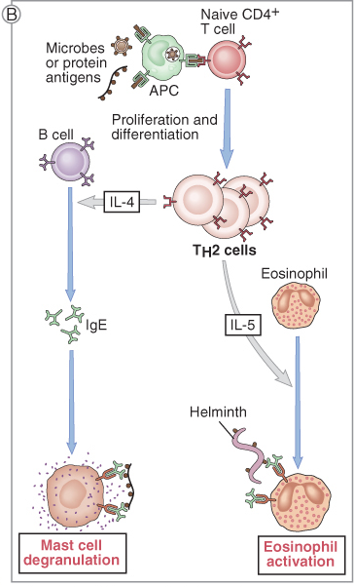
Immunity against helmints
(T_{H}2 response)

Slide 10
Immunity against helmints
(function of eosinophils)

Slide 11
Immune responses to helminth infections.
Most extracellular
Size: too large for phagocytosis.
Some gastrointestinal nematodes - host develops inflammation & hypersensitivity.
Eosinophils & IgE initiate inflammatory response in intestine / lungs.
Histamine elicited - similar to allergic reactions.

Slide 12
Immune responses to helminth infections.
Acute response
IgE & eosinophil mediated systemic inflammation = worm expulsion.
Chronic exposure = chronic inflammation:
DTH, Th1 / activated macrophages - granulomas.
Th2 / B cell responses increase IgE, mast cells & eosinophils = inflammation.

Slide 13
Immune responses to helminth infections.
Helminths induce Th2 responses - IL-4, IL-5, IL-6, IL-9, IL-13 & eosinophils & ab (IgE).
Characteristic ADCC reactions, i.e. killer cells directed against parasite by specific ab.
E.g. Eosinophil killing of parasite larvae by IgE.

Slide 14
Mechanisms of defense
against parasites
Injurious effect of immune response
- granuloma formation and fibrosis (Schistosoma sp.)
- immune complex formation (Plasmodium sp.)
Mechanisms of immune evasion
- existence of different forms/stages (Plasmodium sp...)
- alteration of surface antigens (Trypanosoma sp....)
- complement resistance (many parasites)
-“concealing” – cysts (Toxoplasma sp.), residence in gut (intestinal parasites)

Slide 15
Mechanisms of Immune evasion by Parasites
1- Sequestration of Parasite
2- Parasite movement
4- Antigenic modification: variation, mimicry , shedding
5-Inhibition of Immune Factors (cytokines)
6- Immunosuppression
7- Size (large)
Plasmodium parasite
Encysted larva of T.spiralis

Slide 16
Immunopathology
Pathological effect of the immune response
Result of inappropriate and excessive host response
May be an inevitable outcome of persistent parasitic infection
Variability in clinical outcome – from asymptomatic disease to fatal outcome

Slide 17
Examples:
1- Allergic reactions (type 1 hypersensitivity)
2- Eosinophilic pneumonia
3- Autoimmune reactions
4-Deposition of immune complex (type 3 hypersensitivity reaction)
5- Granuloma formation (delayed type hypersensitivity)
6-Immunosuppression:

Slide 18
Parasite vaccine strategies
There is as yet no safe uniformly effective vaccine against any human parasitic infection
Complexity of the life cycle of the parasite makes the stage to be chosen for vaccine preparation difficult.
Difficulty of identification and isolation of protective antigen to be used as vaccine.
Possibility of inducing immunopathological lesions in response to the vaccine.
Parasites may evade the immunity produced by the vaccine.
Vaccine preparation may not be equally effective.
Notes:
RTS,S/AS01- malaria vaccine that as been developed through partnership between GSK and the PATH malaria vaccine initiative with support from Bill and Melinda gates foundation.
It is the most advanced malaria vaccine in development and is the only one to have completed phase 3 testing
It is a vaccine against Plasmodium falciparum with no protection against p. vivax malaria
Should it be licenced, it will be first ever licenced vaccine against parasitic disease in humans.

Slide 19
Fungi
extracellular agents
(some survive phagocytosis)
- yeast (unicellular)
- molds (multicellular)
- local and systemic mycoses
most systemic infection - opportunistic
some endemic (dimorphic fungi)
- risk factor - immunodeficiency (neutropenia)

Slide 20
Fungi as Infectious Agents
Molds and yeasts are widely distributed in air, dust, fomites and normal flora.
Humans are relatively resistant.
Fungi are relatively nonpathogenic.
Of the 100,000 fungal species, only 300 have been linked to disease in animals.
Fungi are the most common plant pathogens.
Human mycoses are caused by true fungal pathogens and opportunistic pathogens.

Slide 21
True or primary fungal pathogen can invade and grow in a healthy, noncompromised host.
Most striking adaptation to survival and growth in the human host is the ability to switch from hyphal cells to yeast cells.
Thermal dimorphism – grow as molds at 30°C and as yeasts at 37°C

Slide 22
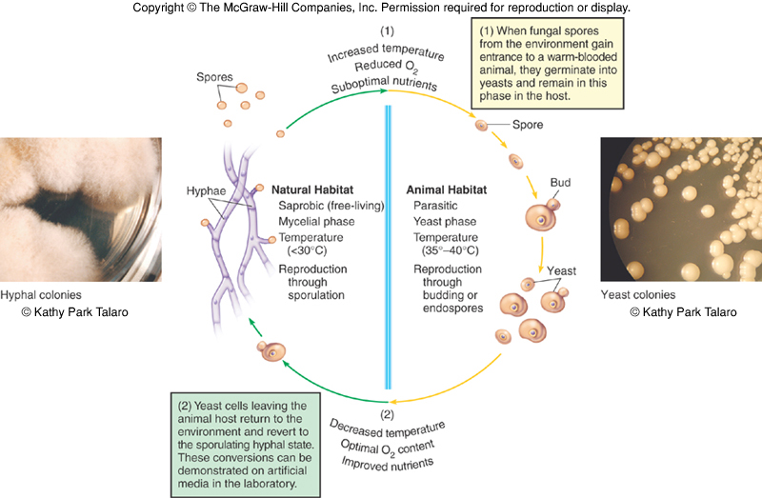

Slide 23
Emerging Fungal Pathogens
Opportunistic fungal pathogen has little or no virulence; host defenses must be impaired.
Vary from superficial and colonization to potentially fatal systemic disease
An emerging medical concern; account for 10% of all nosocomial infections
Dermatophytes may be undergoing transformation into true pathogens.

Slide 25
Epidemiology of the Mycoses
Most fungal pathogens do not require a host to complete their life cycles and infections are not communicable.
Dermaphytes and Candida sp naturally inhabit human body and are transmissible.
True fungal pathogens are distributed in a predictable geographical pattern - climate, soil.
Dermaphytoses most prevalent
Cases go undiagnosed or misdiagnosed.
Systemic, subcutaneous, cutaneous or superficial infections

Slide 26
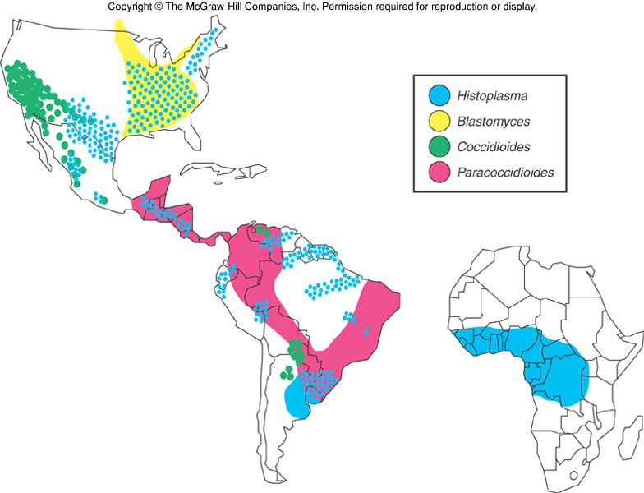

Slide 27
Pathogenesis of the Fungi
Portal of entry
primary mycoses – respiratory portal; inhaled spores
subcutaneous - inoculated skin; trauma
cutaneous and superficial – contamination of skin surface
Virulence factors – thermal dimorphism, toxin production, capsules and adhesion factors, hydrolytic enzymes, inflammatory stimulants

Slide 28
Antifungal Immunity
Antifungal defenses are the integrity of the barriers and respiratory cilia.
Most important defenses are cell-mediated immunity, phagocytosis, and inflammation.
Long-term immunity can only develop for some.

Slide 29
Mechanisms of defanse
against fungi
Mechanisms of innate immunity
Fungi – mostly susceptible
- phagocytosis (neutrophils)
- complement
Mechanisms of adaptive immunity
Cell-mediated immunity
- macrophage and neutrophil activation (CD4⁺ T_{H}1 and T_{H}17 cells)
Injurious effect of immune response
- granuloma formation and fibrosis (Histoplasma capsulatum)
Mechanisms of immune evasion
- inhibition of phagocytosis (C. neoformans...)

Slide 30
Diagnosis of Mycotic Infections
Diagnosis and identification require microscopic examination of stained specimens, culturing in selective and enriched media and specific biochemical and serological tests.

Slide 31
THANK YOU

