Slide 1
SECONDARY IMMUNODEFFICIENCY
DR DEEPA PATEL

Slide 2
Primary immunodeficiency
Usually an immunodeficiency one is born with.
secondary immunodeficiency
Born with normal immune responses but some secondary factor or occurrence causes a decrease in immune response

Slide 3
Secondary immunodeficiency is induced by factors such as:
Malnutrition. Inhibits lymphocyte maturation and function.
Some viruses, e.g., HIV. Depletes T4-lymphocytes.
Irradiation - exposure to X-rays and gamma rays. Causes a decreased production of lymphocyte precursors in the bone marrow.
Cytotoxic drugs such as many used in cancer chemotherapy. Causes a decreased production of lymphocyte precursors in the bone marrow.

Slide 4
Secondary immunodeficiency is induced by factors such as: (cont)
Corticosteroids – anti-inflammatory steroids. Damages lymphocytes.
Leukemias, cancers of the lymphoid system, metastases. Reduces areas for lymphocyte development.
Aging. Adaptive immunity, especially cell-mediated immunity, tends to diminish with aging.
Removal of the spleen. Decreased ability to remove microbes that enter the blood.

Slide 5
ACQUIRED IMMUNO DEFICIENCY SYNDROME (AIDS)
A secondary immunodeficiency caused by human immunodeficiency virus (HIV)
A retrovirus from the lentivirus subfamily.
There are two types of HIV.
HIV – 1 - worldwide, main cause of the worldwide pandemic
HIV – 2 (west Africa, Mozambique and Angola).
Similar illness to HIV – 1, less efficiently transmissible, vertical transmission - rare, less aggressive with slower disease progression

Slide 6
CHARACTERISTICS OF THE VIRUS
Viral particle is spherical, diameter - 80-100 nm
Icosahedral (20 sided), enveloped virus
Retroviruses - transcribe RNA to DNA.
Two viral strands of RNA found in core surrounded by protein outer coat.
Outer envelope contains a lipid matrix within which specific viral glycoproteins are imbedded.
These knob-like structures responsible for binding to target cell.

Slide 7
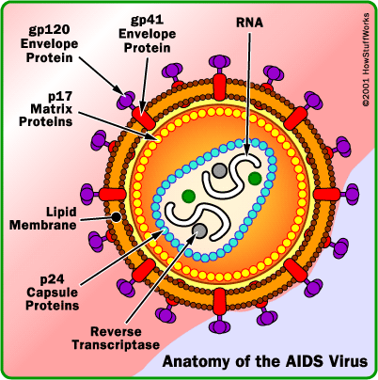

Slide 8
The outer shell - viral enevlope.
Embedded in the viral envelope is a
Complex protein known as env
Consists of an outer protruding cap glycoprotein (gp) 120, and a stem gp 41.
Within the viral envelope - HIV protein called p17(matrix)
Within matrix there is the viral core or capsid, which is made of another viral protein p24 (core antigen).

Slide 9
HIV LIFE CYCLE
Binding, Fusion and Entry
Integration & Replication
Transcription
Budding
Maturation

Slide 10
BINDING
First step, HIV attaches to susceptible host cell - HIV envelope glycoprotein GP 120 binds to the host receptor CD4 molecule co-receptors are necessary (CCR5/CXCR4).
CD4 antigen is found on a variety of cells
Helper T cells, macrophages, monocytes, B cells, microglial brain cells, intestinal cells
T cells infected later on.

Slide 11
FUSION AND ENTRY
Viral binding to host cell triggers fusion of the viral and host cell membranes (Mediated by gp 41)
Allows entry of virus core into host cell cytoplasm
Core protein dissolved by host enzymes releasing viral RNA and enzymes

Slide 12
INTEGRATION
Reverse transcriptase converts the single stranded viral RNA into a double stranded DNA molecule
The DNA enters the host cell nucleus
Integrase catalyses the process of integration of the viral DNA into the host cell’s DNA

Slide 13
TRANSCRIPTION
Integrated viral DNA turns the host cell into a "factory" for manufacturing more virus.
Activation of host cell results in transcription of viral DNA into mRNA.
mRNA translated into viral precursor proteins
Viral proteins are produced as a single multi-protein molecule
Viral proteins cleaved by protease enzyme

Slide 14
BUDDING AND MATURATION
Viral proteins together with RNA gather at the membrane of the CD4+ cells
Viral particles are formed which bud off the cell and enter the blood stream
The CD4 cells are often destroyed by HIV virus infection and replication resulting in profound immunodeficiency.

Slide 15
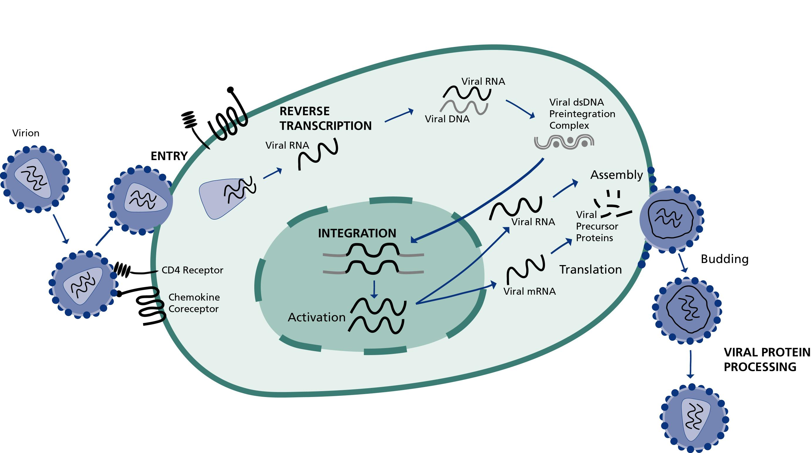

Slide 16
Transcription:
Activation of host cell results in transcription of viral DNA into mRNA.
mRNA translated into viral precursor proteins
Assembly & Budding
Viral precursor proteins processed by protease enzyme into usable forms
Proteins assembled with RNA to form viral particles which then bud
Reverse Transcription
The viral enzyme reverse transcriptase converts the single stranded viral RNA into double strand DNA
Integration:
The viral enzyme integrase inserts the viral DNA (viral genetic material) into the host DNA.

Slide 17
EARLY (ACUTE) HIV INFECTION
Median incubation period - around 10 years
Mucosal lymphoid tissues - virus primarily infects and destroys memory T4-lymphocytes & dendritic cells.
Dendritic cells capture antigens through pinocytosis and phagocytosis and become activated by pro-inflammatory cytokines,
The dendritic cells detach from the epithelium, enter lymph vessels, and are carried to regional lymph nodes.
By the time they enter the lymph nodes, the dendritic cells have matured and are now able to present antigens of HIV to naive T-lymphocytes located in the the lymph nodes in order to induce adaptive immune responses.
Notes:
The envelope glycoproteins gp41 and gp120 of HIV contain mannose-rich glycans that bind to mannan-binding proteins (pattern recognition receptors; also called lectin receptors) on the dendritic cells.

Slide 18
CHRONIC PHASE
Characterized by viral dissemination, viremia, and induction of adaptive immune responses.
The viremia allows the viruses to spread and infect T4-helper lymphocytes, macrophages & dendritic cells found in peripheral lymphoid tissues.
During most of this phase - immune system remains active and competent (few clinical symptoms).
A steady state-infection generally persists where T4-lymphocyte death and T4-lymphocyte replacement by the body are in equilibrium.

Slide 19
CHRONIC PHASE (CONT)
It is estimated that 10 billion virions are produced and cleared in an infected individual each day. However,
The enormous turnover of T4-lymphocytes eventually exhausts the lymphopoietic system and it becomes unable to replace the T4-cells being destroyed.
A variety of mechanisms then eventually lead to immunodeficiency.

Slide 20
MECHANISMS OF HIV-INDUCED IMMUNODEFICIENCY
Direct HIV-induced cytopathic effect on infected T4-lymphocytes. This can occur through:
Increased cell permeability as a result of gp41 expression in the host cell membrane and viral release by budding
Inhibition of host cell protein synthesis as a result of viral replication within the infected cell
Fusion of infected T4-cells with numerous uninfected T4-cells resulting in syncytia formation
Killing of HIV-infected T4-cells by cytotoxic T-lymphocytes or CTLs

Slide 21
MECHANISMS OF HIV-INDUCED IMMUNODEFICIENCY (CONT)
Killing of HIV-infected T4-cells by antibody-dependent cytotoxicity or ADCC
Apoptosis of T4 cells as a result of chronic activation by HIV & cytokines
Shedding of gp120 molecules by HIV - triggers a series of events that cause the adaptive immune system to become less and less effective, primarily by altering the normal balance of immunoregulatory T_{h}1 and T_{h}2 cells in the body.
Impaired function of HIV infected macrophages and dendritic cells.

Slide 22
During the replication of HIV the reverse transcriptase of HIV exhibits a high error rate as it transcribes the RNA genome into DNA.
As a result, HIV readily mutates - immunoresistant, more drug resistant, and able to change the preferred cell type it is able to infect, , e.g, M-tropic to T-tropic

Slide 23
PROGRESSION TO AIDS
Viral load progressively increases in number while the immune system weakens (destruction of increasing numbers of t4-lymphocyte)
Inability of the body to continually replace these destroyed cells
The loss of T4-helper lymphocytes leads to a marked decline cytotoxic T-lymphocytes (CTLs), the primary cells the body's immune responses use to destroy virus-infected cells.

Slide 24
AIDS
Susceptible to a variety of opportunistic infections by
Bacteria - Mycobacterium avium complex (MAC), Salmonella, and Nocardia
Protozoa - Cryptosporidium and Toxoplasma
Viruses - cytomegalovirus (CMV), herpes simplex viruses types 1 and 2 (HSV-1, HSV-2), and varicella zoster virus (VZV)
Candida, Cryptococcus, Coccidioides, Histoplasma, and Pneumocystis.

Slide 25
Increased incidence of tumors
Epstein-barr virus-associated b-cell lymphomas,
Other lymphomas,
Cervical cancer, and
Kaposi’s sarcoma.
Wasting syndrome and encephalopathy are also common.

Slide 26
CORTICOSTEROIDS
Changes in cell traffic
Circulating lymphocytopenia
Peaks 4 – 6hrs, returns to normal – 24hrs
CD4 cells are more depleted
Monocytopenia (depletion do not occur with repeated dosage)
Neutrophilia – release of mature stored cells from bone marrow
T cell activation & B cell maturation inhibited

Slide 27
CORTICOSTEROIDS (CONT)
Cytokine synthesis is inhibited (IL -1, IL – 2, IL – 4, IL – 6, IL – 10, TNFα & IFNγ), this inhibits activation of T cells & cells of monocyte/macrophage system

Slide 28
CYCLOPHOSPHAMIDE
Mainly affects lymphocyte function & numbers, particularly after low dose oral therapy.
Low dose oral therapy –greater impact on cell mediated response
Bolus intermittent therapy – greater impact on Ab production
As it Interferes with both B & T cell function, effective in controlling both Ab mediated & cell mediated immune responses
Clinical significance – management of
Auto-antibody mediated disease
Allograft rejection
Notes:
Immunomodulatory drugs – cyclophosphamide, chlorambucil
Low dose bolus - B lymphocytes reduced > T lymphocytes – CD8 >CD4, high dose – all d similarlyucecells red

Slide 29
AZTHIOPRINE
Active only on dividing cells (cytotostatic)
Action – competitive inhibition of purine metabolism & by incorporation into DNA
T & B cells are reduced after prolonged oral therapy
Decreased NK cell activity
Mycophenolate – lymhocyte (both T & B cells) proliferation is blocked.
Notes:
Azothioprine – treats gout

Slide 30
METHOTREXATE
Structural analogue of folic acid & blocks folic acid dependent pathways needed for DNA synthesis
Prolonged treatment – reduction in immunoglobulin's
Anti inflammatory effects
Adenosine (produced during inhibition of dihydrofolate reductase in purine synthesis) – inhibitor of activated PMN’s
Methotrexate Inhibits of arachidonic acid
⬇ in CRP & ESR

Slide 31
CICLOSPORIN, TACROLIMUS & RAPAMYCIN
Affect T cell signaling, hence T cell functioning
Ciclosprin & tacrolimus
Binds to immunophilins (cytoplasmic proteins) ⬆ intracellular calcium inhibiting cytokines & genes essential for T cell proliferation & function.
Rapamycin
Arrests cells in G₁ phase cell death by apoptosis

Slide 32
NUTRIENT DEFECIENCIES
Most common cause of immunodeficiency worldwide
There are 5 aspects of immunity which are consistently affected
CMI
Phagocyte function
Complement system
Secretory antibody
Cytokine production

Slide 33
NUTRIENT DEFECIENCIES (CONT)
Can result from
Economic constraints
Cancer, chronic renal failure, burns, multiple trauma, chronic infection (particularly measles, pneumonia, TB, diarrhea)
Infection and malnutrition can aggravate each other
Affects lymhoid tissue, lymphoid atrophy (morphological feature of malnutrition)

Slide 34
NUTRIENT DEFECIENCIES (CONT)
The extent of damage of lymphoid tissue depend on
Rate of cell proliferation
Amount and rate of protein synthesis
Role of individual nutrients in metabolic pathways (Zn, Fe, Vit B₆ etc. have key roles in immune process
Nutritional thymectomy – malnourished children, ⬇ in weight and size
Notes:
Histology of nutritional thymectomy – ill defined lobular architecture, loss of corticomedullary demarcation, fewer lymphoid cells, hassals corpuscles – enlarged, degenerated & calcified

Slide 35
NUTRIENT DEFECIENCIES - PEM
Affects CMI & phagocytosis
Reduction in CMI indicated by ⬇ CD4 cells & ⬇ CD4/CD8 ratio
Phagocytosis
⬇ opsonisation (due to ⬇ C_{3,} C₅ & factor B)
Ability to kill intracellular organisms impaired (but ingestion not impaired)
⬇ production of cytokines like IL 2, TNF

Slide 36
NUTRIENT DEFECIENCIES – ZINC & IRON DEFICIENCY
Zinc
Reduction in delayed cutaneous hypersensitivity
⬇ CD4/CD8 ratio & T cell function
Iron
⬇ lymphocyte responseto mitogens& antigens
Impaired NK cell activity
Selenium and copper – imporatant for immune response

Slide 37
Moderate excess, vit E, vit A, Zn, selenium – enhance immunity
Nutritional intervention –
prevent infection by ⬆ immunity
⬇ complications like sepsis, poor wound healing
Probiotics
Desirable bacteria – L acidophillus, L casei
Given orally, ⬆ gut microflora
Barrier effect, produces bacteriocidin
Change of cytokine profile in gut mucosa & ⬆ Ab production

