Slide 1
Transplantation Immunology
Dr. Barasa AK
200818

Slide 2
Learning Objectives
Understand the basics of transplantation
Describe the mechanisms of T cell recognition of antigen
Understand the effector pathways of graft injury
Describe the aetiology and pathophysiology of GVHD

Slide 3
Introduction
Transfer of cells, tissues or organs (graft) from one part of the body to another, or from one individual to another
Used to replace organs or tissues that have failed e.g. in
ESRD
Heart failure
Cirrhosis
Leukaemia
Can use cadaveric or living donors

Slide 4
Genetic Barriers to Transplantation
The main immunological problem with transplantation is rejection
Grafted organ or tissue is seen as ‘foreign’ by the immune system
It is then recognized and attacked
The genetic relationship between the donor & recipient determines whether or not rejection will occur
Autografts and isografts usually accepted
Allografts and xenografts usually rejected

Slide 5
Immunology by David Male et al, 8th edition

Slide 6
Organ Donation
Shortage of donors is a limiting factor for organ transplantation
One cadaveric donor can provide many organs for transplantation
Potential solutions to increase the number of donors include :
Advertising and donor recruitment campaigns
Role of legislation*
‘Presumed consent’ – policy whereby everyone is assumed to have given consent for their organs to be used, unless they indicate otherwise
‘Opt in’ approach – individuals/relatives have to give permission for organs to be used

Slide 7
Organ Donation
Increasing facilities for organ harvesting, including transplant coordinators, surgical teams
Relaxing donor selection criteria - allow use of organs that would not have been used previously
E.g. use of non heart beating donors
Marginal donors (older donors, those with diseases that would have previously excluded them)
Use of living donors or animal donors

Slide 8
Ethical Issues in Living Donation
Used in situations where the donation of an organ poses little risk to the living donor
E.g. kidney transplantation – it is possible to live with just one healthy kidney
It is also possible to donate a lobe of a liver, as it can regrow
Donation of a lung lobe is also possible, but much riskier
Haematopoietic stem cell transplants also involve living donors

Slide 9
Ethical Issues in Living Donation
Potential donor should be healthy
Donation should be compatible (appropriate blood group)
Donor should be aware of the risks & should not be coerced into giving an organ
Majority of donations carried out between close relatives and friends
Some cases - altruistic donors
In most countries it is illegal to sell organs for transplantation
Organ exchange programs to maximize the number of transplants formed - paired donations

Slide 10
Graft Rejection
Immune response in which the recipient immune system responds to & attacks the donor tissue due to immune recognition of antigenic differences between the donor organ & the recipient
MHC molecules are the major target for rejection
Ability to accept a graft is dependent on the recipients sharing all the donor’s histocompatibility genes
Animal that differ at loci other than MHC reject graft from each other, but more slowly

Slide 11
Graft Rejection
Adaptive immune response – shows memory
Once an animal has rejected an organ graft the first time, if a second graft is performed from the same species or donor, it is rejected more rapidly (second set rejection)

Slide 12
Immunology by David Male et al, 8th edition

Slide 13
Graft Rejection
In a primary alloresponse, most of the alloreactive CD4 or CD8 T cells directly recognise the donor MHC molecules displayed by donor APCs in the graft (direct response/presentation/pathway)
However, there are other forms of alloresponse:
Against minor MHC antigens

Slide 14
Graft Rejection
Indirect response – recipient CD4 T cells recognise donor MHC molecules that have been processed by recipient APCs, presented in context of recipients MHC II molecules
(similar to conventional T cell recognition of antigens e.g. pathogens). CD8 cells only see alloantigen by the direct pathway
The indirect pathway of recognition occurs in lower frequency but is important during chronic rejection (very few donor-derived professional APCs to stimulate a direct immune response)

Slide 15
Immunology by David Male et al, 8th edition

Slide 16
Graft Rejection
Minor histocompatibility antigens can be the targets of rejection even when the MHC is identical between donor and recipient
Their nature assumed to be normal polymorphic molecules, peptides from which bind to host MHC and induce an immune response
Can be tissue-specific
E.g. H-Y system – antigens encoded by the Y chromosome; expressed only on male cells

Slide 17
Immunology by David Male et al, 8th edition

Slide 18
Immune Effector Mechanisms in Graft Rejection
Rejection can occur at various times, each associated with different immune effector mechanisms
Immunology by David Male et al, 8th edition

Slide 19
Hyperacute Rejection
Immediate
Mediated by pre-existing antibody
Individual sensitized to donor MHC e.g. previous transplants, multiple blood transfusions or pregnancy
Natural pre-existing antibodies e.g. ABO blood group incompatibility
Rejection seen within minutes of connecting the circulation into the transplanted organ

Slide 20
Hyperacute Rejection
Pre-existing antibodies bind to the endothelial cells lining the blood vessels and initiate immune effector functions
Complement activation by the classical pathway
Complement activation leads to death of the endothelium, or, when damage is sub-lethal, activation of the endothelial cells
Causes an inflammatory response increasing vascular leakage and coagulation
Results in rapid destruction of the graft

Slide 21
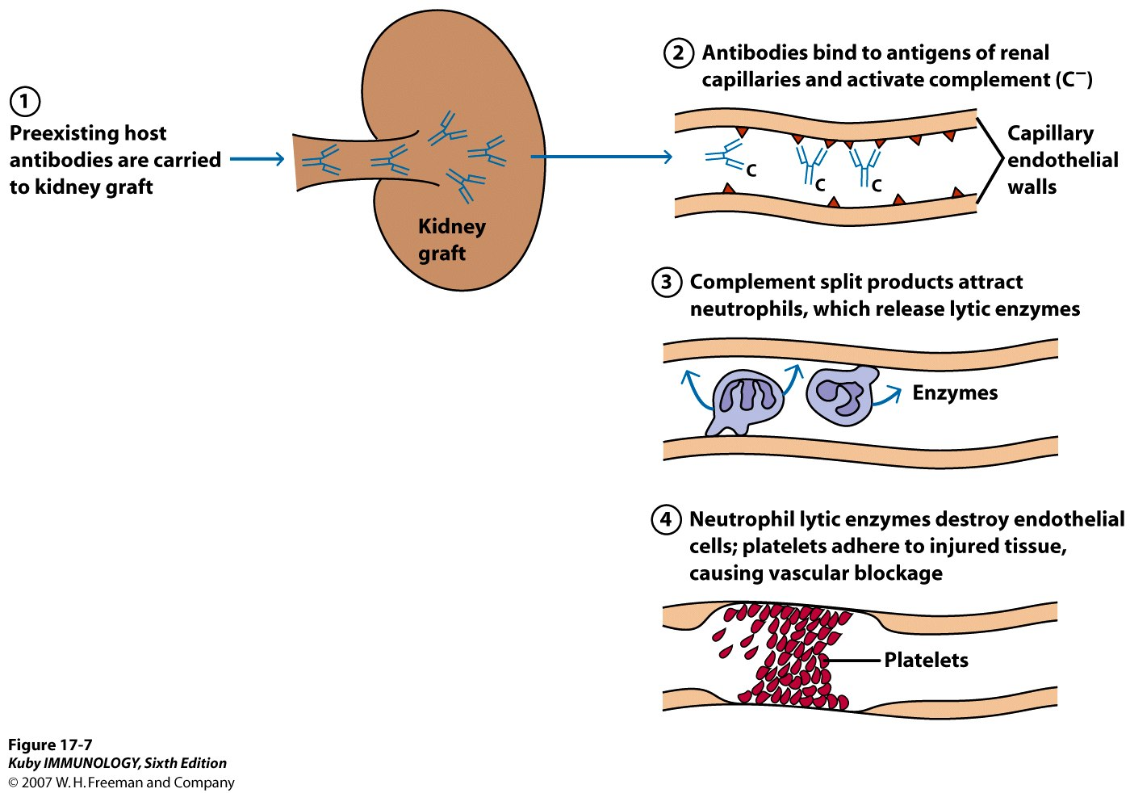
p. 453

Slide 22
Hyperacute Rejection
Prevention:
ABO matching
Cross-matching donor and recipient
Donor leucocytes incubated with recipient serum in the presence of serum complement
Cell death indicates presence of anti-donor antibody. Is a contraindication to proceeding with transplantation
Performed immediately before the surgery

Slide 23
Acute Rejection
Seen in days to weeks after transplantation
Caused by activation of allospecific T cells capable of damaging the graft
Following transplantation, donor dendritic cells present in the organ (passenger leucocytes) migrate to the lymph nodes draining the organ and stimulate a primary alloimmune response

Slide 24
Acute Rejection
Activated T cells migrate to the organ and cause tissue damage by
Generation of T_{C} cells
Induction of DTH reactions
If the patient has already been exposed to the alloantigens expressed by the graft, there will be alloreactive memory cells, leading to accelerated rejection of the graft

Slide 25
Chronic Rejection
Seen months to years after transplantation
In vascularized organs, presents as occlusion of blood vessels – narrowed lumen due to thickening of the intima by smooth muscle proliferation and mononuclear cell infiltrate
Eventually leads to blockage of the blood vessels and subsequent ischaemia of the organ
The parenchyma is slowly replaced by non-functioning fibrous tissue

Slide 26
Mechanisms of Chronic Rejection
Low-grade T cell response (indirect allospecific pathway due to loss of passenger leucocytes that activate T cells with direct pathway specificity)
Antibody (indicated by deposition of complement component – C4d – in tissues)
Non immunological processes:
Response of the graft to injury caused at the time of transplantation or by acute rejection episodes
Recurrence of the original underlying disease
Drug-related toxicities
Chronic rejection responds poorly to current immunosuppressive therapy

Slide 27
Graft versus Host Disease
Occurs when competent immune cells (donor T cells) are transplanted into a recipient e.g. in BMT when normal donor T cells may be infused into the recipient
The T cells can recognise the MHC molecules &/or minor histocompatibility antigens of the recipient as foreign , and produce an immune response against the recipient
Occurs when the recipient is immunocompromised
BMT
Neonatal blood transfusion

Slide 28
GvHD
Can be lethal
Acute GvHD – epithelial cell death in the skin, liver and GIT
Rash, jaundice, diarrhoea, GI haemorrhage
Chronic GvHD – fibrosis and atrophy of one or more organs without evidence of acute cell death
Complete dysfunction of affected organ

Slide 29
GvHD – Prevention and Treatment
Elimination of mature T cells from the graft and APCs from the host
BMT
Treat bone marrow to deplete T cells
Use autologous bone marrow
Use umbilical cord blood
GvHD is treated by immunosuppression

Slide 30
HLA Matching
The major antigenic differences recognized by the alloimmune response are found on MHC molecules (HLA)
Matching the donor & recipient to minimize antigenic differences (so that they share as many alleles as possible)
The better the HLA matching of donor & recipient, the less the strength of rejection
Performed using PCR

Slide 31
HLA Matching
Matching is rarely perfect between unrelated donors because of the difficulty in matching all MHC I & II gene loci & the high level of polymorphism at each locus
Potentially 12 different loci of maternal & paternal HLA class I (HLA-A, -B, -C) & class II loci (HLA-DR, -DP, DQ)
Hundreds of variants of each antigen

Slide 32
HLA Matching
Very important in BMT
Also has a significant influence on the outcome of kidney transplantation
No benefit in corneal transplantation
For those organs where transplantation is essential to maintain life (heart & liver), there is no possibility of waiting for a well-matched organ to become available

Slide 33
Immunosuppressive Drugs
Control the alloimmune response
Rejection episodes still occur but are kept in check, to minimize lasting damage
Cause blanket suppression of the immune system
Recipients more prone to opportunistic infections & have a higher incidence of malignancies
Strategies to promote specific immunological tolerance a subject of interest
Present challenge is to use the currently available agents well to minimize side effects while preserving graft function

Slide 34
Immunosuppressive Drugs
Antiproliferative drugs
Inhibit synthesis of purines required for cell division
6-MP
Azathioprine – purine antagonist that competes with inosine monophosphate
Mycophenolic acid – inhibits inosine monophosphate dehydrogenase which is essential in the de-novo synthesis of purines

Slide 35
Immunosuppressive Drugs
Inhibitors of T cell activation
Ciclosporin - binds to cyclophilin, inhibiting calcineurin (a calcium-dependent phosphatase) which would otherwise activate the NFAT complex & lead to IL-2 gene transcription; thereby inhibiting IL-2 production
Tacrolimus - binds to FK-binding protein 12, an intracellular protein; the resulting complex inhibits calcineurin
Sirolimus/Rapamycin - inhibits signals transmitted by IL-2 binding to IL-2R (sirolimus)

Slide 37
Immunosuppressive Drugs
Anti-inflammatories
Corticosteroids
Inhibit proinflammatory cytokine secretion – IL-1, -3, -4, -5, -8, TNFα
Inhibit nitric oxide synthase
Inhibit expression of adhesion molecules, leading to reduced inflammatory cell migration
Induction of endonucleases leading to apoptosis in lymphocytes & eosinophils

Slide 38
Immunosuppressive Drugs
Antibody therapy
Anti-lymphocyte globulin/anti-thymocyte globulin
Polyclonal antibodies raised by immunizing rabbits or horses with lymphocytes or thymocytes
Deplete circulating T cells

Slide 39
Immunosuppressive Drugs
Antibody therapy
Monoclonal antibodies
Muromonab-CD3 – binds to CD3 on T cells, suppressing T cell responses
Daclizumab & Basiliximab – anti-IL-2 receptors
Alemtuzumab (CAMPATH-1 H) – depletes CD52 expressing leucocytes
Rituximab - anti-CD20; depletes B cells
Abatacept & Belatacept – fusion proteins of CTLA4 with Fc portion of antibody

Slide 40
Induction of Donor-Specific Tolerance
Immune system specifically becomes non-responsive to the donor antigens, but is capable of responding normally to other antigens
Demonstrated in animal models but difficult to translate into the clinical setting
Alloreactive T cells can be anergized by blockade of co-stimulatory signals such as CD80 & CD86 with CTLA-4-Ig, as a way of inducing tolerance
Alternative is to induce a regulatory response to the alloantigen

Slide 41
Immunology by David Male et al, 8th edition

