Slide 1
1. Death, its Definition, establishment.
2. Transplantation, Statutes
3. Autopsy
Dr Edwin Walong. MBChB, Mmed (Pathology), FCPath ECSA
Anatomic Pathology Unit, Department of Human Pathology, CHS, UON
LEVEL 2 MBChB, LME

Slide 2
Death
Refers to complete cessation of life, demonstration of irreversible physiological processes, necessary for maintenance of life.
For death to be deemed to have occurred:
1. There must be significant life threatening pathology that directly leads to death.
2. Irreversible pathophysiology, affecting organs necessary for cognition (brain) and in the absence of appropriate life support, cardiac, respiratory and metabolic functions.

Slide 3
MedicoLegal Aspects of Death
1. Establishment of death: who does it, what criteria
2. Determination of cause of death, mechanisms of death and manner of death.
3. Handling and eventual disposal of mortal remains - their use for therapeutic purposes (transplantation, stem cells); use for medical education, research, public health; disposal.

Slide 4
Establishment of Death
This is the primary role of a medical practitioner as described by the Medical Practitioner's and Dentists Act. In Kenya, physician assistants (ie clinical officers) may have delegated responsibility for this role, particularly in public hospitals.

Slide 5
Process of Establishment of Death
1. There should be evidence of primary life limiting pathology.
2. The medical practitioner must evaluate for absence of cardiac, respiratory function (in the absence of appropriate life support)
3. The medical practitioner must evaluate for signs of 'brain death'.
4. Demonstration of post mortem changes (eg Rigor Mortis, Livor Mortis, putrefaction) are also important

Slide 6
Pictures and illustrations may be of a distressing nature, their use is for educational purposes only

Slide 7
Algor Mortis (Body Cooling)
Process of cooling
Rectal temperature (core temperature) evaluation
Loss of 1.5-2 degrees centrigrade during the first 12 hours of death on average
Accelerated by ambient temperatures, sorroundings, IV infusions
Slowed by body habitus, ambient temperatures

Slide 8

Rigor Mortis
(Skeletal/Cardiac Muscle Spasm)
Develops as a result of ATP depletion
Develops in all muscles simultaneously
First evident in smaller muscle groups
Appears 1-2h, peaks at 12 hours, diminishes over 12h

Slide 9
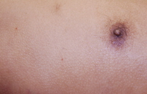
Erector Pili

Slide 10
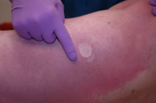
Livor Mortis (Lividity)
Appears 30 min to 2 hours
Sooner – cardiac failure
After 12 h, extravasation of rbcs
Before then, blanching occurs
Also affects organs

Slide 11
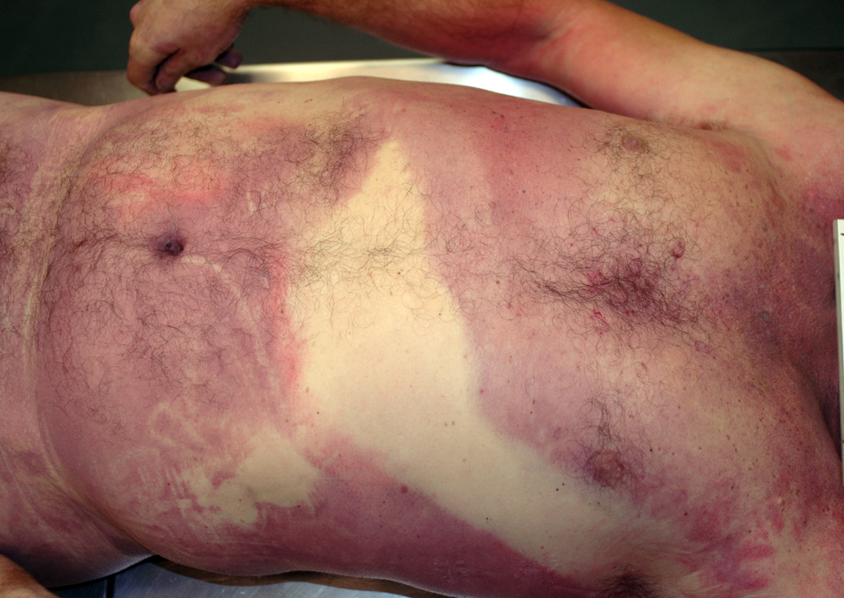
Livor Mortis
Affects internal organs
Decomposition over areas of lividity – tissue breakdown
Mimics trauma
Pattern of livor-associated with postmortem position

Slide 12
Cause of Death
Disease or condition directly attributable to death
Must be classifiable using existing classification systems eg ICD 10 by WHO

Slide 13
Role of the Medical Practitioner, documentation of Cause of Death
On establishing death, the medical practitioner documents the time and circumstances on the medical record. In addition, each hospital has documents that are filled out at death.
The doctor should then determine and document cause of death in the D1 form (see lecture on registration of births and deaths). cause of death is the disease or condition directly leading to death.
If the medical practitioner is unable to determine the cause of death, or the manner of death (see below) is unnatural, she (or he) should not fill this form, and refer the case to the Forensic Pathologists.

Slide 14
Mechanisms of Death
Mechanisms of death : Refers to pathophysiological processes associated with the cause of death (eg hypoxia)

Slide 15
Manner of Death
Manner of death: this is the circumstances associated with the cause of death. Manner of death may be natural (due to an existing disease process) or unnatural. Unnatural manner of death may be homicide (killing of a human being by another human being), suicide, or accidental (due to the sorrounding environment).
All unnatural mortalities must be investigated by a Forensic Pathologist.
According to the current law (refer to the inquest act) the manner of death is determined by a judicial officer at an inquest.

Slide 16
Handling and Disposal of Remains of the Deceased
On establishment of death, the deceased is admitted into a mortuary. Documentation focus on its identification, within the mortuary, appropriate tags are placed that identify the deceased.
In cases that require intervention by a forensic pathologists, international statutes recommend that the bodies be stored in tamper proof body bags, with appropriate chain of custody, to approved mortuaries where the body may be stored at -10 to -20 degrees centigrade if autopsies will be delayed.
Due to the absence of appropriate laws in Kenya, these process is not defined. Disposal may be done by the relatives upon production of the D1 form, or by the state.
Must conform to existing cultural norms
Use: Teaching, Research: The Autopsy (Human Tissue Act cap 242)

Slide 17
States that must be considered:
Brain Death
Vegetative State
Locked in Syndrome
Coma

Slide 18


Slide 19
Brain Death
A brain dead patient is unconscious, has lost the capacity to breathe (apnea) and requires mechanical ventilation. Even with full supportive care and treatment, the heart will soon stop, occurs usually after a few days.
Brain death is equated with the death of a person. It is the expression of irreversible loss of brain function. Confirmatory tests include the absence of brain stem reflexes (nystagmus, gag reflexes, pupillary reflexes, etc). For evidence based criteria for establishment of brain death, the reader is referred to the text 'Hutchinson's manual of Clinical examination'.

Slide 20
The Vegetative State
Vegetative state: this is characterised by unconsciousness,the eyes are open and can breathe spontaneously. A patient in a vegetative state requires artificial feeding.
Automatic vegetative functions and some active functions of the injured brain is preserved. Diagnosis of the vegetative state is based on repeated clinical observations and modern neuroimaging tests. Provision of adequate treatment is associated with survival for years, recovery towards a minimally conscious state or (in) complete recovery.

Slide 21
Ethical Aspects
In Kenya, although there are no laws that govern this process, establishment of death is the duty of the medical practitioner.
Establishment of brain death and the vegetative state is the prerogative of specialist medical practitioners (Neurology, Emergency Medicine, Critical Care) as well as practice based on the clients social, economic and religious practises.
There are no laws that govern euthanasia in Kenya. The general consensus and the constitution

Slide 22
Use of Human Tissues for Transplantation
In Kenya transplantation surgeons perform autologous skin transplantation and heterologous Kidney transplants (from live donors) use of cadaveric donors is currently limited to corneal transplantation.
Internationally, cadaveric transplants include kidneys, bones, heart-lungs, face, corneas, pancreas. Autologous and heterologous bone marrow transplantation is also performed.

Slide 23
Statutes that govern transplantation
Kenyan law does not cover transplantation beyond the provisions of the Human Tissue Act. As the Kenyan constitution recognises and domesticates international conventions, trafficking of humans for transplantation is illegal. Non remunerated donation policies are preferred, these require appropriate informed consent.
Prevention of organ trafficking, exploitation

Slide 24
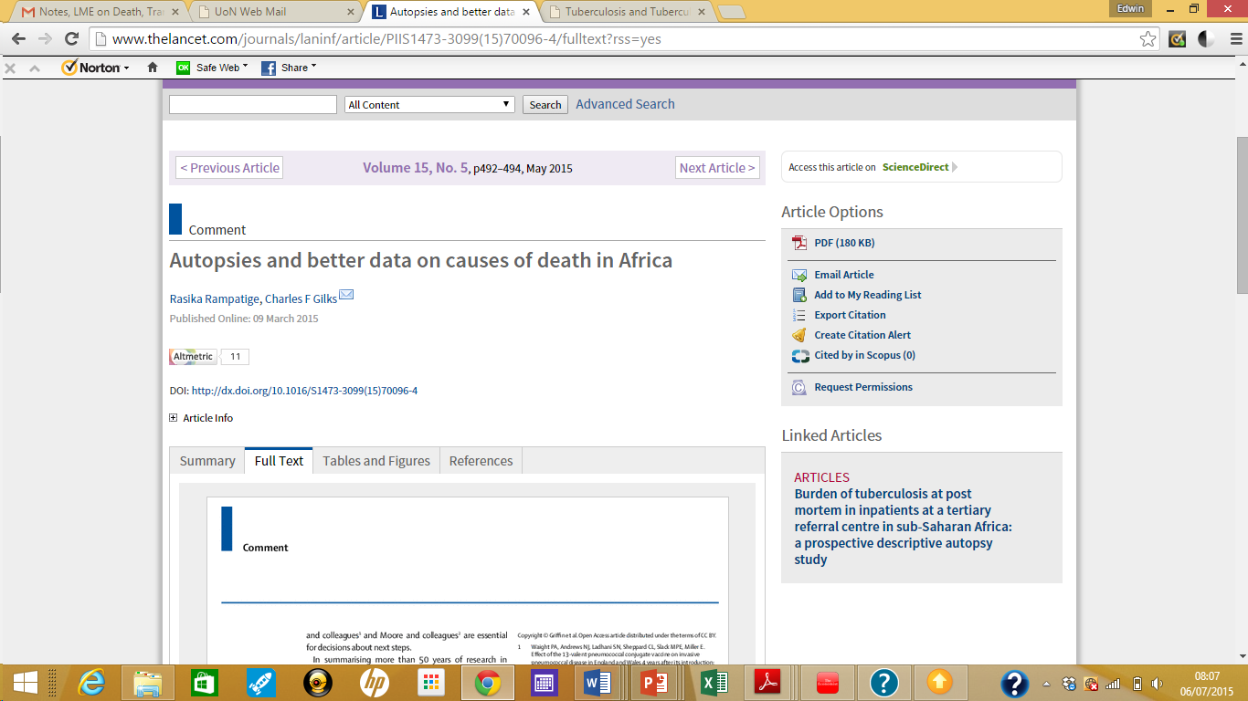
Autopsy

Slide 25
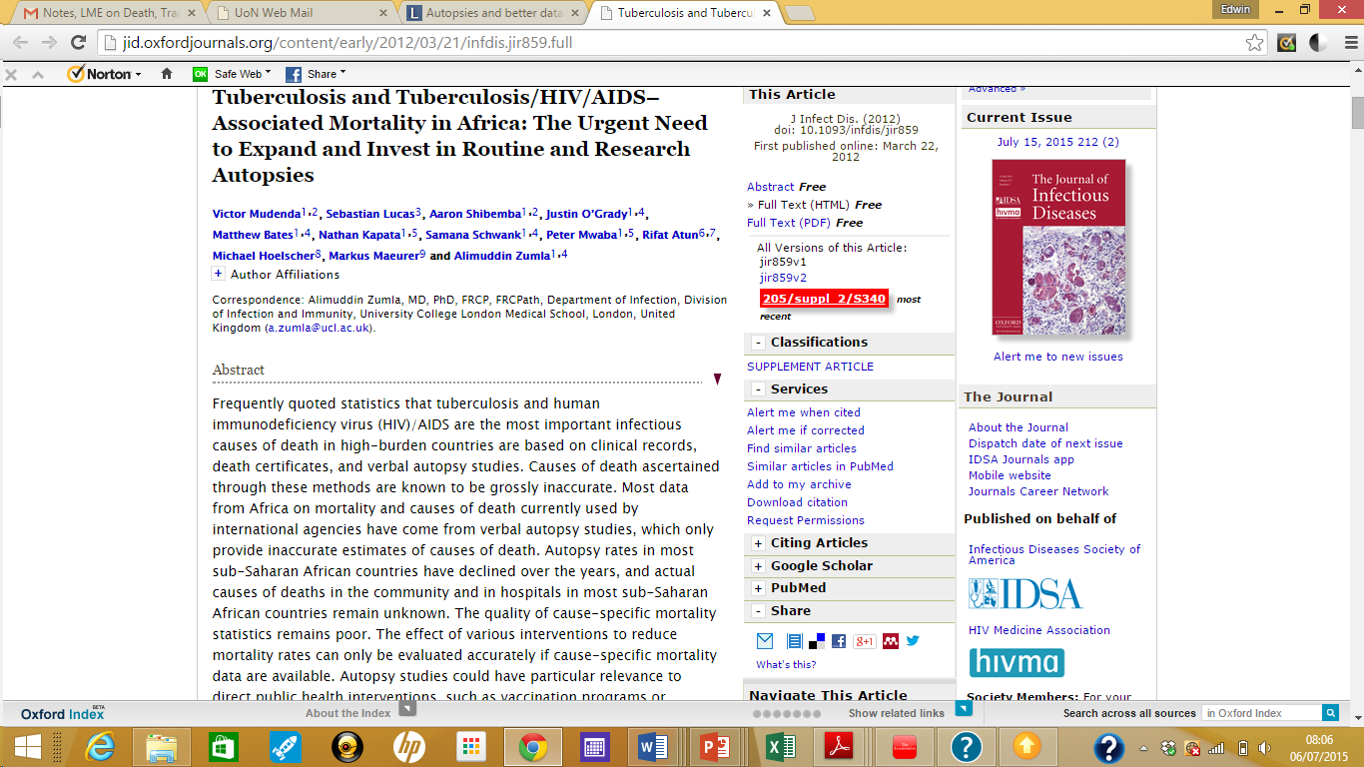
Autopsies

Slide 26
Autopsy
Examination of the deceased by a medical practitioner to establish the cause of death
Forensic
Clinical

Slide 27
Objectives of the Forensic Autopsy
Identify the deceased
Establish the cause of death
This information is important for establishment of the manner of death

Slide 28
Forensic Autopsy , Indications
All Unnatural Deaths
  Homicides
  Suicides
  Accidental
Situations where the cause of death cannot be established or is suspicious
  Death within 24 hours of admission
  Deaths associated with invasive surgical/medical procedures

Slide 29
Objectives of the Clinical Autopsy
Estabishment of the Cause of Death
Establishment of mechanisms of death
Public Health/Disease surveillance

