Slide 1
IMPORTANT LAWS IN MEDICAL PRACTICE
OBJECTIVES
LIST ALL IMPORTANT LAWS
UNDERSTAND MEDICAL PRACTIONER AND DENTISTS ACT CAP 253
KNOW OTHER LAWS HAVING A BEARING ON MEDICAL PRACTICE

Slide 2
Important laws
CONSTITUTION
Health bill
Medical practitioner and dentists act CAP 253
The public health act CAP 242
The human tissue act CAP 252
Pharmacy and poisons act CAP 244
Dangerous drugs act CAP 245
Birth and death registration CAP 149
The medical laboratory technicians technologists act CAP 253A
Nurses CAP 257
Registered clinical officers CAP 260

Slide 3
CAP 253
Commencement: 1st January 1978
DEFINATION
An act of parliament to consolidate and amend the law to make provision for the registration of MP and D and for purposes connected therewith and incidental thereto

Slide 4
VISION MISSION
To be an efficient, effective and accessible world class health regulatory body.
To ensure the provision of quality and ethical health care through appropriate regulation of training, registration, licensing, inspections and professional practice.

Slide 5
CORE VALUES
To be an efficient, effective and accessible world class health regulatory body.
To ensure the provision of quality and ethical health care through appropriate regulation of training, registration, licensing, inspections and professional practice.
Integrity and professionalism
Respect for quality of human life and dignity
Ethical practice
Accountability
Timeliness
Justice and fairness
Honesty
Good governance
Total commitment to service delivery
Practice of knowledge led and evidence based medicine
Effective communication
Non-discrimination

Slide 6
Regulates Doctors and Dentist
Specifies training requirements
Registration and issue of certificates
Licensure
Disciplines Doctors and dentists

Slide 7
MPD board
Registrar –Medical director of health
Deputy medical director
Appointed members 4
Elected members 5
Representative of the faculty of medicine nominated by faculty board

Slide 8
Activities of the board
Register
register doctors and dentists
Certificate of registration
Correction of register
Publication of register
Publication prima facie evidence of registration
Persons eligible to be registered as doctor/dentists

Slide 9
Person may have additional qualification
Licensing of person(s) to render medical or dental services
Effect of registration and license under section 13
License for private practice
Licenses to be published in Kenya Gazette
No fee recoverable unless person is licensed under section 15

Slide 10
Certificate not valid unless signatory is registered
Penalty for fraudulently procuring registration of licenses
Disciplinary proceedings CAP 63
Effect of removal, cancellation or suspension
Penalty for unregistered and unlicensed person practicing

Slide 11
Rules
AG consent
finances

Slide 12
communications
Nomination letters
Voting letters
Applications and certificate for registration, annual retention
Application for license to render medical practice
Application and license for private practice
Internship Rules
Disciplinary proceeding-procedure/Rules
Application for Restoration of name in the register
Certificate of identity and good character
Witness summon

Slide 13
MPBD Private practice rules
General practice
Specialist
Locum
Premises
Paramedical staff

Slide 14
Requirements for Doctors/Dentist
Apply for internship
Apply for registration
Annual retention in register upon paying a fee and fulfilling requirements of attending CMEs and attaining enough CPD (professional development) points
Registration as specialist after postgraduate
Private practice license – fulltime or part time
Disciplinary measures

Slide 15
Tribunal in disciplinary cases
Complaint lodged
Inquiry committee
Submission of complaint or information
Conviction in court of law
Conduct
Admission of case if 2 practitioners each has their procedure

Slide 16
Other ACTs affecting medical/dental practice – Public health CAP 242
Introduction of infectious disease into KE
Promote Public health
Limitation/suppression of infection communicable or preventable
Advice local authorities in regard to matters affecting public health
Promote/carry out research & investigation in relation to prevention or Rx of I/disease

Slide 17
Prepare & prepare report s and statistical or other information relative to P/health
Generally carry out in accordance with directions the power and duties in relation to public health conferred or imposed by this Act

Slide 18
Requirements of medical officers
Notification of infectious disease in patient or at post mortem
Formidable epidemic, endemic or infectious diseases
Venereal diseases treatment and provision of printed material on the same
Food, Milk, Water in relation to transmission of diseases. Food handlers, abattoirs, milk bars, water supplies etc

Slide 19
Prevention of malaria
Cemeteries and disposal of human bodies/parts
Regulation of nursing homes, hospitals, markets and public latrines

Slide 20
Essential drugs-pharmacy and poisons act CAP 244, dangerous drugs act CAP245
Diagnostics services i.e. lab and imaging/radiology
Paramedical staff i.e. nurses, clinical officers etc

Slide 21
Human tissue act CAP 252
Commencement 1st January 1967
Regulates removal of bodies for medical purposes
Limitation on removal limited to a doctor who certifies death on a body
Relatives may object even if a person had offered their body/parts for medicine

Slide 22
Birth and death registration CAP 149
Registration form B1/A1 and notification of birth
Notification within six months
Death notification registration Form D1
Burial permit is required before moving boards

Slide 23
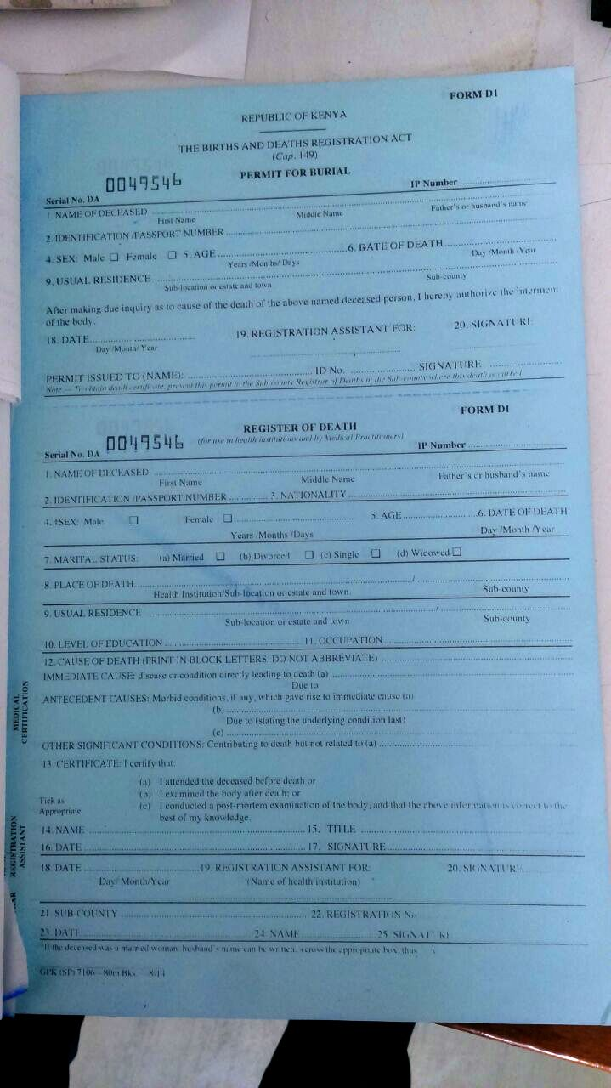
Burial permit and D1 form

Slide 24
Evidence act CAP 80
Expert witness
Public document
Public officer

Slide 25
Medical malpractise
“professional negligence by an act or omission of a health care provider in which the treatment provided falls below the accepted standards of practice in the medical community and causes injury or death to the patient”.

Slide 26
complaints
The Board may receive complaints from the following:-
  Patients or their relatives /Advocates,
  Aggrieved members of the public,
  Director of Medical services,
  Health institutions,
  Professional bodies/ Associations,
  Office of the Ombudsman,
  Media etc.

Slide 27
Types of conduct raising dispute issues
Termination of pregnancy- the Laws of Kenya do not permit termination of pregnancy which is only allowed in a few exceptions.
Gender reassignment- is not permitted on demand.
In-vitro Fertilization (IVF) and assisted reproduction-patients in need of IVF should always be referred to an IVF accredited center.
Sex selection- it is unethical for practitioners to engage in such a practice, to support or to encourage sex selection.
Abuse of professional confidence- practitioner shall not disclose to a third party information which has been obtained in confidence from the patient or patient’s guardian. However; there are exceptions to this rule

Slide 28
Abuse of relationships between practitioners and patients:- health practitioners are privileged people who gain confidential information by virtue of their position of trust.
Abuse of financial opportunities- practitioners should adhere to consumer rights as provided for in Article 46 of the Constitution.
Advertising, canvassing and related professional offences
Conduct negatively affecting the reputation of the profession
Medical errors which include: mis-diagnosis, failure to diagnose, Wrong treatment/ medication, Emergency room errors, Surgical errors, Patient abandonment, Transfer without proper instruction, Lack of consent, lack of informed consent, Dental errors , Psychiatric malpractice

Slide 29
  C. TRIBUNAL
The Full Board exercising judicial or quasi judicial functions to determine disciplinary matters is known as a Tribunal
Board members act as the jury.
The Tribunal hears matters referred to it by the Preliminary Inquiry Committee and the Professional Conduct Committee

Slide 30
Penalties under preliminary inquiry committee and profession conduct committe
a. To admonish a doctor, dentist or the institution and conclude the
case.
b. Make an order compelling a medical practitioner or dentists to undergo continuous professional development of not more than fifty points.
c. Suspend the license of a medical institution for a period of not more than six months.
d. Make an order for the closure of an institution pending the compliance by that institution, of a conduction or requirement under the license issued to it under the Act;
e. Make such further recommendations as the committee deems fit;
f. Levy reasonable costs of the proceedings from the parties

Slide 31
PENALTIES UNDER
THE TRIBUNAL
a) Admonish a doctor, dentist or institution and conclude the case.
b) To place the doctor or dentist under probation( the Board may at its
own discretion direct the doctor or dentist to be supervised during the probation period which does not exceed six (6) months.
c) To order for the payment of costs for the Board’s sitting(s) to be paid by the medical or dental practitioner or the institution on such terms as shall be deemed fit in the circumstances;
d) To direct the suspension of a doctor’s or dentist’s registration or license for a period not exceeding twelve (12) months
e) To direct removal from the register;
f) To suspend licenses for medical institutions for up to six (6) months
g) To order the closure of medical/ dental institution until compliance with
requirements of operating licenses

