Slide 1
MBCHB – LEVEL II
LECTURES IN LAW, MEDICINE & ETHICS
KENYA HEALTH POLICY AND THE LAW
Dr. P J Muriithi
School of Public Health

Slide 2
KENYA HEALTH POLICY AND THE LAW
OUTLINE
HISTORICAL PERSPECTIVES
POLICY CONCEPTS & DEFINITIONS
POLICY FORMULATION & CONSIDERATIONS
POLICY HIGHLIGHTS 1994 – 2010
POLICY HIGHLIGHTS 2012-2030
KENYA CONSTITUTION, HEALTH LAW
REFERENCES

Slide 3
Health Care delivery in Kenya
Historical perspectives
The Imperial British East Africa Company introduced Western medicine to Kenya. Mainly control of rats and malaria.
Medical administrators are requested to undertake the
following health activities:
      Preserve the health of the European community
      Keep the African and Asiatic labor force in good working condition
      Prevent the spread of tropical disease epidemics
These activities did not improve the health of African and /Asians. One third of Africans and Asians were found to be unfit during the drafting of porters and carriers for 1st World War (1914-1918)

Slide 4
Health Care delivery in Kenya
A statement by the medical directors - "African population is entitled to preventive and curative services".
Local Native Councils (LNCs) are given authority to pass resolutions concerning public health.
LNCs established funds to build hospitals and dispensaries and passed a resolution on the control of venereal diseases.
A post-war committee on health is established within the medical department that concentrated on:
    Development of a system of health centers throughout the colony
    Construction of a new and larger medical training school in Nairobi and a group hospital in Nairobi.
    Thus the spread of dispensaries to the reserves in addition to a broad training program became one of the major goals of the government

Slide 5
Health Care delivery in Kenya
Historical perspectives
Public sector development
Up to early 80's the health policy action plans were directed towards increasing the capacity of medical and health care delivery system, both quantitatively and qualitatively. This culminated in the establishment of a vast health infrastructure we are currently possessing - over 3,200 health care institutions nationwide comprising a network of dispensaries, health centers, district and provincial and the referral hospitals

Slide 6
Health Care delivery in Kenya
Historical perspectives
Faith –based Services
Church Missionary Society of Scotland had started some form of organized medical work in Mombasa and Rabai.
Before the World War 1, had furthered medical care to the interior mainly through voluntary efforts.
Presbyterian Hospital at Kikuyu by Scottish Presbyterian missionaries.
Theodora Hospital, now Kijabe Hospital by African Inland Mission .

Slide 7
Health Policy and Health Care delivery and in Kenya
The need for a health policy
The health in human is significant for both social and economic development of Kenya population
Political imperative to tackle forcefully the major public health threats and escalating burden of illness that impede overall health development
Health development is one of the pillars of Vision 2030
Policy makers determine the necessary interventions (health strategy) that most effectively deal with identified health problems.
Such strategies are geared towards improvements in health status, health development, or the production of healthy people.

Slide 8
Health Policy
The concept
A policy defines an area within which a decision will be consistent with, and contribute to an objective.
Definition
A Policy can be defined as - A Plan of action, Statement of ideals, A Blue print etc., proposed or adopted by a government, political party etc.

Slide 9
Health Policy and Health Care delivery and in Kenya
Formulating a health policy
A national health policy is defined after a careful review of the negative and positive aspects of the factors that determine or influence health, e.g. diseases in the population (morbidity), causes of death (mortality)and health problems (the problems affecting provision of health care such as financing, cultural beliefs, poor supply of drugs, physical inaccessibility, inadequate personnel etc.) in different age groups, socio-economic strata, and geographical locations.

Slide 10
Health Policy and Health Care delivery and in Kenya
Formulating a health policy
Kenya Health Policy Framework (1994-2010)
A comprehensive analysis of health situation in Kenya.
This identified gaps in health care which included: declining health status and high disease burden resulting from communicable diseases, inadequate public health care financing, weak management structures etc.
Subsequently, policy goal was stated as
"To promote and improve the health status of all Kenyans through the deliberate restructuring of the health sector to make all health services more effective, accessible and affordable” (GOVERNMENT OF KENYA 1994. Kenya Health Policy Framework (1994-1910) Nairobi, Ministry of Health)

Slide 11
Kenya’s policy on health
Kenya Health Policy Framework (1994-2010)
What to be done (Strategic Policy Imperatives)
Ensure the equitable allocation of government resources to reduce disparities in health status.
Increase the cost effectiveness and the cost efficiency of resource allocation and use.
Continue to manage population growth
Create an enabling environment for increased private sector and community involvement in health service provision and finance.
Enhance the regulatory role of the government in all aspects of health care provision.
Increase and diversify per capita financial flows to the health sector.

Slide 12
Health priorities in Kenya
Essential Health care packages
To reduce the burden of diseases, Kenya has identified the following key areas that are defined as the essential health care packages namely:
    Expanded Programme on Immunization
    Malaria prevention and treatment
    Integrated Management of Childhood Illnesses (IMCI)
    Reproductive health
    HIV/AIDS/TB prevention and management

Slide 13
Kenya’s policy on health
Kenya Health Policy (2012-2030)
Situation analysis
Identified declining health status indicators during the period 1994-2010 , LE 45.2 but increased to 60 years in 2009.
The country is not on track regarding:
Commitments relating to health related Millennium Development Goals
  MDG’s 1 (eradicate extreme poverty and hunger)
  MDG’s 4, (reduce child mortality rates)
  MDG’s 5 (improve maternal health),
  MDG’s 6 ,(combat HIV, malaria),
Abuja Declaration

Slide 14
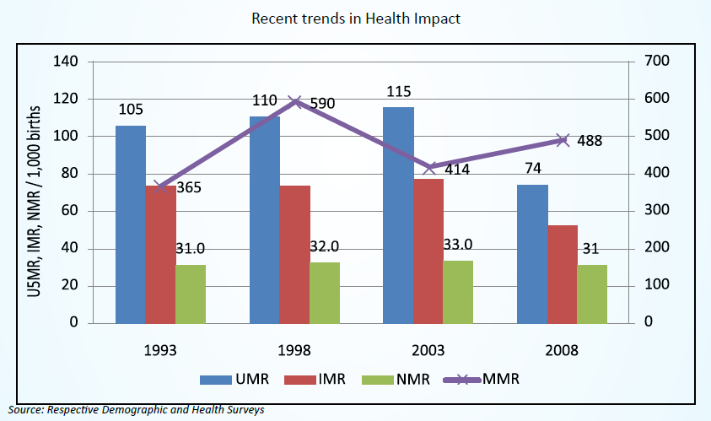
Health Indicators (1994-2010)

Slide 15
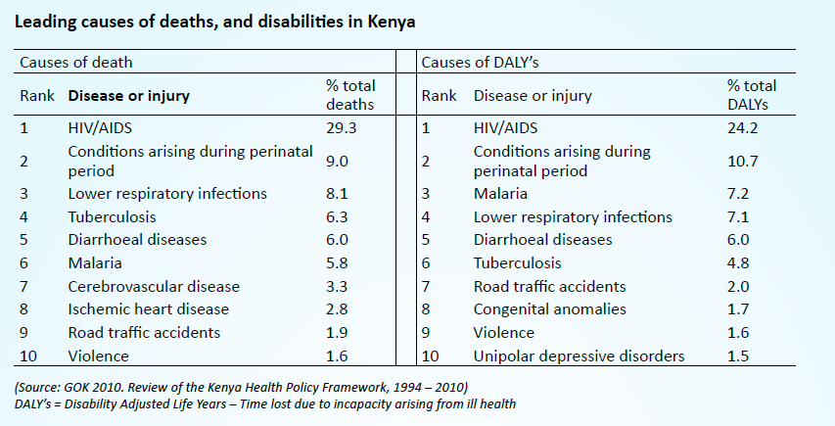
Situation Analysis(1994-2010)

Slide 16
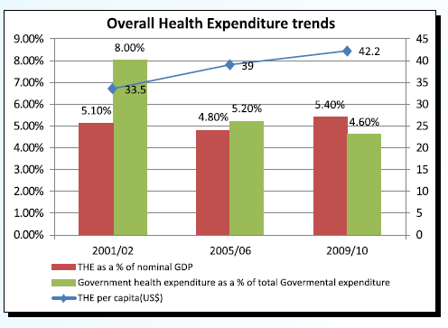
Situation Analysis (1994-2010)

Slide 17
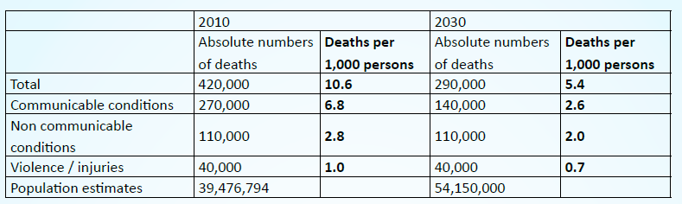
Situation Analysis (1994-2010)

Slide 18
Situation Analysis (1994-2010)
Law/Regulatory Matters and Health Policy
New Constitution (Kenya Constitution 2010)
The Public Health Act not attuned to the stewardship role
Other Legislations governing Health Care provision not effective ,e.g. Regulation of health professionals and private health care(Muriithi 2013, Doctoral Thesis[not published]
Kenya Health Law [Health Bill] not yet enacted

Slide 19
Kenya's Health Policy and the Law (CONSTITUTION 2010)
The mandate and obligation of Kenya government:
Kenya Constitution 2010: Economic and social rights
43. (1) Every person has the right—
(a) to the highest attainable standard of health, which includes the right to health care services, including reproductive health care;
(2) A person shall not be denied emergency medical treatment
The Constitution of Kenya 2010 provides an overarching legal framework to ensure a comprehensive rights-based and people-driven approach to health services delivery.

Slide 20
Kenya Health Policy and Constitution 2010
Constitution also guarantees the underlying determinants of the right to health, such as:
adequate housing,
food,
clean safe water,
social security and
Education.
Kenya policy 2012 -2030 seeks to make the realization of the right to health by all Kenyans a reality.

Slide 21
Kenya Health Policy 2012-2030
Policy Goal 2012-2030
The goal Kenya Health Policy 2012-2030 is
“attaining the highest possible standard of health in a manner responsive to the needs of the population’.
The Policy aims to achieve this goal through supporting provision of equitable, affordable and quality health and related services at the highest attainable standards to all Kenyans.
What to be done
Align the policy with Kenya Constitution 2010, realization of fundamental human rights
Contribution to economic development as envisioned in the Vision 2030
Address the regional and global health challenges

Slide 22
Kenya Health Policy and Constitution 2010
The policy provides mechanisms and frameworks within which health systems strengthening and development will be defined and considered, to ensure the progressive realization of the right to health for every person across the country under the devolved system.
The policy takes cognisance of the specific functions assigned to the two levels of governments as elaborated in the Fourth Schedule of the Constitution:
    National Government will provide leadership in policy development, management of national referral facilities and capacity development
    the County Governments will be responsible for service delivery.

Slide 23
Kenya Health Policy and Constitution 2010
The two levels of government with respect to this policy aims to:
a) To promote democracy and accountability in delivery of health care;
b) Foster seamless service delivery during and post transition period;
c) Give powers of self-governance to the people and enhance their participation in making decisions on matters of health affecting them;
d) Recognize the right of communities to manage their own health affairs and to further their development;

Slide 24
Kenya Health Policy and Constitution 2010
e) Protect and promote the health interests and rights of minorities and marginalized communities;
f) Promote social and economic development and the provision of proximate, easily accessible health services throughout Kenya;
g) Ensure equitable sharing of national and local resources targeting health delivery throughout Kenya;
h) Enhance capacities of the two levels of governments to effectively deliver health service in accordance with their respective mandates.

Slide 25
Health Policy and Health Law
Without a regulatory framework, implementing the policy is vain.
The Kenya Government aims at formulating a comprehensive legal framework to ensure the implementation.
THE KENYA HEALTH LAW........STILL A DRAFT HEALTH BILL

Slide 26
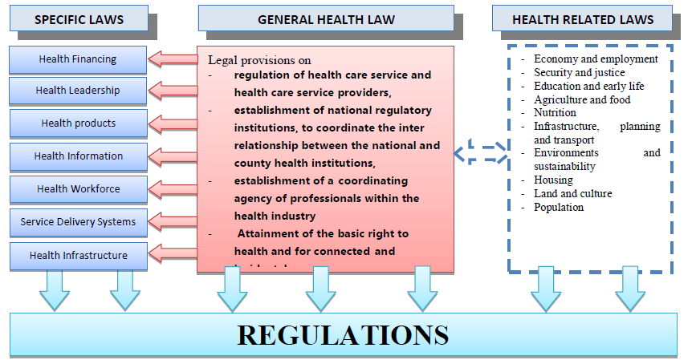
HIGHLIGHTS OF THE LEGAL FRAMEWORK

Slide 27
References
GOK 1994. Kenya Health Policy Framework 1994-2010
GOK 2013.Draft Kenya Health Policy 2012-2030
WHO 2005 . Health Systems Action Framework, Geneva
Republic of Kenya 2010. Kenya Constitution 2010
Muriithi P.J. 2013. Private Health Care Regulation in Kenya. Doctoral Thesis [Unpublished]

