Slide 1
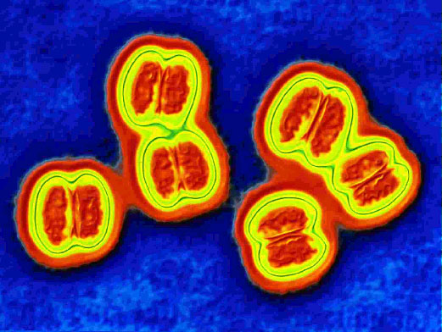
MORAXELLA
KIMAIGA H.O
MBChB(University of Nairobi)

Slide 2
INTRODUCTION
This genus is a member of the family Neisseriaceae.
They are
Coccobacilliary rods
Assacharolytic
Oxidase positive
Catalase positive
M. catarrhalis is the major pathogen in this genus and is formerly named Branhamella catarrhallis

Slide 3
Moraxella catarrhalis
Gram negative cocci, diplococci or coccobacilli
Assacharolytic
Strict anaerobes
Oxidase positive, catalase positive
Only found in humans
Normal flora – mouth and nasopharynx
Transmission – respiratory aerosol droplets
Can gain access to the lower resp tract of patients with chronic obstructive pulmonary disease

Slide 4
Lab diagnosis:
Gram film made from sputum indicates large numbers of gram negative diplococcic dispersed between pus cells.
Sputum is cultured on BA/CBA , incubated in 5% carbon dioxide atmosphere overnight.
They are oxidase positive, and do not ferment any sugars.
Buryrate esterse ⁺ve
Deoxyribonuclease ⁺ve

Slide 5
Clinical Manifestations
In children, otitis media and paranasal sinusitis
In the elderly, bronchitis, pneumonia
Moraxella nonliquefaciens is one of the two common causes of blepharitis (eyelid infection), the other being Staph. aureus. Treatment is local application of antibiotic eg erythromycin

Slide 6
Treatment
Trimethoprim-sulphamethoxazole (co-trimethoxazole) or amoxicillin-clavulanate (co-amoxiclav) can be used for treatment.

Slide 7
Acinetobacter species
Gram negative coccobacilli easily confused with Neisseria;
Oxidase positive, catalase positive
Habitat: soil and water
Found as normal flora of skin, respiratory and intestinal tract and the genitor-urinary tract
Opportunistic pathogens.

Slide 8
Clinical Manifestation
Acinetobacter calcoaceticus, causes
Nosocomial respiratory infections usually traced to contaminated inhalation therapy equipment
Nosocomial bacterimia traced to infected intravenous catheters
Sepsis, Pneumonia, UTIs, meningitis, soft tissue infections

Slide 9
Culture
Grow well on MacConkey and other media
Acinetobacter baumannii is often cultured from hospitalized patients' sputum or respiratory secretions, wounds, and urine.
In a hospital setting, Acinetobacter commonly colonizes irrigating solutions and intravenous solutions.
Acinetobacter will grow on routine laboratory media, including sheep blood agar; colony growth appears smooth, mucoid, and nonpigmented.

Slide 10
Treatment
Acinetobacter spp are resistant to many classes of antibiotics including penicillin, cephalosporin, chloramphenicol and aminoglycosides
Rifampicin with meropenem has been used in treatment of post neurosurgical Acinetobacter menengitis.

Slide 11
VEILLONELLA
An anaerobic gram negative diplococci.
Part of the normal flora of the mouth, colon, vagina.
A rare opportunistic pathogen, can cause abscesses of sinuses, tonsils & brain.
Generally regarded as a minor component in mixed anaerobic infections.

