Slide 1
INTRODUCTION TO MICROBIOLOGY AND CLASSIFICATION OF BACTERIA
KIMAIGA H.O
MBChB (University of Nairobi)

Slide 2
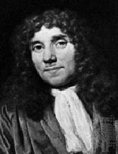
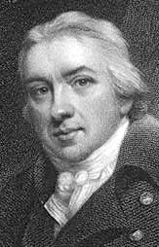
Milestones in Microbiology
Ancient and Medieval Times – microorganisms were unknown and their effects (e.g. plagues) were attributed to Divine judgement, magic, or sorcery.
1674 - Anton van Leeuwenhoek observes microorganisms - "animalcules" - and reports them to the British Royal Society.
1798 - Jenner uses the first vaccine and begins a process that will lead to the eradication of smallpox in the 1970s.
Anthon van Leeuwenhoek (1632-1723)
Edward Jenner (1749 - 1823)

Slide 3
17th-19th - The theory of spontaneous generation was centuries was slowly disproved, a process which was finally completed by Pasteur and Tyndall.
1860s - Pasteur furthers the germ theory of disease by his work on silkworms, and develops pasteurization.
1870s - Lister uses "antisepsis" to control surgical infections.
1876 - Koch demonstrates that anthrax is caused by Bacillus anthracis.

Slide 4
1881 – Lina Hesse suggests agar to solidify growth media for bacteria.
1880-1900 - “The Golden Age of Microbiology” - many pathogens first identified.
1940s - Development of antibiotics begins.
1940s–present - Widespread use of immunization leads to huge reductions in illness and death caused by many previously common infections, e.g. measles, diphtheria.
1980s - Development of molecular techniques for diagnosis and engineering begins.

Slide 5
FORMS OF LIFE
EUKARYOTES
PROKARYOTES
Are higher forms of organisms
Have complex cellular organization
Their nucleus is membrane bound (eukaryotic)
Replication process is complex due to the nuclear membrane
Size 5-10m
Ribosomes 80S (70S)
Examples; Animals, Fungi, Algae and Protozoa
Are simple forms of organisms
Have simple cellular organization
Have no nuclear membrane (prokaryotic)
Replication is simple
Have no histones, the ones normally associated with the cell membrane
Size 0.5-2.0 m
Ribosomes 70S
Examples; Bacteria, Viruses and the former Ricketsia, Mycoplasm and Chlamydia which are now bacteria.

Slide 6
Koch’s Postulates- to establish if an organism is the cause of a disease
An organism must be constantly present in the lesion
The organism must be recovered from the animal and grown in pure cultures
Organisms from the pure culture should reproduce the disease when inoculated into healthy susceptible animals
The organism should be recovered from the experimentally infected animal in pure cultures.
Koch later went on to prove the aetiologic agents of cholera, plague and tuberculosis

Slide 7
Medical Microbiology
The study of the subject entails the following;
Aetiology (Where the organism is found and other characteristics)
Pathogenesis (This is the mechanism of how it attacks the tissues)
The clinical presentation; signs and symptoms
Laboratory diagnosis
Treatment of infection
Epidemiology
Control and prevention

Slide 8
Role of Microbiology in the Community
Microbiology is mainly concerned with control and prevention of diseases
It also deals with factors influencing infection in the community which include;
Overcrowding
Nutrition
Contamination of foods and drinks
Atmospheric pollution
Civil unrest; Post Election Violence
Displacement; IDP
Poverty etc

Slide 9
Branches of Microbiology
Bacteriology: Scientific study of bacteria and the diseases caused by bacteria
Virology: Scientific study of viruses and the diseases caused by viruses
Mycology: Scientific study of fungi
Protozoology: Scientific study of protozoa
Helminthology: Scientific study of worms
Entomology: Scientific study of arthropods

Slide 10
Ecology of Microorganisms
Free living: Include saprophytes found in soil, water, sewage plants and similar environment.
Commensals: Found in animals including man
Pathogens (those that can cause disease) versus non-pathogens (those that don’t and can be useful)

Slide 11
Classification of Bacteria
Bacteria are classified based on consideration of all characters which are;
Anatomical
Physiological
Serological (place of residence)
Ecological
The essential pure cultures that are essential are;
Clones
Strain
Family
Genes
Species

Slide 12
Bacterial Identification and classification
Colony appearance
Shape - cocci, bacilli, spiral
Arrangement - single, pairs, chains, clusters
Size - 1 to 10 μm
Gram-positive vs. Gram-negative
Aerobic vs. anaerobic
Physical/structural characteristics
Biochemical characteristics
DNA analysis

Slide 13
Morphologic Classification
Morphology includes size, shape and arrangement.

Slide 14
Size
Size: Bacteria are approximately 0.5-1.0 μm in diameter (cocci), and 0.1-3 μm width and 0.5-20 μm length (bacilli).
The important consequence of small sizes high surface area/volume (S/V) ratio. The large S/V ratio through which nutrients enter and wastes leave the cell, compared to the small volume of the cell substance to be nourished accounts for the usually high growth rate and metabolism of bacteria. Also due to high S/V ratio, the mass of cell substance to be nourished is close to the surface, requiring no circulatory mechanisms to distribute the nutrients.

Slide 15
Shape:
Shape is governed by the rigid cell wall.
Typical bacterial cells are:
Cocci (singular, coccus)- spherical cells, e.g. staphylococci, streptococci, Neisseria spp.
Bacilli (singular, bacillus)- straight rods, e.g. clostridia, pseudomonads, members of Enterobacteriaceae, etc.
Spirilla (singular, spirillum)- rods that are helically curved /twisted, e.g. spirochaetes.
Pleomorphic

Slide 16
Arrangement:
Bacterial cells are usually arranged in a manner characteristic of their particular species.
However, not all cells of a species may be arranged in the same manner; the predominant arrangement is the important feature.
Cocci appear in several characteristic arrangements, depending on the plane of cellular division, and whether the daughter cells stay together following division. common arrangements encountered include:
Diplococci (divide in one plane)
Streptococci (divide in one plane with most daughter cells staying together)
Tetrads or tetracocci (divide in two planes).
Staphylococci (divide in three planes in irregular patterns)
Sarcina (divide in three planes in regular patterns)

Slide 17
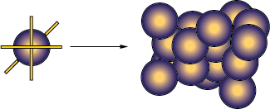
Bacteria can be categorized as follows;
Spheres: These are termed as Cocci and can be in form of clusters, chains, pairs & tetrads.
Coccus
Tetrad
Pairs - Diplococcus
Sarcinae
Chain- Streptococcus
Clusters - Staphylococcus

Slide 18
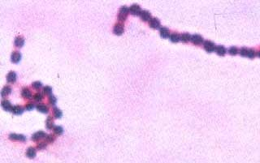
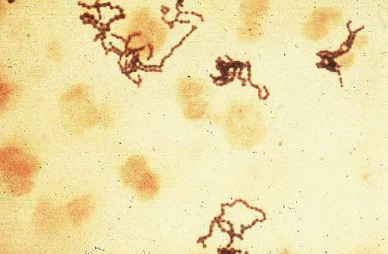
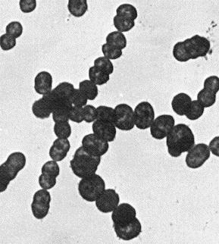
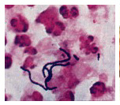
Chains of cocci
Streptococci (Strepto - chain)
Knee tap smear
Streptococcus pyogenes

Slide 19
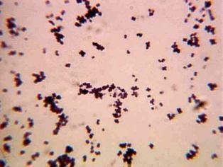
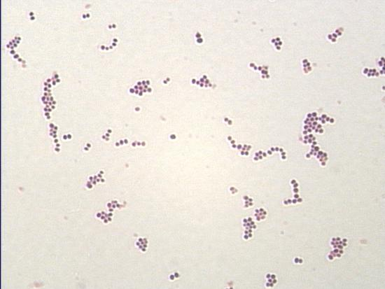
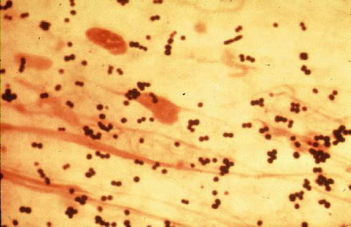
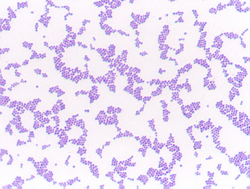
Clusters of cocci
Staphylococci (Staphylo - grapes)
Staphylococcus aureus
Sputum smear

Slide 20
Rods: These are termed as Bacilli and take the shape of a cylinder. - Fusiform,
Most bacilli occur singly or in pairs (diplobacilli). Some species form chains (streptobacilli) e.g. Bacillus subtilis.
Some species have cells lined side by side like match-sticks (palisade arrangement) e.g. Corynebacterium diphtheriae. Some species form long branched multinucleate filaments (hyphae or mycelia) e.g. Streptomyces spp. Some species form curved (vibroid) cells e.g. Vibrio cholerae and V.
Parahaemolyticus. Some are helical e.g. spirichaetes- flexible helices e.g. Treponema spp, or rigid helices e.g. Spirillum spp. Other shapes and arrangements also occur

Slide 21
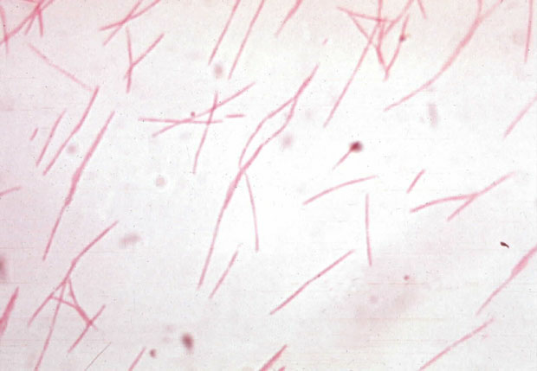
Rods
Fusobacterium

Slide 22
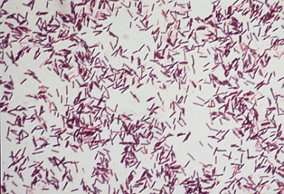
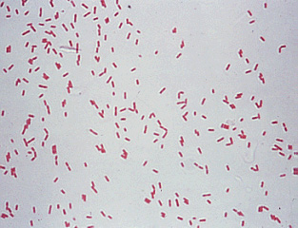
Bacillus shaped bacteria
Pseudomonas aeruginosa
Escherichia coli

Slide 23
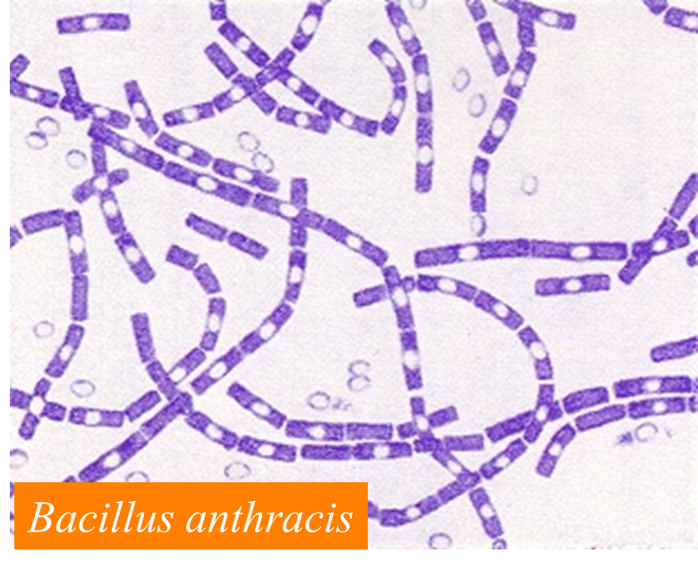
Bacillus chains

Slide 24
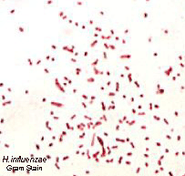
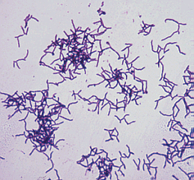
Cocco-bacilli
Branching Rods

Slide 25
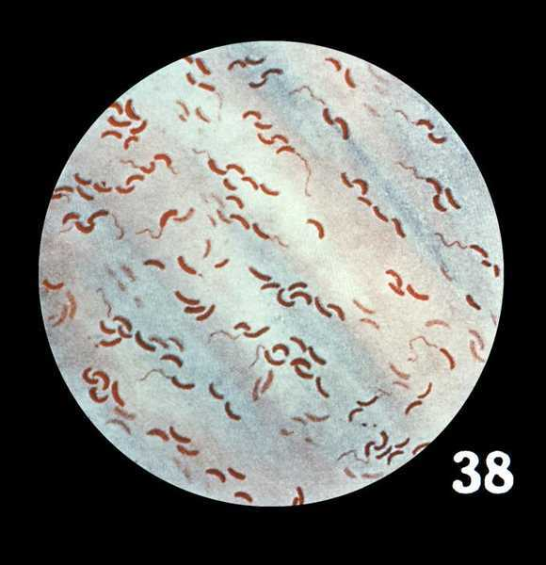
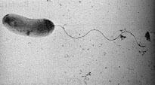
Vibrio: Curved into comma shape
Vibrio
Vibrio cholerae

Slide 26
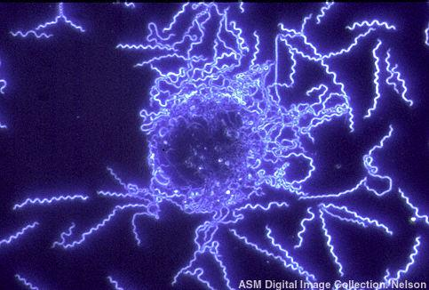
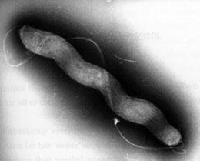
Curved bacteria
Campylobacter
Borrelia burgdorferi

Slide 27
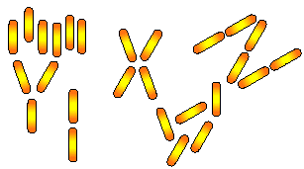
Palisades arrangement
Corynebacterium diphtheriae

Slide 28
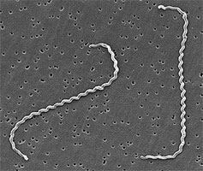
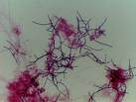
Sprilla :Curved longer than a comma and take a spiral shape e.g Spirillum, Spirochaetes
Filaments with branching
Spirochaetes
Branching Filaments

Slide 29
