Slide 1
BACTERIAL ANATOMY
KIMAIGA H.O
MBChB (University of Nairobi)

Slide 2
Introduction
Bacteria are unicellular microorganisms
Vary in shape ranging from 0.2-0.5 µm
Smallest bacteria (mycoplasma) is the size of the largest viruses (pox)
Irrespective of the shape bacteria have common structures e.g cell wall, cell membrane, cytoplasm, ribosomes and the chromosome.
Other structures such as plasmid, inclusion bodies, capsule, fimbriae and flagella are possessed only by some bacteria

Slide 3
Cell structures
EXTERNAL
INTERNAL
Capsule
Cell wall
Cell membrane
Bacteria Appendages
Pili/ Fimbriae
Flagella
Ribosomes
Mesosome
Plasmids
Nucleoid
Granules
Spores

Slide 4
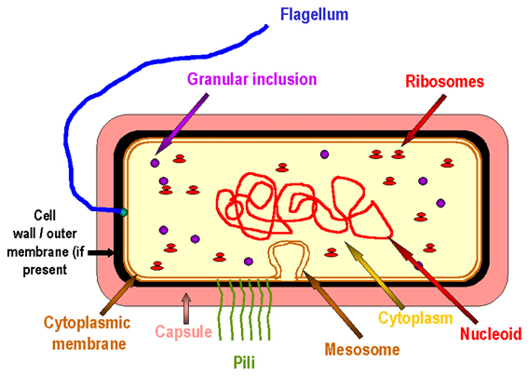
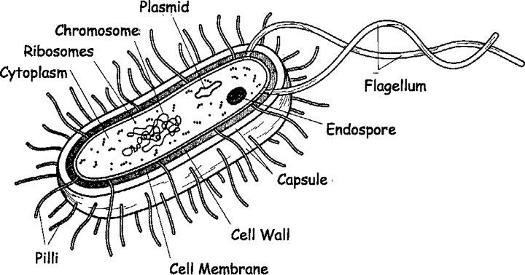
BACTERIAL ANATOMY

Slide 5
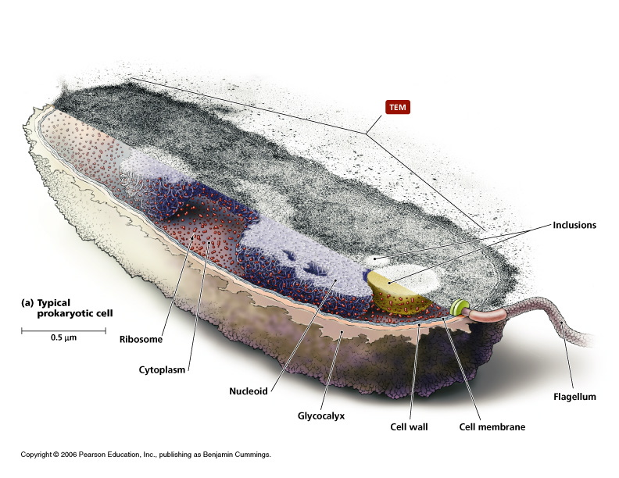

Slide 6
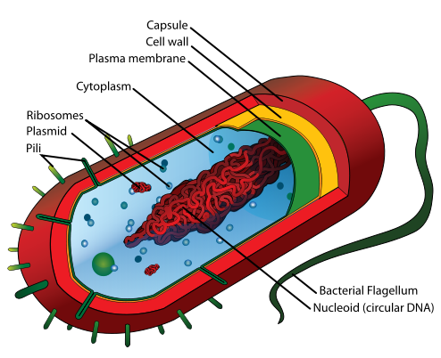

Slide 7
Capsule/Glycocalyx/Slime layer
Structures surrounding the outside of the cell envelope.
A gelatinous polysaccharide or polypeptide coating secreted by bacteria is called glycocalyx
Capsule - glycocalyx attached firmly to the cell wall
Slime layer-glycocalyx attached loosely to the cell wall.
Glycocalyx is an extracellular polysaccharide and helps in the formation of biofilms on inert surfaces such as catheters, teeth and heart valves.

Slide 8
Capsule
Not impermeable.
Composed of polypeptides or polysaccharides (exception: Bacillus anthracis (anthrax) poly-glutamate).
They have no net charge and hence they can’t be stained.
Identification made by using antiserum against the capsular polysaccharide (Quellung reaction)
Can also be visualized by India ink preparation or dark-field microscopy
Bacteria with capsules form smooth colonies while those without capsules form rough colonies.
Capsules are sometimes referred as K antigens (in Enterobacteriaceae) or as Vi antigen (in Salmonella typhi).
Examples of bacteria with capsules;
Streptococcus pneumoniae, Streptococcus mutans, Klebsiella pneumoniae, Bacillus anthracis, Neisseria meningitides, Pseudomonas aeruginosa, Cryptococcus neoformans

Slide 9
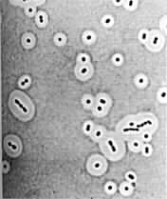
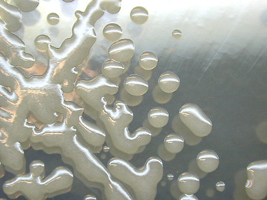
Capsule
Klebsiella pneumoniae
Bacillus anthracis

Slide 10
Significance of capsules
Antiphagocytic hence a virulence factor. Is often associated with pathogenic bacteria because it serves as a barrier against phagocytosis by white blood cells.
Prevent complement-mediated bacterial cell lysis
Growth in a biofilm prevents access of host cells or antibiotics
Capsules protect the cells from lysozyme.
Permit bacteria to adhere to cell surfaces and structures such as medical implants and catheters.
Capsules can be a source of nutrients and energy to microbes e.g Streptococcus mutans, which colonizes teeth, ferments the sugar in the capsule and acid byproducts contribute to tooth decay.
Prevent cell from drying out (desiccation)
Capsules may protect cells from bacteriophages.
Attaches bacterial cell to host cell
Capsular antigens are used as antigens in certain vaccines e.g pneumococcal vaccine

Slide 11
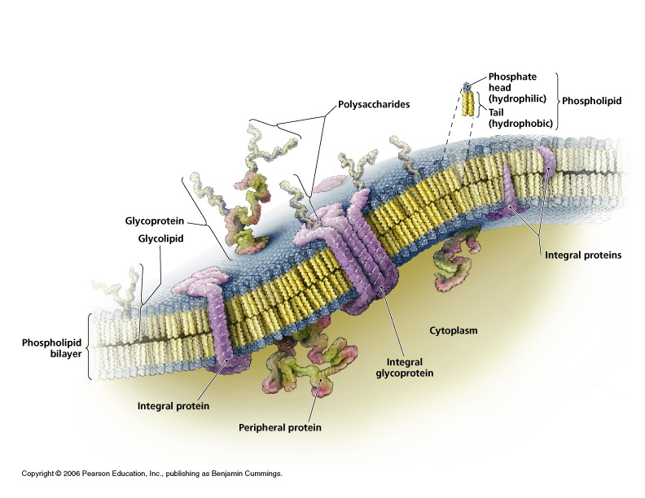

Slide 12
Cell Wall
Found in all bacteria except mycoplasma and metanotrophs. Mycoplasma are bacteria that have no cell wall and therefore have no definite shape.
Fully permeable
Unique to bacteria hence ideal target for selective toxicity
Degraded by:
Autolysins (hydrolytic enzymes produced by the bacterial themselves) – amidases, peptidases
Lysozymes – present in some secretions e.g. tears, saliva, mucus

Slide 13
Functions
Maintain cell shape and rigidity – structural integrity of the cell. The three primary shapes in bacteria are coccus (spherical), bacillus (rod-shaped) and spirillum (spiral).
Carries bacterial antigens– important in virulence & immunity
Protect cell from external stresses (host)
Contributes to virulence, promotes colonization by sticking bacteria to surface of host cells.
Target for antimicrobial agents (E.g. Penicillins, Cephalosporins)
Protects bacteria cell from osmotic lysis in hypertonic environment.
Protect peptidoglycan layer from action of agents such as lysozomes
Determines reactivity to Gram stain

Slide 14
Structure of cell wall
Made of long chains of polysaccharide (Peptidoglycan/mucopeptide) cross-linked by short peptides (amino acid chains).
The polysaccharides are formed by N-Acetyl Glucosamine (NAG) and N-Acetyl Muramic Acid (NAM)
The peptides contain amino acids D-alanine and D-glutamate and a diamino acid (LL- or meso-diaminopimelic acid, L-lysine, L-ornithine or L-diaminobutyric acid).

Slide 15
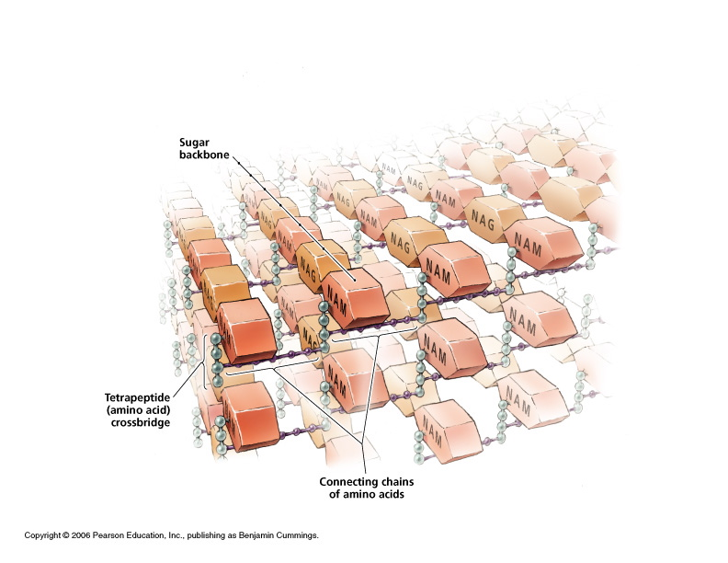

Slide 16
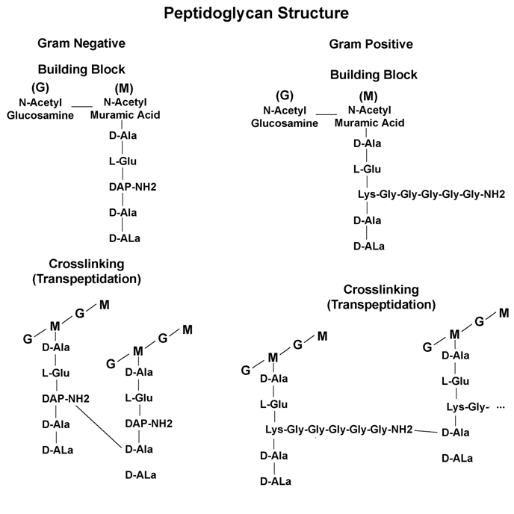

Slide 17
Staining the cell wall
The cell wall stains using the Gram stain hence can be divided into two
Gram positive (blue)
Gram negative (pink)
Acid fast stain
Acid fast (red on blue/Green)
Wall-less (can’t stain)
Spirochaetes, chlamydia & Rickettsia.

Slide 18
Gram Positive cell wall
Thick (appx 20-80 nm), multilayered peptidoglycan layer (50-90% of cell wall material/ 40+ layers of chain link fence) outside of the cytoplasmic membrane
Accessory polymers linked to peptidoglycan
Teichoic acid
Lipoteichoic acid

Slide 19
Teichoic acids
Water soluble polymers of phosphate or ribitol phosphate linked via phosphodiester bonds
There are two types of teichoic acid, wall teichoic acid (linked to peptidoglycan) and lipoteichoic acid (linked to membrane)
serve to act as chelating agents, and also for certain types of adherence.
Some gram positive bacteria may lack wall teichoic acid but all contain lipoteichoic acid
mediate attachment to mucosal membranes
Induce septic shock in certain G+ve bacteria

Slide 20
Lipoteichoic acid
Are teichoic acids made up of polyglycerol phosphate or rubitol phosphate with sugars and amino acids which are linked to a glycolipid in the underlying membrane
Induce septic shock in certain gram positive bacteria.
Role in anchoring the cell wall to the cell membrane
Also as an epithelial cell adhesion
Polysaccharides and proteins
Protect peptidoglycan layer from action of agents such as lysozymes (enzymes present in tears, mucus, saliva) which can cleave peptidoglycan
Sometimes promote colonization by sticking the bacteria to the surface of host cells

Slide 21
Gram Negative Cell wall
Consist of a relatively thin single layer of peptidoglycan (appx 10 nm) comprising 5-10% of cell wall material.
Do not retain the primary dye in Gram stain - appear pink.
Have an additional outer membrane.
There is a periplasmic space between the inner and outer membranes, which contains digestive enzymes and other transport proteins.

Slide 22
The outer membrane includes;
Porin proteins: Specifically allow transport of solutes in and out of the cell
Lipopolysaccharides (LPS)
Lipoprotein stabilizes the outer membrane by anchoring it to peptidoglycan.
The S-layer (surface layer) is directly attached to the outer membrane, rather than the peptidoglycan
If present, flagella have four supporting rings instead of two because of presence of double membranes hence a pair of rings per membrane

Slide 23
Lipopolysaccharide (LPS)
Consists three distinct unit;
Polysaccharide core of five sugars,
Phospoholipid called Lipid A (endotoxin) responsible for toxic effects (fever, hypotension, septicemia)
Outer polysaccharide of 25 repeating units- major surface antigen (somatic or O antigen) serving as an antigenic determinant

Slide 24
LPS also protects the cell from phagocytosis and lysozyme.
LPS confers a negative charge and also repels hydrophobic molecules
Has toxic and pyrogenic properties and is extremely important in pathogenesis.

Slide 25
Differences between Gram Positive and Gram Negative Bacterial Cells
Gram Negative | Gram Positive
Has an additional cell wall layer making it bi-layered | Has one cell wall layer
Has a thin peptidoglycan layer | Has a thick peptidoglycan layer
Has porins in outer membrane that act as pores | Has no porin
No teichoic acids or lipoteichoic acids are present | Is made of teichoic acids linked to peptidoglycan polymers of either glycerol phosphate or rubitol phosphate with sugars and amino acids
The S-layer is directly attached to the outer membrane, rather than the peptidoglycan | S-Layer is directly attached to the peptidoglycan and not to the membrane
If present flagella have four supporting rings instead of two due to presence of two membrane layers | If present flagella have two supporting rings because it has only one membrane layer
Most do not sporulate | Most sporulate
Does not retain the purple stain after washing off with alcohol following staining | Retains the purple color even after washing off with alcohol

Slide 26
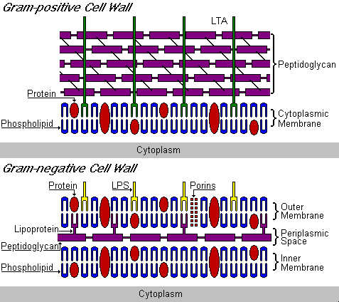

Slide 27
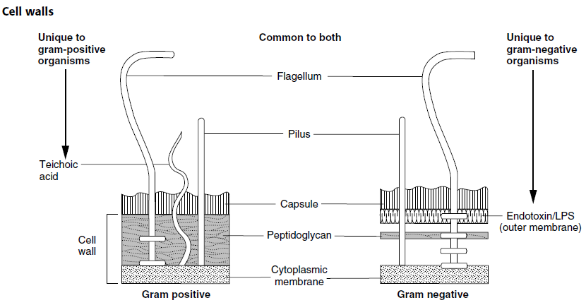

Slide 28
Acid-fast bacteria
Found in Mycobacteria and Nocardia
More complex cell envelopes than other bacteria.
Retain stain/Acid fast-Resist decolourization with acid-alcohol after staining with carbolfuschin
Composed of long chained branched fatty acids (Mycolic acid) are covalently bound via a polysaccharide to peptidoglycan.
Other mycolic acid containing compounds and complex lipids form a thick waxy membranous layer outside the peptidoglycan layer
NB: A mycolic acid derivative called cord factor (trehalose dimycolate) is toxic and plays an important role in diseases caused by Corynebacterim diphtheriae and Mycobacterium tuberculosis.
Wax D, cord factor, arabinogalactans, and sulfolipids are mycobacterial virulence factors)

Slide 29
Cell wall-deficient bacteria
Mollicutes- do not have a cell wall e.g mycoplasma and ureaplasma
L-forms or L-phase- lack cell walls derived from bacteria that normally possess cell wall
Result from action of:
enzymes lytic for cell wall
Antibiotics inhibiting peptidoglycan biosynthesis
Protoplasts - Have their cell wall entirely removed
Spheroplasts - Have their cell wall only partially removed

Slide 30
Plasma/Cytoplasmic/Cell membrane
Thin layer 5-10 nm
Separates cell wall from cytoplasm
Acts as a semipermeable membrane: controlling the movement of water, nutrients, and excretory substances in and out of the cell
Composed of lipoproteins with small amounts of carbohydrates
Generally do not contain sterols (except for Mycoplasma)
Function
Has numerous proteins whose functions include Passive water transport, Active transport of ions, nutrients and waste across the cell
Energy generation through oxidative phosphorylation
Contains enzymes involved in synthesis of precursors of the cell wall
Secretes proteins including enzymes and exotoxins
In gram negatives, it contains endotoxin

Slide 31
Flagella
Long (3 to 12 µm), filamentous surface appendages
Originate from the basal body in the cytoplasm .
Responsible for bacterial motility and chemotaxis by rotating in a propeller- like manner by means of a "motor" located just under the cytoplasmic membrane.
Are composed of flagellins (proteins)
They are anchored to the plasma membrane and protrude through the cell wall to the external part of the cell.
Possed by most rods/bacilli
Presence shown by motility test e.g. hanging drop preparation

Slide 32
Flagella - Arrangements
Monotrichous- a single flagellum at one end of the cell
Lophotrichous- a tuft of flagella (2 or more) at one end of the cell
Amphitrichous- one flagella at the opposite ends of the cell
Peritrichous- flagella present around the entire body of the cell.
Amphilophotrichous – Clusters of flagella at both ends

Slide 33
Functions of flagella
Virulence factors -allow bacteria to evade phagocytes by swimming away from them
Allow bacterial cell to come into close contact with the adhesion receptors on the human cell.
Source of H-antigen used in serotyping motile spp. of bacteria.
Serve as antigenic determinants.
Recognized by TLR5

Slide 34
Pilli
Hollow, Hair-like projections on the surface of the cell
Shorter, Straighter and thinner than flagella
Composed of subunits of a protein (pilin)
Mostly on gram negative bacteria
Sex pili:
Relatively long but is often found in few no. (1 to 6)
Involved in conjugation i.e transfer of DNA between bacteria
Receptor for bacteriophages.
Common pili (Fimbriae)
Relatively short and many (about 200).
Provide means for attachment/ adhesions and colonization ) of gram negative bacteria to host cells

Slide 35
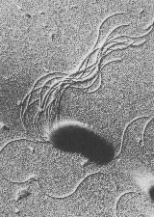
Pili and flagella
Salmonella

Slide 36
Cytoplasmic Components
Bacteria have a very simple internal structure, and no membrane-bound organelles.
Cytoplasm - Forms the site for all cellular metabolic processes
Mesosome
Ribosomes
Nucleoid
Nutrient granules

Slide 37
Mesosomes
Appear as convoluted indentations in the cytoplasmic membrane
More prominent in Gram +ve bacteria
Functions
Are sites of respiratory enzyme activity
Coordinate nuclear & cytoplasmic division during binary fission
Phagocytosis

Slide 38
Ribosomes
They are composed of RNA and proteins.
Site of activity of antimicrobials that disrupt protein synthesis e.g aminoglycosides, tetracyclines, chloramphenicol, macrolides - erythromycin
Ribosomes give the cytoplasm of bacteria a granular appearance in electron micrographs. Though smaller than the ribosomes in eukaryotic cells, these inclusions have a similar function in translating the genetic message in messenger RNA into the production of peptide sequences (proteins).
70S in size with 50S and 30S subunits
50S subunit contains the 23S and 5S rRNA
30S contains the 16S rRNA
Function; Site of protein synthesis

Slide 39
Nucleoid
This is the location of DNA in cytoplasm and has homogenous material.
Bacterial DNA consists of a single, circular double-stranded DNA
Lacks nuclear membrane (called nucleoid or nuclear body)
The nucleoid also lacks nucleolus, histones, and mitotic spindle
Contains genetic material that codes for all genetic information expressed by the cell

Slide 40
Nutrient granules/Storage granules
Reserve of energy and phosphate for cell metabolism. Nutrients may be stored in the cytoplasm in the form of glycogen, lipids, polyphosphate, or in some cases, sulfur or nitrogen.
Inclusion granules are composed of volutin, lipid and polysaccharide.
Stain characteristically with certain dyes e.g volutin stains red with methylene blue.
Examples; metachromatic granules in diphtheria bacilli
Function; Serve as storage area for nutrients and energy for cell metabolism

Slide 41
Additional Organelles
Spores
Plasmids

Slide 42
Spores
It may be round, oval, or elongated
Formed inside the parent cell (Endospores) and contains bacterial DNA
Formed in response to nutrient depletion, extreme environments or stress
They do not multiple to increase in number coz one cell yields just one spore
Composed of a thick keratinlike coat responsible for resistance
Contain dipicolinic acid
They exhibit no metabolic activity
Resistant to heat, chemicals, radiation and drying and can remain dormant for hundreds of years
Formed by bacteria like Clostridia, Bacillus
Some bacteria of Clostridia and Bacillus species e.g Clostridium botulinum, form spores that are highly resistant to drying, high temperature , radiatiation and other environmental hazards.(need autoclave at 121˚C, 15 min)Once the hazard is removed, the spore germinates to create a new population. Hence the need to bury infected organisms even deeper into the soil
The spore may be positioned at the end (terminal) of the bacterium or centrally (median).

Slide 43
Shape & position of bacterial spore
Oval central
Spherical central
Oval sub terminal
Oval terminal
Spherical terminal

Slide 44
Endospores
When bacteria are generally subjected to increasingly unfavourable environmental conditions, including lack of water, depletion of nutrients and deviation of temperature from optimum, which are suitable for growth and multiplication, they may die. But certain rod-shaped bacteria under the family Bacillaceae are able to develop structures called endospores i.e. spores within cells. These spores are formed to enable the bacteria withstand the unfavourable conditions. Bacterial cells without spores are called vegetative cells.

Slide 45
Not all spores are equally resistant to adverse physico-chemical forces. Spores of the common soil bacterium Bacillus subtilis can withstand 100 oC for 3 hours while spores of Clostridium botulinum can withstand the same temperature for 4 hours.
Spores of thermophilic bacteria such as Bacillus stearothermophilus are more resistant to heat whereas non-sporing bacteria are killed by exposure to temperatures of 65-80 oC for only a few minutes.

Slide 46
The spore lies within the sporangial wall and is surrounded by many layers. The spore wall and spore core are difficult to resolve and are therefore resistant to unfavourable physico-chemical environments.
Spores can remain dormant and stable for many years, and have been cultured from spores 300 years old. When spores are exposed to favourable conditions, they germinate into vegetative cells.

Slide 47
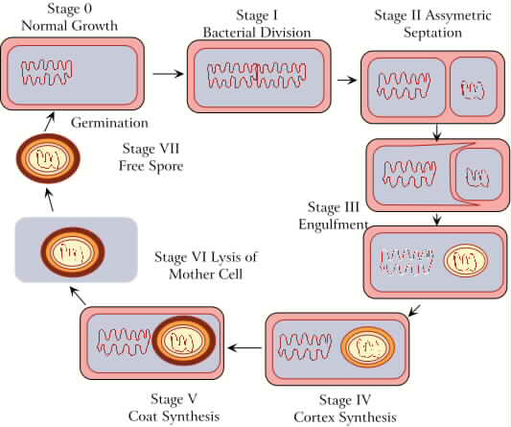
Endospore formation

Slide 48
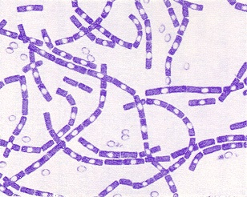
Endospores
Bacillus anthracis

Slide 49
PLASMIDS
Small circular, self-replicating, double-stranded circular DNA molecules and exist independently of chromosomal DNA in bacterial cells.
Are extrachromosomal hence can replicate independently during cell division and may be inherited by both daughter cells.
Transferred between bacteria by conjugation through sex pili
Used in genetic engineering
Free or integrated into the chromosome
Transmitted to daughter cells during binary fission
Confer properties like resistance and virulence factors
May encode genes of antibiotic resistance and pathogenesis factors (e.g. tolerance to toxic metals, enzymes, and toxins)

Slide 50
Classes of plasmids
(1) Transfer and sex factors (plasmids)
They are conjugative plasmids which determine their own transfer in bacteria and also promote transfer of other genes from donor to recipient cells during conjugation. Some conjugative plasmids can cause the transfer of chromosomal genes during conjugation. Such plasmids are termed as sex factors.
(2) Resistance (R) plasmids
These are plasmids responsible for infectious antibiotic resistance. The “R” factors plasmids carry genes that encode for enzymes responsible resistance to various antibiotics.

Slide 51
(3) Virulence / pathogenicity plasmids
These are plasmids that carry genes which encode for toxigenic and invasive properties e.g. -(i) Enteric plasmids which encode for heat stable (ST), and both heat stable (ST) and heat liable (LT) toxins in E . coli
-(ii) H/y plasmids which encode for haemolysis
-(iii) K plasmids which encode for specific antigens on bovine and porcine E . coli strains which cover the fine pili (i.e. K99 and K88 antigens respectively).
(4)bacteriocins/col . plasmids
These are plasmids commonly found in E . coli which encode bacteriocins (colicins). Some of these plasmids are conjugative and others non-conjugative.

Slide 52
(5) Staphylococcal plasmids.
These are plasmids found in S . aureus which encode for antibiotic and heavy metal resistance, and production of enterotoxins and haemolysis. They are non-conjugative and specific to Staphylococcus.
(6) Mercury resistance plasmids
They are plasmid common in some strains of enteric bacteria, Pseudomonas and S. aureus which enable the host tolerate otherwise toxic concentrations of mercury and other heavy metal ions. They also specify the conversion of relatively harmless mercury compounds to neurotoxic organomercurial methyl compounds.

Slide 53
(7) Degradative plasmids
They enclose for versatile enzymes which enable the host to degrade many organic molecules, including complex organic compounds including xenobiotics which are reculcitrant. The versatility of pseudomonas is due to the presence of plasmids which code for enzymes of catabolic pathways of a number of complex organic substrates.
Some fermentation reactions are specified by plasmids, e.g the ability to ferment lactose ( lac plasmid) and other carbohydrates in some strains of the enteric bacteria salmonella , proteus and yersinia. The presence of lac plasmids can cause confusion in diagnosing these medically important bacteria, since the ability or inability to ferment lactose is often in identifying clinical isolates.

Slide 54
8. Tumour inducing plasmids
A large plasmid has been found in the bacterium Agrobacterium tumefaciens which causes crown gall disease in plants. Avirulent strains donot have the plasmid.
9.Cryptic plasmids
They are small plasmids found in many genera of bacteria, for which no biological role has been established.

Slide 55
Transposons (Tn elements)
Many plasmid genes determining drug resistance are known to be located in discrete DNA units. These genes may be dissociated from the plasmids and be transposed into another DNA molecule, and from there undergo further translocation.
Thus a gene can hop from a drug rasistance plasmid to the chromosome, to another plasmid, or to a temperate phage (prophage, provirus) genome. Such movable units of DNA have been called transposons, transposable elements translocatable elements, drug resistance determinants or jumping genes.

