Slide 1
BACTERIAL PHYSIOLOGY
KIMAIGA H.O
MBChB (University of Nairobi)

Slide 2
Physical Factors for Bacterial Growth
They include Oxygen, carbon dioxide, temperature, moisture, pH, pressure and light.
1. OXYGEN
Acts as a final electron accepter in aerobic organisms.
The superoxide radical (O2-) is toxic and must be rendered safe for cells to survive. Anaerobic organisms lack the means to detoxify O2
Oxygen is provided in various forms like H2O, components atoms of various nutrients, or molecular oxygen. -.
In terms of oxygen utilization, bacteria are classified as follows;
Strict (Obligate) aerobes: Depend solely on oxygen supply. How?
Strict (Obligate) anaerobes: Do not need oxygen at all. Why?
Microaerophilic or aerotolerant Require very low oxygen levels for growth but cannot tolerate the levels of O2 present in an air atmosphere.
Facultative anaerobes: Grow better in presence of oxygen but can still grow even in absence of oxygen. They do not require O2 for growth although they may use it for energy production if it is available.
Some anaerobes can tolerate low levels of O2 (non-stringent or tolerant anaerobes), but others (stringent or strict anaerobes) cannot tolerate even low levels and may die upon brief exposure to air.

Slide 3
Oxygen requirements
1.
2.
1.
2.
1.
2.
3.
4.
3.
4.
3.
4.
Aerobic culture
Anaerobic culture
Microaerobic culture
1. Obligate anaerobe
2. Facultative anaerobe
3. Microaerophile
4. Obligate aerobe
1.
2.
3.
4.

Slide 4
Oxygen toxicity
Oxygen is a toxic substance to anaerobic and microaerophilic bacteria. The toxicity of oxygen to these bacteria is due to its inactivation of enzymes and damage due to its toxic derivatives.

Slide 5
Molecular oxygen inactivates enzymes by directly oxidizing certain essential groups such as thiol (-SH). Various cellular enzymes catalyze chemical reactions involving molecular oxygen (O2); some of these reactions can result in addition of a single electron to an oxygen molecule thereby forming superoxide radical
(O2 + e-_____ O.-2). This radical is very reactive and can inactivate vital cell components. This radical can also produce more toxic substances such as hydrogen peroxide (H2O2) and hydroxyl radicals (OH.).
O.-2 + 2H+ ___________ O2 + H2O2
O.-2 + H2O2 _chalated iron_____ O2 + OH- + OH.

Slide 6
OH. radicals are among the most reactive free radicals known and can damage almost every kind of molecule found in living cells. H2O2 is not a free radical, but is a powerful oxidizing agent. Singlet oxygen (O) is another toxic derivative of oxygen which is produced in biological systems by certain photochemical reactions;
O2 _light energy_____ 2[O]
Aerobic and facultative bacteria have developed various protective mechanisms against toxic forms of oxygen. Their superoxide dismutase (SOD) enzyme eliminates superoxide radicals. H2O2 can be eliminated by their catalase and peroxidase enzymes. H2O2 _catalase_______ 2H2O + O2
H2O2 + reduced substrate ___peroxidase_____ 2H2O + oxidized substrate

Slide 7
2. . TEMPERATURE
The temperature that allows for most rapid growth during a short period of time (12-24 hours) is known as optimum growth temperature.
In reference to temperature, the following classifications apply;
Psychrophiles: Low temperature required 4-20°C
Mesophiles: 20 – 40ºC required 15-48°C
Thermophiles: > 40ºC required 42-68°C
Extreme thermophiles >68°C

Slide 8
i) Psychrophiles
These are bacteria able to grow at 0 oC or lower, though they grow best at higher temperatures. Many workers restrict the term psychrophile to organisms that can grow at 0 oC but have optimum temperature of 15 oC or lower and a maximum temperature of about 20 oC. The term psychrotroph or facultative psychrophile is used for those able to grow at 0 oC but will grow best at temperature range of about 20-30 oC.
Physiological factors responsible for strict psychrophiles have been speculated to be heat instability of ribosomes and various enzymes, increased leakage of cell components, and impaired transport of nutrients above the maximum temperature.
Listeria and Yersinia enterocolitica - 4˚C
ii) Mesophiles
These grow best within a temperature range of approximately 25-40 oC. For instance, all pathogenic bacteria for humans and other warm-blooded animals are mesophiles, most growing best at about body temperature (37 oC).

Slide 9
iii) Thermophiles
Thermophiles grow best at temperatures above 45 oC. The growth range of many thermophiles extends into mesophilic region; these species are designated as facultative thermophiles. Other thermophiles cannot grow in the mesophilic range; these are termed true thermophiles, obligate thermophiles or stenothermopiles.
Factors implicated in the ability to grow at higher temperatures are: increased thermal stability of ribosomes, membranes, and various enzymes. Loss of fluidity that exists within the lipid bilayer of the cytoplasmic membrane may be a factor governing the minimum temperature. Thermoduric bacteria are those capable of serviving an exposure to high temperature like boiling etc.
Campylobacter - 42˚C

Slide 10
3. CARBON DIOXIDE
CO2 is required by all bacteria and usually available as a products of metabolism. Slow growing or fastidious organisms may not generate enough CO2 so that this must be supplied exogenously. The requirement may be increased by environmental change e.g. caused by the transfer of bacteria from growth in vivo to culture in vitro.
Many pathogenic bacteria therefore require addition of 5 - 10% CO2 to the incubator for primary isolation in vitro from clinical material.
Carbon Sources
Simple carbohydrates, sugars, proteins.
Some organisms can fix atmospheric CO2 .
Some bacteria use CO2 as their major, or even sole, source of carbon (autotrophs). Other bacteria require organic compounds as their carbon source (heterotrophs).

Slide 11
4. PH (ACIDITY OR ALKALINITY) - HYDROGEN ION CONCENTRATION
For most bacteria, the optimum pH for growth lies between 6.5 and 7.5 and the limits generally lie somewhere between 5 and 9.
Based on pH values requirements, bacteria are grouped into three broad categories.

Slide 12
i) Acidophiles:
Require pH values of 6 or less for maximum growth, and usually have pH optimum of 2 - 3.5, and can grow in a range between pH 0.5 and 6.0 e.g. Thiobacillus thioxidans has an optimum pH of 2.0 - 3.5. This organism oxidizes sulfur to H2 SO4
and can grow at pH 1.0.

Slide 13
ii) Neutrophiles
Neutrophiles prefer pH values around neutrality (pH 7.0), i.e. pH range between 6.5 - 7.5. Animal and human pathogens are usually favoured by an environment at pH 7.2 - to 7.4. However, bacteria that infect the human urinary tract and hydrolyze urea to give NH3 can grow at pH 11.0. Also bacteria that form part of the normal flora of the birth canal of young adult females do grow at pH 4.5 e.g. Lactobacillus acidophillus.

Slide 14
iii) Alkalophiles
Alkalophiles grow at pH values 7 - 12 with the optimum around 9.5.
When bacteria are cultivated in a medium originally adjusted to given pH e.g. 7.0, it is very likely that this pH will change as a result of the chemical activities of the organism, depending on the composition of the medium also. Degradation of proteins and other nitrogenous compounds frequently yields ammonia (NH3) or other alkaline products which will raise the pH. Oxidation or fermentation of carbohydrates often produces organic acids, thus decreasing the pH of the medium. Such shifts in pH may be so great that further growth of the organism is eventually inhibited.

Slide 15
5.ILLUMINATION
Photosynthetic (phototrophs) must be exposed to the source of illumination since light is the source of energy.
6. HYDROSTATIC PRESSURE
Bacterial growth may also be influenced by hydrostatic pressure. Bacteria have been isolated from the deepest ocean trenches where the pressure is measured in tons per square inch, and many of these organisms will not grow in the laboratory unless the medium is subjected to a similar pressure

Slide 16
7.SALINITY
Halophililes and osmophiles from the sea and other natural water bodies of high salinity can grow only when the medium contains an unusually high salt concentration.

Slide 17
8. WATER
Moisture is an absolute requirement for growth of all bacteria; at least 80% of the bacterial cell mass is water. For instance, more population of bacteria is encountered in the moist part of the skin - e.g. in armpits and between thighs.
Bacteria require soluble nutrients for diffusion into the cell.
Growth is inhibited in strong solutions.
Bacteria with defective cell walls burst in very weak solutions.
Bacteria require water, and all nutrients must be in aqueous solution before they enter the cells. Water is a highly polar compound that is unequaled in its ability to dissolve or disperse cellular components and to provide suitable milieu for the various metabolic reactions of a cell. Also, the high specific heat capacity of water provides resistance to sudden transient temperature changes in the environment. Water is also a chemical reactant being required for the many hydrolytic reactions carried out by the cell. Water is also a source of hydrogen and oxygen required by the cell.

Slide 18
Other requirements for Bacterial Growth
Nitrogen source
Essential nutrients
Inorganic ions, iron

Slide 19
Nitrogen Sources
Protein, amino acid, peptides
Nitrates, ammonium salts
Some organisms can fix atmosphericN₂

Slide 20
Essential Nutrients
Bacteria vary in their requirements
Some can synthesize all their needs
Others need complex organic molecules, blood, vitamins to grow. These are called fastidious.
Macronutrients: C, O2, H2, N, S, P, K, Ca, Mg, Fe
Micronutrients: Mn, Zn
Growth factors: Organic compounds, amino acids, purines, pyrimidines and vitamins

Slide 21
Iron
Required for enzyme action.
Fe³⁺ is insoluble.
Bacteria produce siderophores, which bind to Fe³⁺ and make it possible to import it.
Sulfur, phosphorus
Sulphur is needed for synthesis of certain amino acids (cystine, and methionine). Some bacteria require organic sulfur compounds, while some are capable of utilizing inorganic sulfur compounds and some can even use elemental sulfur. Phosphorus is usually supplied in the form of phosphate (PO-4) and is an essential component of nucleotides, nucleic acids, phospholipids, teichoic acid, and other compounds.

Slide 22
Metal ions
Metal ions such as K+, Ca2+, Mg2+, Fe2+, etc. Bacteria require such metal ions for normal growth. Other metal ions (termed, trace elements) such as Zn2+, Cu2+, Mo6+, Mn2+, Mo6+, Ni2+, B3+, and Co2+ are needed but usually only at very low concentrations. These trace elements often occur as contaminants of other compounds of culture media in amounts sufficient to support bacterial growth.
Not all biological functions of metal ions are known, but Fe2+, Mg2+, Mo6+, Mn2+, and Cu2+ are known to be co-factors for various enzymes
Most bacteria do not require Na+, but certain marine bacteria (e.g. Vibrio parahaemolyticus), cyanobacteria, and photosynthetic bacteria do require it. Some members of the archaebacteria called the extreme halophiles can not grow with less than 12 - 15% NaCl. They require this high level of NaCl for maintenance of the integrity of their cell walls and for the stability and activity of certain of their enzymes.
Source of energy
All organisms require a source of energy. Some rely on chemical compounds for their energy and are designated as Chemotrophs. Others can utilize radiant energy (light) and are called Phototrophs.

Slide 23
Source of electrons
Bacteria like other organisms require a source of electrons for their metabolism. Some bacteria can use reduced inorganic compounds as electron donors and are termed as lithotrophs (some may be chemolithotrophs, others, photolithotrophs).
Other bacteria use organic compounds as electron donors and are called organotrophs. (some are chemoorganotrophs, others photoorganotrophs).
Vitamins & vitamins like compounds
These function either as coenzymes for several enzymes or as the building blocks for coenzymes. Some bacteria are capable of synthesizing their entire requirements of vitamins from other compounds in the culture medium, but others cannot do so and will not grow unless the required vitamins are supplied pre-formed to them in the medium.
Folic acid metabolism.
Humans get folic acid as a nutrient but bacteria must synthesize
Sulfanilamide is a PABA analog that inhibits dihydropteroate synthetase
Trimethoprim inhibits dihydrofolate reductase

Slide 24
BACTERIAL REPRODUCTION AND GROWTH
Reproduction in bacteria is usually asexual. The modes of cell division in bacteria include binary fission, bidding, fragmentation and formation of conidiospores or sporangiospores.
Binary fusion
A single cell divides to form two new cells of equal size after developing a transverse septum ( crosswall). Transverse binary fission is the most common and important mode of cell division in the usual growth cycle of bacterial populations.

Slide 25
Budding
Some bacteria such as Rhodopseudomonas acidophila reproduce by budding, a process in which a small protuberance (bud) develops at one end of the cell. The bud enlarges and eventually develops into a new cell which separates from the parent.
Fragmentation
Bacteria that produce extensive filamentous growth, such as Nocardia species reproduce by fragmentation of the filaments into small bacillary or coccoid cells, each of which gives rise to new growth.
Formation of conidiospores/sporangiospores
Species of the genus Streptomyces and related bacteria produce many spores per organism by developing crosswalls (septation) at the hyphal tips. Each spore gives rise to new organism.

Slide 26
Prototrophs and auxotrophs
Prototrophs are wild-type bacteria with normal growth requirements. They are nutritionally independent and are able to synthesize all required growth factors from simple substances. Auxotrophs are mutants (biochemical mutants) which require an additional growth factor not needed by the parental or wild-type strain. The specific nutrients required by the auxotrophs may be amino acids, purine and pyrimidine bases and vitamins.

Slide 27
Growth of Bacteria
The term growth as commonly applied to bacteria refers to the changes (increase) in the total population rather than an increase in the size or mass of an individual organism.
The most common means of bacterial reproduction is binary fission.Thus, if we start with a single bacterium, the increase in population is by geometric progression:
1....2.....4.....8......16......32.....................
1....21......22.......23.......24.........25..........2n
The rate of growth is limited by:
the availability of nutrients
temperature
ability to remove toxic products
The time required to divide is called the generation time.
for most organisms, it is measured in minutes
Fast - as little as 10 min. generation time (Vibrio vulnificus) as long as 24 hr. (Mycobacterium tuberculosis)

Slide 28
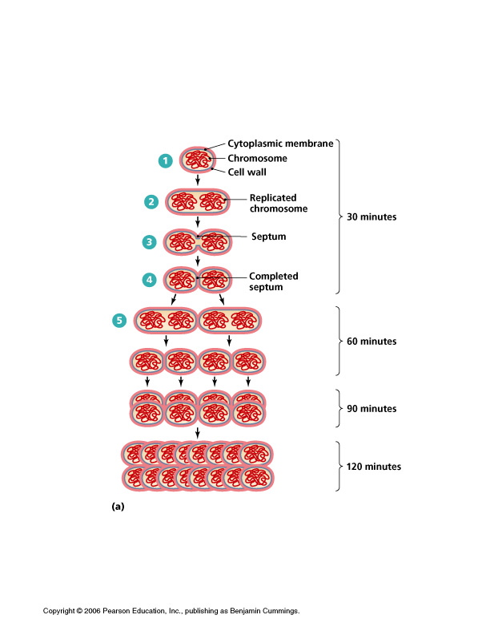

Slide 29
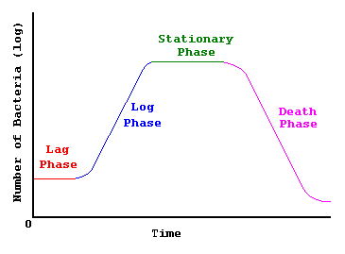
Bacterial Growth Curve

Slide 30
Lag Phase
No growth
No cell division has started
The cells are adapting to environment
Active synthesis of enzymes and other constituents and metabolic processes are now taking place.
Log (i.e. logarithmic) /Exponential Phase
Maximal growth rate
Increased metabolic rate
Rapid reproduction/ Increased cell number and increased total cell mass
Antibiotics most active

Slide 31
Stationary Phase
Slow growth then stops due to nutrient depletion and waste accumulation
Equilibrium of dying cells and new cells i.e Rate of reproduction equals rate of cell death
Cell variation is taking place as spores form and gram negative bacteria test negative.
Decline/Death Phase
Caused by decreased viability leading to cell death due to toxic waste accumulation
There is decrease in selective permeability leading to lysis
Ability to reproduce decreases
Death rate exceeds reproduction

Slide 32
Transport in Bacteria
There is passive diffusion for CO₂, O₂ and H₂O
Facilitated diffusion is by means of carrier proteins hence no energy is required in both cases coz the movement is along a concentration gradient
Aerobic bacteria get accustomed to active transport due to presence of oxygen for energy production. This is against a concentration gradient.
In some bacteria, group translocation is used; the molecule itself is chemically altered to be able to be transported. It is energy dependent and mainly used to transport sugars like glucose, fructose and sucrose.

Slide 33
Bacterial Oxygen Use
Results in production of H₂O₂ and 2O₂⁻ (superoxide radical)
The bacteria use;
Superoxide dismutase: Catalyzes the reaction
2O₂⁻ + 2H⁺ H₂O₂ + O₂
Catalase: It catalyzes the reaction below
H₂O₂ 2H₂O+ O₂
By these two reactions, the bacteria avoid their own death that may be caused by accumulation of the waste products inside them.

Slide 34
Biosynthesis
This involves;
Protein synthesis
Lipid synthesis
Polysaccharide synthesis
Metabolic Products
Toxins (exotoxins and endotoxins)
Extracellular enzymes
Pigments

