Slide 1
PATHOGENICITY, VIRULENCE, INVASIVENESS AND TOXIGENICITY
KIMAIGA H.O
MBChB(University of Nairobi)

Slide 2
BACTERIA AND DISEASE
(a) Host-Parasite Relationship
Microorganisms, in their struggle for existence under natural conditions, must find a suitable host where they can grow or multiply. The hosts are usually higher plants and animals. Where the relationship is not mutually beneficial, parasitism results, where the microorganism which usually receives the benefit is the parasite, and the animal/plant is the host.
Majority of host-parasite relationships involving microorganisms appear relatively harmless to the host, where the microorganisms benefits from the association, the host being unaffected. This is commensalism.
In most successful associations, the microbe and host achieve a balance which ensures their survival, growth, and reproduction. Majority of microbes found at various sites of the body fall in this category, and are referred to as normal body flora.

Slide 3
Microbe-host interaction sometimes elicits a violent defense reaction, with three possible outcomes.
i) the parasite is killed or expelled
ii) the host may be killed.
iii) the microbe and host reach a sort of equilibrium and live together

Slide 4
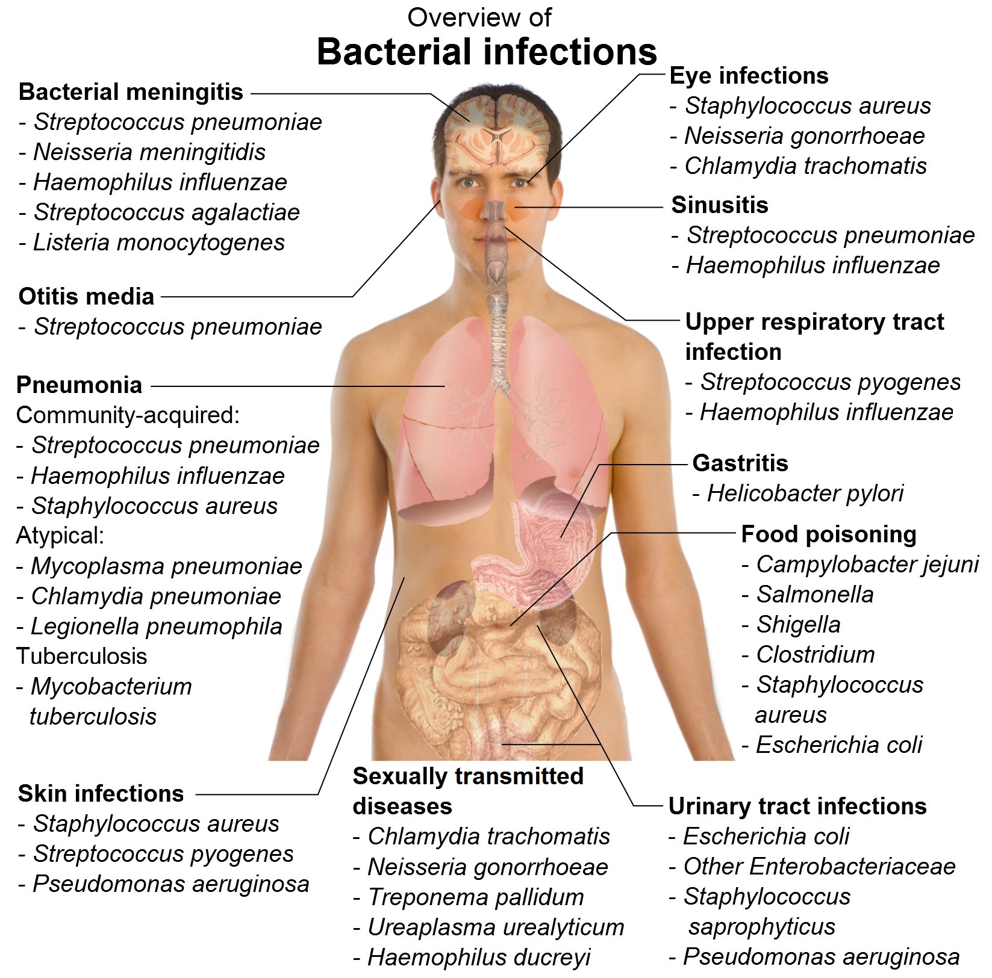

Slide 5
(b) Infection and Disease
Infection is the invasion of the host by a microbe and establishment of the latter upon or within the former. The results of infection may or may not be apparent. When the result of infection is apparent and the host is injured, disease is said to occur.

Slide 6
Pathogenicity, Virulence, Invasiveness and Toxigenicity
All along the path from the portal of entry to the final site of lodgment, there is a struggle for supremacy between the parasite and the host. The attributes of the parasite which may enable it to attack and injure the host include its pathogenicity, virulence, invasiveness and toxigenicity.

Slide 7
Pathogenicity denotes the ability of a microorganism to cause disease, while virulence is the degree of pathogenicity. A microorganism is either pathogenic or non- pathogenic. Some strains/species of a microorganism are more virulent than others. However, non - pathogenic strains/species are also said to be avirulent
Virulence is measured in terms of the number of microorganisms or micrograms of toxin necessary to kill a given host when administered by a certain route. It is usually expressed as LD50 (lethal dose - 50) i.e. the number of microorganisms or amount of toxin which must kill 50% of the test host organisms.

Slide 8
Invasiveness
Commonly bacteria cause disease by invading tissues, multiplying within them and spreading from the primary side of lodgment. This behaviour is called invasiveness.

Slide 9
Toxigenicity
Toxins are normal cellular components or metabolic products (secondary metabolites) of bacteria that damage or interfere with tissue cells of the host. One mechanism of pathogenicity and virulence is the harmful effects of the toxins. Bacteria producing toxins are said to be toxigenic and the ability to produce toxins is called toxigenicity.
Bacteria produce endotoxins and exotoxins.
Exotoxins
Soluble proteins secreted or released into the surrounding of the bacterium.
They are usually potent and extremely fatal in small doses, and may be disseminated throughout the body and cause generalized symptoms and lesions of various types.

Slide 10
Endotoxins
Structural components of microbes, which are complexes of lipids, polysaccharides and proteins.
Usually part of the cell wall of gram negative bacteria and are usually released after autolysis.
The protein portion is not essential for toxicity. It is the lipopolysaccharide portion which is highly toxins but less potent than exotoxins.
All endotoxins are emetic and pyrogenic and commonly diarrhoeic.
They are thermostable, withstanding 100 0C for an hour unlike the thermolabile exotoxins which are destroyed by heating at 60 0C for 1 - 2 hours.

Slide 11
INFECTION, PATHOGENICITY AND VIRULENCE
Terminologies used to refer to certain aspects of interaction between disease causing bacteria and the host, i.e. the host-parasite relationship. These are at times used interchangeably
Relationships between host and microbes.
Commensal - Microbe received benefit, but there is no harm to the host.
Opportunist - Microbe received benefit, and is able to cause disease if host defenses are weakened.
Pathogenicity - The ability of an organism to cause disease.

Slide 12
PATHOGENICITY
Ability or potential of an organism to cause disease and varies from one genus to another. Bacteria are grouped into;
Pathogenic bacteria
Non-pathogenic bacteria
Opportunistic pathogenic

Slide 13
Transmission: Movement from one location to another;
Enhanced if organism is in large numbers and excreted in large numbers
Enhanced in availability to survive extreme conditions
Infectivity: Ability to penetrate a healthy host’s 1st line of defence e.g. intact skin, intact mucous membrane and varies from host to host. If the organism has certain factors e.g. virulence, it enhances infectivity

Slide 14
Pathogenesis
Pathogenesis is the process that covers initiation of an infection process, from beginning of signs and symptoms
Pathogenesis can result in;
Lack of symptoms and may be referred to as asymptomatic
May be unnoticed but detectable in the laboratory
Visible symptoms like a swelling at the site of entry i.e. a localized lesion or with pain e.g. sore throat

Slide 15
VIRULENCE
This is the capacity (how much damage) / extent of an organism to cause a disease and varies from organism to another. Can be described as;
Avirulent; cannot cause harm
Virulent; causes harm
Very virulent; extremely dangerous in disease causing

Slide 16
Factors related to virulence and the host
Bacterial factors
Ability to initiate infection
Presence and production of structures called bacterial ailment structures
Adherence factors
Aggressive Factors
Include capsules, prevents phagocytosis
Enzyme and enzyme related factors
Siderophores
Plasmids
Bacterial toxins

Slide 17
Virulence Factors
The properties that an organism has to enable it to cause infection.
May enable an organism to evade host defenses.
May improve access to the body's nutrients.
Colonization factors, e.g. fimbriae
Allow an organism to adhere to cells.
Adhesions are proteins that allow organisms to stick to cells.
Antiphagocytic mechanisms, e.g. capsule
Body's immune cells are unable to engulf organisms.
Exotoxins (toxins excreted from the bacterial cell).
A wide variety of enzymes and toxic proteins are released.

Slide 18
Substances that help organisms invade
Hemolysins - cause lysis of red blood cells, and damage other body cells.
Leukocidins - kill white blood cells.
Hyaluronidase - breaks down connective tissue extracellular material allowing spread.
Collagenase - breaks down collagen, a structural protein.

Slide 19
Toxins that cause disease
Enterotoxins - attack the bowel.
Neurotoxins - inhibit normal neurological function.
Protein synthesis inhibitors - can kill cells or damage organs, e.g. diphtheria
Superantigens - these toxins bind to macrophages and short circuit the mechanism for stimulation of the immune system, causing a massive response and consequent damage to the body, e.g. Toxic Shock Syndrome, "Flesh eating disease".

Slide 20
Endotoxin ("Pyrogen")
Found in the outer membrane of gram negative organisms.
Causes fever, drop in blood pressure (shock).
Acts by binding macrophages and causing release of active substances (cytokines).

Slide 21
INFECTION
This basically means disease. Involves the process by which organisms enter a relationship with a host then multiplies to harmful levels inside the host causing illness.
Reservoirs: These are sources to organisms e.g. human host, animal etc
Human infection can be;
Exogenous: Source outside from the host e.g. patient, animals, environment etc
Endogenous: Arise from within the individual hence the organism gives rise to sign and symptoms and the person can be a carrier.

Slide 22
Modes of Transmission
a.) Respiratory Tract Organisms
Include sneezing, coughing and talking
The droplets of infected secretions are released into the atmosphere causing contamination
b.) Skin and wound infection
Coming into contact with infected site/material causing contamination
c.) Sexually Transmitted Bacteria
Present in secretions and mucosal membranes of genitalia

Slide 23
Transmission of Infection
Sources may be
from the normal flora
from other sources
Other sources:
people
animals (direct or via food)
environment
vectors and fomites
Vectors: a small organism (e.g. insect) that transmits an infectious agent.
Fomite: an inanimate object that transmits infection when contaminated. e.g. doorknob.

