Slide 1
BACTERIAL GENETICS
KIMAIGA H.O
MBChB (University of Nairobi)

Slide 2
BACTERIAL GENETICS
Bacteria are haploid organisms. Genetic variation in them is introduced by mutations and transfer of genes among them selves, and through viruses and the environment.

Slide 3
Introduction
Like every other organism, bacteria also have ways of passing their genes from one set of generation to another
Bacteria do not have nuclei.
In bacteria, their unit of inheritance is the DNA and unlike viruses which only have DNA or RNA, bacteria just has DNA
Composition is composed nucleosides composed of the bases; purines and pyrimidines, cytosine and guanine, adenine and thymine
Special enzymes cut DNA when it has the specific base sequence for that enzyme.
The ration of combining is set that analysis of the ratio can be determined.
DNA in bacteria occurs as a single circular molecule, and sometimes as small circular molecules (plasmids) that are independent of the chromosome but are expressed.
A double helix arrangement is formed by the DNA
DNA polymerase initiates the replication process/forking of the DNA helix to synthesis the complementary half ending up with an almost original form like before.

Slide 4
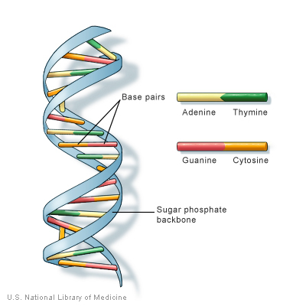

Slide 5
Definitions
Codon: A set of three base pairs that cater for the selection of one amino acid
Code: Genetic information in the DNA molecule
Gene: A segment of DNA which codes for the production (synthesis) of a complete of functional polypeptide
Genome: Full compliment of genes in a bacterial chromosome
Genotype: Specific set of genes an organism possesses
Phenotype: Collection of external observable characteristics of the organism
The gene codes for a polypeptide of mRNA and tRNA
The genetic code is arranged in codons, each codon consisting of three successive base pairs that code for one amino acid e.g. AAA codes for Lysine

Slide 6
Steps in Polypeptide Synthesis
Step 1:
DNA replication: This is the process in which DNA duplicates itself. Replication is somewhat complex, but what basically happens is that the two complementary strands which form the DNA molecule unzip and then are used as templates from which new strands are made as free nucleotides combine with their complementary bases.
Replication of DNA is semi-conservative. That is, one side of each new DNA strand is "old" and the other side is "new".

Slide 7
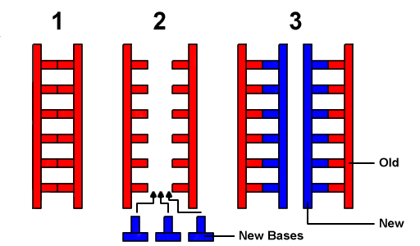
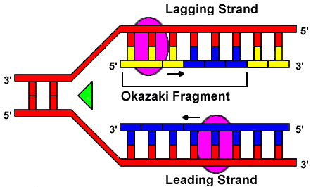
DNA polymerase
The image above shows replication. The helix will unwind in the direction of the green arrow. The yellow bases are RNA molecules - the primer. The purple ellipses are DNA polymerases which are linking the new bases together. They move in the direction of the black arrows. As the new strands form, DNA polymerase II moves along the strands and proof-reads them for errors /mutations.

Slide 8
Step 2:
Transcription of mRNA from DNA
Transcription is the synthesis of mRNA from a DNA template. It is like DNA replication in that a DNA strand is used to synthesize a strand of mRNA. Only one strand of DNA is copied. A single gene may be transcribed thousands of times. After transcription, the DNA strands rejoin.
RNA polymerase - inhibited by rifampin.

Slide 9
Step 3:
Translation
Translation is the process where ribosomes synthesize proteins using the mature mRNA transcript produced during transcription.

Slide 10
Step 4: Termination and release Genetic coding
First Base | Second Base |  |  |  | Third Base
 | U | C | A | G
U | UUU phenylalanine | UCU serine | UAU tyrosine | UGU cysteine | U
 | UUC phenylalanine | UCC serine | UAC tyrosine | UGC cysteine | C
 | UUA leucine | UCA serine | UAA stop | UGA stop | A
 | UUG leucine | UCG serine | UAG stop | UGG tryptophan | G
C | CUU leucine | CCU proline | CAU histidine | CGU arginine | U
 | CUC leucine | CCC proline | CAC histidine | CGC arginine | C
 | CUA leucine | CCA proline | CAA glutamine | CGA arginine | A
 | CUG leucine | CCG proline | CAG glutamine | CGG arginine | G
A | AUU isoleucine | ACU threonine | AAU asparagine | AGU serine | U
 | AUC isoleucine | ACC Threonine | AAC asparagine | AGC serine | C
 | AUA isoleucine | ACA threonine | AAA lysine | AGA arginine | A
 | AUG (start) methionine | ACG threonine | AAG lysine | AGG arginine | G
G | GUU valine | GCU alanine | GAU aspartate | GGU glycine | U
 | GUC valine | GCC alanine | GAC aspartate | GGC glycine | C
 | GUA valine | GCA alanine | GAA glutamate | GGA glycine | A
 | GUG valine | GCG alanine | GAG glutamate | GGG glycine | G

Slide 11
Gene Regulation
Regulation of protein synthesis is primarily at level of initiation of transcription involving regulatory DNA binding proteins to turn on/off genes in response to environmental conditions (Lac operon)
The LAC Operon
LAC- This refers to lactose. It shows how lactose is regulated
Operon – Refers to set of structural genes that work together to regulate synthesis of a functionality
Some genes regulated in response to stress - heat shock proteins involved in survival.

Slide 12
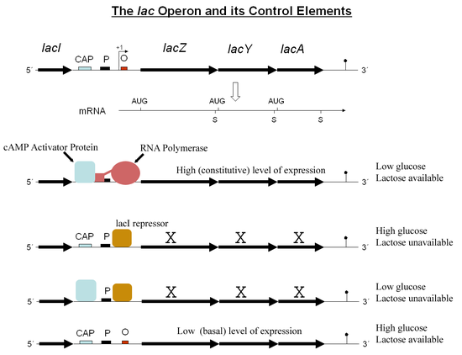

Slide 13
Promoter gene sits on position two and suppresses the function of the rest of the gene.
The promoter gene now removes the suppressor and allows the process to resume functionality

Slide 14
Sources of genetic diversity
Mutation: The alteration of the sequence of the bases in the organization of the gene
10⁻⁹/base or 10⁻⁶/gene per replication
Happen all of the time, regardless of growth conditions - are they selected for to become enriched in the bacterial population?

Slide 15
Gene transfer
DNA or genetic material from external sources;
Gene transfer in bacterial cells produces partial diploids called merozygotes. The original genome of the recipient cell is called the endogenote while the donated (transferred) DNA is called exogenote. Genes from the exogenote may be exchanged or integrated into the endogenote, a process called molecular recombination.
Importance
a. moving antibiotic resistance genes among bacteria
b. moving virulence gene among bacteria
c. changing the antigenic make-up to avoid immunity
Mechanisms
a. Transformation - uptake of naked DNA
b. Transduction - bacteriophage as vectors
c. Conjugation - plasmids moved by cell-cell contact

Slide 16
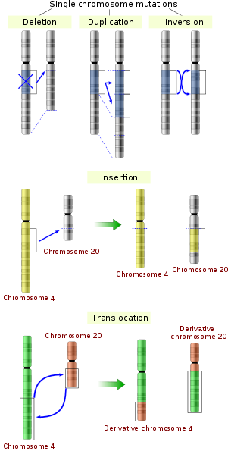
Mechanisms of mutation
Deletion
Insertion
Substitution

Slide 17
3. Frameshift mutation (involves a large segment of DNA molecule superimposing them on another locus. Are responsible for the largest mutations
A frameshift mutation is a mutation caused by insertion or deletion of a number of nucleotides that is not evenly divisible by three from a DNA sequence. Due to the triplet nature of gene expression by codons, the insertion or deletion can disrupt the reading frame, or the grouping of the codons, resulting in a completely different translation from the original. The earlier in the sequence the deletion or insertion occurs, the more altered the protein produced is.
For Example: The principle of a frameshift can be explained using the sentence below. If the letters are read three at a time and one is deleted, the second sentence becomes meaningless.
Original DNA: THE BIG RED ANT ATE ONE FAT BUG
Frameshift mutation: THB IGR EDA NTA TEO NEF ATB UG?

Slide 18
Rate of Mutation
1 x 10³ 1 x 10⁸
High frequency Low frequency
We also have reversible vs non-reversible mutations
Selection of Mutants
In Vivo
Development of mechanisms to escape the host’s natural defences
Has enhanced capacity to parasitize the host
In Vitro
These mutations lead to acquired resistance to chemicals that lead to bacterial eradication
Loss of ability to utilize certain carbon sources

Slide 19
Role of Mutagens
Mutagens: Substances that induce mutation. Can be in form of;
1. Chemical Mutagens
Analogous of purines and pyrimidines e.g. S-bremouracil, nitrous acid, acridine dyes e.g. acroflavine, acidine orange etc
2. Physical Mutagens
Include ionizing radiations e.g. UV and X-ray radiations
Infrared heat

Slide 20
Effects of Mutation on the Phenotype
a.) Nonsense Mutation
No observable changes to the organism
b.) Lethal mutations
Leads to the production of visible organism
c.) Conditional lethal
Mainly effects of temperature (optimum is important)
Effect of nutrients
d.) Mutations affecting carbon source and other growth factor utilization
e.) Mutations affecting sensitivity of bacteriophages and chemicals including antibiotics
f.) Mutations affecting antigenicity, involve surface structures like cell wall, capsules, fimbriae and flagella
g.) Mutations affecting virulence; this include attach by bacteriophages which are viruses that attack bacteria and make them lose their virulence

Slide 21
Gene Transfer
Horizontal Gene Transfer (HGT)
HGT is a process in which a prokaryotic cell can acquire genes from other microbes of the same generation, which, in some cases, can be a different species, or even a different genus than the donor. There are three types of horizontal gene transfer/ recombination.
Transformation
Transduction
Conjugation

Slide 22
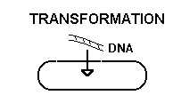
1. TRANSFORMATION
This is the process in which a recipient cell takes up DNA from the environment (such as DNA released from a dead organism).
Recipient cell must be competent for uptake of DNA
Natural competence versus artificial competence
Only certain bacteria are naturally transformable - Streptococcus pneumoniae, Haemophilus influenzae, Neisseria gonorrhoeae, Vibrio

Slide 23
Genetic modification occur when the cell-free or naked DNA fragments from one cell enter and are integrated into the genome of another cell.
Transformation was first observed by Griffith (1928) who noted the transformation of harmless pneumococci into virulent ones. Later Avery et al. (1944) showed the transforming agent to be DNA.
Studies showed that DNA extracts of heat-killed pathogenic encapsulated (smooth) Streptococcus pneumoniae transformed non-pathogenic and non-capsulated (rough) strains of Streptococcus pneumoniae into virulent (encapsulated) stains. Genetic transformation has also been demonstrated in several other bacterial genera, including Haemophilus, Bacillus, Salmonella, Neisseria etc.

Slide 24
2. TRANSDUCTION
This process involves the transfer of DNA from one cell to another via a replicating virus/ bacteriophage as the vector.
Transduction can occur between prokaryotic cells or between eukaryotic cells.
Example by bacteriophage virus.:
The bacteriophages inject their DNA into the bacterium, where the DNA replicates and directs the synthesis of new phage proteins.
The new DNA combines with the new proteins to make progeny viral particles which are released by the destruction of the cell wall and lysis of the bacterial cell (lytic cycle).
When a phage is being replicated inside a host cell, the new viruses self-assemble from proteins and viral nucleic acid (genetic material) that the host cell has produced.

Slide 25
Sometimes some of the DNA of the host, which had been chopped up during the lytic replication process, gets inside a new virus during viral self-assembly. When that phage then infects another cell, the new host may incorporate the donated DNA into its chromosome by recombination.
Bacteriophage (phage) are viruses of bacteria - can be either lytic or temperate/lysogenic
i. lytic - always lyse (kill) host bacterial cell
ii. temperate - can stably infect and coexist within bacterial cell (lysogeny) until a lytic phase is induced
However, some bacteriophages get their DNA integrated into the bacterial chromosome to behave as some kind of episome in the bacteria. In this state, the viruses are called prophages (provivuses) (non lytic cycle). The bacteria carrying prophages are called lysogenic bacteria.

Slide 26
Lysogenic bacteria can be induced by various physico-chemical agents such as UV light to make the phages excised from chromosomal DNA to start to replicate and go through a lytic growth cycle resulting in the lysis of the host cell with release of new phage particles.
Some of these particles may exist with bacterial chromosomal DNA or a mixture of chromosomal and phage DNA (rather than completely with phage DNA as is normally the case.
Such aberrant phages can infect other bacteria and introduce bacterial rather than just phage DNA into them.
By this means, phages transfer bacterial DNA from one bacterial cell to another, a process called transduction (sex duction).

Slide 27
3. CONJUGATION
Conjugation is the transfer of genes (genetic material) between bacterial cells that are in physical contact with each other (Landerberg and Tatum, 1946).
It has been observed to occur between genetically different cells of the same species, closely related species and between different genera.
The recipient cells appear to have a specific receptor site for conjugation.
A conjugation tube is established between the two conjugants, followed by the transfer of the genetic material from one cell (donor, or male) to the other (recipient, or female).
The conjugation tube is formed by special appendages called sex pili specified by a plasmid, the F (fertility) factor in the donor. Therefore;
Bacteria containing a conjugative plasmid are called donor, male, (F+)
Bacteria receiving the plasmid are called recipient, female, (F-)
Once the recipient cell receives the F factor, it becomes male, and can act as donor cell.

Slide 28
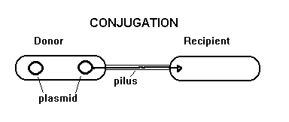
At times, the F factor may be integrated into the bacterial chromosome to form an episome. Such cells are called Hfr cells. These cells are designated Hfr due to the high frequency of transfer of the F factor to daughter cells Unlike the processes of transformation and transduction, the donor cell is not killed during this type of gene transfer.
The process involves one bacterium making a copy of a portion of DNA, called a plasmid, and transferring that copy to another bacterium.
Mediated by pili
Conjugation is especially important in gram negatives.

