Slide 1
ANTIMICROBIAL RESISTANCE
KIMAIGA H.O
MBChB (University of Nairobi)

Slide 2
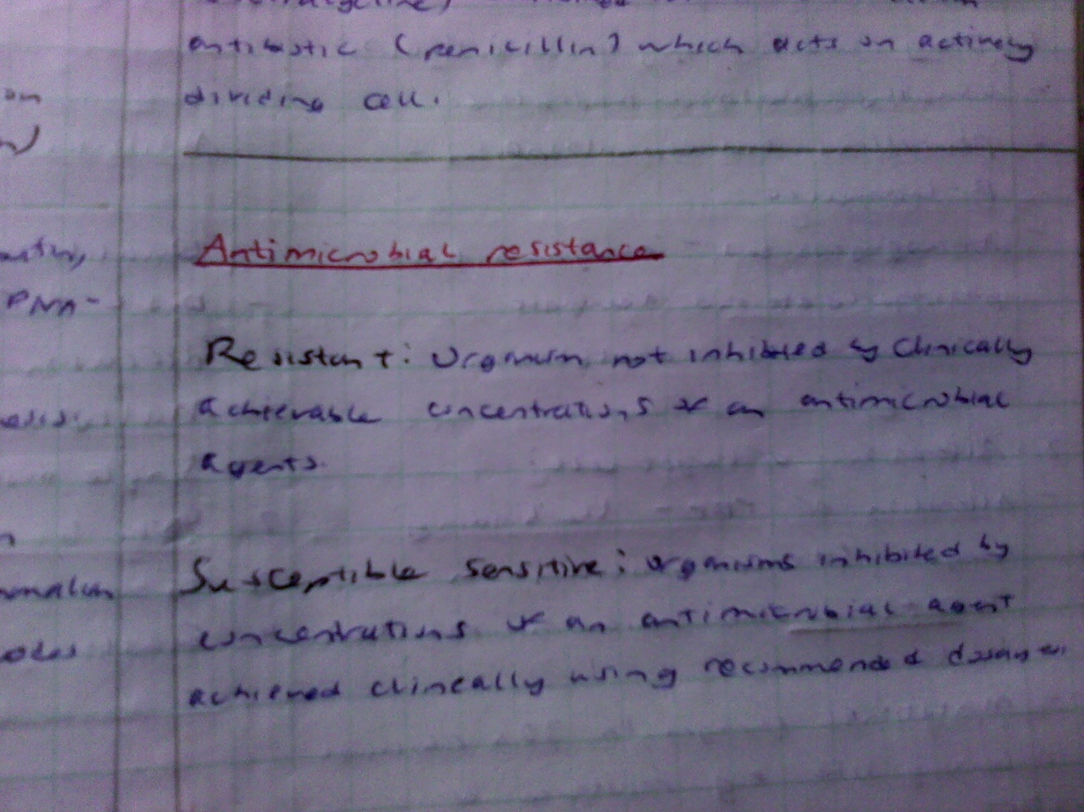

Slide 3
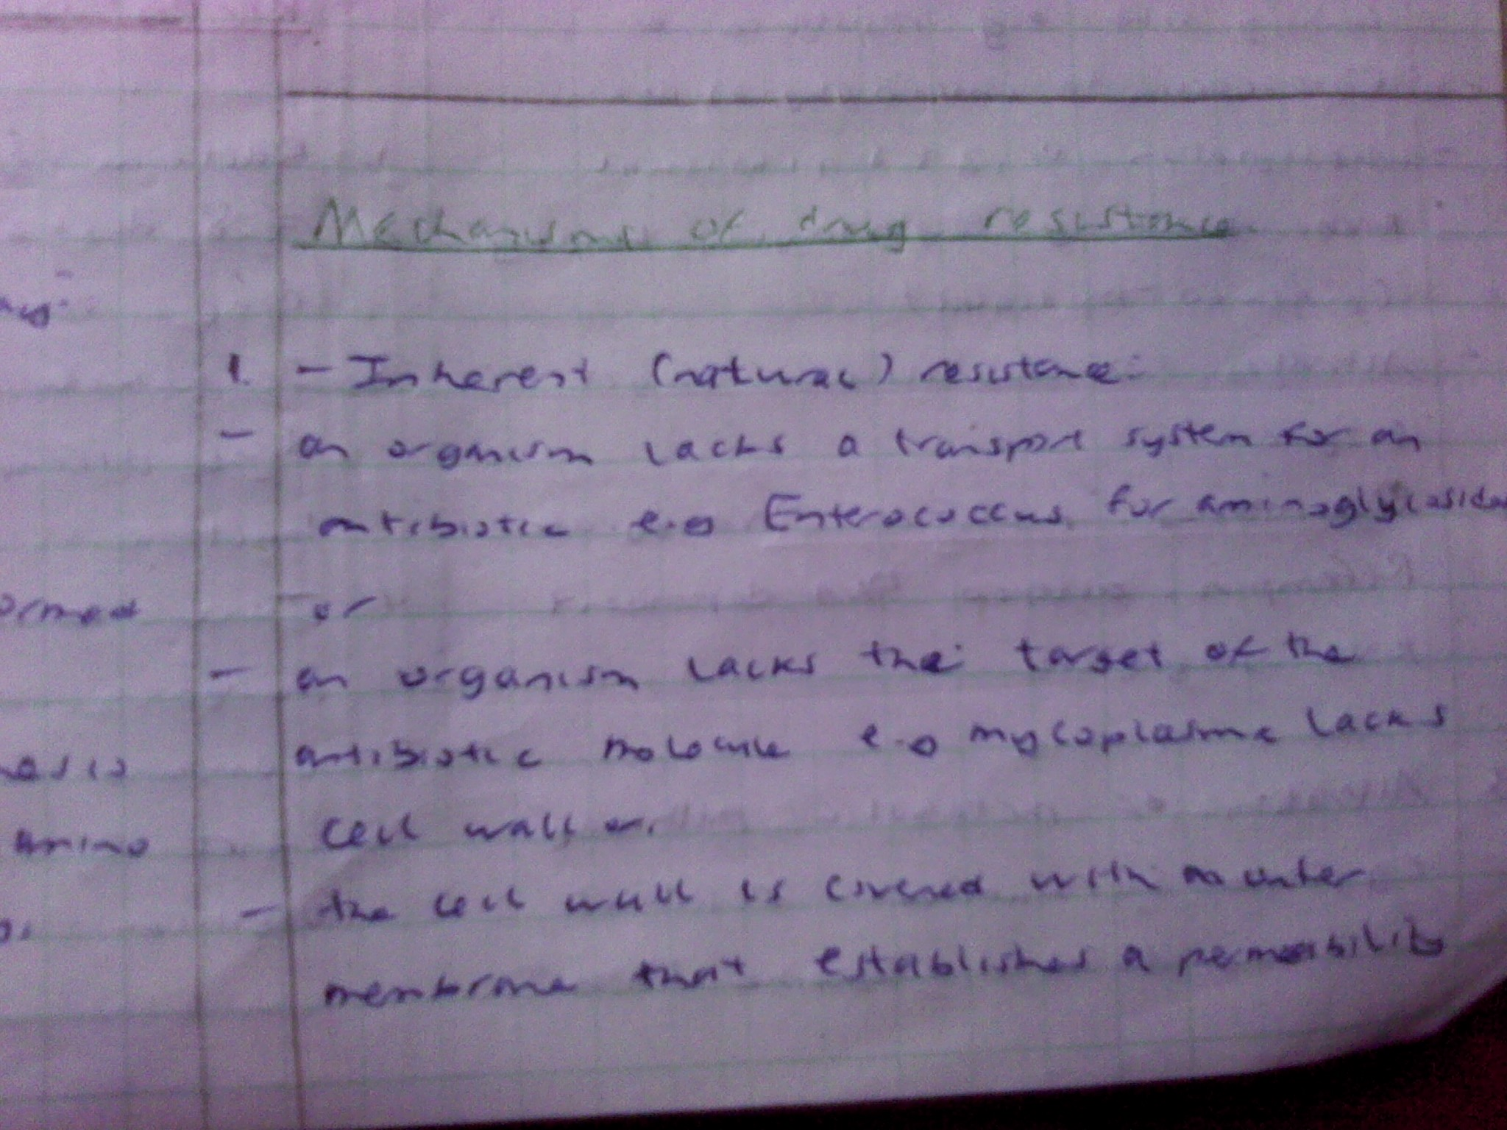

Slide 4
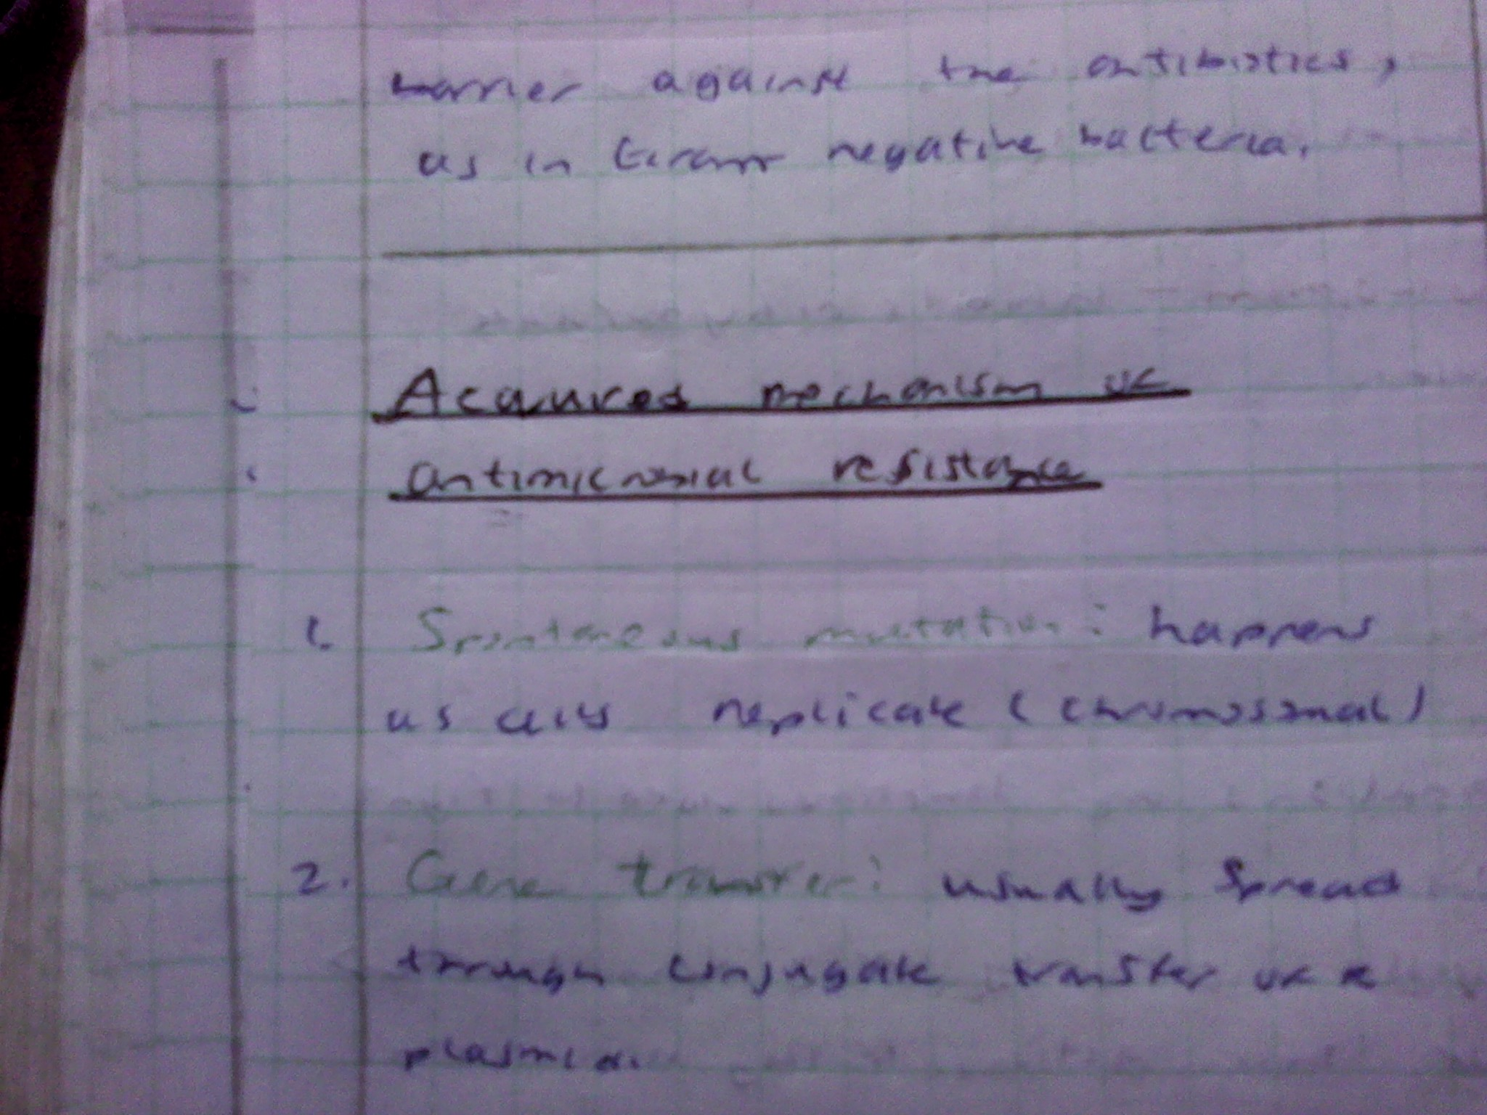

Slide 5
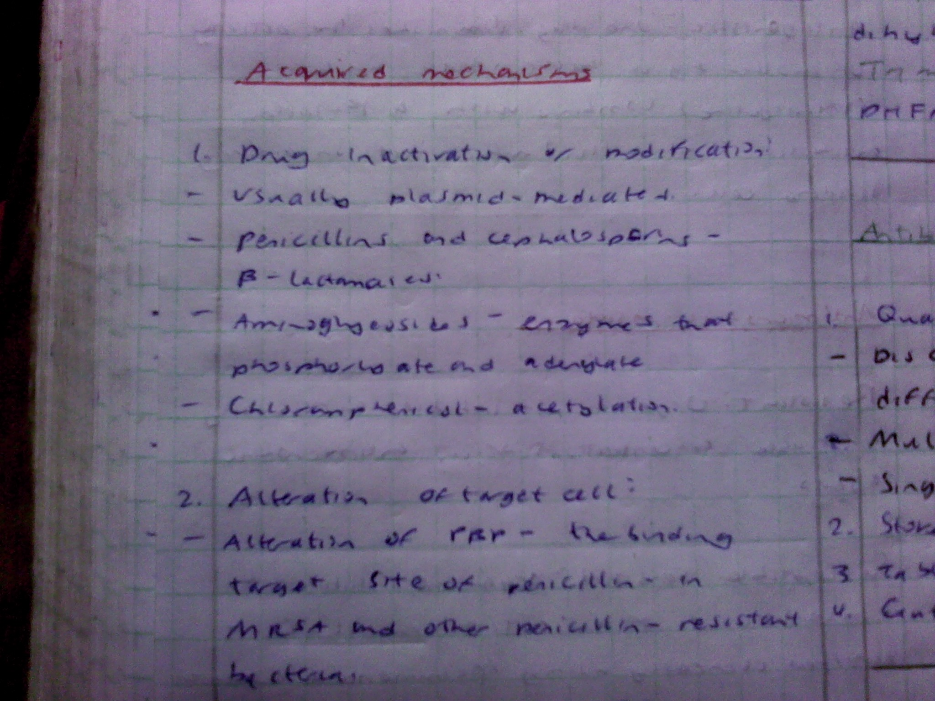

Slide 6
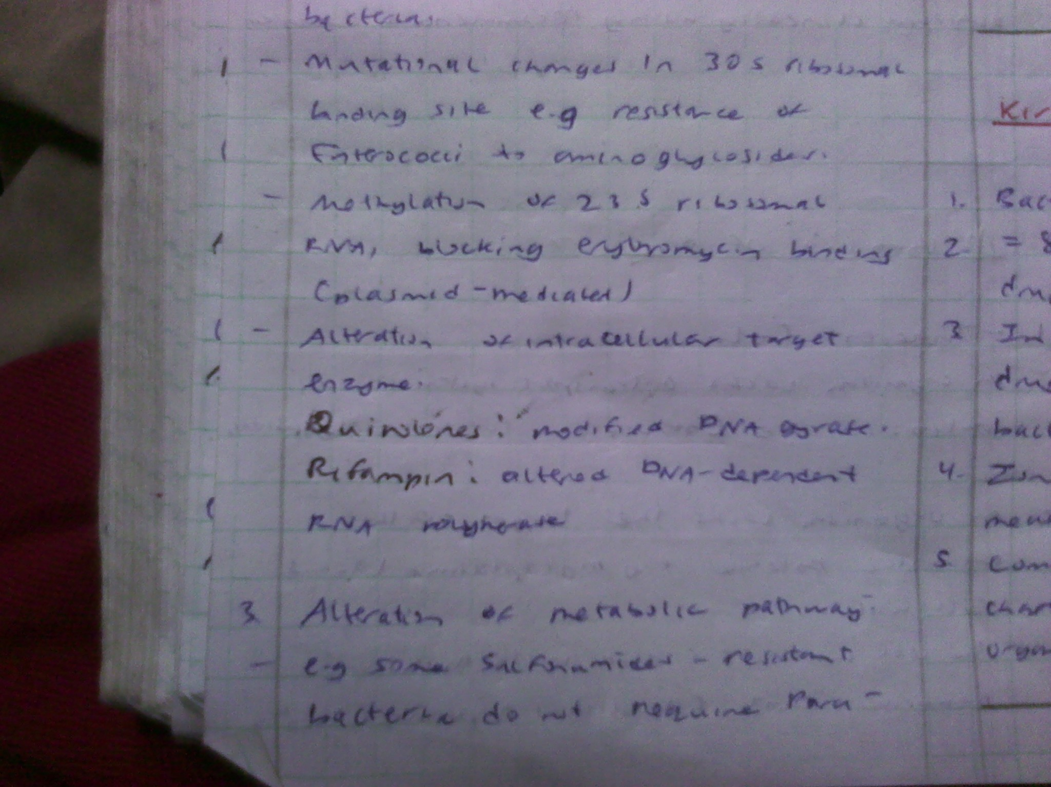

Slide 7
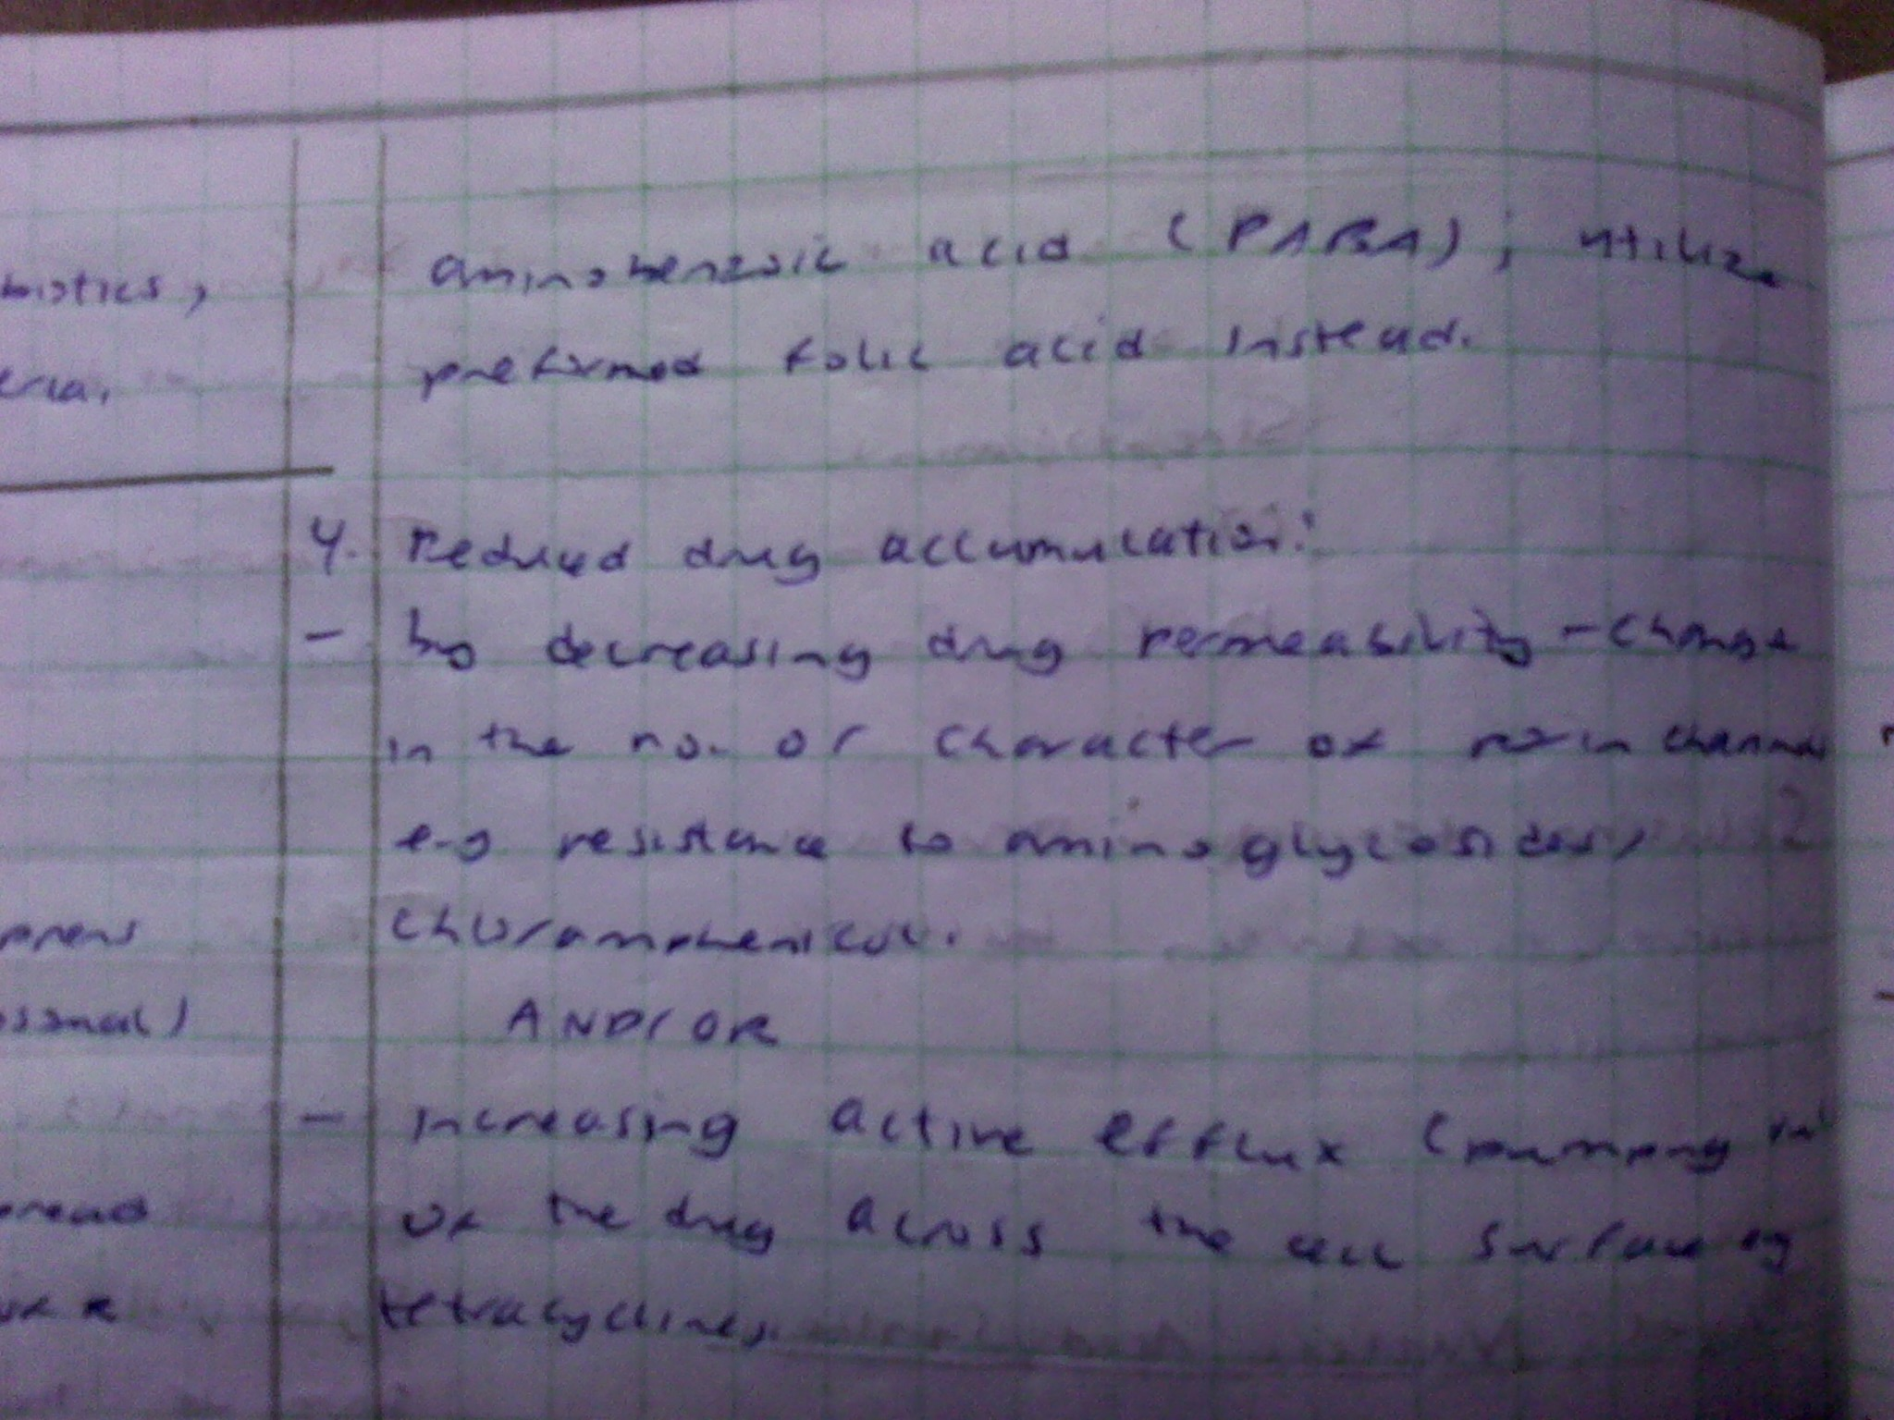

Slide 8
