Slide 1
BACTERIA MEDIA AND CULTURE
KIMAIGA H.O
MBChB (University of Nairobi)

Slide 2
Bacteria growth
Atmosphere:
  Aerobic, anaerobic or microaerophilic
  Facultative or obligate anaerobes
Usually at 37 degrees for 24 hours
Most clinically important bacteria grow overnight, or within a few days
Mycobacteria can take months and some can not be grown

Slide 3
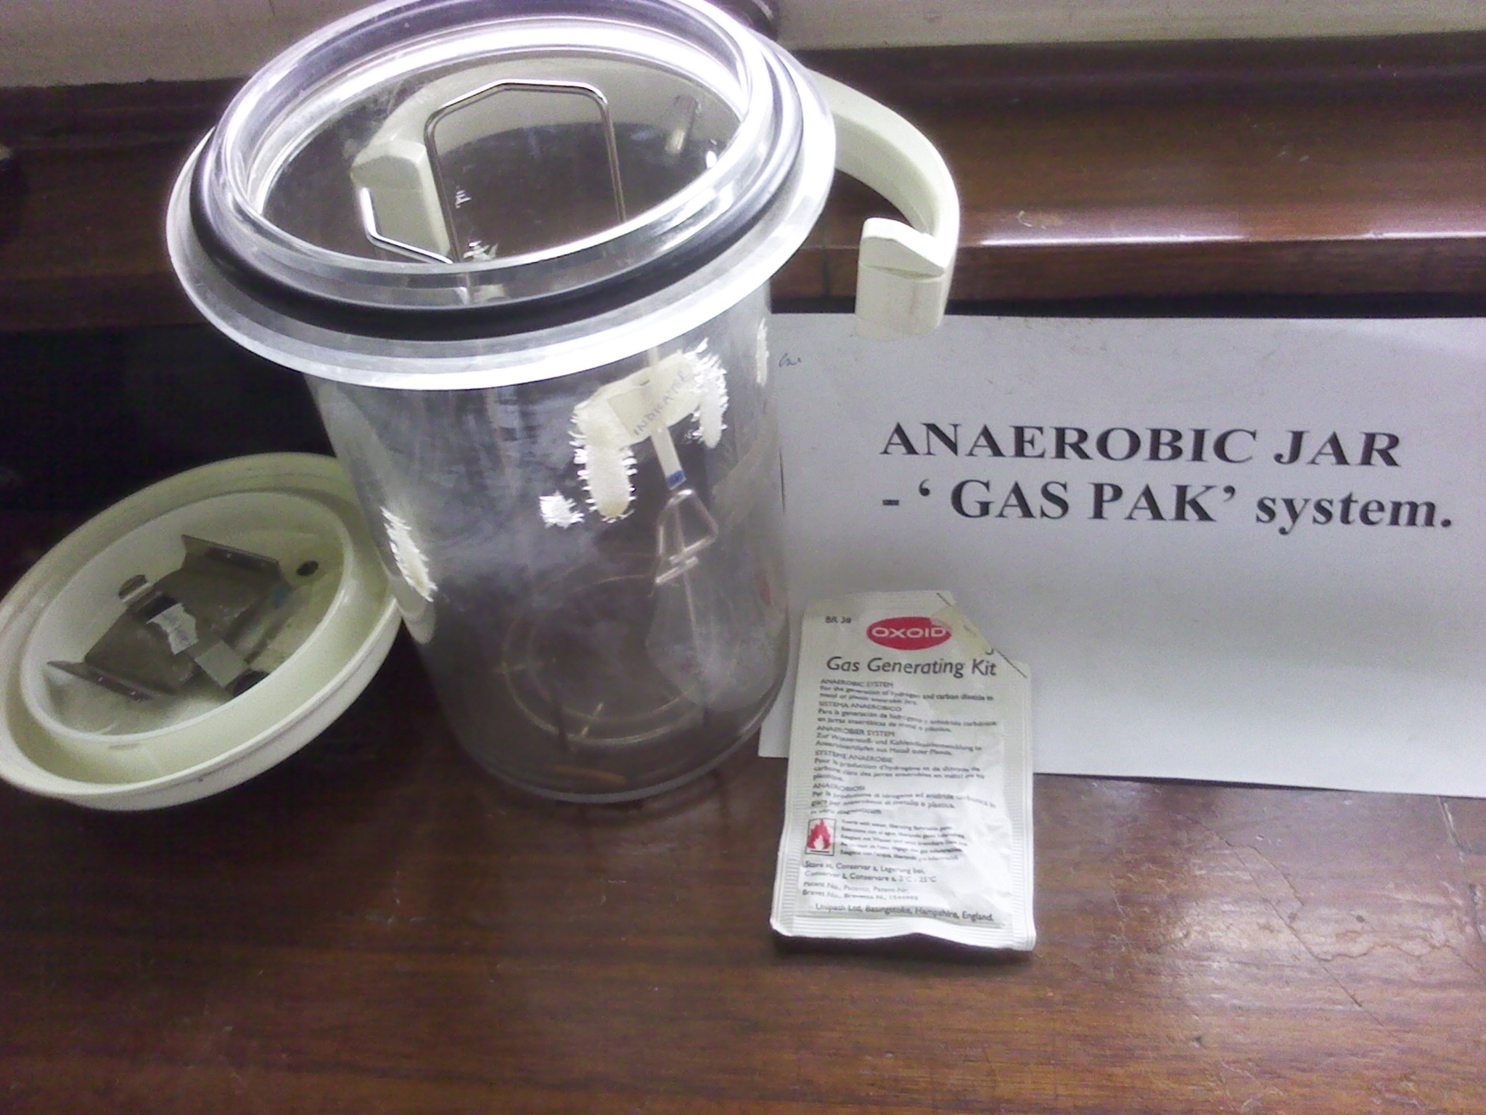
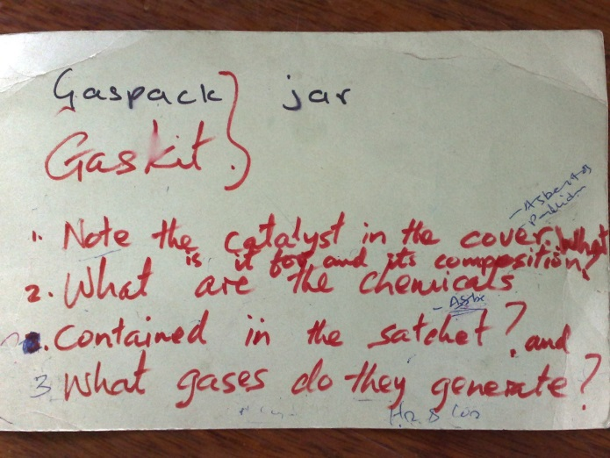

Slide 4
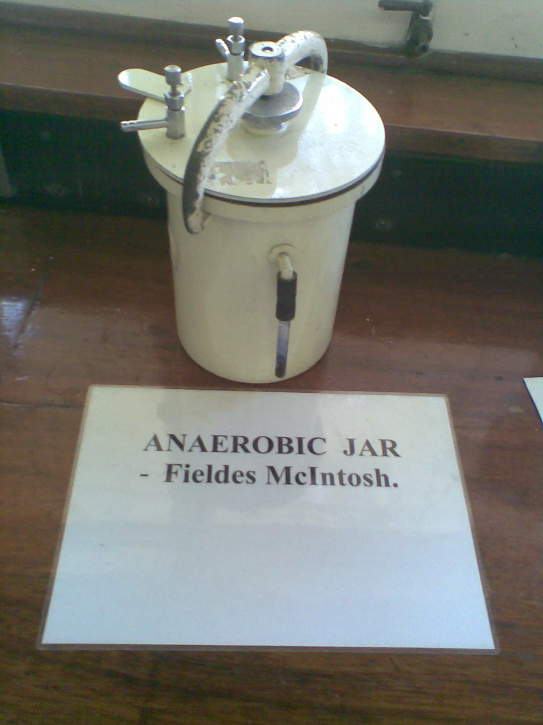
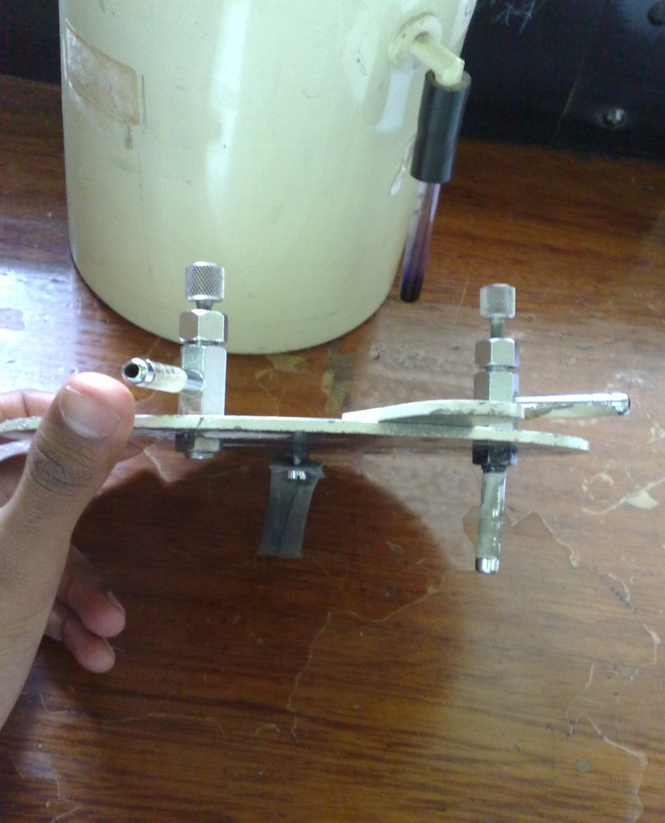
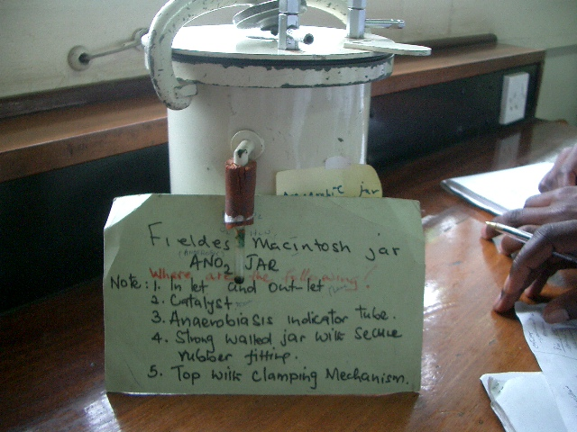
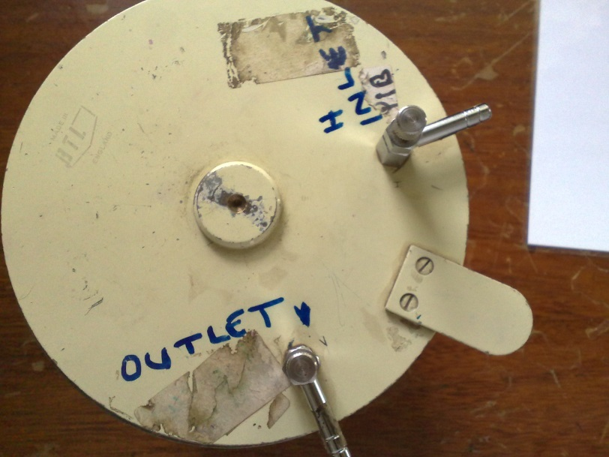

Slide 5
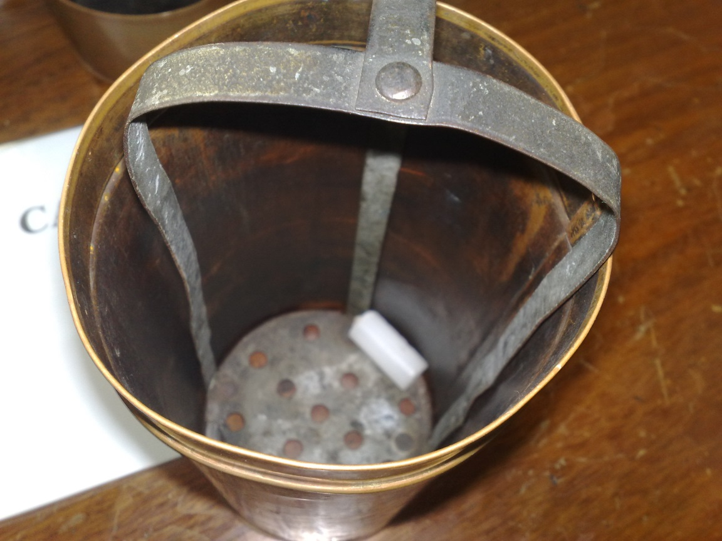
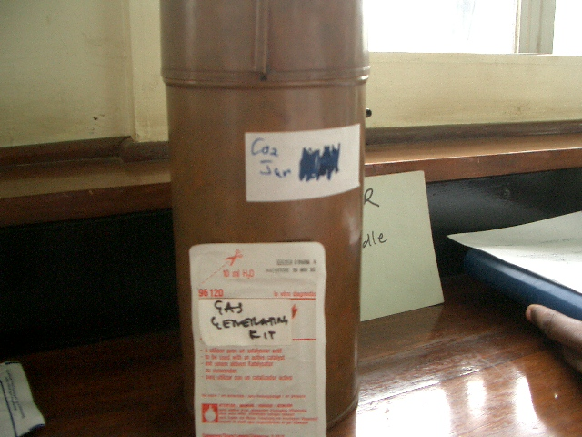
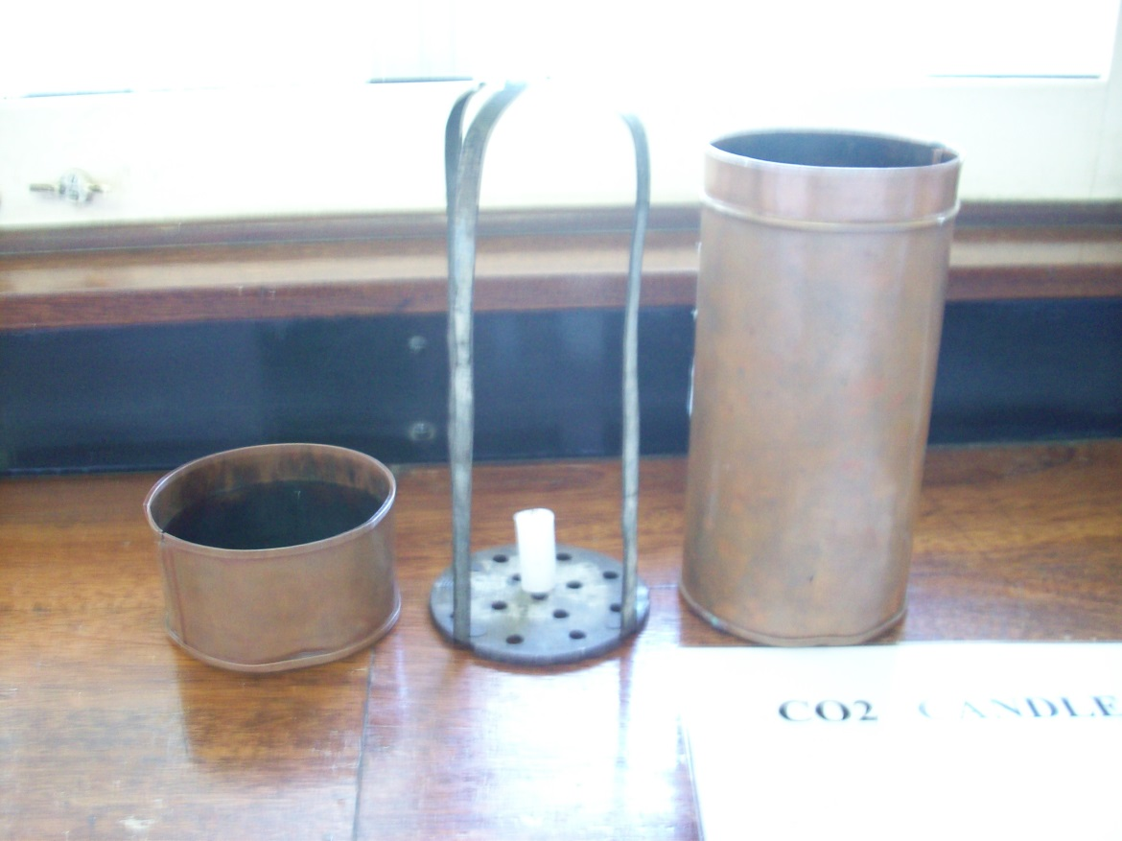
CO2 Candle jar

Slide 6
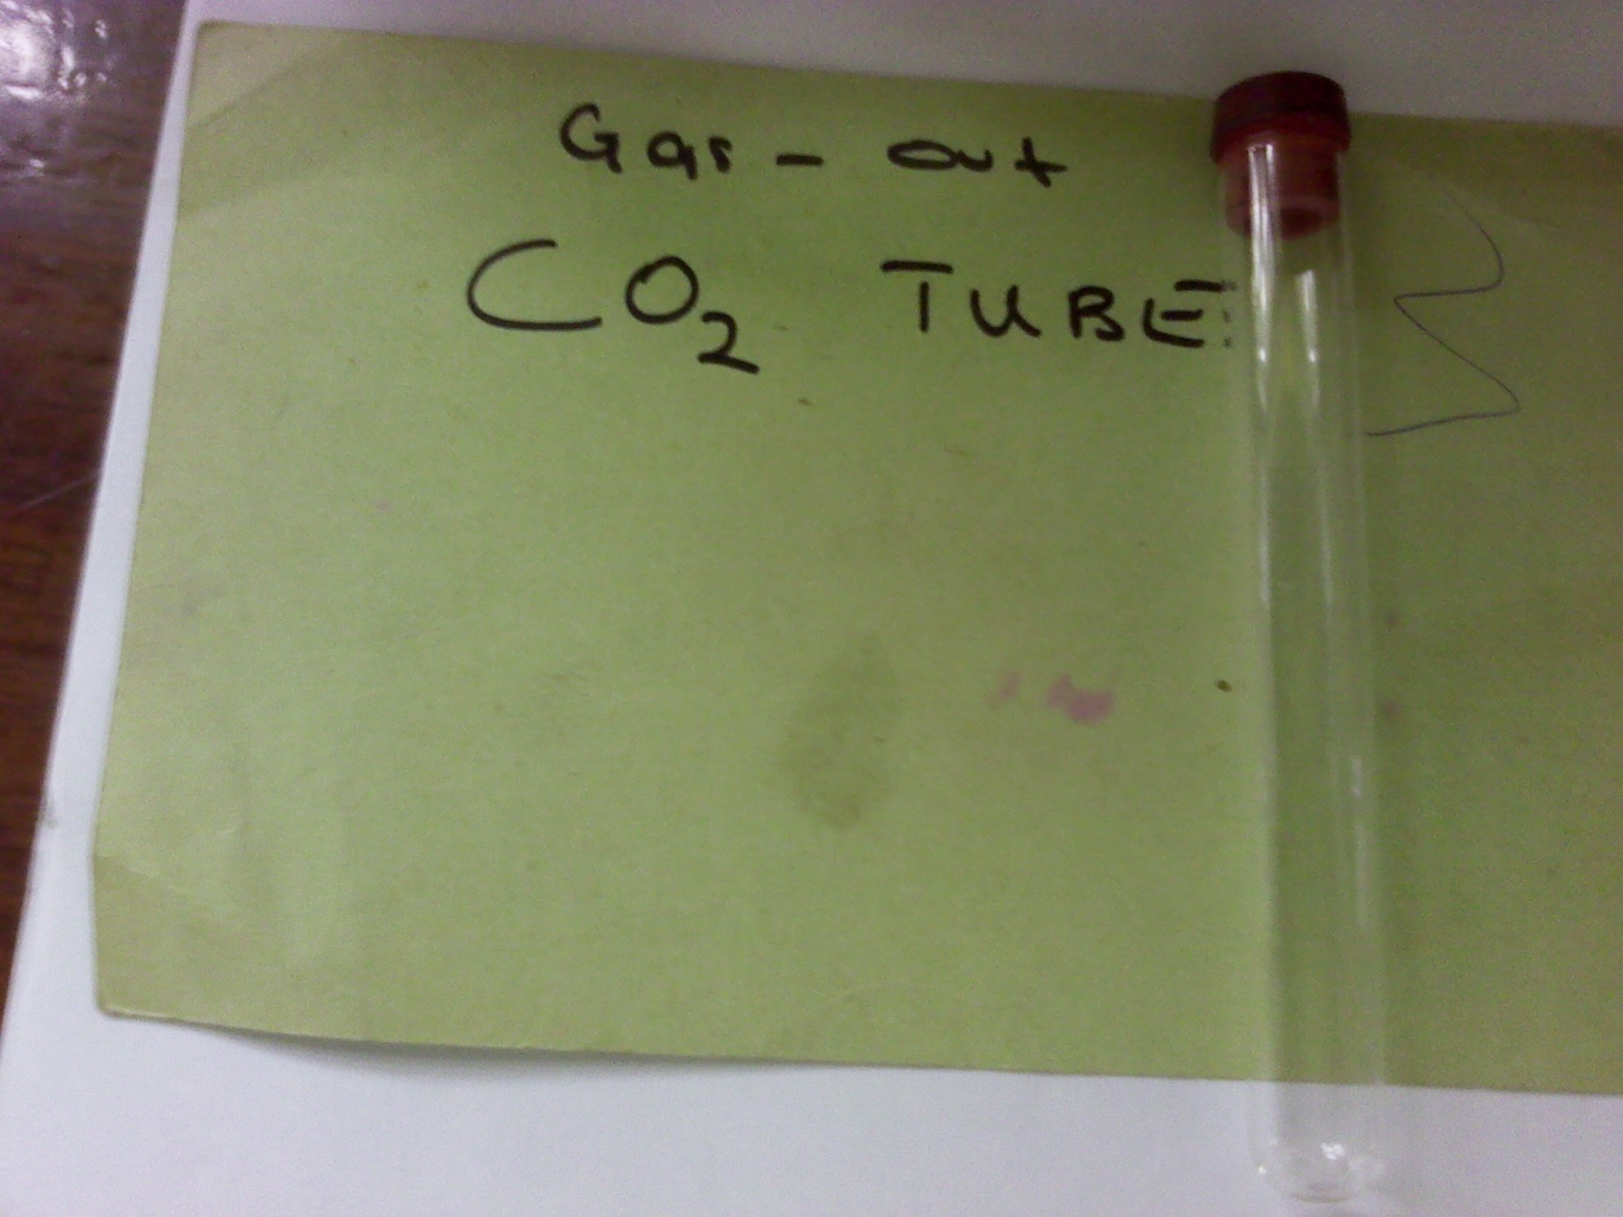

Slide 7
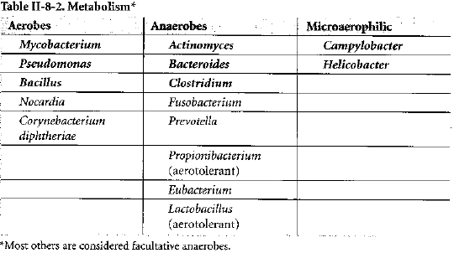
Aaerobic or facultative anarobic rods
Bacteria likes chocolate m & n :
Bacillus
Listeria
Corynebacterium
Mycobacterium
Nocardia

Slide 8
BACTERIA MEDIA
Blood agar
Bile Esculin Agar
CAMPY-BAP
Chocolate Agar
MacConkey Agar
Eosin Methylene Blue (EMB) Agar
Hektoen Enteric (HE) Agar
Mannitol Salts Agar
Chopped Meat Glucose Medium
Triple Sugar-Iron Agar
Tryptic Soy Agar/Broth

Slide 9
Bacteriology media can either be liquid or solid (broth) media in broad perspective.
They are classified into; (Mneumonic BEST)
  Basic/Simple media
    Has peptone(aminoacids and polypeptides)
    Nutrient agar and nutrient broth
  Enriched media
    Has nutrients for isolation of bacteria
    Blood agar
    Chocolate blood agar
    Selenite F broth
  Selective media
    Has chemicals and antimicrobials that make it selective
    Thayer-Martin medium- Has antimicrobials
    Deoxychocolate citrate agar- Has bile salts
  Transport media
    Cary Blair
  Indicative media
    MacConkey agar

Slide 10
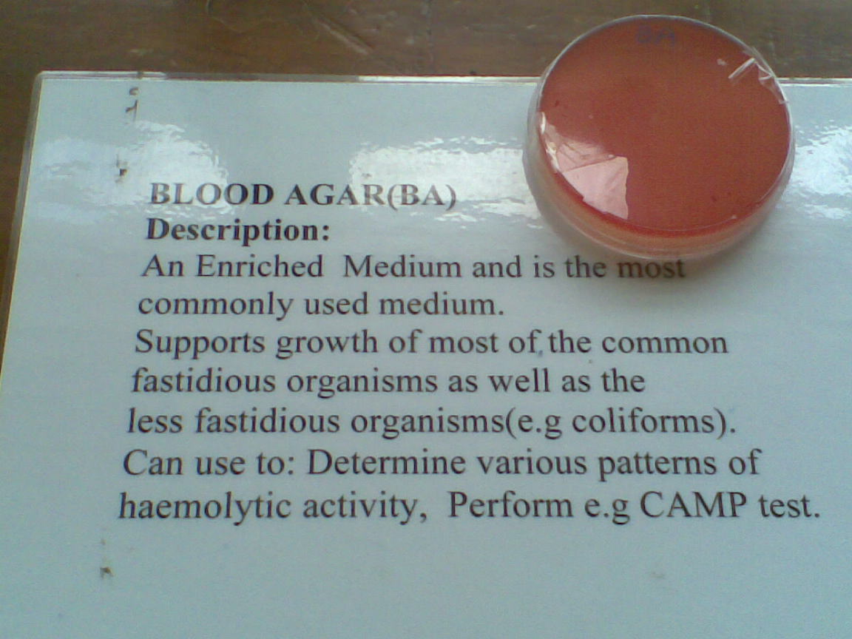
Blood agar

Slide 11
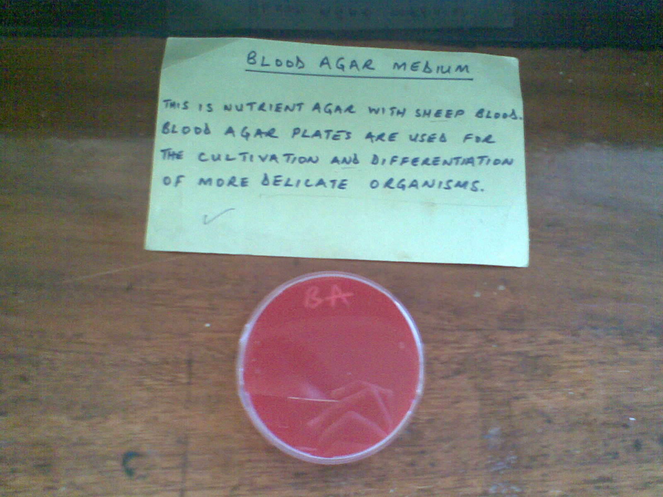

Slide 12
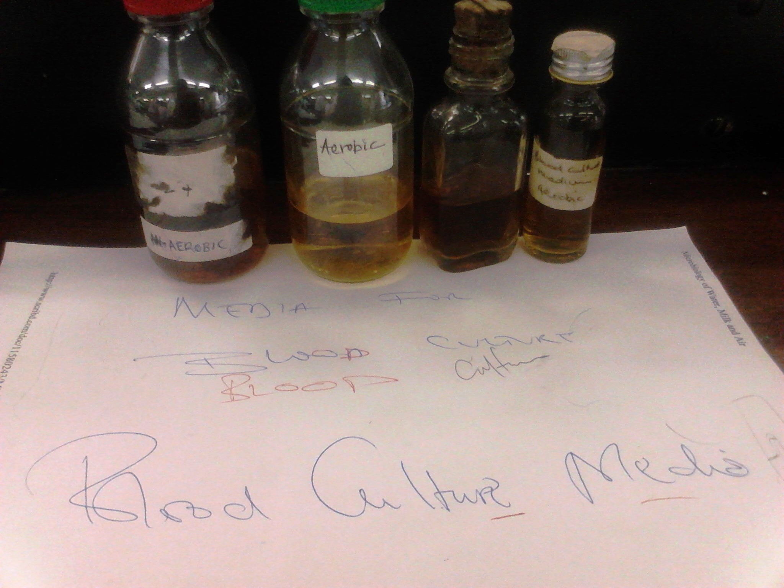

Slide 13
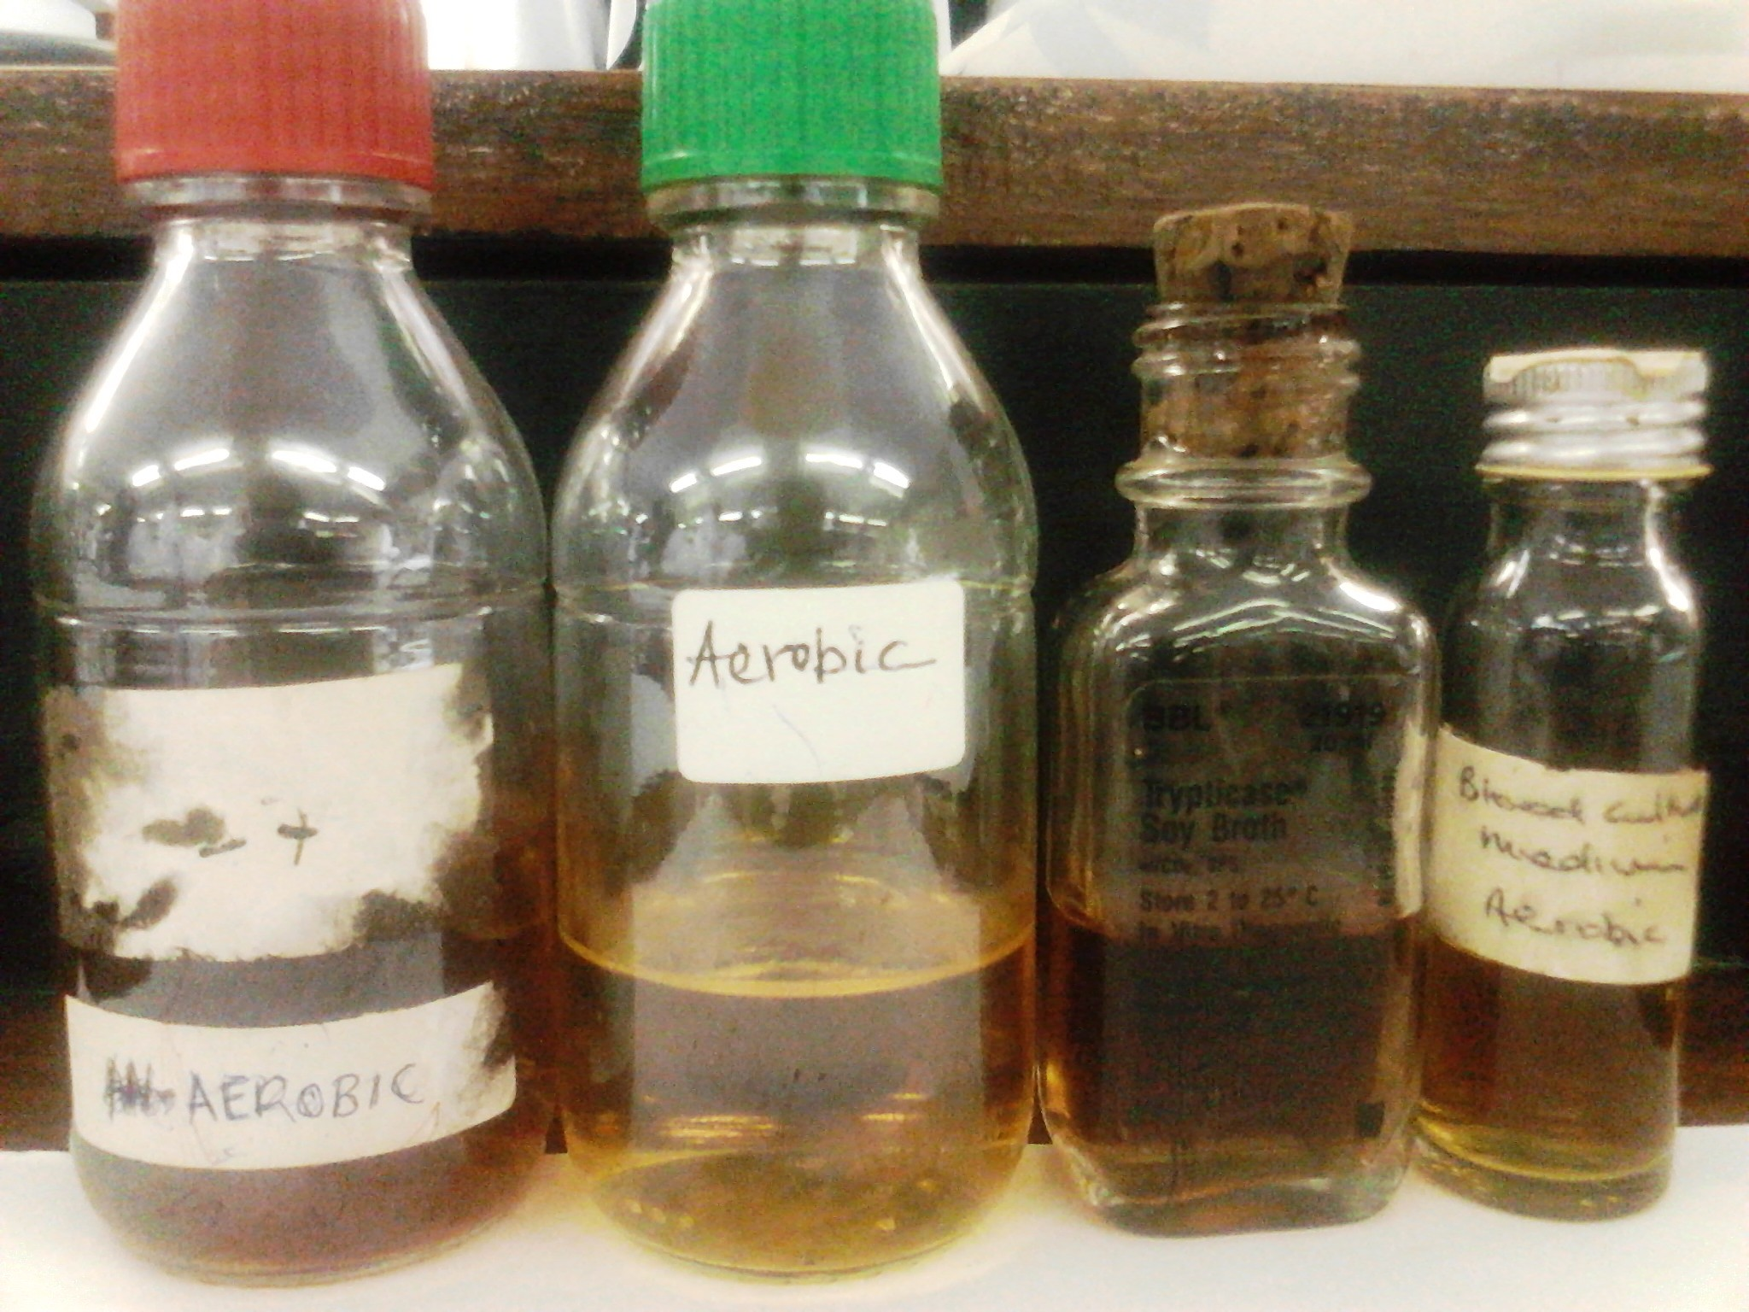

Slide 14
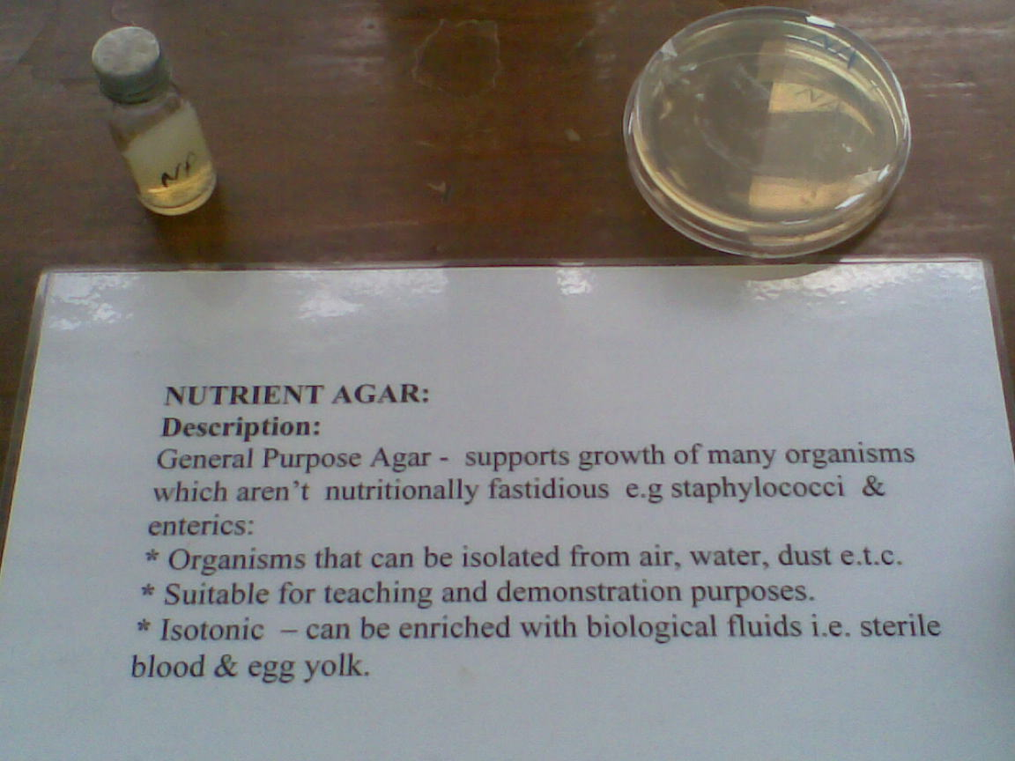

Slide 15
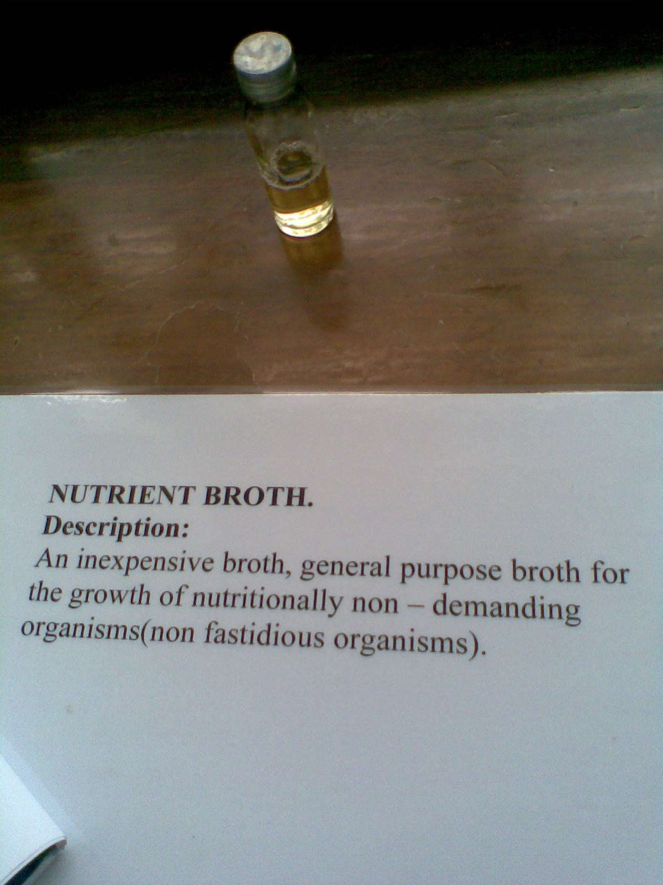

Slide 16
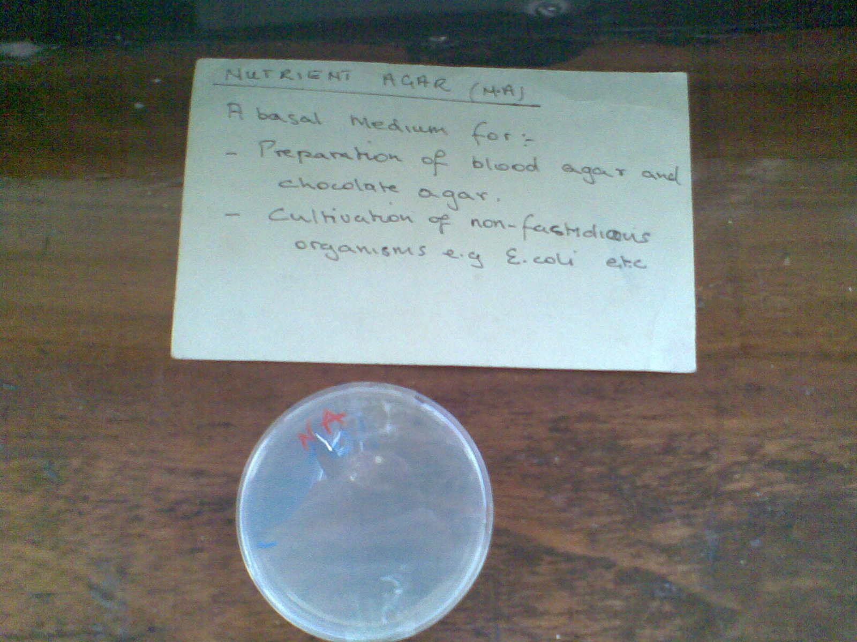

Slide 17
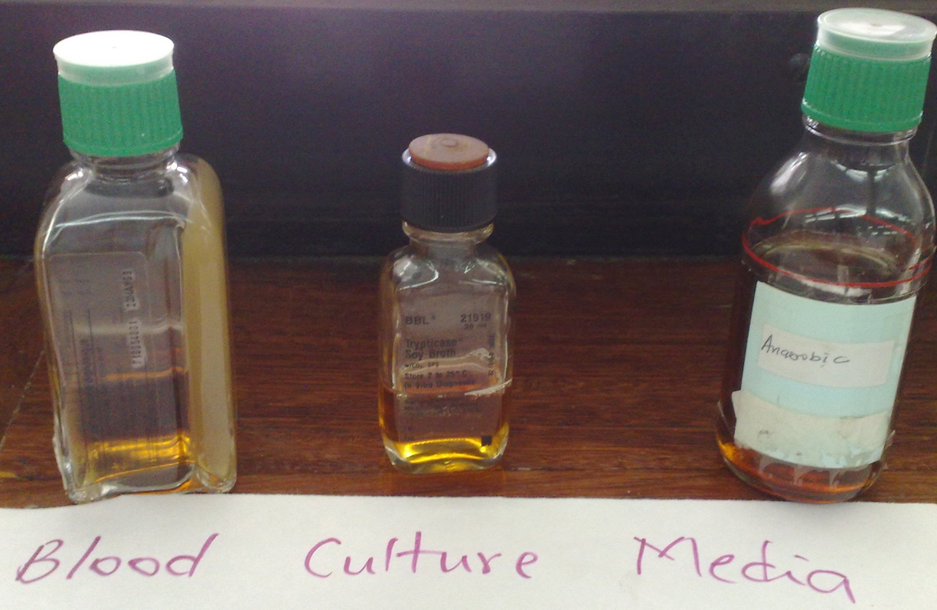

Slide 18
BILE ESCULIN AGAR
Bile esculin agar is a medium used to identify group D streptococci. This group of bacteria have the ability to grow in the presence of bile, an emulsifying agent produced in the liver. Group D streptococci also have the ability to hydrolyze esculin.
This hydrolysis of esculin turns the medium black and denotes a positive test. Other bacteria capable of growing in the presence of bile do not turn the medium black. A variation of this medium uses sodium azide to inhibit the growth of all other Gram-positive bacteria and Gram-negative bacteria.

Slide 19
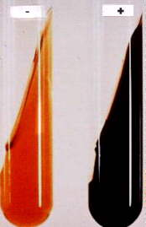

Slide 20
CAMPY-BAP
Campy-BAP is a blood agar that is highly selective for the growth of Campylobacter species. It contains several antibiotics which inhibit the growth of Gram-positve bacteria as well as most Gram-negative organisms.
After the plate is inoculated, it is placed in a microaerophilic environment such as a sealed bag containing high carbon dioxide concentrations and low oxygen concentrations.

Slide 21
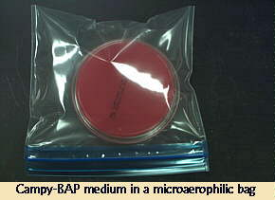

Slide 22
CHOCOLATE AGAR
Chocolate agar is a nutrient medium which is used in culturing fastidious organisms such as Haemophilus species and Neisseria.
It is comprised of sheep blood that provides the X and V factors necessary for Haemophilus growth. Chocolate agar, however, does not reveal hemolysis data, so species differentiation among the members of Haemophilus must be performed in another manner.

Slide 23
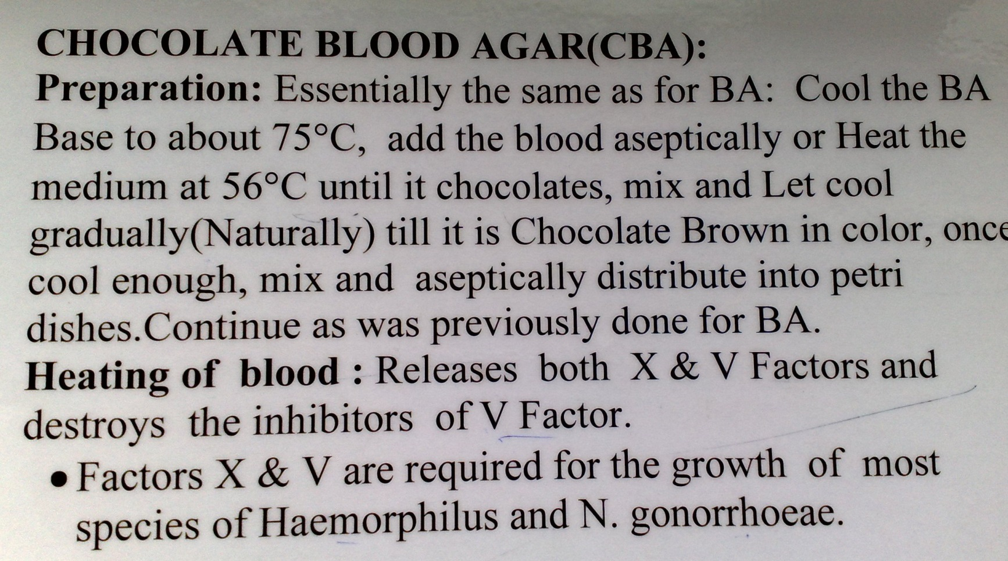

Slide 24
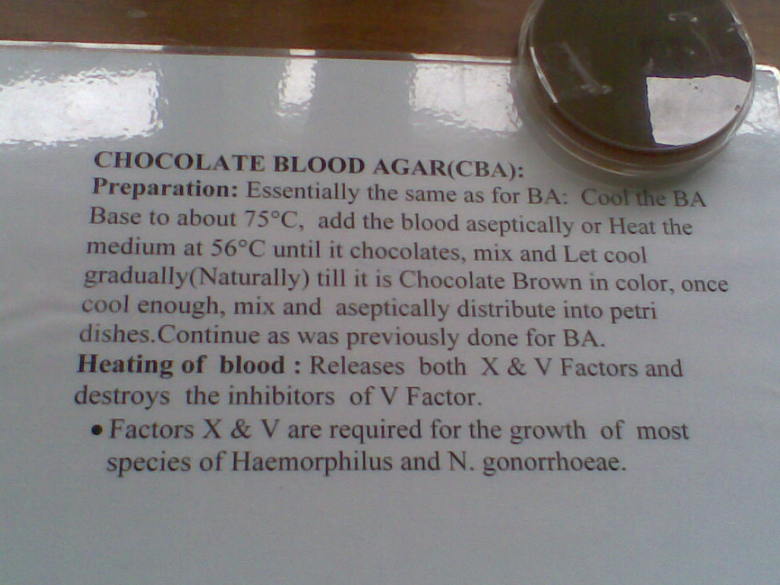
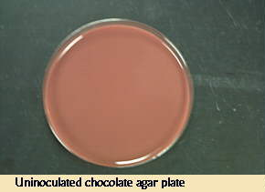
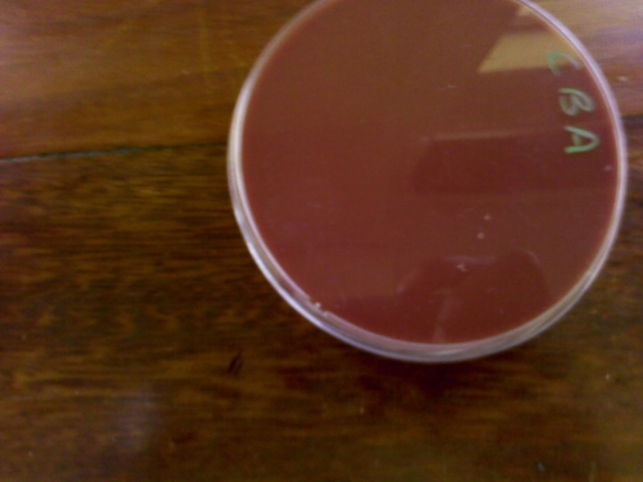

Slide 25
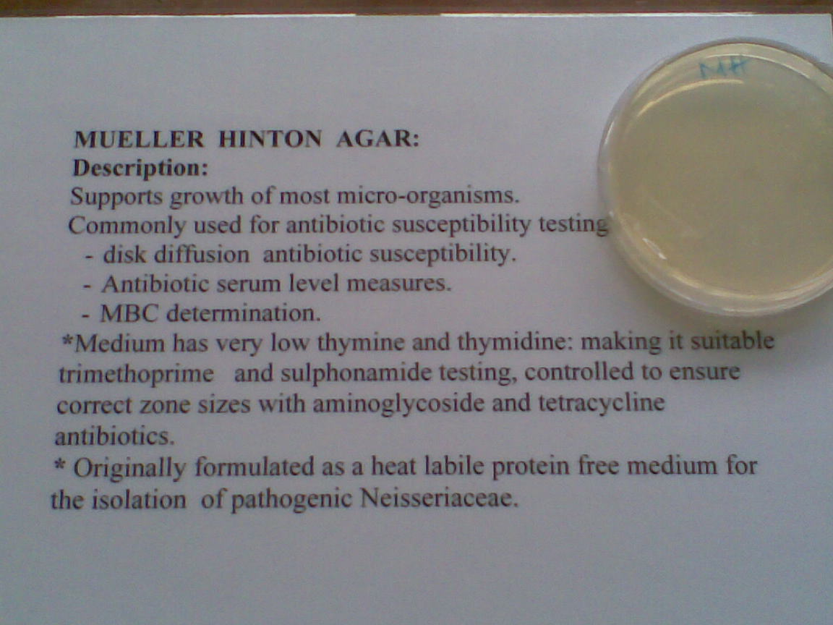

Slide 26
MacConkey Agar
Contains
  Lactose,
  Bile salts,
  Neutral red (and crystal violet).
Selective media
  Gram-positive organisms are inhibited by the bile salts and the crystal violet.
Differential
  When bacteria ferment lactose and produce enough acid products to reduce the pH below 6.8, the neutral red turns from colorless to red.
  Thus, MacConkey is a differential media on which lactose fermenting colonies appear red (or pink). Nonlactose fermenters are colorless.

Slide 27
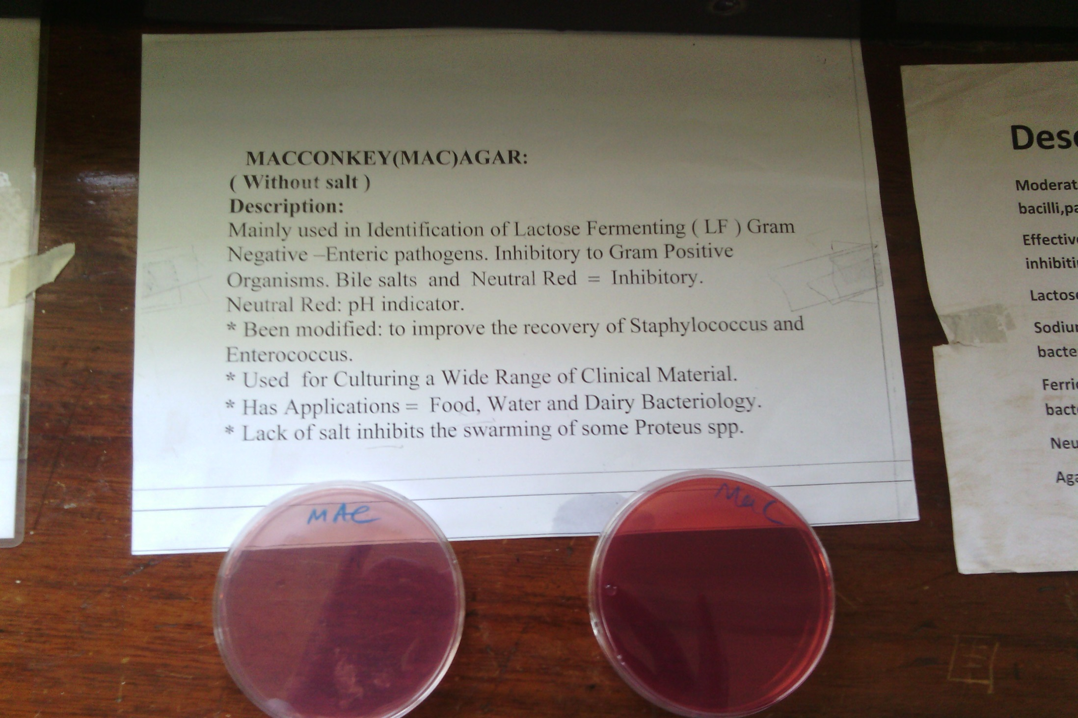
MacConkey Agar

Slide 29
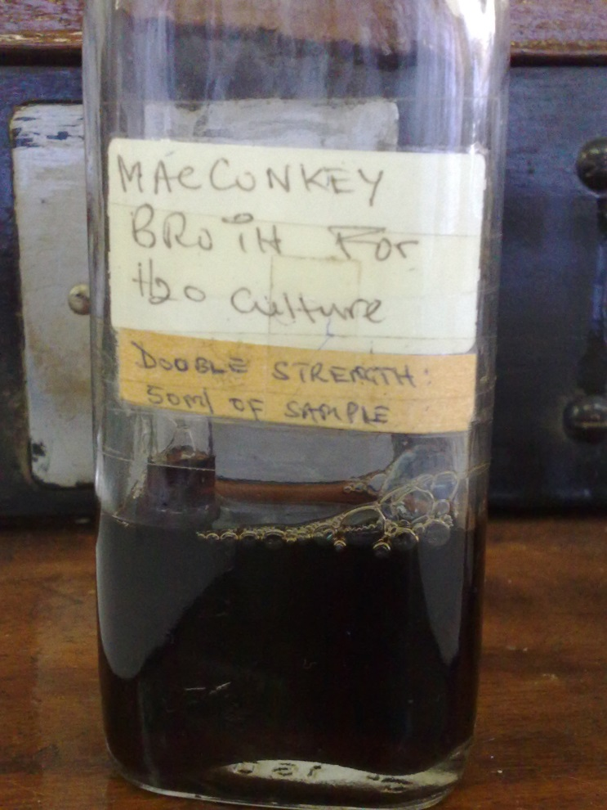
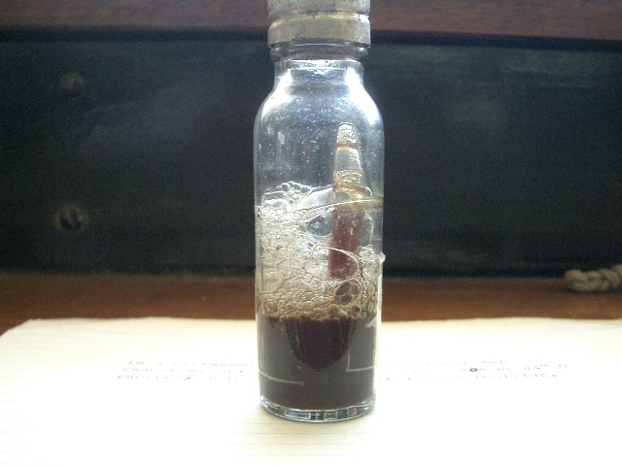
MacConkey Broth for water Culture
MacConkey Broth for presumptive coliform count

Slide 30
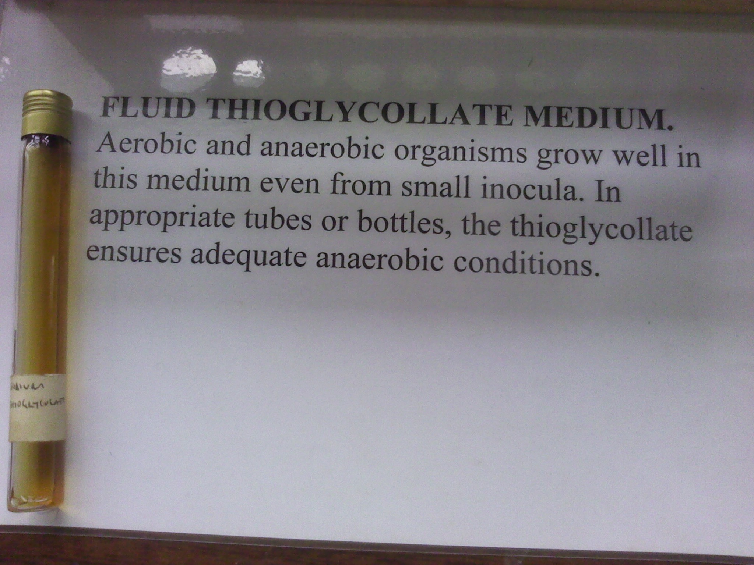

Slide 31
Alkaline peptone water
Peptone water with Sodium Hydroxide to raise the pH to 8.6

Slide 32
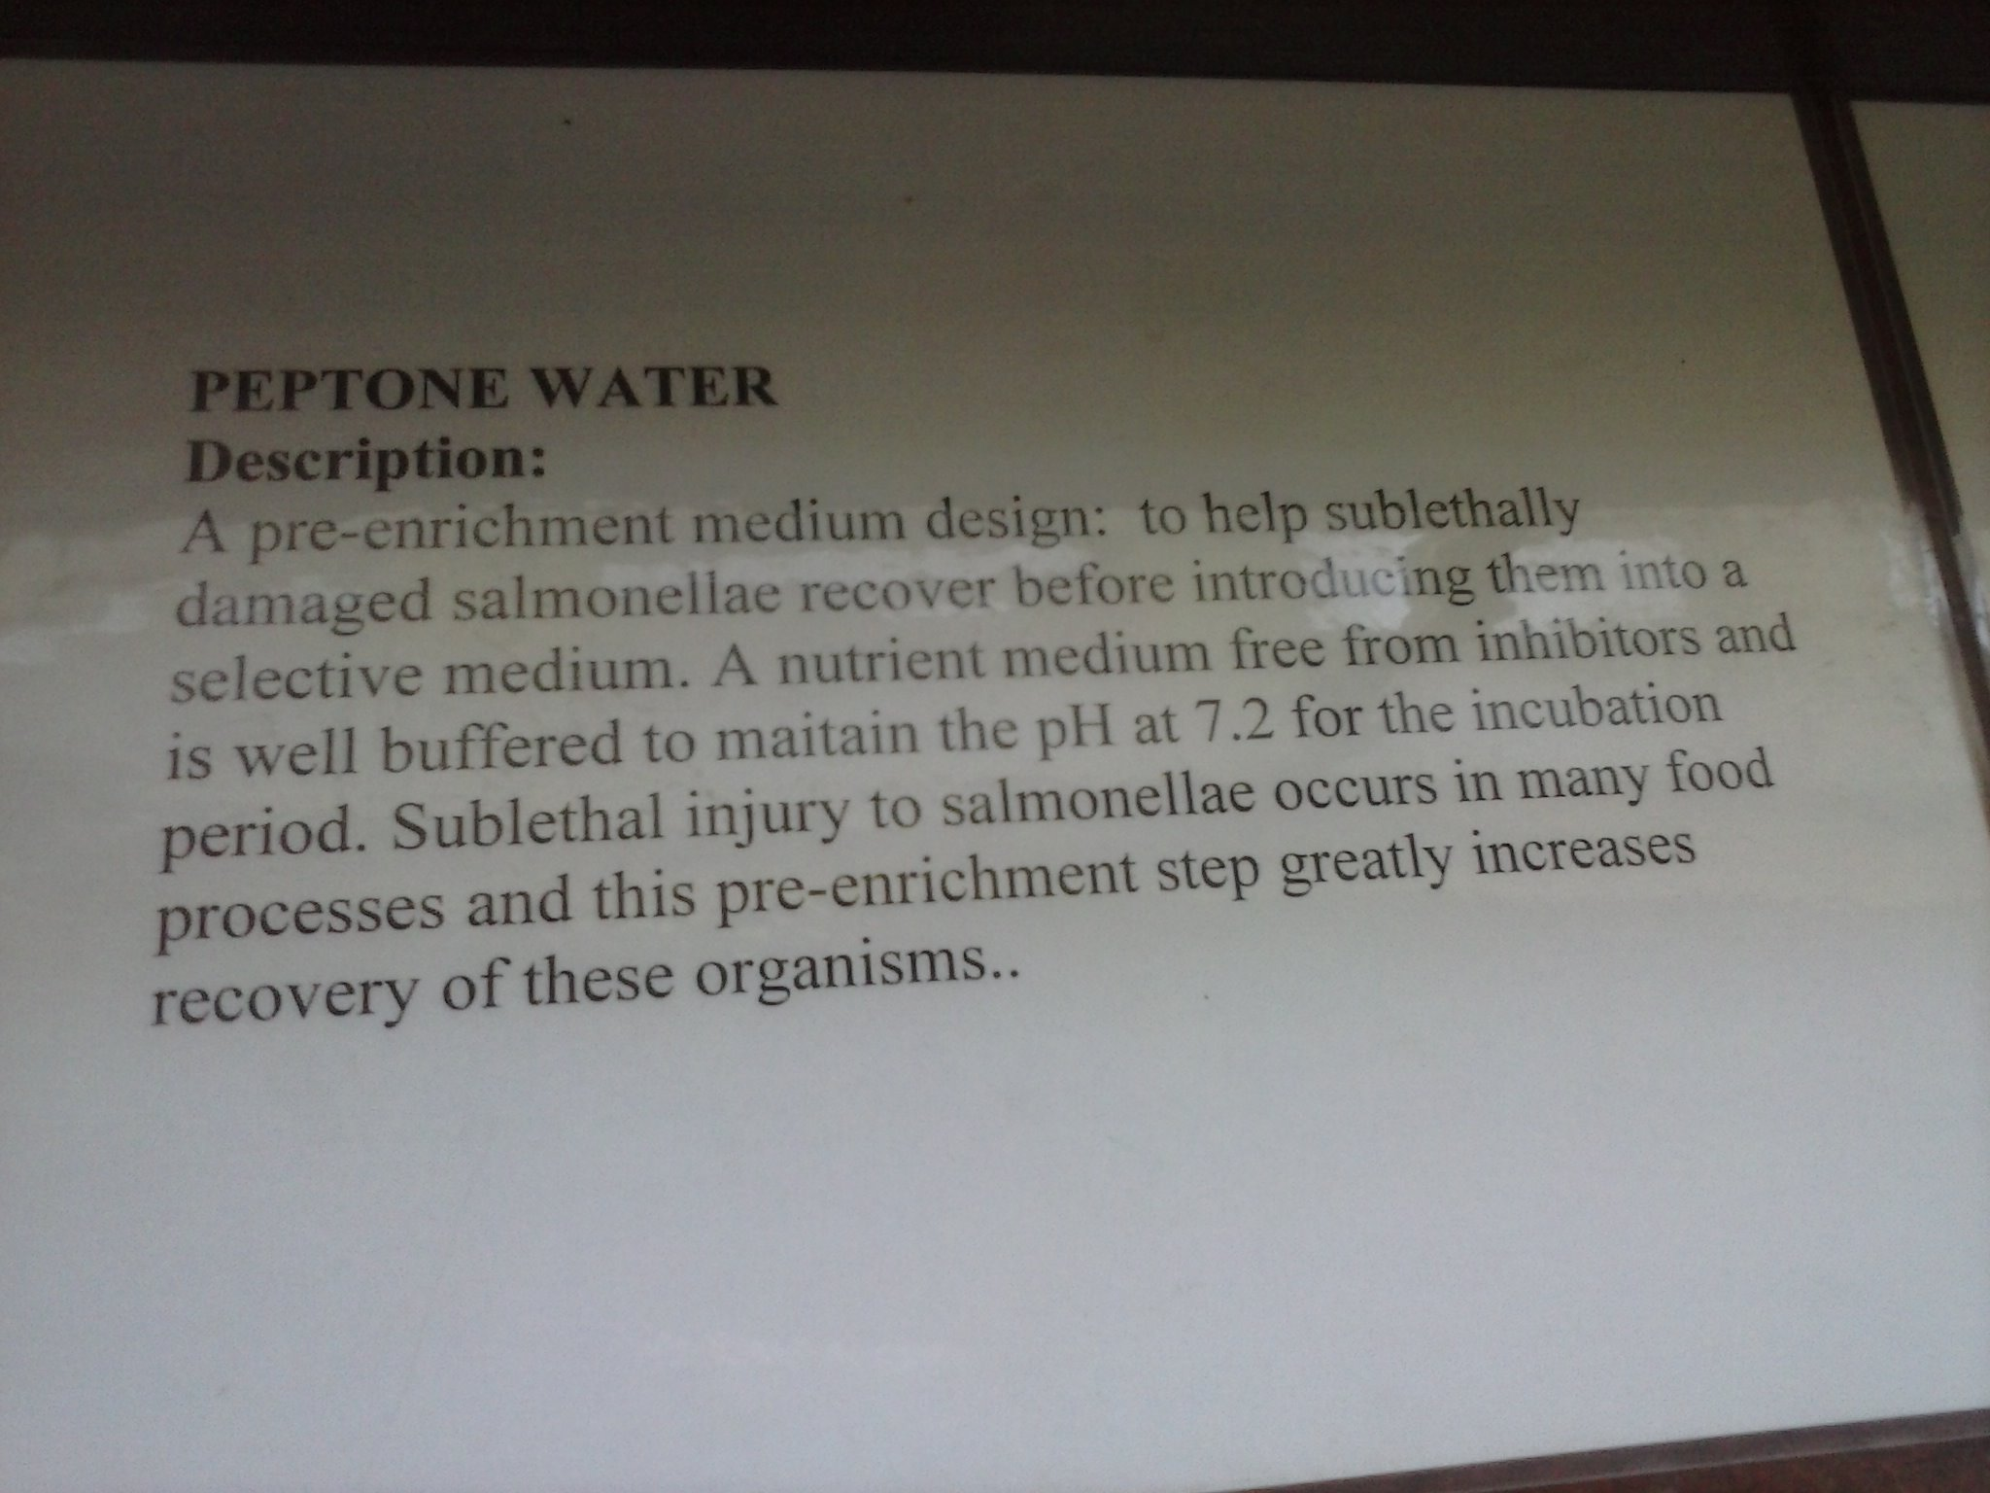
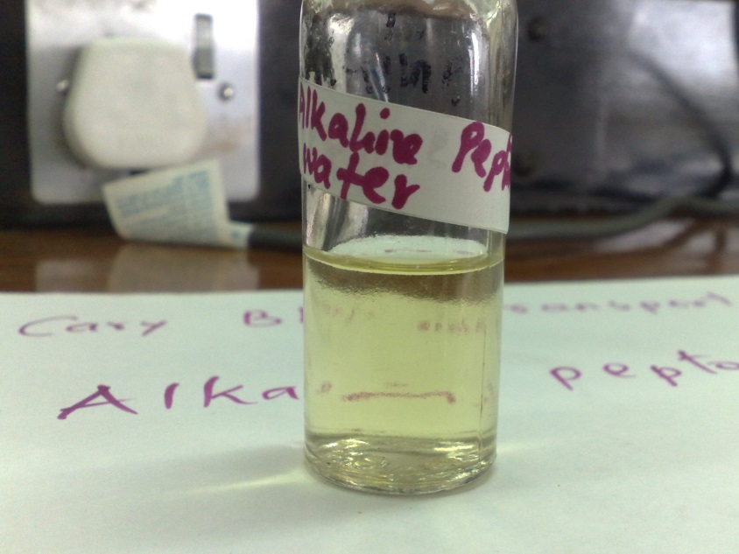

Slide 33
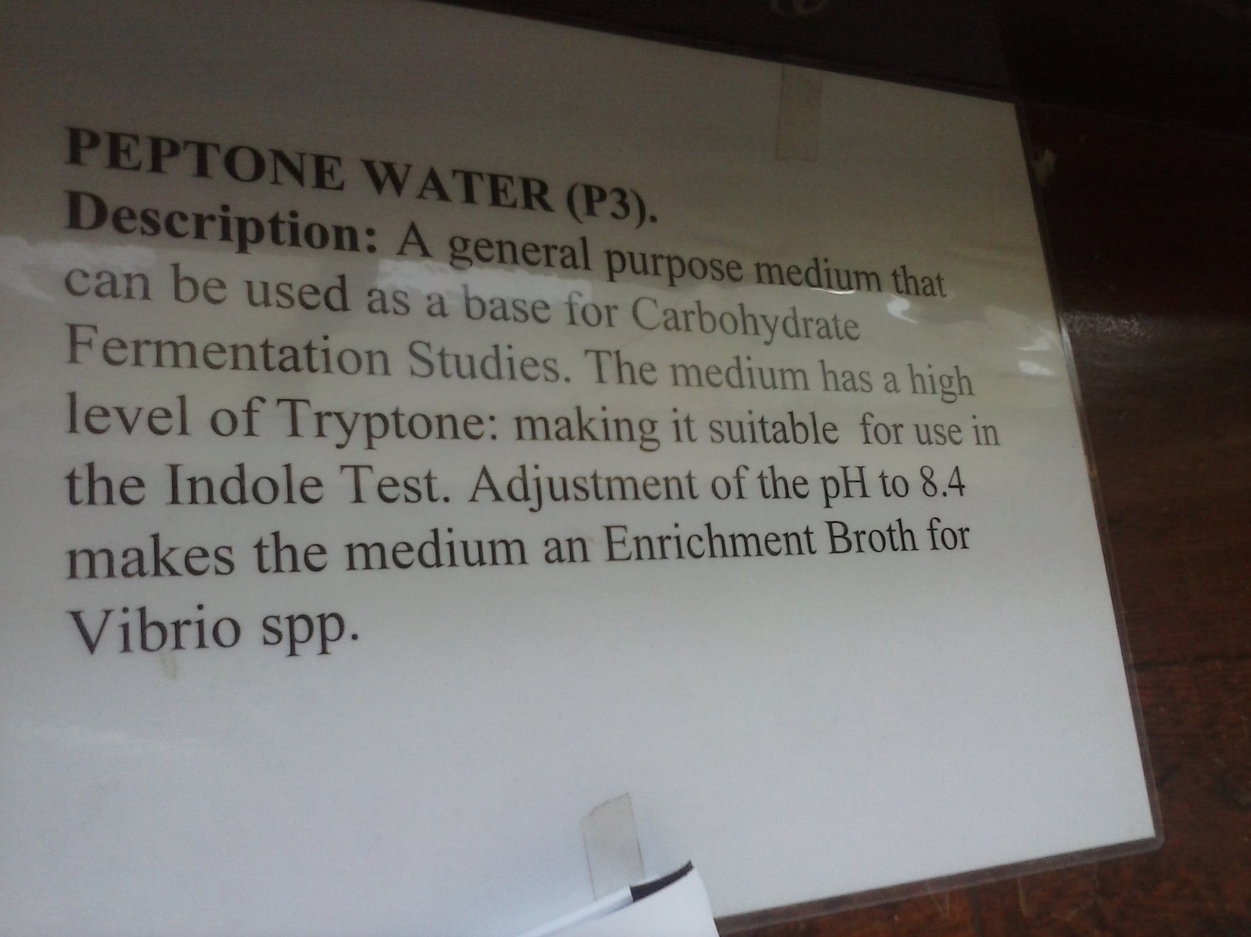

Slide 34
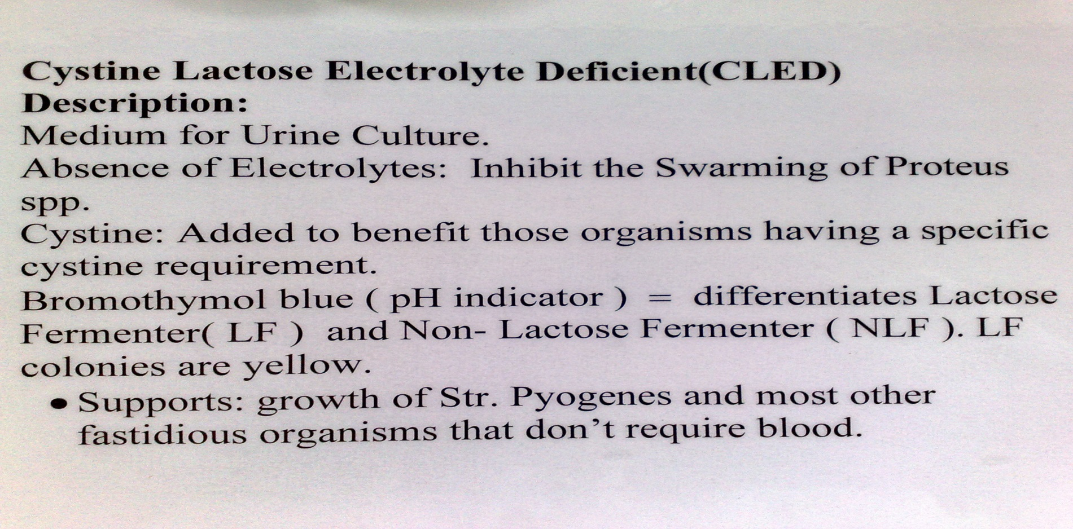
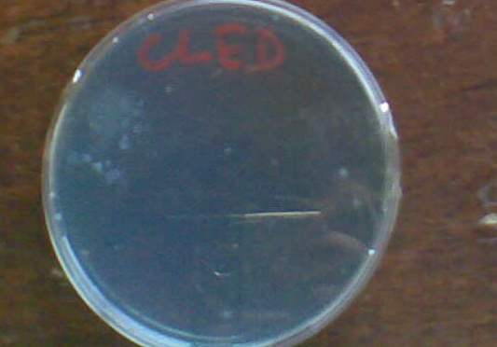

Slide 35
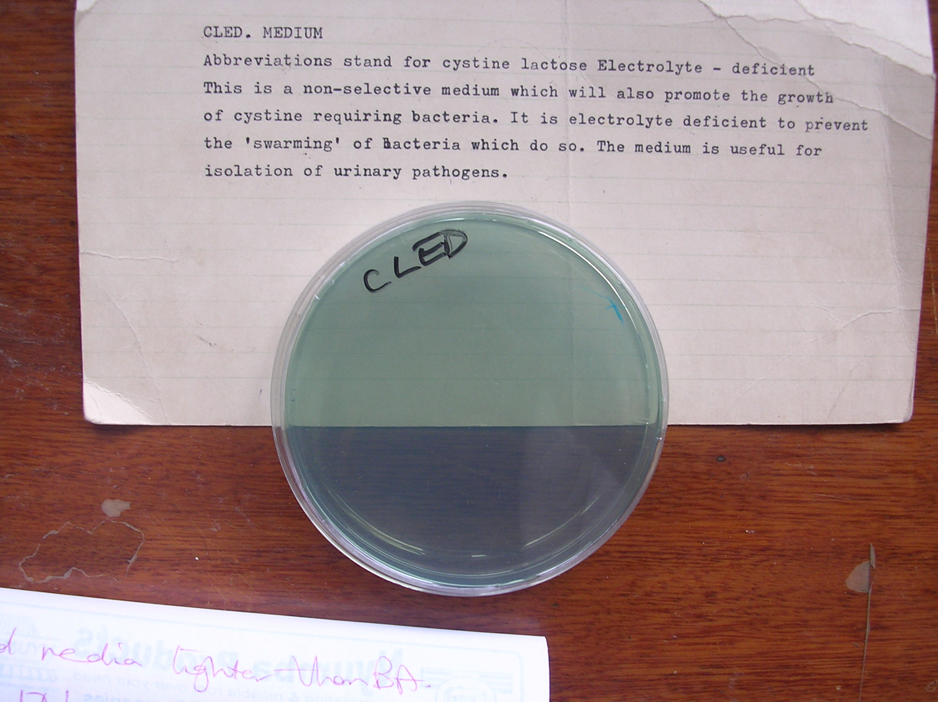

Slide 36
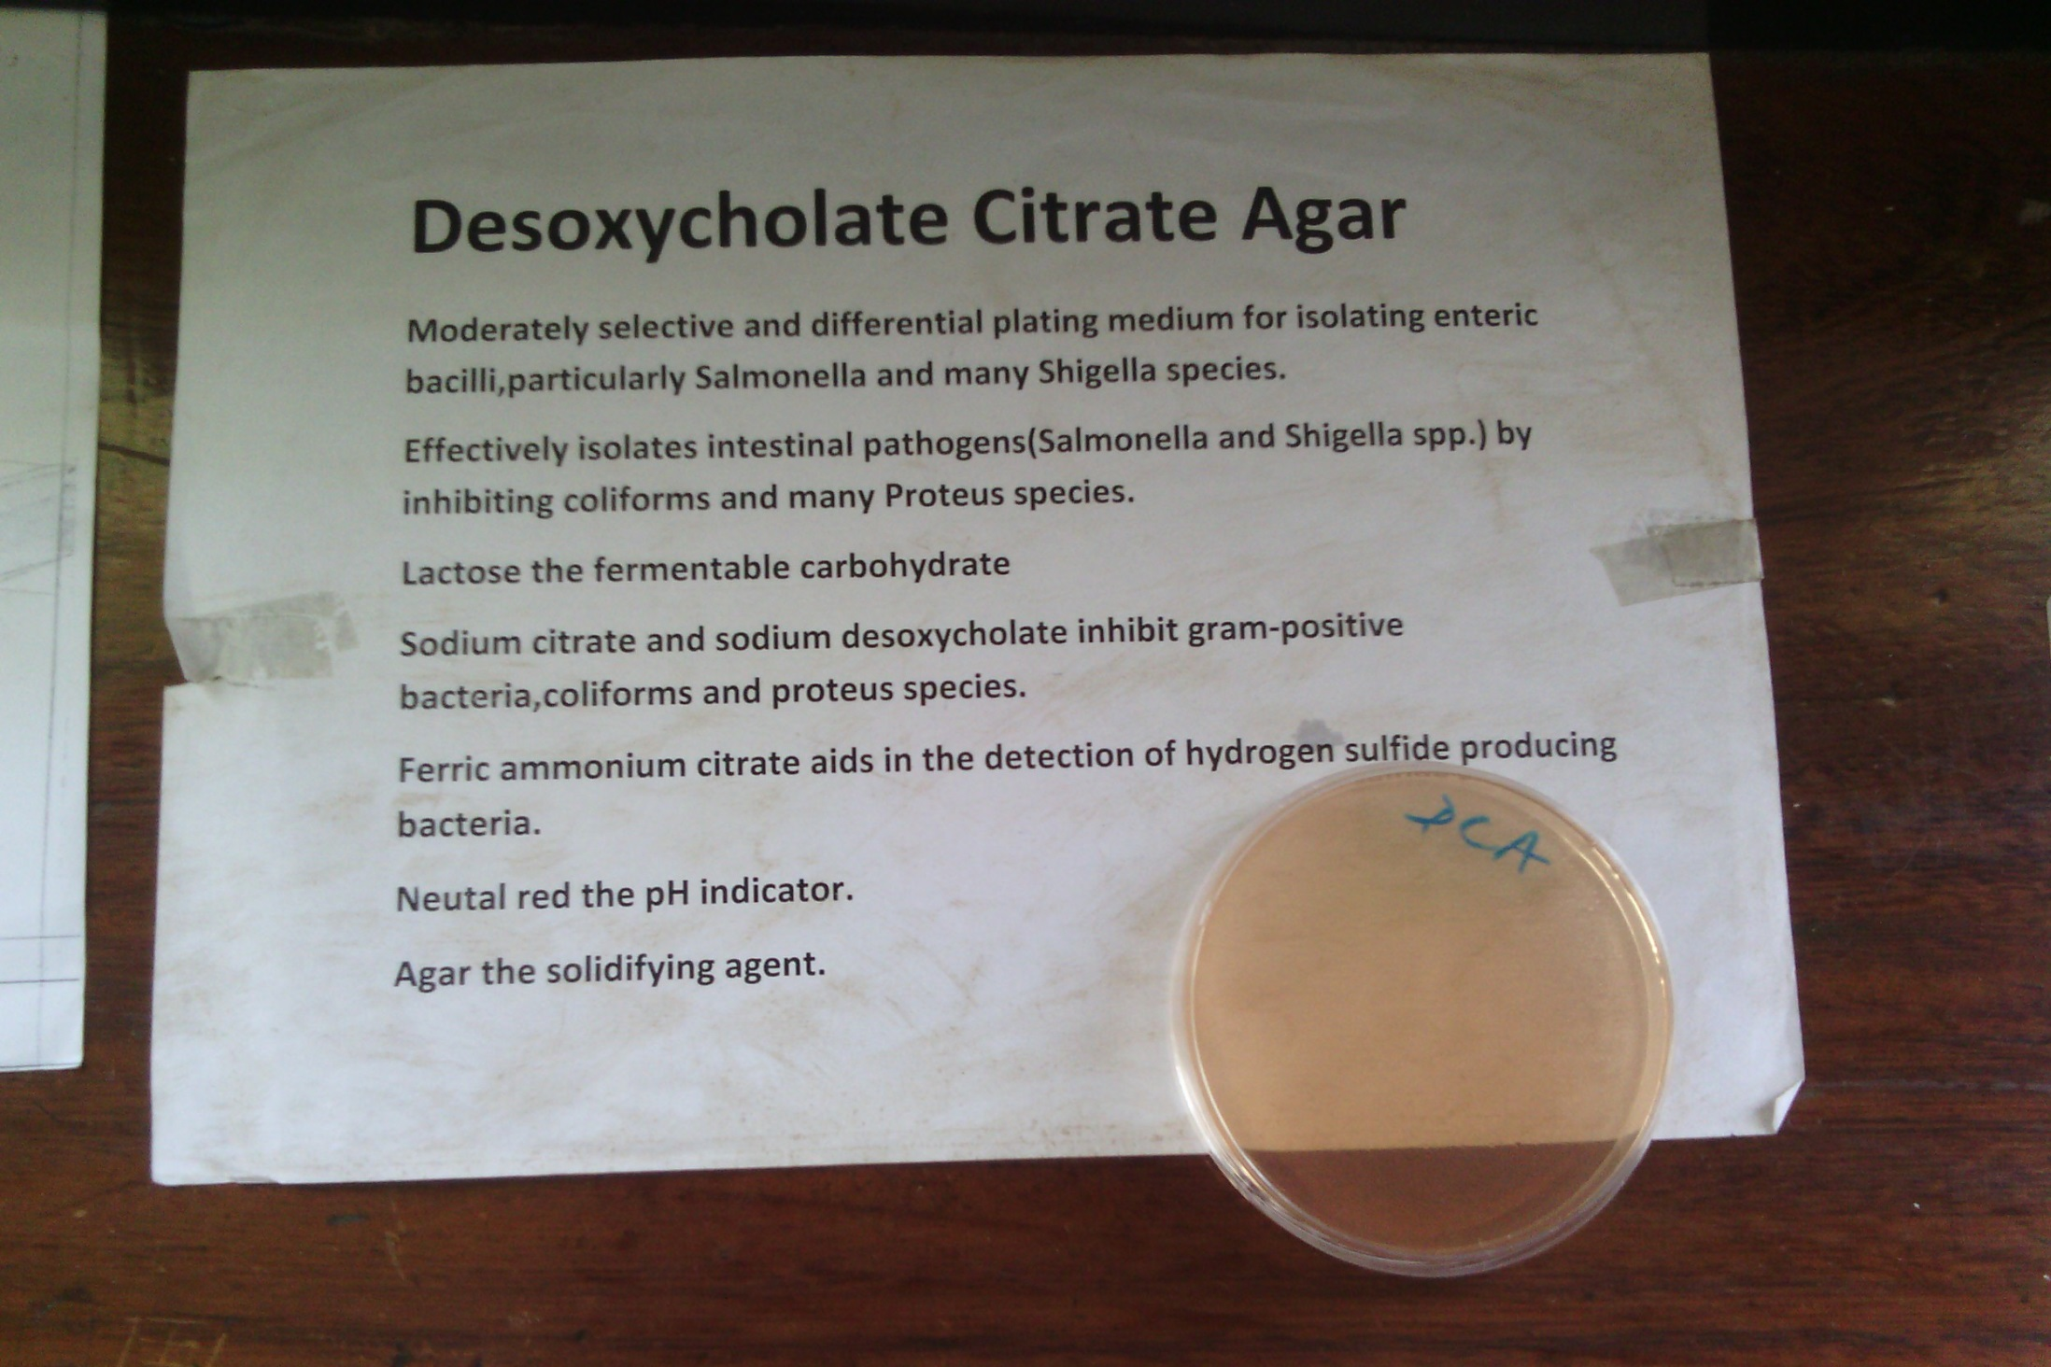

Slide 37
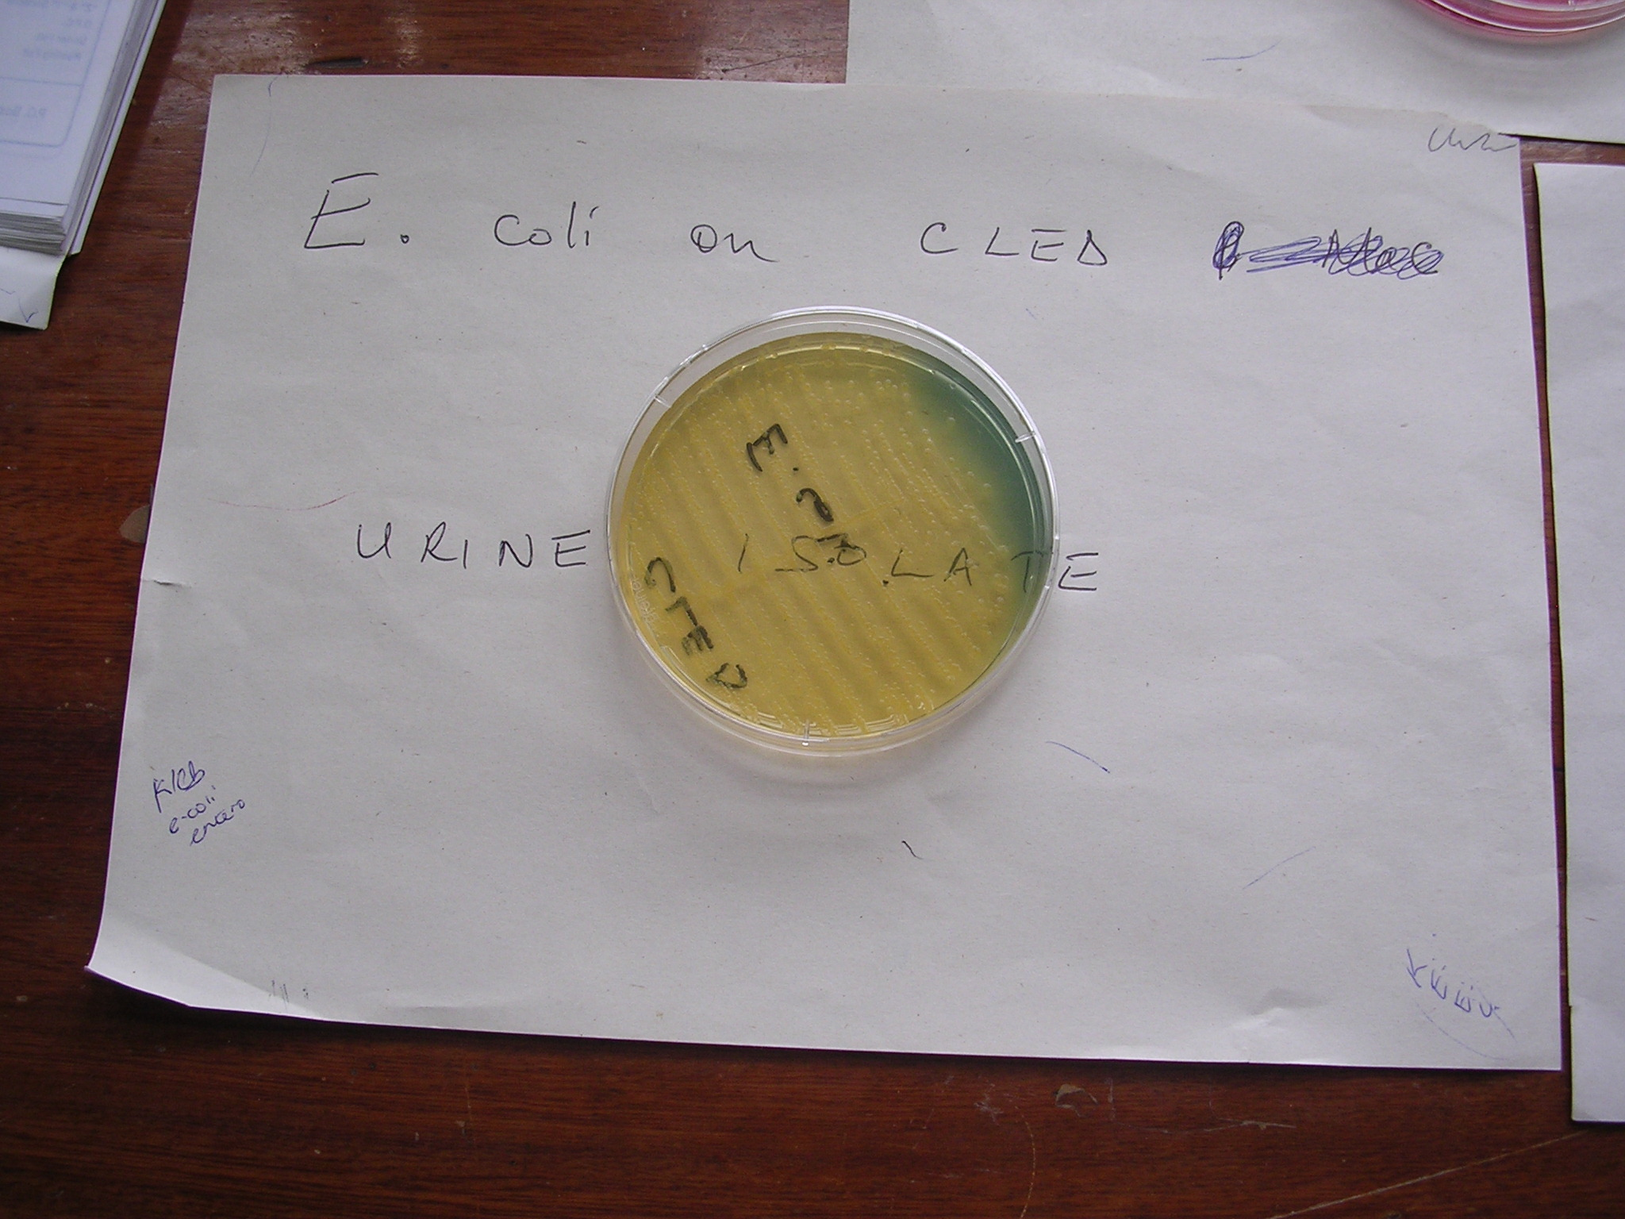

Slide 38
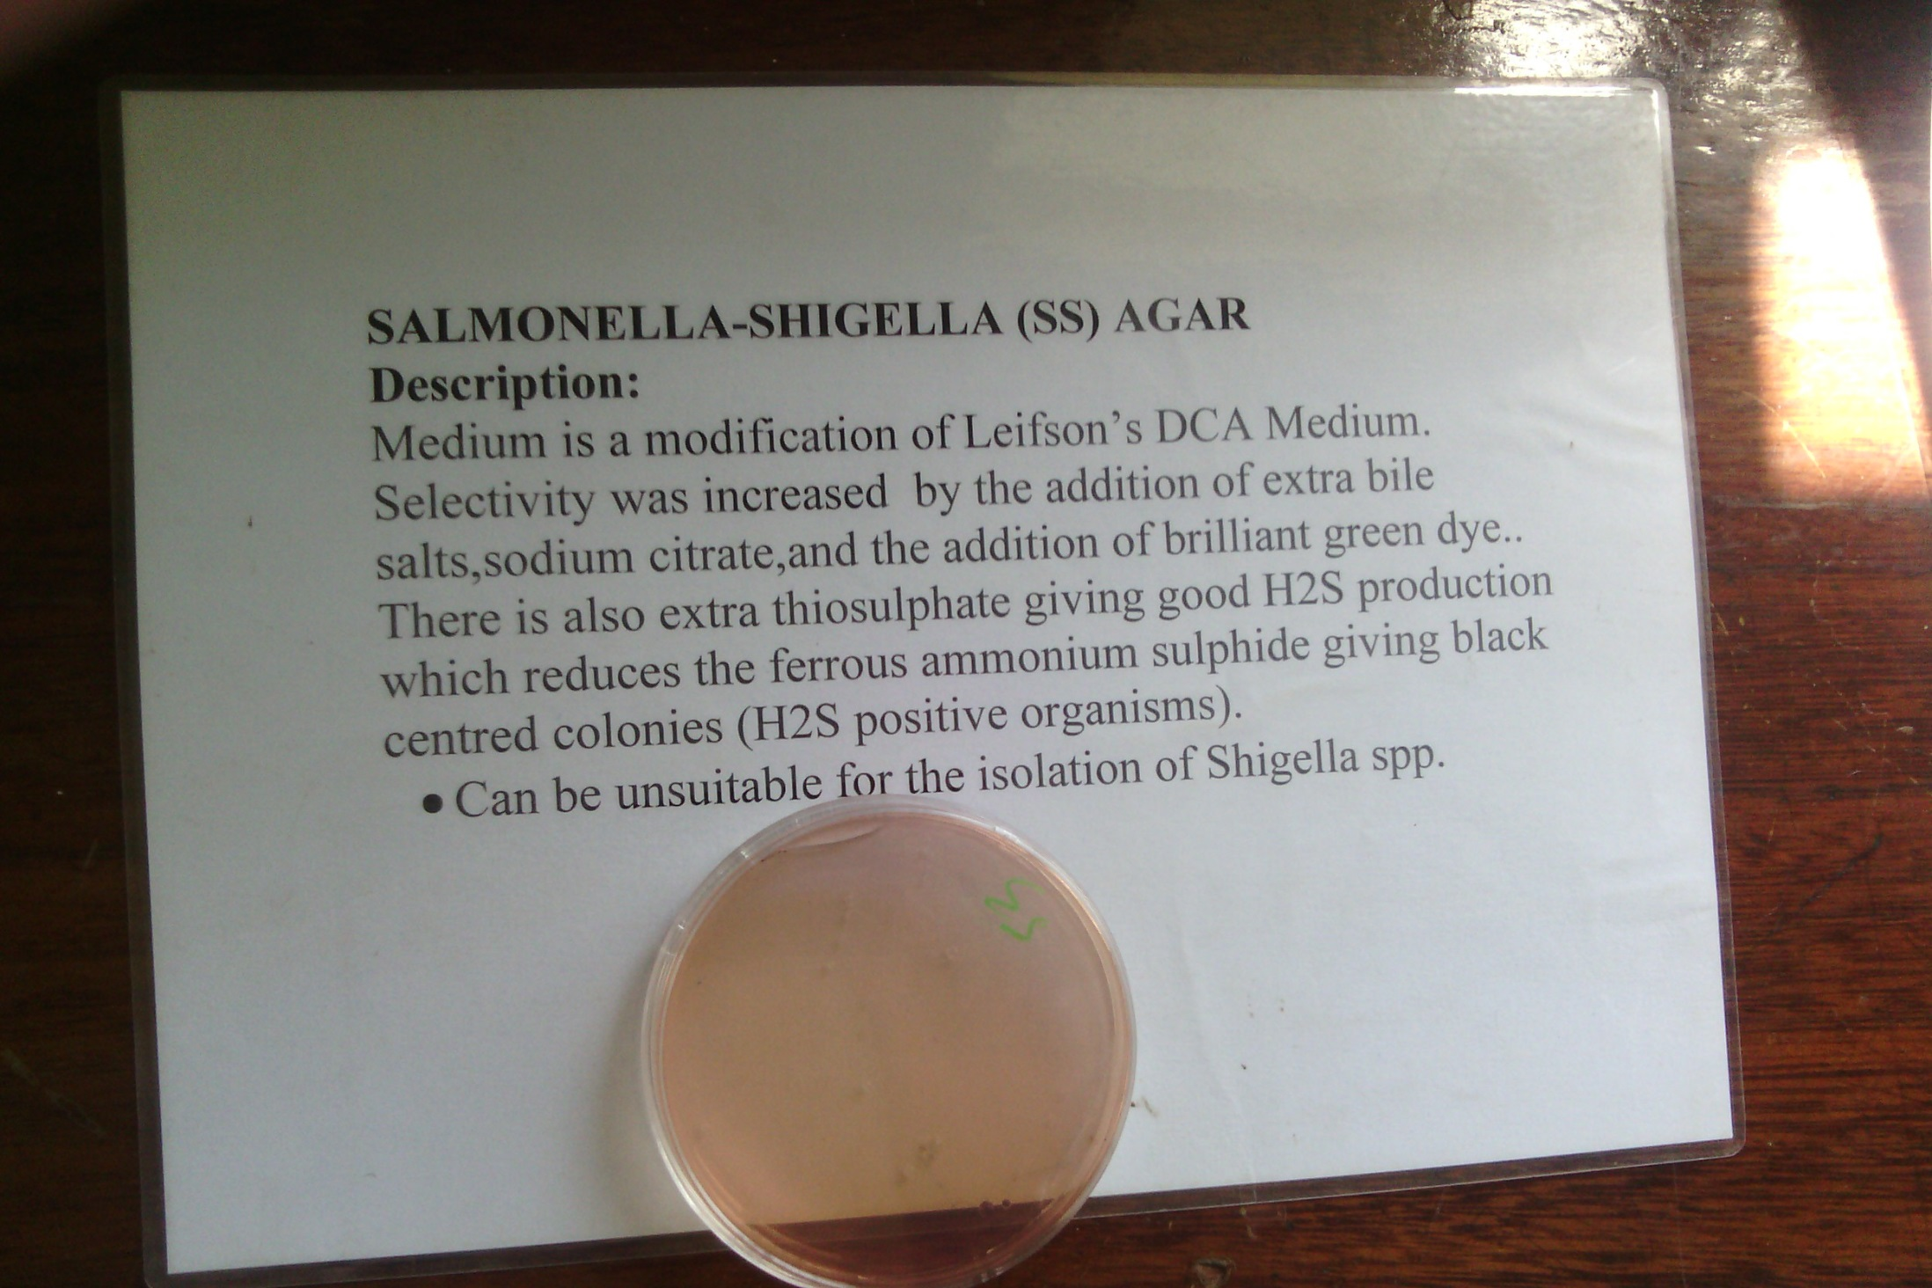
SS Agar

Slide 39
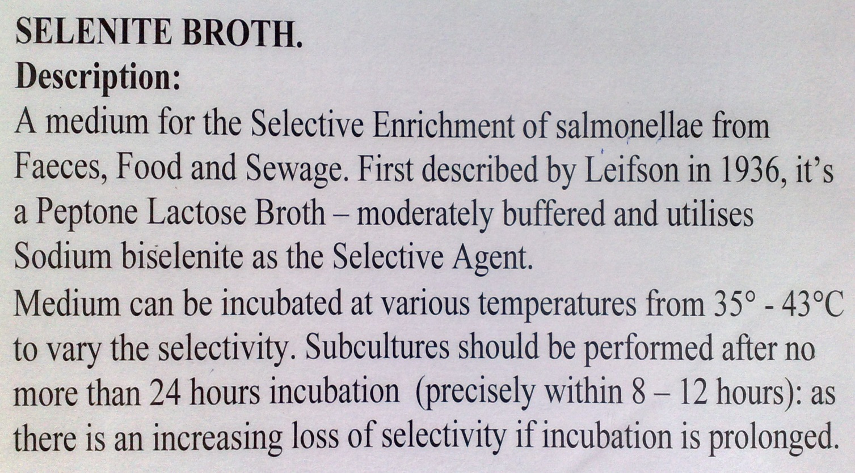
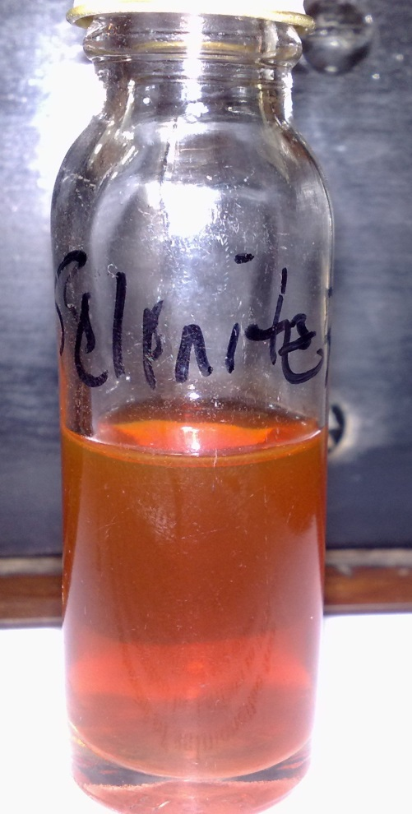
Selenite F Broth

Slide 40
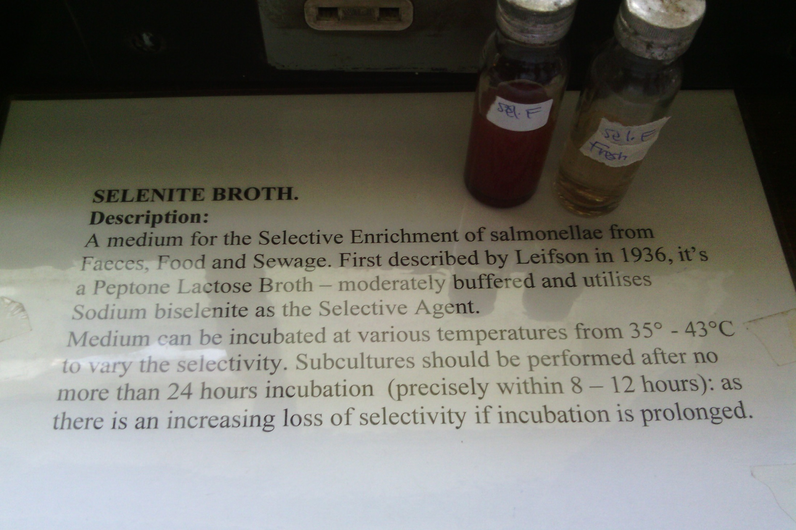

Slide 41
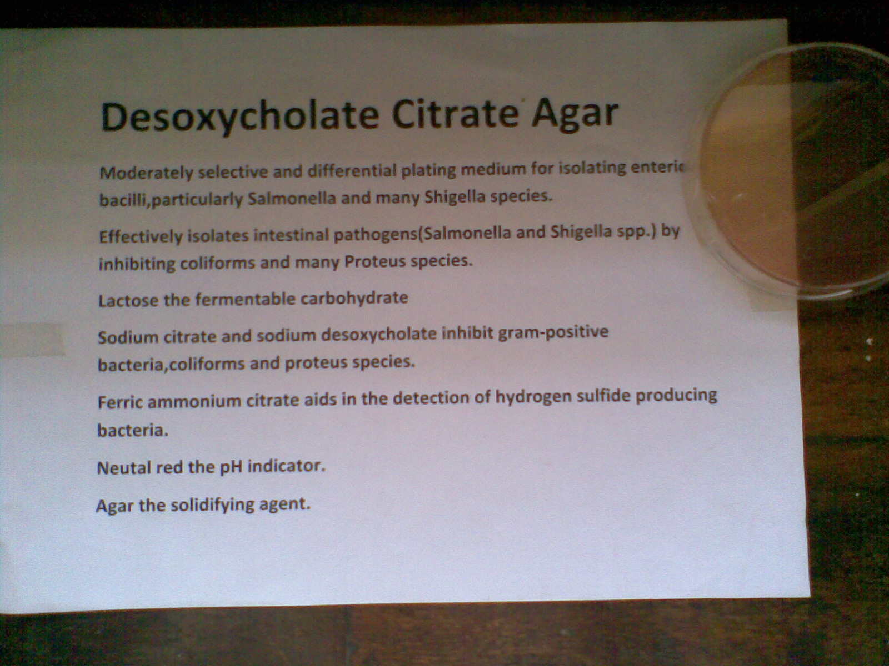

Slide 42
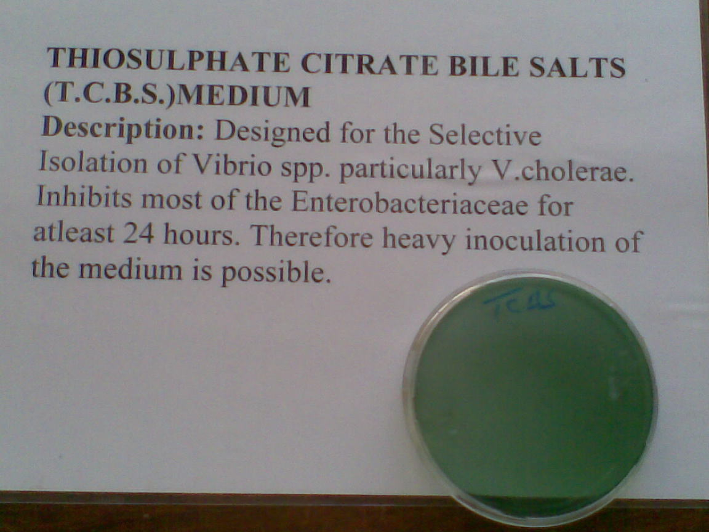

Slide 43
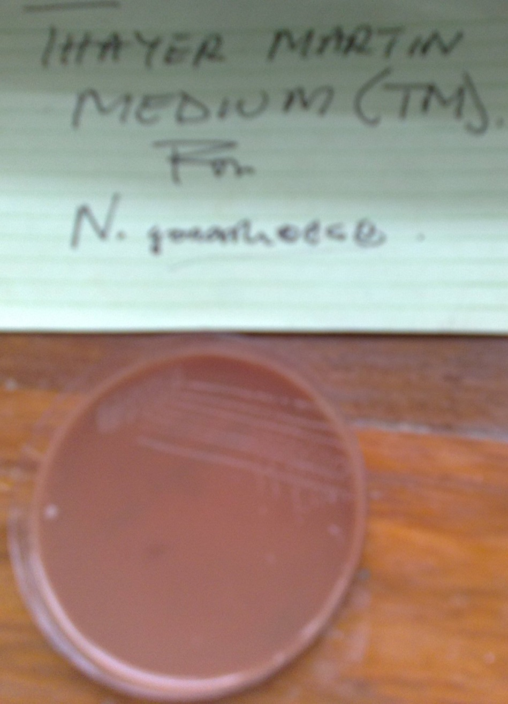

Slide 44
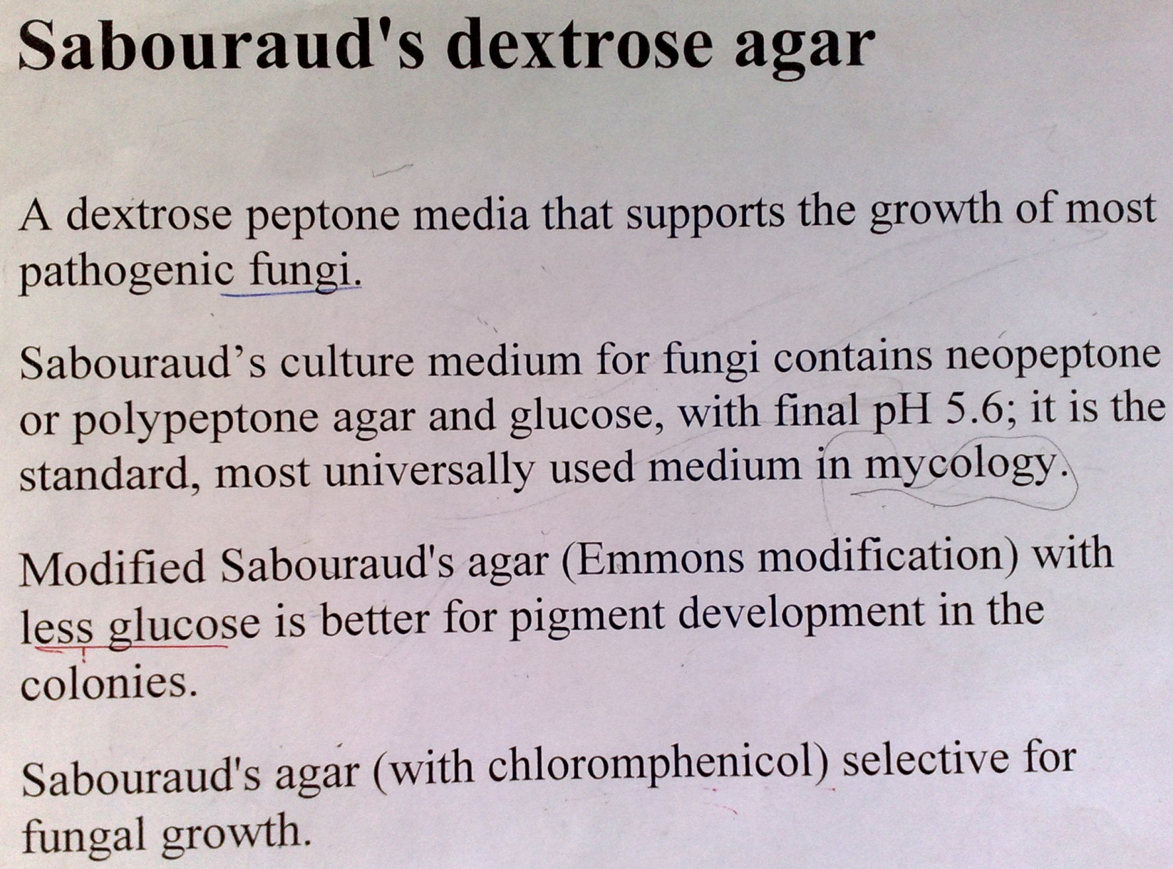

Slide 45
Tripple Sugar Iron(TSI) Agar
Sugars present:
  Glucose - 0.1%
  Lactose - 0.1%
  Sucrose - 0.1%
  Ferrous Ammonium Sulphate
Differentiates some of the Enterobacteriaceae on the basis of four reactions:
  The fermentation of glucose, Lactose, Sucrose and H₂S gas production
Colour changes
  Pink - Alkaline
  Yellow - Acid
It should be used in conjuction with a Urease Test to eliminate Proteus spp. when screening for Salmonella spp.

Slide 46
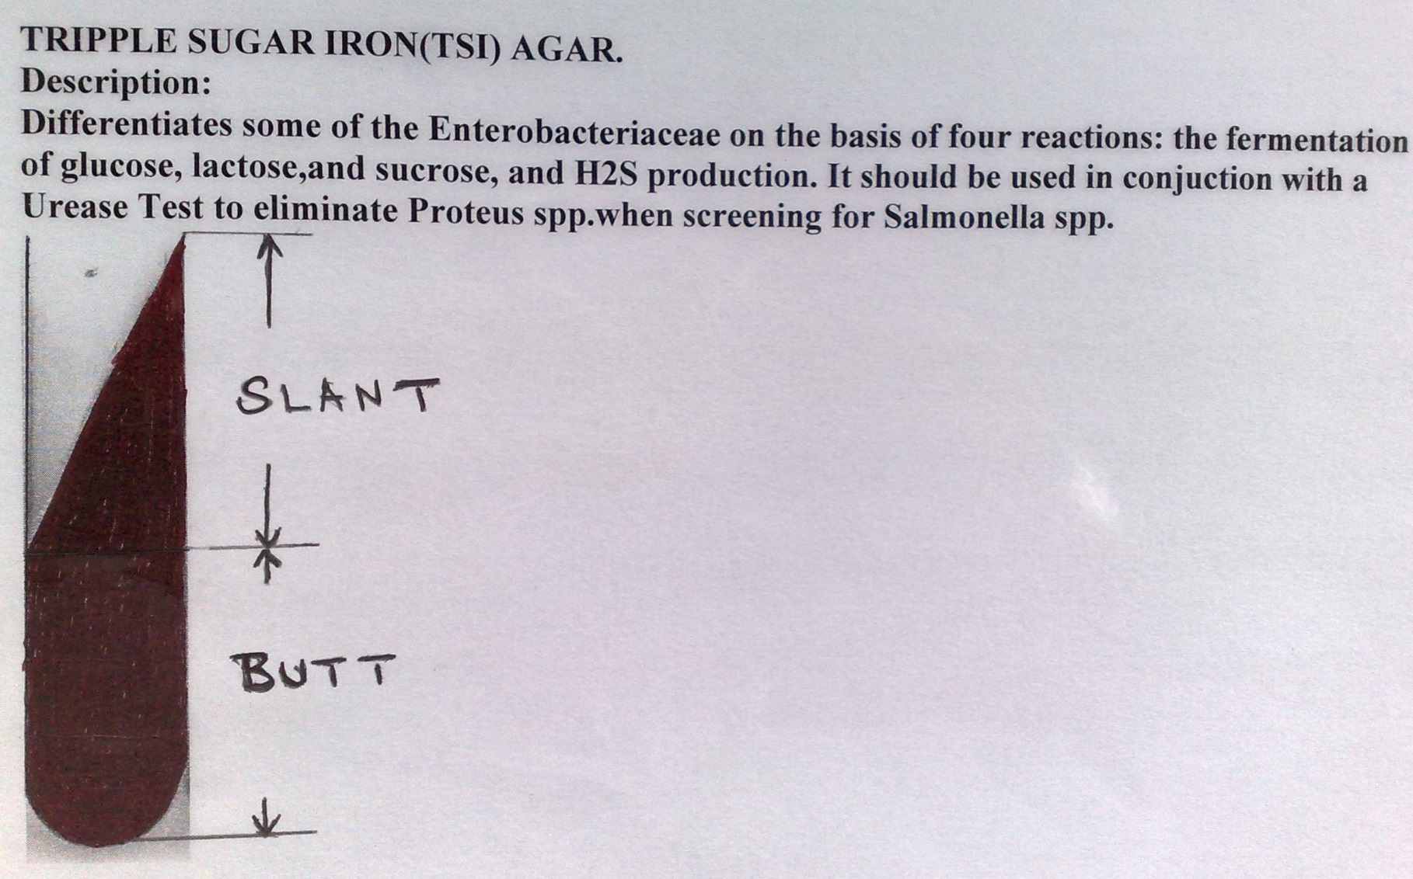
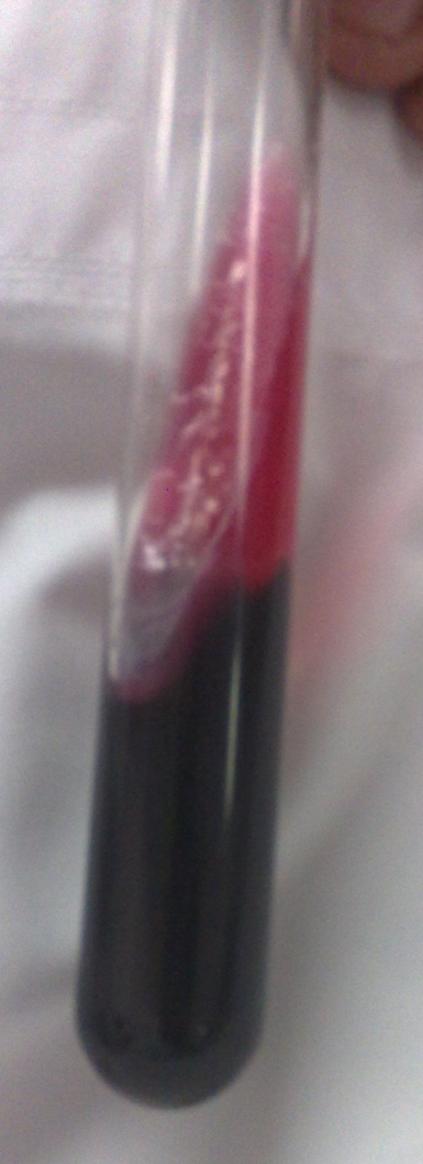
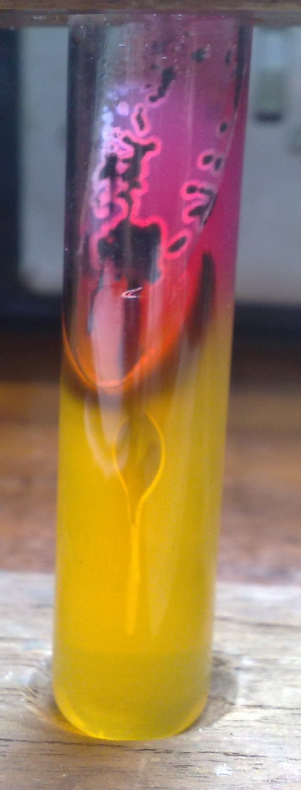
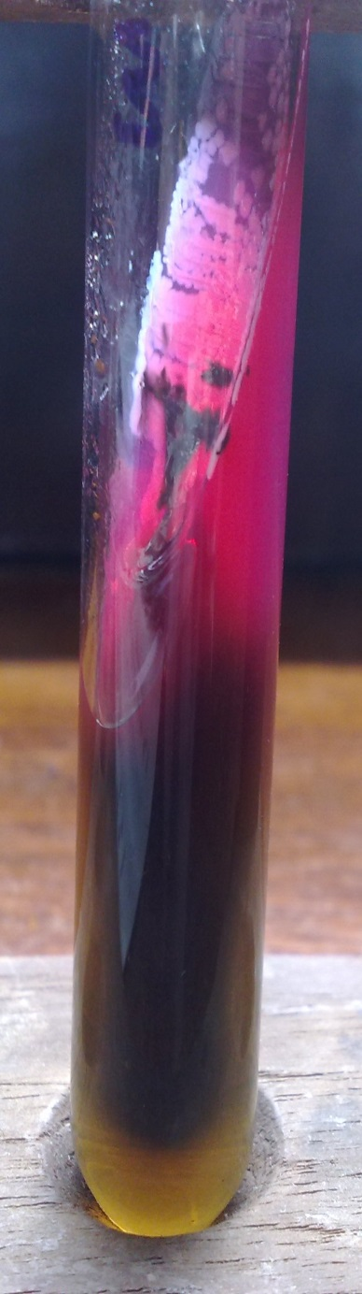

Tripple Sugar Iron(TSI) Agar

Slide 47


Slide 48


Slide 49


RSM media

Slide 50



Slide 51


Slide 52




Slide 53


Cary Blair
Cary Blair With A rectal Swab Stick

Slide 54



Slide 55


Castanedas’s medium

Slide 56

Diphasique medium

Slide 57

Trypcase Soy Broth

Slide 58


Slide 59

Harada moni culture tech.

Slide 60

Lowenstein Jensen Media.jpg

Slide 61
Contents of LJ Medium
Coagulated hen's eggs
Malachite green (Represented by green chilly)
Mineral salt
Asparaginase (Represented by PeppeR)

Slide 62

Manitol Salt Agar

Slide 63


Slide 64


Slide 65


