Slide 1
STAPHYLOCOCCUS AND MICROCOCCUS
KIMAIGA H.O
MBChB (University of Nairobi)

Slide 2
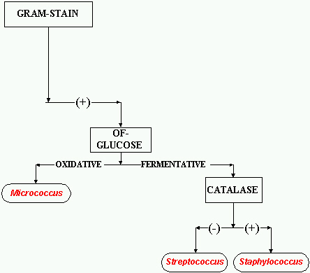

Slide 3
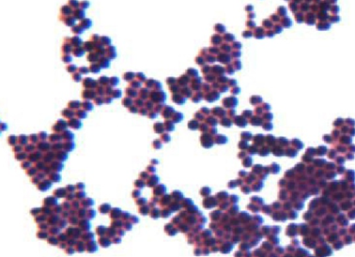
STAPHYLOCOCCUS
Derived from Greek “staphyle” (bunch of grapes)
Non-spore, non-motile and few are capsulated
Gram positive cocci arranged in irregular grapelike clusters
At least 40 spp. have been described. Most are harmless and reside normally on the skin and mucous membranes of humans and other organisms and also as component of soil microbial flora

Slide 4
Classification
Clinically they are grouped into two
Coagulase positive Staphylococci
Staphylococcus aureus
Coagulase negative Staphylococci
Frequently involved in nosocomial and opportunistic infections
Staphylococcus epidermidis/ Staphylococcus albus
Staphylococcus saprophyticus
S. haemolyticus
S. lugdunensis
S. schleiferi

Slide 5
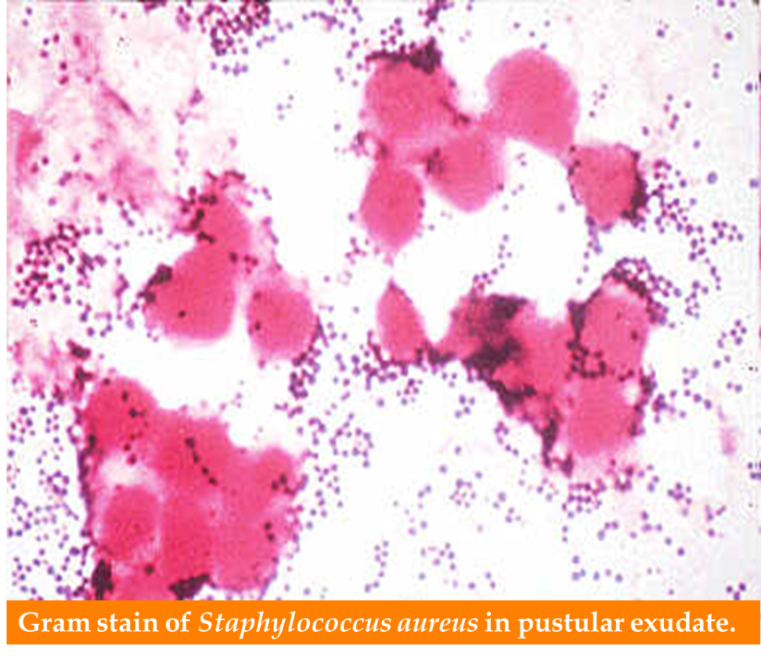
Staphylococcus aureus
Facultative anaerobic gram positive cocci
Arranged in irregular grapelike clusters
Found as part of the normal on the skin and nasal passages

Slide 6
Mechanisms of pathogenicity
Capsule
polysaccharide
slime layer
Capsule
Antigenic
Antiphagocytic
Techoic acid
Peptidoglycan
layer
Protein A
Teichoic acid
Binds to fibronectins
on surface of host cells
Phospholipid
Cytoplasmic
membrane
PBP
PBP
Transport protein
Protein A
Has great affinity to Fc portion of IgG and inhibits
phagocytosis and opsonization
Notes:
cytosis

Slide 7
Adherence to Host Cell Proteins
S. aureus cells express surface proteins that promote attachment to host proteins such as laminin and fibronectin that form the extracellular matrix of epithelial and endothelial surfaces.
In addition, most strains express a fibrin/fibrinogen binding protein (clumping factor) which promotes attachment to blood clots and traumatized tissue
Most strains of S. aureus express both fibronectin and fibrinogen-binding proteins. In addition, an adhesin that promotes attachment to collagen has been found in strains that cause osteomyelitis and septic arthritis.
Interaction with collagen may also be important in promoting bacterial attachment to damaged tissue where the underlying layers have been exposed.

Slide 8
Membrane-damaging toxins- activates T and non T-lymphocytes
a-toxin (a-hemolysin
The best characterized and most potent membrane-damaging toxin of S. aureus is a-toxin.
ß-toxin
is a sphingomyelinase which damages membranes rich in this lipid.
d-toxin
is a very small peptide toxin produced by most strains of S. aureus.
It is also produced by S. epidermidis. The role of d-toxin in disease is unknown

Slide 9
Staphylokinase
Many strains of S aureus express a plasminogen activator called staphylokinase.
This factor lyses fibrin.The genetic determinant is associated with lysogenic bacteriophages.
Other extracellular enzymes
S. aureus can express proteases, a lipase, a deoxyribonuclease (DNase) and a fatty acid modifying enzyme (FAME).

Slide 10
Mechanisms of pathogenicity
Produces enzymes which contribute to its invasiveness
Coagulase- Clots plasma, interferes with phagocytosis, facilitates spread in the tissues. Coagulase binds to prothrombin in the host to form a complex called staphylothrombin.
Haemolysins- Lyze red cells.
Leukocidin- Kills leucocytes. Important factor in necrotizing skin infections.
Fibrinolysin- Digests fibrin.
Lipase- Breaks down fat
Hyaluronidase- Facilitates spread in tissues by destroying hyaluronic acid
Protein A: Antiphagocytic, reacts with Fc portion of IgG molecule and inhibits phagocytosis and opsonization
Chemotaxis inhibitory protein: Inhibits migration and activation of neutrophils
B lactasamase-associted with antibiotic resistance

Slide 11
Produces toxins that contribute to tissue damage
Enterotoxins (heat stable); Cause food-poisoning
Enterotoxins and TSST-1 are superantigens that may cause toxic shock.
Staphylococcal enterotoxins cause emesis (vomiting) when ingested and the bacterium is a leading cause of food poisoning.
The exfoliatin toxin causes the scalded skin syndrome in neonates, which results in widespread blistering and loss of the epidermis
Toxic shock syndrome toxin: Shock, rash, desquamation of skin.
Epidermolytic toxins A and B: Generalized peeling of the skin.

Slide 12
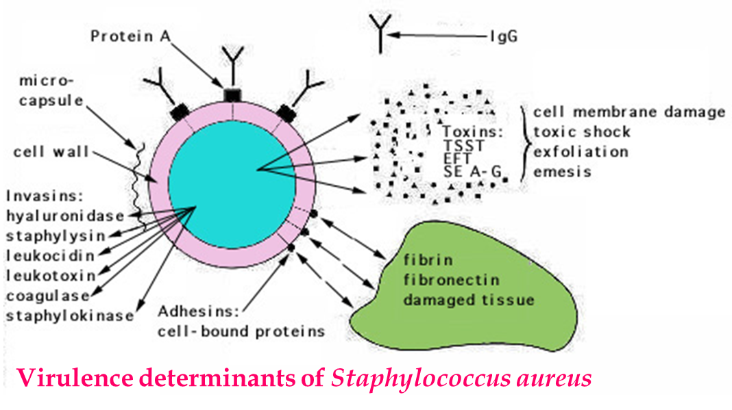

Slide 13
Clinical features
Causes Pyogenic diseases and toxin-mediated diseases
1. Pyogenic diseases
Local lesions of skin - impetigo, furuncles (boils) and carbuncles (boils clustered together), paronychia, cellulitis, folliculitis, suppurativa, eyelid infection, acute bacterial endocarditis (ABE) and mastisits
Systemic infections – (PAINS)Pneumonia, Acute endocarditis, Infective arthritis, Necrotizing fasciitis Sepsis. Osteomyletis, Post surgical wound infections and Abscess

Slide 15
2. Toxin mediated diseases
(a) Food poisoning- (gastroenteritis)
Due to enterotoxin
Vomiting and watery non-bloody diarrhea
Enterotoxin stimulates release of IL-1 and IL
Stimulates release of cytokines- stimulates entric nervous system to activate the vomiting centre in the brain
Enterotoxin is heat resistant hence not inactivated by brief boiling
Also resistant to stomach acid and enzyme
Six immunogenic types of the enterotoxin exist (A-F)
Resolves within 24 hours

Slide 16
(b)Toxic shock syndrome
Mediated via ‘toxic shock syndrome toxin’
Characterised by fever, hypotension, erythematous skin rash which desquamate, vomiting, diarrhoea and shock due to enterotoxin F (TSST-1).
This is followed 1-2 weeks later by desquamation, particularly of the palms of the hands and the soles of the feet
Occurs in women using tampons, individuals with wounds, patients with nasal packaging.
The toxin stimulates release of IL-1, IL-2 and tumuor necrosis factor(TNF)

Slide 17
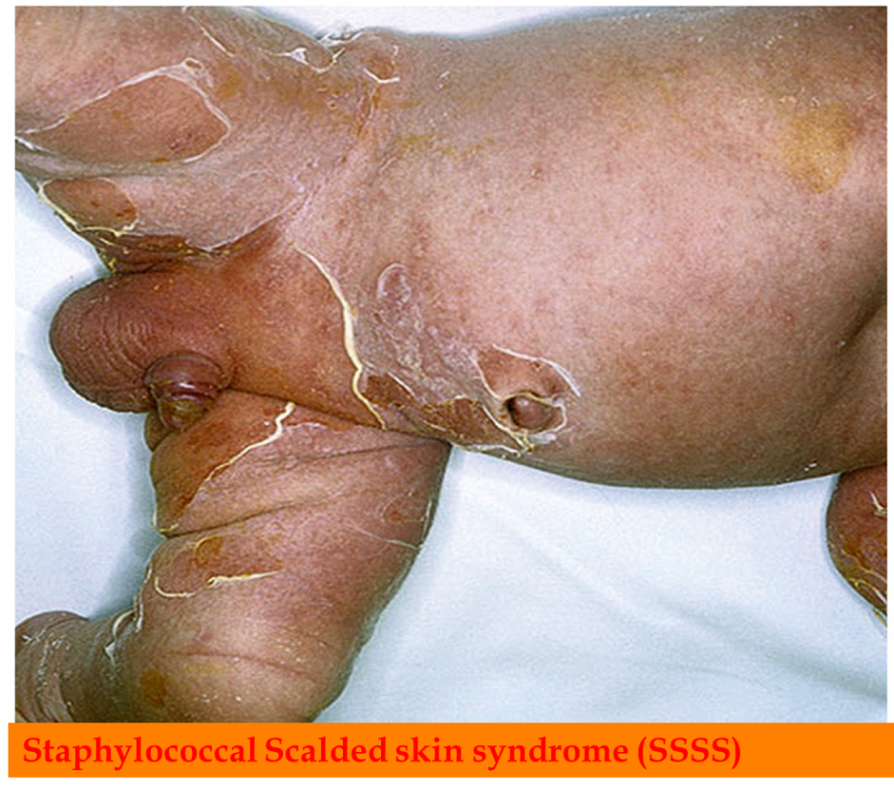
Staphylococcal Scalded skin syndrome (SSSS)
SSSS-(ritter’s disease) characterized by fever, and large erythematous rash, loss of hair and nails
Mediated by Exfoliative or epidermolytic toxin- acts as a protease which cleaves protein desmoglein (attaches epidermal cells) resulting in separation of the epidermal layer -sloughs off the body
Common in children, neonates and adults with renal failure

Slide 18
Laboratory Diagnosis of Staphylococci
Specimens
Pus and swabs from infected sites, sputum, cerebrospinal fluid, blood for culture. Faeces, vomit and the remains of food when food poisoning is suspected, nasal swabs from carriers.
Microscopy
Gram stain and observe for gram positive cocci in clusters or singly and in pairs
Colony:
Smooth circular 2-3 mm diameter
Yellow-S aureus white- S epidermidis(albus)

Slide 19
Culture
Blood agar, chocolate blood agar: S. aureus produces golden-yellow colonies that are betahaemolytic.
Smooth circular 2-3 mm diameter
Yellow-S aureus white- S epidermidis(albus)
Fermentation of glucose produces mainly lactic acid - facultative anaerobes
Mannitol salt agar (selective and differential for isolation from faeces -staphylococcal food-poisoning) : yellow colonies
High salt (7.5%) inhibits the growth of most other organisms, but Staph. are facultative halophiles and can grow in up to 10% NaCl.
MSA also contains mannitol and the pH indicator phenol red. If an organism growing on MSA ferments mannitol, the acid produced turns the colonies yellow hence apositive test.
S. aureus ferments mannitol and S. epidermidis does not.

Slide 20
Mannitol Salt Agar test
Golden-yellow-B- haemolytic colonies

Slide 21
Biochemical tests
S. aureus is:
Coagulase positive;S aureus +ve others –ve
DNA-ase positive
Catalase positive
Are catalase-positive (can convert hydrogen peroxide (H2O2) to water and oxygen) catalase test useful to distinguish staphylococci from enterococci and streptococci.
The test is performed by adding 3% hydrogen peroxide to a colony on an agar plate or slant. Catalase-positive cultures produce O2 and bubble at once. The test should not be done on blood agar because blood itself contains catalase.
Novobiocin test(diff btw coagulase –ve Staph)

Slide 22
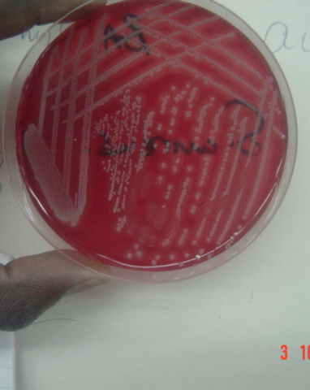
Staph Cultures

Slide 23
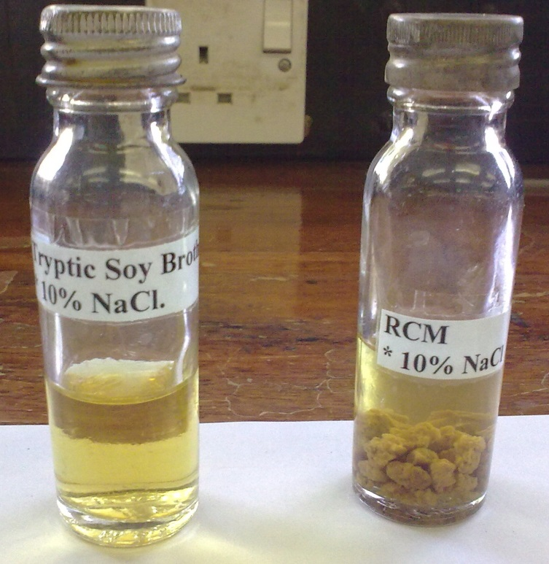
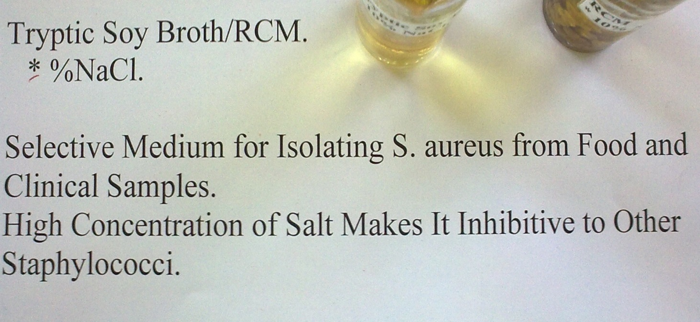
Tryptic Soy Broth/ RCM 10% NaCl

Slide 24
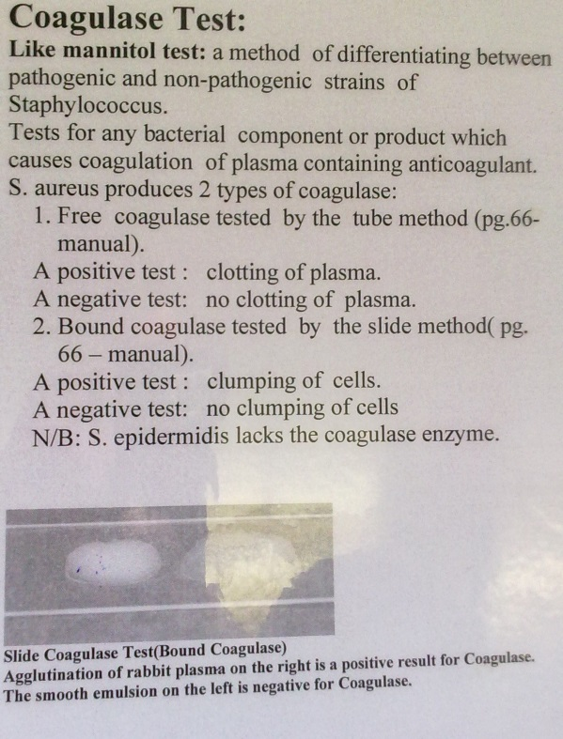
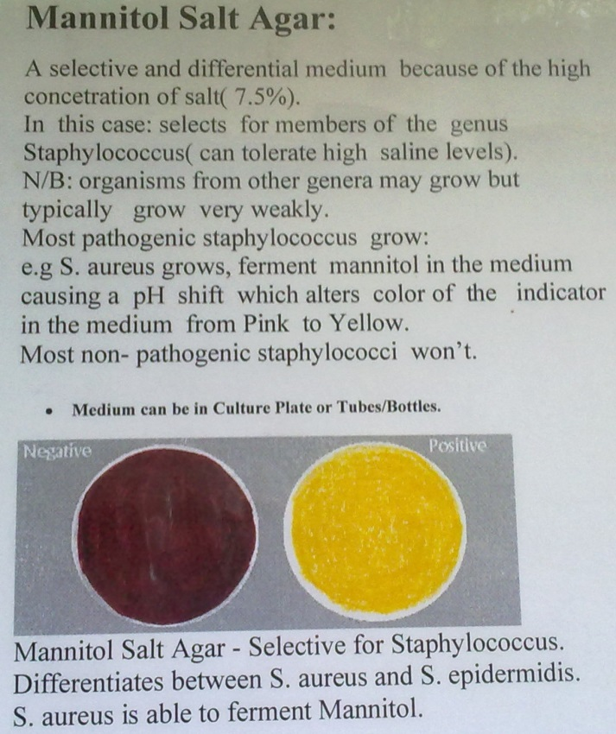
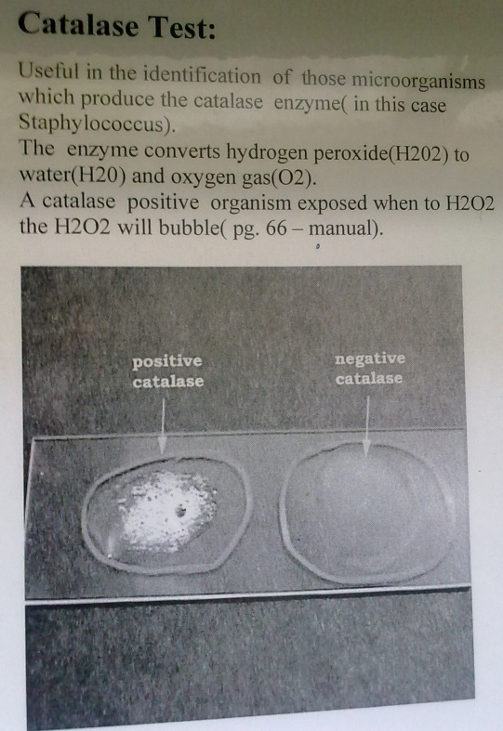

Slide 25
Antimicrobial susceptibility
Antibiotics with activity against S. aureus include: Penicillins,Vancomycin, Macrolides, Cephalosporins, Fusidic acid, Erythromycin, Lincomycin and Clindamycin (Dalacin C)
Most strains of S. aureus are resistant to penicillin – produce plasmid-coded beta-lactamase
MRSA (methicillin resistant S. aureus): resistant to methicillin and related penicillins -treated with vancomycin or a combination therapy using sulfa drugs and minocycline or rifampin
VRSA (Vancomycin Resistant S.aureus) & VISA (Vancomycin Intermediate S.aureus) have emerged-treat with a combination of Quinupristin-Dalfopristin (synercid) or Linezolid
Skin infection- topical antibiotic e.g mupirocin
A plasmid associated with vancomycin resistance has been detected in Enterococcusfaecalis which can be transferred to S. aureus in the laboratory, and it is speculated that this transfer may occur naturally (e.g. in the gastrointestinal tract).
Antibiotic sensitivity tests is a must by lab on all staph isolated from clinical materials to determine drug of choice

Slide 26
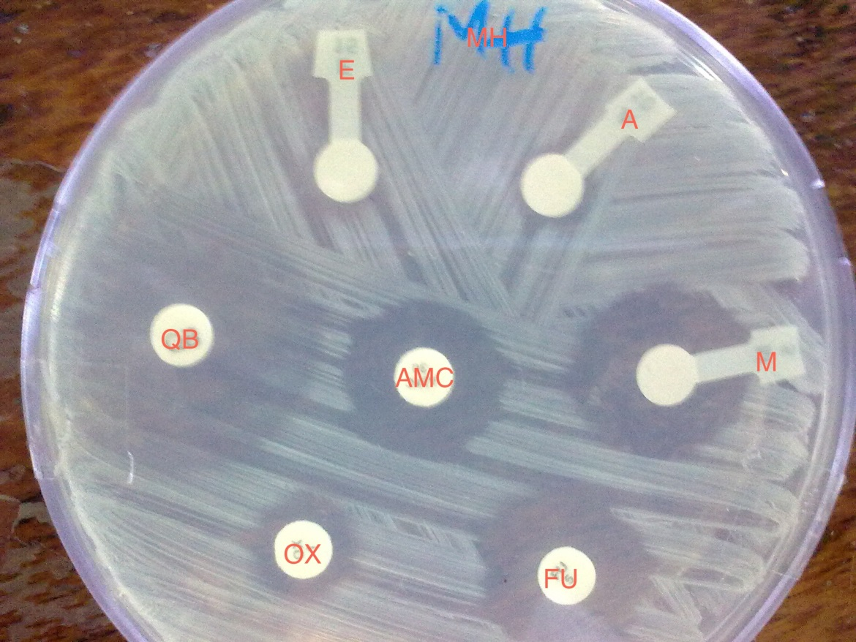
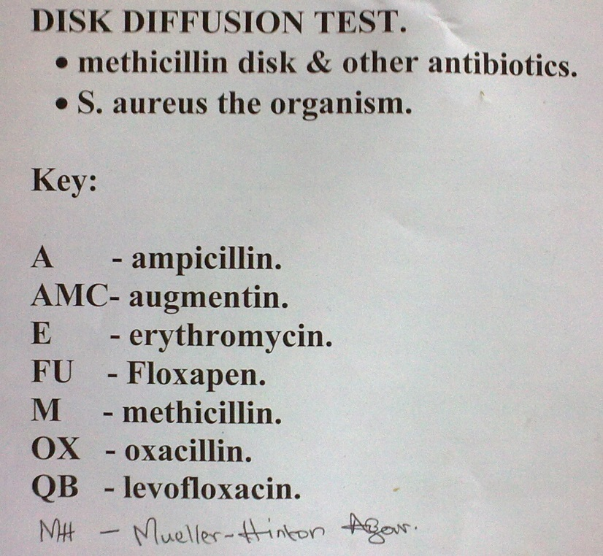

Slide 27
Prevention
Hand antisepsis
The proper cleansing of wounds and surgical openings
Aseptic use of catheters or indwelling needles
Appropriate use of antiseptics

Slide 28
Other pathogenic Staphylococcus species
Staphylococcus epidermidis
Staphylococcus saprophyticus
S. haemolyticus

Slide 29
Staphylococcus epidermidis
Characteristics
Gram-positive cocci- grape-like clusters
Forms white raised colonies
Non-hemolytic on blood agar
Catalase positive,
Coagulase negative
It does not ferment mannitol
It is resistant to polymyxin B
Sensitive to novobiocin (S. saprophyticus is resistant)

Slide 30
Staphylococcus epidermidis
Normal flora of the skin and mucous membrane Anterior nose & External ear canal
Hospital-acquired
May cause endocarditis and bacteraemia following infection of cannulae, indwelling catheters, shunts or other appliances positioned in the body.
Also causes sepsis in neonates and peritonitis in patients with renal failure-peritoneal dialysis
Produce glacocalyx which adheres to the catheter
associated with bacteremia in neonatal intensive care units
highly antibiotic resistant.
Produce B-lactamase
Resistant to methicillin and nafcillin
Treated with vancomycin + rifampin or and aminoglycoside

Slide 31
S. saprophyticus
Most infections are hospital acquired (nosocomial)
Opportunistic pathogen in immuno-suppressed
Strongly associated with presence of foreign bodies
Prosthetic heart valves (endocarditis)
IV catheters (bacteremia)
Urinary catheter (UTI in elderly)
CSF shunts (meningitis)
Peritoneal dialysis catheter (peritonitis)

Slide 32
Staphylococcus saprophyticus
Saprophytic
Most infections are community-acquired
Coagulase negative
Inhabits the skin surrounding the genitourinary tract
Urease and lipase positive.
Resistant to antibiotics – novobiocin, penicillins & cephalosporins
Treated with quinolone (norfloxacin) or trimethroprim-sulfamethoxazole

Slide 33
S. haemolyticus
Haemolytic on BA
Coagulase –ve
Vancomycin R
2nd most clinically isolated CoNS (S. epidermidis is the first)
Nosocomial pathogen
Human infections include: native valve endocarditis, septicemia, peritonitis, urinary tract, wound, bone, and joint infection.
Forms biofilms- prosthetic valves, cerebrospinal fluid shunts, orthopedic prostheses, and intravascular, urinary, and dialysis catheters.
S. haemolyticus is multi-drug resistant

Slide 34
S. schleiferi implicated in endocarditis, septicemia, joint infections, osteomyelitis, and wound infections
S. lugdunensis implicated in endocarditis, urinary tract infection, endophthalmitis, septic arthritis, and vascular catheter infections, associated with aggressive infections having a high mortality

Slide 35
S. aureus can be distinguished from other staphylococcus on the basis of the following factors
forms a fairly large golden-yellow colony on rich medium
S. aureus is often hemolytic on blood agar
S. aureus is coagulase-positive whereas most other Staphylococcus species are coagulase-negative
S. aureus ferments mannitol and hemolyzes red blood cells, whereas others do not.
S. aureus also possesses DNAase enzyme in cell while other staphylococci rarely possesses this enzyme
Antibodies to protein A agglutinates S. aureus but not other staphylococci.

Slide 36
Biochemical reactions that differentiate S. epidermidis and S. saprophyticus from S. aureus
Test | S. aureus | S. epidermidis | S. saprophyticus
Coagulase | + | - | -
DNA-ase | + | + (weak) | -
Mannitol | + | - | +
Sucrose | + | + | +
Novobiocin (5g disc) | Susceptible | Susceptible | Resistant
Notes:
Staphylococci: novobiocin test to distinguish coagulase negative staphylococciepidermidis stays away from the novobiocin disc like an epidemic. · Therefore, epidermidis is sensitive to novobiocin. Staph saprophyticus, much friendlier, comes up to the disc and says, "'sap?'" [short for "whassup?", ie "what's up"]. · Therefore, saprophyticus is novobiocin resistant.

Slide 37
Micrococcus
Gram-positive cocci forming pairs, tetrads (predominantly), or irregular clusters
Catalase positive
Micrococcus transient flora on exposed skin of face, arms, hands, and legs
Micrococcus coagulase-negative, furazolidone-resistant, and bacitracin-susceptible
Micrococcus cytochrome oxidase positive
Micrococcus species are strictly aerobic.
Micrococci may be distinguished from staphylococci by a modified oxidase test. Staphylococcus species, with the exception of S. sciuri, S. lentus and S. vutulus are oxidase-negative and Micrococcus species are oxidase-positive.
Micrococcus species produce yellow or red-pigmented colonies on blood agar

Slide 38
Immunity to Staphylococcus Infections
Body responds with antibodies to the many antigens of staph but protective capacity for the antibodies is uncertain and repeated infections occur
Both antigenic polysaccarides and proteins from cell wall and secreted toxins and enzymes are involved in serological test for staphylococci, thus causing confusion
Autogenous vaccines are of limited value success in chronic infections. They are made from killed organisms of patients own staph isolated from lesions. Colonization with low virulence strains may keep off pathogenic strains

Slide 39
Epidemiological Typing of Staphylococci
Reasons for finger printing or staph strains in the following situations;
Food poisoning outbreaks
Nosocomial infection (hospital X-infection)
Nursery outbreaks
Staphylococcal Scalded Skin Syndrome (SSSS) outbreaks
Toxic shock syndrome (TSST-1) outbreak in females sanitary towels especially tampons contaminated with staph at manufacturing plant

Slide 40
Techniques used in epidemiological studies
Technique | Limitations
Serological typing (Serotypes I, II and III) | Too many sources of Antigens Few specific for pathogenic markers
Biochemical reactions | Too many substrates involved Not limited to pathogenic Have many fermentation patterns (except manitol-Salt Concentration)
Antibiotic pattern | Too many patterns Not dynamic/stability change
Phage typing in special labs is limited use in some strains

Slide 41
Bacteriophages (Phages) Typing
International set available of 24 Bacterio-phages success of typing of strains (70-90%) in Staph.aureus but are;
Species specific
Methodology complicated for routine labs
There are two types of phages
B lysogenic and lytic bacteriphages; use only lytic bacteriophages

Slide 42
International Set of Phages
Groups | Phage Members | Significances
I | 29 52 52a 79 80 | Hosp. X infection Toxic shock syndrome
II | 3A 3C 55 71 | Epidermolytic toxins strains causing SSS
III | 6 42E 47 53 54 75 77 83A 84 85 | Food poisoning strains Drug resistant plasmid mediated
IV | 42D 187 Unclassified 81 91 95 96 | Animal origin staph Isolates e.g. Bovine mastitis
NB: Patterns may change with time and ‘new’ phages replace old e.g. 80/81 in 1960 while in the 80’s 94/96 replaced it in group I phage types

