Slide 1
STREPTOCOCCI AND ENTEROCOCCI
KIMAIGA H.O
MBChB (University of Nairobi)

Slide 2
STREPTOCOCCACEA (10 genes)
Genus: Streptococcus (21 Species)
Strep pyogenes (Beta Haemolysis Group A)
Strep agalactiae (Beta Haemolysis Group B)
Strep pneumoniae (Alpha Haemolytic)
Strep viridans (Alpha Haemolytic)
Strep faecalis (Enterococci)
Genus: Peptostreptococcus (5 Species)
Are strict anaerobic streptococci
Some are pathogenic and cause abscesses
Genus: Aerococcus
Is a strict anaerobe
Genus: Lactobacilli
Leucoriastae streptococci

Slide 3
Morphological Characteristics and Cultural
Gram positive cocci and form chains when observed by microscope
The organisms are catalase negative
Colonies show haemolysis on blood agar; Can be complete (Beta/clear), partial (Alpha/green) or no haemolysis (Gamma)
Are small, pin pointed, form white-gray or at times non pigmented colonies
Some are capsulated, non motile and facultative (both aerobic and anaerobic)
Require complex media enriched with blood or tissue fluids and growth enhanced by 5-10% CO₂
Enterococci grow in high salt (6.5% NaCl) and Bile (MacConkey’s agar)-Strep fecalis
Most streps are resistant to aminoglycosides and tetracyclines but sensitive to penicillin and erythromycin

Slide 4
Classification of Streptococci
Based on haemolysis on blood agar
  Beta -hemolysis
    Colonies on BA surrounded by a clear haemolytic zone (no intact erythrocytes and haemoglobin is broken down)
  Alpha-hemolysis
    Colonies on BA surrounded by green zone (incomplete hemolysis) – ‘greening’ is caused by H₂O₂, which reduces haemoglobin into methoglobin.
  Gamma haemolysis
    Absence of macroscopically visible haemolytic zones
    Nonhemolytic colonies have been termed gamma-hemolytic. Hemolysis is affected by the species and age of red cells, as well as by other properties of the base medium.

Slide 5
Group B can manifest alpha, beta or gamma hemolysis. Most strains of S. pneumoniae are alpha-hemolytic but can cause ß-hemolysis during anaerobic incubation. Most of the oral streptococci and enterococci are non hemolytic.
The property of hemolysis is not very reliable for the absolute identification of streptococci, but it is widely used in rapid screens for identification of S. pyogenes and S. pneumoniae.

Slide 6
Based on antigenicity of a carbohydrate (C substance) in their cell wall (lancefield antigen)
Lancefield Classification
Haemolysis | Group | Species name
Alpha |  | S. pneumonia
Alpha or non |  | Viridans streptococci
ß | A | S. pyogens
ß | B | S. agalactiae
 | C | S. dysagalactiae, S.equi
 | D | S. bovis; enterococcus
Beta or non | A,C,F,G | S. milleri (now S. anginosus group)
Non (anaerobe) |  | Peptostreptococcus

Slide 8
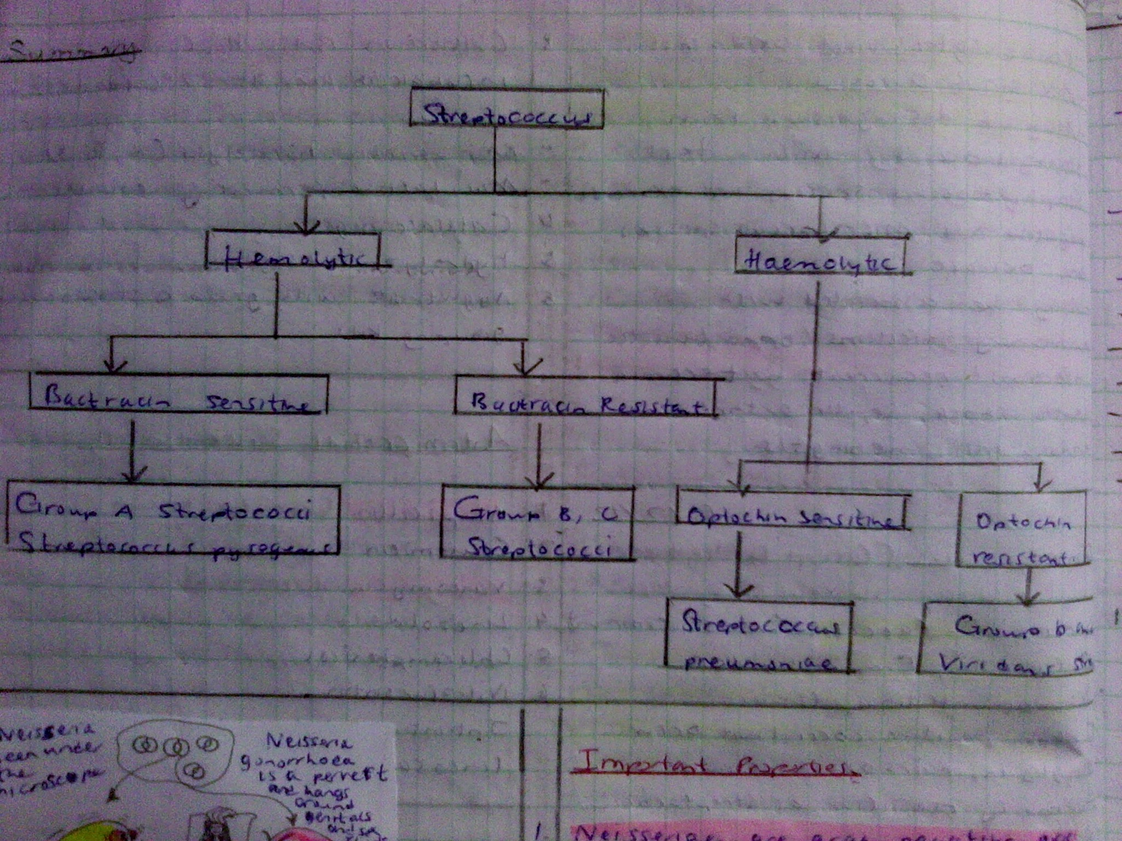

Slide 9
Streptococcus pyogenes (Group A streptococcus)
Gram-positive cocci and occurs in chains or in pairs of cells.
Non-motile, Non-spore forming
± Capsulated
Facultative anaerobe/ aerotolerant anaerobe .(Except peptostreptococci which is an obligate anaerobe) and requires enriched medium containing blood for grow. Ferment carbohydrates with production of lactic acid
Streptococcus pyogenes is one of the most frequent pathogens of humans.
It is estimated that between 5-15% of normal individuals harbor the bacterium, usually in the respiratory tract, without signs of disease.
Transmission is mainly by air droplets
As normal flora, S. pyogenes can infect when defenses are compromised or when the organisms are able to penetrate the constitutive defenses.
When the bacteria are introduced or transmitted to vulnerable tissues, a variety of types of suppurative infections can occur.

Slide 10
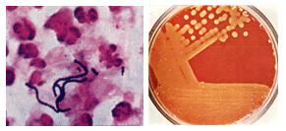
Streptococcus pyogenes. Left. Gram stain of Streptococcus pyogenes in a clinical specimen. Right. Colonies of Streptococcus pyogenes on blood agar exhibiting beta (clear) hemolysis.

Slide 11
Streptococcus pyogenes is one of the most frequent pathogens of humans.
It is estimated that between 5-15% of normal individuals harbor the bacterium, usually in the respiratory tract, without signs of disease.
Transmission is mainly by air droplets
As normal flora, S. pyogenes can infect when defenses are compromised or when the organisms are able to penetrate the constitutive defenses.
When the bacteria are introduced or transmitted to vulnerable tissues, a variety of types of suppurative infections can occur.

Slide 12
Antigenic types
The cell surface structure of Group A streptococci is among the most studied of any bacteria.
The cell wall is composed of repeating units of N-acetylglucosamine and N-acetylmuramic acid, the standard peptidoglycan. Historically , the definitive identification of streptococci has rested on the serologic reactivity of "cell wall" polysaccharide antigens as originally described by Rebecca Lancefield.
Eighteen group-specific antigens (Lancefield groups) were established. The Group A polysaccharide is a polymer of N-acetylglucosamine and rhamnose. Some group antigens are shared by more than one species. This polysaccharide is also called the C substance or group carbohydrate antigen.

Slide 13
Other antigenic structures
M-Proteins on the cell wall
  Basis of Griffith typing system of strep.
  Has anti phagocytotic properties
  Involved in adherence to host epithelial cells
C-Polysacharides on cell wall
  Basis of Lancefield grouping of streps (A-R) important in man are A-H
T and R proteins on cell wall
  Correlate with colonial types

Slide 14
Virulence factors
1. Adherence (colonization) surface macromolecules -
Lipoteichoic acid (LTA), Protein F and Sfb . F Protein mediates fibronectin binding-baterial internalization into host cell.
2. Evasion of phagocytosis/ Defense against host
immune responses
  Antigenic disguise and tolerance provided by hyaluronic acid capsule.
  Antigenic variation by M protein , a fibrillar surface protein. Its distal end bears a negative charge that interferes with phagocytosis and blocks complement deposition on the cell surface. Mutations during the course of infection alter the structure of M proteins, rendering some antibodies ineffective. Strains that persist in carriers frequently exhibit altered M proteins.

Slide 15
3. Invasion
Streptokinase: Activation of plasminogen to proteolytic enzyme plasmin and breaks down fibrin leading to spread of the strep
Hyaluronidase: Breaks down hyaluronic acid of connective tissue cement substance allowing spread
Deoxyribonucleases (DNase): Depolymerises DNA and deoxyribonucleoprotein to make it less viscous and facilitate spread of streptococci
4. Production of Toxins and Enzymes(Antigenic Strains) and other
systemic effects.
Exotoxins, such as pyrogenic (erythrogenic) toxin which causes the rash of scarlet fever and systemic toxic shock syndrome.
Toxic shock: Exotoxin is superantigen that binds directly to MHC II (without being processed) and binds abnormally to the T cell receptor of many (up to 20% of) T cells. Exaggerated production of cytokines causes the signs of shock: fever, rash, low blood pressure. aberrant interaction between toxin, macrophage, and T cells.
Soluble toxins are the basis for Dick test to detect antibodies in circulation by Schwaltz-Charlton reactions

Slide 16
5. Leukocidins, including streptolysin S and streptolysin O,
are proteins secreted by streptococci to kill phagocytes
(and probably to release nutrients for their growth)
Streptolysins: Are of two types, O and S and both are haemolysins
  ‘O’ is oxygen sensitive and is active in reduced state and hence a powerful toxic to both man and animals to the heart
  ‘S’ is not inactivated by oxygen hence is not antigenic. Is responsible for β-haemolysis on blood agar aerobically.
  Diagnostically, ASOT test is based on Streptolysins
6. Induction of circulating, cross-reactive antibodies
Some of the antibodies produced during infection by certain strains of streptococci cross-react with certain host tissues. These antibodies can indirectly damage host tissues, even after the organisms have been cleared, and cause autoimmune complications.

Slide 17
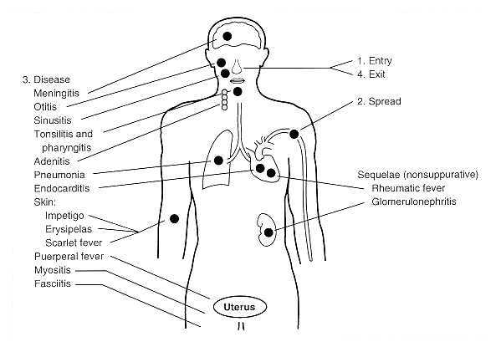
Summary of diseases caused by Streptococcus pyogenes

Slide 18
Effects
Acute sore throat;
  Tonsillitis
  Lymphodenitis
  Pharyngitis (strep throat)
Scarlet fever/ rash; caused by erythrogenic toxins which cause skin rash thus causing scarlet fever and later on toxic shock syndrome
Invasive, toxigenic infections can result in necrotizing fasciitis, myositis
Otitis media and mastoidis

Slide 19
Meningitis
Infections of the skin;
  Cellulitis- infection of the deep layers of the skin
  Impetigo- infection of the superficial layers of the skin
  Erysipelas
  Pyoderma
  Wound infections
Puerperal sepsis after childbirth due to infection of the uterus
Septicemia and sepsis after trauma, accidents, surgical wounds and burns
Acute bacterial endocarditis (ABE)
Post streptococcal sequelae; immunological mediated syndrome as a response to the Strep pyogenes. The diseases include;
  Cardiac muscle causing acute rheumatic fever (ARF)
  Kidney muscle causing acute glomerulonephritis (AGN); both are hypersensitivity reactions and appear 2-3 weeks after infection

Slide 20
Suppurative conditions
(Active infections associated with pus) occur in the throat, skin, and systemically.
Throat
Streptococcal pharyngitis is acquired by inhaling aerosols emitted by infected individuals. The symptoms reflect the inflammatory events at the site of infection. A few (1-3%) people develop rheumatic fever weeks after the infection has cleared.
Skin
Impetigo involves the infection of epidermal layers of skin. Pre-pubertal children are the most susceptible. Cellulitis occurs when the infection spreads subcutaneous tissues. Erysipelas is the infection of the dermis. About 5% of patients will develop more disseminated disease. Necrotizing fasciitis involves infection of the fascia and may proceed rapidly to underlying muscle.

Slide 21
Non-suppurative Sequelae .
Some of the antibodies produced during the above infections cross-react with certain host tissues. These can indirectly damage host tissues, even after the organisms have beencleared, and cause non suppurative complications.
Rheumatic fever. M protein cross reacts with sarcolemma. Antibodies cross-react with heart tissue, fix complement, and cause damage.
Glomerulonephritis. Antigen-antibody complexes may be deposited in kidney, fix complement, and damage glomeruli. Only a few M-types are nephritogenic.

Slide 22
Lab Diagnosis
Specimens
  Pus and swabs from infected sites e.g throat, sputum, blood for culture.
Microscopy
  Gram stain and observe for gram positive cocci in chains.
Culture
  Blood agar, 37⁰C in air for 18-24 hours
  Colonies are smooth circular 2-3 mm in diameter (S pneumoniae has pinpoint colonies with draughtsman appearance due to autolysis)
  Beta haemolytic on blood agar
  Gram stain- chains of cocci 8-16 cells( S pneumoniae lanceloate diplococci)

Slide 23
Biochemical tests
  Catalase testAre catalase-negative (cannot convert hydrogen peroxide (to water and oxygen) distinguishing them from staphylococci.
  Bacitracin sensitivity -differentiate between GAS(sensitive) and GBS(resistant)
  Aesculin-differentiate between GBS(No hydrolysis) and Enterococcus(Hydrolysis)
  CAMP factor production by GBS
  Sodium Hippurate hydrolysis-GBS and Gadnerella hydrolyse
  Optochin Test-Differentiate between alpha hemolytic streptococci, S pneumoniae(Susceptible) and S. Viridans(Resistant)
  Bile Lysis-Differentiate between S pneumoniae(Susceptible) and Viridans streptococci and E faecalis (Both are resistant)
  Pyrrolidonyaryl amidase (PYR) test-E faecalis hydrolyses PYR

Slide 24
Serological Diagnosis- Group A streps infection may give antibody titre rise with ASOT/anti DNase for ARF and AGN (post strep disease)
    ASOT test for GAS-(skin infx doesn't elicit ASO)-to det Rheumatogenic Spp (is raised in ARF)
    Anti DNAse test for GAS in AGN
  Quellung Test for S pnemoniae polysaccharide capsule
  Latex agglutination test- Serology

Slide 25
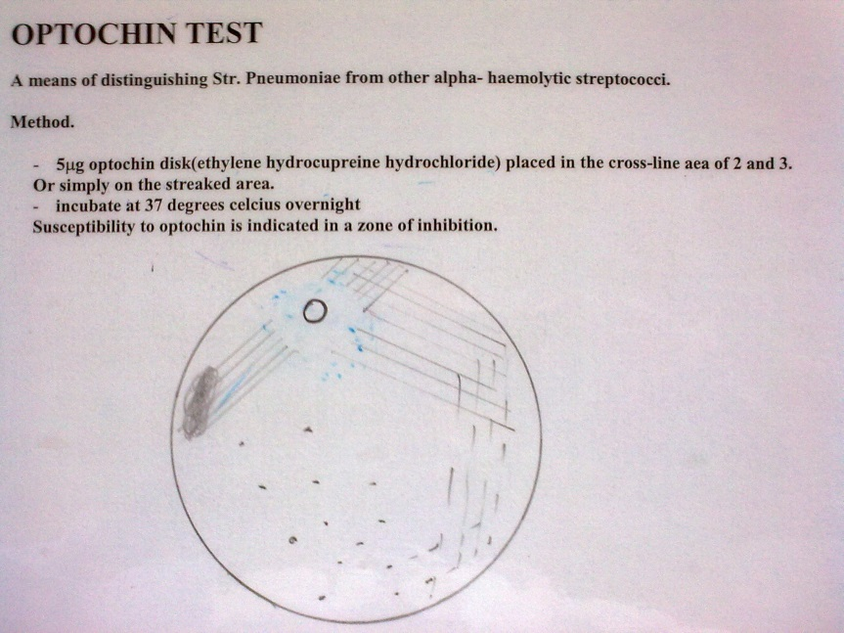
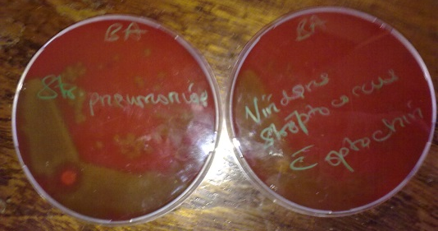

Slide 26
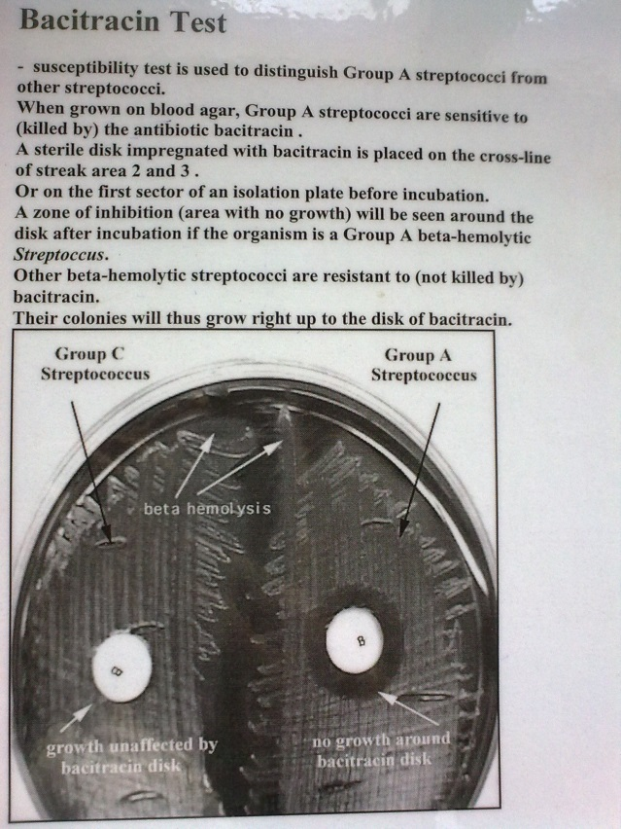

Slide 27
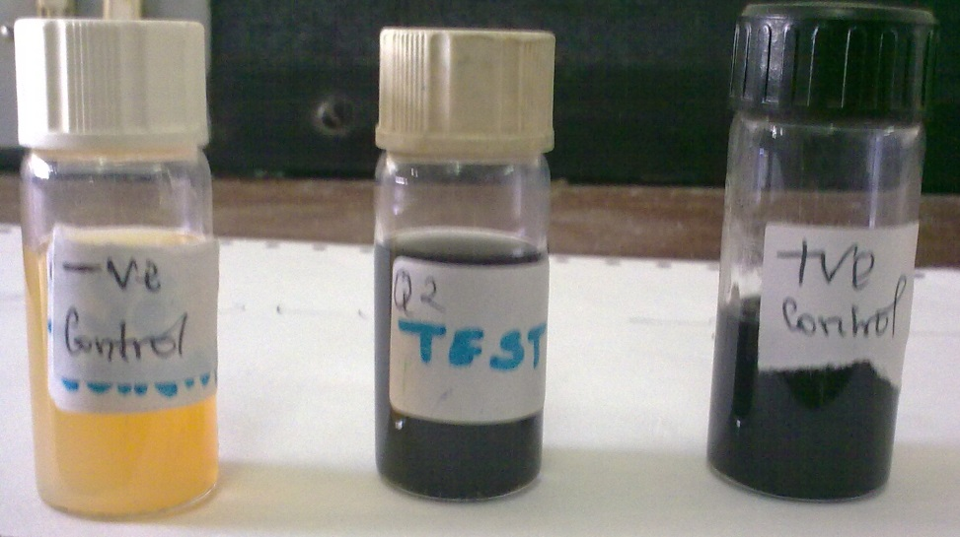
Esculin Test
Esculin Test- Positive for enterococcus species.
Provide a reliable means of identifying enterococci and to differentiate enterococci from non-enterococci.
Enteroccoi spp. Is able to hydrolyze esculin into glucose and esculin.
Esculin combines with ferric ion to produce a black complex.
Inoculation is done using the stab technique

Slide 28
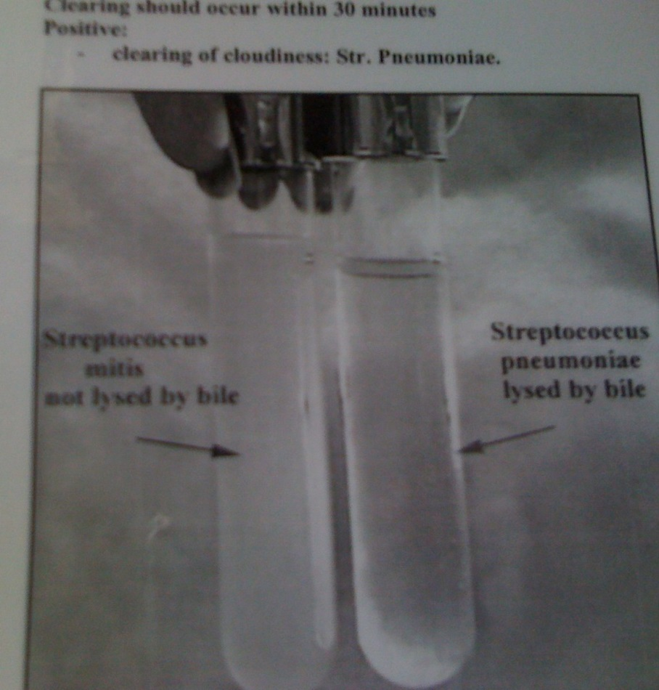
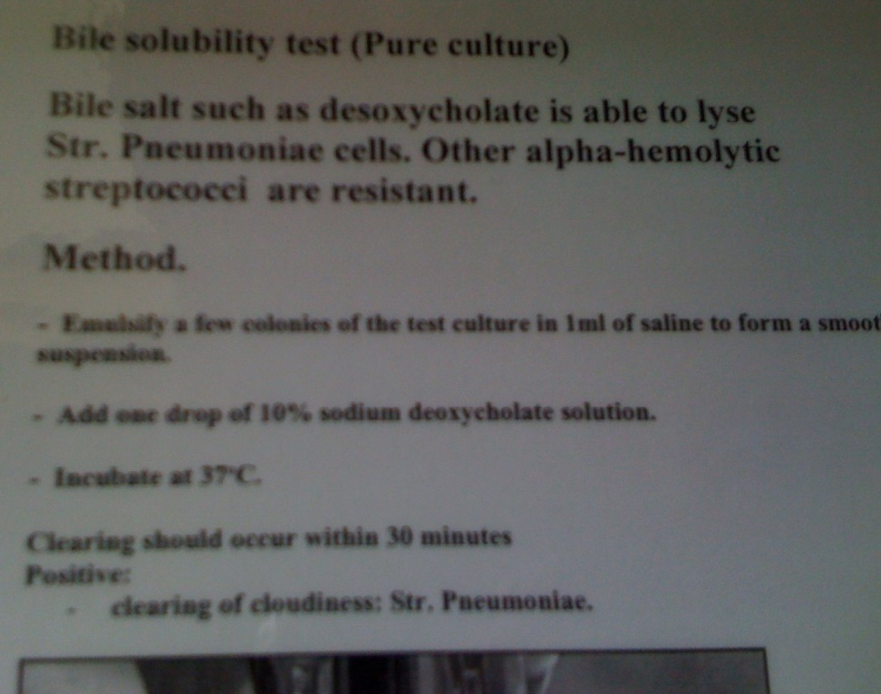
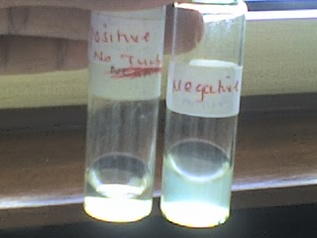
Bile solubility test
Positive for S.pneumoniae

Slide 29
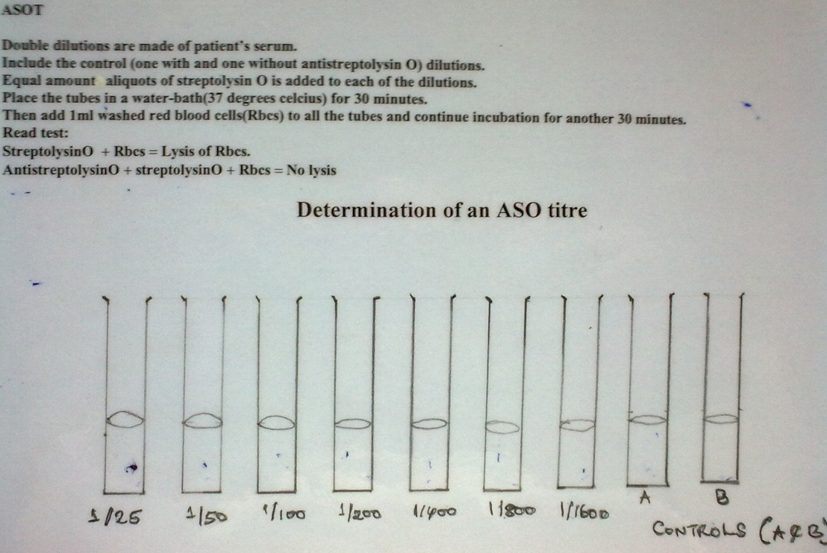

Slide 30
Bile Lysis Test
To differentiate between A-hemolytic strep
Sensitive | Resistant
S pneumoniae | Viridans streptococci

Slide 31
Treatment
Most species are resistant to amino-glycosides and tetracylines
Penicillin is the drug of choice but if the penicillin fails, then erythromycin is the next best option

Slide 32
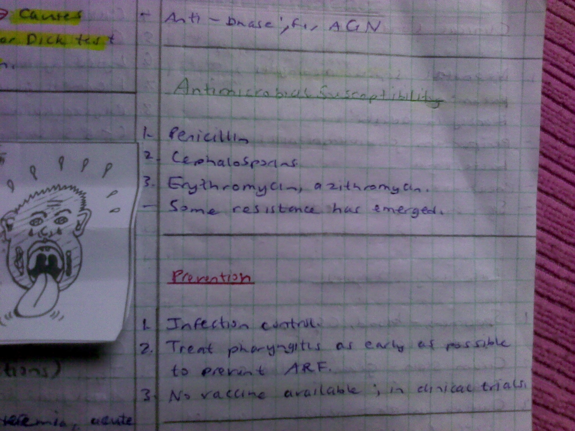

Slide 33
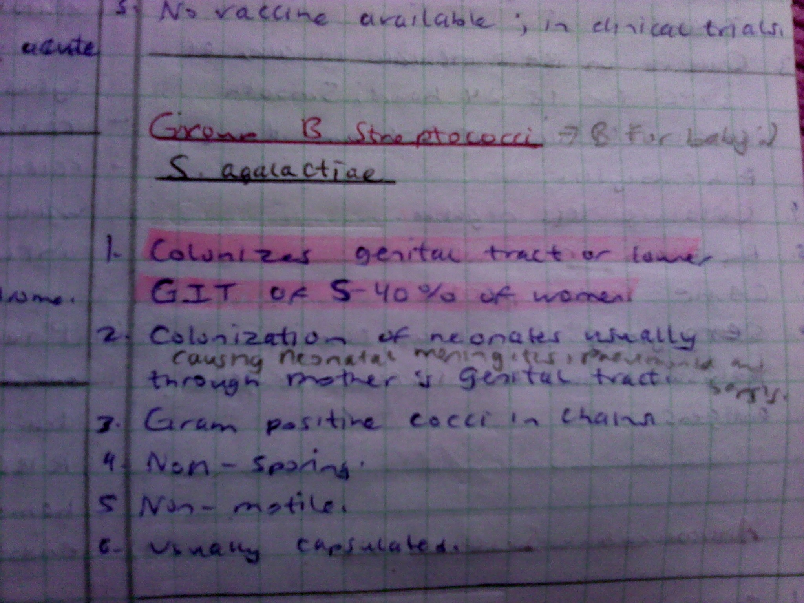

Slide 34
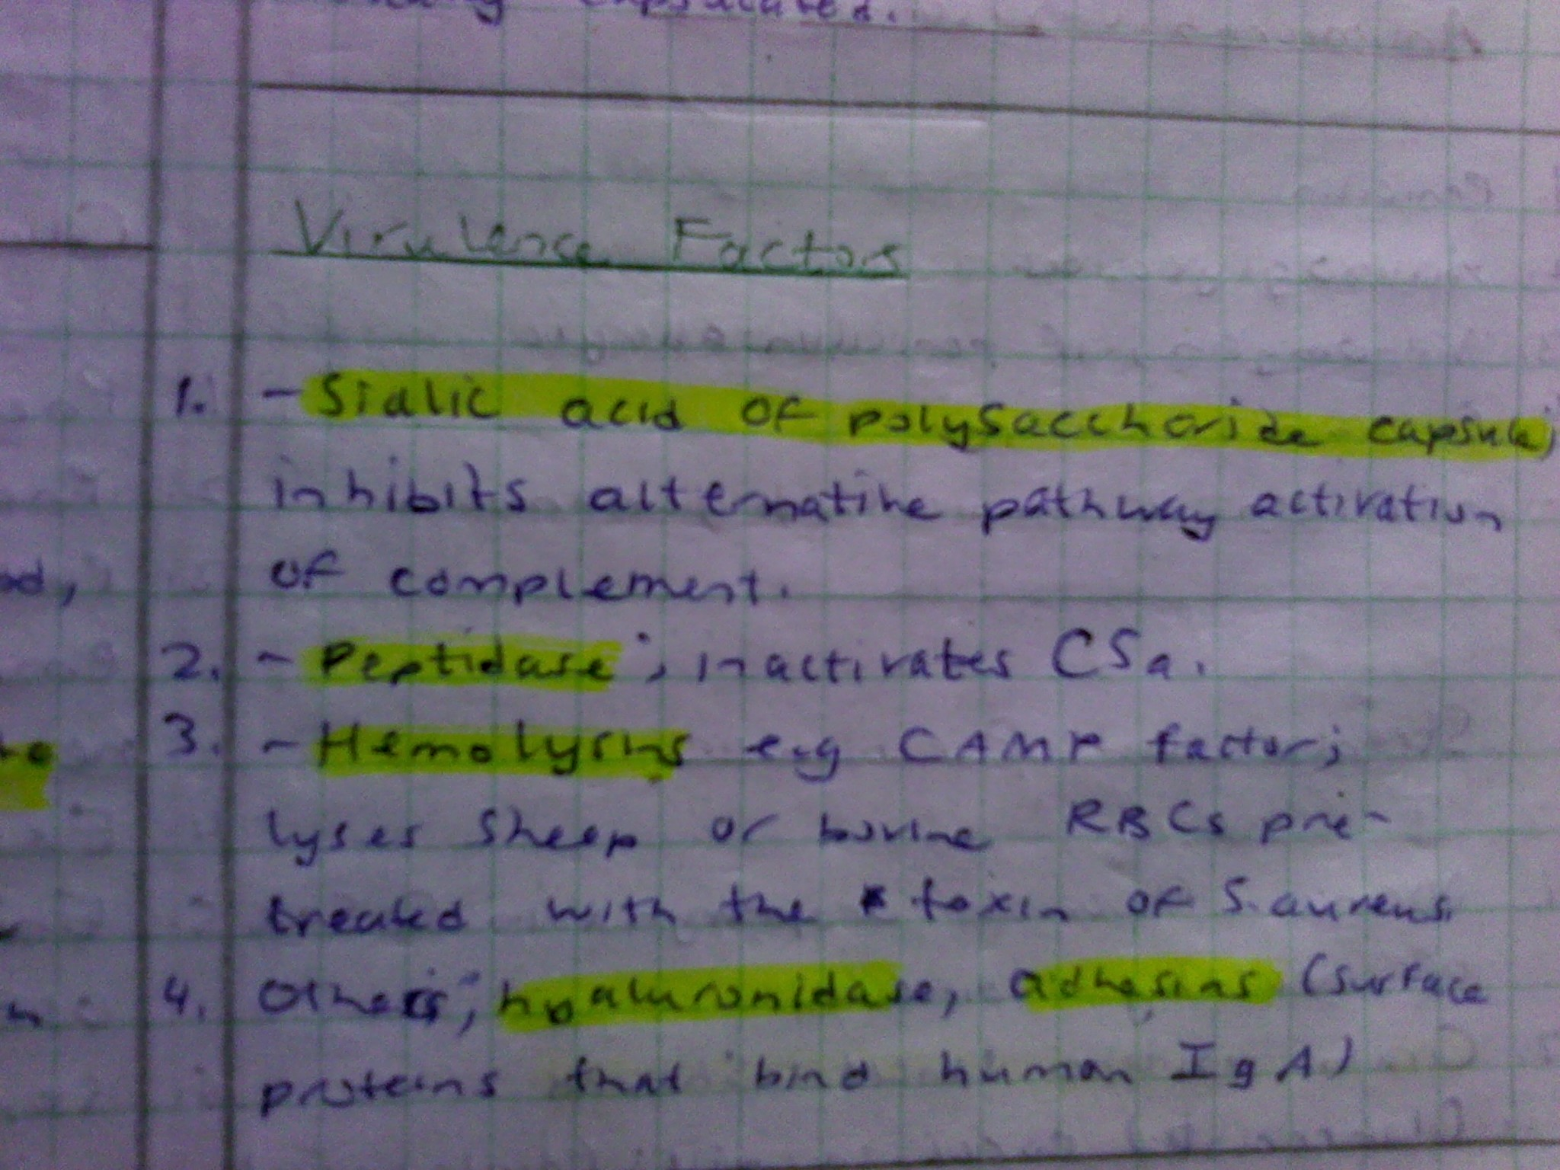

Slide 35
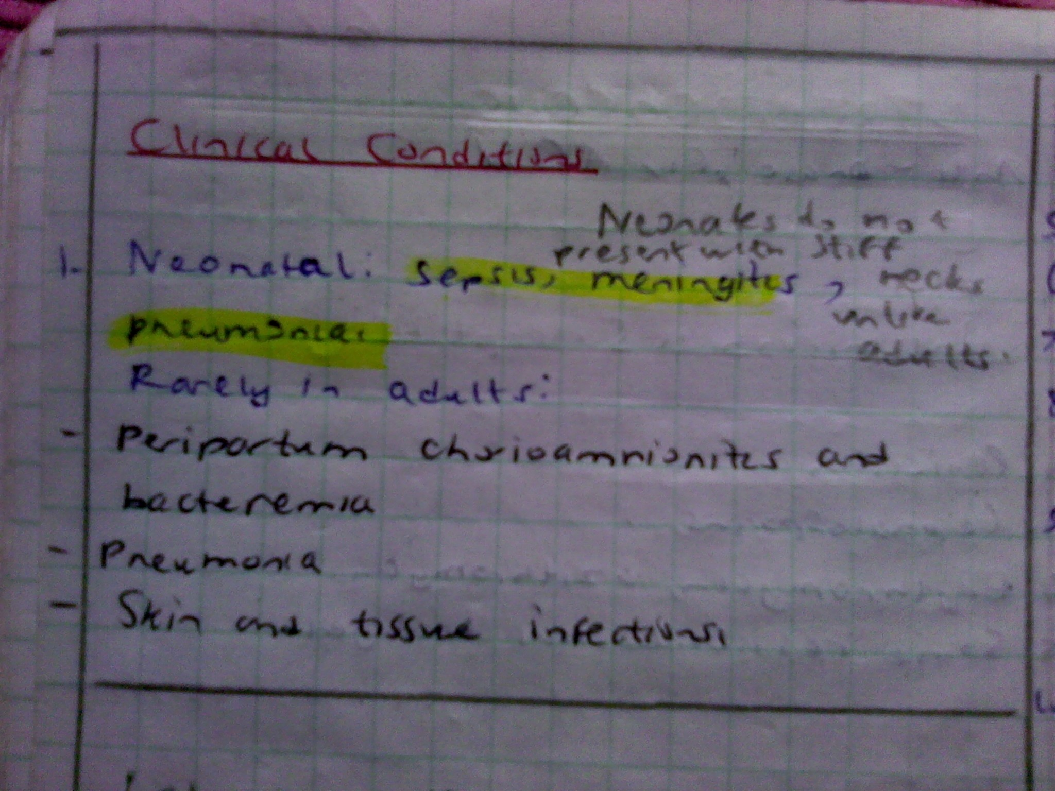

Slide 36
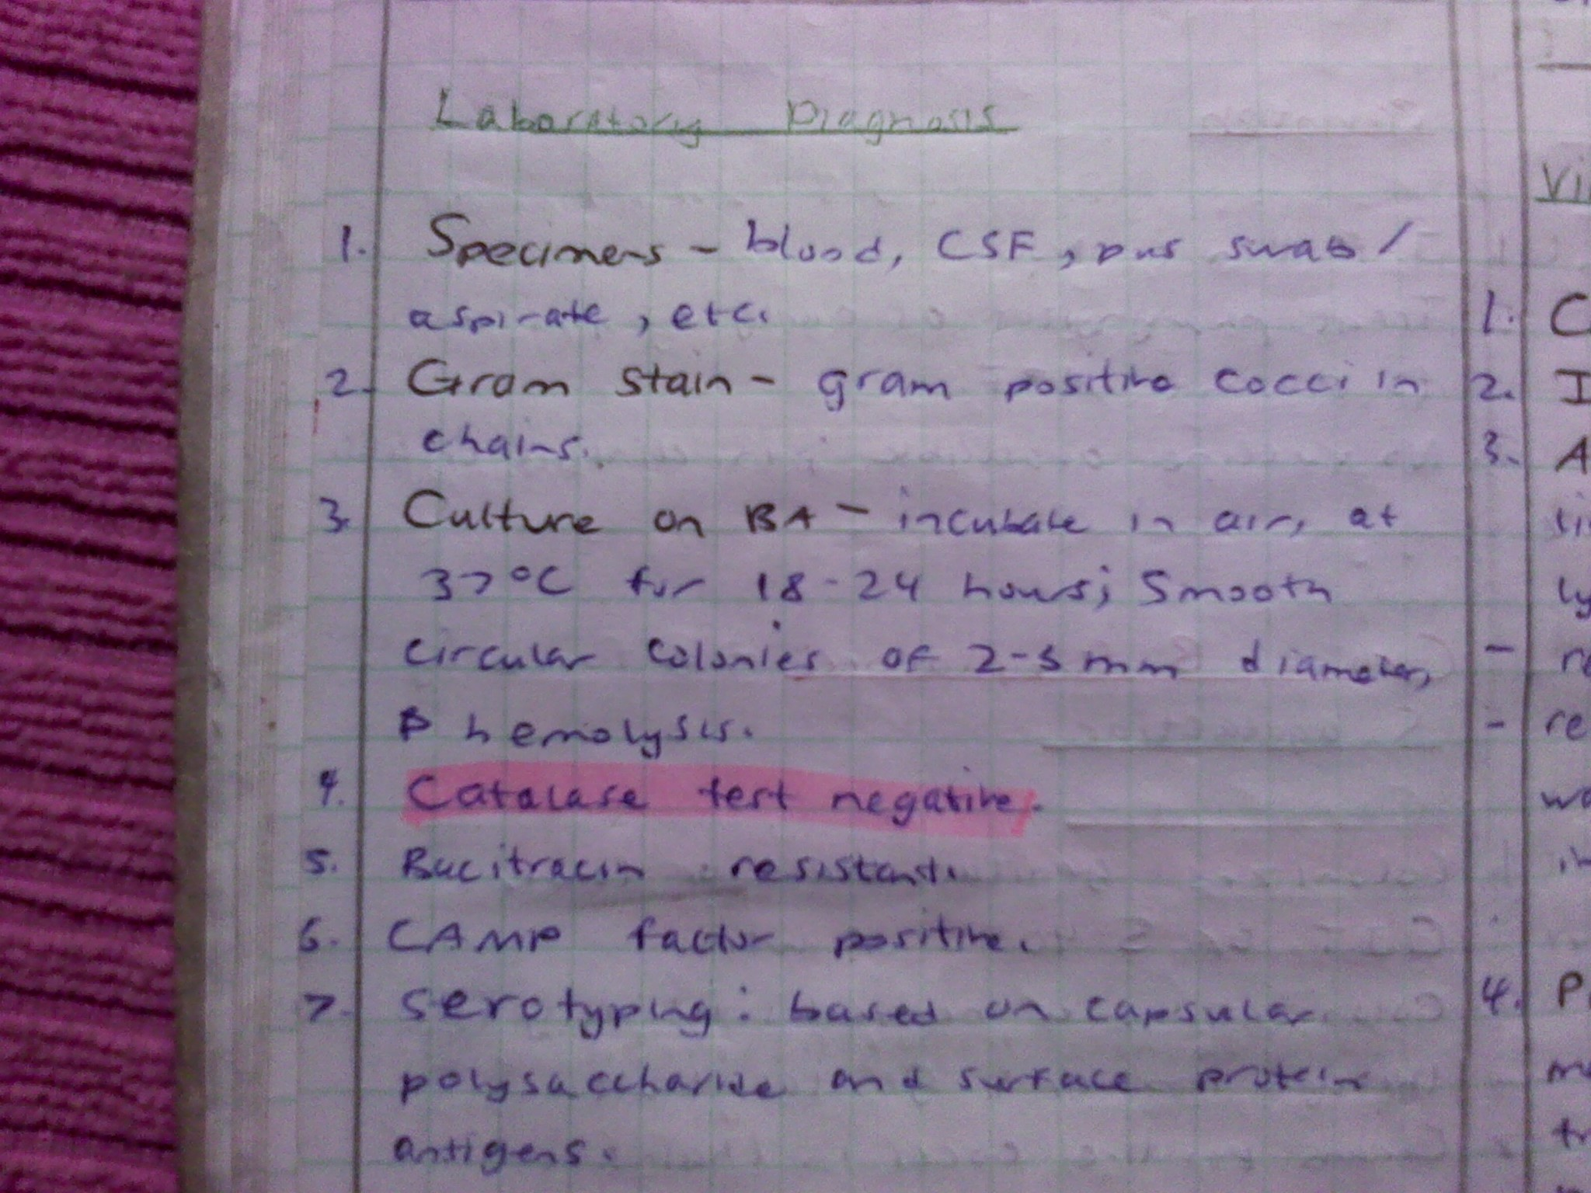

Slide 37
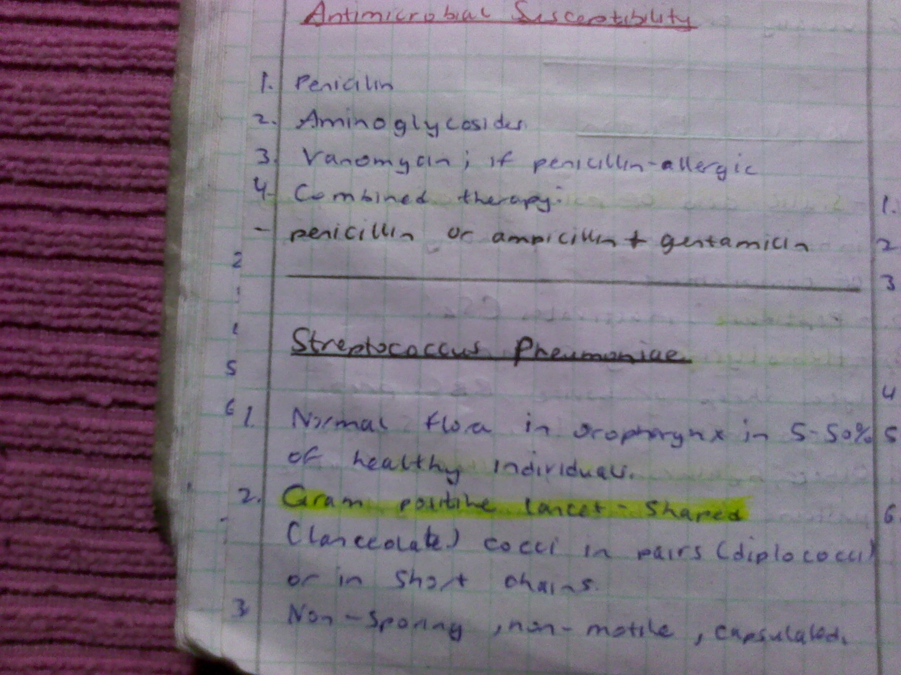

Slide 38
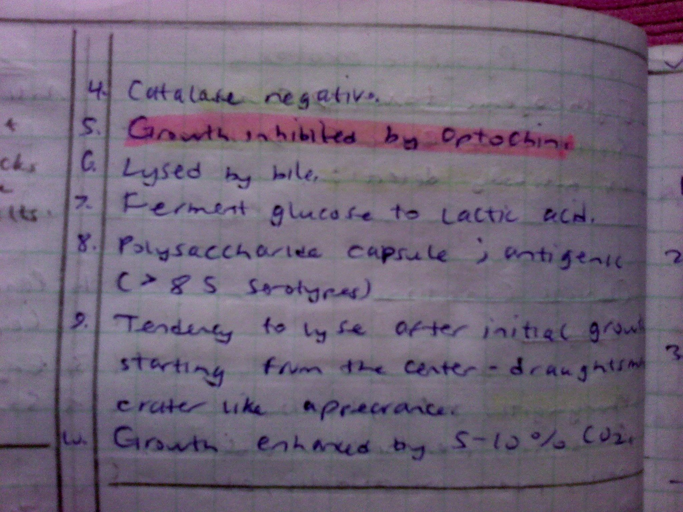

Slide 39
Streptococcus pneumoniae/ Pneumococcus.
Is a common pathogen of human respiratory tract but is also carried as normal flora in 5-30% in URT; (5-10% adult and 20-40% children)
Gram-positive, lancet-shaped cocci (elongated cocci with a slightly pointed outer curvature).
Usually they are seen as pairs of cocci (diplococci), but they may also occur singly and in short chains.
Nonmotile, non-spore forming spores
Like other streptococci, they lack catalase and ferment glucose to lactic acid.
Unlike other streptococci, they do not display an M protein, they hydrolyze inulin, and their cell wall composition is characteristic both in terms of their peptidoglycan and their teichoic acid).

Slide 40
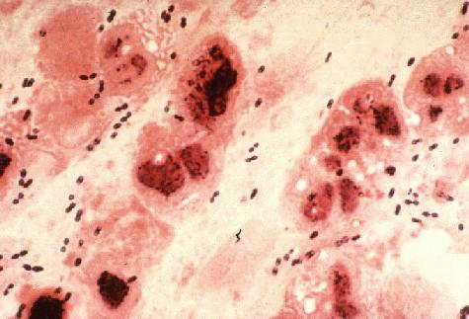
Gram Stain of a film of sputum from a case of lobar pneumonia

Slide 41
Cultivation
Streptococcus pneumoniae is fastidious bacterium, growing best in 5% carbon dioxide. Nearly 20% of fresh clinical isolates require fully anaerobic conditions. In all cases, growth requires a source of catalase (e.g. blood) to neutralize the large amount of hydrogen peroxide produced by the bacteria. In complex media containing blood, at 37°C, the bacterium has a doubling time of 20-30 minutes.
On agar, pneumococci grow as glistening colonies, about 1 mm in diameter.
Two serotypes, types 3 and 37, are mucoid. Pneumococci spontaneously undergo a genetically determined, phase variation from opaque to transparent colonies at a rate of 1 in 105 . The transparent colony type is adapted to colonization of the nasopharynx, whereas the opaque variant is suited for survival in blood.

Slide 42
Streptococcus pneumoniae is a fermentative aerotolerant anaerobe.
It is usually cultured in media that contain blood.
On blood agar, colonies characteristically produce a zone of alpha (green) hemolysis, which differentiates S. pneumoniae from the group A (beta hemolytic) streptococcus, but not from commensal alpha hemolytic (viridans) streptococci which are co-inhabitants of the upper respiratory tract.
Special tests such as inulin fermentation, bile solubility, and optochin (an antibiotic) sensitivity must be routinely employed to differentiate the pneumococcus from Streptococcus viridans.

Slide 43
Identification
The minimum criteria for identification and distinction of pneumococci from other streptococci are bile or optochin sensitivity, Gram-positive staining, and hemolytic activity.
Pneumococci cause alpha hemolysis on agar containing horse, human, rabbit and sheep erythrocytes. Under anaerobic conditions they switch to beta hemolysis caused by an oxygen-labile hemolysin.
Typically, pneumococci form a 16-mm zone of inhibition around a 5 mg optochin disc, and undergo lysis by bile salts (e.g. deoxycholate).
Addition of a few drops of 10% deoxycholate at 37°C lyses the entire culture in minutes. The ability of deoxycholate to dissolve the cell wall, depends upon the presence of an autolytic enzyme, LytA. Virtually all clinical isolates of pneumococci harbor the autolysin and undergo deoxycholate lysis.
Microscopy -Lanceolate diplococci in pathological materials surrounded by a capsule (carbohydrate polysaccharide)

Slide 44
Culture
Growth is enhanced by addition of carbon dioxide by 5-10% by lighting a candle in a jar (blood culture positive)
Colonies vary from 1-2mm and show greenish/alpha haemolysis and are flat domed (draughtsman)

Slide 45
The laboratory observations are confirmed by;
  Optochin test; detects sensitive zone
  Bile salt solubility tests for sensitivity
  Quelling (swelling or organisms) reaction; 84 serotypes based on polysaccharide capsule antigens but only 23 serotypes are common

Slide 46
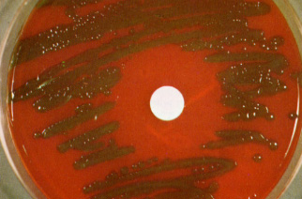
Streptococcus pneumoniae A mucoid strain on blood agar showing alpha hemolysis (green zone surrounding colonies). Note the zone of inhibition around a filter paper disc impregnated with optochin. Viridans streptococci are not inhibited by optochin.

Slide 47
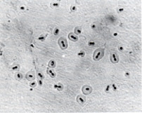
Serotyping
The quellung reaction (swelling reaction) forms the basis of serotyping and relies on the swelling of the capsule upon binding of homologous antibody The test consists of mixing a loopful of colony with equal quantity of specific antiserum and then examining microscopically at 1000X for capsular swelling.
Streptococcus pneumoniae Quellung (capsular swelling) reaction can be used to demonstrate the presence of a specific capsular type of the bacterium.

Slide 48
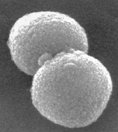
Cell Surface Structure
Streptococcus pneumoniaescanning electron micrograph of a pair of diplococci

Slide 49
Capsule
A capsule composed of polysaccharide completely envelops the pneumococcal cells. During invasion the capsule is an essential determinant of virulence.
The capsule interferes with phagocytosis by preventing C3b opsonization of the bacterial cells. 90 different capsule types of pneumococci have been identified and form the basis of antigenic serotyping of the organism.
Anti-pneumococcal vaccines are based on formulations of various capsular (polysaccharide) antigens derived from the highly-prevalent strains.

Slide 50
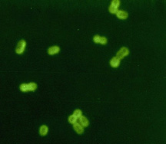
Streptococcus pneumoniae Fluorescent antibody stain of capsular material

Slide 51
Cell Wall
The cell wall of S. pneumoniae is roughly six layers thick and is composed of peptidoglycan with teichoic acid attached to approximately every third N-acetylmuramic acid.
Lipoteichoic acid is chemically identical to the teichoic acid but is attached to the cell membrane by a lipid moiety. Both the teichoic acid and the lipoteichoic acid contain phosphorylcholine; two choline residues may be covalently added to each carbohydrate repeat.
This is an essential element in the biology of S. pneumoniae since the choline specifically adheres to choline-binding receptors that are located on virtually all human cells.

Slide 52
Surface Proteins
On the basis of functional genomic analysis, it is estimated that the pneumococcus contains more than 500 surface proteins.
Some are membrane-associated lipoproteins, and others are physically associated with the cell wall. The latter includes five penicillin binding proteins (PBPs), two neuraminidases, and an IgA protease. A unique group of proteins on the pneumococcal surface is the family of choline-binding proteins (CBPs).
Twelve CBPs are noncovalently bound to the choline moiety of the cell wall and are used to "snap" various different functional elements onto the bacterial surface. The CBPs all share a common C-terminal choline-binding domain while the N-termini of the CBPs are distinct, indicating their functions are different.
The CBP family includes such important determinants of virulence such as PspA (protective antigen), LytA, B, and C (three autolysins), and CbpA (an adhesin).

Slide 53
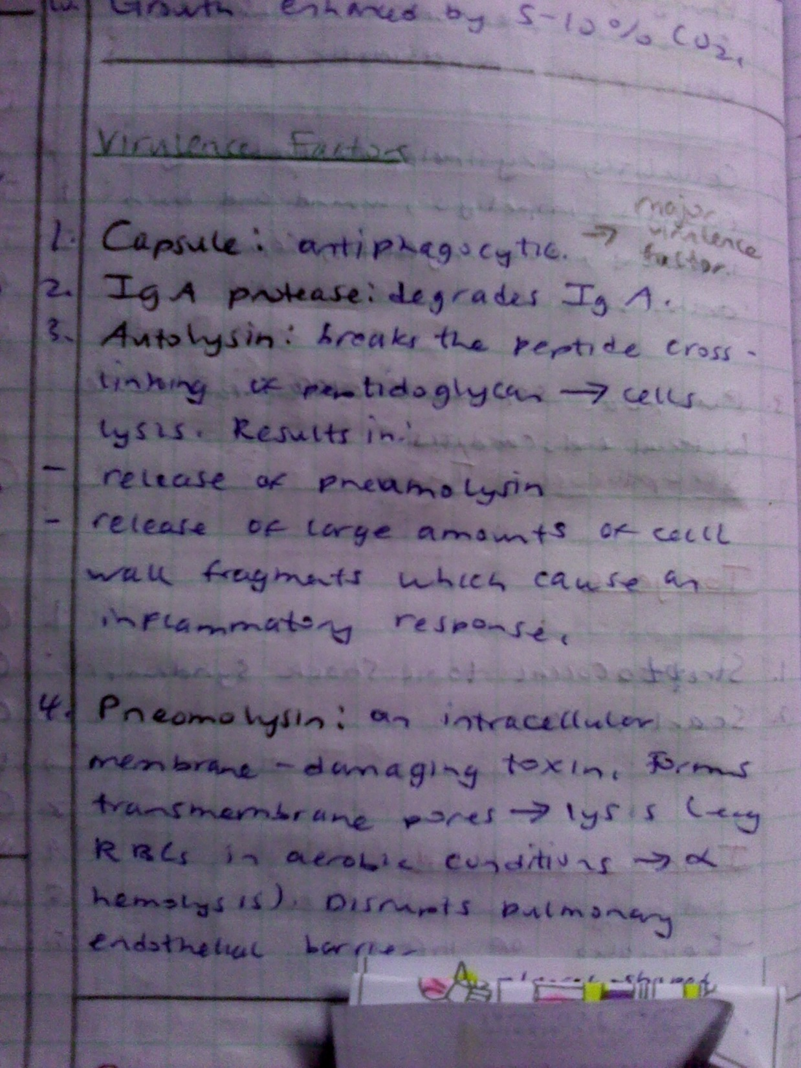

Slide 54
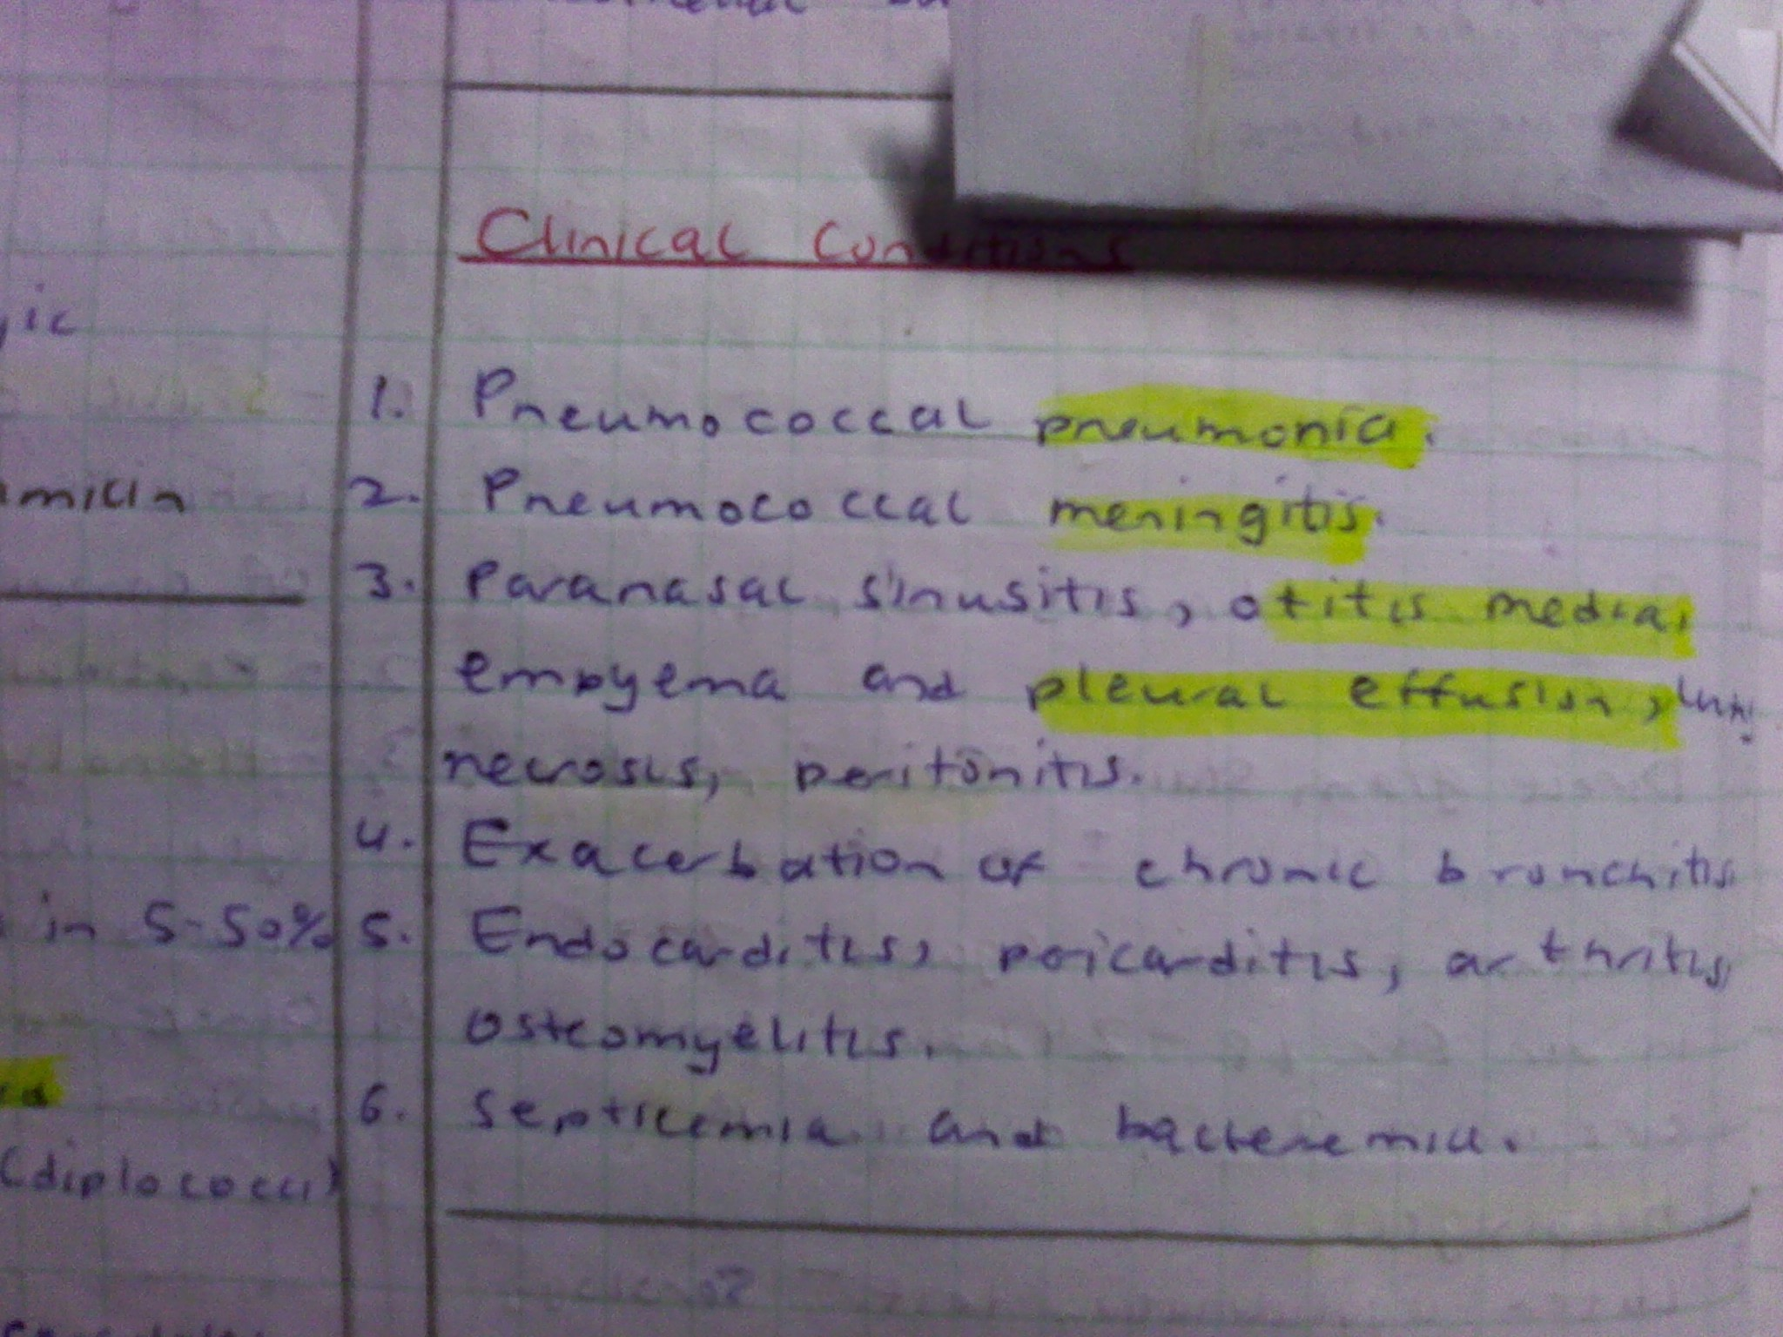

Slide 55
Causes
Lobar pneumonia and bronchopneumonia
Chronic bronchitis
Sinusitis
Otitis media
Meningitis of all ages
Peritonitis
Empyema and pleural effusion
Septicaemia and bacterimia
Arthritis
Endocarditis

Slide 56
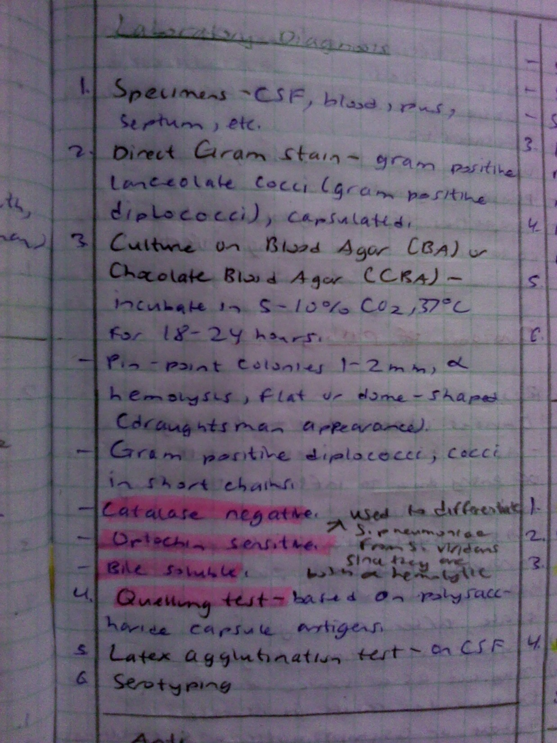

Slide 57
Treatment
Large doses of penicillin G but resistance has emerged in 20% of cases in Kenyatta National Hospital.
Other countries that have shown penicillin resistance include Australia, Canada, USA, Britain and South Africa with cases in Kenya being reported in 1980

Slide 58
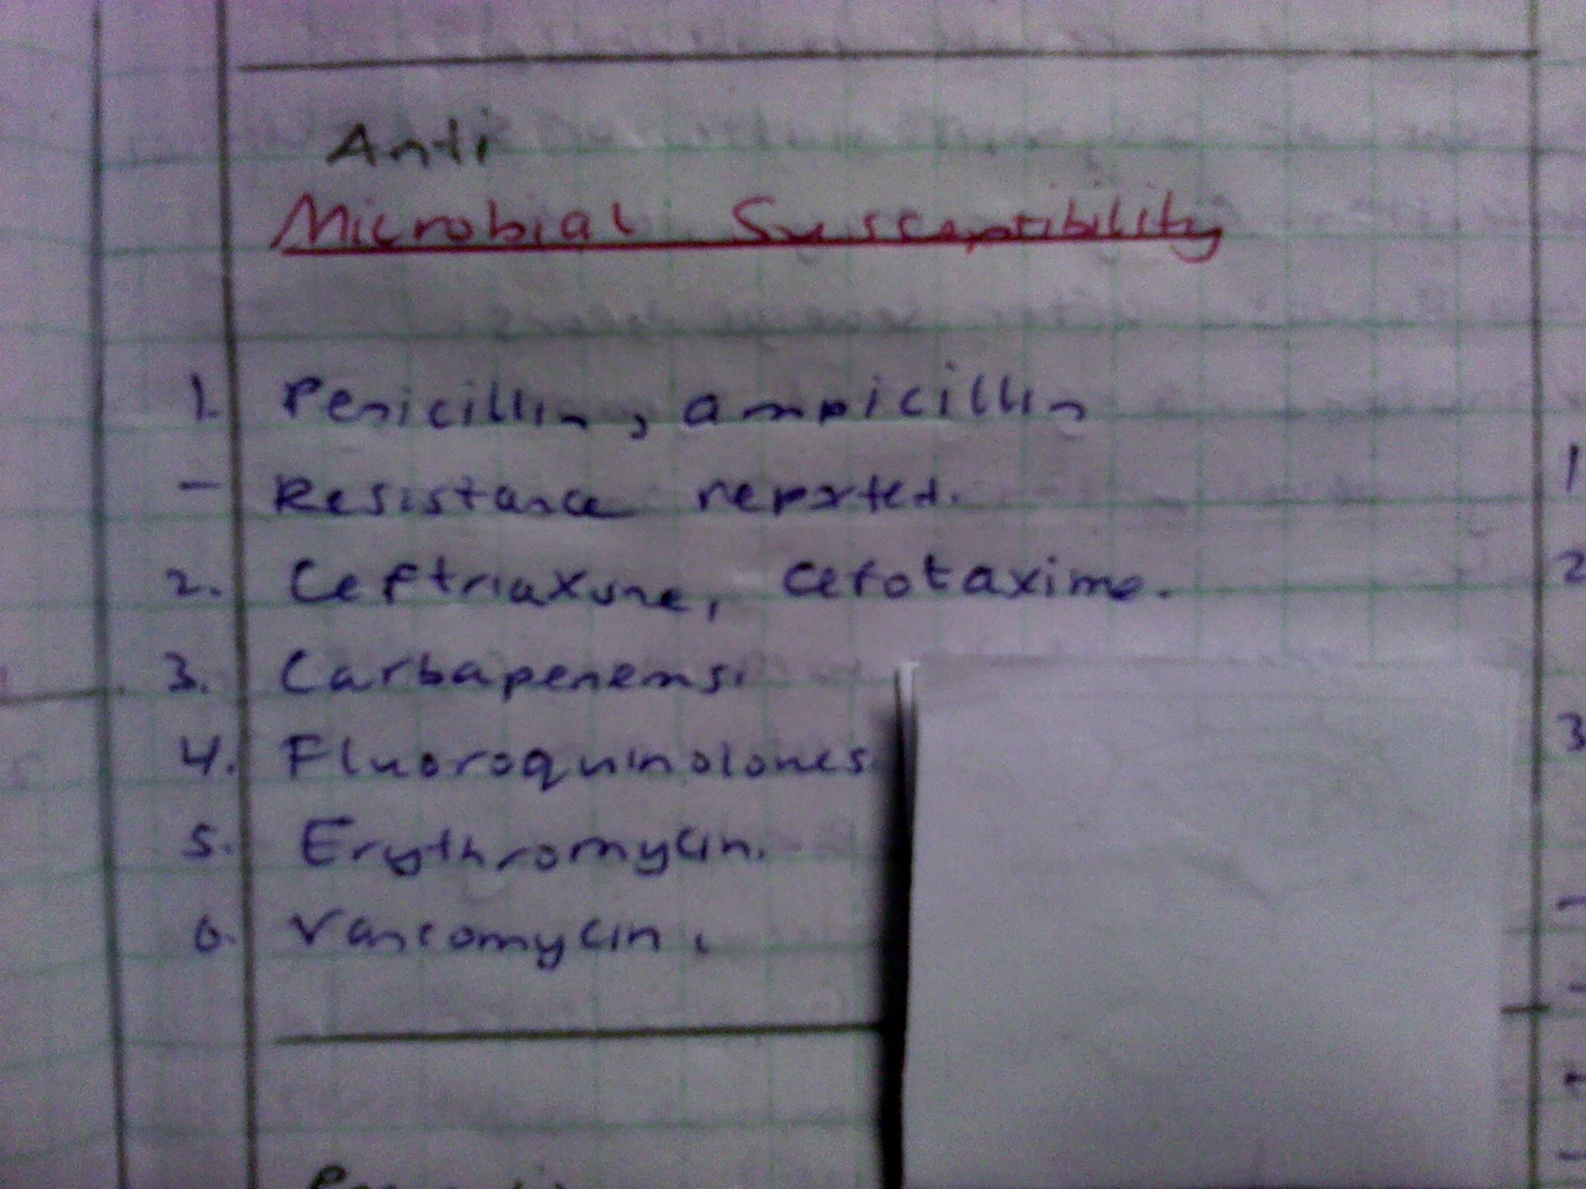

Slide 59
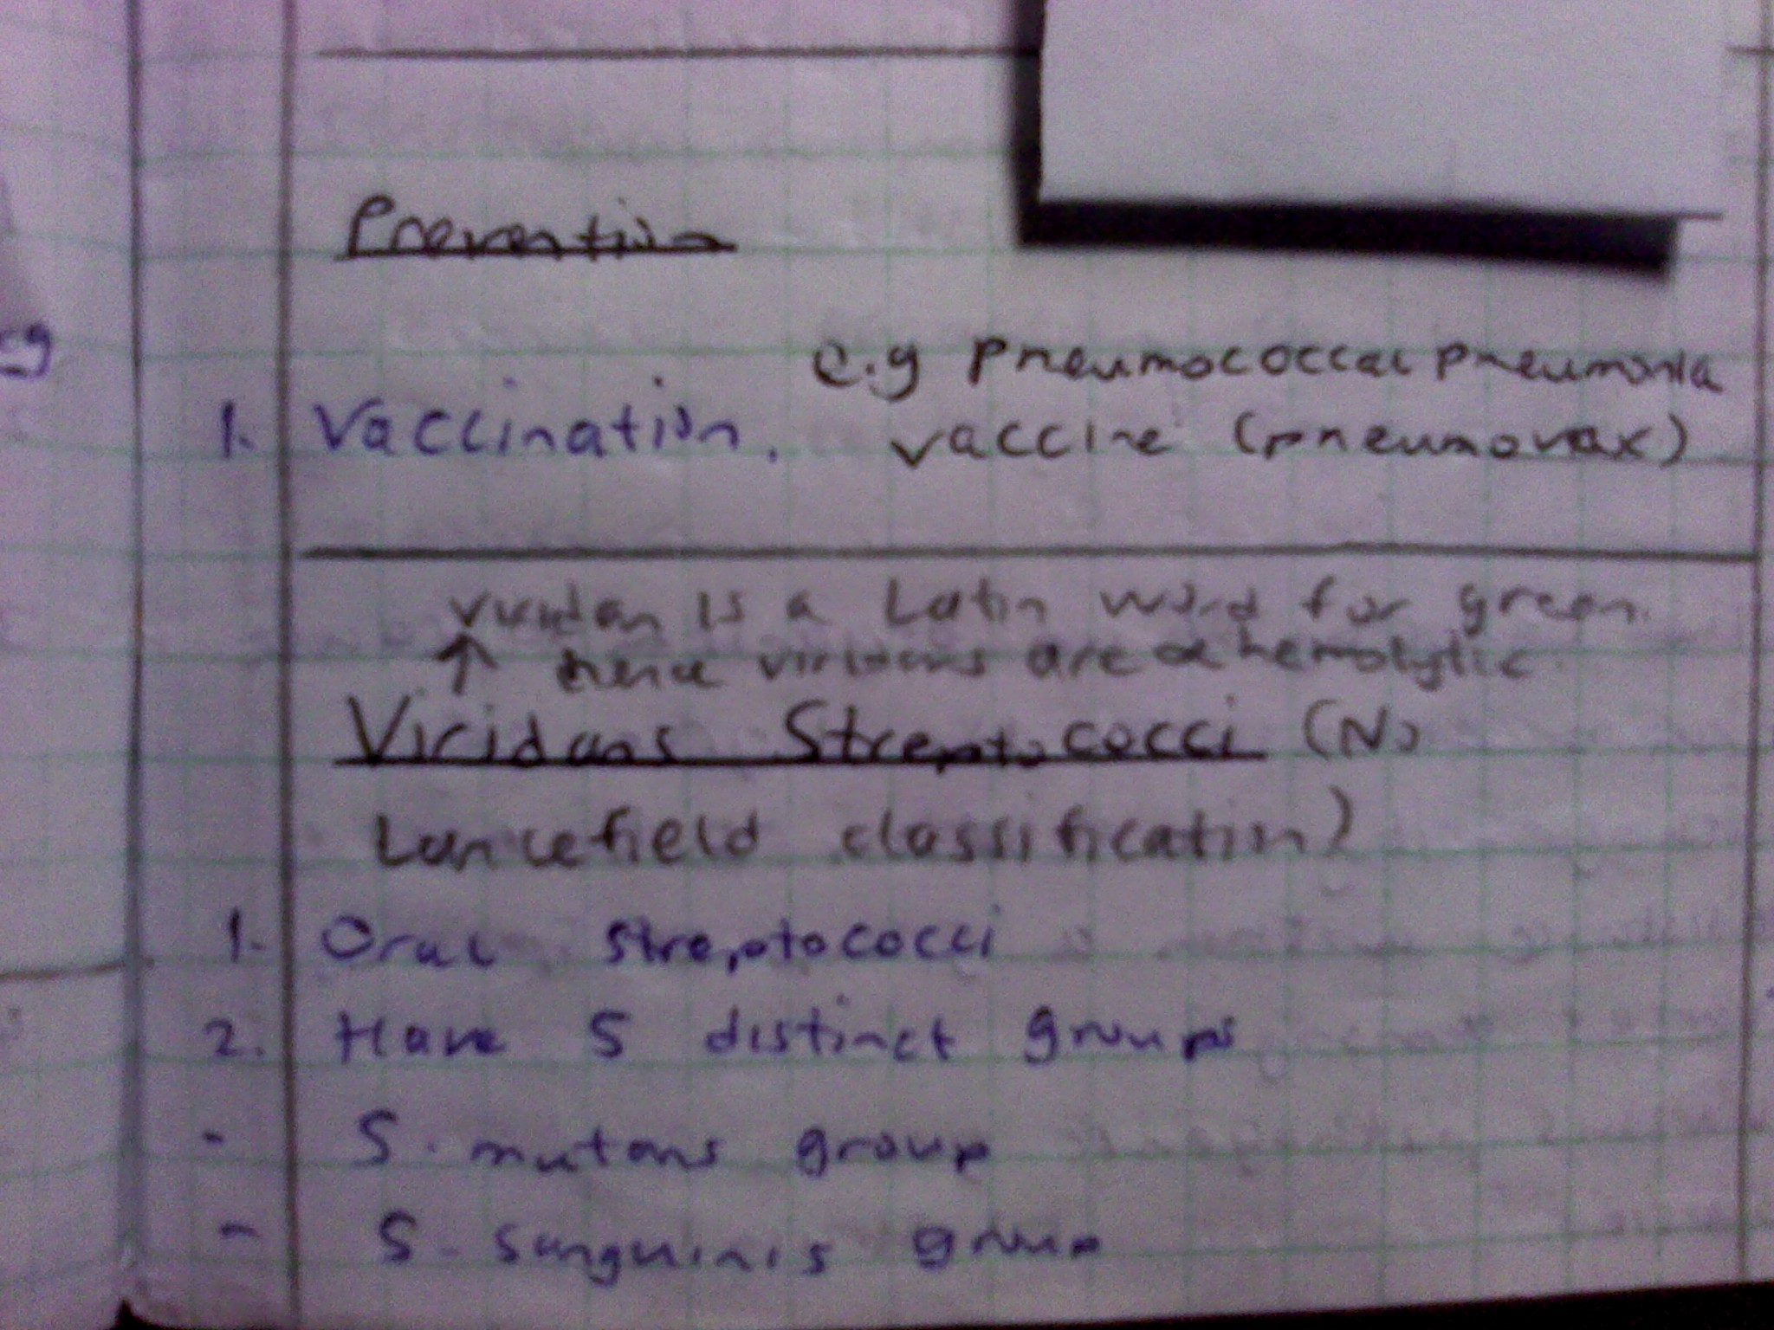

Slide 60
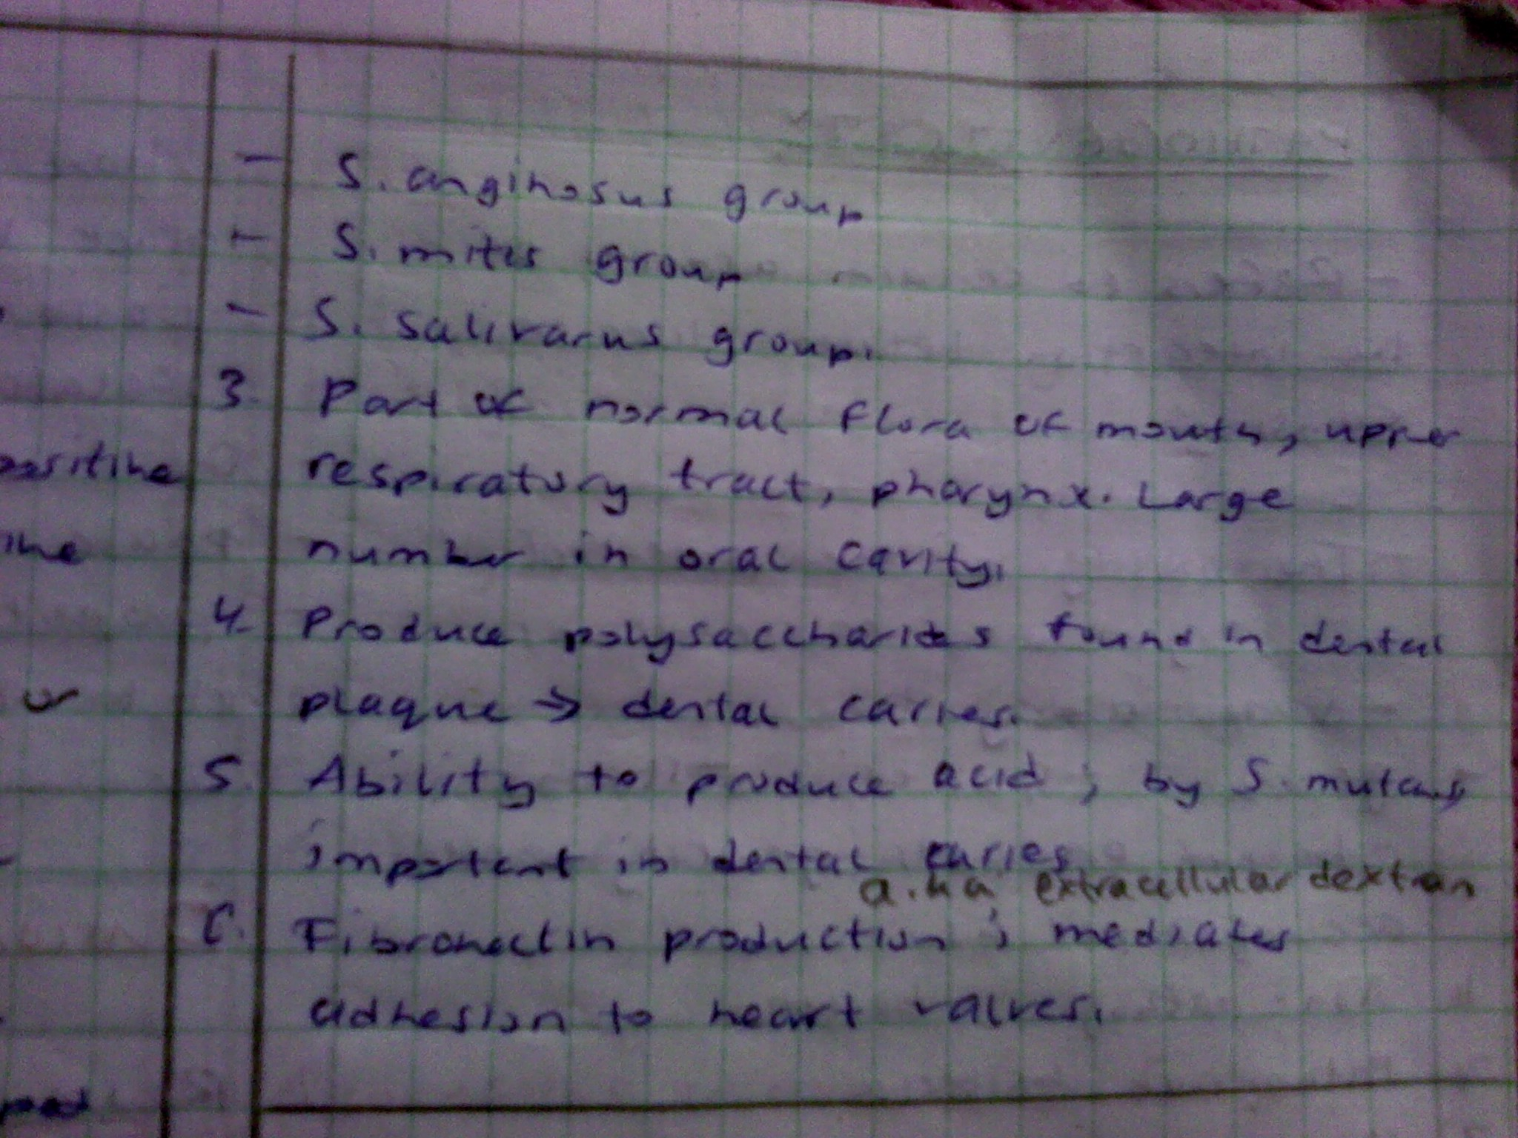

Slide 61
Strep viridans group (10 species)
Are pathogens to humans
Are all non-typable by Lancefield
All show alpha (greenish) haemolysis
Are found in the normal flora of the mouth, URT (upper respiratory tract), pharynx
They are chain forming streps and are catalase negative

Slide 62
Causes
Dental carries in oral cavity pathology (S.mutans and others)
50-80% of subacute bacterial endocarditis (SBE) also called ‘Infective Endocarditis)
Fever disease (RHF, RHD) in patients with rheumatic heart lesions where they settle on damaged valves (vegetations)

Slide 63
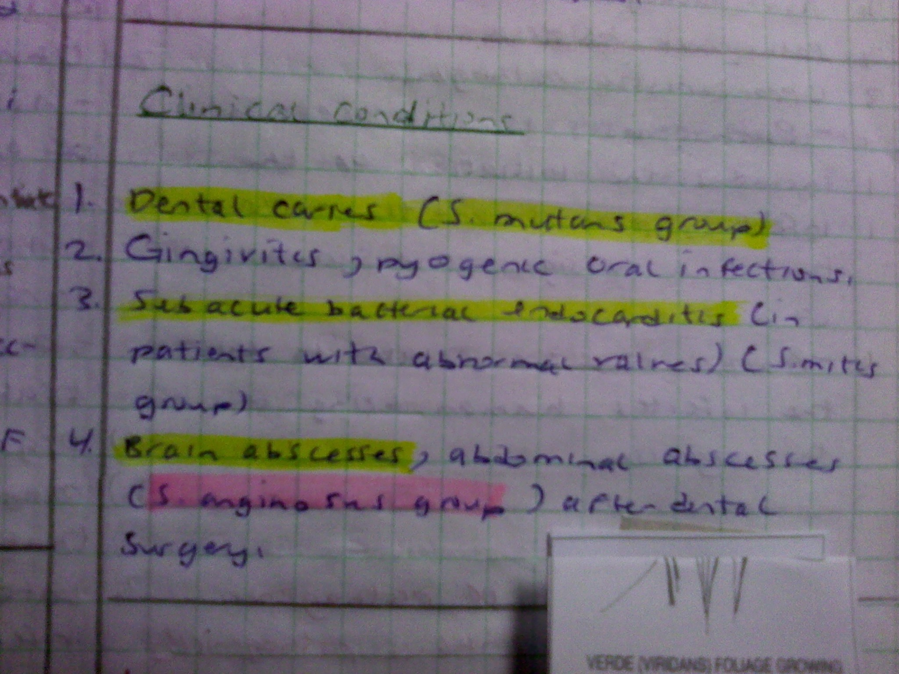

Slide 64
Culture
As in Strep pyogenes on blood agar, it shows alpha haemolysis but are optothin resistant (not inhibited)
Microscopy
Show long chains in clinical culture material and are gram positive cocci
Treatment
Penicillin prophylactically during dental operation to reduce risk to patients from getting SBE

Slide 65
Diagnosis
In SBE, requires persisten blood culture (3-6 specimens) and treatment of SBe requires combination of drugs and laboratory monitoring of efficacy
Reaction combination between 4-6 weeks is also important e.g. Penicillin and Streptomycin or Ampicillin and Gentamycin

Slide 66
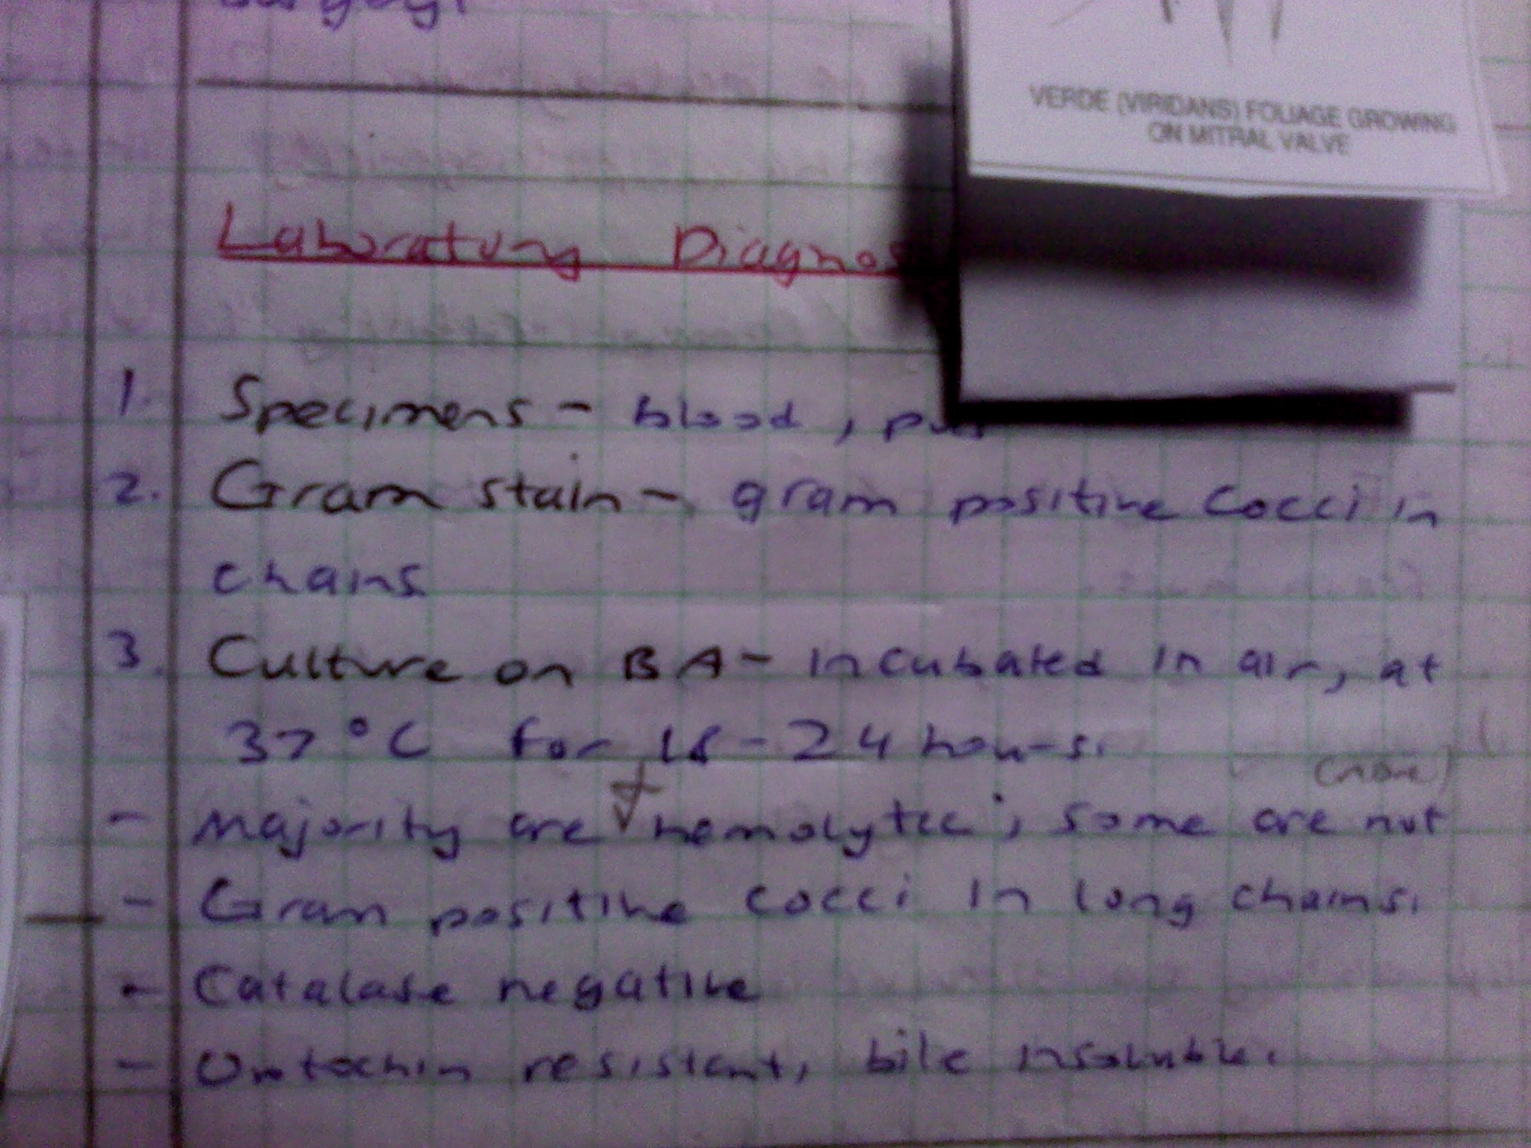

Slide 67
