Slide 1
STRONGYLOIDES STERCORALIS
(dwarf threadworm)
KIMAIGA H.O
MBChB (University of Nairobi)

Slide 2
STRONGYLOIDIASIS
Causative agent is The nematode (roundworm) Strongyloides stercoralis (dwarf threadworm)
Other Strongyloides include S. fülleborni, which infects chimpanzees and baboons and may produce limited infections in humans.

Slide 3
GEOGRAPHICAL DISTRIBUTION
World wide (hot,humid areas clay soils)
Hot humid tropical areas and subtropical areas, but cases also occur in temperate areas (including the South of the United States).
East africa
Kenya: Coast,Nyanza,Eastern all slums
School going children,under fives,nursery pregnant women,malnourished groups,elderly.
More frequently found in rural areas, institutional settings, and lower socioeconomic groups.

Slide 4
Structure/morpholgy
Free-living (males & females – dioecious)
Adult male/females (females 2.5mm * 50µm) burried and thrives in mucosal glands of the S. intestines. It is an intestinal nematode & can also be free living.
Females are ovoviviparous. (producing living young from eggs that hatch within the parasite) Parthogenetic-produce without mating.Females may lay ova(have 2 embryonate in soil) or larvae
Eggs not seen in environment.
In intestines, it can moult from rhabditiform larvae to filarial larvae to penetrate Bvs leading to migration to heart & lungs ⬄ autoinfection.
Autoinfection is possible, can gain access to venous system and migrate to heart & lung and cause similar problems to hookworms.
May also fail to migrate and get arrested in the submucosa of S.intestines from granulomous after they die, and cause severe diarrhoea in immunosuppressed victims.
NB: difference btn hookworm & strongyloides is Autoinfection & free-living. Strongyloides in rhabditiform larvae are notched at the tail end, the hookworms are not.

Slide 5
Structure/morpholgy
Rhabditoid first-stage (L1) larvae
The first-stage rhabditoid larvae (L1) of Strongyloides stercoralis are 180-380 µm long, with a short buccal canal, a rhabditoid esophagus and a prominent genital primordium. These L1 larvae are usually found in stool, as the eggs embryonate and hatch in the mucosa of the small intestine of the host. They may also be found in soil and cultured feces.

Slide 7
Filariform (L3) larvae
Infective, third-stage filariform larvae (L3) of Strongyloides stercoralis are up to 600 µm long.
The tail have a notch and the esophagus to intestine ratio is 1:1.
Infective L3 larvae are found in soil and invade the human host by direct penetration of the skin. They may be found in respiratory specimens during cases of autoinfection.

Slide 13
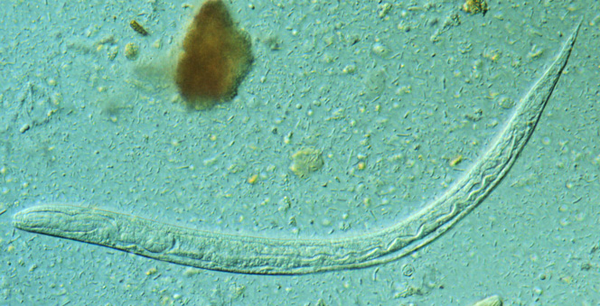
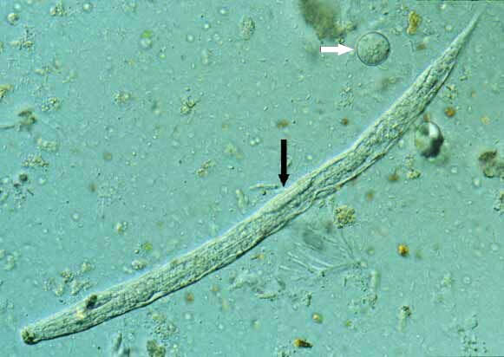
S. Stercoralis
(L1 larvae)

Slide 14
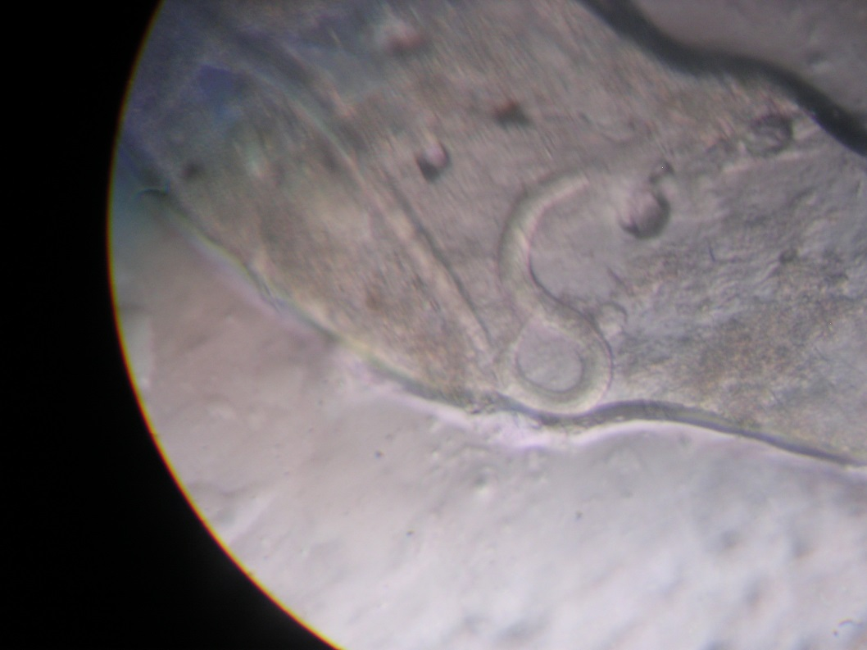
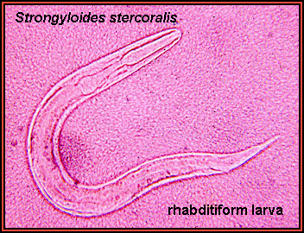
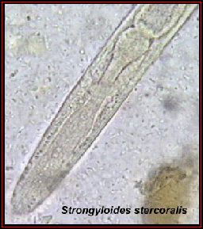
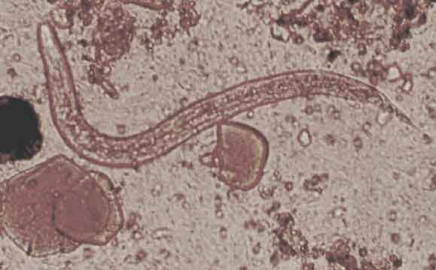

Slide 15
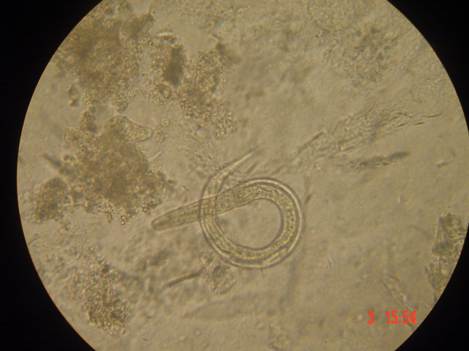
Strongyloides stercoralis - larva

Slide 16
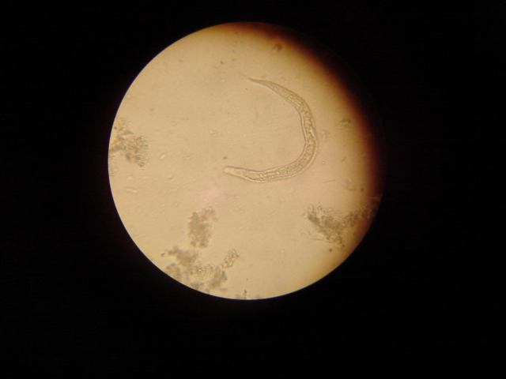
Strongyloides stercoralis (female is partogenetic & ovoviviparous) - larva

Slide 17
LIFE CYCLE
The Strongyloides life cycle is more complex than most nematodes with its alternation between free-living and parasitic cycles, and its potential for autoinfection and multiplication within the host.
Two types of cycles exist:
Free-living cycle:
Adult stay on mucosa membrane of small intestine (jejunum, duodenum) lay eggs in strings on mucosa from which rhabditiform larvae L1 emerges and is passed in the stool
Can either molt twice and become infective filariform larvae (direct development)
Or molt four times and become free living adult males and females that mate and produce eggs from which rhabditiform larvae hatch and can either develop into a new generation of free-living adults or into infective filariform larvae
The filariform larvae penetrate the human skin to initiate the parasitic cycle

Slide 18
Parasitic cycle/direct lifecycle or homogonic development:
Filariform larvae in contaminated soil penetrate the human skin
They are transported to the lungs where they penetrate the alveolar spaces
They are carried through the bronchial tree to the pharynx, are swallowed and then reach the small intestine.
In the small intestine they molt twice and become adult female worms
The females live threaded in the epithelium of the small intestine and by parthenogenesis produce eggs , which yield rhabditiform larvae.

Slide 19
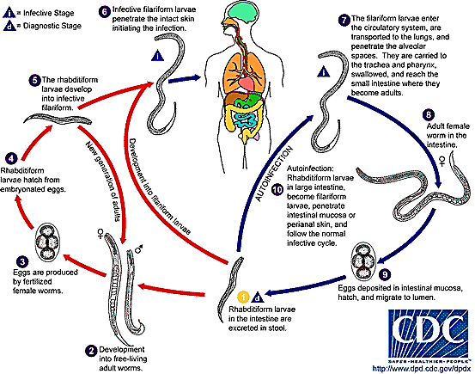

Slide 20
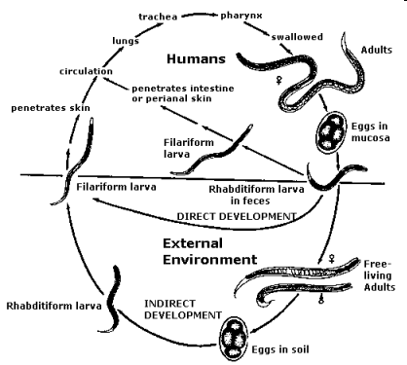

Slide 21
The rhabditiform larvae can either be passed in the stool or can cause autoinfection
Hyperinfection/autoinfection -The rhabditiform larvae become infective filariform larvae, which can penetrate either the intestinal mucosa (internal autoinfection) or the skin of perianal area (external autoinfection); in either case, the filariform larvae L3, penetrates the mucosal wall to undergo heart-lung-alveoli-trachea-pharynx-mouth cavity then small intestine where it matures and disseminate widely in the body.
Autoinfection cases in humans with helminthic infections is recognized only in Strongyloides stercoralis and Capillaria philippinensis infections hence may explain persistent infections in persons who have not been in an endemic area and of hyperinfections in immunodepressed individuals.

Slide 22
PATHOLOGY
Cutaneous lesions
  Slight haemorrhage
  Bacterial infection
  Allergy and itch at site of penetration
  Inflammation & necrosis
  Dermatitis
Pulmonary lesions
  Alveolar damage and allergy during migration
  Haemorrhages in alveoli
  Cellular rxn
  Pneumonitis eosinophilia, illeitis
Intestinal lesions
  Rarely penetrate beyond muscularis mucosa
  GIT irritation/damage of villi directly
  Destruction of tissues – sloughing of mucosa fibrosis
  Sepsis esp in hyperinfection.
  Malabsoption

Slide 23
Immunology of infections
Serum IgE tents to be high
Hyperesinophilia
No permanent protective immunity is known

Slide 24
Clinical presentations
Frequently asymptomatic.
Cutaneous
  Urticarial rashes in the buttocks and waist areas.
  Linear erythematous weal
Pulmonary
  Burning sensation
  Coughing
  Bronchial pneumonia
  Pulmonary symptoms (including Loeffler’s syndrome) can occur during pulmonary migration of the filariform larvae.
  Alveolar damage asthma like symptoms such as wheezing

Slide 25
Intestinal
  Localised burning sensatio
  Gastrointestinal symptoms include abdominal pain, severe/ Intractable diarrhoea (difficult to manage or mould, vomiting, poor appetite and malasbsoption.
  Malnutrition(kwashiokor) body weaknesses and rowth retardation
In immunosuppressive conditions
  Severe diarrhoea
  Malabsorption
  Peritonitis
  Meningitis
  Brain abscess
  Bacteraemia

Slide 26
Disseminated strongyloidiasis occurs in immunosuppressed patients, can present with abdominal pain, distension, shock, pulmonary and neurologic complications and septicemia, and is potentially fatal.
Blood eosinophilia is generally present during the acute and chronic stages, but may be absent with dissemination.

Slide 27
Diagnosis
Stool examination
  Larvae in fresh stool by direct observations (kato-keitz technique)
  After concentration (formalin-ethyl acetate)
  After recovery of the larvae by the Baermann funnel technique
  After culture by the Harada-Mori filter paper technique
  After culture in agar plates
Larvae from duodenal aspirate
Duodenal biopsy - The duodenal fluid can be examined using techniques such as the Enterotest string or duodenal aspiration
Larvae in sputum in patients with disseminated strongyloidiasis.

Slide 28
Antibody Detection
Immunodiagnostic tests for strongyloidiasis are indicated when the infection is suspected and the organism cannot be demonstrated by duodenal aspiration, string tests, or by repeated examinations of stool. Antibody detection tests should use antigens derived from Strongyloides stercoralis filariform larvae for the highest sensitivity and specificity. Although indirect fluorescent antibody (IFA) and indirect hemagglutination (IHA) tests have been used, enzyme immunoassay (EIA) is currently recommended because of its greater sensitivity (90%). Immunocompromised persons with disseminated strongyloidiasis usually have detectable IgG antibodies despite their immunodepression. Cross-reactions in patients with filariasis and some other nematode infections may occur. Antibody test results cannot be used to differentiate between past and current infection. A positive test warrants continuing efforts to establish a parasitological diagnosis followed by antihelminthic treatment. Serologic monitoring may be useful in the follow-up of immunocompetent treated patients: antibody levels decrease markedly within 6 months after successful chemotherapy.

Slide 29
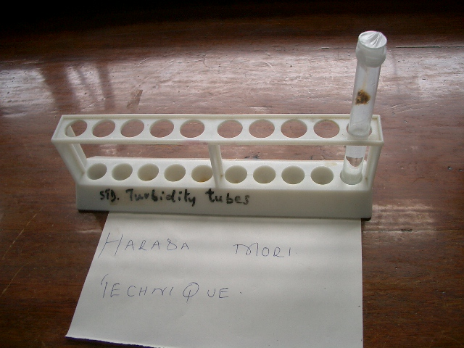
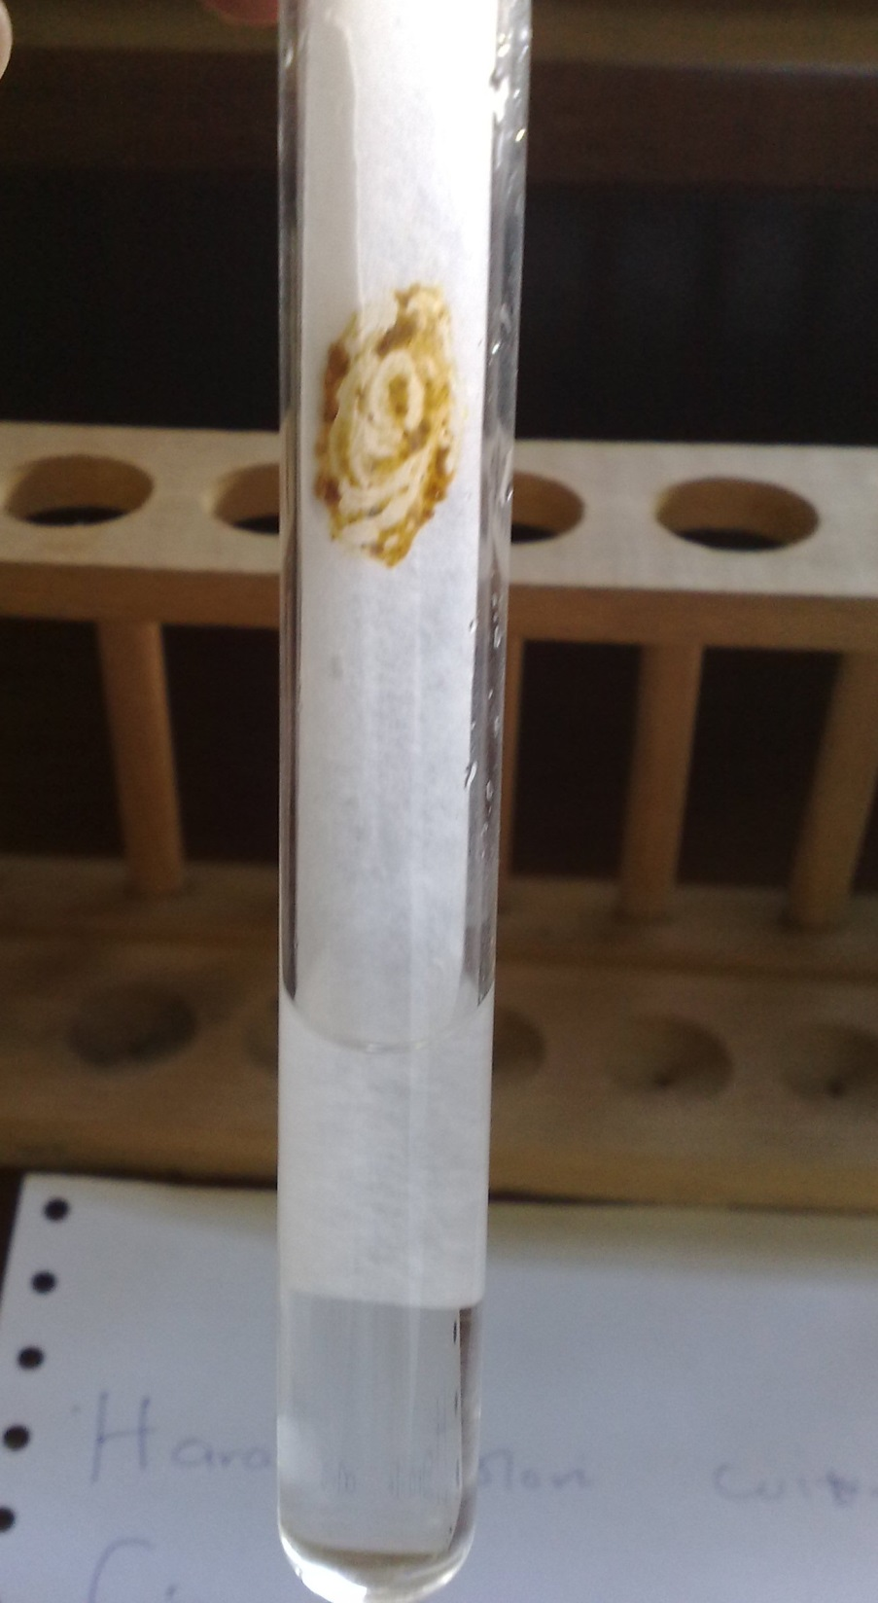
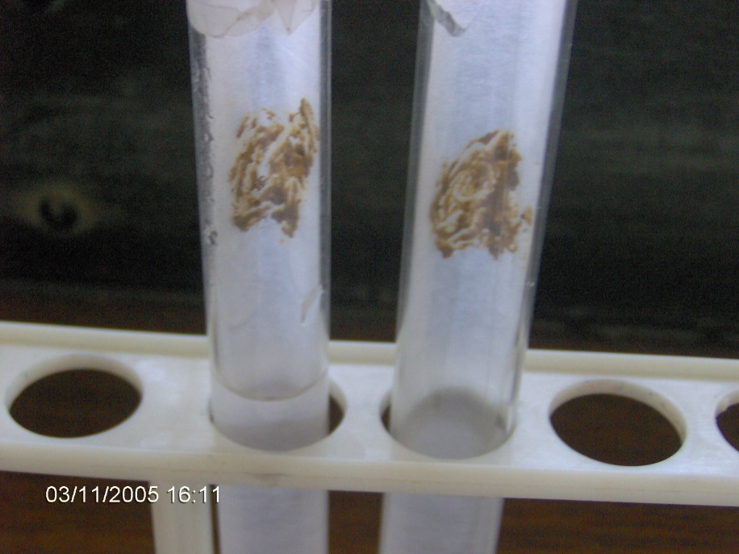
Harada Mori

Slide 30
Treatment
Chemotherapy
Ivermectin
Albendazole 200mg start, Mebendazole 400mgs,Thiabendazole
Supplement Vitamins and Folate
Proteins therapy
Surgery no role

Slide 31
Prevention and control
Control is usually aimed at breaking the life cycle/interfere with the life cycle
Mass deworming programmes in schools and children homes,ANC x2 yearly (coz most patients are asymptomatic).
Improving sanitation and Toilets use in rural areas
Health education
General nutritional improvement in vulnerable population
Protective clothing-shoes

Slide 32
Summary
School going children,pregnant women, elderly and children homes bears the biggest problem of intestinal nematodes(worms)-strongyloides
To monitor impact of treatment intensity of infection by egg/gram of stool is more helpful to determine
Drugs for use are cheap,available,effective and safe and given thru mass chemotherapy.

