Slide 1
CLASSIFICATION OF PARASITES
KIMAIGA H.O
MBChB (University of Nairobi)

Slide 2
Classification of Parasites
Classification has the following sub units;
Genus
Species
Parasites occur in single-celled protozoa and multicellular metazoa called helminths or worms.
Protozoa can be subdivided into four groups: Sarcodina (amebas), Sporozoa (sporozoans), Mastigophora (flagellates), and Ciliata (ciliates).
Metazoa are subdivided into two phyla: the Platyhelminthes (flatworms) and the Nemathelminthes (roundworms, nematodes).
The phylum Platyhelminthes contains two important classes: Cestoda (tapeworms) and Trematoda (flukes)

Slide 3
CLASSIFICATION OF PARASITES
KIMAIGA H.O
MBChB (University of Nairobi)

Slide 4
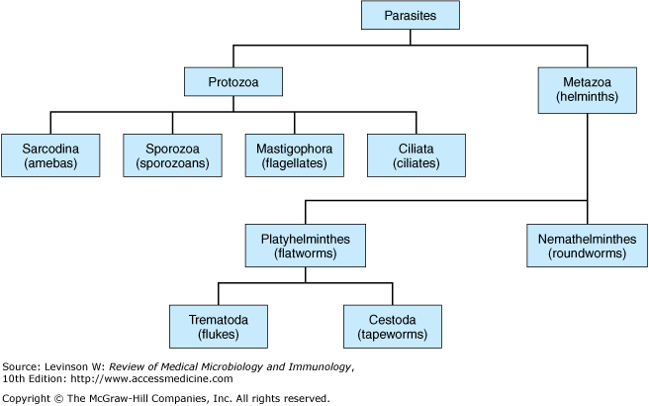

Slide 5
CLASSIFICATION:HELMINTHES
1. Phylum: Nematoda (round worm)
[nema(Gk)-threadlike; oidos-form]
Multicellular
Cylindrical body
Radial symmetry
Non-cellular outer cuticle
Usually bisexual
Sexes distinct
Bilateral symmetry
Complete digestive tract

Slide 6
Class: Asphasmida
Order: Trichurida
Family: Cappilaridae
Capillaria phillipinensis (capillariasis)
Family: Trichinillidae
Trichinella spiralis (trichinosis; trichinelliosis)
Family: Trichuridae
Trichuris trichiura (whipworm; trichuriasis)

Slide 7
Class: Rhabditae
Order: Rhabditidae
Strongyloides stercoralis (dwarf threadworm; strongyloidiasis)
Order: Strongylida
Family: Ancylostomidae
Ancylostoma duodenale (hookworm)
Necator americanus ii
Family: Angiostrongyloidae
Angiostrongylus spp. (angiostrongylidiasis)

Slide 8
Order: Ascaridida
Ascaris lumbricoides (human roundworm; ascariasis)
Toxocara canis (canine roundworm; toxocariasis)
T. cati (feline round worms; toxocariasis)
Anasikis simplex (marine roundworms; anasikiasis)
Pseudoterranora decipiens ii
Gnathosoma spinigerum (animal roundworm; gnathosomiasis; VLM; CLM)
G. hispidium ii

Slide 9
Order: Oxyurida
Enterobius vermicularis (pinworm; enterobiasis)
Order: Spirurida
Sub Order: Spirurina
Family: Onchocercidae
Brugia malayi (brugian filariasis)
Dirofilaria immitis (canine heartworm; dirofilariasis)
Loa loa (african eyeworm; loiasis)
Onchocerca volvulus (river blindness; onchocerciasis)
Wuchereria bancrofti (bancroftan elephantitis; wuchereriasis)
Suborder: Camallanidae
Family:Drucunculidae
Druncunculus medinensis (fiery serpent; guinea worm; drucunculiasis)

Slide 10
2. Phylum: Platyhelminthes (flatworms)
Class: Trematoda
Dorsiventrally flattened body
Bilateral symmetry (leaf shaped)
Complex outer tergument
Lacks body cavity
Usually hermaphroditic
Intermediate host snail
Great morphological diversity between stages
Digestive canal present except in sporocyst stage

Slide 11
Sub Class: Dignea (digenic trematodes)
Order: Echinostomatiformes
Family: Fasciolidea
Fasciola hepatica (sheep liver fluke; fascioliasis)
Fasciolepsis buski (fasciolepsiasis)
Order: Plagiochiformes
Suborder: Plagiorchiata
Family: Dirocoiliidae
Dirocoelium dendriticum (lancet fluke; dirocoeliasis; liverfluke)

Slide 12
Order: Strigeiformes
Family: Schistostomatidae
Schistosoma mansoni (intestinal schistosomiasis; blood fluke)
S. haematobium (urinary schistosomiasis)
S. japonicum (japonicum schistosomiasis)
Order: Opiothorchiformes
Family: Opisthorchiidae
Clonorchis sinensis (oriental/chinese liver fluke; clonorchiasis)
Family: Heterophydae
Heterophyes heterophyes (heterophyasis; intestinal fluke)
Metagonimus yokagawayi (metagonimiasis; intestinal fluke)
Sub Order: Troglotremata
Family: Troglotrematidae
Paragonimus westermani (human lung fluke)

Slide 13
Class: Cestoda
Segmented structures (segment = proglottid)
Adults vary in size (from 2-3mm-20-30ft)
Have scolex (head) with attached organs and strobila (chain of proglottids)
No alimentary canal
Absorbance across the tergument
Always hermaphroditic; each proglottid has ♂ and ♀ genital organs

Slide 14
Sub Class: Eucestoda (tapeworm)
Order: Cyclophyllidae
Echinococcus granulosus (hydated cyst; echinococciasis)
E. multicularis (alveolar hydated disease)
Hymenolepsis nana (dwarf tapeworm; hymenolepiasis)
Hymenolepsis diminuta (rat tapeworm; hymenolepiasis)
Taenia saginata (beef tapeworm; taeniasis)
T. solium (pork tapeworm; cysticercosis)
Dipilidium canium (cucumber tapeworm; dipylidiasis)
Order: Pseudophyllidae
Diphyllobothrium latum (broad fish-tapeworm; diphyllibothriasis)

Slide 15
CLASSIFICATION:PROTOZOA
1. Phylum: Sarcomastigophora (Protozoa) [protos(Gk)-primary, zoon-animal]
a) Sub-Phylum: Mastigophora (Flagellates)
Locomotory organs flagella
Class: Zoomastigophora
Order: Kinetoplastida
Haemoflagellates
Trypanosoma brucei rhodensiense (E. African trypanosomiasis)
Trypanosoma brucei gambiense (W. African trypanosomiasis)
Leishmania donovani (visceral leishmaniasis)
L. mexicana (cutanous leishmaniasis)
L. brazilliensis (mucocutanous leishmaniasis)

Slide 16
Order: Diplomonadida
Intestinal flagellates
Giardia intestinalis (G. lamblia) (giardiasis)
Order: Trichomonadida
Genitourinary flagellate
Trichonomas vaginalis (trichonomiasis)
b) Sub-phylum: Sarcodina (Amoeba)
Super Class: Rhizopoda
Locomotory organs pseudopodia
Asexual reproduction/binary fission
Entamoeba histolytica (amoebiasis)
Naegleria fowleri (primary amoebic meningoencephalitis [PAM])
Acanthamoeba spp. (granulomatous amoebic enchephalitis [GAE])

Slide 17
2. Phylum: Apicomplexa
No permanent motility organelles
Organelle complex at anterior end
Sexual and asexual reproduction
Class: Sporozoea
Sub Class: Coccidia
Order: Eucoccidiorida
Sub Order: Haemosporoina
Plasmodium falciparum (malaria)
P. vivax
P. ovale
P. malariae

Slide 18
Sub Order: Eimeriorina
Family: Cryptosporidiidae
Cryptosporidium parvum (cryptosporodiasis)
C. hominis
Cyclospora spp.(cyclosporiosis)
Family: Eimeriina
Eimeria spp. (coccidiosis)t
Isospora belli (isoporidiosis)
Family: Sarcocystidae
Toxoplasma gondii (toxoplasmosis)
Sarcocystis spp. (sarcocystosis)
Sub Class: Pirolasmasina
Family: Babesiidae
Babesia spp. (babesiosis)

Slide 19
3. Phylum: Ciliophora (Ciliates)
Locomotory organs cilia in trophozoites
Class: Litsostomatea
Balantidium coli (balantidiasis)

Slide 20
4. Phylum: Microspora
Obligate intracellular protozoan
Produce resistant spores
Have unique organelle polar tube or polar filament
Branchiola spp. (microsporodiosis)
Enchephalitozoon cuniculi ii
En. hellem ii
En. intestinalis ii
Enteroctytozooon bieneusi ii
Nosema spp. ii
Pleistophora spp. ii
Trichilpeistophora spp. ii
Vittaforma corneae ii
Microsporidium spp. ii

Slide 21
CLASSIFICATION OF ARTHOPODS
1. Phylum: Arthopoda
Class: Arachnida
Order: Acariae
Family: Ixodidae (hard ticks)
Amblyomma americanum (lone star tick)
Boophilus microplus (southern cattle tick)
Dermancetor sp. (dog tick)
Ixodes scapularis (deer tick)
Rhipicephalus sp.
Family: Argasidae (soft ticks)
Ornithodoros moubata (tick borne (endemic) relapsing fever)
Order: Astigmata
Sarcoptes scabei (human itch-mite; scabies)

Slide 22
Class: Insecta
Order: Dictyoptera
Periplenata americana (American cockroach)
Order: Anoplura
Pediculus humanus capitis (head louse)
Pediculus humanus corporis (body louse)
Phthiuris pubiss (pubic louse)
Order: Hemiptera
Family: Cimicidae
Cimex hemiptera (tropical bedbug);
C. lectularius (common bedbug; Hepatitis A,B)
Family:Reduviidae
Triatoma infestans (kissing bug)

Slide 23
Order: Siphonaptera
Family: Siphonaptera
Ctenocephaledes felis (cat flea)
Ctenocephaledes canis (dog flea; Dipylidium canium)
Xenopsilla cheopis (rat flea)
Pulex irritans (human flea)
Family: Tungidae
Tunga penetrans (jigger flea)
Order: Diptera
Family: Tabanidae
Chrysops sp. (Deer flies; loa loa)
Family: Glossinidae
Glossina sp (tsetse fly; trypanosomiasis)

Slide 24
Family: Ceratopogonidae
Culicoides sp.(biting midge; Mansonella perstans; M. streptocerca))
Family: Culicidae
Anopheles sp. (mosquitoes)
Aedes sp.
Culex sp.
Family: Phlebotominae
Phlebotomus sp.; Sergentomyia sp. (sandflies;leishmaniasis; sand fly fever; Oroya fever)
Musca domestica (house fly)
Family: Simuliidae
Simulium damnosum; S. neavei (black flies; onchocerciasis)

Slide 25
Classification of Parasites
Subkingdom | Phylum | Organisms
Protozoa | Sarcomastigophora | Ameba, flagellates
 | Ciliophora | Ciliates
 | Apicomplexa | Sporozoa, coccidian
Metazoa | Nematoda | Microsporidia
 | Platyheminthes (flat) | Flatworms
 | Trematodes | Flukes
 | Cestodes | Tapeworms
 | Arthropoda
 | Chilopoda | Centipedes
 | Pentastomida | Tongue worms
 | Crustacea | Crabs, crayfish, shrimp, copepods
 | Arachnida | Mites, ticks, spiders, scorpions
 | insecta | Mosquitoes, flies, lice, fleas, wasps, ants, beetles, moths, roaches, true bugs

Slide 26
Organism Class | Morphology | Reproduction | Organelles of locomotion | Respiration | Acquisition of Nutrients
Protozoa
Amoeba | Unicellular; can exist in cyst and trophozoite forms | Binary fission | Pseudopods | Facultative anaerobe | Assimilation by pinocytosis or phagocytosis
Flagellates | Unicellular; can exist in cyst and trophozoite forms; possibly intracellular | Binary fission | Flagella | Facultative anaerobe | Simple diffusion or ingestion via cytostome, pinocytosis, or phagocytosis

Slide 27
Organism Class | Morphology | Reproduction | Organelles of locomotion | Respiration | Acquisition of Nutrients
Ciliates | Unicellular; cysts or trophozoite | Binary fission or conjugation | Cilia | Facultative anaerobe | Ingestion via cytostome, food vacuole
Coccidian | Unicellular, frequently intracellular; multiple forms, including trophozoites, sporozoites, cysts (oocyte), gametes | Schizogony and sporogony | None | Facultative anaerobe | Simple diffusion
Microsporidia | Obligate intracellular forms; small, simple cells and spores | Binary fission, schizogony and sporogony | None | Facultative anaerobe | Simple diffusion

Slide 28
Helminthes
Nematoda | Multicellular; round, smooth, spindle shaped, tubular alimentary tract; possibility of teeth or plates for attachment | Separate sexes | No single organelle; active muscular motility | Adults usually anaerobic; larvae: possibly aerobic | Ingestion or absorption of body fluids, tissue, or digestive contents
Cestoda | Multicellular; head with segmented body (proglottids); lack of alimentary tract; head equipped with hooks and/or suckers for attachment | Hermaphroditic | No single organelle; usually, attachment to mucosa, possible muscular motility (proglottids) | Adults; usually anaerobic | Abs of nutrients from intestine
Trematoda (cup-like structures for attachment) | Multicellular; leaf shaped with oral and ventral suckers; bind alimentary tract | Hermaphroditic (schistosoma group has separate sexes) | No single organelle; muscle-directed motility | Adults; usually anaerobic | Ingestion or abs of body fluids, tissue or digestive contents

Slide 29
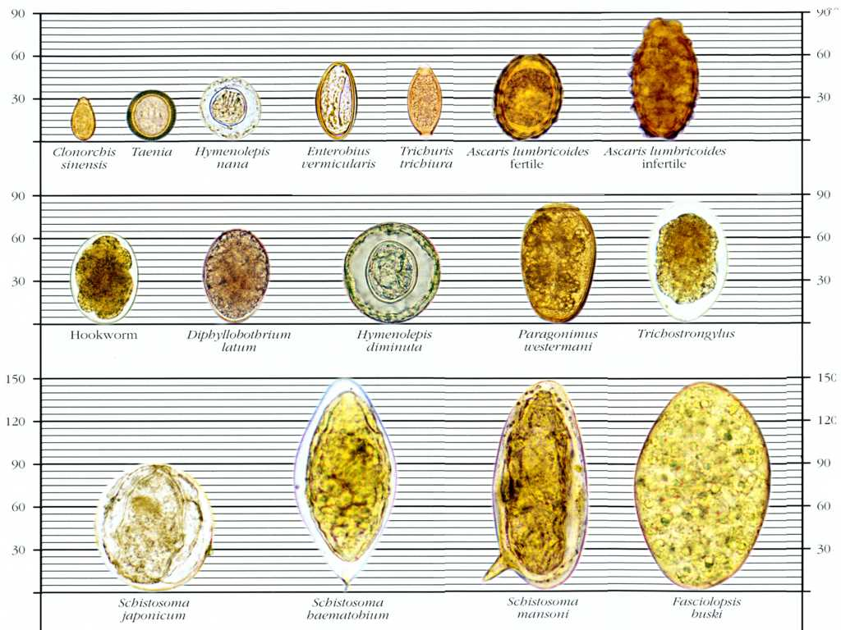

Slide 30
CLASS NEMATODA (Round Worms)
Nematodes are unsegmented worms with elongated rounded body pointed at both ends
They are among the most abundant animals on earth - over 500,000 species have been described.
Majority of nematodes are free-living in every conceivable habitat.
Ascaris lumbricoides (roundworm),
Trichinella spiralis (trichinosis),
Trichuris trichiura (whipworm),
Enterobius vermicularis (pinworm),
Strongyloides stercoralis (Cochin-china diarrhea),
Ancylostoma duodenale and Necator americanes (hookworms)

Slide 31
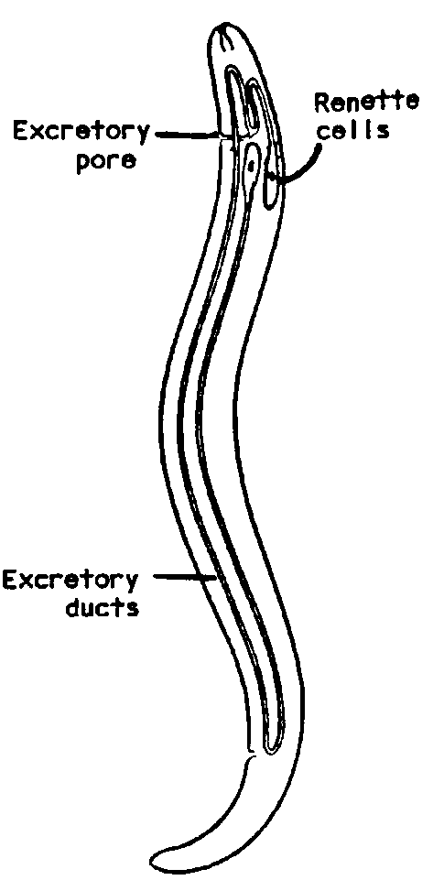
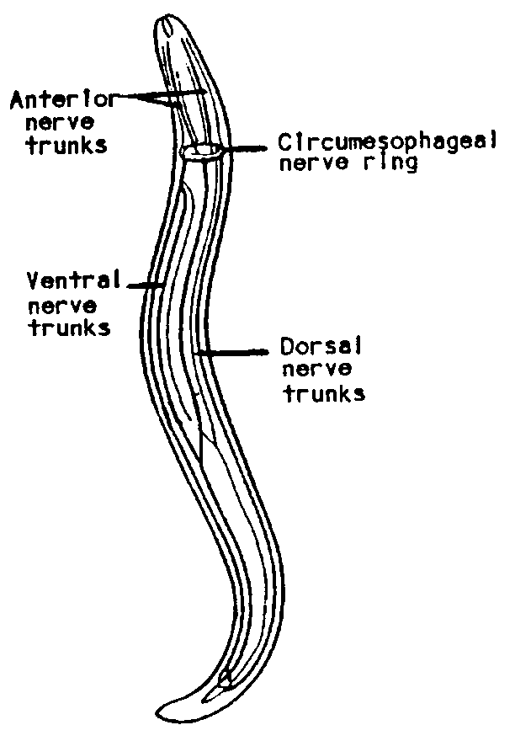
Characteristics of the Phylum Nematoda

Slide 32
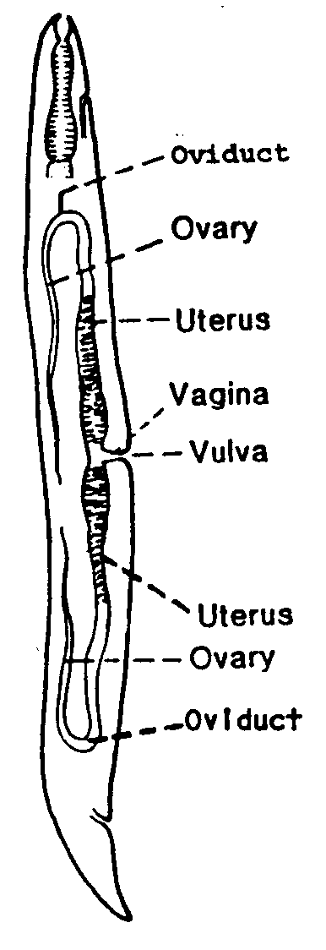
Characteristics of the Phylum Nematoda
Reproductive system consists of tubular organs lying in the pseudocoelom.
MALE nematodes are generally smaller in size.
FEMALE nematodes are larger in size. The female reproductive organs are doubled.

Slide 33
Nematode development is similar in all nematodes.
Consists of 4 larval (=juvenile) stages between the egg and adult. Each stage is separated by a molt of the cuticle.
M₁ M₂ M₃ M₄
Egg L₁ L₂ L₃ L₄ Adult
Larval stages may be passed within the egg, free-living in soil, parasitic in an intermediate host, or parasitic in definitive host.
L1-Rhabditiform
L3- Filariform

Slide 34
Larval migratory route
Egg(L1) →(L2) duodenum →burrow capillaries intestinal wall →H.P.V → liver →Right heart → pulmonary circulation(L3) → lung → break into alveolar space (L4) → Up bronchial tree → Ascend down trachea → pharynx → oesophogus → swallowed → stomach (L5) → S. intestine → Adult

Slide 35
CLASS CESTODA/ TAPEWORMS
Classification into 2 main groups
Cyclophyllidae
Pseudophyllidae

Slide 36
1. Cyclophillidae
Occasionally, rostelum may be present with
Scolex armed with four acetabula suckers with or without hooks
Have a single compact vitelline gland, with a few exceptions
Lateral genital pores, no uterine pores, parasites of birds and mammals.
Body called proglotid. The segments nearer the head are the immature segments
5 genera
Taenia ssp: T. saginata and T. solium
Hymenolepis ssp: H. nana and H. dimunita
Dipylidium ssp : D. caninum
Echinococcus ssp: E. granulossus (dog tape worm)
Multiceps ssp: multiceps multiceps.

Slide 37
2. Pseudophillidae
Scolex has dorsal and ventral Slit like grooves (bothria)
or sucking groove and no hooklets
May be deep or shallow, smooth or cilliated, fixed or free, and some species have hooks
Lateral or median genital pore, uterine pores, unlike the Taenia Spp which only have the lateral genital pores
Eggs with operculum and larvae coracidium
Vetellaria are usually follicular and scattered
Members have numerous testes
More than one set of reproductive organs
2 genera of medical importance
Diphyllobothrium ssp: D. latum (fish tapeworm)
Spirometra ssp: S. mansoni & S. proliferum.

Slide 38
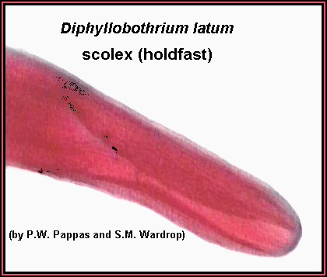

Slide 39
The reproductive system

Slide 40
General Features: Cestodes
Flat worms flattened dorso-ventrally like tape hence called tape worms
Endoparasites
They are hermaphrodites
Segmented in body and broader than long
All require intermediate host except H. nana.

Slide 41
Morphology: Adults
Adults have scolex or head for attachment on GIT of host.
Head has sucking organs or hooks on the rostellum for some ssp. E.g. T. solium
Narrow neck followed by the body called Strobilla which is segmented.
Segments are immature towards the tail end of the worms.
Each mature proglottid contains male and female reproductive organs.
New proglottids produced by strobilization which is a budding that occurs from the neck region (the zone of proliferation).

Slide 42
Egg Release from Proglottids
Apolysis - entire proglottid containing eggs is released or disintegrates releasing eggs.
Anapolysis or Pseudopolysis- proglottids remains attached eggs are released through some uterine pore or tear in the gravid proglottid.
Hyperapolysis - immature proglottid released and matures within the host.

Slide 43
Morphology: Larvae
Cysticercus emerges from the egg
Usually has fully formed scolex or head.
Rest of tissues not developed
It may develop into various forms e.g. hydatid cyst, coenurus, cysticercoids and strobilocercus.
Cysts of larvae are found in the intermediate host.
Morphology: Egg
Eggs are fully embryonated for cyclophillidae and partial for pseudophyllidae
Eggs are released in stool by definitive host. (is a host that has mature male & female parasites)
Hatches to form an onchosphere (hexacanth)

Slide 44
Patterns of life cycle of cestodes
GROUP PSEUDOPHYLLIDAE
(e.g. Diphyllidrium latum)
Partially embryonated egg
After some time hatches in water to release ciliated coracidium
Also has some embryonic hooks
Ingested by arthropods (usually aquatic e.g. copepod & other microscopic crustaceans)
Penetrates gut, attaches in the haemocoel & develops to precercoid (without embryonic hooks).

Slide 45
Rudiments of holdfast organs start developing.
Crustacean eaten by vertebrate (e.g. fish, reptile or amphibian)
Procercoid released and penetrates tissues, becomes prelocercoid. (is the last intermediate host b4 reaching man)
Usually have rudiments of adult holdfast organs.
2nd intermediate host eaten by definitive host attaches to tissues, usually gut and develop into the adult tape worm.
Then stobilation begins.

Slide 46
GROUP CYCLOPHILLIDAE
Fully embryonated eggs.
Usually do not hatch until swallowed by definitive or intermediate host
Egg hatches to form an oncosphere (hexacanth)
Hold on to and penetrate the gut mucosa.
Penetrates into tissues, form a cysticercus.
Usually has an invaginated retractable scolex enclosed in a bladder (e.g. T. solium)
Rest of tissues not fully developed.
Cysticercus may develop into various larval forms
Hydatid cyst- Inner layer is germinal layer and is contained in a broad capsule which has hydatid fluid may contain up to one million protoscolices
Strobilocercus
Coenurus
Cysticercoids- a solid larva with adult scolex (e.g. H. nana)

Slide 50
CLASS TREMATODA
GENERAL CHARACTERISTICS
Are leaf-shaped unsegmented flat worms also called flukes, subclass Digenea
Vary in size from 1mm to several centimeters
Have 2 strong muscular cup-shaped depressions called suckers used as organs of attachment
The sucker surrounding the mouth is referred to as the oral sucker
The one on the ventral surface of the body is known as the ventral sucker (acetabulum)

Slide 51
Each individual worm is hermaphrodite except for schistosomes which have separate sexes
Have no body cavity with an incomplete alimentary canal
The excretory and nervous systems are present. The excretory system consisting of ‘Flame cells’, which open into a posterior excretory pore
Reproductive system is highly developed and complete
The worms are oviparous thus as they produce eggs
Eggs are operculated i.e. have a lid (operculum) except for the schistosomes and can only develop in water. Schistosomes’ eggs have a spine that can define the type of spp of schistosomes, i.e. terminal, lateral & rudimentary spines.

Slide 52
Life cycle
The worms pass their life cycle in 2 different hosts
The definitive host: generally humans, harbor the adult worm
The intermediate host: a fresh water snail or mollusc
The 2nd intermediate host: (fish or crab) may be required

Slide 53
Systematic classification of Trematodes
Family | Genus | Species | Habitat | Manifestation
Schistosomatiodae | Schistosoma | S. haematobium S. mansoni S. japoni | Blood Blood Blood | Haematuria Dysentery Dysentery & Liver cirrhosis
Paramphistomatidae | Gastrodiscoides Watsonius | G. hominis W. watsoni | L.I S.I | Mucous diarrhoea Diarrhoea

Slide 54
Fascioloidea | Fasciola Fasciolopsis | F. hepatica F. buski | Liver of sheep/man S.I | Diarrhoea
Opisthrochdae | Cionorchis Opisthorchis | C. simensis O. felineus | Liver Liver of cat/man | Jaundice Jaundice
Heterophyidae | Heterophyse Metagonimus | H. heterophyse M. yokogawai | S.I S.I | Diarrhoea Diarrhoea
Paragonimus | Paragonimus | P. Westermani P.Kellicotti | Lungs | Haemoptysis

Slide 55
Classification of Trematodes
According to the habitat of the trematodes
Intestinal trematodes (intestinal flukes)
S.I: F. buski, H. heterophyes, M. yokogawai, W. watsoni
L.I: G. hominis
Hepatic trematodes (liver flukes) mainly in china & far East
E.g. C. sinensis, O. felineus, F. hepatica
Lung trematodes (lung flukes) far East*
E.g. P. westermani they simulate TB
Blood trematodes (blood flukes). They are mainly in Africa, & Asia
In vesical venous plexuses: S. haematobium (bullinus snail)
In rectal & portal venous system: S. mansoni (biomphalaria) & S. japonicum (oncomelania snail)

Slide 56
Terms used in the description of trematodes
Miracidium:
The 1st larval stage coming out of the trematode egg in water. Infective to a snail/mollusc only
Sporocyte
The 2nd larval stage of the trematode occurring in the mollusc. Asexual multiplication occurs at this stage in schistosomes
Cercariae
The final stage of larval devt of trematodes in the mollusc. It possesses a body & a tail. It escapes into the water & remains either free or encysted on vegetation or in other animals.

Slide 57
Mode of infection
By digestion of encysted infective stage known as cercarie/metacercarie in:
Vegetables as in F. hepatica, F. buski, W. watsoni
Fish as in C. sinensis, H. heterophyes, M. yokogawai
Flesh of crab or crayfish as in P. westermani
Free cercarie penetrating through the skin
As in S. mansoni, S. haematobium, & S. japonicum

Slide 58
PREPARATION TECHNIQUES
Wet preparation
Formal-ether
Kato technique
Urine filtration technique
Kato technique
Requirements:
Sieve
Template
Spatula
Cellophane cover slips soaked in Kato solution (malachite glycerine, water & glycerol)
Place stool specimen on template (hole contains sieve)
Place filtered 1.7mg stool specimen on slide
Cover with coverslip soaked in Kato solution
Press over a filter paper to spread specimen
Allow specimen to settle for 1hour for eggs to absorb glycerine
Count eggs at power 10 e.g. 10 eggs in 1.7mg
Urine filtration technique
Fill Luer syringe with specimen urine
Inject into a filter holder containing filter
Eggs stick to the filter
Count under light microscope

Slide 59
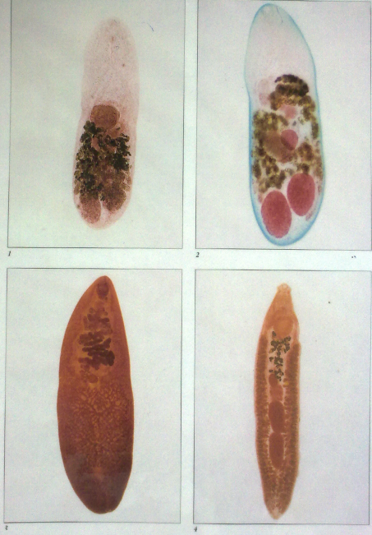
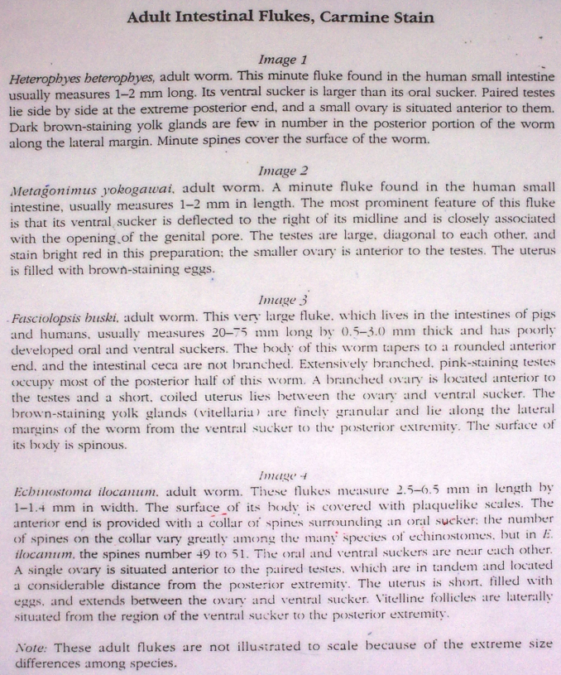

Slide 60
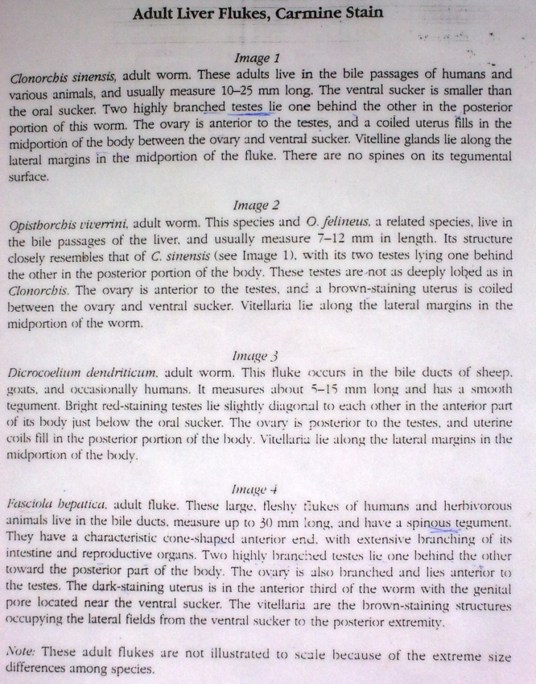
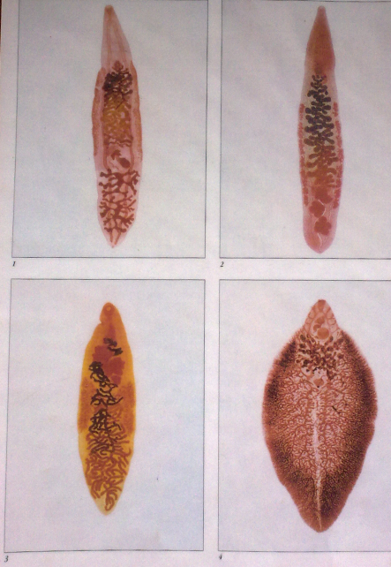

Slide 61
