Slide 1
METHODS IN PARASITOLOGY
KIMAIGA H.O
MBChB (University of Nairobi)

Slide 2
Laboratory Diagnosis of Parasitic Infections
Purpose –
Confirmation of clinical suspicion
Identification of unsuspected infection
Methods same as used in Bacteriology & Virology but significance of different methods varies.
Isolation least important, morphological identification very important.
Serology relatively less important

Slide 3
Morphological identification
Examination of faeces –
Gross
Microscopy
Saline mount
Iodine Mount
Thick smears – not commonly used
Permanent stained smears
Iron hematoxylene
Whearley’s trichrome stain
Concentration methods
Floatation techniques
Sedimentation techniques

Slide 4
Morphological identification
Examination of Blood
Thin Smear
Thick smear
Wet mount for microfilaria
Stains used

Slide 5
KATO-Katz technique for helminth eggs
Materials:
Kato-set
(Template with hole, screen, nylon or plastic, plastic spatula)
Newspaper or glazed tile
Microscope slides
Cellophane as cover slip, soaked in Glycerol-malachite green solution
Fresh stool
Gloves

Slide 6
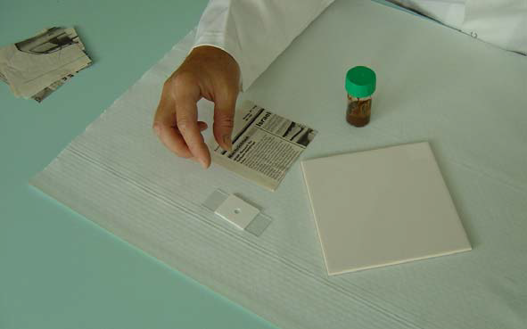
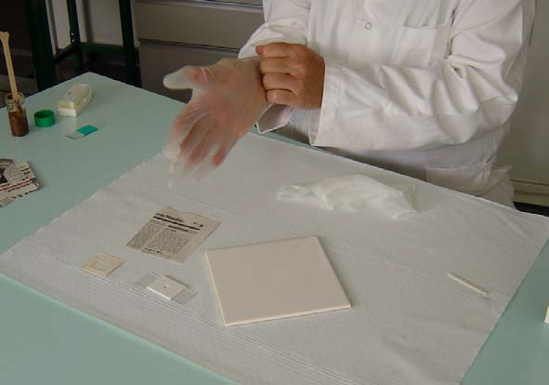
Prepare the layer
Glazed tile or newspaper
Place the template with hole in the centre of a microscope slide
Use gloves!

Slide 7
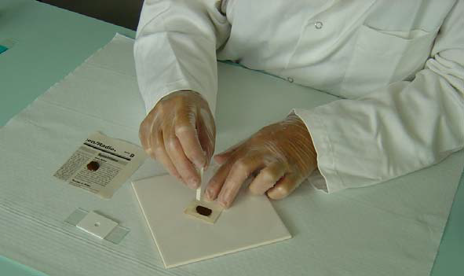
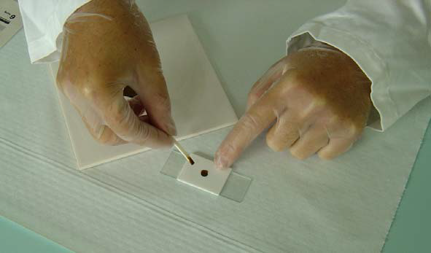
Place a small amount of faecal material on the newspaper or the glazed tile.
Press the screen on top so that some of the faeces filters through and scrape with the flat spatula across the upper surface to collect the filtered faeces.
Add the collected faeces in the hole of the template so that it is completely filled.

Slide 8
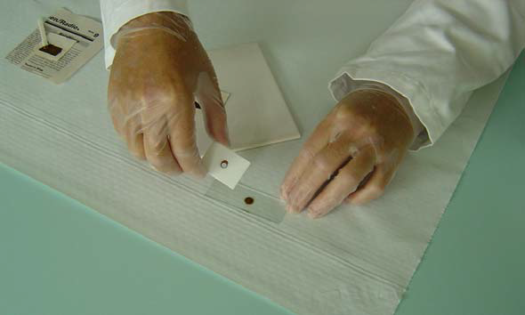
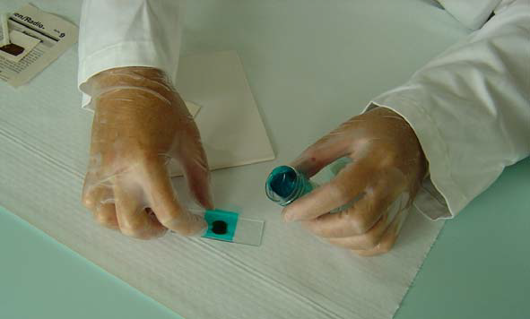
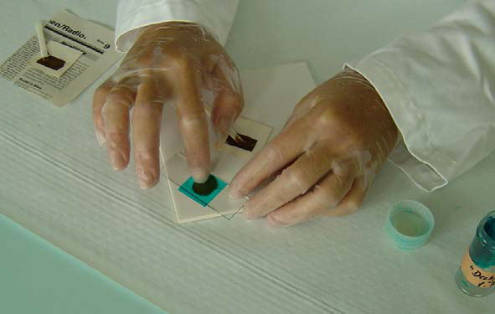
Remove the template carefully so that the cylinder of faeces is left on the slide.
Cover the faecal material with the pre-soaked cellophane strip.
Invert the microscope slide and firmly press the faecal sample against the cellophane strip on a smooth hard surface such as a tile

Slide 9
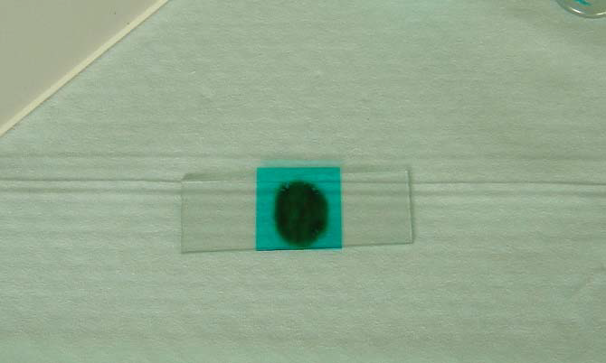
The material will be spread evenly.
Carefully remove the slide by gently sliding it sideways to avoid separating the cellophane strip. Place the slide with the cellophane upwards.
The smear should be examined in a systematic manner and the eggs of each species reported.
Later multiply by the appropriate number (seeinlet-information of the Kato-set) to give the number of the eggs per gram faeces.

Slide 10
Adhesive tape method for the detection of pinworm eggs
Clear adhesive tape
Microscope slides
Gloves
(Xylene or Butyl acetate)

Slide 11
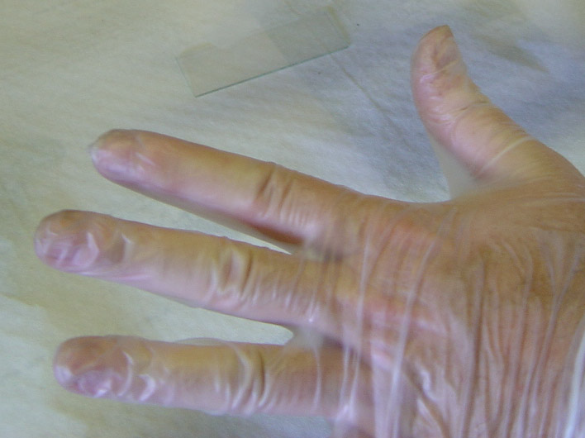
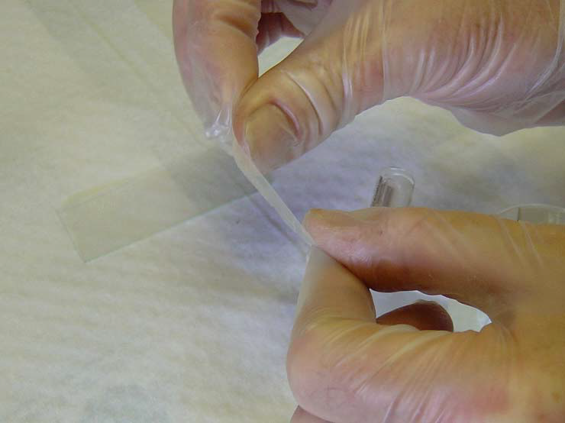
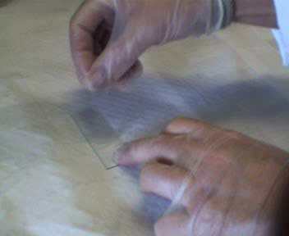
Use gloves! (pinworm eggs are infectious!)
Prepare the tape
Take sample on peri-anal skin in the morning
Stick tape on microscope slide
4-6 negative tapes are needed to rule out a pinworm infection!

Slide 12
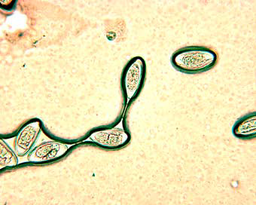
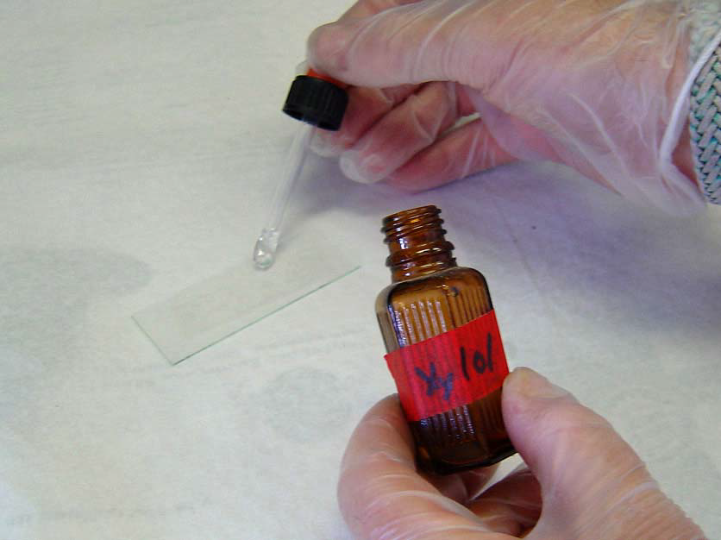
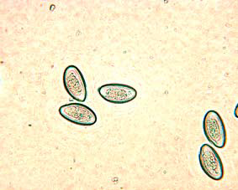
Picture under microscope:
Tape without Butyl acetate /Xylene produces many air bubbles!
Place a drop of Xylene on the edge of the tape to remove air bubbles
Picture under mikroscope:
Without air bubbles

Slide 13
Cultivation of parasites
Culture methods –
Amoeba
Leishmania & Trypanosoma
Malarial parasite
Animal inoculation – Not practical
Xenodiagnosis – Vectors infected experimentally
Immunological diagnosis

Slide 14
Immunological diagnosis
Serology – All tests available
IHA
ELISA
CIEP
IF
CFT
More useful in
Amoebiasis
Leishmaniasis
Malaria
Toxoplasmosis
Trichinosis
Filariasis
Echinococcosis
Skin Tests – Specificity low, cross reactions common
Casoni’s test
Leishmanin test

Slide 15
Need for Serodiagnosis
1. Unattainable parasitological diagnosis
Special specimens & Tests,
Trichinosis- muscle biopsy
Toxoplasmosis- lymph node, placenta
Long prepatent period
Filariasis
No method available, e.g., gnathostomiasis
Micros. exam of excreta tedious, time-consuming, impractical
Negative in light infection, e.g., strongyloidiasis, opisthorchiasis
2. Cost-effective in epidemiological survey
Labour
Time

Slide 16
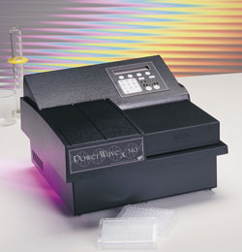
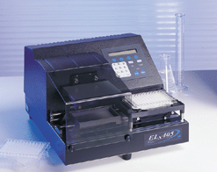
Drawbacks of serodiagnosis
1. Specificity and sensitivity not 100%
2. Depending on host's immune response- e.g., ocular parasitosis
3. Sophisticated and expensive equipment
4. Well-trained personnel

Slide 17
Antibody Assay
1. Skin or intradermal test
Easiest to perform
Type I & IV hypersensitivity
Type I-> helminthiases
Type IV->protozoan infections

Slide 18
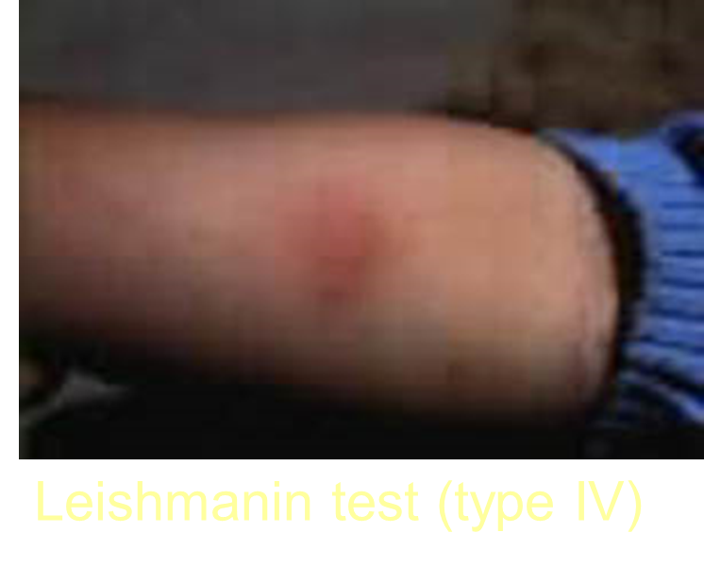
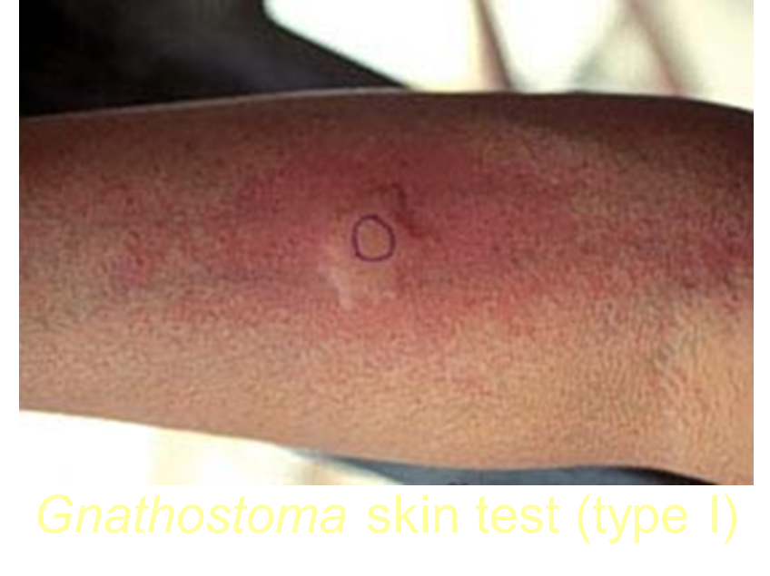

Slide 19
2. Complement fixation test (CF)
3. Precipitin methods -Double diffusion in agar (DD) -Counterimmunoelectrophoresis (CIEP) -Immunoelectrophoresis (IEP) -Nephelometry

Slide 20
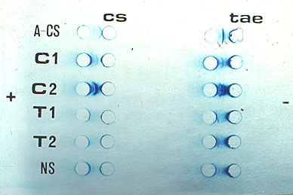
CIEP for cysticercosis

Slide 21
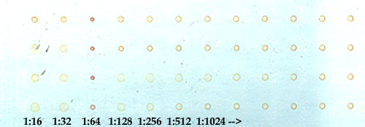
4. Agglutination methods
Direct agglutination (DA)
Bentonite flocculation (BF)
Latex agglutination (LA)
Indirect hemagglutination (IHA)

Slide 22
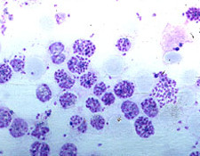
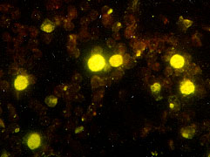
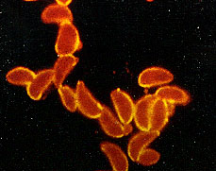
5. Labelled reagent methods
Label with fluorescein dye
Immunofluorescence (IF)- FITC, rhodamine
P. falciparum
Toxoplasma

Slide 23
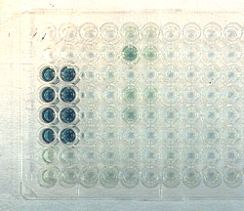
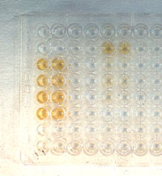
Label with enzyme
Enzyme immunoassay- ELISA
ABTS-substrate
OPD-substrate

Slide 24
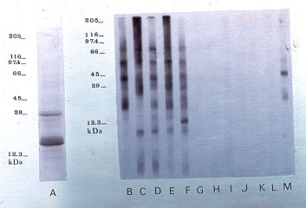
-Electroimmunotransfer blot (EITB)

Slide 25
Antigen assays
Merits:
Appear earlier than antibody
Amount directly varies with degree of infection
Not persist
Commercial kit
Intestinal amoebiasis, giardiasis, cryptosporidiosis, etc.

Slide 26
Method:
Use monoclonal or polyclonal antibodies in CIEP, ELISA
DNA detection by PCR

Slide 27
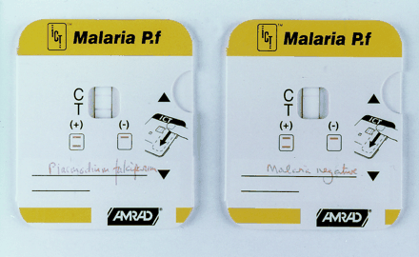
ICT (immunochromatographic assay)

Slide 28
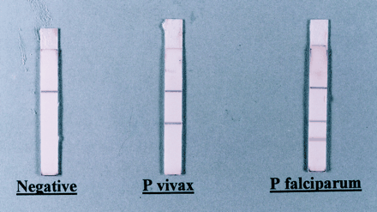

Slide 29
Validation of immunoassays
Most important = Predictive value (PV)
PV - A measure of how accurately a test can predict the presence or absence of disease when applied under special circumstance
PV depends on Sensitivity, Specificity and Prevalence
Sensitivity = % diseased population whose tests are POSITIVE
Specificity = % nondiseased pop whose test are NEGATIVE
Prevalence = % diseased pop in total population tested

Slide 30
Definition
PV for positivity (%) = % of positive-test population who really get disease
PV for negativity (%) = % of negative-test population who really don't have disease
PV(+) decreases when prevalence of disease decreases

Slide 31
Example- ELISA for ascariasis
280 Serum specimens
80 cases with Ascaris eggs in stool
40 cases = positive
200 normal volunteers with negative stool examination
10 cases = positive

Slide 32
Category n Test results
+ -
Disease 80 40 (TP) 40 (FN)
No disease 200 10 (FP) 190 (TN)
Sensitivity = 40/80 x 100 = 50%
Specificity = 190/200 x 100 = 95%
Prevalence = 80/(80+200) x 100 = 28.6%

Slide 33
Category n Test results
+ -
Disease 80 40 (TP) 40 (FN)
No disease 200 10 (FP) 190 (TN)
PV(+) = TP/(TP+FP) x 100
= 40/(40+10) x 100 = 80%

Slide 34
Category n Test results
+ -
Disease 80 40 (TP) 40 (FN)
No disease 200 10 (FP) 190 (TN)
PV(-) = TN/(TN+FN) x 100
= 190/(190+40) x 100 = 82.6%
Under the condition that prevalence of the disease = 28.6%

Slide 35
Interpretation
Test applied to 300 villagers where prevalence of ascariasis = 25.6%
90 are positive, 210 are negative
PV(+) = 80% means that from 90 above, only (90 x 0.8) = 72 cases really have disease
PV(-) = 82.6% means that from 210 above, only (210 x 0.826)= 173 cases do not have disease

Slide 36
What happen if tested with 1000 villagers with the prevalence of ascariasis about 5% ?
1000 villagers
(0.05 x 1000) = 50 cases have ascariasis; test sens = 50%, so only 25 cases are positive (TP=25, FN=25)
(.95 x 1000)=950 cases do not have infection; test spec.=95%, so only (.95 x 950)= 860 cases are negative (TN=860, FP=90)
PV(+) = 25/(25+90) x 100 = 21.7% (decreased from 80%)
PV(-) = 860/(860+25) x 100 = 99.4% (increased from 82.6%)

Slide 37
Nematodes
NEMATODE AND CESTODE EGGS FOUND IN STOOL SPECIMENS OF HUMANS
Capillaria philippinensis
Enterobius vermicularis

Slide 38
Trichuris trichiura
Ascaris lumbricoides fertile

Slide 39
Ascaris lumbricoides infertile
Hookworm

Slide 40
Trichostrongylus spp.

Slide 41
Cestodes
Taenia spp.
Hymenolepis nana

Slide 42
Hymenolepis diminuta
Diphyllobothrium latum

Slide 43
Dipylidium caninum

