Slide 1
ASCARIS LUMBRICOIDES
(Common roundworm)
KIMAIGA H.O
MBChB (University of Nairobi)

Slide 2
INTRODUCTION
Causes the disease Ascariasis
Largest nematode in size.
Common in moist places with poor hygiene
Commonest roundworm; prevalence is about 1.3 billion infections
The parasite is transmitted via the fecal-oral route meaning fecal matter contaminates the soil and end up being ingested. They are thus called Geohelminthes
It is an exclusive parasite for the human and both the male and female live in the small intestines

Slide 3
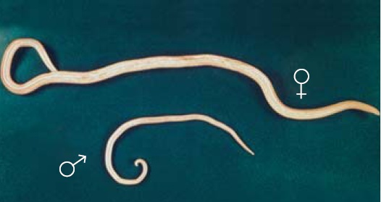
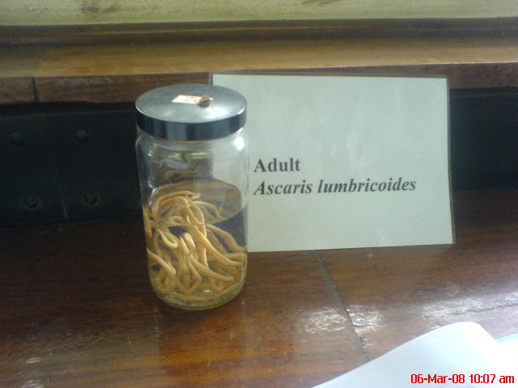
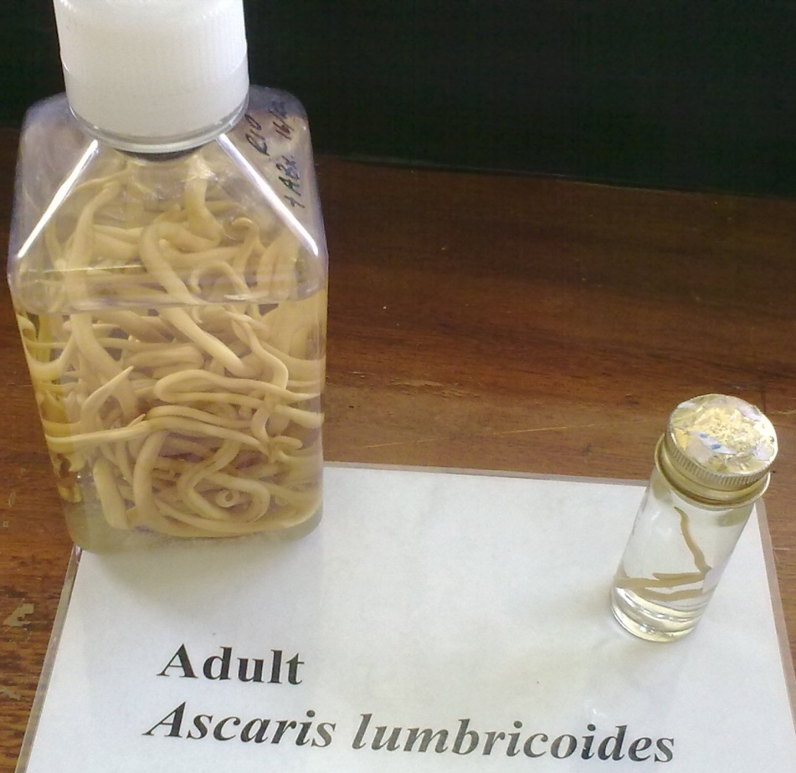
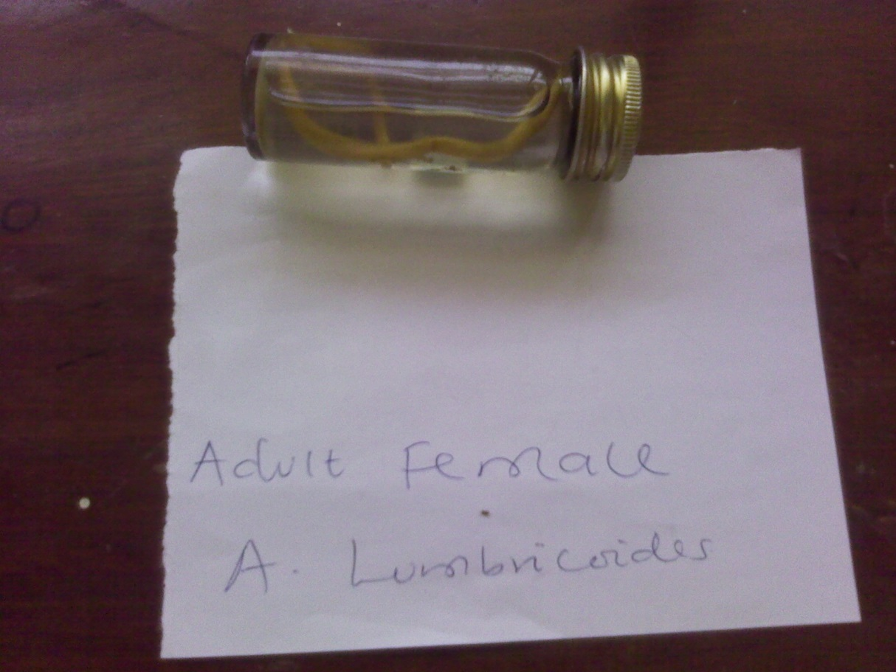
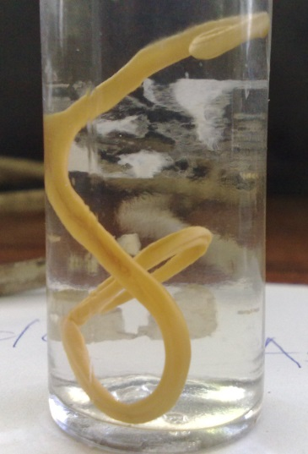
Female
male

Slide 4
GEOGRAPHICAL DISTRIBUTION
Most common worm found in human.
It is worldwide in distribution and most prevalent through out the tropical and subtropical areas with warm ,moist soil for longer survival of eggs.
More prevalent in the countryside than in the city.
South East Asia is the most affected-73%,other places being Africa and Latin America.
Countries with reported cases of this disease include India, Bangladesh, Kenya, Indonesia, Malasya, Phillipines, Tanzania, China, Turkey, Mexico, Afghanistan, Brazil and Peru.
Approximately 1.4 billion people worldwide are affected , mostly children .
Roughly 10,000 people die from the disease per year.

Slide 5
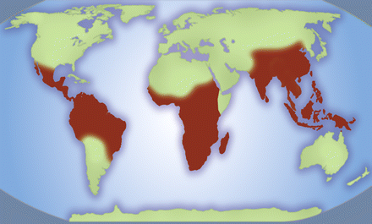
GEOGRAPHICAL DISTRIBUTION OF ASCARIASIS
C
A
B
D
Central America and Nothern part of South America- A and B
West ern ,Southern, Eastern central and coastal border of Africa including Madagascar-D
The Southeastern part of Asia-C

Slide 6
PREVALENCE IN KENYA
Mostly regions with poor hygiene and sanitation especially the rural areas and refugee camps with poor toiletry facilities .
Areas with poor drainage systems like the swamps ,the rice growing areas, the flooded river banks and the irrigation system e.g. Kano plains and Ahero irrigation schemes

Slide 7
MORPHOLOGY
ADULTS
Largest nematode (Adult females: 20 to 35 cm; adult male: 15 to 30 cm.)
Creamy-white or pinkish in color.
Are cylindrical in a cross section and have tapering ends
The male has a curved tail with a pair sickle like copulatory spines. On the tip of the head there are three lips, arranged as a Chinese word “ 品 ”.
Have a mucous layer called ascaron to avoid being digested by the host’s enzymes

Slide 8
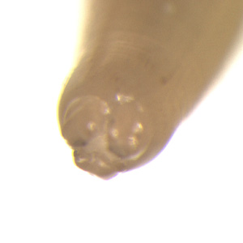
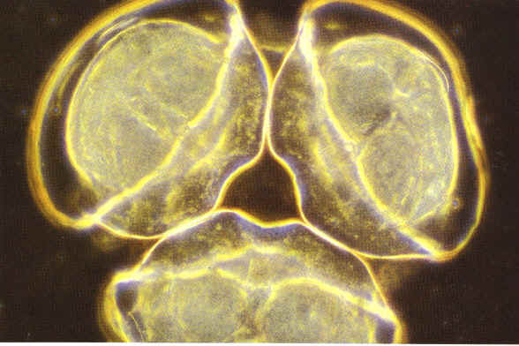
The three lips are seen at the anterior end. The margin of each lip is lined with minute teeth which are not visible at this magnification.

Slide 9
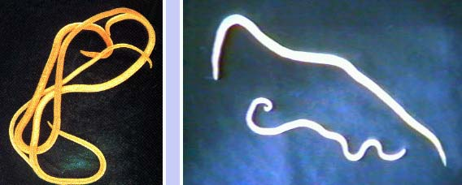
They have a complete digestive tract.
Reproductive organs are tubular. male has a single reproductive tubule. The female has two reproductive tubules and the vulva is ventrally located at the posterior part of the anterior 1/3 of the body.

Slide 10
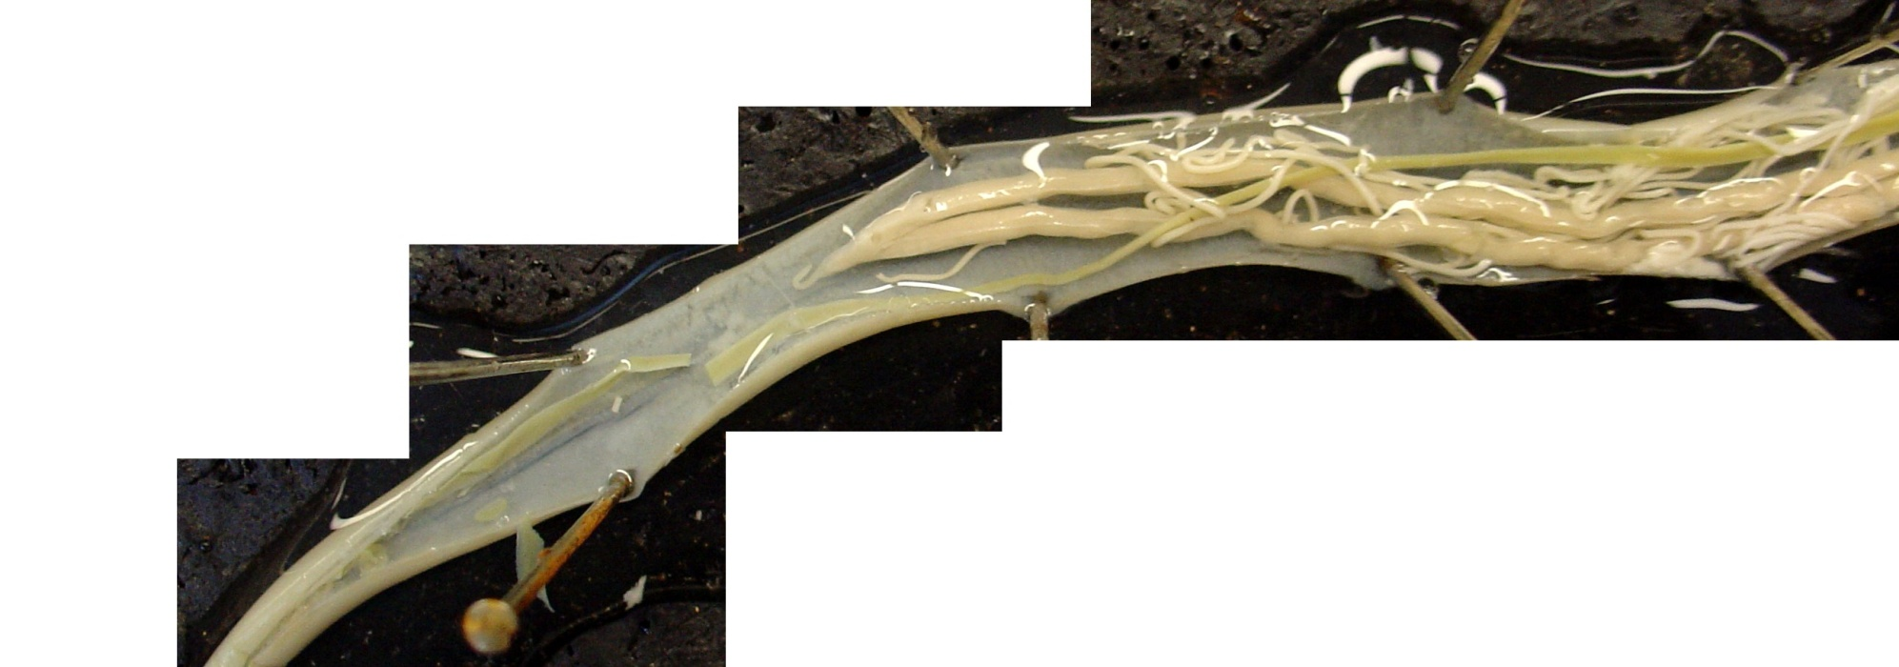
Female
gut
oviduct
genital pore
uterus
vagina

Slide 11
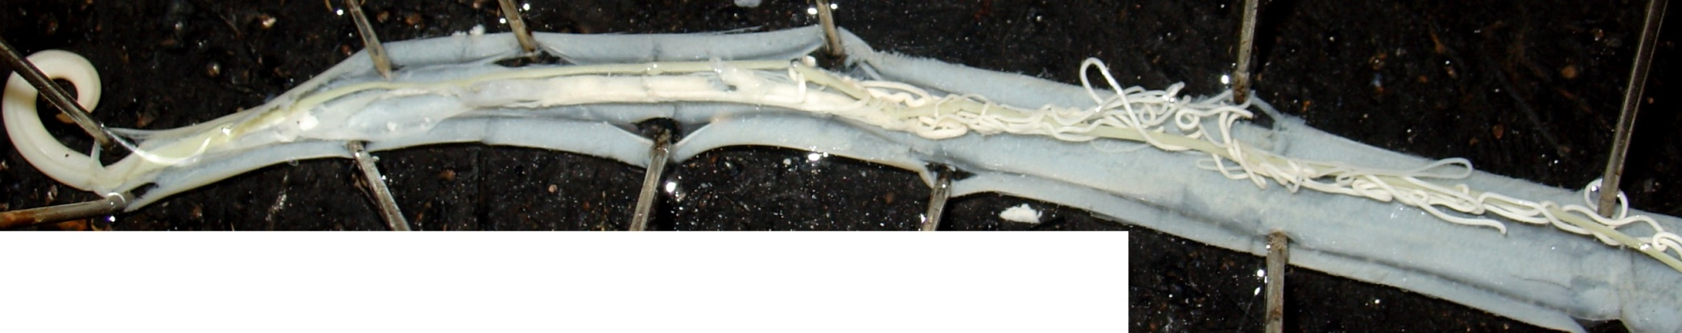
Male
sperm duct
seminal vesicle
testes
gut

Slide 12
EGGS
There are three kinds of the eggs.
  They are fertilized eggs
  Unfertilized eggs
  Decorticated eggs.
We usually describe an egg in 5 aspects: size, color, shape, shell and content.

Slide 13
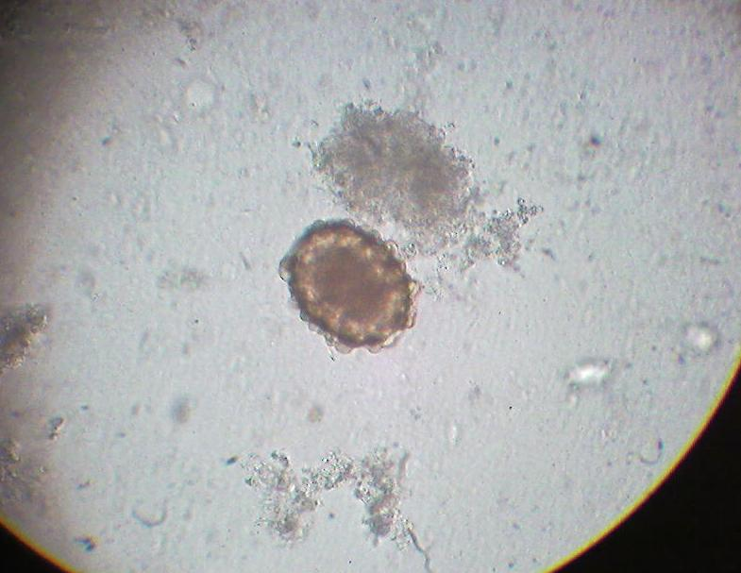
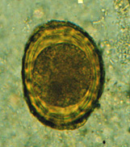
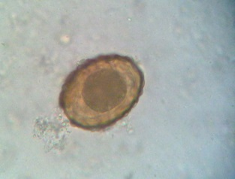
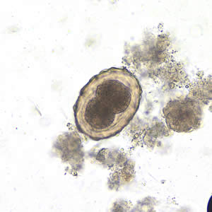
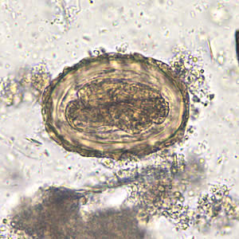
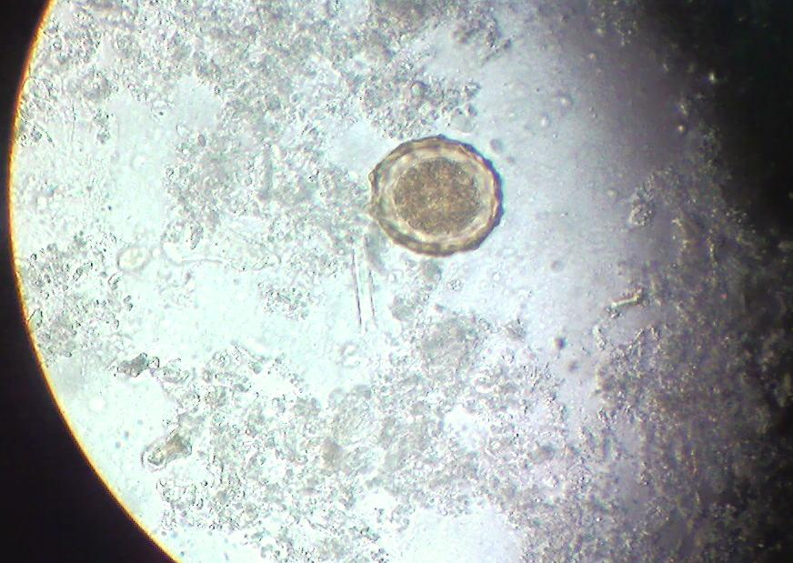
Fertilized
  More round than the unfertilized egg,
  Brown in color, average size 60× 45µm.
  Underdeveloped unicellular embryo
  Thick shell (made of chitin)
  May be corticated or decorticated (a layer of albumin that may be lost during movement)
  Has centrally located embryo

Slide 14
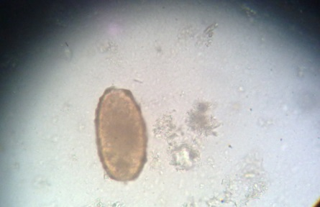
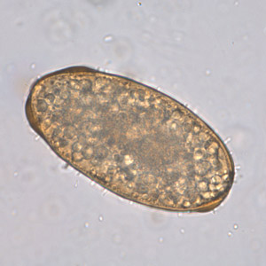
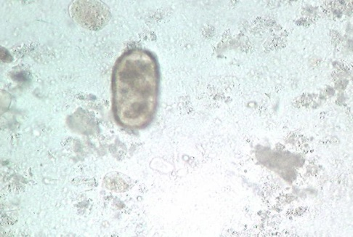
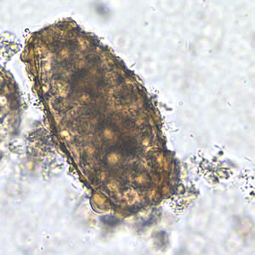
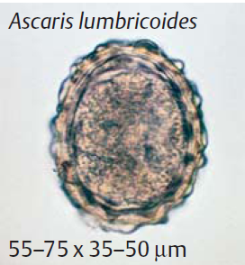
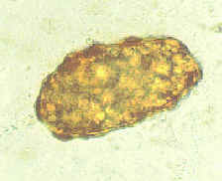
Unfertilized Egg
  Thin shell
  Shape varies from round to oblong. Longer and slender than a fertilized egg
  Unembryonated (with amorphous mass of protoplasm)
  Usually corticated
  There is no distinction between the inner mass and the cortex.
Embryopore
Corticated layer

Slide 15
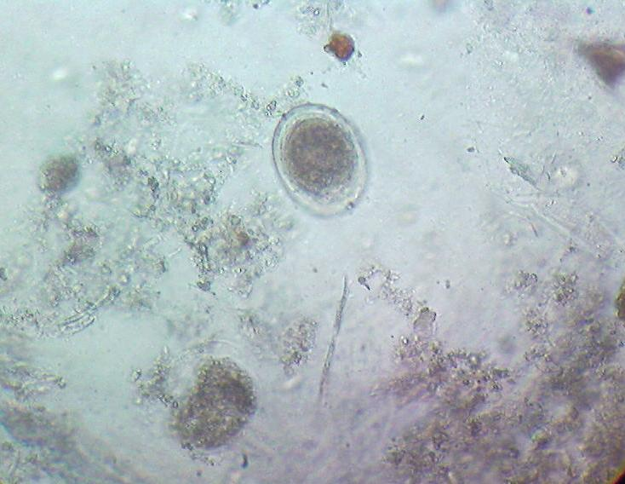
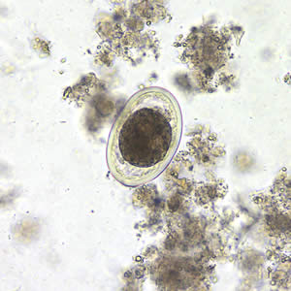
Decorticated egg
  Both fertilized and unfertilized eggs sometimes may lack their outer albuminous coats and are colorless.
Fertilized uncorticated egg with centrally located embryo

Slide 16
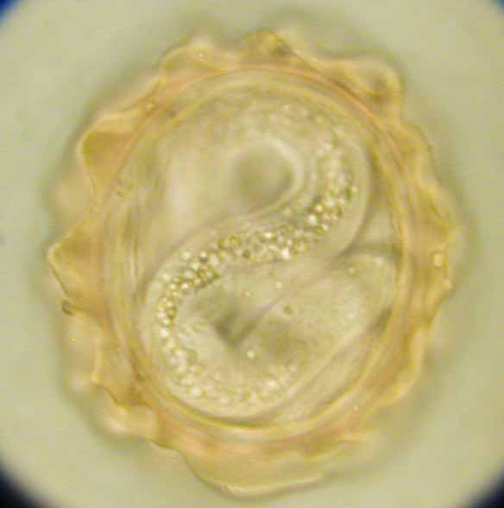
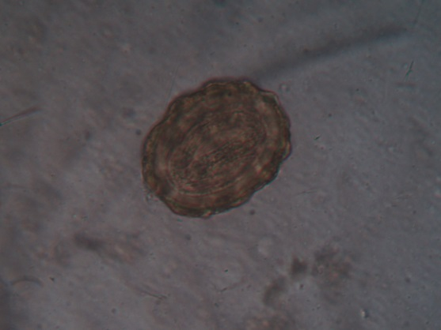

Slide 17
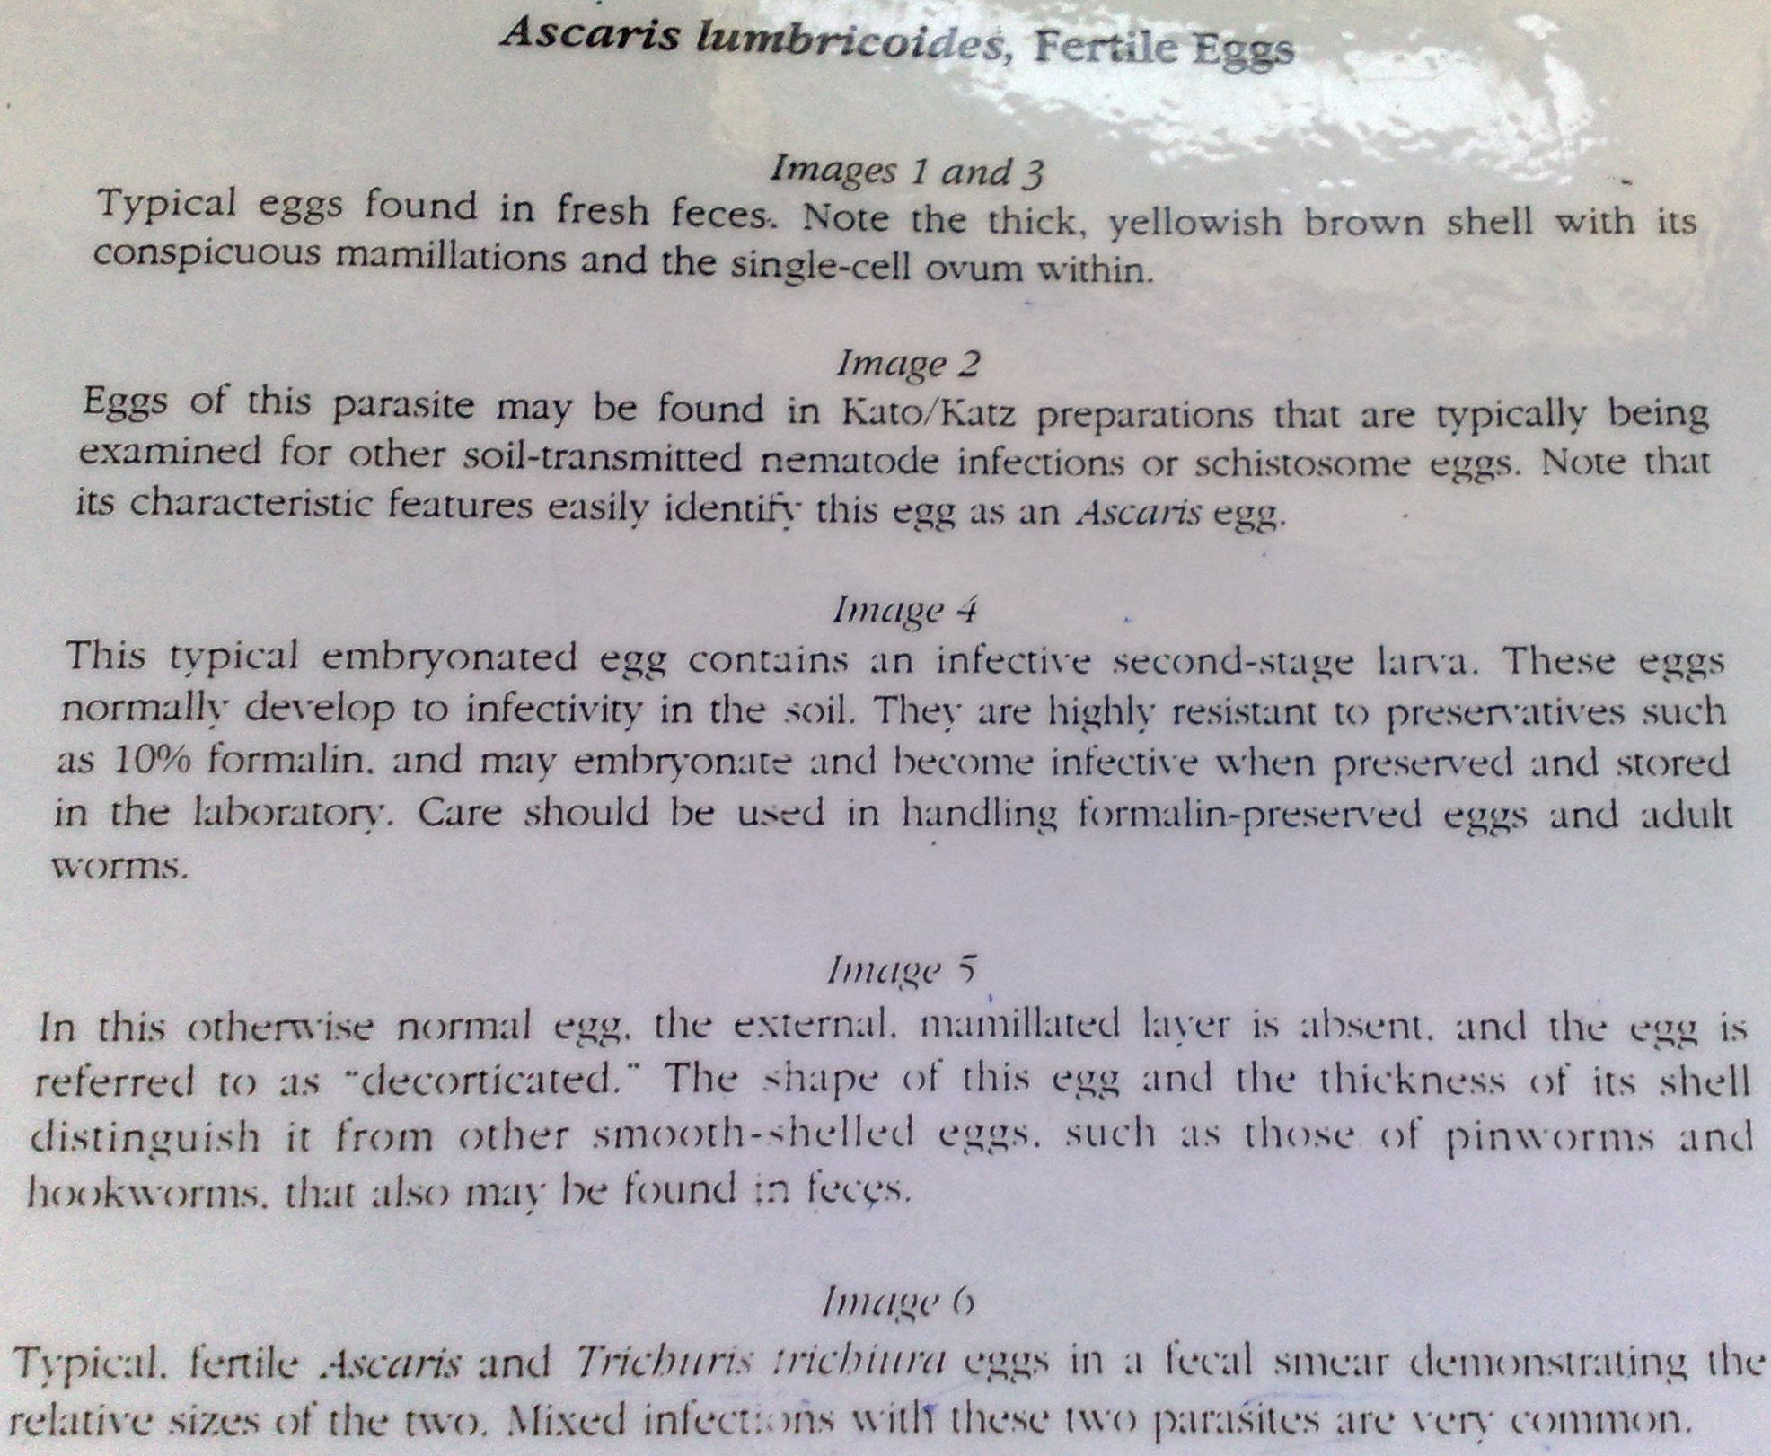

Slide 18
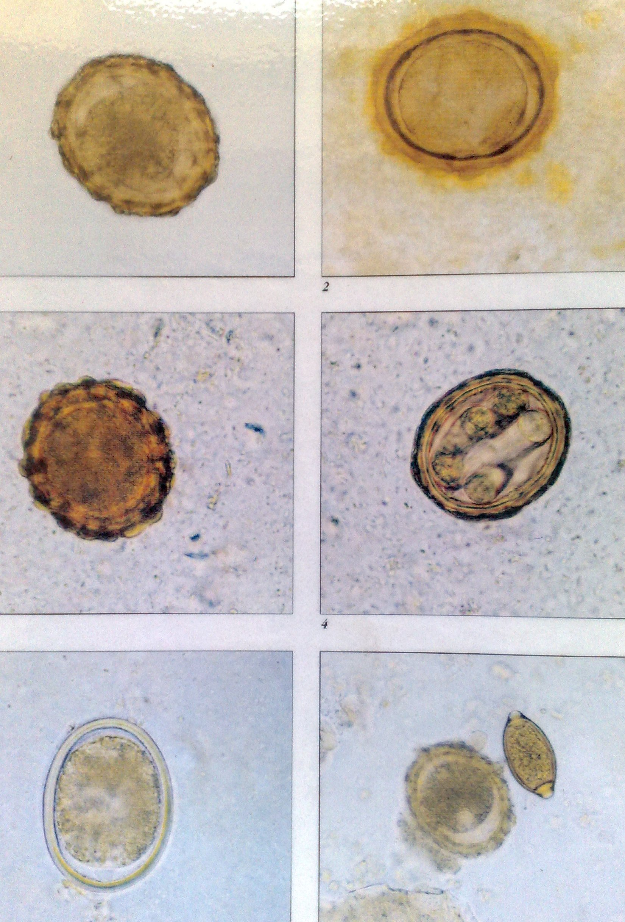

Slide 19
CHAIN OF INFECTION
INFECTIOUS AGENT-Eggs of Ascaris
RESERVOIR-Small Intestine of infected man
PORTAL OF EXIST-Passed in stool
CHAIN OF INFECTION
SUSCEPTIBLE HOST-Man who has ingested the eggs
PORTAL OF ENTRY-Orally ingested to the small intestine
MODE OF TRANSMISSION-Fecal-oral contamination

Slide 20
DISCUSSION OF THE CHAIN OF INFECTION
AGENT’S RESERVOIR
The small intestine of the infected man.
Male and female adult mate and lay eggs.
Eggs passed in stool and to a lesser extent the soil as it’s a transient reservoir for the eggs

Slide 21
ROUTE OF EXIT FROM RESERVOIR
The agents eggs are passed in stool into moist, warm soil

Slide 22
  MODE OF TRANSMISSION AND ROUTE OF ENTRY
Through fecal-oral contamination e.g. through ingestion of contaminated water, soil or food.
The ingested egg hatches to larva stage 2-undergoes blood lung migration where it develops to larvae stage 3 which moves up to the throat and forms larvae stage 4 that’s swallowed during a cough.
It’s the larvae stage 4 that resides in the small intestine and matures to adult worm

Slide 23
SUSCEPTIBLE HOST
Is the person who has ingested the infected eggs through fecal-oral contamination

Slide 24
LIFE CYCLE
Adult male and female (1) reside in the small intestine
They mate and female passes around 200,000 eggs per day, which are passed in stool (2) to moist, warm shaded soil.
Unfertilized eggs need warm and moist environment in the soil and takes 2-3 days to embryonate and fertilize after 2 weeks and develop to a motile larva stage 1(3)
Larvae stage 1 (rhibidiform) is ingested(4) and host digestive juices acts on the egg shell and liberate the larva into the small intestine.

Slide 25
It develops to larvae stage 2(5) (filariform) which penetrates the intestinal wall to the blood(6) They enter lymphatics and mesenteric vessels
They are carried by circulation to the liver, right heart and finally to the lungs
Here, the larvae stage 2 develops to larvae stage 3 which moves into the alveoli in which they molt twice and stay for 10-14days and then they are carried, or migrate, up the bronchioles, bronchi, and trachea to the epiglottis and throat(7).
It develops to larvae stage 4 that’s swallowed during a cough to the small intestine where it matures to adult male and female(1)

Slide 26
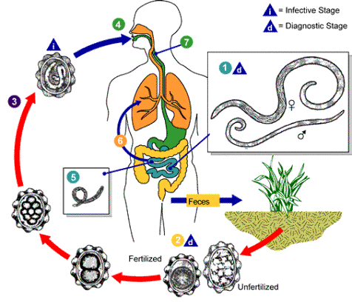

Slide 27
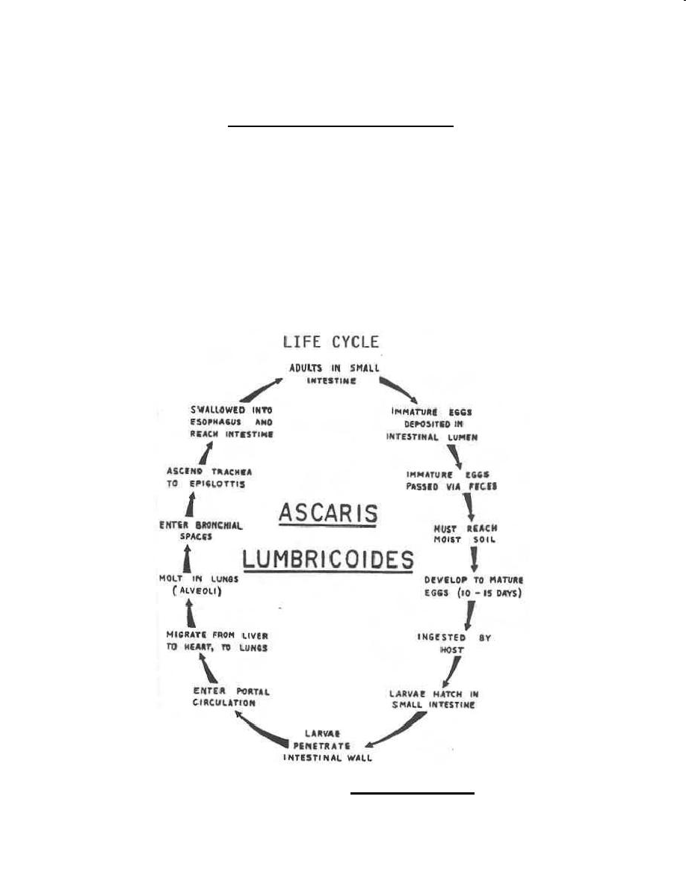
The time from the ingestion of embryonated eggs to oviposition by the females is about 60-75 days.
The adult worms live for about one year.
No intermediate and reservoir hosts

Slide 28
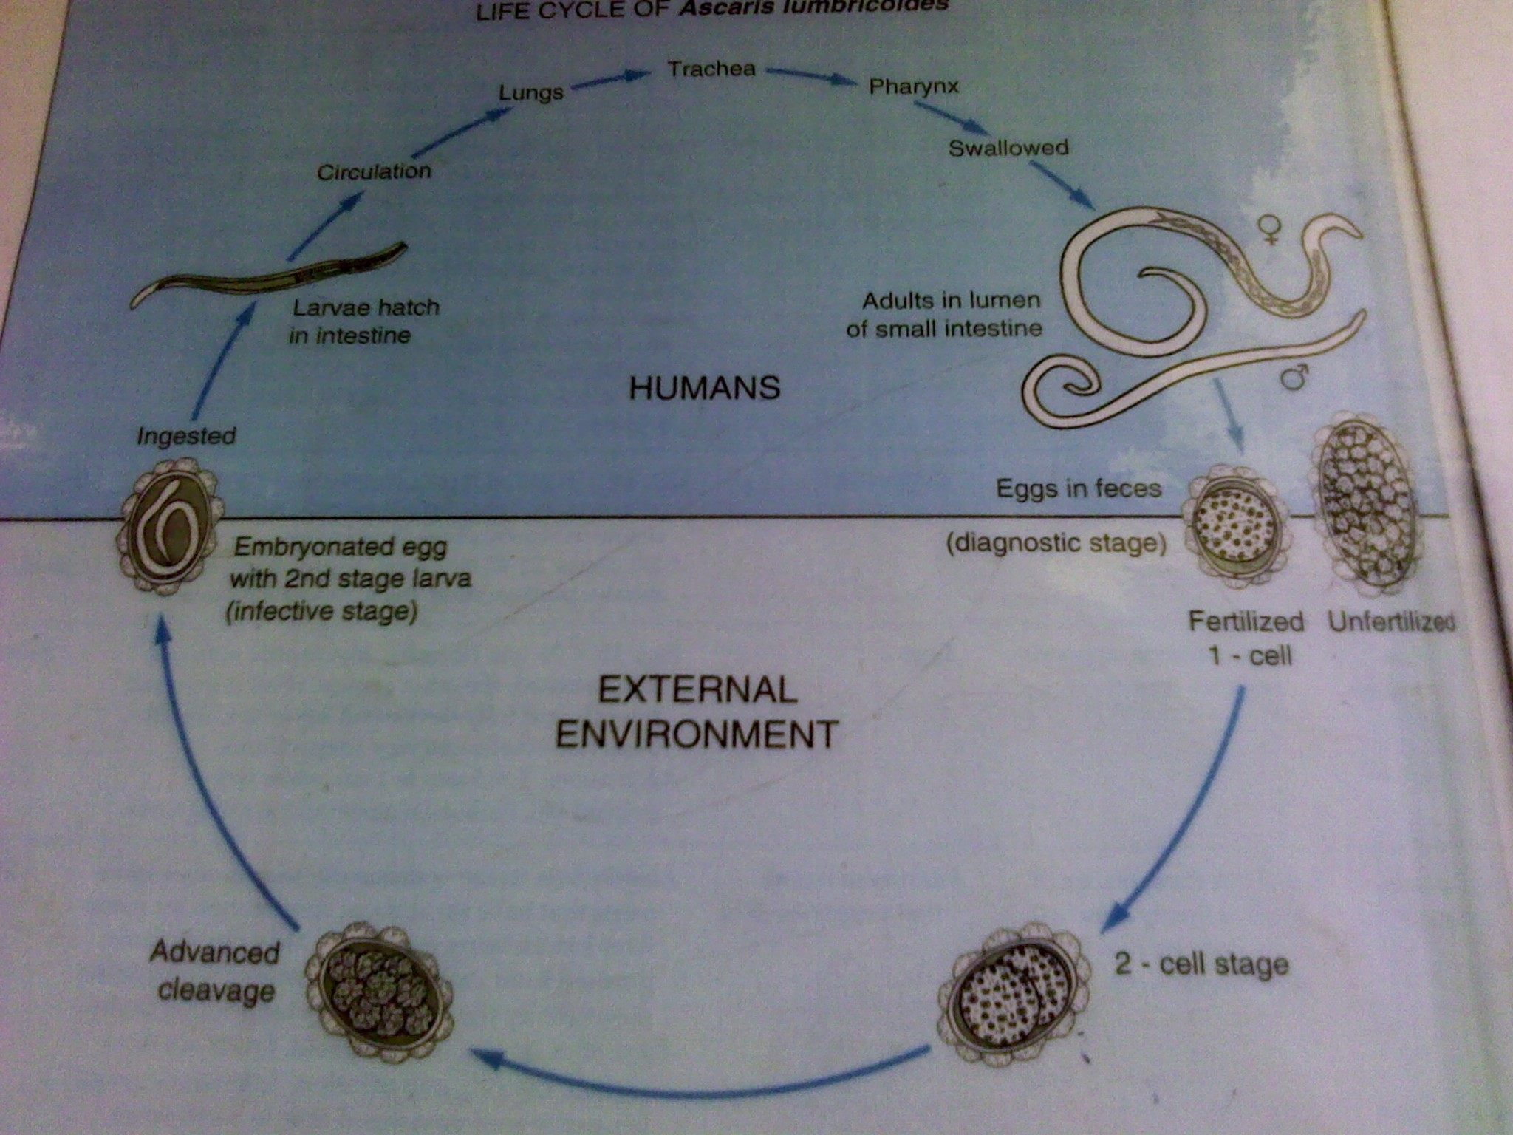

Slide 29
Ascaris lumbricoides worms have a reputation for wandering, and often do so if the body they are in-the host-is ill or taking certain medications.
Adult roundworms sometimes spontaneously exit the host through the anus, mouth, or nose.
They are found in the bathtub, toilet bowl, in diapers, or even on the pillow upon waking.

Slide 30
PATHOGENESIS
There are two phase in ascariasis:
The blood-lung migration phase of the larvae:
During the migration through the lungs, the larvae may cause a pneumonia.
The symptoms of the pneumonia are low fever, dry cough, blood-tinged sputum, asthma.
Can interfere with normal vocal vibrations
In untreated cases and numerous worms, pneumonitis develops with lymphatonitis and may give rise to allergic symptoms and eisinophilia (sputum and saliva with a lot of eisinophilia) all called Loeffler’s syndrome

Slide 31
2. The intestinal phase of the adults.
The presence of a few adult worms in the lumen of the small intestine usually produces no symptoms, but may give rise to vague abdominal pains or intermittent colic, especially in children due to mechanical injury by embedding on the intestines
A heavy worm burden can result in malnutrition.
Due to their many numbers, they can cause intestinal obstruction because they fill the intestinal lumen
In cases of fever or other abnormal body states, the intestines become a hostile environment to the Ascaris and they start moving around to look for better conducive environment (Wandering adults) and may end up going to block the bile ducts causing jaundice and can migrate to the esophagus via stomach causing suffocation. Can also go to the appendix and cause appendicitis
Biliary ascariasis, perforation of the intestine, cholecystitis, pancreatitis and peritonitis, etc., may occur, in which biliary ascariasis is the most common complication.

Slide 32
SIGNS AND SYMPTOMS
INTESTINAL SYMPTOMS
Usually in children (1 in 500) with heavy infections
Worms form a bolus causing obstruction (ileocecal valve) during starvation but they do not degenerate. Rx with Mebendazole leads to their excretion and are seen in stool. Albendazole Rx causes degeneration of the worms, thus are not seen in stool
Abdominal discomfort and pain, anorexia, nausea and diarrhea, vomiting, poor appetite
Impaired proteins and micronutrients absorption in heavy infection e.g. Vitamin A causing deficiency
Colicky(excessive gas in gut) abdominal pain, vomiting and constipation
Complications – volvulus, ileocecal intussusception (folding due to growth), gangrene, and intestinal perforation

Slide 33
HEPATOBILIARY AND PANCREATIC SYMPTOMS
Due to accidental migration of worms to these sites.
Bile duct obstruction ,cholecystitis, ascending cholangitis, Obstructive jaundice ,bile duct perforations
Hepatic abscesses after their death
Pancreatic duct obstruction – pancreatitis
LUNGS
Eosinophilic Pneumonitis (Loffler's syndrome)
Restlessness and shortness of breadth
COMPLICATIONS
In intestinal obstruction-volvulus , Intestinal perforation, ileocecal intussusceptions, gangrene,and appendicitis
Acute appendix
Internal bleeding due to hooking of the worms and may result to hypovolemic shock

Slide 34
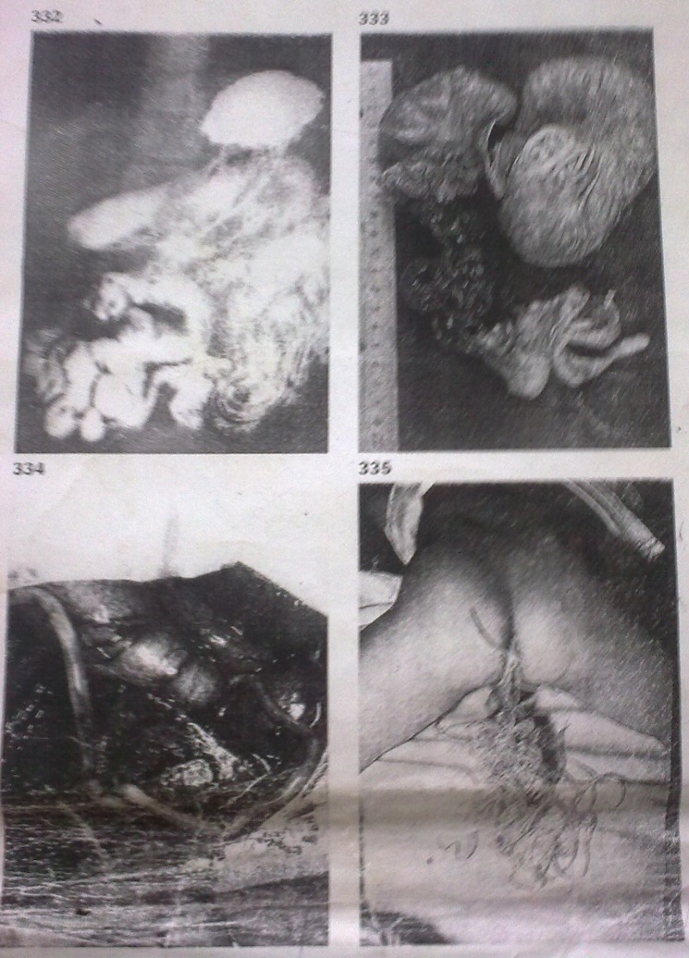
331 Adult Ascaris They mature into adult roundworm in the small intestine. The adult males are about 15 to 30 cm long, and females 20-35 cm.
332 A.lumbricoides seen in X-ray The adults may be seen as filling defects in patients having barium meals for investigation of intestinal symptoms.
333 Obstruction due to roundworms Heavy infections, especially in children, may lead to intestinal obstruction. Volvulus is an additional complication in this intestine from a two year old child.
334 Adult roundworms migrating in liver The adult worms have marked tendency to penetrate any available hole in their vicinity and may escape through abdominal fistulae following operations such as appendicectomy. They also block such organs as the common bile duct, and appendix itself.
335 Massive Ascaris infection in child A large bolus of roundworms expelled following anthelminthic treatment.

Slide 35
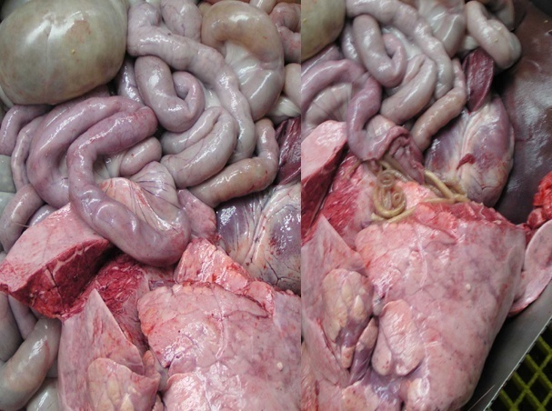
Ascaris Worms in Intestine
Notes:
35

Slide 36
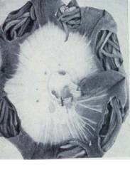
Ascaris lumbricoides penetrating the intestinal wall resulting to peritonitis

Slide 37
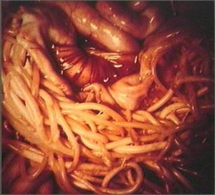
Diagram showing Ascaris lumbricoides in the small intestine

Slide 38
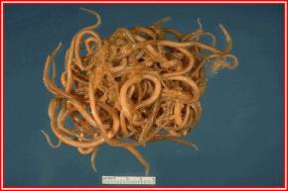
Bolus of the worm from intestinal lumen

Slide 39
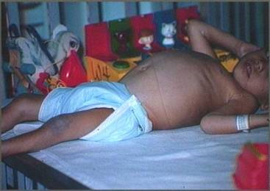
Photo of child suffering from multiple helminthes infection Ascaris lumbricoides being one of them

Slide 40
Laboratory Diagnosis
Clinical
Stool specimen with naked eyes showing pink worms
Eosinophil count- Examination of sputum reveals eosinophilia (diagnostic not differential).
Larvae can be identified in sputum or gastric aspirate during the pulmonary migration phase (examine formalin-fixed organisms for morphology).
Chest x-ray/ imaging (Barium ingestion)- showing worm presence around the hilum
Ultrasound– e.g. a bolus of worms may be seen

Slide 41
Microscopic stool examination through:
  Direct wet smear/ fecal film preparation. It is simple and effective. The eggs are easily found using this way due to a large number of the female oviposition, approximately 240,000 eggs per worm per day. So this method is the first choice.
  Concentration technique
  Kato- Katz technique- For quantitative assessments of infection
Serology(serum study)

Slide 42
PARASITOLOGY TECHNIQUES
DIRECT WET PREPARATION
Drop of normal saline on slide
Apply stool specimen
Place cover slip
Examine
FORMAL ETHER PREPARATION
Measure 7ml of 4% formal saline and pour in mortar
Add a pea size stool specimen to mortar
Mix and crush with p
estle
Sieve with 4 layered gauze (wet with water or saline)
Add 3ml of diethyl ether and mix vigorously (away from mouth!)
Centrifuge at 2000revs for 2 min, four layers obtained:
Ether
Dissolved fat
Formal saline
Deposit
- Place deposite on slide, cover slip and examine

Slide 43
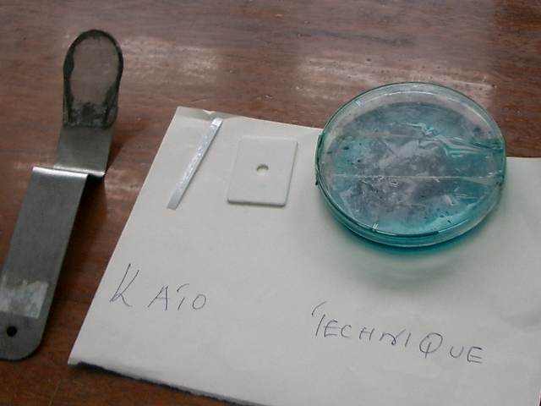

Slide 44
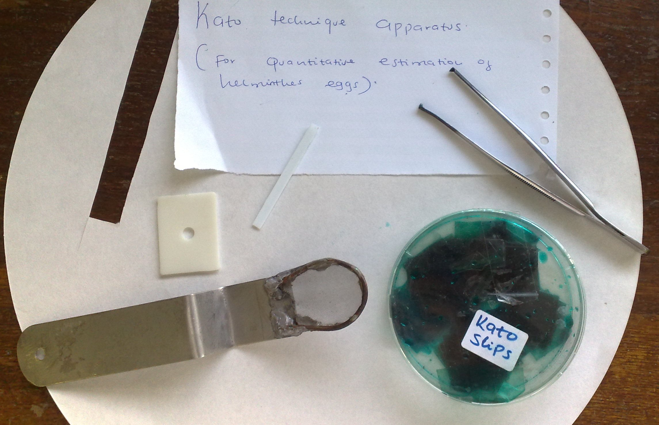

Slide 45
Microscopic identification of eggs in the stool is the most common method for diagnosing intestinal ascariasis. The recommended procedure is as follows:
  Collect a stool specimen.
  Fix the specimen in 10% formalin.
  Concentrate using the formalin–ethyl acetate sedimentation technique.
  Examine a wet mount of the sediment.

Slide 46
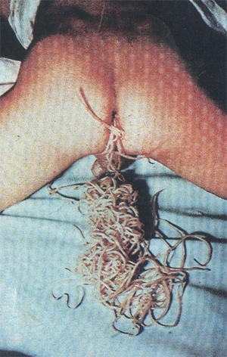
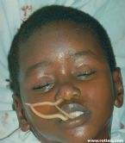
Diagram of a child passing Ascaris lumbricoides

Slide 47
Epidemiology
World wide distribution
Factors favoring the spread of the transmission:
Simple life cycle.
Enormous egg production ( 240,000 eggs/ day/ female ).
These eggs are highly resistant to ordinary disinfectants( due to the ascroside). The eggs may remain viable for several years.
Social customs and living habits.
Disposal of feces is unsuitable.

Slide 48
Treatment
Choosing the right drugs (pyrantel pamoate, mebendazole, albendazole, ivermectin, piperazine citrate, and levamizole)
Therapy
Follow-up and,
Supportive care for the patient. E.g. in case of deficiency of Vits, give supplements
Drugs

Slide 49
PREVENTION AND CONTROL
AT THE RESERVOIRS LEVEL
Stabilize patient e.g. pain management procedures
Performing confirmatory tests
Treatment using Benzimidazole antihelmintics(BZA’s) like Albendazole, Mebendazole, Thiobendazole, Levamizole, Pyrantel Pamote, Piperazine and Nitazoxanide. (Treated for 1-3 days)
Provision of health education on proper hygiene e.g. proper fecal disposal.
AT THE POINT OF EXIT LEVEL
Proper human excreta disposal to minimize contact of infected eggs with soil.

Slide 50
AT THE MODE OF TRANSMISSION LEVEL And POINT OF ENTRY
Improvement of hygiene standards through washing hands, raw vegetables and fruits and through avoidance of use of human waste as manure since one may accidentally ingest the infected soil
Water and sewage treatment
AT THE SUSCEPTIBLE HOST LEVEL
Through health education
Treatment of victims and maintenance of proper hygiene

Slide 51
STRATEGIES TO CONTROL THE DISEASE(WHO)
Ensuring availability of single dose antihelminths in all health services in endemic areas.
Ensuring good passive and active case management.
Regularly treating of school children by deworming
Improve access to clean water and proper sanitation through intersectoral collaboration
Provision of health education on the cause, effect and control of the disease

