Slide 1
TOXOCARA CANIS
(dog roundworm)
KIMAIGA H.O
MBChB (University of Nairobi)

Slide 2
Causal Agents
Toxocariasis is caused by larvae of Toxocaracanis (dog roundworm) and less frequently of T. cati (cat roundworm), two nematode parasites of animals.

Slide 3
GEOGRAPHICAL DISTRIBUTION
Worldwide

Slide 4
Toxocara canis & T. cati
Females 4-18cm long
Males 3-10cm long
Head usually curved ventrally
Egg shell is usually pitted

Slide 5
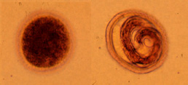
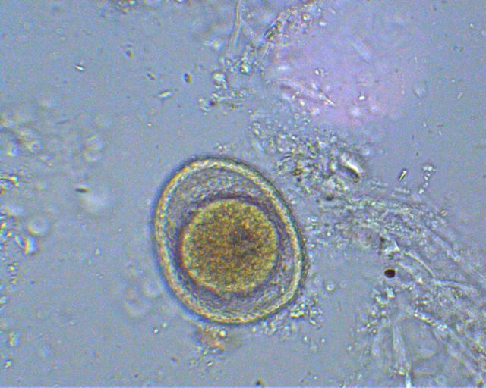
Toxocara sp. (eggs)

Slide 6
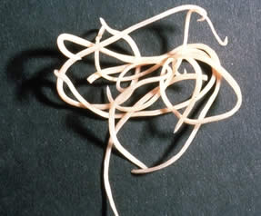
Adult

Slide 7
LIFE CYCLE
Toxocara canis completes its life cycle in dogs, with humans acquiring the infection as accidental hosts.
Unembryonated eggs are shed in the feces of the definitive host .
Eggs embryonate and become infective in the environment .
The infective eggs are ingestion by dogs
They hatch and larvae penetrate the gut wall. In puppies the larvae migrate through the lungs, bronchial tree, and esophagus; adult worms develop and oviposit in the small intestine

Slide 8
In older dogs there is development arrest but development is resumed due to hormonal stimulation during pregnancy hence the larvae migrate to ovary and uterus and infect puppies by the transplacental and transmammary routes.
Adult worms establish in the small intestines of puppies
Puppies and are a major source of environmental egg contamination.
Toxocaracanis can also be transmitted through ingestion of paratenic hosts: eggs ingested by small mammals (e.g. rabbits) hatch and larvae penetrate the gut wall and migrate into various tissues where they encyst .

Slide 9
The life cycle is completed when dogs eat these hosts and the larvae develop into egg-laying adult worms in the small intestine.
Humans are accidental hosts who become infected by ingesting infective eggs in contaminated soil - paratenic (not the usual host) host
Also by eating infected paratenic hosts .

Slide 10
After ingestion, the eggs hatch and larvae penetrate the intestinal wall and are carried by the circulation to a wide variety of tissues (liver, heart, lungs, brain, muscle, eyes) .
The larvae do not undergo any further development in these sites (developmental arrest), they can cause severe local reactions that are the basis of toxocariasis.
  The two main clinical presentations of toxocariasis are visceral larva migrans and ocular larva migrans.
  Diagnosis is usually made by serology or the finding of larvae in biopsy or autopsy specimens.

Slide 11
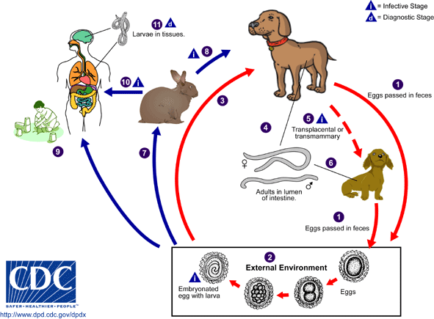

Slide 12
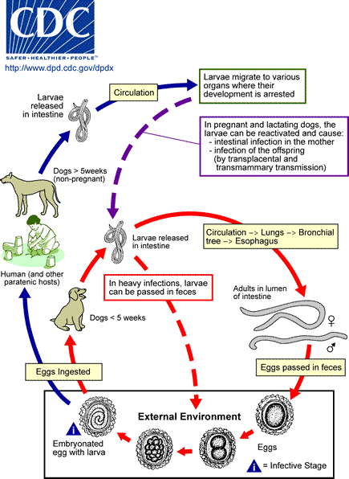

Slide 13
PATHOLOGY
Prolonged wandering to tissues e.g liver, lungs, brain, kidney, muscles and skin
Severity pathology depends on the size of the inoculum and previous history of exposure

Slide 14
Clinical Presentation
The 2 main clinical presentations of toxocariasis are
Visceral larva migrans (VLM)
Ocular larva migrans (OLM).

Slide 15
Visceral larva migrans (VLM)
  The larvae invade multiple tissues (liver, heart, lungs, brain, muscle) and cause various symptoms including fever, anorexia, weight loss, pulmonary symptoms (cough, wheezing), rashes, fever, hepatosplenomegaly, and hypereosinophilia. Death can occur rarely, by severe cardiac, pulmonary or neurologic involvement.
  Mostly occurs in preschool children.

Slide 16
Ocular larva migrans (OLM).
  The larvae produce various ophthalmologic lesions, which in some cases have been misdiagnosed as retinoblastoma, resulting in surgical enucleation.
  Often occurs in older children or young adults, with only rare eosinophilia or visceral manifestations.

Slide 17
Symptoms
Fever
Pulmonary symptoms
Eosinophilia (particularly peripheral)
Severe allergic reaction in tissues & granulomatous formation
Leading to a scar tissue formation
Visceral larva migrans can be caused by other larval nematodes (e.g. Spirurida, Filarida, Strongylida)
E.g. Gnathostoma spinigerum, Angiostrongylus cantonensis, Aniskis marina, Capillaria hepatica, Dirofilaria sp.

Slide 18
Laboratory Diagnosis:
History of exposure (contact with puppies) is important
Diagnosis does not rest on identification of the parasite. Since the larvae do not develop into adults in humans, a stool examination would not detect any Toxocara eggs. However, the presence of Ascaris and Trichuris eggs in feces, indicating fecal exposure, increases the probability of Toxocara in the tissues.
For both VLM and OLM, diagnosis rests on clinical signs, history of exposure to puppies.
Serological diagnosis and tissue biopsy - Eousinophilia, Leukocytosis and the detection of antibodies to Toxocara.

Slide 21
CONTROL
Preriodic deworming of pets
General hygiene

Slide 22
Treatment
Diethylcarbamazine
Thiabendazole
Albendazole
Mebendazole
VLM is treated with antiparasitic drugs, usually in combination with antiinflammatory medications.

