Slide 1
Introduction
Intestinal nematode (round worm)
Found in the large intestines, cecum and appendix of the host.

Slide 2
TRICHIURIS TRICHIURA
(Human whip worm)
KIMAIGA H.O
MBChB (University of Nairobi)

Slide 3
Geographic Distribution
The third most common round worm of humans.
Worldwide distribution, more in the tropics and in the southern United States.
More common in areas with poor sanitary conditions.
Children are most affected
Causes disease known as trichuriasis
It is estimated that 800 million people are infected worldwide

Slide 4
Morphology
Grayish white in colour
Adult males of Trichuris trichiura are 30-45 millimeters long, with a coiled posterior end.
Adult females are 35-50 millimeters with a straight posterior end.
Both sexes have a long, whip-like anterior end.

Slide 5
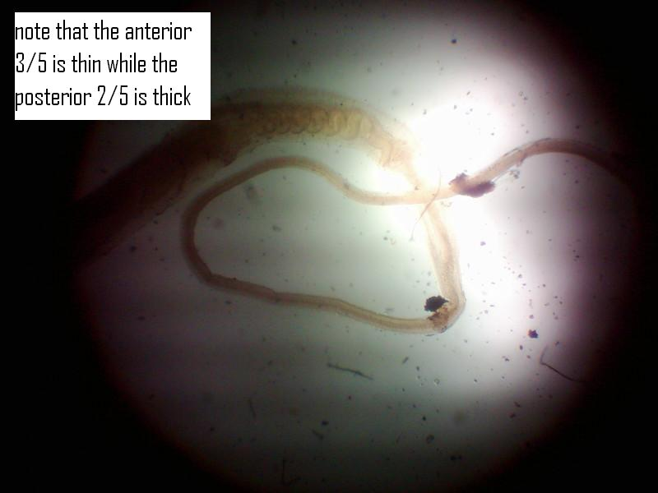
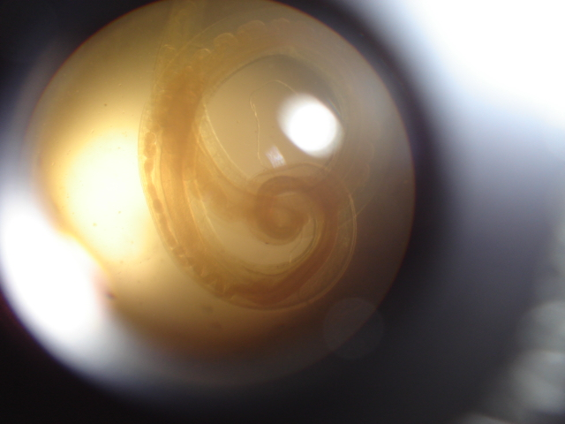

Slide 6
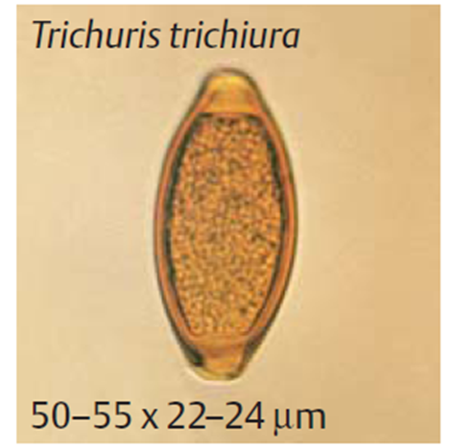
EGGS
Trichuris trichiura eggs are 50-55 micrometers by 20-25 micrometers.
They are oval, thick-shelled, brownish
White polar plugs on both ends
Eggs are passed unembryonated in stool.

Slide 7
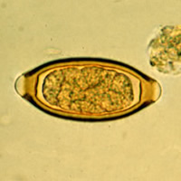

Slide 8
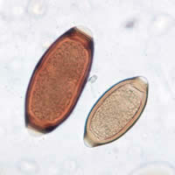

Slide 10
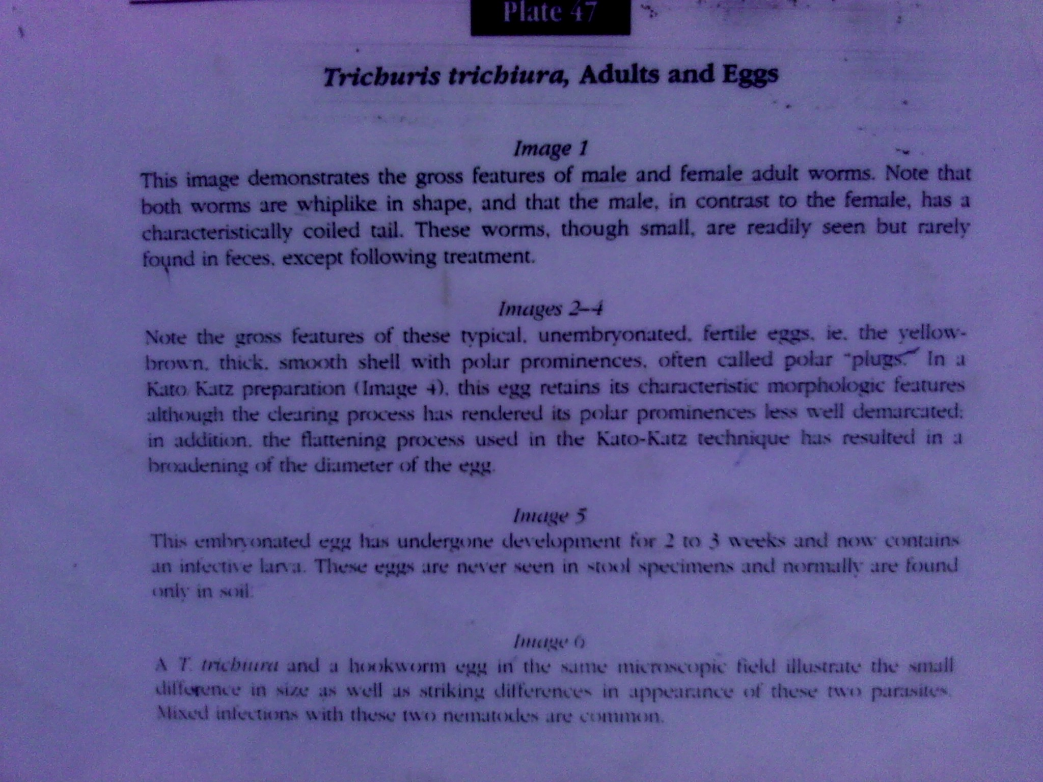
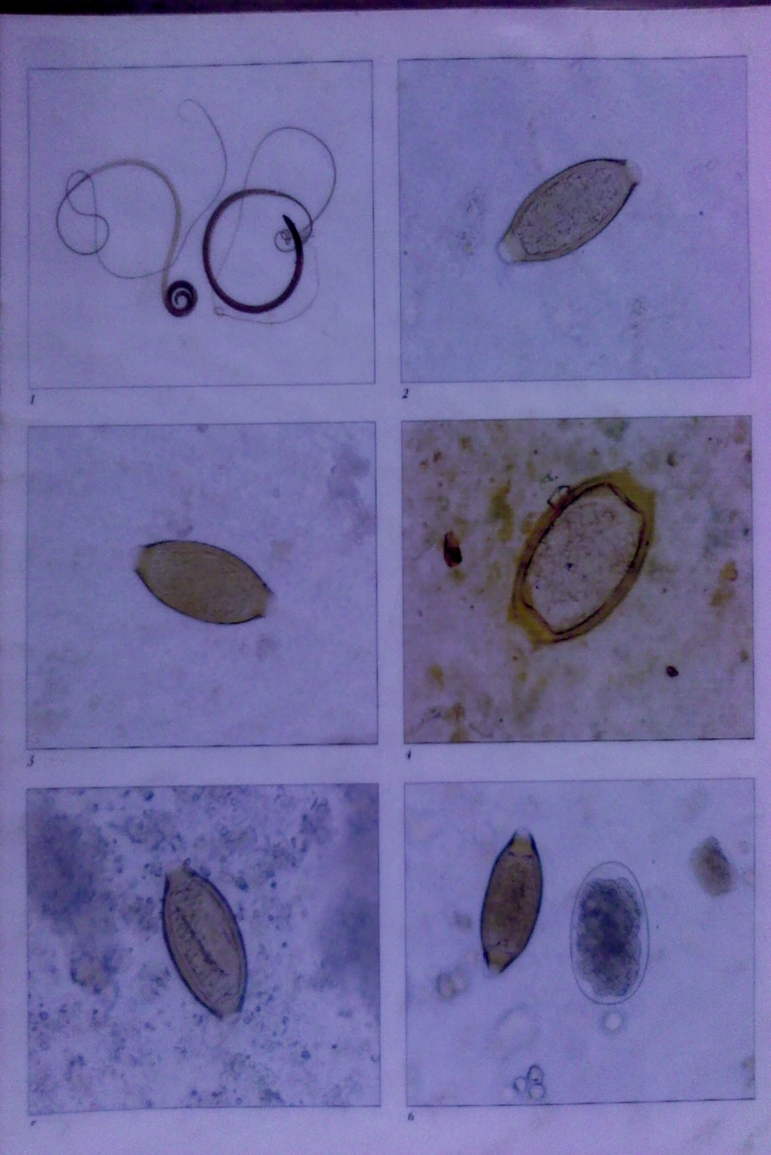

Slide 11
Life Cycle
Adults mate in the large intestines and the female lays the eggs. The unembryonated eggs are passed with the stool .
In the soil, the eggs develop into a 2-cell stage,
an advanced cleavage stage,
and then they embryonate ; eggs become infective in 15 to 30 days. (approximately 3 weeks)
After ingestion (soil-contaminated hands or food), the eggs hatch in the small intestine, and release larvae
The larvae mature and establish themselves as adults in the colon .

Slide 12
From ingestion of eggs to adult it takes approximately 3 months. The adult worms (approximately 4 cm in length) live in the cecum and ascending colon. The adult worms are fixed in that location, with the anterior portions threaded into the mucosa. The females begin to oviposit 60 to 70 days after infection. Female worms in the cecum shed between 3,000 and 20,000 eggs per day. The life span of the adults is about 1 year.
In summary, females lay eggs, eggs passed in stool, ingested and mature in the large intestines again

Slide 13
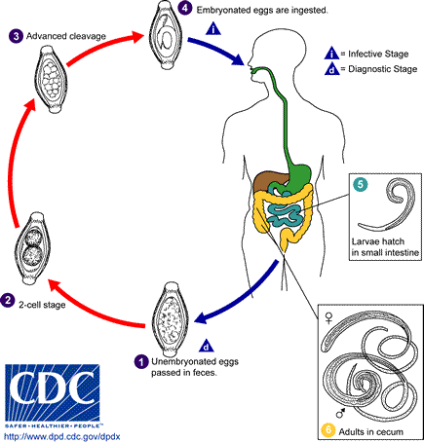

Slide 14
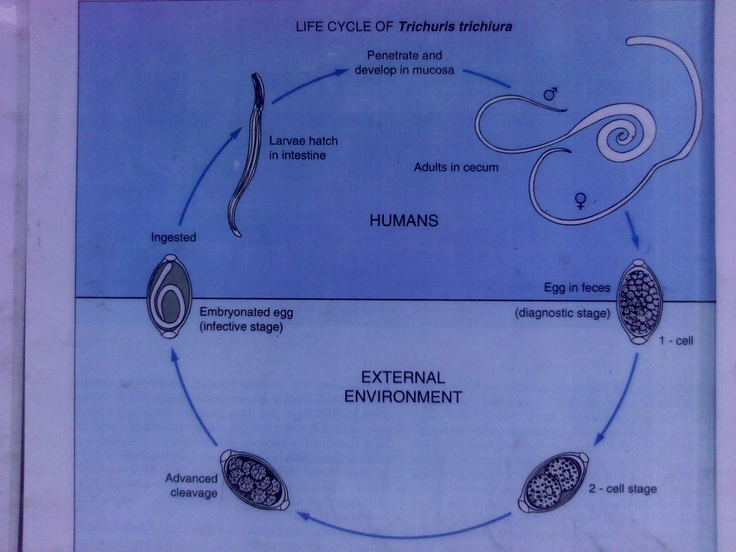

Slide 15
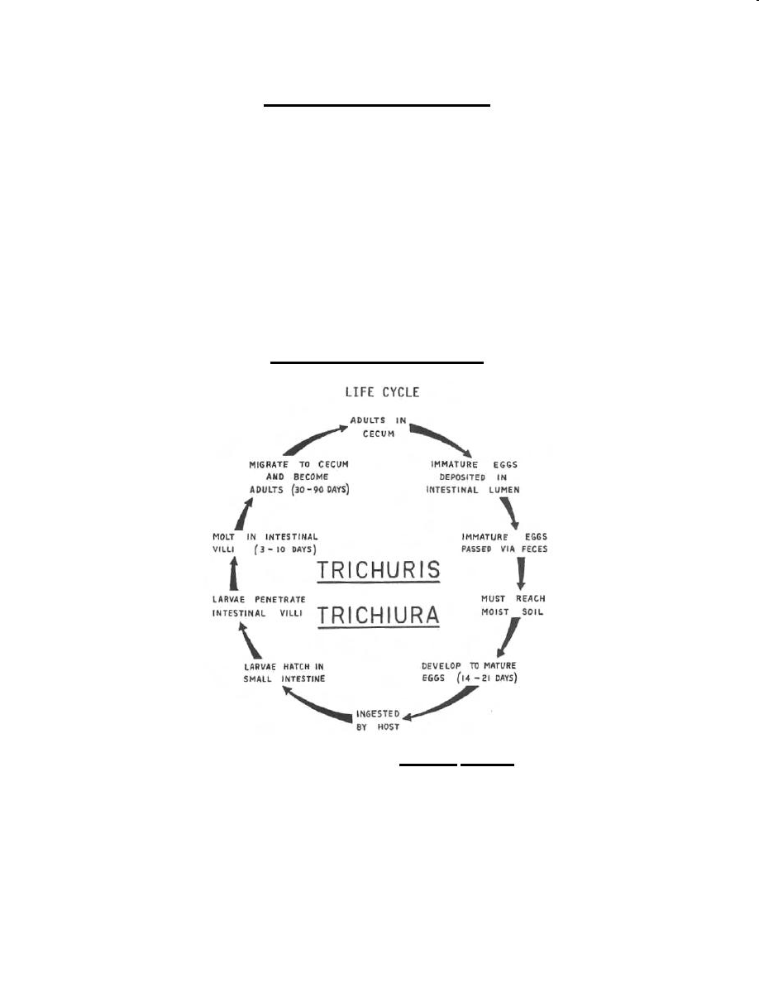

Slide 16
Clinical Presentation
Light infection mostly asymptomatic
Heavy infection especially in small children causes abdominal discomfort pain, diarrhea and bloody stool that may lead to anemia
Complication; rectal prolapse, the rectum becomes edematous then becomes loose and descends and growth retardation

Slide 17
Laboratory diagnosis
Stool examination; direct smear and identification of whipworm double-shelled, bile-stained eggs with bipolar mucoid plugs
Formalin ethyl acetate concentration sedimentation methods.
Because the severity of symptoms depend on the worm burden, quantification of the concentration technique (e.g. with the Kato-Katz technique) can prove useful
Sigmoidoscopy; adult worms attached to the mucosa
Examination of the rectal mucosa by proctoscopy (or directly in case of prolapses) can demonstrate adult worms.
Serological tests, including ELISA, have been used experimentally to measure antibodies, but are not used for routine diagnosis.
Faeces contain numerous Charcot-Leyden crystals and eosinophils.

Slide 18
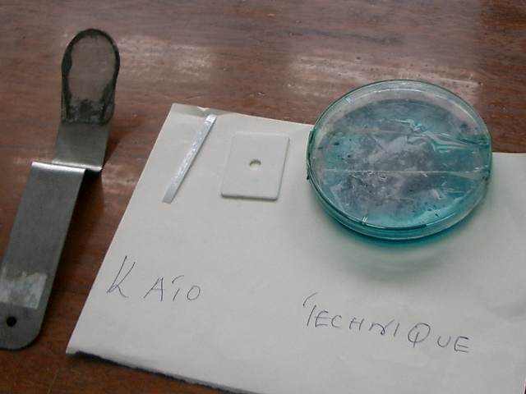

Slide 19
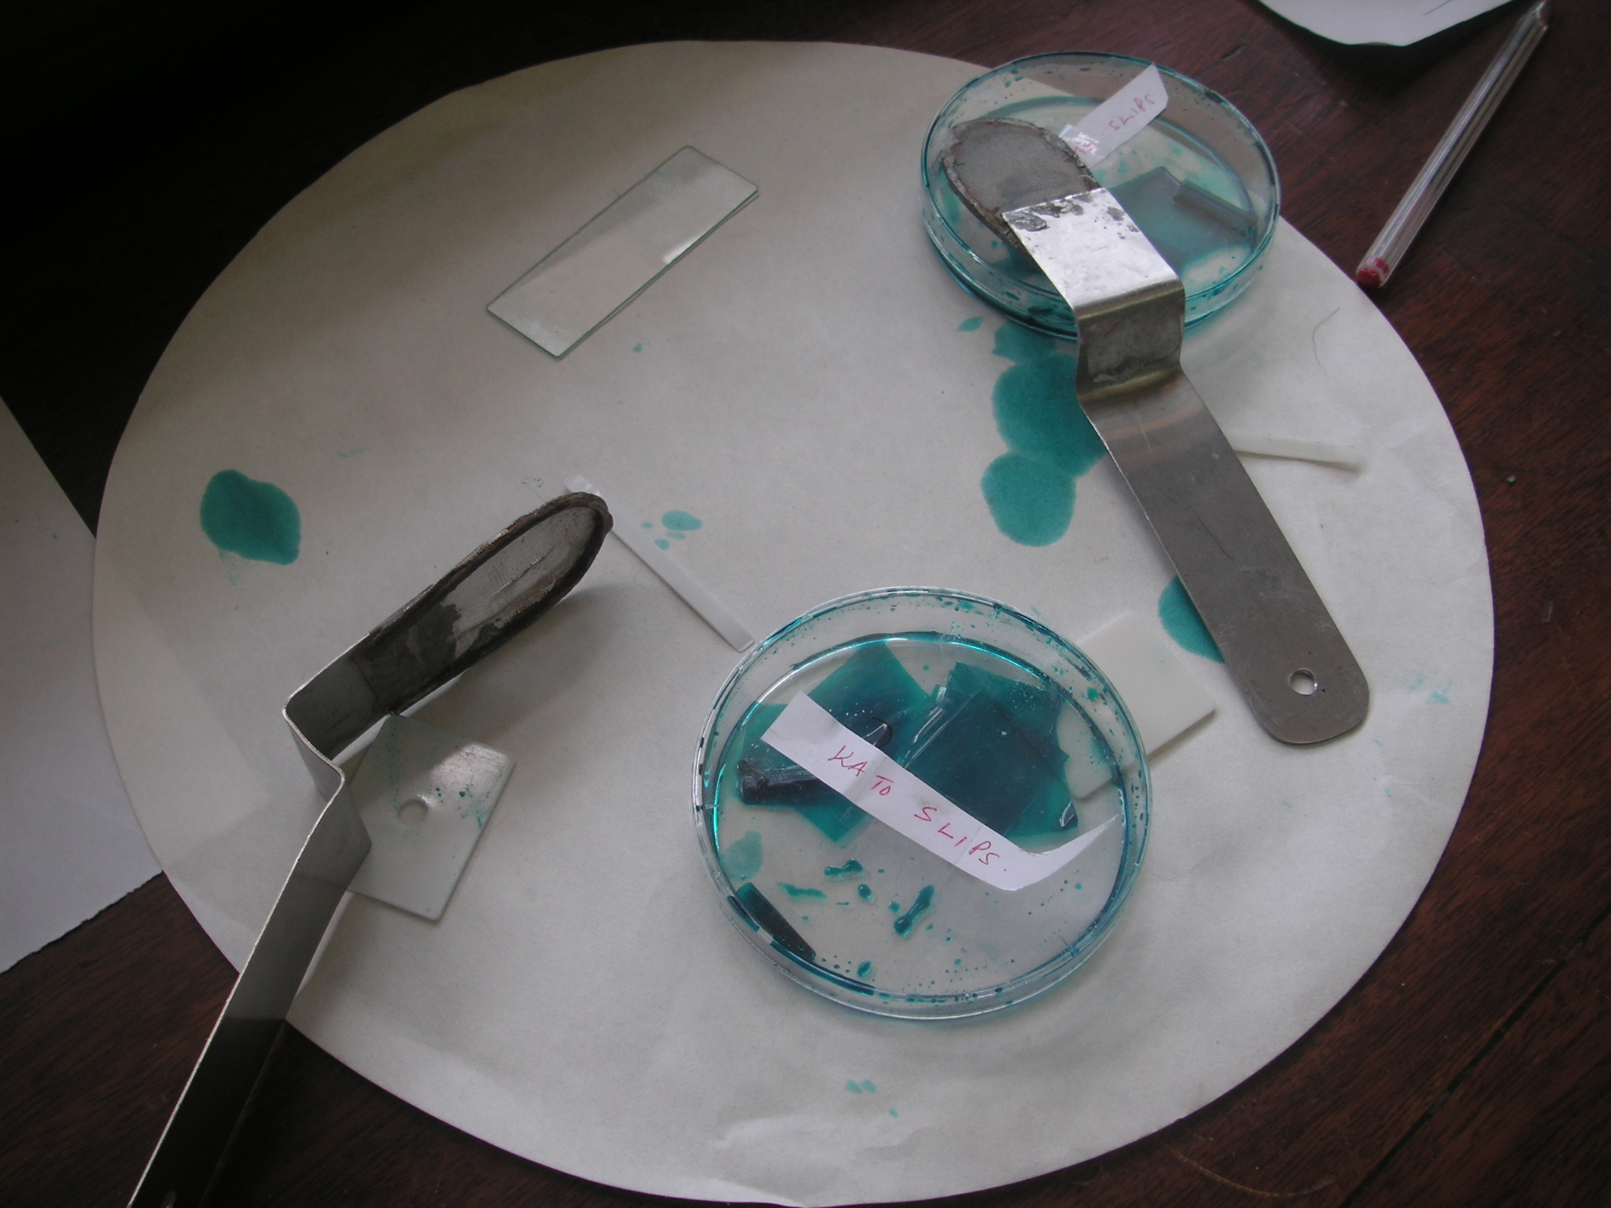

Slide 20
Treatment
Mebendazole
Albendazole
These are the Broad Spectrum Antihelminthes.

Slide 21
Prevention and Control
Proper fecal disposal in pit latrines
Don’t use untreated human feces as manure
Health education on how disease is transmitted
Proper hygiene; washing of hands before taking meals, proper washing of vegetables that is eaten raw
Treatment of infected persons

