Slide 1
ENTEROBIUS VERMICULARIS
KIMAIGA H.O
MBChB (University of Nairobi)

Slide 2
Causal Agent:
The nematode (roundworm) Enterobius vermicularis (previously Oxyuris vermicularis) also called human pinworm.
Humans are considered to be the only hosts of E. vermicularis.
A second species, Enterobius gregorii, has been described and reported from Europe, Africa, and Asia. The morphology, life cycle, clinical presentation, and treatment of E. gregorii is identical to E. vermicularis.

Slide 3
Geographic Distribution:
Worldwide, with infections more frequent in school- or preschool-children and in crowded conditions e.g. orphanages, boarding schools etc
Enterobiasis appears to be more common in temperate and cold climates than tropical and warm countries.
The most common helminthic infection in the United States (an estimated 40 million persons infected).

Slide 4
Morphology
Adult
  Adult females: 8 to 13 mm, adult male: 2 to 5 mm.
  Adult males have a blunt posterior end with a single spicule
  Females possess a long pointed tail.
  In both sexes, there are cephalic expansions.
Eggs
  Planoconvex in shape (like capital D)
  Usually are embryonated (larvae inside visible)

Slide 5
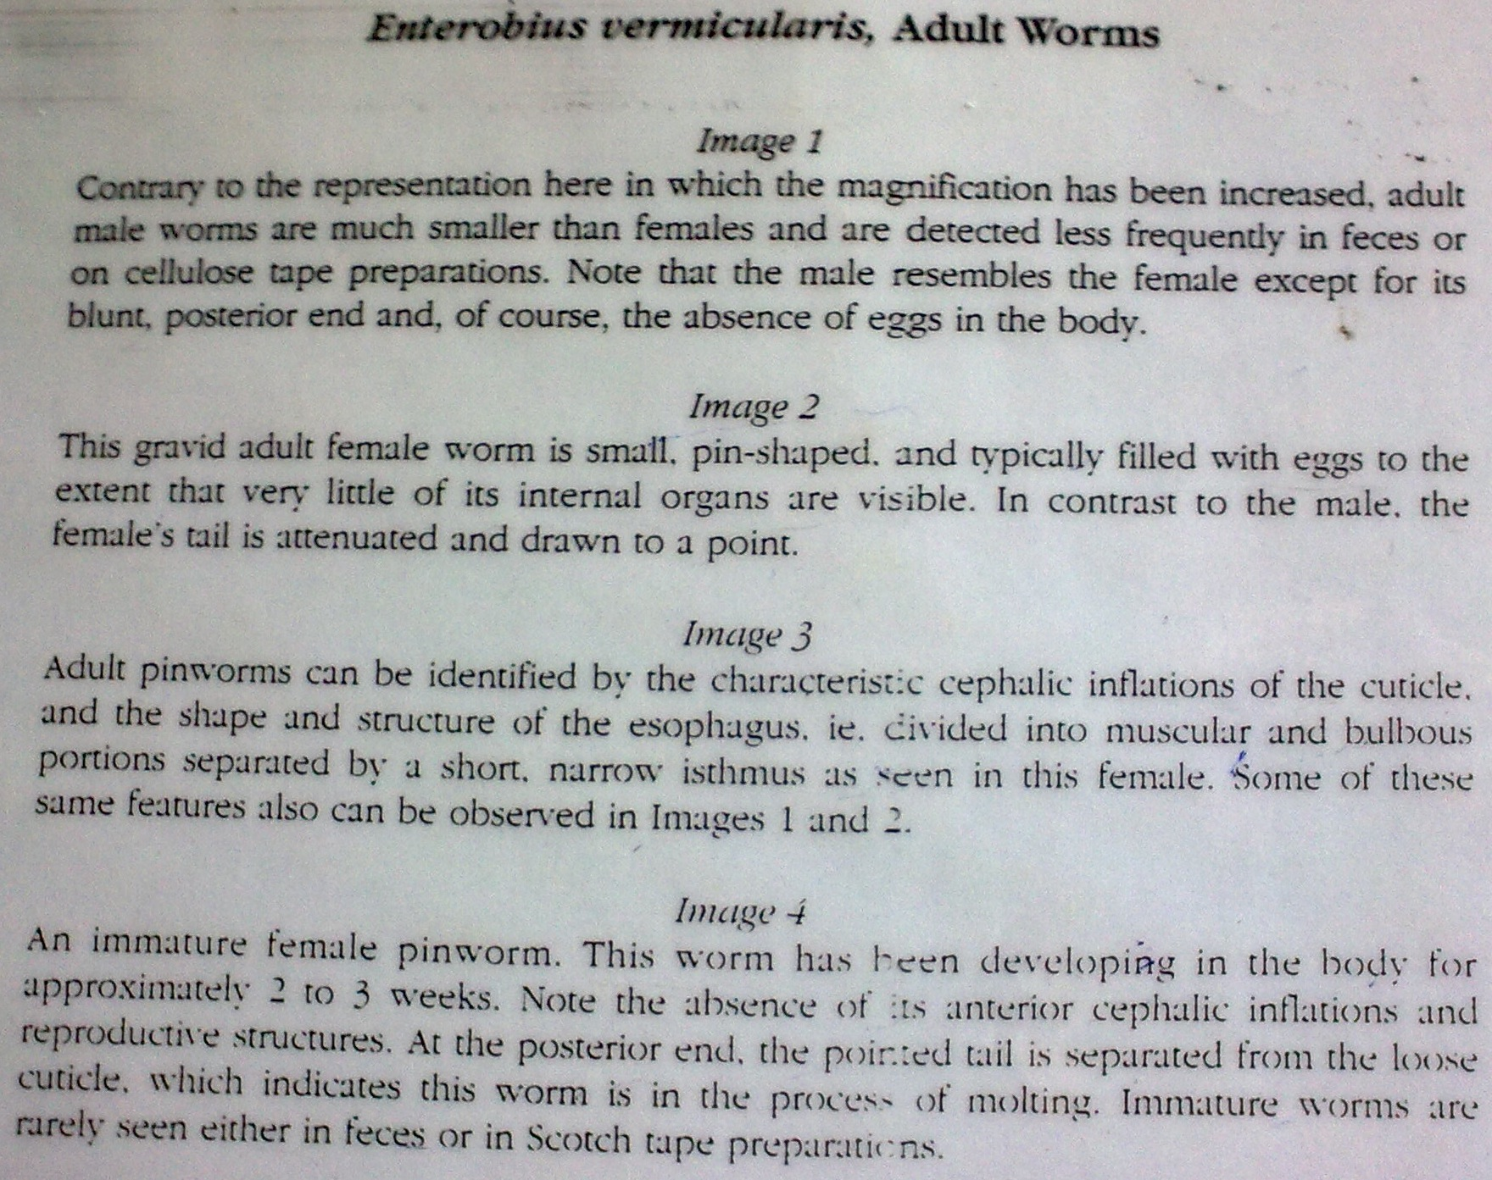
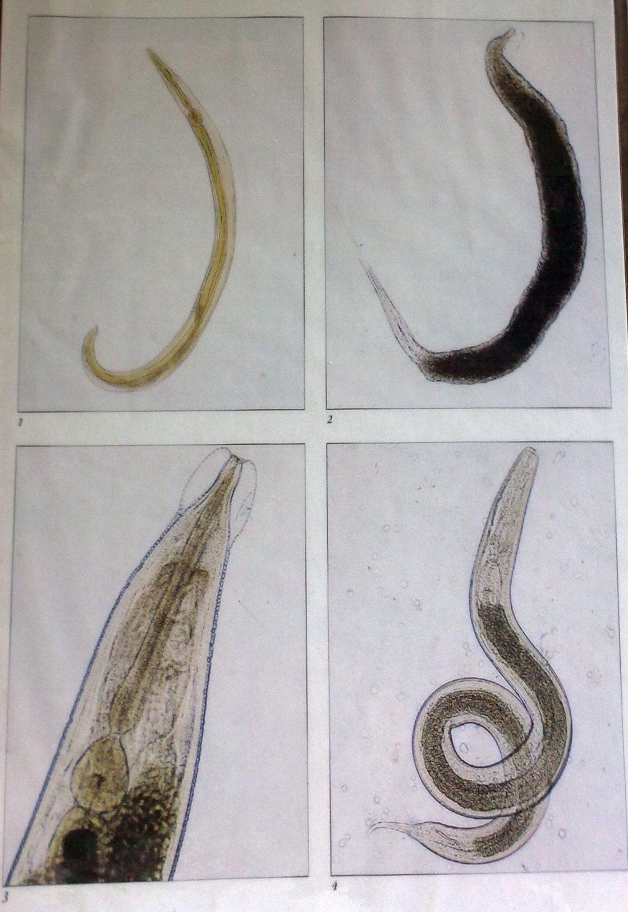

Slide 6
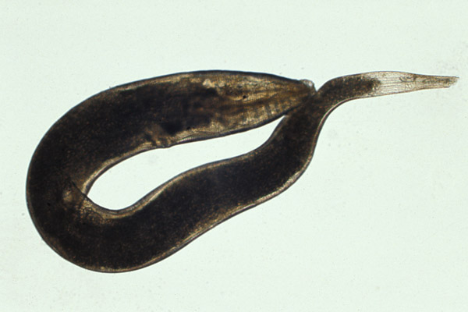
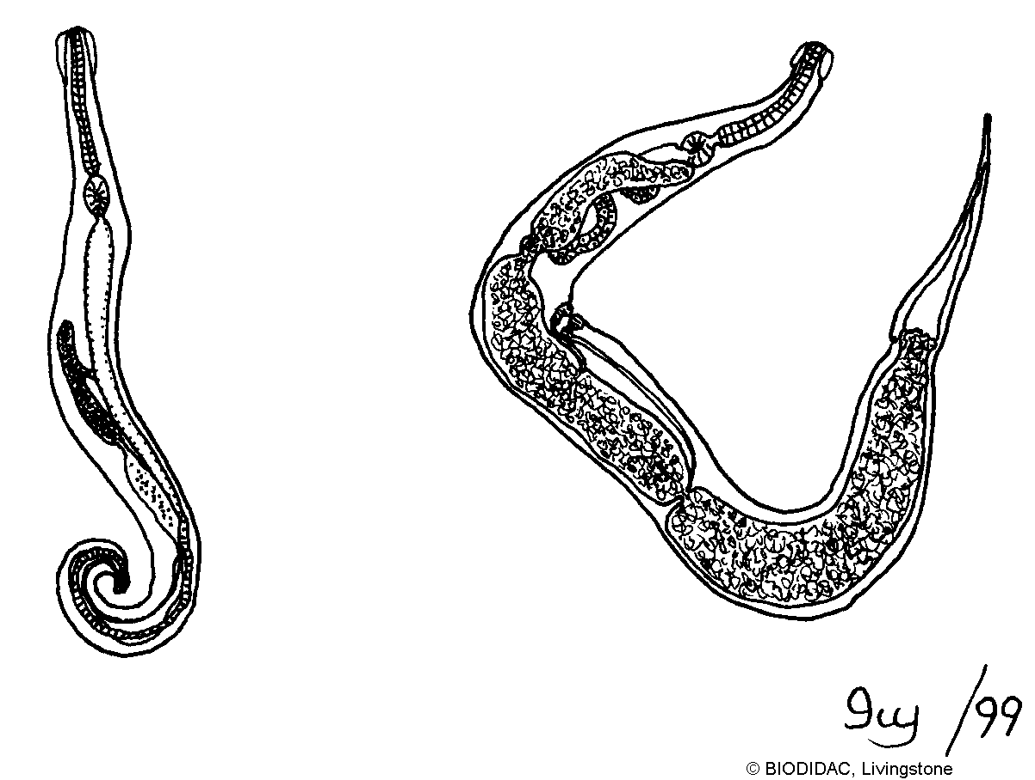
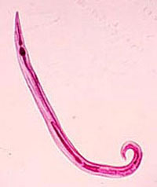
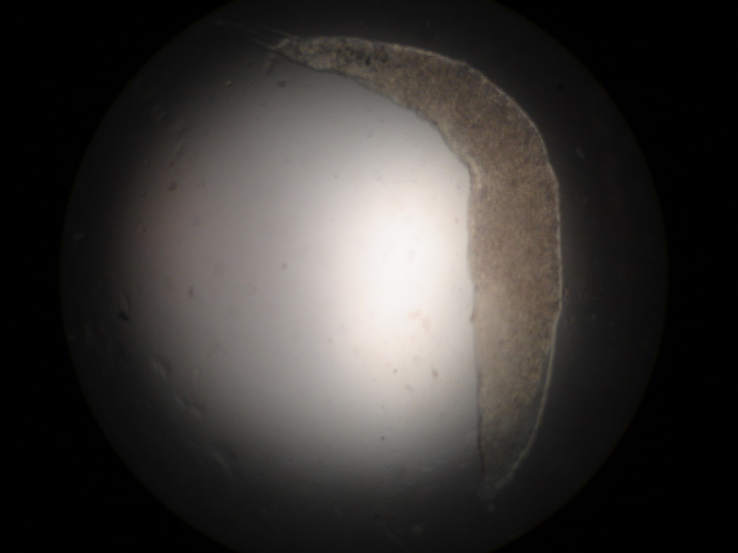

Slide 7
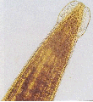

Slide 10
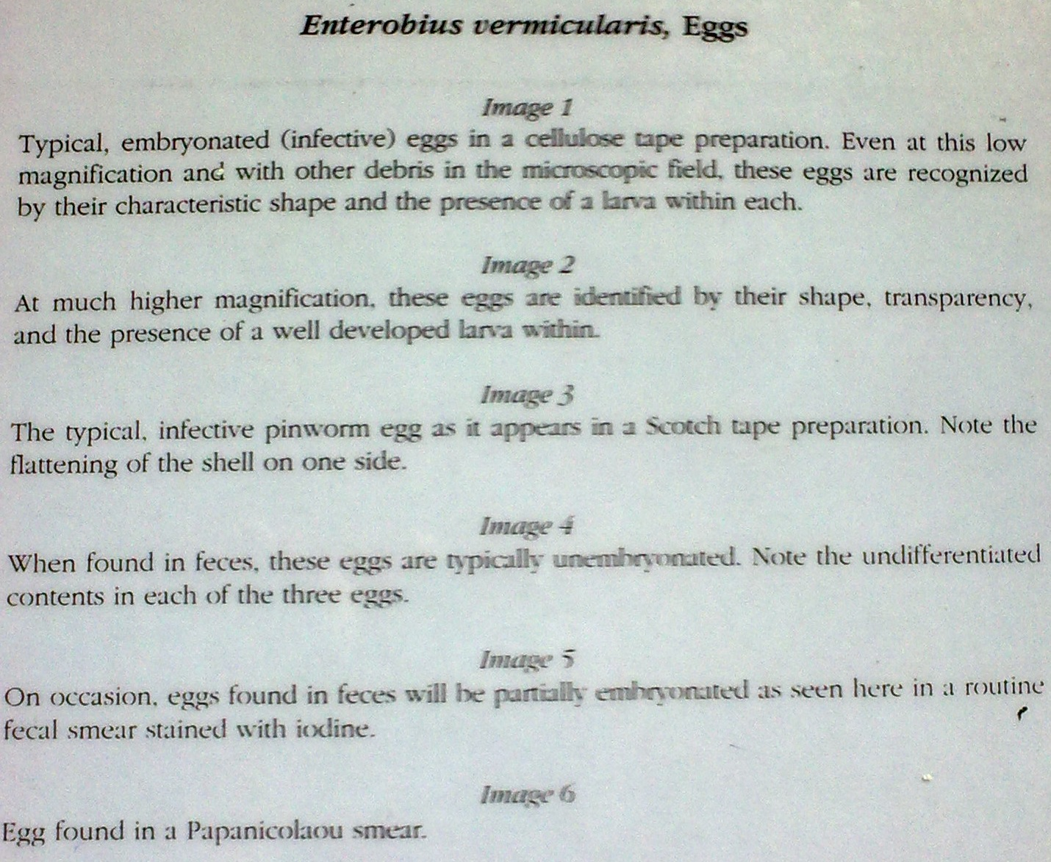
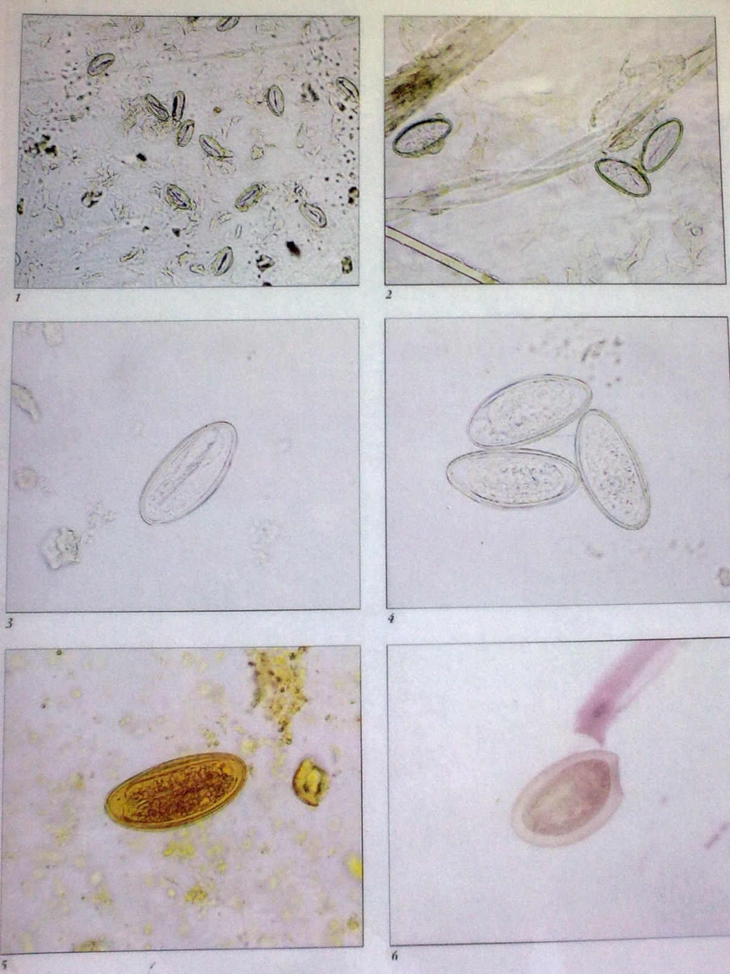

Slide 11
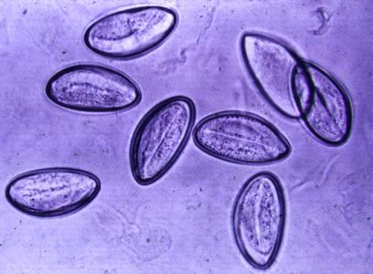
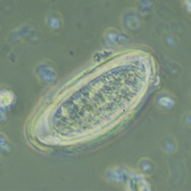
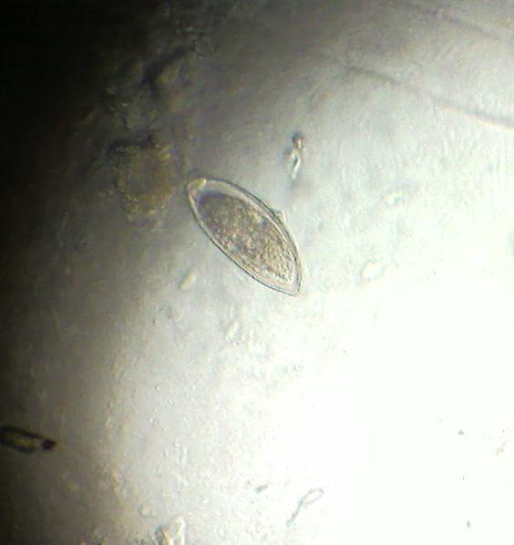
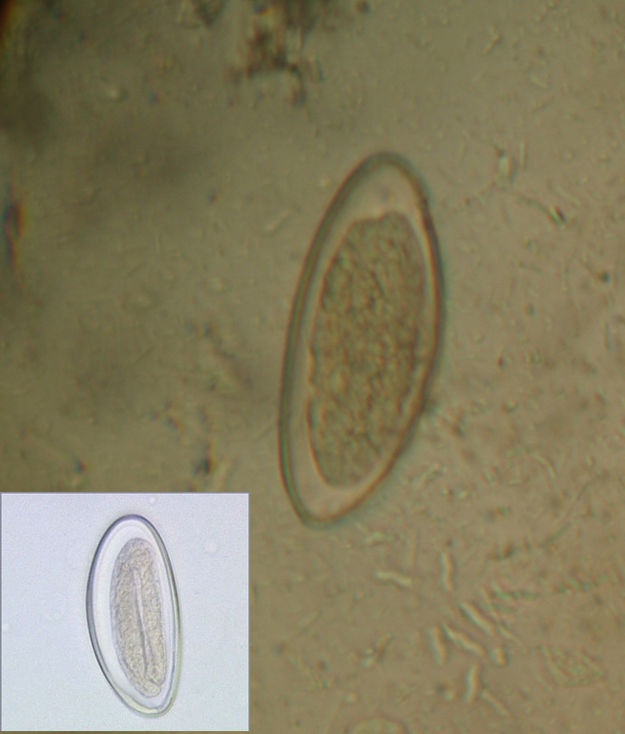
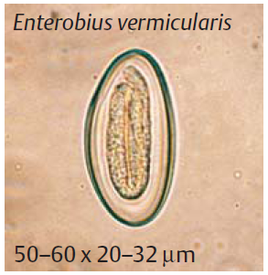

Slide 14
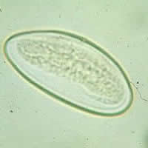
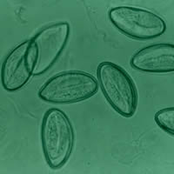
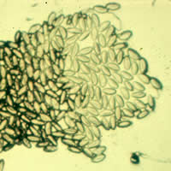
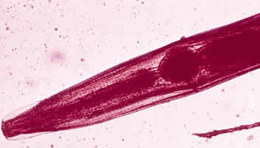
Entarobius sp.
(eggs/larvae)

Slide 15
Life Cycle
Adult males live in the large intestines, females gets out of anus and lays eggs in perianal folds .
Self-infection occurs by transferring infective eggs to the mouth with hands that have scratched the perianal area .
Person-to-person transmission can occur through handling of contaminated clothes or bed linens. Enterobiasis may also be acquired through surfaces in the environment that are contaminated with pinworm eggs (e.g., curtains, carpeting). Some small number of eggs may become airborne and inhaled. These would be swallowed and follow the same development as ingested eggs. Following ingestion of infective eggs, the larvae hatch in the small intestine

Slide 16
The adults establish in the colon. The time interval from ingestion of infective eggs to oviposition by the adult females is about 1 month. The life span of adults is about 2 months.
Gravid females migrate nocturnally outside the anus and oviposit while crawling on the skin of the perianal area. The larvae contained inside the eggs develop (the eggs become infective) in 4 to 6 hours under optimal conditions. Retroinfection, or the migration of newly hatched larvae from the anal skin back into the rectum, may occur.

Slide 17
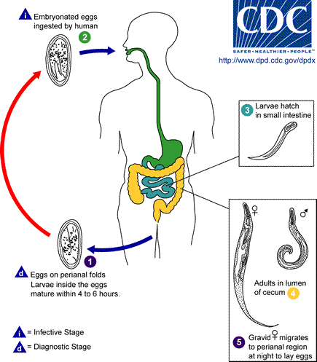

Slide 18
Enterobiasis: Transmission:
Autoinfection of ova (perianal to circulation)
Person-person (contaminated clothes/beddings)
Exposure to viable eggs in the environment(floor, curtains, carpets etc) (one study reports presence as much as 5000 eggs per square foot on the walls of a school lavatory)
Air-born (aerosolized) eggs in dust produced by shaken bed clothes, pajamas, etc
Ectopic pinworm migrations
After hatching on the anal mucosa, larvae can migrate back to the host's intestine (retroinfection)

Slide 19
Clinical Presentation
Enterobiasis is frequently asymptomatic.
The most typical symptom is perianal pruritus, especially at night, which may lead to excoriations and bacterial superinfection.
Sleep disturbance due to discomfort
Invasion of the female genital tract with vulvovaginitis and pelvic or peritoneal granulomas can occur.
Other symptoms include anorexia, irritability, and abdominal pain.
Complications include
  Appendicitis
  Salpingitis in females (rare)

Slide 20
Laboratory Diagnosis:
Microscopic identification of eggs collected in the perianal area is the method of choice. This must be done in the morning, before defecation and washing, by pressing transparent adhesive tape ("Scotch test", cellulose-tape slide test) on the perianal skin and then examining the tape placed on a slide.
Camel hair brush
Alternatively, anal swabs or "Swube tubes" (a paddle coated with adhesive material) can also be used. Eggs can also be found, but less frequently, in the stool, and occasionally are encountered in the urine or vaginal smears.
Adult worms are also diagnostic, when found in the perianal area, or during ano-rectal or vaginal examinations.

Slide 21
Treatment:
The drug of choice is pyrantel pamoate.
Mebendazole
Albendazole (Broad Spectrum Antihelminthes - treat many parasites. Helminth = Parasitic worm. Infests on the intestines of vertebrates esp. roundworms, tapeworms and flukes)

Slide 22
Prevention and control
Measures to prevent reinfection, such as personal hygiene and laundering of bedding, should be implemented in cases where infection affects other household members.
Bathe when you wake up to help reduce the egg contamination.
Change and wash your underwear each day. Frequent changing of night clothes are recommended.
Change underwear, night clothes, and sheets after each treatment. Because the eggs are sensitive to sunlight, open blinds or curtains in bedrooms during the day.
Personal hygiene should include washing hands after going to the toilet, before eating and after changing diapers.
Trim fingernails short.

Slide 23
Discourage fingernail-biting, and avoid scratching the skin in the perianal area
Apply heavy petroleum oil combined with anti-itching cream to the perianal and anal areas (this will prevent eggs' activation by oxygen, prevent larvae hatching and re-entering, and also diminish desire to scratch)
Showering may be preferred to avoid possible contamination of bath water.
Careful handling (avoid shaking) and frequent laundering of underclothes, night clothes, towels, and bed sheets using hot water also helps reduce the chance of infection and reinfection by reducing environmental contamination with eggs.
Treatment involving two doses of medication with the second dose being given 2 weeks after the first dose. All household contacts and caretakers of the infected person should be treated at the same time.

Slide 24
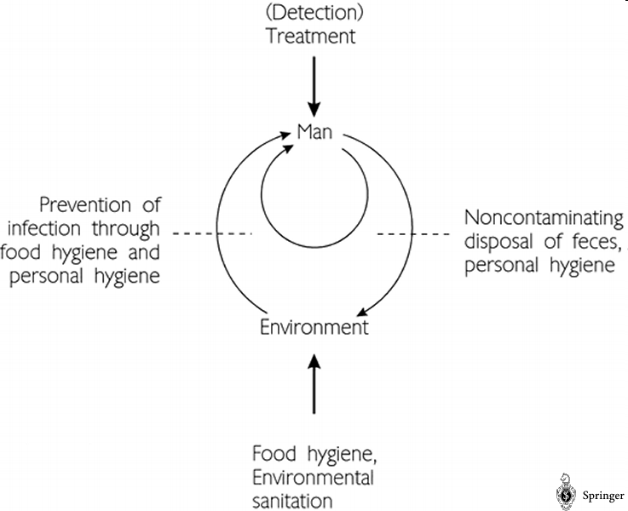
Targets and approaches for the control of enterobiasis

