Slide 1
HOOKWORMS
KIMAIGA H.O
MBChB (University of Nairobi)

Slide 2
HOOKWORMS
These are intestinal nematodes of the family Ancylostomatidae.
Two main species:Ancylostoma duodenale and Necator americanus
A larger group of hookworms infecting animals can invade and parasitize humans (A. ceylanicum) or can penetrate the human skin (causing cutaneous larva migrans), but do not develop any further (A. braziliense, A. caninum, Uncinaria stenocephala).
Occasionally A. caninum larvae may migrate to the human intestine, causing eosinophilic enteritis. Ancylostoma caninum larvae have also been implicated as a cause of diffuse unilateral subacute neuroretinitis.

Slide 3
ANCYLOSTOMIASIS
It is an intestinal infection caused by Ancylostoma duodenale and/or Necator americanus.
It is recognized to cause intestinal blood loss, leading to iron deficiency anemia, common in tropical subtropical areas.
The disease is also known as miners or brick makers anemia, Tunnel disease, Hookworm infection or Egyptian chlorosis.

Slide 4
It presents when hookworms are in large numbers in the intestines. Light infections are asymptomatic.
They penetrate the skin of man to cause cutaneous larva migrans. They do not develop further.
Commonly infects skin, eyes and viscera in humans.
It is the second most common human helminthic infection after ascariasis.

Slide 5
Epidemiology
All genders are susceptible.
In endemic areas, high prevalence occurs among school aged children.
It is also prevalent pregnant women, malnourished groups and elderly people.
A warm, moist climate with temperatures between 25⁰C-35⁰C with a shady, clay, sandy or loamy soil and vegetation favour larval development.
22-26℃ is the optimal temperature for Ancylostoma duodenale development and 31-35℃ is suitable for Necator americanus

Slide 6
World Distribution
Worldwide distribution.
Hookworm is the second most common human helminthic infection (after ascariasis).
It is estimated that 1 billion individuals are infected with the disease today.
The main etiology, N. americanus, is found in the Americas, Sub-Saharan Africa, Australia and Asia.
A. duodenale is found in more scattered focal areas such as the Mediterranean region, Middle East, North Africa and southern Europe.
Prevalent in Kenya in Coast region, Nyanza, Eastern and all the slums.

Slide 7
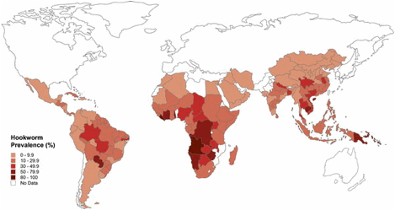
World Distribution

Slide 8
Morphology
Adults:
Adult hookworms reside in the small intestine of their hosts and look like an odd piece thread .
Males measure approximately 8-12 mm long and are bursate,
The male’s posterior end is expanded to form a copulatory bursate with two simple similar needle-like slender spicules that do not fuse at their distal ends.
Lateral lobes joined by small dorsal lobe
Lateral lobes supported by fleshy rays
Females are slightly larger than male measuring approximately 10-15 mm long.
Adults of both sexes have a buccal capsule containing sharp teeth.
They are white or light pinkish when living.

Slide 9
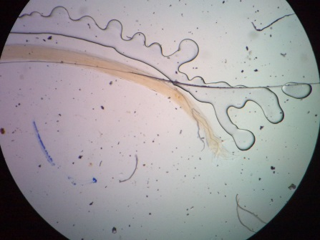
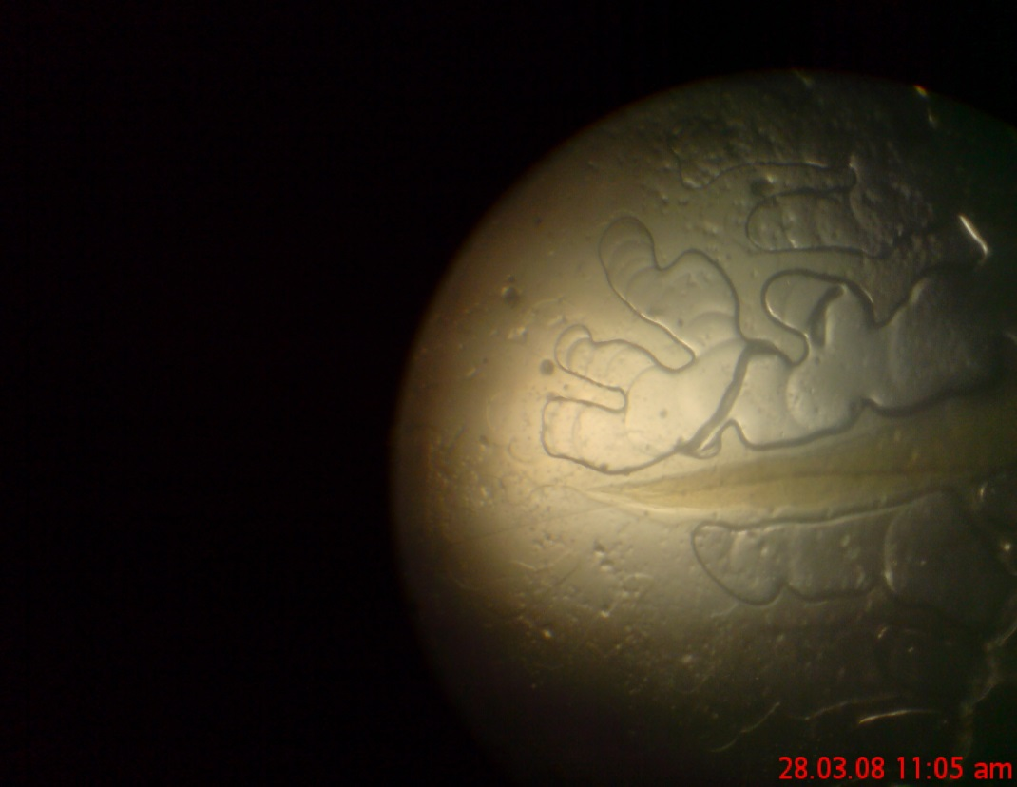
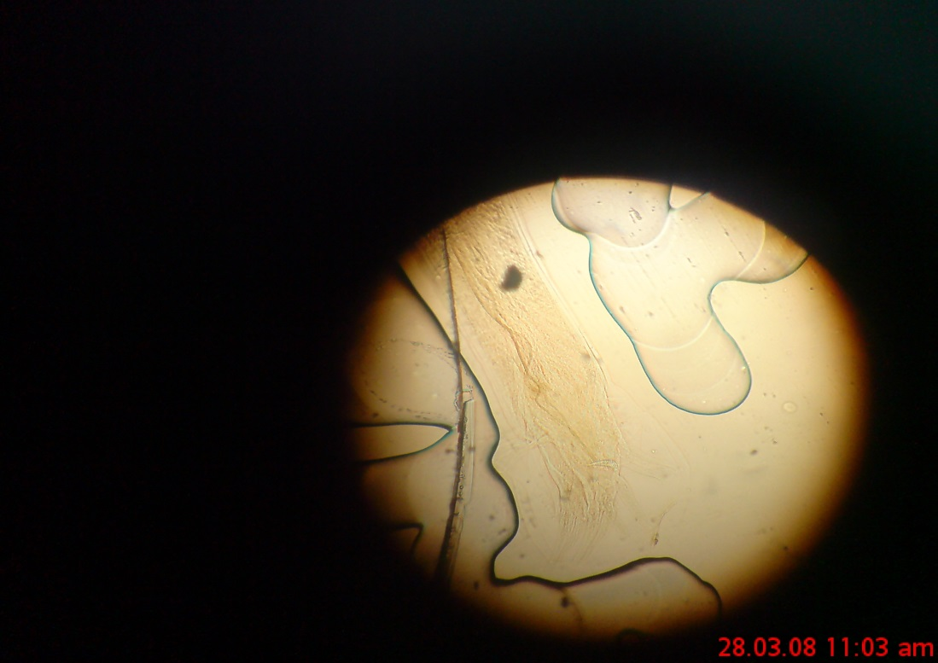
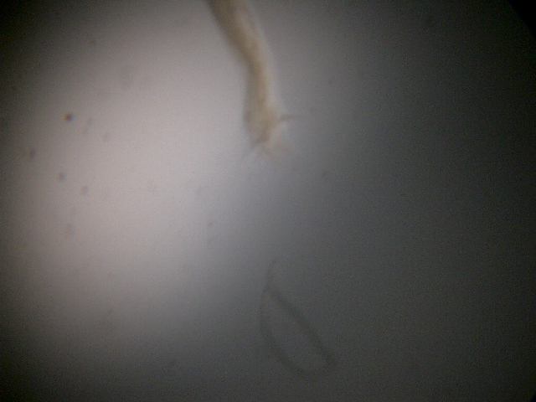
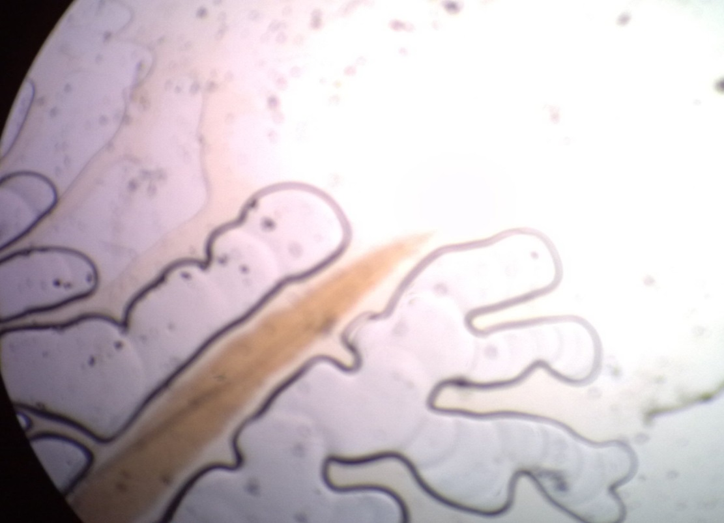
Adult Male hookworm
Adult Female hookworm

Slide 10
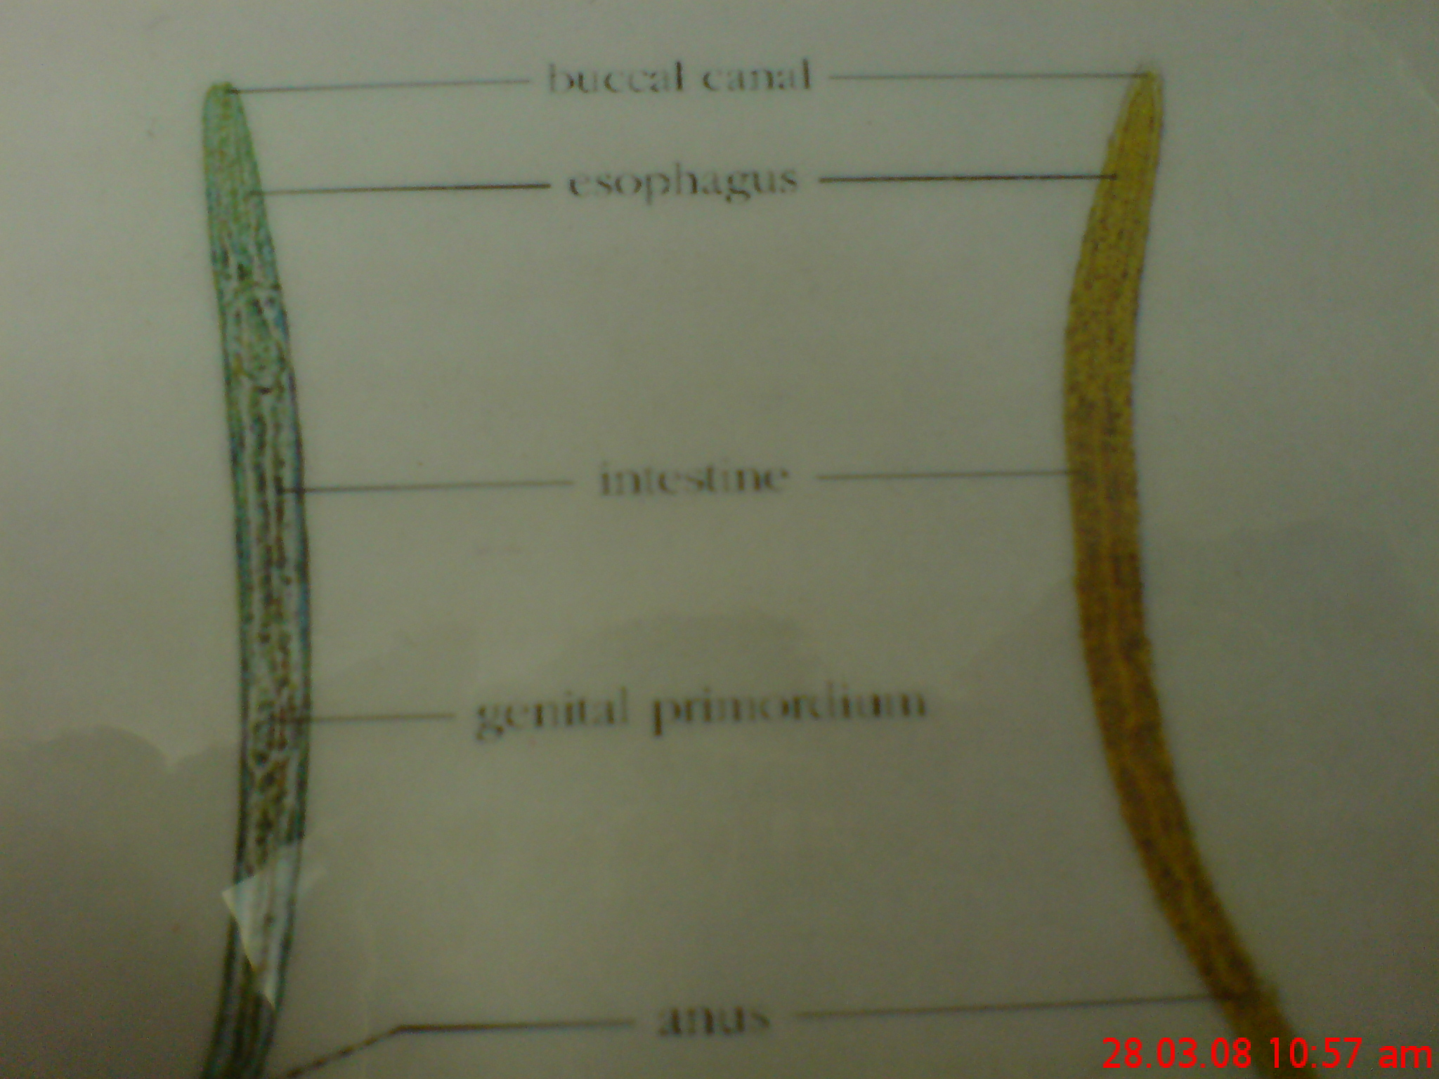
Morphology of Hookworm and Strongyloides

Slide 11
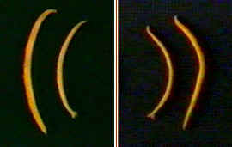
Differences between two hookworms
Adults of A. duodenale
Adults of N. americanus

Slide 12
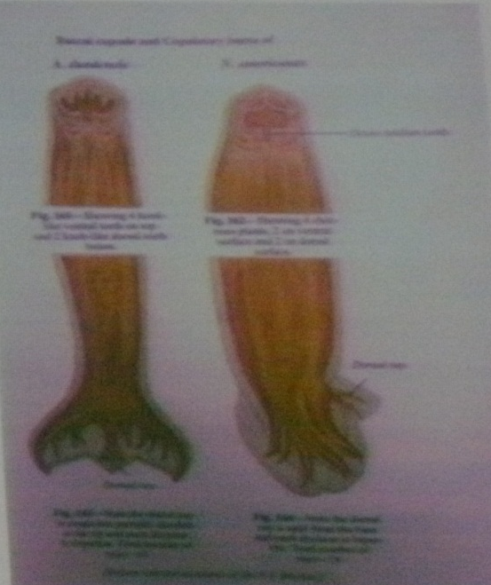
The Morphological Differences between Two species of Hookworms
_____________________________________________________
A. duodenale N. americanus
______________________________________________________
Size larger smaller
______________________________________________________
Shape single curve, looks like C double curves, looks like S
______________________________________________________
Mouth 2 pairs of ventral teeth 1peir of ventral cutting plates
____________________________________________________________
Copulatory circle in shape oval in shape
Bursa (a top view) (a top view)
____________________________________________________________
Copulatory 1pair with separate 1pair of which unite to form
spicule endings a terminal hooklet
_______________________________________________________
caudal spine present no
_______________________________________________________
vulva position post-equatorial pre-equatorial
_______________________________________________________

Slide 13
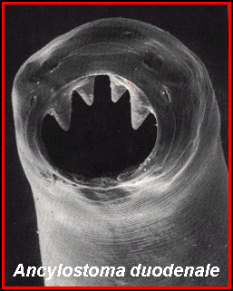
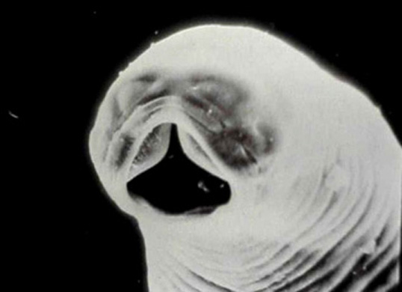
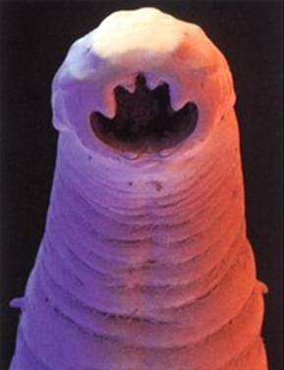
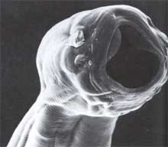
Scanning electron micrograph of the mouth capsule of Ancylostoma duodenale.
Has four ventral teeth, two on each side.
Scanning electron micrograph of the mouth capsule of Necator americanus.
Has two ventral teeth semi lunar cutting plates

Slide 14
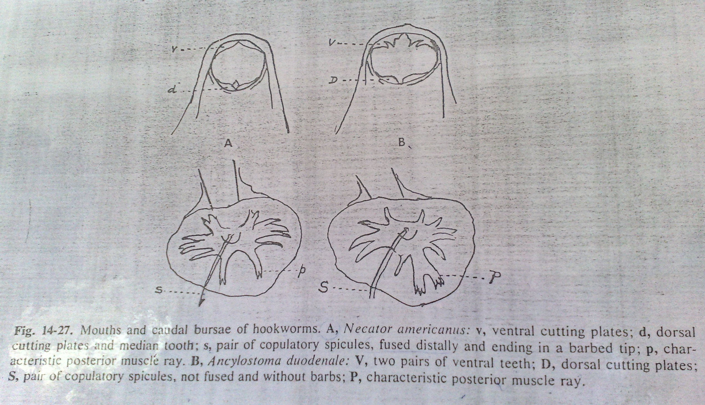

Slide 15
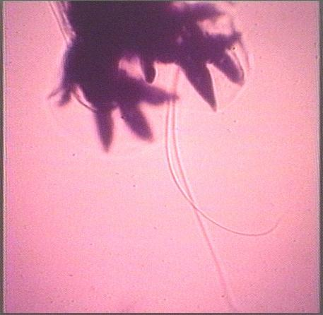
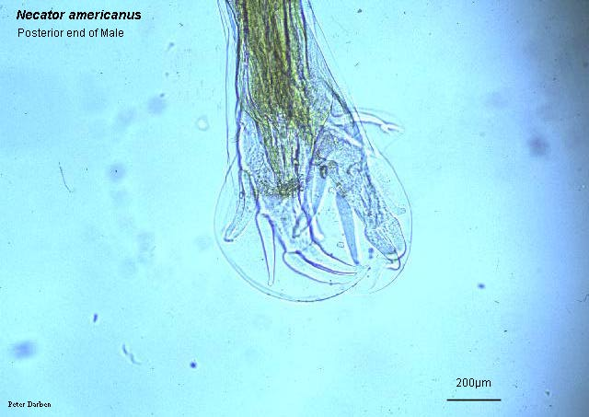
Ancylostoma duodenale - copulatory bursa and spines of male(a side view)
Copulatory bursa of N. americanus(a side view)

Slide 16
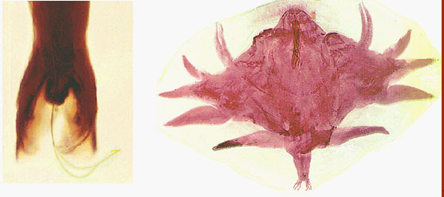
Copulatory bursa of A. duodenale (a top view)
Copulatory bursa and spines of N. americanus (a side view);

Slide 17
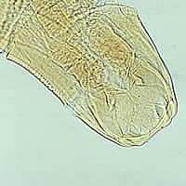
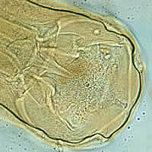

Slide 18
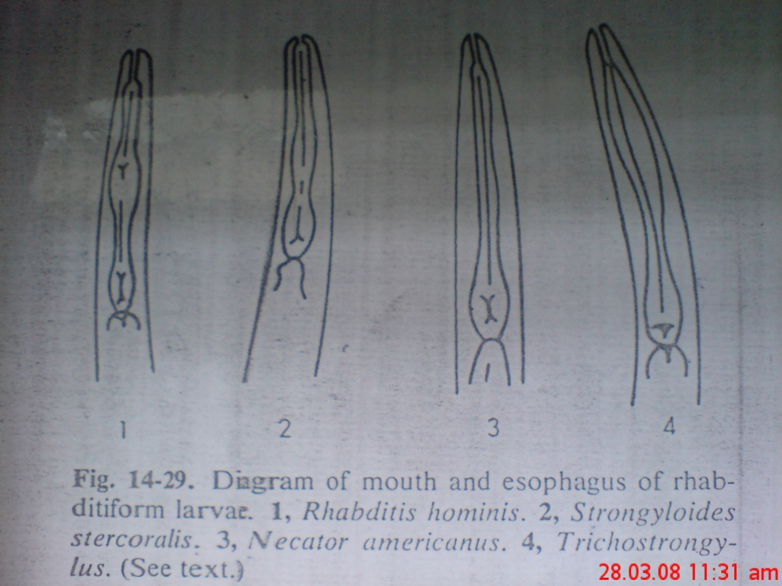
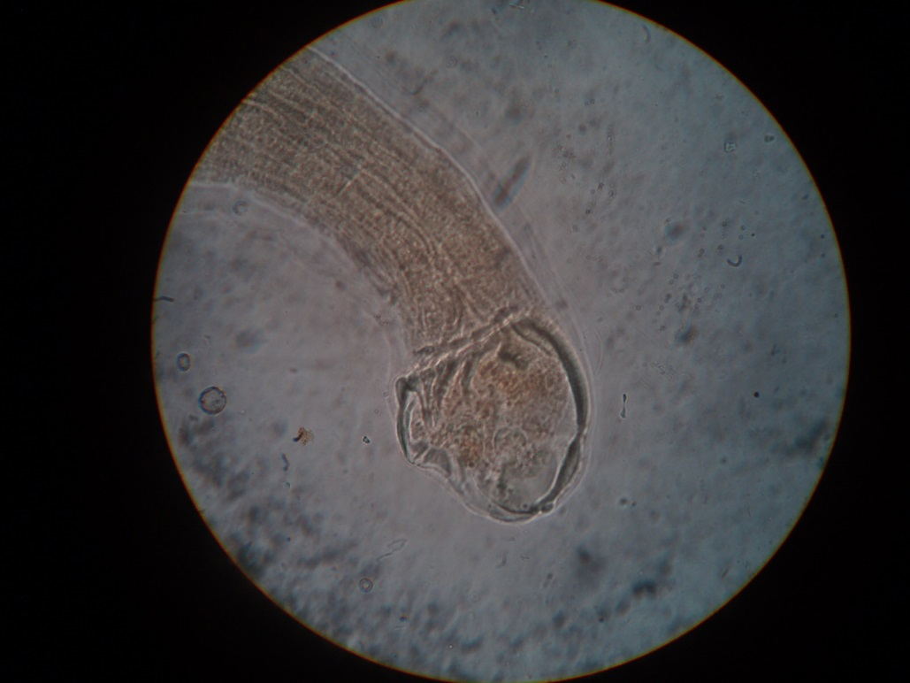
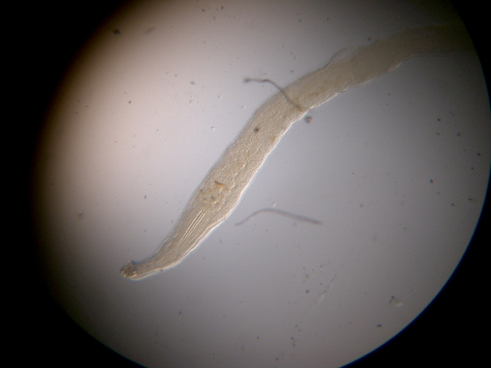
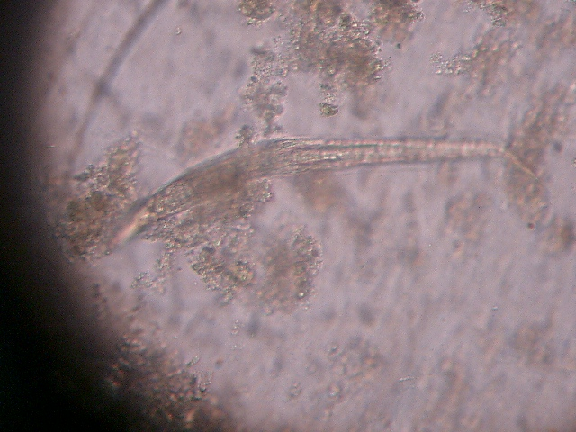
Filariform of Necator americanus pointed tail

Slide 19
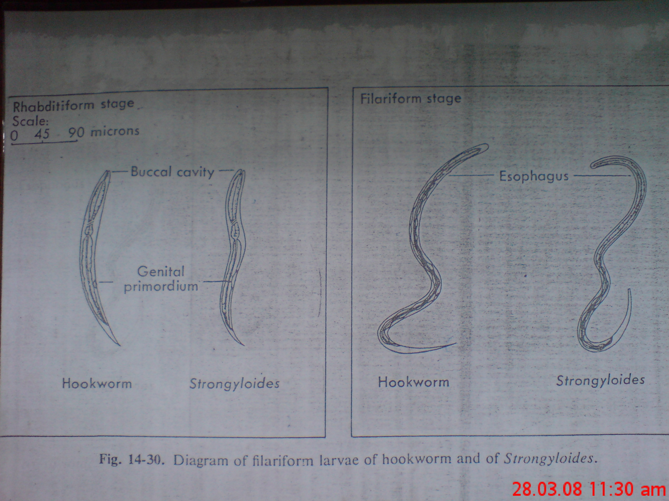

Slide 20
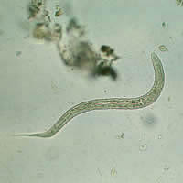
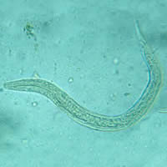
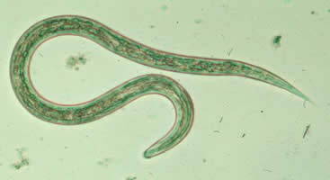
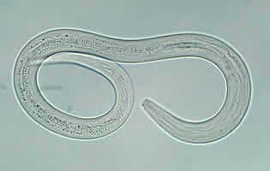
Hookworm larvae
Rhabdiform L2
Filariform L3

Slide 21
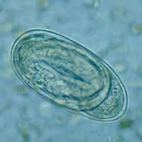
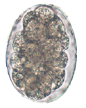
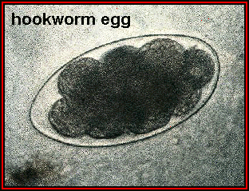
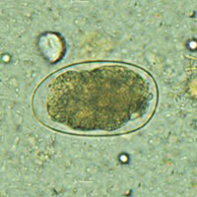
Eggs
60-75 µm by 35-40 µm in size
Oval in shape
Shell is thin and colorless. Content is 2-8cells.
The eggs of Ancylostoma and Necator cannot be differentiated microscopically

Slide 22
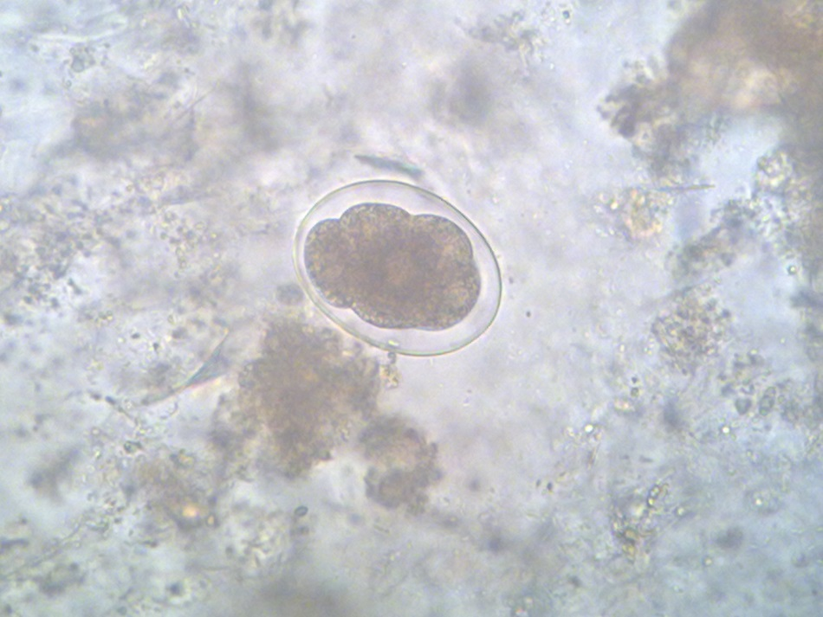
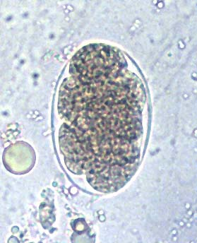
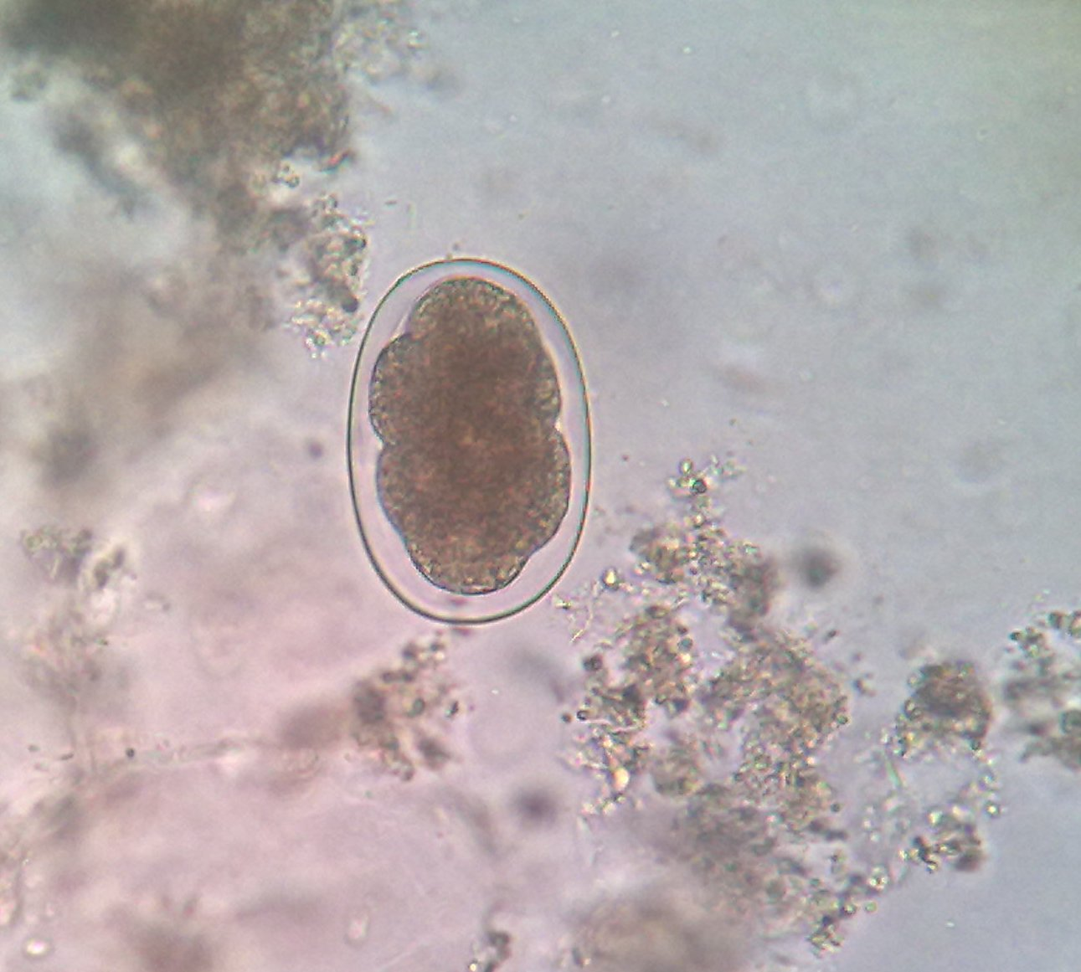
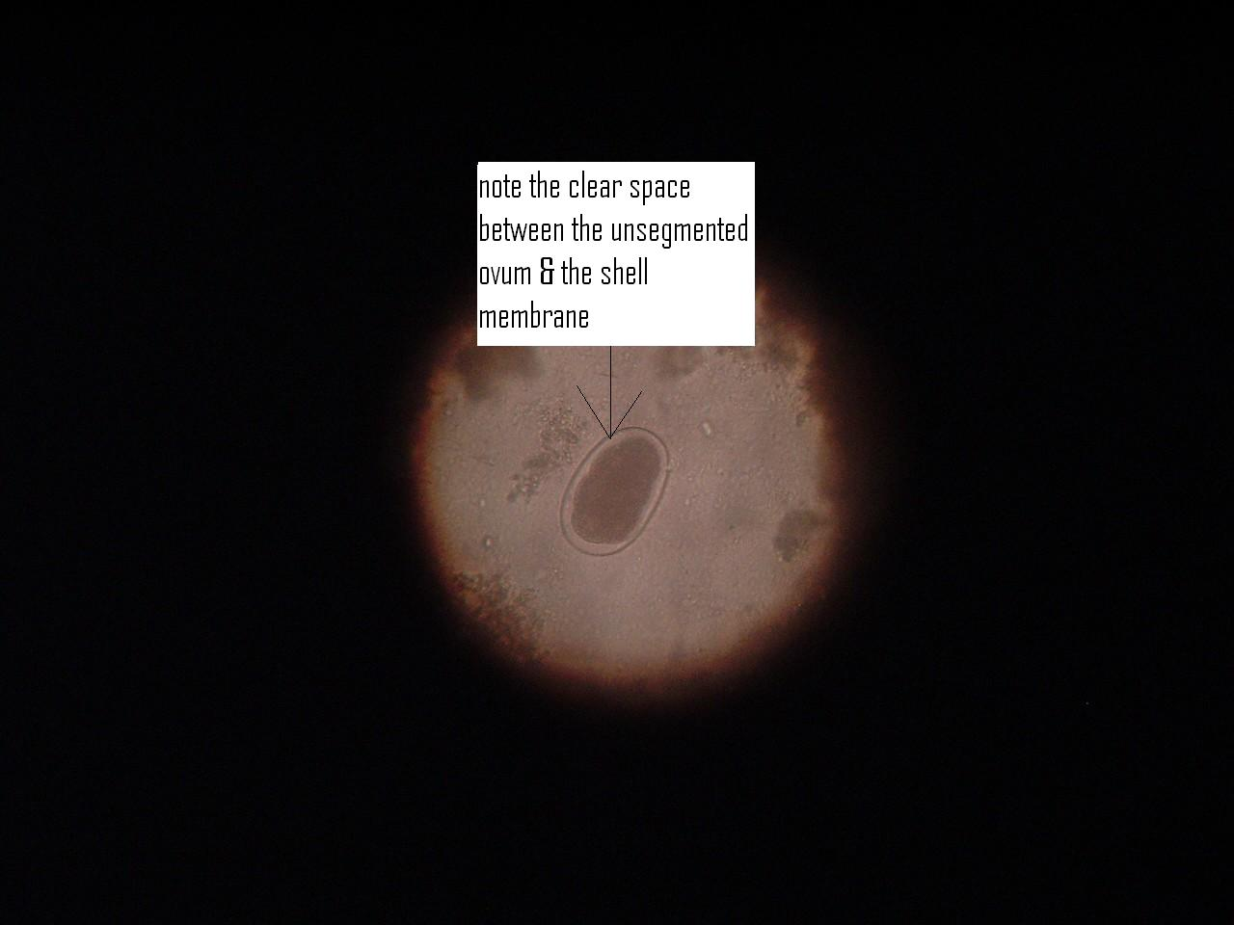
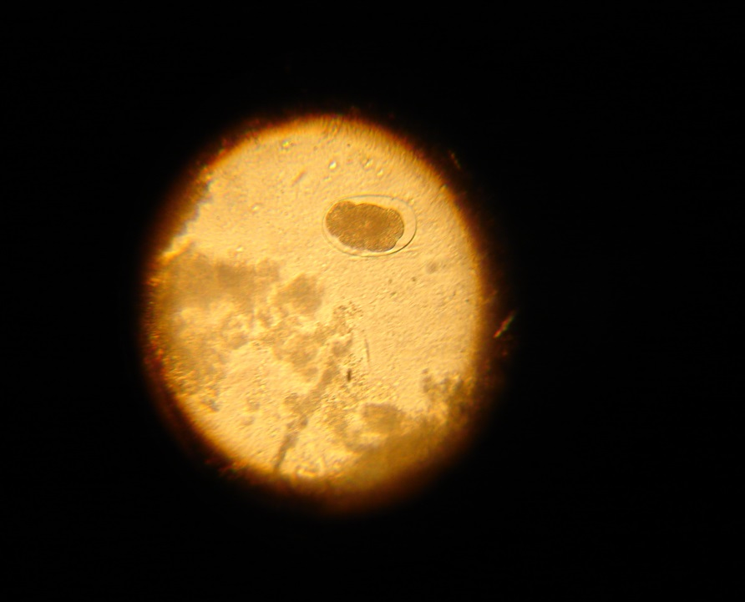
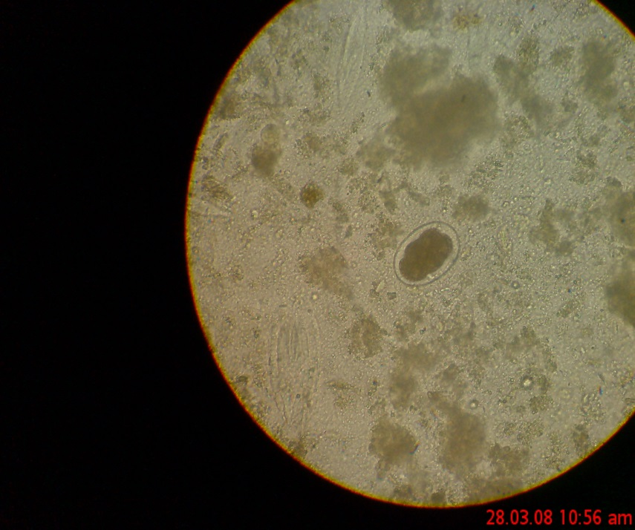

Slide 23
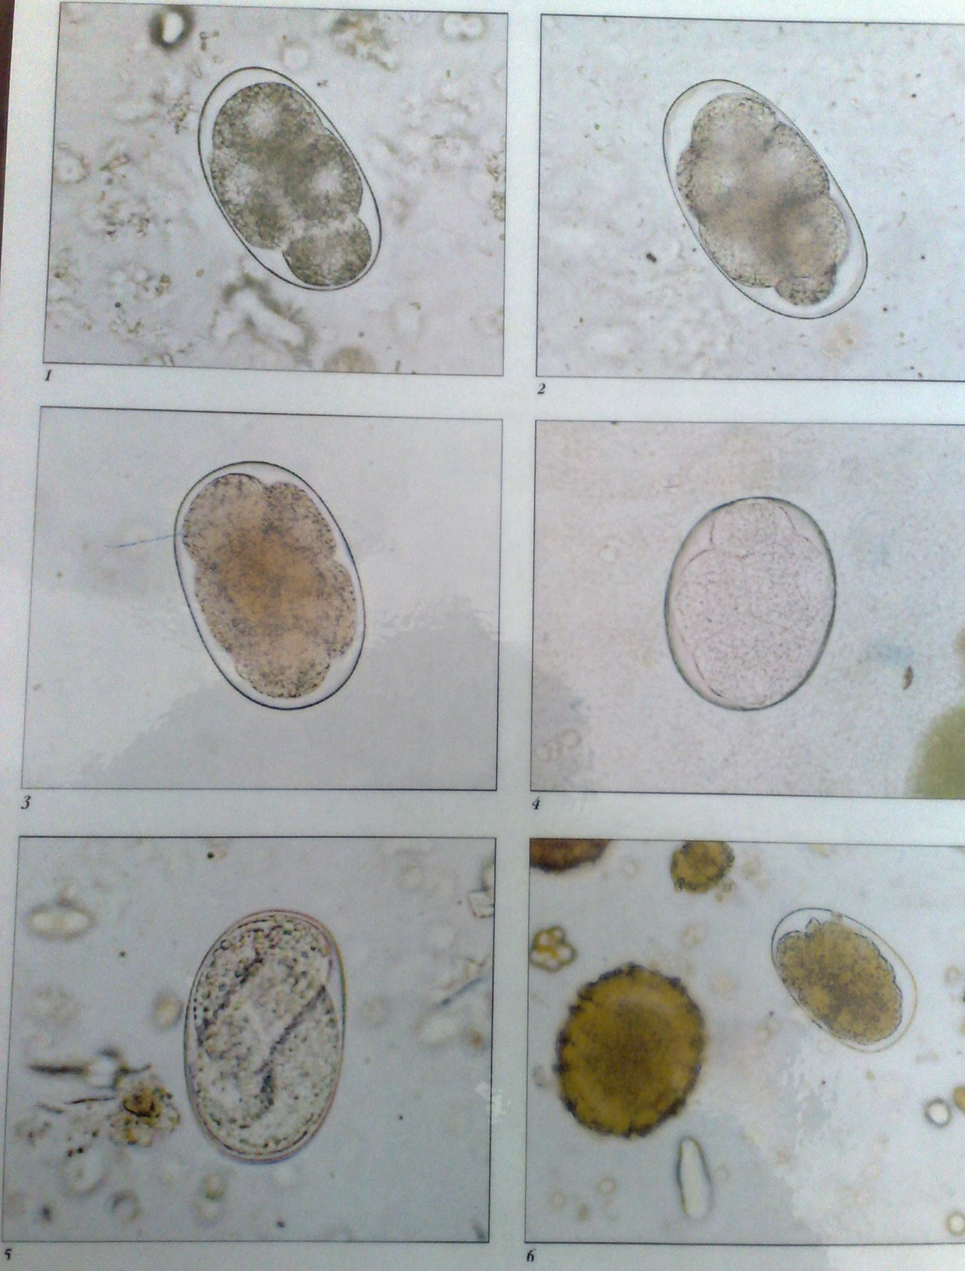

Slide 28
PRINCIPAL OF COMMUNICABLE DISEASES
Agent’s reservoirs
Route of exit from reservoir
Transmission
Route of entry into host
Susceptible host

Slide 29
Agent Reservoirs
Human beings-mainly.
Dogs
Cats

Slide 30
Route of Exit from resevior
Gastrointestinal route- through defecation.
Respiratory route- through coughing and sneezing of the infective larval stage(L3).

Slide 31
Mode of Transmission
Indirect passive transmission-contamination of soil.
It occurs after 5 or more minutes of skin contact with the soil that is infected with the viable larvae.

Slide 32
Route of Entry into host
Skin penetration-The larvae transforms and feeds in conducive (warm, moist) environment. At the 3rd larval stage, filariform larvae, it penetrates intact skin(foot, hands and buttocks)
It penetrates within about 5minutes of contact.

Slide 33
Life Cycle (intestinal hookworm infection):
Eggs are passed in the stool
Under favorable conditions (moisture, warmth, shade), larvae hatch in 1 to 2 days and release rhabditiform (L1 ) larvae which grow in the feces and/or the soil feeding on bacteria
After 5 to 10 days (and two molts) they become L2, L3 filariform larvae that are infective and can survive 3 to 4 weeks in favorable environmental conditions.
On contact with human skin(foot,hands and buttocks) , they penetrate the skin using proteolytic enzymes and are carried via the blood vessels to the right heart then penetrate pulmonary alveoli, ascend bronchial tree to the pharynx, and are swallowed.
The larvae reach the small intestine, where they reside and mature into adults(L5).

Slide 34
Adult worms live in the small intestine and mate
They attach to the small intestine wall.
They suck blood and feed from the host.
Hookworms have a anticoagulant like secretion to keep you bleeding once they bite a blood vessel
N.amer sucks .03mls and A.duod .15mls of blood and may stay for 2-5 yrs. This is because A.duod. Has teeth like structures while N.amer has cutting plates.
Most adult worms are eliminated in 1-2 years but some may take several years.
Some A. duodenale larvae, following penetration of the host skin, can become dormant (in the intestine or muscle). In addition, infection by A. duodenale may probably also occur by the oral and transmammary route. N. americanus, however, requires a transpulmonary migration phase.
NB: If the larvae are unable to complete their migratory cycle in humans, they migrate just below the skin producing” snake” like markings that is creeping eruption/ cutaneous larva migrans

Slide 35
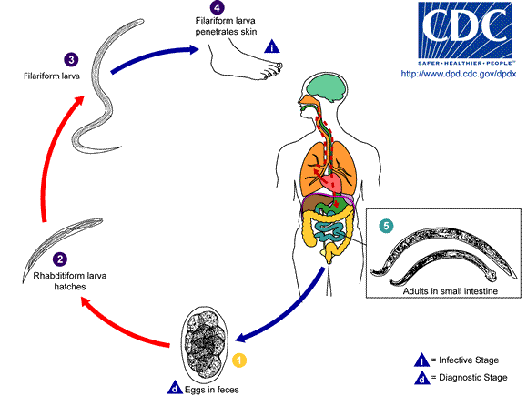
Life Cycle (intestinal hookworm infection):

Slide 36
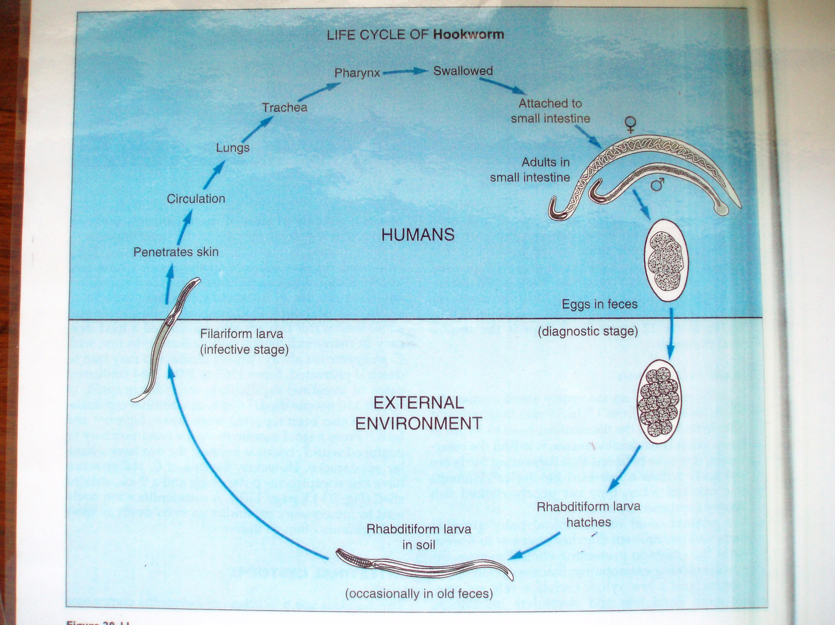

Slide 37
Life Cycle (cutaneous larval migrans)
Cutaneous larval migrans (also known as creeping eruption) is a zoonotic infection with hookworm species that do not use humans as a definitive host
Is caused by 2 main spp related to the hookworm, known as Ancylostoma brasiliensis & Ancylostoma canina.
The normal definitive hosts for these species are dogs and cats. The cycle in the definitive host is very similar to the cycle for the human species.
Eggs are passed in the stool
Under favorable conditions (moisture, warmth, shade), larvae hatch in 1 to 2 days. The released rhabditiform larvae grow in the feces and/or the soil
After 5 to 10 days (and two molts) they become filariform (third-stage) larvae that are infective. These infective larvae can survive 3 to 4 weeks in favorable environmental conditions.

Slide 38
On contact with the animal host , the larvae penetrate the skin
They are not normal parasites of the human hence they penetrate the skin and find themselves in a strange environment.
They cease progression because the human is not their definitive host and cannot move further in their life cycle.
They fail to gain access to the venous system and remain in the skin without further development.
They keep on migrating around the skin within the epidermis, sometimes as much as several centimeters a day. Some larvae may persist in deeper tissue after finishing their skin migration.

Slide 39
They cause damage to skin – skin eruptions/lesions, thus known as Cutaneous Larva Migrans.
They don’t gain access to the blood system.
They attempt to move around without success until they are empowered by the host’s immune system and die & disintegrate and in some cases may calcify.
Commonest site is skin of feet, hands, buttocks esp. in pple who go sunbathing.
Treatment is not very necessary, but the skin eruptions may be itchy thus application of steroid creams e.g. tetramethasole. Antipluritic (antihistamines) may suppress the itchiness (pluritis) e.g. piriton (chlorphenamine).
Angiostrongilus it penetrates the skin but remains cutaneous.

Slide 40
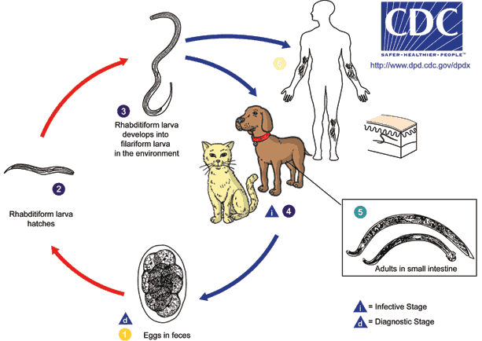
Life Cycle (cutaneous larval migrans)

Slide 41
Susceptible Host
The disease affects mostly school aged children. In susceptible children, it causes mental retardation.
In pregnant women it causes intrauterine growth retardation, prematurity as well as low birth weight of the baby. It is the leading cause of child morbidity in the developing countries.
Also elderly people and malnaurished persons.

Slide 42
Pathogenesis and Clinical Manifestations
LARVAL MIGRATION
Dermatitis, known as "ground itch" or "stool poison".The larvae penetrating the skin cause allergic reaction, petechiae 0r papule with itching and burning sensation. Scratching leads to secondary infection.
Pneumonitis (allergic reaction), Loeffier's syndrome: cough, asthma, low fever, biood-tinged sputum or hemoptysis, chest-pain, alveolar damage, inflammation shadows in lungs under X-ray. These manifestations go on about 2 weeks.
Hepatomegaly(due to venous congestion linked)

Slide 43
ADULTS IN SMALL INTESTINE
Epigastric pain as that of a duodenal ulcer.
A large worm burden results in microcytic hypochromatic anemia (character manifestation). The symptoms are lassitude, edema, palpitation of the heart. In severe case, death may result from cardiac failure or physical exhaustion.
Allotriophagy (orpica) is due to the lack of trace element iron .
Amenorrhea, sterility, abortion may take place in women.
Gastrointestinal bleeding
Infantile hookworm disease

Slide 44
Hookworm Disease
Cutaneous phase
  During larval penetration, lasts 1-2 wks;
  More common in N. americanus
  Urticarial, ground itch (ancylostome dermatitis)
  Exacerbated by pyrogenic bacteria in the larvae.
Pulmonary phase
  Larvae break through the Bvs in the alveoli
  Bronchitis & bronchopneumonia
  Marked eosinophilia
  Haemorrhage, which is serious in massive infection.
  Symptoms like severe dry cough and pneumonitis (inflammation of alveoli).
  NB: no voice hoarseness unlike in Ascaris pneumonitis.

Slide 45
Intestinal phase
  Adult worms in the intestines.
  Worms repeatedly cut intestinal mucosa.
  Secrete anticoagulants.
  Anaemia
    Worms feed on blood (A. duodenale – 0.26ml; N. americanus – 0.03ml)
    Loss of iron – hypochromic microcytic anaemia
    Loss of Vit B12 and folic acid deficiency – macrocytic anaemia. It causes ilitis.
    Dimorphic anaemia.
    Severity depends on number and species of hookworms.
  Nephritic syndromes – proteinuria & loss of plasma proteins.

Slide 46
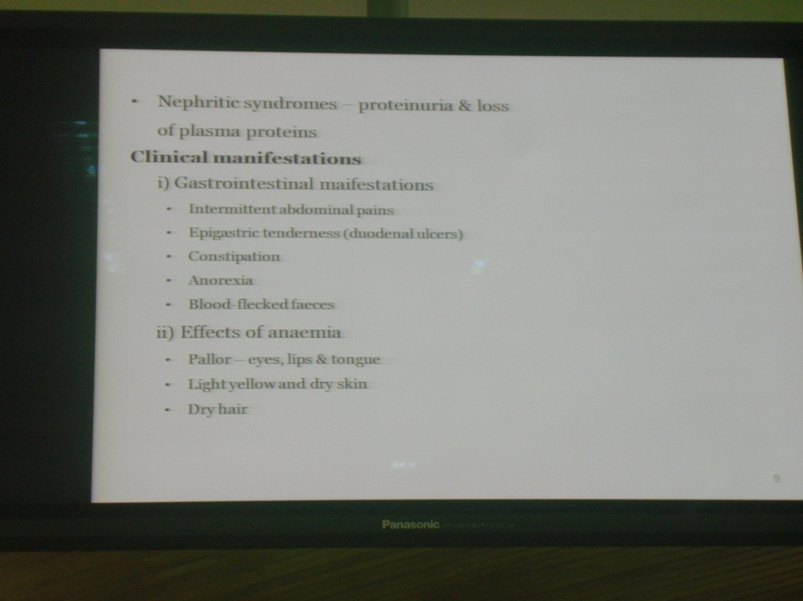

Slide 47
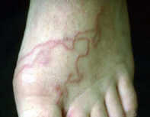
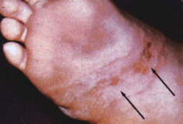
Clinical Presentation
There are no specific signs and symptoms for the infection. This is because they present as a combination of intestinal inflammation and progressively iron deficiency.
Ground itch, urticaria- This is an inflammatory response resulting from larval invasion into the skin causing intense local itching and lesions on the legs and feet.
Cutaneous larva migrans. These are tortuous tunnels of the larvae between the stratum basale and stratrum corneum.
Pneumonia- Inflammation of the lung parenchyma as result of the larval break into the alveoli.
Serum IgE tents to be high
Hyperesinophilia

Slide 48
Loeffluer’s syndrome- comprising of hilum lymphadenopathy, pneumonitis and pulmonary eosinophilia.
Coughing - Results from heavy larval migration up the trachea, which causes tracheal irritation, coughing, wheezing and chest pains.
Early or late stages can be characterized by vomiting, nausea, constipation, epigastic pains, indigestion, diarrhea and gastrointestinal discomfort - As a result of maturation of the larva.
Pale mucous membranes- conjuctiva, tongue, nail beds
Nails are spoonlike
Advanced or severe infections are characterized by anemia and protein deficiency, including cardiac failure, emancipation and abdominal distension with ascites, Mental and growth retardation,delayed puberty, abortions/stillbirths, FTG poor memory

Slide 49
Clinical Manifestations
G.I manifestations
  Intermittent abdominal pains
  Epigastric tenderness (duodenal ulcers)
  Constipation
  Anorexia
  Blood-flecked/spotted faeces

Slide 50
Effects of anaemia
  Pallor-eyes, lips & tongue
  Light yellow and dry skin
  Dry hair
  Enlarged liver due to Congestive Cardiac Failure
  Heart murmurs coz of anaemia.
  Protein loosing enteropathy leads to a drop in plasma protein. Oedema develops due to exacerbation of fluid into extracellular space.
  Oedema (usually facial but may be generalised)
  Puffy face & swollen eyelids
  Potbellies due to ascites
  Koilonychia (spoon nails as a result of hypochromic microcytic anaemia, esp iron deficiency)
  Stunted growth and general malaise
  Acute mental distress
  Mental dullness
  Delayed puberty
  Heavy infections – heart failure

Slide 51

Abdominal distention

Slide 52
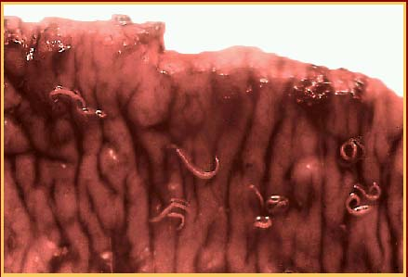
Adults in intestinal mucosa

Slide 53
Laboratory Diagnosis
Microscopic identification of eggs in the stool. The recommended procedure:
Collect a stool specimen.
Fix the specimen in 10% formalin.
Concentrate using the formalin–ethyl acetate sedimentation technique.
Examine a wet mount of the sediment.
Where concentration procedures are not available, a direct wet mount examination of the specimen is adequate for detecting moderate to heavy infections. For quantitative assessments of infection, various methods such as the Kato-Katz can be used.

Slide 54
Cutaneous larval migrans is usually diagnosed clinically, as there are no serologic tests for zoonotic hookworm infections. Larvae may be seen in stained tissue sections, but this procedure is usually not recommended as the parasites are usually not found in the visible track.
Culture of stool in test tube(oval eggs with colourless shell, eggs have blastomeres)
  Indirect PBF RBCs-microcytic hypochromic anaemia- Hemoglobin is lower than 120g/L in man, 110g/L in woman.
Clinical diagnosis –pallor of mucus membranes eyes hands
Saturated brine flotation technique

Slide 55
Treatment
Expulsion of adult worm
  Albendazole (efficancy 72%)
  Mebendazole (efficancy 15%)
  Thiabendazole
  Pyrantel Pamoate
  They kill the adult worms by binding to the beta-tubulin and therefore, preventing microtubule polymerization within the parasite.
Dosage is the same for children as for adults
  Albendazole: 400 mg orally once
  Mebendazole: 100 mg twice a day for 3 days OR 500mg orally once.
  Pyrantel pamoate: 11mg/kg (up to a max of 1mg) orally daily for 3 days
Larvae
  Thiabendazole (migratory or dormant larvae)
  Levamisole (less effective against N. americanus)

Slide 56
WHO recommends no anti-helminthic treatment to pregnant women at least before the end of the first trimester.
Mass deworming programs in schools and children at home, twice annually.
Deworming of pet dogs is also necessary.
Treatment of anaemia
  Iron supplements
  Folic acid & Vit B12 in some cases
  Transfussion in severe anaemia in children
Antispasmodics for abdominal pain
Proteins therapy

Slide 57
Prevention and Control (Levels)
Reservoir
Treatment of infected individuals
Mass deworming programs in schools and children at home, twice annually.
Deworming of pet dogs is also necessary.

Slide 58
b) Portal of exit
Proper waste disposal
c) Transmission
Soil treatment-heat therapy, spraying of antihelminths.
d) Portal of entry
Usage of proper footwear.
Health education
Mass public awareness and social education programs on modes of transmission of the parasite
e) Host
Treatment of the infected persons using albendazole, mebendazole, levamisole and pyrantel pamoate.( refer to treatment of reservoir)

Slide 59
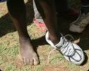
Prevention: putting on shoes

