Slide 1
VIRAL REPLICATION
KIMAIGA H.O
MBChB (University of Nairobi)

Slide 2
Virus Replication
Viral populations do not grow through cell division, because they are acellular. A virus is unable to grow or reproduce outside a host cell.
It replicates within the host cell while utilizing the host cell’s nucleic acids
Viral life cycle consists of 6 stages within the host cell.
Attachment
Penetration
Uncoating
Multiplication-Transcription, Translation
Assembly
Release

Slide 3
Phases of Virus Replication
Attachment (adsorption): the phage attaches to a protein receptor or polysaccharide molecule (receptor) on the surface of the bacterial cell.
Penetration: the phage injects its DNA into the bacterial cell; the capsid remains on the outer surface of the cell.
Translocation e.g Polio
Endocytosis e.g Influenza
Fusion e.g Parainfluenza and HIV

Slide 4
Uncoating: Removal of lipid membrane and protein coat by cellular proteases “opening up” the capsid
Transcription- Involves production of mRNA. RNA viruses use virus specified enzymes. DNA viruses uses host cell enzymes
Translation- Synthesis of viral proteins
RNA viruses- Viruses specified polymerases
DNA viruses- Host cell polymerases

Slide 5
Assembly: the viral proteins are assembled to produce complete viral particles (virions)
Release: is when the host cell bursts open and all of the new virions escape from the bacterial cell.
Disintegration/ cell lysis -unenveloped/Naked viruses.
Budding though plasma membrane leaving with envelope hence called enveloped viruses. Do not necessarily kill the host cell. Thus, some budding viruses may be able to set up persistence. E.g. Herpes.
Not every released virion is infectious
CD4 cell count to know spread of HIV

Slide 6
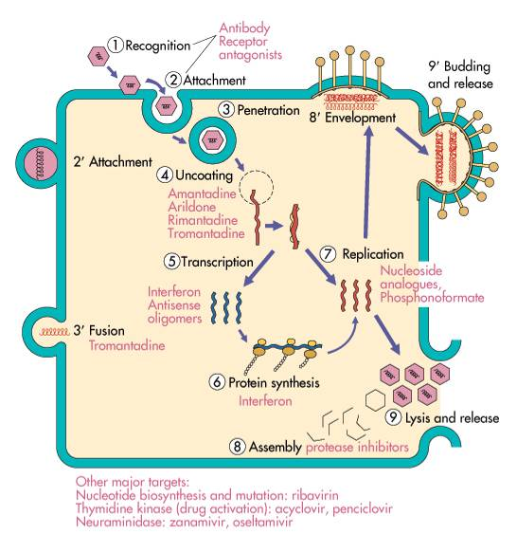

Slide 7
Products of viral replication
Virion
Defective virus - Deficiency in some aspects of replication, but interfering the replication of normal viruses
Abortive infection - When a virus infects a cell (or host), but cannot complete the full replication cycle ( not biosynthesize their components or not assemble virions.), i.e. a non-productive infection.
Integration

Slide 8
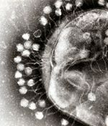
Bacteriophage
Virulent bacteriophages always cause what is known as the lytic cycle, Which ends with the destruction (lysis) of the bacterial cell? The most phages, the whole process (from attachment to lysis) takes less than 1hour.

