Slide 1
VIRAL HEMORRHAGIC FEVERS
KIMAIGA H.O
MBChB (University of Nairobi)

Slide 2
Viral Hemorrhagic Fevers
A group of illnesses caused by RNA viruses from 4 families:
Flaviviridae (Dengue, Yellow fever),
Filoviridae (Ebola, Maburg virus)
Arenaviridae (Lassa, Junin, Sabia, Machupo fever virus)
Bunyaviridae (CCHF – Crea Congo hemorrhagic fever virus, RVF – Rift Valley Fever virus, Hantaviruses)
Differ by geographic occurrence and vector/reservoir
Potential for aerosol dissemination, with human infection via respiratory route (except dengue)
Share certain clinical and pathogenic features

Slide 3
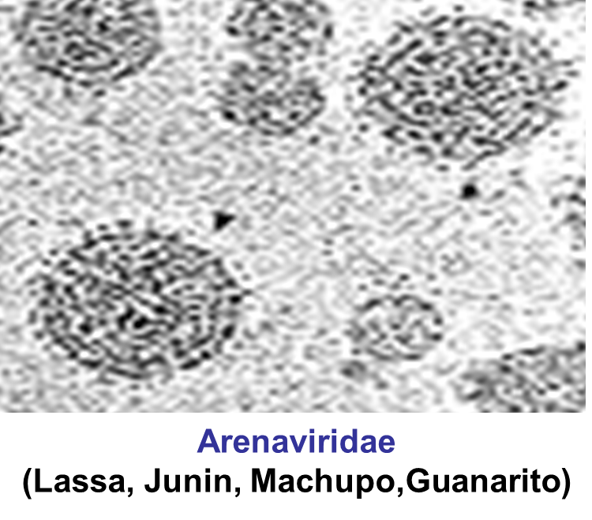
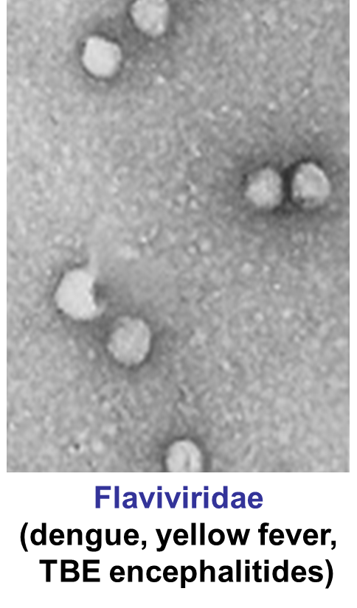
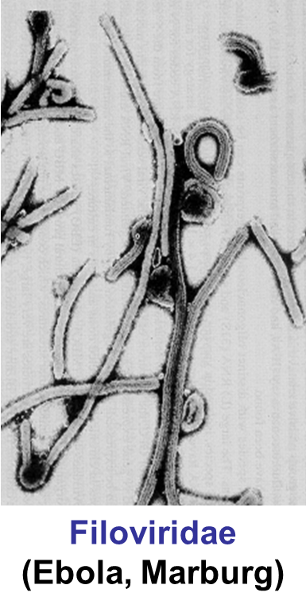
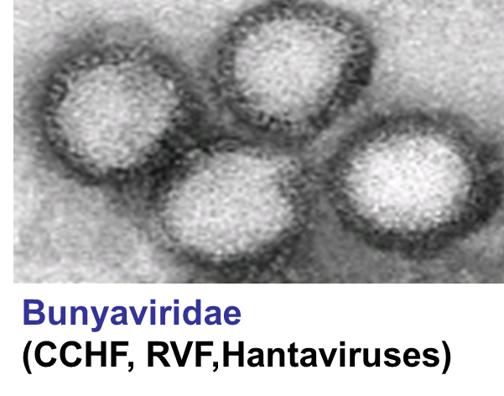
Viral Haemorrhagic Fevers

Slide 4
Why is it important to study VHF
VIFs attract the attention of medical professionals and the general public for a variety of reasons – coz they kill very fast and they have no cure
They are high on the public mind as they are thought of as highly infectious, killing their victims in a dramatic way
Mysteries remain as the source of some of them.
VHF and other infectious dx travel quickly nowadays coz of infected people traveling to foreign countries and getting bitten by vectors.
Early clinical signs & symptoms may be very discrete and cannot easily be distinguished from those of other illnesses
Easier to interpret once the dx has progressed.
NB: application of tourniquet causes bleeding around the tourniquet, indicative of VHF

Slide 5
Viral Haemorrhagic Fever
The term ‘VHF’ is used to describe a severe multisystem syndrome.
Target organ: vascular bed
The overall vascular system is damaged, and the body’s ability to regulate itself is impaired
The viruses make the b/vessels to be permeable to plasma and it leaks but it does it is not fatal, the organ damage they cause is fatal.
There’s acute febrile illness characterized by malaise, myalgia, and prostration
The symptoms are often accompanied by hemorrhage; they are usually diffuse and reflect widespread vascular damage rather than life-threatening volume loss.
Mortality 0.5 -90%, depending on agent

Slide 6
VHF Transmission
Zoonotic diseases
Rodents and arthropods main reservoir
Humans infected via bite of infected arthropod, inhalation of rodent excreta, or contact with infected animal carcasses
Person-to-person transmission possible with several agents
Primarily via blood or bodily fluid exposure
Rare instances of airborne transmission with arenaviruses and filoviruses
Rift Valley fever has potential to infect domestic animals following a biological attack

Slide 7
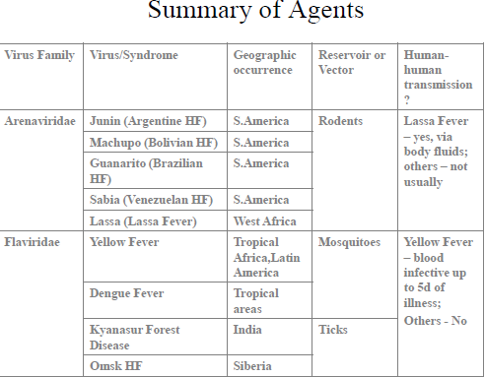

Slide 8
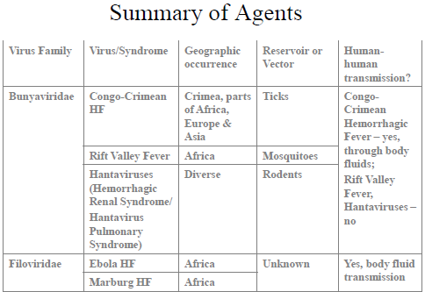

Slide 9
Common features of VH
They are all RNA viruses and are enveloped (i.e covered in a fatty (lipid) coating
Their survival is dependent on an animal or insect host called the natural reservoir
They are geographically restricted to areas where their host species live
Humans are not the natural reservoir for any of these viruses. Humans are infected when they come into contact with infected hosts, and with some viruses, can transmit the virus to one another
Human outbreaks occur sporadically and irregularly. These outbreaks cannot be easily predicted
With few exceptions, there is no cure or established drug treatment for VHFs

Slide 10
Clinical presentation of FHV
Incubation period 2-21 days, depending on agent
Clinical signs and symptoms are easier to interpret once the disease has progressed already
The initial symptoms lasting 1 week and correspond to development of viremia and include the following
High fever, headache, fatigue, abdominal pain, myalgia (muscle pain), prostration (collapse), malaise, weakness, dizziness, joint pain, nausea, non-bloody diarrhea, Rash, exanthema
In more advanced dx, s/s include
Bloody diarrhoea, generalised mucous membrane hemorrhage, rash, edema, altered mental status, CV collapse, pharyngitis, Shock, Flushing, conjunctival injection (“red eye”)

Slide 11
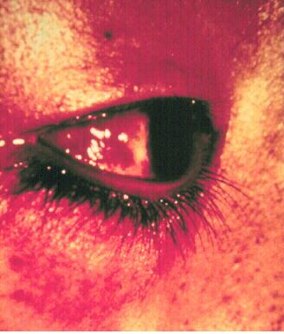
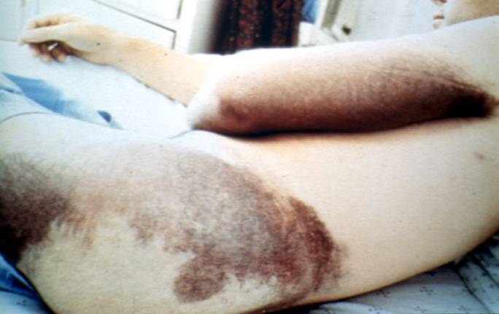

Slide 12
VHF Surveillance: Clinical Identification of Suspected Cases
Clinical criteria:
Temperature 101F(38.3C) for <3 weeks
Severe illness and no predisposing factors for hemorrhagic manifestations
2 or more of the following:
Hemorrhagic or purple rash
Epistaxis
Hematemesis
Hemoptysis
Blood in stools
Other hemorrhagic symptoms
No established alternative diagnosis

Slide 13
VHF – differential diagnosis
VHF vs. Viral Hemorrhagic Fever (from one viral infxn to the other)
Clinical picture-unreliable, epidemiology-approximate, lab-proof
VHF vs bacterial infectious
Typhoid, shigellosis, purulent pharyngitis, sepsis (strep, staph)
VHF vs. parasitic dx
Malaria, African trypanosomiasis, amoebiasis

Slide 14
VHF Treatment
Supportive care
Correct coagulopathies as needed
No antiplatelet drugs or IM injections
Investigational treatments, available under protocol:
Ribavirin x 10 days for arenaviridae and bunyaviridae
Convalescent plasma w/in 8d of onset for AHF

Slide 15
Management of Exposed Persons
Medical surveillance for all potentially exposed persons, close contacts, and high-risk contacts (i.e., mucous membrane or percutaneous exposure) x 21 days
Report hemorrhagic symptoms
Record fever 2x/day
Report temperatures $≥$101⁰F(38.3⁰C)
Initiate presumptive ribavirin therapy
Percutaneous/mucocutaneous exposure to blood or body fluids of infected:
Wash thoroughly with soap and water, irrigate mucous membranes with water or saline
Patients convalescing should refrain from sexual activity for 3 months post-recovery (arenavirus or filovirus infection)
Only licensed vaccine: Yellow Fever
Investigational vaccines: AHF, RV, HV
Possible use of ribavirin to high-risk contacts of CCHF and LF patients

Slide 16
Infection Control
Airborne & contact precautions for health care, environmental, and laboratory workers
Negative pressure room, if available
6-12 air changes/hour
Exhausted outdoors or through HEPA filter
Personal protective equipment
Double gloves
Impermeable gowns, leg and shoe coverings
Face shields and eye protection
N-95 mask or PAPR

Slide 17
Dedicated medical equipment for patients
If available, point-of-care analyzers for routine laboratory analyses
If unavailable, pretreat serum w/Triton X-100
Lab samples double-bagged & hand-carried to lab
Prompt burial or cremation of deceased with minimal handling
Autopsies performed only by trained personnel with PPE

Slide 18
Summary of Key Points
A thorough travel and exposure history is key to distinguishing naturally occurring from intentional viral hemorrhagic fever cases.
Viral hemorrhagic fevers can be transmitted via exposure to blood and bodily fluids.
Contact and airborne precautions are recommended for health care workers caring for infected patients.
Post-exposure management consists of surveillance for fever and hemorrhagic symptoms, and possibly ribavirin therapy for symptomatic individuals.

Slide 19
Lab Diagnosis
VHF are classified as biosafety level 3 and 4 pathogens and must be handled only in maximum containment or security laboratories
ELISA: detection of Ebola antigens by an ELISA test is rapid and sufficiently sensitive for diagnosis in early infxn
PCR method: lower concentrations of viral RNA may be detectable in some circumstances by RT-PCR. For the small fraction of px that survive, IgM capture ELISA tests are usually +ve early in dx for a more reliable diagnosis.

Slide 20
Prevention & control of VHF
Avoid contact with host species
Rodents
Control rodent populations
Discourage rodents from living in human popns
Safe cleanup of rodent nests & droppings
Insects
Use insect repellents
Proper clothing and bed nets
Window screens & other barriers to insects

Slide 21
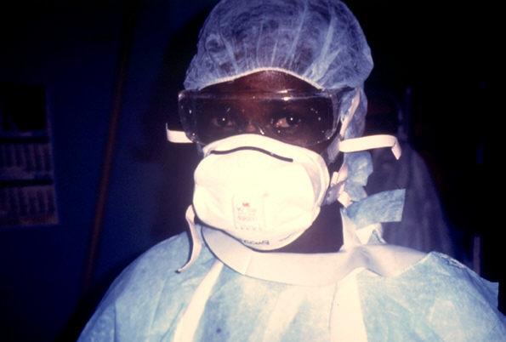
Vaccine available for YF
Experimental vaccines under study: Argentine HF, Rift Valley Fever, Hantavirus & Dengue HF
If human case occurs
Decrease person-person transmission
Isolation of infected individuals
Protective clothing
Disposable gowns, gloves, masks & shoe covers, protective eyewear when splashing might occur, or if px is disoriented or uncooperative

Slide 22
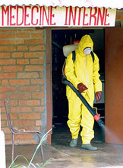
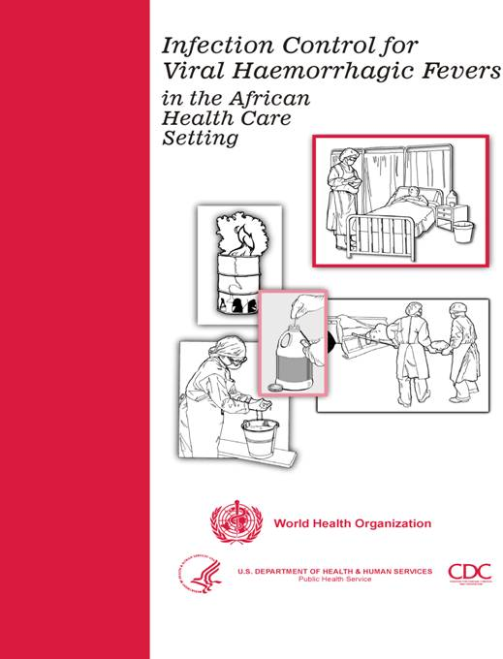
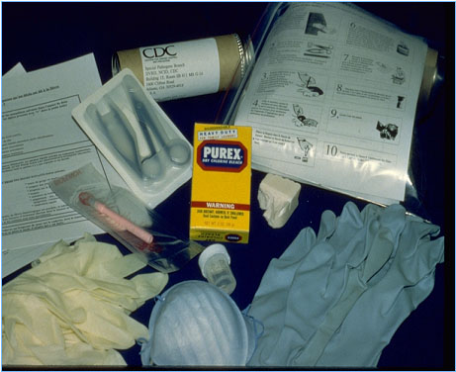
Infection Control

Slide 23
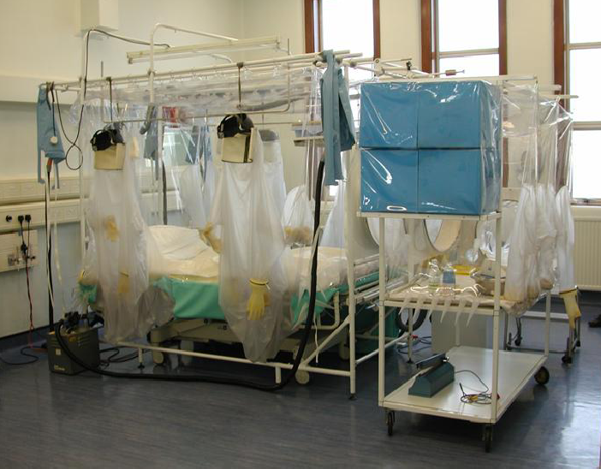

Slide 24
Handling laboratory specimens from patients with suspected or confirmed VHF-non viral diagnostic specimens
Common sense- know the risks
Blood and other specimens are highly infectious
Risk of transmission through skin/mucous membrane contact and needle stick injuries
Respiratory transmission but avoid aerosolisation of specimens
Limit laboratory testing to what is strictly necessary and where possible run specimens at a time when there is minimal disruption to routine work

Slide 25
Useful to for two techs to work together- one to process the specimen, other to operate the instrument
Protective clothing: disposable gown, 2 pairs of gloves, mask and eye protection
Centrifuge with closed buckets and decontaminate after use
Open buckets, specimens and load instrument racks in a BSL-2 cabinet
Discard residual sample and sampling containers into 2% glutaraldehyde or sodium hypochlorite
Decontaminate instruments according to manufacturers instructions
Clean BSL-2 cabinet with glutaraldehyde or sodium hypochlorite
Discard protective clothing, gloves, specimens, ect. Into a biohazard labelled autoclave bag. Double bag and send for autoclaving

Slide 26
Haematology:
prepare slides in a BSL-2 cabinet, once fixed regard as non-infectious
Regard air dried slides as infectious, decontaminate microscope after use
Microbiology:
protective clothing, process specimens in BSL-2 cabinet, discard residual specimen into 2% glutaraldehyde or sodium hypochlorite
Process positive blood cultures in a BSL-2 cabinet
Referral of specimens- appropriate packaging, inform receiving laboratory
Virology:
Routine specimens- as above
VHF diagnosis- requires BSL 3-4 laboratory

Slide 27
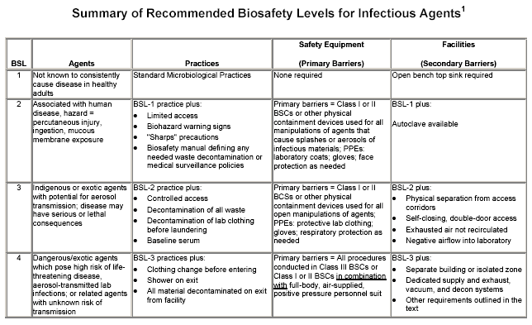

Slide 28
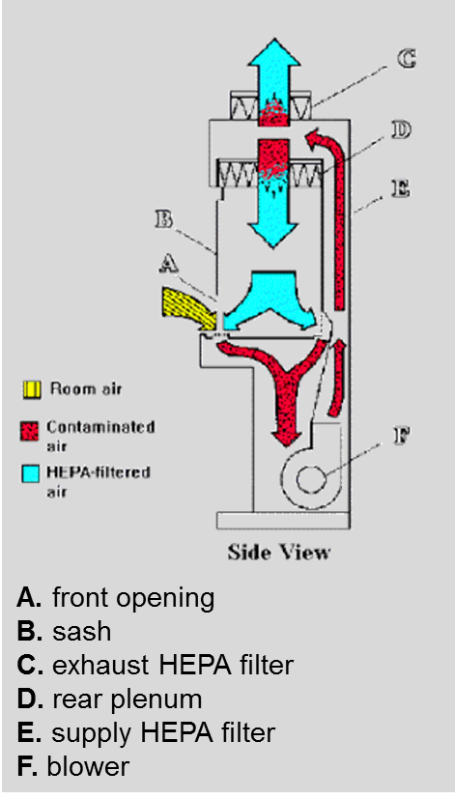
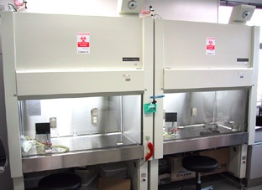
BSL-2 cabinet
Provide personnel, environmental and product protection
Approx 30% air exhausted, 70% re-circulated

Slide 29
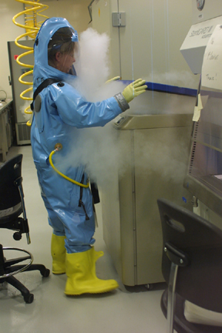
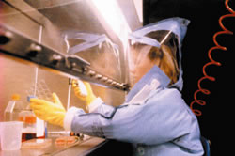
BSL-4 laboratory
Dangerous and exotic agents that pose a high individual risk of aerosol-transmitted laboratory infections and life-threatening disease
Special engineering and design features to prevent microorganisms from being disseminated into the environment.
Activities are confined to Class III biological safety cabinets, or Class II biological safety cabinets used with one-piece positive pressure personnel suits ventilated by a life support system.

Slide 30
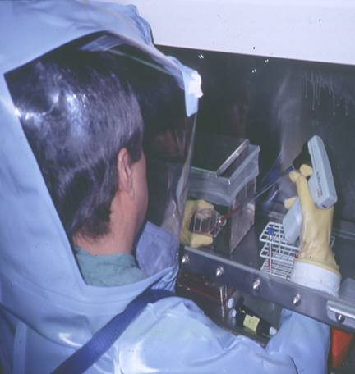
Laboratory safety: BSL-4
In contrast to patient-care,
high-level protection required for:
Laboratory manipulation
Mechanical generation of aerosols
Concentrated infectious material
Viral culture

