Slide 1
VIRAL INFECTIONS OF THE CENTRAL NERVOUS SYSTEM(POLIO, RABIES)
KIMAIGA H.O
MBChB (University of Nairobi)

Slide 2
Viral infections of the CNS
No normal flora in CNS and PNS
Nervous system disease
Meningitis: inflammation of the meninges = membranes surrounding the brain & SC
Encephalitis: inflammation of the brain.

Slide 3
INTRODUCTION
1. Blood-borne invasion takes place across
BBB – encephalitis
Blood-CSF barrier – meningitis
Microbes can traverse these barriers by infecting the cells that comprise the barrier.
CNS infection are usually
Blood-borne invasion most common e.g. poliovirus or Neisseria meningitides
Invasion via peripheral nerves; less common e.g. herpes simplex, varicella zoster virus (chickenpox),

Slide 5
2. Invasion via peripheral nerves
HSV and varicella-zoster virus present in skin or mucosal lesions travel up axons to reach the DRG
Rabies V, introduced into muscle tissue by bite of a rabid animal. It enters peripheral nerves & travel to CNS to reach the neurons

Slide 6
Common characteristics of CNS V infxns
Clinical presentation
Typically acute onset
Healthy hosts are often afflicted
Freq occurs as meningoencephalitis
Meningitis – fever, headache, stiff neck
Encephalitis – meningitis with mental status changes (seizures, decreased consciousness, confusion)
Most CHS infxns – meningoencephalitis
Pure encephalitis – rabies V
Pure meningitis – Coxsackie V

Slide 7
CNS virus pathogenesis
Exposure (epithelial layer disruption. Local replication) → dissemination (viremia, secondary amplification) → CNS entry (BBB disruption, axonal transport) → inflammation (direct & indirect cell damage target cells- neurons, glial cells, endothelial cells) → clinical disease

Slide 8
Causes of Viral encephalitis
Herpes V: HSV1 & 2, VZV, CMV, EBV, HHV-6
Adenovirus
Enteroviruses, poliovirus
Measles, mumps, & rubella V
Rabies
Arboviruses: Japanese encephalitis, St. Louis encephalitis V; West Nile encephalitis V
Reoviruses: Colorado tick fever V
Arenaviruses: lymphocytic choriomeningitis virus

Slide 9
Poliovirus
++ssRNA
Picornaviridae family
Enterovirus genus
Poliovirus spp.
It’s an enterovirus (RNA)
Has 3 serotypes (1,2,3)
Minimal heterotypic immunity btn serotypes
Rapidly inactivated by heat, formaldehyde, chlorine, UV light - enveloped

Slide 10
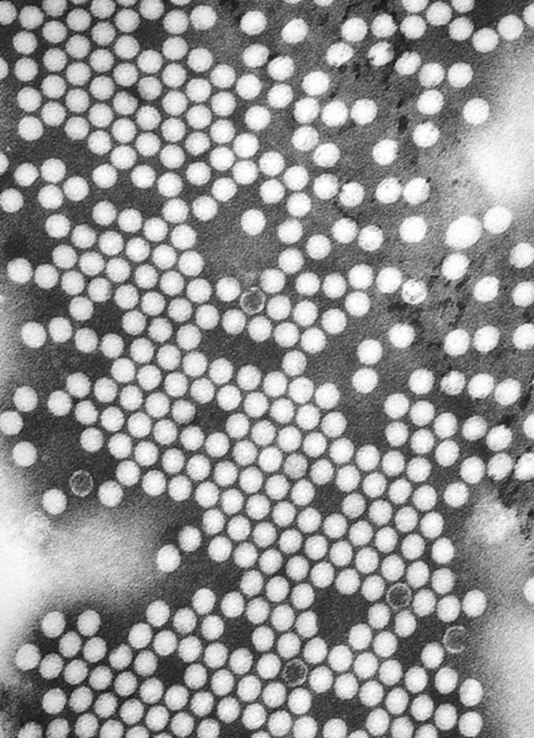
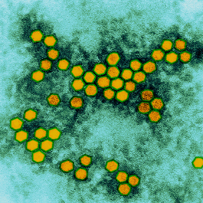
Poliovirus

Slide 11
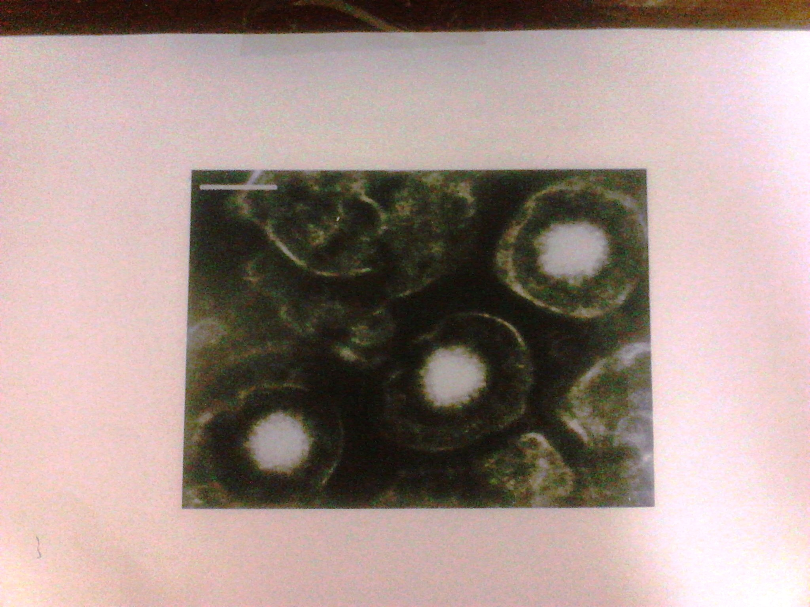

Slide 12
Poliomyelitis
Polio = gray matter
Myelitis = inflammation of SC
The most commonly associated with paralysis
PV infects and causes dx in humans alone!
Individual exposed to PV (infxn or vaccination) develop immunity to PV
3 serotypes of PV have been identified – PV type1, PV2, PV3 – each with a slightly different capsid protein
All 3 are extremely virulent and produce the same dx symptoms
PV1 is the most commonly encountered form, and the one most closely associated with paralysis.

Slide 13
Poliovirus epidemiology
PVs are distributed globally. B4 the availability of immunization, almost 100% of the popn in developing countries b4 the age 5 were susceptible to PV infxn
The availability of immunization and the PV eradication campaign has eradicated PV in most endemic regions except in India Subcontinent & Africa.
As of 2013, polio remains endemic in only 3 countries: Nigeria, Pakistan & Afghanistan – PV vaccine thought to be a bioweapon in some Arab countries

Slide 15
Poliomyelitis in Kenya
The 1st recorded poliomyelitis epidemic in Kenya occurred in 1921-1922
The last case of confirmed poliomyelitis in Kenya was in 1984 and was isolated on stool culture to have been due to PV2
Kenya confirmed a case of circulating vaccine derived polio V in Dadaab refugee camps.

Slide 16
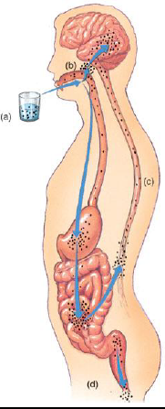
Modes of transmission
Source of infection: Apparent and subclinical patients
Oral-oral infxn: direct droplet infxn
Faeco-oral infxn
Food-borne (ingestion) infxn through the ingestion of contaminated foods. Vehicles include milk, water
Hand to mouth infxn.

Slide 17
Clinical Syndromes
Incubation: 7-14 days
Asymptomatic illness: 90%
Abortive poliomyelitis, the minor illness: 5% infected people
Nonparalytic poliomyelitis or aseptic meningitis: 1%-2% of patients with poliovirus infections.
Paralytic polio, the major illness: 0.1% to 2%of persons with poliovirus

Slide 18
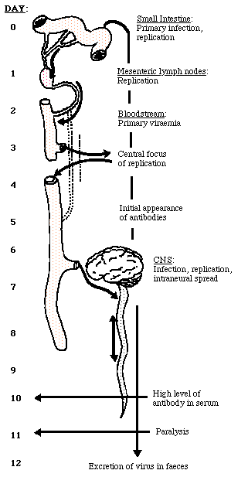
Poliomyelitis – Sequence of Events
Time (days) | Event
0 | Small intestine: 1º infect, replication
1 | Mesentric lymph nodes – replication
2 | Blood stream – 1º viremia
5 | Initial appearance of antibodies
6-7 | CNS– infect, replic, intraneural spread
10 | High level of antibody in serum
11 | Paralysis
12 | Excretion of virus in faeces

Slide 20
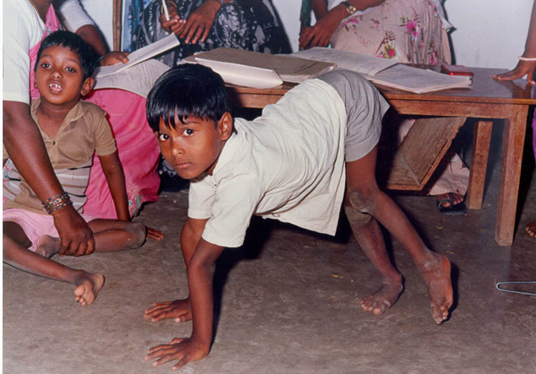

Slide 21
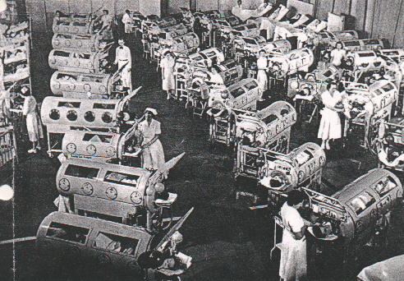

Slide 22
Lab Diagnosis
Definitive diagnosis is made by osolation of the virus from stool, CFS, oropharyngeal secretions
Cell culture involves fibroblastic MRC-5 cells
CPE is usually evident within 36 hours
Serotyping is based on neutralization of CPE by standardized antisera using intersecting pool followed by specific sera.
ELISA
IFA
neutralizing Test
CFT

Slide 23
Virus isolation
PV can be readily isolated from throat swabs, feces, & rectal swabs
Requires molecular techs to differentiate btn the wild type & the vaccine type.
Serological testing
A 4-fold titer rise btn the acute & convalescent specimens suggests PV infxns
CSF analysis
The CSF contains an increased no. of leukocytes – from 10-200 cells/mm³ (primary lymphocytes) and a mildly elevated protein, from 40-50 mg/100 ml.

Slide 24
Prevention
General prevention
Health promotion through environmental sanitation
Health education (modes of spread, protective value of vaccination)
Vaccines
1st vaccine was made in Canada by Connaugt
Immunity
sIgA and neutralizing antibody (IgG, IgA, IgM) persist for life span

Slide 26
Prevention – vaccination
Active immunization
Sabine vaccine-1957
Oral Polio Trivalent live attenuated vaccine
Contains 3 serotypes of vaccine V
Grown on monkey kidney (vero) cells
Shed in stool for up to 6 weeks following vaccination
Salk vaccine – 1954
Intramuscular Polio Trivalent killed/ inactivated vaccine
IPV is used for adult immunization and Immunocopromised patients

Slide 27
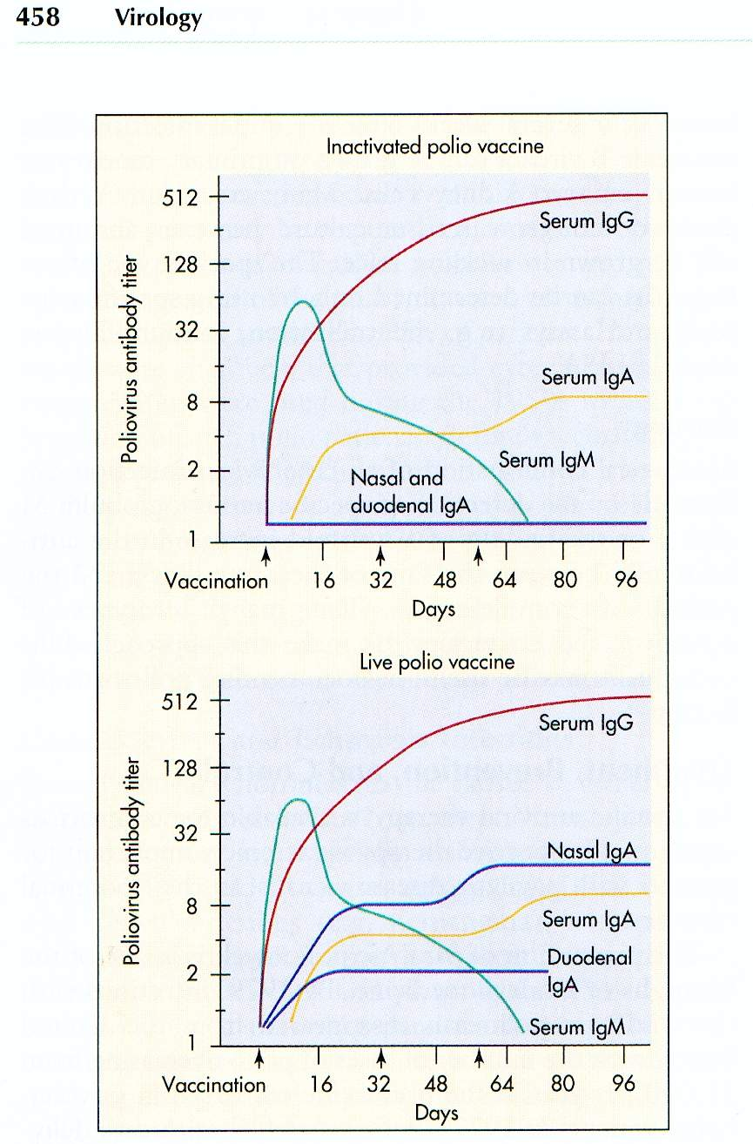

Slide 28
Sabin vaccine - Oral Polio Vaccine
Advantages
Highly effective in producing immunity to PV
50% immune after 1 dose
> 95% immune after 3 doses
Lifelong immunity- – no polio booster necessary.
Local immunity-Induction of secretory antibody response similar to that of natural infection
Possibility of attenuated virus circulating in community by spread to contacts (indirect immunization)(herd immunity)
Ease of administration
Lack of need for repeated boosters

Slide 29
Stops viral replication in G.I.T. Dead Salk vaccine virus has no effect on gut replication
No problem with selective inactivation
Greater cross reaction as vaccine virus also has antigenic drift
Disadvantages
Risk of vaccine-associated poliomyelites in vaccine recipients or contacts
Spread of vaccine to contacts without their consent
Unsafe administration for immunodeficient patients

Slide 30
Salk vaccine – Intramuscular Polio Vaccine
Advantages
Effectiveness
Good stability during transport and in storage
Safe administration in immunodeficient patients
No risk of vaccine-related disease
Disadvantages
Lack of induction of local (gut) immunity
Need for booster vacine for lifelong immunity
Fact that injection is more painful than oral administration
Fact that higher cominity immunization levels are needed than with live vaccine

Slide 31
RABIES
Defn: is an acute progressive encephalomyelitis
Another CNS virus
It is a preventable viral dx of mammals most often transmitted through the bite of a rabid animal
The dog and bats are the main a reservoir of rabies
Rabies is primarily a dx of terrestrial and airborne mammals
The leading viral zoonosis as regards global public health significance.The case to fatality rate is the highest of any infectious dx

Slide 32
Rabies V
It’s a member of the genus Lyassavirus of the family Rhabdoviridae.
Ss (single-stranded) RNA enveloped V, characteristic bullet-shaped appearance with 6-7 nm spike projections
Virion 130-240 nm * 80 nm
Exceedingly wide range of hosts
There are 5 other members of Lyassavirus that cause rabies: Mokola, lagosbat, Duvenhage, EBL-1 &2
Duvenhage and EBL2 have been associated with human rabies.

Slide 33
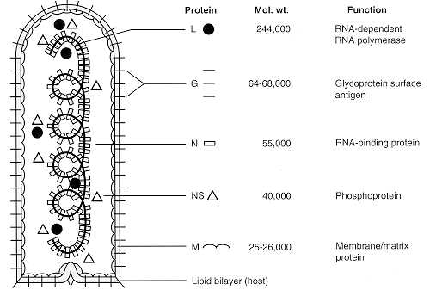
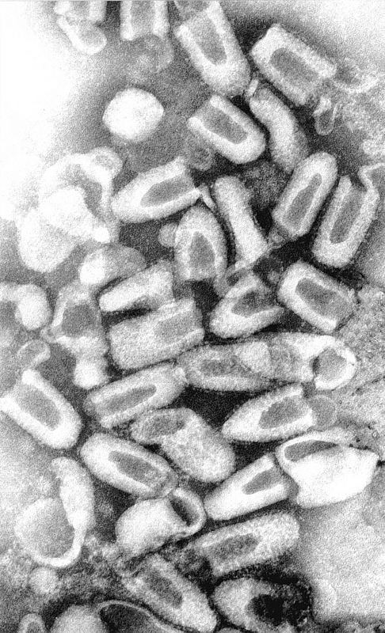

Slide 35
Rabies hosts
All warm-blooded vertebrates are susceptible to experimental infxn
Mammals are the natural hosts of rabies
Reservoirs consist of the Carnivora (canids, skunks, racoons, mongoose, etc.) and Chiroptera (bats)

Slide 38
Distribution of Rabies
Rabies is distributed on all continents ( with the exception of Antarctica)
Several areas are considered ‘free’ of the dx, including many islands in Pacific Oceania
Globalization may threaten the dx-free status of many localities, due to the introduction of rabid animals.
More than ~55,000 human rabies deaths per yr
Most occur in developing countries
Millions of human exposure per yr
The domestic dog is the single most important animal reservoir
Wildlife important, esp in developed countries

Slide 40
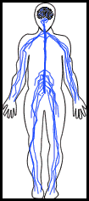
RABIES PATHOGENESIS
Virus is transmitted via bite
Multiplies in the Salivary glands
Enter peripheral nerves
travel by retrograde axon flow in axoplasm of nerves to CNS
Once it reaches this stage, immunisation not effective
Replicate in brain
Centrifugal flow to innervated organs, including the portal of exit, the salivary glands
Viral excretion in saliva
Intervention has to be very fast b4 it disseminates!

Slide 41
Rabies Diagnosis
Based upon history of animal exposure & typical neurological clinical signs
Post-mortem demo of viral antigen in CNS is gold standard
In humans, antemortem detection of V or viral amplicons, antibodies, or antigens (e.g. sera, CSF, saliva, nuchal biopsy

Slide 43
Clinical stages
Incubation period (range = ~<7 days to >6 yrs: average is ~4-6 weeks)
Prodromal phase (non-specific signs)
Acute neurological phase
Coma
Death

Slide 44
Prophylaxis
Pre-exposure vaccination
Provided to subjects at risk b4 occupational or vocational exposure to rabies
Subjects include diagnosticians, lab & vaccine workers, vets, cavers, etc.
Simplifies Postexposure management
Postexposure prophylaxis (PEP)
Provided to subjects after rabies exposure
Consists of wound care, rabies immunoglobulin, and vaccine
If PEP is prompt and proper, survival virtually is assured.

Slide 45
Rabies Biologicals
Rabies Vaccines (for pre- & PEP)
Rabies immunoglobulin (only in PEP)

Slide 46
Rabies Vaccines
2 human rabies vaccines in USA: Human Diploid Cell Vaccine Imovax (HDCV) Purified Chick Embryo Cell Rabavert (PCEC)

Slide 47
Rabies Immunoglobulin
2 human Rabies immune globulins
hyperRab TM S/D
imogam Rabies-HT
Both supplied in vials at ~ 150 IU/ml
Human rabies immune globulin (HRIG) is administered only once, at the beginning of anti-rabies prophylaxis, to previously unvaccinated persons
This will provide immediate antibodies until the body can respond to the vaccine by actively producing antibodies of its own.

Slide 48
Pre-exposure Vaccination
Vaccine given on days 0, 7, and 21 or 28
Serology occurs every 6 months to 2 yrs (if remaining at risk)
If antibody titer not adequate, administer a single booster dose
If ever exposed, give a vaccine dose on days 0 and 3, regardless of titer.
Post-exposure Prophylaxis
Wash lesions well with soap and water (tetanus booster ad hoc)
Infiltrate rabies immune globulin (20 IU/kg) into and around the margin of the bites
Administer vaccine on days 0,3,7,14 & 28.

