Slide 1
Human papillomaviruses
Masika MM

Slide 2
Session Outline
Introduction
Etiology
Epidemiology
HPV – virology, transmission, epidemiology, presentation, investigations, treatment, prevention

Slide 3
Introduction
A million people acquire an STI every day
A majority of STIs are asymptomatic
Each year 500 million people get ill from 4 major STIs:
Chlamydia, gonorrhoea, syphilis & trichomoniasis
Globally, over 500 million people have HSV 2 (genital herpes)

Slide 4
Effects of STIs
Acute: may be asymptomatic or cause acute illness - ulceration, discharge, pain
Long term:
GUT complications – infertility, ectopic pregnancy, chronic pelvic pain
Malignancies
Chronic/lifelong infection
Vertical transmission
Increased risk for HIV transmission
Disease in other organs – CNS, CVS, GIT
Psychological effects/ Stigma

Slide 5
Etiology
Bacterial – N. gonorrheae, T. pallidum, etc.
Parasitic – T. vaginalis, pubic lice, scabies
Viral:
Human Immunodeficiency virus (HIV)
Human papillomavirus (HPV)
Human herpes viruses (HHVs)
Hepatitis B Virus (HBV)

Slide 6
Modes of Transmission
Sexual intercourse: Anal, vaginal, oral,
Blood & blood products (unscreened)
Vertical transmission
Sharing needles (PWIDs – People who inject drugs)
Tattooing & body piercing
Close (direct) contact

Slide 7
Viral vs Bacterial STIs
Viral STIs | Bacterial STIs
e.g. HIV, HPV, HSV, HBV | Gonorrhea, Syphilis, Chlamydia, LGV, Chancroid
No cure, Medication for symptoms only | Can be cured with antibiotics
Can be passed to others for the rest of your life | If untreated, can cause PID, scarring, infertility, etc.
Notes:
Chancroid – Hemophilus ducreyi

Slide 8
Human Papillomaviruses (HPV)
Family: Papillomaviridae
Small (8 kBp), circular dsDNA virus
Non-enveloped
Over 300 genotypes so far, 40 affect anogenital region
HPV linked to anogenital, oropharyngeal cancers
Notes:
Order: unassigned (ICTV 2013)

Slide 9
Classification of HPV
A. Classification as per Viral Tropism
Cutaneous e.g. HPV 1, 2, 3 & 4
Mucosal:
Classified as High-risk or Low risk - depending on propensity to cause cancer
High risk = HPV 16, 18, etc.
Low risk = HPV 6, 11, etc.
B. ICTV classification: Family, genera, species, genotypes

Slide 10
HPV Classification: Most important genotypes are in Alphapapillomavirus genus
Notes:
Alphapapillomavirus
Betapapillomavirus
Deltapapillomavirus
Epsilonpapillomavirus
Gammapapillomavirus
Iotapapillomavirus
Kappapapillomavirus
Lambdapapillomavirus
Mupapillomavirus
Nupapillomavirus
Omicronpapillomavirus
Pipapillomavirus
Thetapapillomavirus
Xipapillomavirus
Zetapapillomavirus

Slide 11
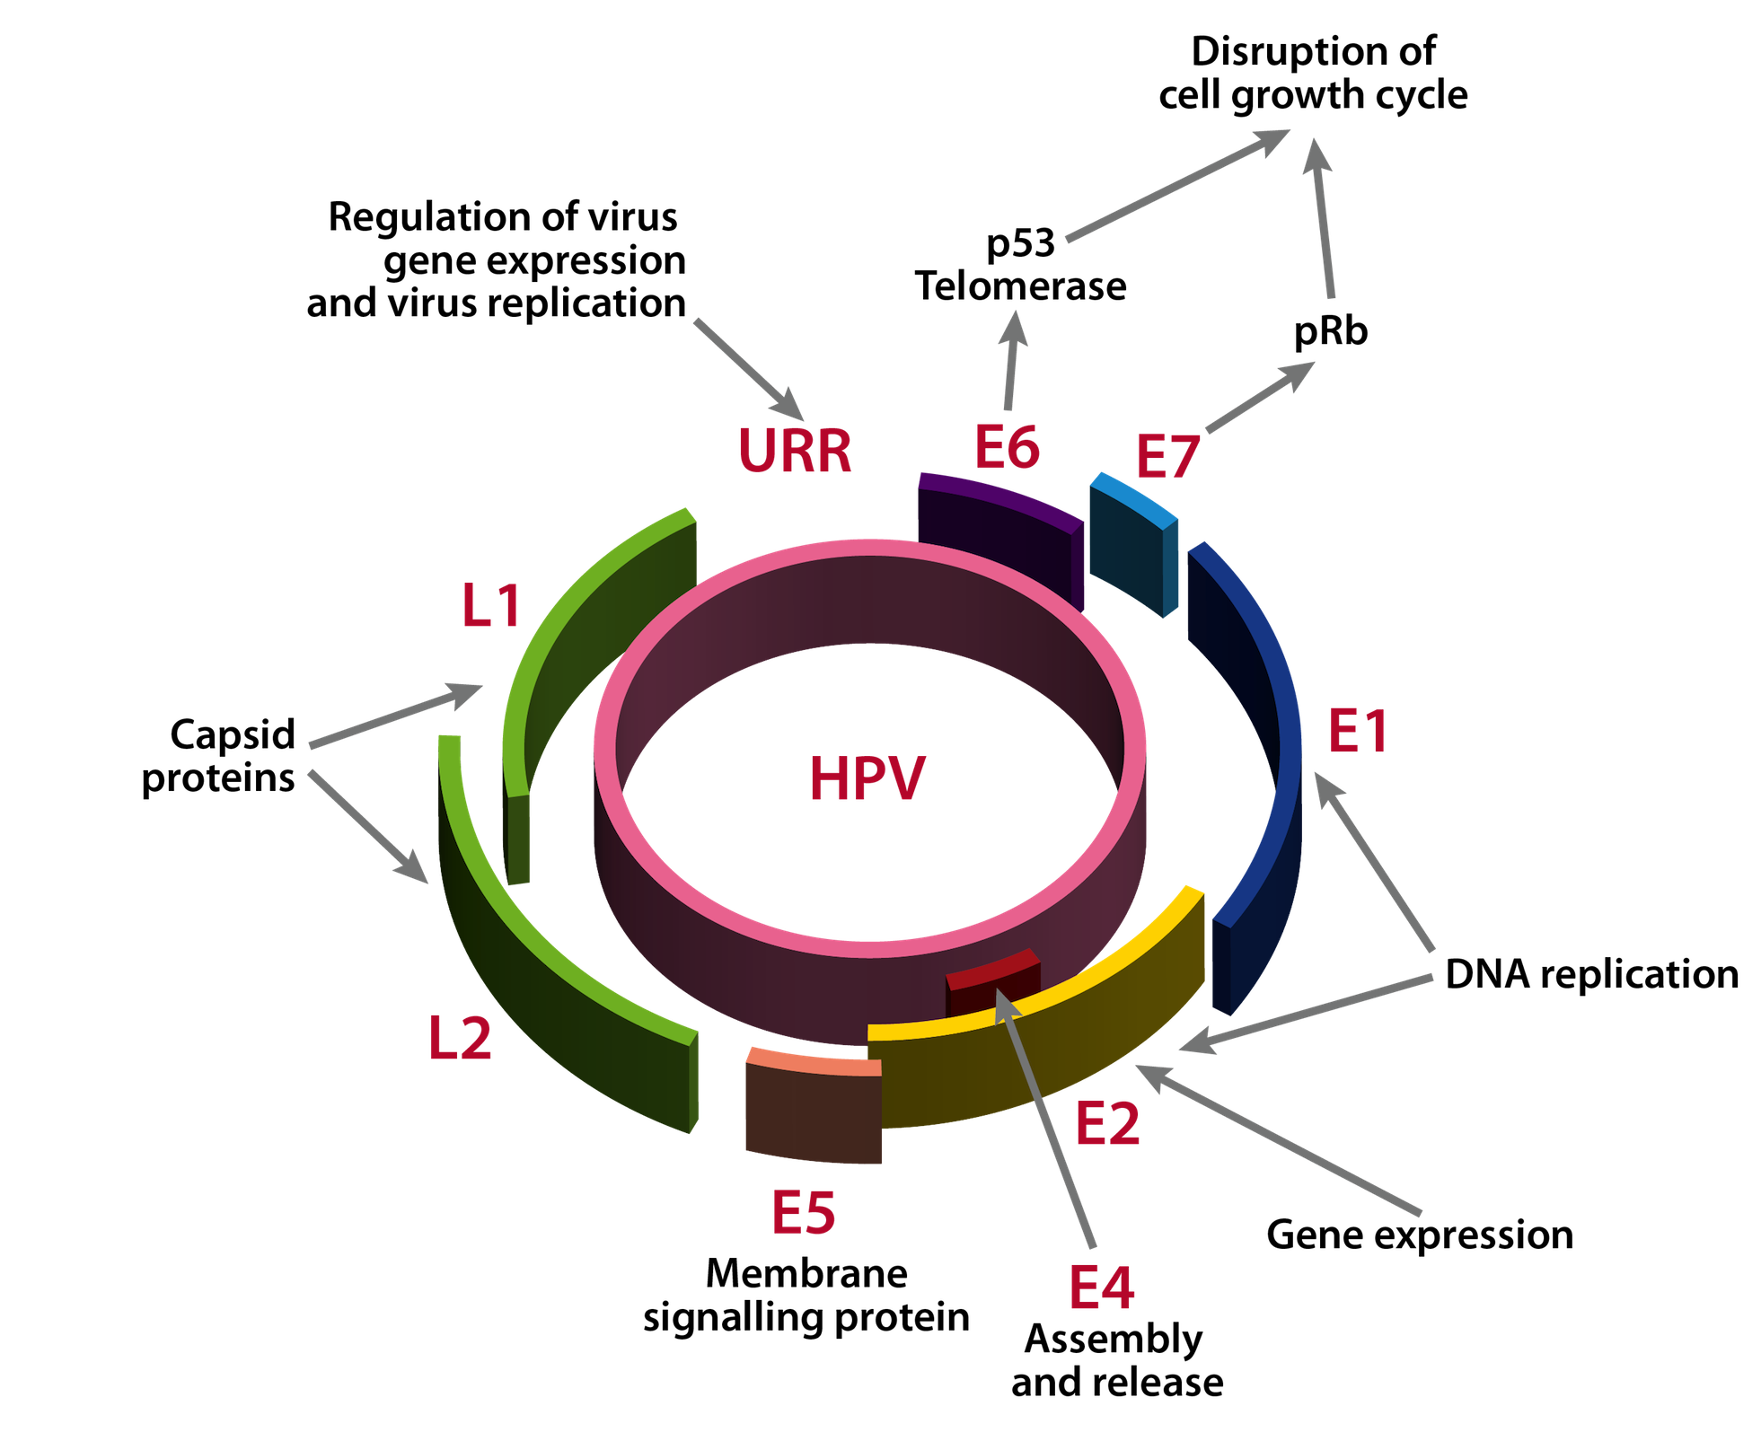
HPV Genome
E6 and E7 cause Cancer
Notes:
p53 – regulates cell cycle – tumor suppressor gene
pRB – retinoblastoma gene – regulates cell cycle
Inhibition of both prevents apoptosis

Slide 12
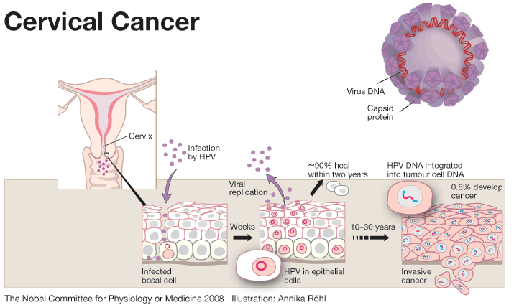
By Harald zurHausen, et al.

Slide 13
Epidemiology
Commonest STI, affects both men & women
Asymptomatic in a majority of cases
Risk Factors: Early coitarche, Multiple sexual partners, Concomitant STDs, Handling meat, poultry & fish – non-genital HPV
After infection, 90% clear within 2yrs
10% develop epithelial neoplasia
<1% develop Ca Cervix
Notes:
70% clear within 1 yr,

Slide 14
Epidemiology
Transmission:
Sexual
Direct contact
Vertical transmission
Prevalent in 12% of all women worldwide; Kenya – 40%
Bimodal: peaks at 25yrs and 55 yrs

Slide 15
Epidemiology
In cervical cancer:
HPV 16 is present in 50-75% of cases
HPV 18 in 12-25% of cases
About 30% of Cervical cancers is due to non-HPV 16 &18 genotypes
Warts
HPV 6 & 11 present in 90% of all anogenital warts

Slide 16
Clinical Manifestations
Warts:
Anogenital Warts (condyloma acuminata)
Mucosal Warts (Non-anogenital): Oral , laryngeal
Cutaneous (skin) Warts: verruca vulgaris, verruca plana
Cancers: anal, genital, oral, pharyngeal
Epidermodysplasia verruciformis
Notes:
Subclinical infection - tiny, slightly raised areas felt or visualized on the cervix or vagina

Slide 17
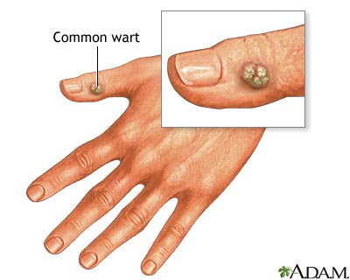
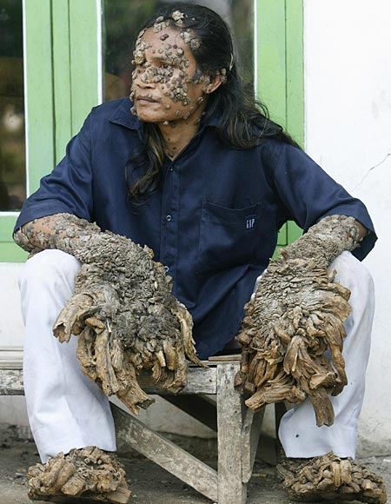
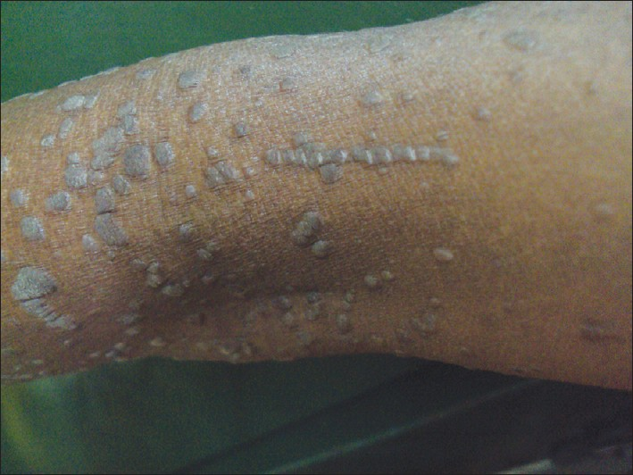
Epidermodysplasia verruciformis
Flat warts
Notes:
Flat warts

Slide 18
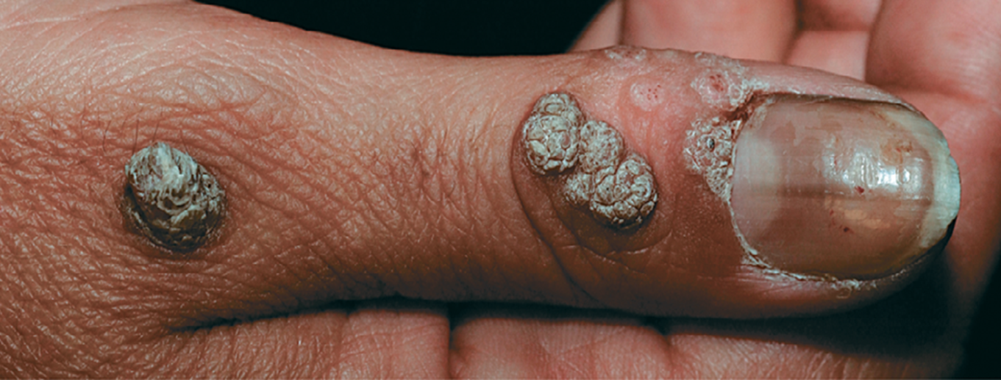
Cutaneous warts

Slide 19
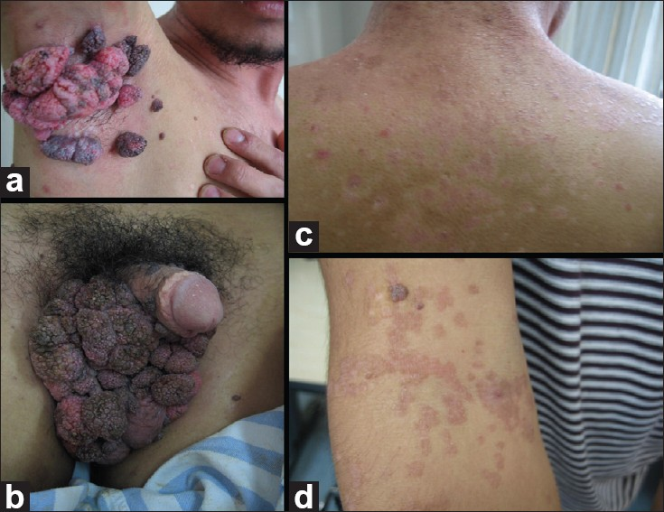
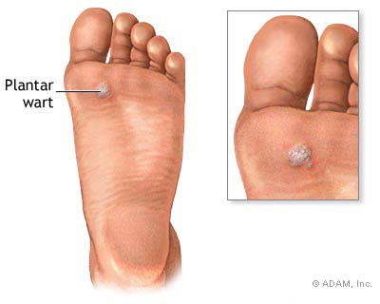
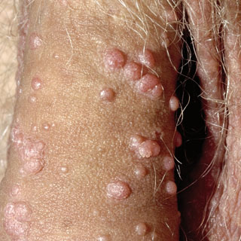

Slide 20
Signs & Symptoms
Most infections are asymptomatic
Varied presentation depending on site of infection
Anogenital warts:
Various surfaces: vagina, introitus, labia, vulva, penis, perineum
Smooth or keratotic
Usually painless
+ pruritus / bleeding
Notes:
Usually on moist surfaces, occasionally on dry ones

Slide 21
Laboratory Diagnosis
HPV DNA typing – PCR, Sequencing
Tissue biopsy and histology e.g. colposcopy
Cytology: e.g. Pap smears
Visual inspection: VIA/VILI – user dependent
Notes:
Pap test: start at 21 years then 3 yearly till 65 yrs if no abnormal pap for 20 yrs before.
Can be done five yearly with HPV testing after 30 yrs

Slide 22
Treatment
Not curative, aims to reduce symptoms or eliminate lesions
Treatment dependent on site and extent of lesions
Recurrence is common &
Retreatment often necessary
Follow up is important
Notes:
Keratolytics are the only agents for non-genital cutaneous warts

Slide 23
Treatment (warts)
NOTE: There is no specific antiviral agents for HPV
1. Pharmacologic agents:
Immune modifiers: imiquimod, INF-α
Cytotoxic agents: podofilox, podophylin, 5-fluorouracil
Keratolytic agents – Salicylic acid, trichloroacetic acid

Slide 24
Treatment (HPV lesions)
2. Surgical ablation
Simple excision
Cryosurgery
Electrosurgery e.g. LEEP (loop electrosurgical excision procedure)
Laser ablation
Cavitron Ultrasonic Surgical Aspiration (CUSA)
Notes:
Also Mohs surgery

Slide 25
Prevention
Health education
Safe sex practices: abstinence, delay coitarche, mutual monogamy
Condoms are partially protective
HPV vaccines:
Bivalent (Cervarix®) – HPV 16 & 18
Quadrivalent (Gardasil®) – HPV 6, 11, 16 & 18
Nonavalent Vaccine – HPV 6, 11, 16, 18, 31, 33, 45, 52 & 58,

Slide 26
Further Reading
www.microbiologybook.org
Medical Microbiology (Lange)

Slide 27
p2.gg/z46
Most cervical cancers are due to the following:
HPV 6
HPV 11
HPV 16
HPV 18
HPV 16 & 18

Slide 28
Questions?
@mosmasika
mosmasika@gmail.com
Masika Moses
@MicrobiologyUoN
Medical Microbiology UoN

