Slide 1
NITRIC OXIDE (NO)
KIMAIGA H.O
MBChB (University of Nairobi)

Slide 2
NITRIC OXIDE (NO)
Is a gaseous molecule that readily diffuses across cell membranes readily and has many physiological functions i.e. is a
Vessel dilator
Platelet inhibitor
Immune regulator and also
A neurotransmitter

Slide 3
Synthesis of Nitric Oxide
Is synthesized by three closely related by Nitric Oxide Synthase (NOS) Isozymes
Neuronal nitric oxide synthase (n – NOS or NOS-1)
Macrophage/ Inducible nitric oxide synthase (I – NOS or NOS-2)
Endothelial nitric acid synthase (e – NOS or NOS-3)
These generate nitric oxide from L-arginine in an oxygen and NADPH reaction

Slide 4
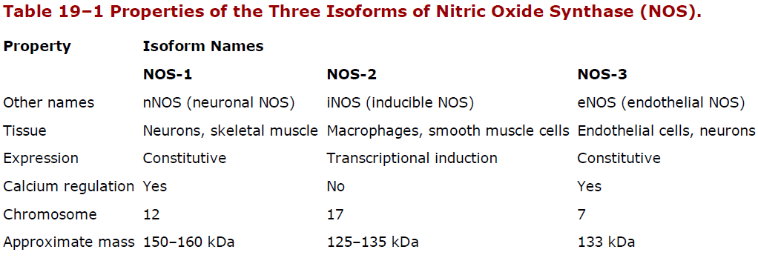
These involve enzyme bound co-factors including heme, tetrahydrobiopterine and FAD (Flavine Adenosine Dinucleotide)
In the case of NOS-1 and NOS-3, nitric oxide is evoked by agents and processes that increase cytosolic calcium concentrations while NOS-2 is not regulated by calcium (it is inducible)

Slide 5
Signalling mechanisms
Nitric Oxide mediates its effect by covalent modification of proteins
The three major effector targets of NO are;
Metalloproteins
Thiols
Tyrosine nitration

Slide 6
Metalloproteins
NO interacts with metals especially the iron of heme and heme is contained in soluble guanyl cyclase and the binding of NO to the iron of heme results in activation of soluble guanyl cyclase and elevation in intracellular cyclic GMP levels
cGMP activates protein kinase G which phosphorylates specific proteins
Vasodilatation exerted by NO is largely mediated by NO-dependent elevation in cGMP and protein kinase G

Slide 7
Several other metalloproteins are targets of guanyl cyclase *NO
Affinity of NO for iron also has inhibitory effects e.g. effect on enzymes that contain iron-sulphur clusters such as tricarboxylic acid cycle enzyme aconitase
It also has inhibition of mitochondrial respiration by inhibiting cytochrome oxidase
Inhibition of CYP450 is the major pathogenic mechanism in inflammatory liver disease

Slide 8
Thiols
NO reacts with compounds containing sulphur hydryl groups to form Nitroso thiols
This process is catalyzed by either metals or oxygen
Exposure of certain proteins containing sulphur hydryl groups may lead to accumulation of nitro thiols which can activate or inhibit the activity of these proteins
NO can undergo both oxidative and reductive reactions resulting in the formation of a variety of oxides that can nitrosylate thiols, nitrate tyrosines or which are stable oxidative products

Slide 9
Nitrosylation activates H-ras which is a gene marker, is a regulator of cell proliferation
When activated, glyceraldehyde 3 phosphate dehydrogenase (G3P-DH) is inhibited
Glutathione interacts with NO under physiological conditions to generate S-Nitroglutathiol and this may serve as a long-lived carrier of NO
Vascular glutathiol is decreased in diabetes mellitus and arthrosclerosis and may account for increase incidence of cardio-vascular complications in these conditions

Slide 10
Tyrosine Nitration
NO reacts with super oxide to form per oxy nitrite which is a powerful oxidant that leads to DNA damage, irreversible nitration of tyrosine, oxidation of cysteine to disulphides or to various oxides
Protein tyrosine nitration is used as a marker for the presence of oxidative and nitroso active stress

Slide 11
Inactivation of Nitric Oxide
NO is labile and reacts with metals and reactive oxygen species
It reacts with heme and hemoproteins including oxyhemoglobin
Oxyhemoglobin catalyzes NO oxidation to nitrate
Reaction with Hb may result in partial S-Nitrosylation of Hb resulting to NO transport throughout the vasculature
NO is also inactivated by superoxide hence scavengers of super oxide anion will enhance its potency and prolong its duration of action

Slide 12
PHARMACOLOGICAL MANIPULATION OF NO
Inhibitors of NO Synthase
Inhibitors of NO synthase are arginine analogs that bind to NO synthase arginine binding site
Most of the NO synthase inhibitors are not selective for the isoforms; they will bind all the three isozymes of NO synthase (NOS-1 – NOS-3)

Slide 14
NO Donors
Are used to elicit smooth muscle relaxation
Organic Nitrates
Nitroglycerine; used in the management of angina pectoris. It dilates the veins and coronary arteries. The drug is metabolized to NO by mitochondrial aldehyde reductase
Isosomide dinitrate; is metabolized to NO releasing species. Continues administration of organic nitrates leads to loss of therapeutic effect and this tolerance may derive from NO mediated inhibition of mitochondrial aldehyde reductase

Slide 15
Organic Nitrites
The organic nitrites are arterial vessels dilators e.g. antiangina isoamylnitrite
It also requires metabolic activation to elicit basal relaxation. It does not exhibit rapid tolerance seen in the nitrates
Sodium nitroprusside used in rapid lowering of blood pressure in arterial hypertension. It generates NO in response to light as well as chemical or enzymatic mechanisms in cell membranes.
Hybrid NO donors involves incorporation of NO donating moieties into currently available cardiovascular drugs

Slide 16
NO Gas Inhalation
Results in reduced pulmonary artery pressure and improved perfusion of ventilated areas of the lung.
Sildenafile is an inhibit of type 5 phosphodiesterase and causes prolongation of the duration of NO induced cAMP elevations in a variety of tissues

Slide 17
NO in Disease Vascular Effects
Has significant effects on smooth muscle tone and blood pressure because it is a vasodilator
The endothelium dependent vasodilators e.g. acetylcholine and bradykinnin act by increasing intracellular calcium levels which induce NO synthase
The effect of basal pressure drugs is increased by inhibition of NO synthase
NO protects against thrombosis and inhibiting proliferation and migration of vascular smooth muscle

Slide 18
The antithrombotic effect is also mediated by NO dependent inhibition of platelet aggregation
Endothelial cells respond to these vasorelaxants by releasing a soluble endothelial-derived relaxing factor (EDRF).
EDRF acts on vascular muscle to elicit relaxation.
NO is the major bioactive component of EDRF.

Slide 19
Both endothelial cells and platelets contain e-NOS which regulates thrombus formation
cGMP mediates the effect of NO in platelets
NO reduces endothelial adhesion of monocytes and leucocytes which are the key features of early development of artheromatus plugs
NO may also act as an antioxidant; blocking oxidation of LDL preventing/reducing of foam cells
Plug formation is affected by NO-dependent reduction in endothelial cell permeability to lipoproteins
Arthrosclerosis risk factors such as smoking, hyperlipidemia, diabetes and hypertension are associated with decreased endothelial NO production hence you get enhanced arthrogenesis

Slide 20
Septic Shock
Lipopolysacharide components from bacterial cell wall induce synthesis of inducible NO synthase
This results in exaggerated hypotension, shock and even death
The hypotension can be reversed by NO-synthase or compounds that prevent action of NO or scavengers of NO
Increased urinary excretion of nitrate is a feature of gram negative bacterial infection

Slide 21
Inflammation
NO is one of the inflammatory mediators
Cytokines like TNF (Tumor Necrosis Factor) and IL1 as well as bacterial derived mediators induce transcription of macrophage NO synthase in leucocytes, fibrinoblasts and other cell types
This accounts for increased levels of NO
NO is also microbiside and may have a role in tissues adopting to inflammatory states but over production may exerrbate tissue injury in both acute and inflammatory conditions

Slide 22
NO generated during inflammation is involved in vessel dilatation
Elevated levels of NO and inducible NO-synthase is demonstrated in Psoriasis lesions, airway epithelium in asthma and inflammatory bowel lesions
It has been shown that NO stimulates synthesis of inflammatory PGs by stimulating COX-2
NO plays an important protective role in the body via immune cell function

Slide 23
CNS and PNS
NO has a major role as a NT, as a modulator of ligand gated receptors or both
In the peripheral nervous system, NO is a mediator for certain NANC actions and that some of these neurons release NO
Penile erection is caused by release of NO from these neurons
NO promotes relaxation of smooth muscle in the corpora cavernosa resulting in penile erection

Slide 24
Respiratory Disorders
Inhalation of NO decreases arterial pressure and improves blood oxygenation
May have an additional role of relaxing airways smooth muscle and acting as a bronchodilator
NO improved cardiopulmonary function in patients with pulmonary artery hypertension
It is also of benefit to new borns with pulmonary hypertension and acute respiratory distress syndrome

