Slide 1
Cephalosporins and Cephamycins
EO

Slide 2
Objectives
By the end of this lecture you should be able to
Classify Cephalosporins
Understand their mechanism of action and resistance
Antibacterial spectrum and indications
Adverse effects

Slide 3
Cephalosporins source
Fungus
Semisynthetic
- addition of cephalosporin C nucleus
or different R₁ or R₂ side chain
- results in more water soluble or acid
acid stable product

Slide 4
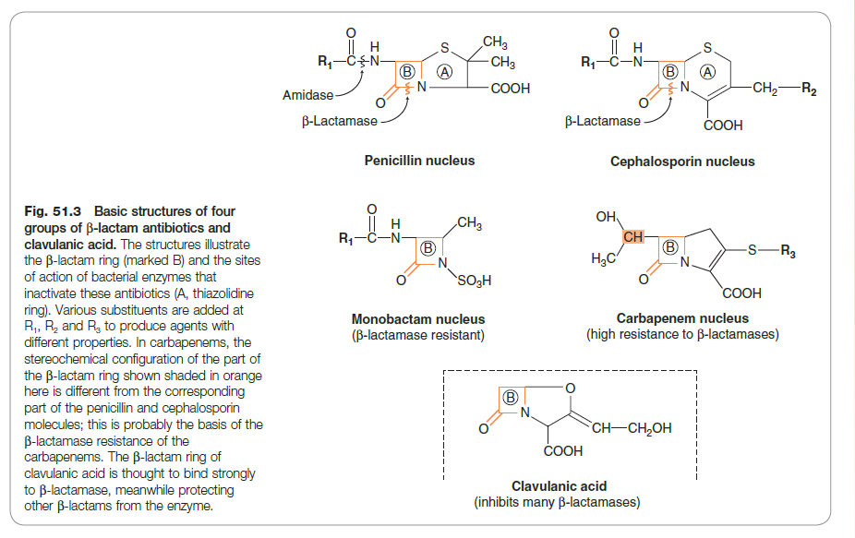
β-Lactam Antibiotics
Rang and Dale

Slide 5
Chemistry
7- aminocephalosporanic acid structure similar to
6 - aminopenicillanic acid in penicillins

Slide 6
Cephalosporins
Similar to penicillins
More stable to many β- lactamases
Broader spectrum of action
ESBL - strains of E coli and K pneumoniae
No activity against enterococci and L monocytogenes

Slide 7
Mechanism of action
Similar to penicillin
What is the mechanism of action of β-lactam antibiotics ?
Why are the susceptibility of bacteria to different groups of β-lactam antibiotics varied ?

Slide 8
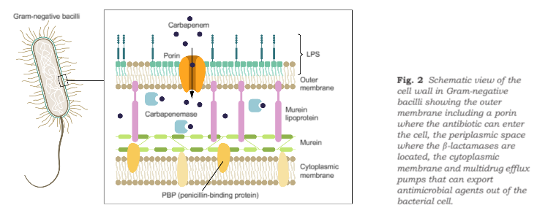
Bacterial cell wall structure
Journal of Internal Medicine 2015 ; 277:502-12

Slide 9
Resistance
Plasmid encoded or chromosomal mediated β - lactamase production ( all gram negatives)
Active hydrolysis of ring > penicillins
Single mutation results in high level costitutive production of enzymes
Other mechanisms- ↓ drug penetration due to change in outer membrane protein or mutation of binding site protein

Slide 10
Pharmacokinetics
Few given PO
Most parenteral - IM , IV
Widely distributed following absorption
Ceftriaxone , Cefuroxime ,Cefotaxime cross BBB
Excretion- kidney, > tubular secretion
40% Ceftriaxone - biliary

Slide 11
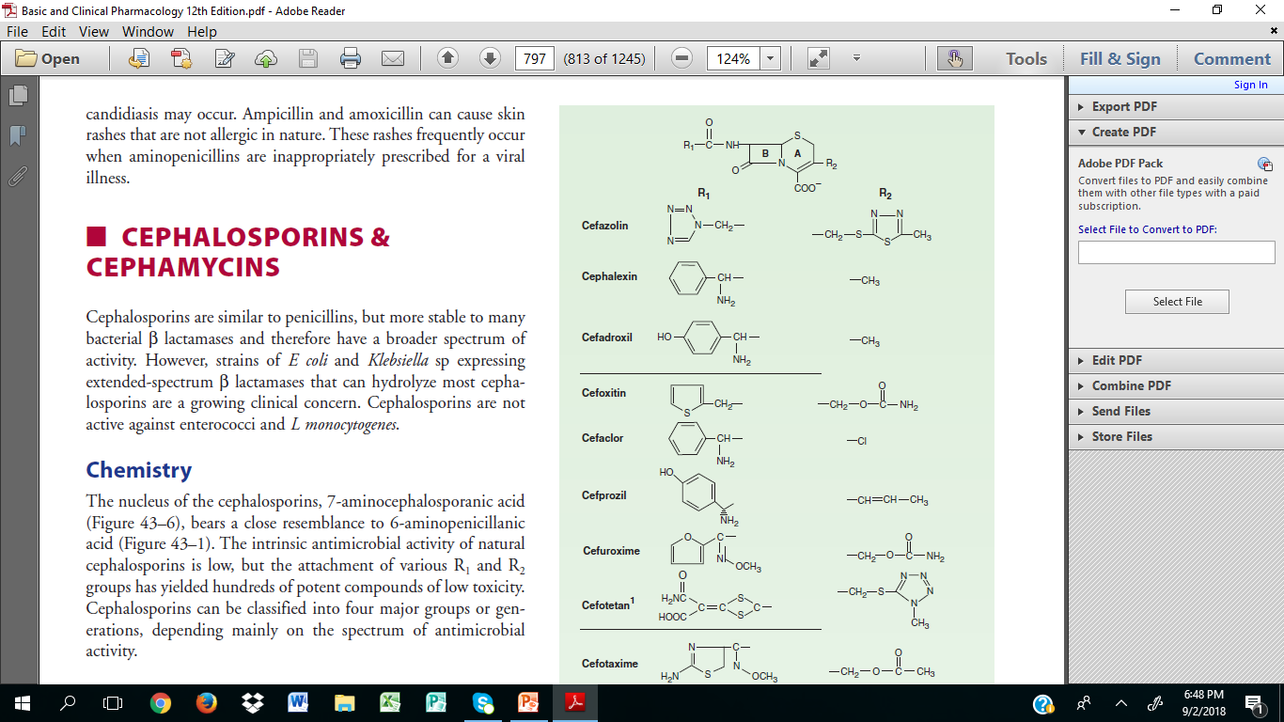
First Generation
Cefazolin, Cephalexin ,Cephadrine Cephapirin , Cephalothin
Gram +ve cover : Strep. Staph. Pneumococci
No activity against MRSA
Anaerobic cover excluding B fragilis
PO –variable
High urine conc.
Tissue < serum level
Excretion by glomerular filtration and tubular secretion
Probenecid ↑ level in serum
↓ in renal dysfunction

Slide 12
Activity
Which 1st generation cephalosporins are used orally ?
What properties make the drug to be stable as oral agents?

Slide 13
Parenteral 1st generation Cephalosporins
Cefazolin
Penetrates well most tissue
Used for surgical prophylaxislow toxicity infection produced by E coli and K pneumoniae
Staph and Strep where patient allergic to penicillin
No CNS penetration
Alternate anti staphylococcal agent

Slide 14
Second Generation
Cefaclor,Cefamandole , Cefonicid , Cefuroxime ,Cefprozil,Loracabef,Ceforanide
Cefoxitin ,Cefometazole,Cefotetan
(Cephamycins) - active against anaerobes
Active against organisms inhibited by 1st Gen.
Gram –ve -K pneumoniae , H influenzae
No activity against enterococci and P aeruginosa

Slide 15
Uses
Active against H influenzae , M catarrhalis
Sinusitis , otitis ,LRTI
Cephamycins are used for periodontal infections, diverticulitis and pelvic inflammatory diseases
Which are the Cephamycins?
Why are the choice agents in the above listed
conditions ?
Cefuroxime - CAP

Slide 16
Pharmacokinetics
PO - Cefaclor , Cefuroxime axetil, Cefprozil Loracabef
Unpredictable activity against penicillin non-susceptible pneumococci
Cefaclor has higher susceptibility to β- lactamases
IV use
IM painful

Slide 17
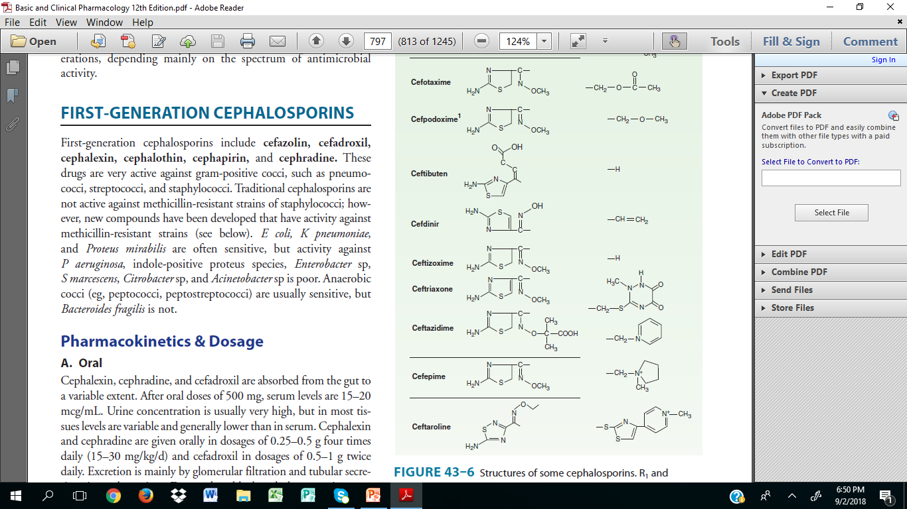
Third Generation
Cefoperazone ,Cefotaxime,Ceftazidime
Ceftriazone , Cefixime
Cefpodoxime proxetil,Cefdinir
Cefditoren pivoxil
Ceftibuten, Moxalactam

Slide 18
Third Generation Cephalosporins
↑ gram negative activity
Penetrate body tissue well
Used in meningitis and neutropaenic fever

Slide 19
Activity
Which organisms are third generation Cephalosporins active against ?

Slide 20
Antipseudomonal 3rd gen . agents
Ceftazidime
Cefoperazone

Slide 21
They are hydrolysed by AmpC β lactamases
Cefixime and Moxalactam are active against B fragilis

Slide 22
PK
Cefixime ,Ceftibuten are used orally
Cefoperazone and Ceftriaxone - biliary excretion

Slide 23
Fourth Generation
More resistant to hydrolysis by chromosomal β-lactamases
Hydrolysed by ESBLs
Active against enterobacteriaceae, S aureus, S pneumoniae
↑activity against Haemophilus and Neisseria
Penetrates CSF and has renal clearance
Unlike ceftazidime effective against non-susceptible strep.
Useful in enterobacter

Slide 26
Fifth Generation
MRSA active ↑ PBP 2a
Ceftobiprole and Ceftaroline

Slide 27
Adverse Drug Reactions
Hypersensitivity
10 % of Penicillin hypersensitive patients have cross reaction
Nephrotoxicity - cefradine most common
Drug induced ETOH intolerance
Diarrhoea - C. difficile

Slide 28
Cephalosporin with MTT
Methylthiotetrazole group - Cefamandole, Cefmetazole, Cefotetan, Cefoperazone
May cause hypothrombinemia and bleeding
Can be prevented by oral vitamin k 10mg x 2 weekly
Disulfuram like reaction

Slide 29
Food for thought
Ex
Cell Lent
↑ ↑ ↑
MAXI MIDI MINI

Slide 30
Excellence is choice
You do not need to be the best but must seek to do your best
He who finds purpose in what they do finds fullfilment

