Slide 1
DRUG ABSORPTION
23.09.2013

Slide 2
Introduction
The absorption, distribution, metabolism, and elimination of drugs are the processes of pharmacokinetics.
Absorption is the movement of a drug from its site of administration into the central compartment.

Slide 3
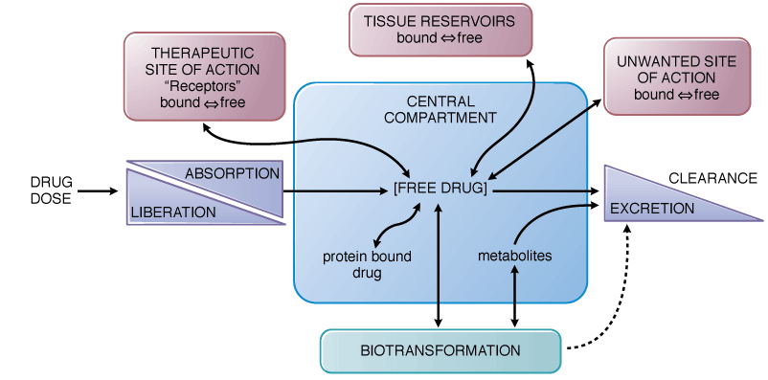
Interrelationship…

Slide 4
Transfer of drugs across membranes
In most cases, a drug must traverse the plasma membranes of many cells to reach its site of action.
Characteristics of a drug that predict its movement and availability at sites of action are:
its molecular size and structural features
degree of ionization
relative lipid solubility
its binding to serum and tissue proteins

Slide 5
Transfer of drugs across membranes
Drugs cross membranes either by passive or active processes.
In passive transfer, the drug molecule penetrates by diffusion along a concentration gradient by virtue of its solubility in the lipid bilayer.
Such transfer is directly proportional to:
concentration gradient across the membrane
lipid-water partition coefficient of the drug
the membrane surface area exposed to the drug.

Slide 6
Influence of pH & ionization
Many drugs are weak acids or bases that are present in solution in both the non-ionized and ionized forms.
Non-ionized molecules are more lipid soluble and can diffuse readily across the cell membrane.
Ionized molecules are less able to penetrate the lipid membrane because of their low lipid solubility.

Slide 7
Carrier-mediated membrane transport
Active transport is characterized by:
direct requirement for energy
movement against an electrochemical gradient
Saturability
Selectivity
Competitive inhibition by co-transported compounds.
Ex. Na⁺,K⁺-ATPase is an important example of an active transport mechanism that is a therapeutic target of digoxin in the treatment of heart failure.

Slide 8
.
Facilitated diffusion is a carrier-mediated transport process in which there is no input of energy.
Movement of the involved substance is down a chemical gradient eg. glucose transport using the insulin-sensitive glucose transporter GLUT4.
May also be an efflux pump eg. P-glycoprotein
- Limits oral absorption of transported drugs because it exports compounds back into the lumen of the GI tract after their absorption.

Slide 9
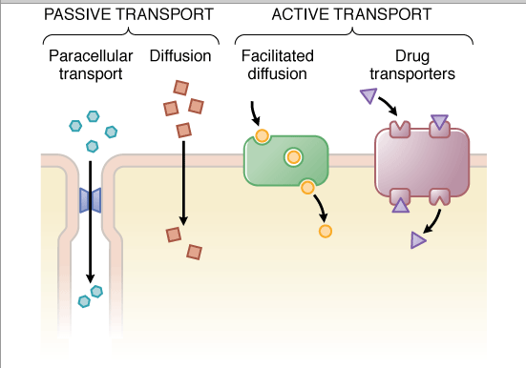
Drug movement across cellular barriers

Slide 10
Absorption after oral drug administration
Absorption from the GI tract is determined by:
surface area for absorption
blood flow to the site of absorption
the physical state of the drug (solution, suspension, or solid dosage form)
its water solubility
the drug's concentration at the site of absorption.

Slide 11
Oral administration (2)
For drugs given in solid form, the rate of dissolution may limit their absorption, especially drugs of low aqueous solubility.
Since most drug absorption from the GI tract occurs by passive diffusion, absorption is favored when the drug is in the non-ionized and more lipophilic form.

Slide 12
.
The stomach epithelium is lined with a thick mucus layer, and its surface area is small; by contrast, the villi of the upper intestine provide an extremely large surface area (~200 m²).
Thus, rate of absorption of a drug from the intestine will be greater than that from the stomach.
Any factor that accelerates gastric emptying eg. recumbent position will ↑ the rate of drug absorption and vice versa.

Slide 13
Controlled Release Preparations
The rate of absorption of a solid oral drug is partly dependent on its rate of dissolution in GI fluids.
This is the basis for controlled-release, extended-release, or sustained-release preparations.
Produce slow, uniform absorption of the drug for ≥8 hrs.

Slide 14
Sublingual Absorption
Small surface area available for absorption.
Venous drainage from the mouth is to the superior vena cava, bypassing the portal circulation.
Thus protects the drug from rapid intestinal and hepatic first-pass metabolism.
Ex. Sublingual nitroglycerin is absorbed very rapidly as it is non-ionic and has very high lipid solubility.

Slide 15
Transdermal Absorption (1)
Not all drugs readily penetrate the intact skin.
Absorption of those that do is dependent on:
surface area over which they are applied
their lipid solubility because the epidermis behaves as a lipid barrier.

Slide 16
Transdermal Absorption (2)
The dermis, however, is freely permeable to many solutes. Systemic absorption is ↑d in:
Abraded, burned, or denuded skin.
Inflammation and other conditions that increase cutaneous blood flow.
Toxic effects sometimes are produced by absorption through the skin of highly lipid-soluble substances e.g. lipid-soluble insecticides.

Slide 17
Transdermal Absorption (3)
Absorption through the skin can be enhanced by suspending the drug in an oily vehicle and rubbing the preparation into the skin.
Because hydrated skin is more permeable than dry skin, an occlusive dressing may be used to facilitate absorption.
Controlled-release topical patches available include:
nicotine for tobacco-smoking withdrawal
scopolamine for motion sickness
various estrogens and progestins for birth control
fentanyl for pain relief.

Slide 18
Rectal Administration
Approximately 50% of the drug that is absorbed from the rectum will bypass the liver; hepatic first-pass metabolism is thus less than that for an oral dose.
A major drug metabolism enzyme, CYP3A4, is present in the upper intestine but not in the lower intestine.
However, rectal absorption can be irregular and incomplete, and certain drugs can cause irritation of the rectal mucosa.

Slide 19
PARENTERAL ADMINISTRATION
.

Slide 20
Introduction
Absorption from subcutaneous and intramuscular sites occurs by simple diffusion along the gradient from drug depot to plasma.
The rate of absorption is limited by:
the area of the absorbing capillary membranes
solubility of the substance in the interstitial fluid.
Relatively large aqueous channels in the endothelial membrane facilitate diffusion of molecules regardless of their lipid solubility.
Larger molecules, such as proteins, slowly gain access to the circulation by way of lymphatic channels.

Slide 21
Intravenous Route
No need for absorption hence bioavailability is complete and rapid.
Potentially immediate effects.
Suitable for large volumes and for irritating substances, or complex mixtures, when diluted.

Slide 22
Subcutaneous Route
Only for drugs that are not irritating to tissue; otherwise, severe pain, necrosis, and tissue sloughing may occur.
Rate of absorption is sufficiently constant and slow to provide a sustained effect.
Can vary the period over which a drug is absorbed.
Ex. insulin absorption can be varied using particle size, protein complexation, and pH to provide short-acting (3-6 hours), intermediate-acting (10-18 hours), and long-acting (18-24 hours) preparations.

Slide 23
Subcutaneous route(2)
A vasoconstrictor agent can be incorporated into a solution of a drug to be injected subcutaneously to ↓ absorption.
Ex. local anesthetic lidocaine + epinephrine.
Absorption of drugs implanted under the skin in a solid pellet form occurs slowly over a period of weeks or months.
Ex. Contraceptives. Implantable plastic rod delivering etonogestrel can provide effective contraception for 3 yrs.

Slide 24
Intramuscular
Drugs in aqueous solution are absorbed quite rapidly after intramuscular injection.
Depends on the rate of blood flow to the injection site.
This may be ↑d by:
local heating/ hot bath- cause vasodilation
Massage
exercise.
Rate of absorption is faster when injection made into the deltoid or vastus lateralis compared to gluteus maximus.

Slide 25
Intramuscular (2)
Absorption rate is even slower for females after injection into the gluteus maximus (more subcutaneous fat, which is relatively poorly perfused).
Absorption may be abnormal in very obese or emaciated patients.
Slow, constant absorption results if the drug is injected in solution in oil or suspended in other repository (depot) vehicles.
Ex. Antibiotics.

Slide 26
Intra-arterial
A drug may be injected directly into an artery to localize its effect in a particular organ, eg. treatment of liver tumors.
First-pass effects are not available when drugs are given by this route.

Slide 27
Intra-thecal
The blood-brain barrier and the blood-cerebrospinal fluid barrier often slow the entrance of drugs into the CNS.
Direct injection into the spinal subarachnoid space is used when local and rapid effects of drugs on the CNS are desired, eg.
spinal anesthesia
treatment of acute CNS infections.
Brain tumors also may be treated by direct intraventricular drug administration.

Slide 28
Pulmonary Absorption
Gaseous and volatile drugs may be inhaled and absorbed through the pulmonary epithelium.
Access to the circulation is rapid because the lung's surface area is large.
Drug absorption is almost instantaneous.
Is also an important route of entry of certain drugs of abuse and toxic environmental substances.

Slide 29
TOPICAL APPLICATION
.

Slide 30
Mucous membranes
Drugs are applied to the mucous membranes of the conjunctiva, nasopharynx, oropharynx, vagina, colon, urethra, and urinary bladder mainly for their local effects.
Sometimes systemic absorption is the goal, eg. intranasal synthetic anti-diuretic hormone.
Absorption through mucous membranes occurs readily.
Local anesthetics applied for local effect sometimes may be absorbed so rapidly that they produce systemic toxicity.

Slide 31
Eye
Topically applied ophthalmic drugs are used primarily for their local effects.
Systemic absorption may result from drainage through the nasolacrimal canal.
Absorbed drug is not subject to first-pass intestinal and hepatic metabolism thus unwanted systemic pharmacological effects may occur.

Slide 32
Eye (2)
Local effects usually require absorption of the drug through the cornea; corneal infection or trauma thus may result in more rapid absorption.
Ophthalmic suspensions & ointments may provide prolonged duration of action.
Ocular inserts, eg. for the treatment of glaucoma, provide continuous delivery of small amounts of drug with minimal systemic side effects.

Slide 33
THE END
.

