Slide 1
PRINCIPLES OF PHARMACOKINETICS
KIMAIGA H.O
MBChB (University of Nairobi)

Slide 2
Definitions
Pharmacokinetics: Is frequently defined as the ‘study of the kinetics of drug – ADME’(absorbance,distribution,metabolism and excretion)
Clinical Pharmacokinetics: Is the term used to describe the application of pharmacokinetic principles to the text of individual patients in the clinical situation. Consideration is given to such factors as age, weight, sex of the patient as well as his capacity to excrete and metabolize drugs. Elimination is done via;
Biotransformation
Excretion or both
Clinical effectiveness of drug is usually directly related to its concentration at the site of action
This is determined by the size of dose administered, rate and extent of drug absorption, the distribution of drug between blood tissues and rats of drug metabolism and excretion.

Slide 3
ADME (Absorption, Distribution, Metabolism and Excretion)
Information about ADME is required to select dose, route and form of administration to provide optimal or therapeutic effect with minimal unwanted or toxic effects

Slide 4
Factors causing variation in drug kinetics
Disease i.e. liver, kidney
Genetic factors
Age
Body weight
Personal factors e.g. smoking
Pregnancy
Sex
Lactation
Exercise
Posture
Haemodyalisis etc

Slide 5
In Pharmacokinetics
Concentrations of drugs and metabolites in blood plasma or plasma are routinely measured as are concentrations in urine and occasionally in other body fluids such as saliva
By applying various mathematical techniques, the rate constants of several processes that a drug undergoes in the body can be determined and once these are known, pharmacokinetics can be used to predict the plasma levels which would be attained on altering the dose, dose regime (e.g. take 2 tablets twice per day, this is referred to as a dose regime) or formulation of the drug

Slide 6
Importance of Pharmacokinetics
To the pharmacists during the development, formulation and evaluation of dosage forms, this knowledge is important
To the pharmacologist, it is important when accessing the therapeutic activity of drugs
To the clinician of clinical pharmacist, when selecting the most suitable drug and dose regimen, knowledge of pharmacokinetics is important.

Slide 7
Drugs Concentration
Concentrations of drug in the immediate vicinity of the receptor sites can rarely be measured directly but usually equilibrium is established between the concentration and that of the drug circulating in the blood stream.
Once this equilibrium has been reached, measurements of the drug concentration in the plasma give directly a measure of the concentration at the receptor sites and of the pharmacological activity

Slide 8
D + R
D – R (Complex)
Dosage
Concentration on Serum Water
Concentration at site of action
Intensity of Effect

Slide 9
Pharmacokinetic Investigation
It is done in three stages;
Gathering experimental data
Fitting data to model
Use of model for prediction and evaluation

Slide 10
Fitting Data to Model
In P’kinetics the experimental data obtained is used to construct a ‘compartment model’ which is a mathematical approximation of biological systems involved.
Compartments allow satisfactory P’kinetics analysis of drug time course in the body
The easiest way to select the correct model for a particular drug is to examine the rate at which the plasma concentration decreases after an intravenous injection of the drug

Slide 11
One Compartment Open Model
If after an IV administration the decline in plasma drug concentration can be represented mathematically by an equation consisting of a single exponential term, then a one compartment model is applicable.
This is the simplest model. The body appears to behave kinetically as a single compartment (homogenous unit in handling the drug) indicating that the injected drug distributes extremely rapidly between blood and other body fluids and tissues.
Open means that the drug is continually being removed from the system
The drawing of models have three functions;
Enables the P’kinetist to write differential equations to describe the concentration changes in each compartment.
Gives usual representation of the rate processes
Shows how many P’kinetic constants are necessary to describe the process adequately

Slide 12
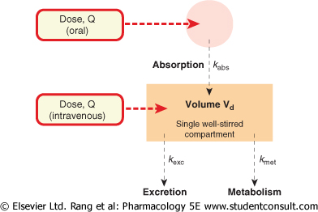
One Compartment Open Model
Constant

Slide 13
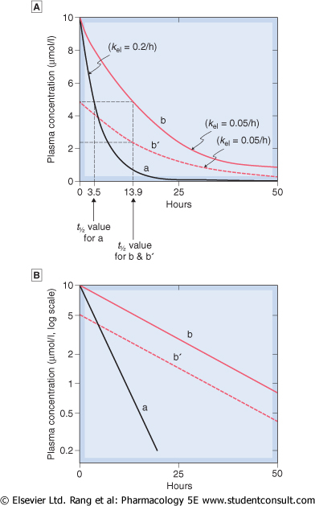
Predicted behaviour of single-compartment model following intravenous drug administration at time 0. Drugs a and b differ only in their elimination rate constant, k_{el}. Curve b shows the plasma concentration time course for a smaller dose of b. Note that the half-life (t_{1/2}) (indicated by broken lines) does not depend on the dose. Linear concentration scale. B- Logarithmic concentration scale.

Slide 14
Two Compartment Model
The body behaves kinetically as if it consisted of two compartments;
The central or first compartment into which the drug is injected and from which elimination occurs. This usually consists of blood and extracellular fluid of several highly perfused tissues such as the heart, lungs, liver, kidney and endocrine glands.
The peripheral tissue or 2nd compartment consists of less well perfused tissues such as the skin, muscle, body fat, bone and hair into which the drugs passes more slowly.
If after intravenous administration the decline in plasma drug concentration can be represented mathematically by an equation consisting of 2 exponential terms, then a 2 compartment model is applicable.

Slide 15
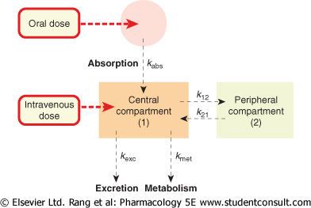
Two Compartment Open Model

Slide 16
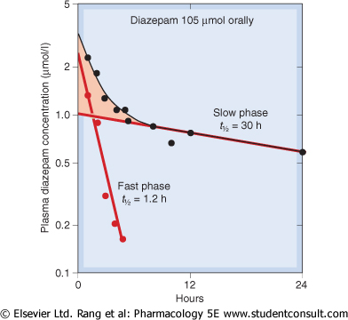
Kinetics of diazepam elimination in humans following a single oral dose. The graph shows a semilogarithmic plot of plasma concentration versus time. The experimental data (black symbols) follow a curve that becomes linear after about 8hours (slow phase). Plotting the deviation of the early points (pink shaded area) from this line on the same coordinates (red symbols) reveals the fast phase. This type of two-component decay is consistent with the two-compartment model and is obtained with many drugs

Slide 17
Apparent Volume of Distribution
To get the volume of plasma into which a drug is dissolved, you divide the amount of drug administered by the concentration of plasma obtained. This is the theoretical compartment that the drug disappears into
Value differs from one drug to another and depends upon the extent to which the drug is distributed in the body e.g.
If the physiochemical properties of a particular drug enables it to become widely distributed throughout the body (V is large) then the Cp resulting from a given dose will be less than that resulting from an equal dose of drug which remains in the blood stream and whose Vd (volume of distribution) is very small.
NB:- Cp is plasma drug concentration.

Slide 18
Vd also depends on the size of individual receiving the dose
In general Vd is found to be directly proportional to weight but some deviation is observed with exceptionally fat individuals. Obesity affects drugs in different ways;
Digoxin distributes in striated muscles and heart but low concentration in other tissues
Thiopentone Vd increases with obesity. It is quoted in Litres/Kg Body Weight. Varies from 0.04L/Kg for drugs confined to the plasma to 20L/Kg or more for drugs extensively bound in tissues i.e. 5L (plasma volume), 45L (tissue vol), > 50L (deep tissue i.e. bone)

Slide 19
Utility of Volume of Distribution
It explains why initial effect is rapidly ‘lost’ for some drugs given as IV (intravenous) bolus i.e. biphasic
Allows calculation for loading dose (LD) or priming dose
LD = Vd x Wt x Cp (If Vd is given in L/Kg)
LD = VdC_{av}/F F = Fraction of Drug available (bioavailability)
Allows calculation of maintenance dose
R_{o} = Css x Vd x k = Css x CL_{T} (Css-Concentration Steady State)
Maintenance: FD = kvCavtao = CL_{T}Cav (Cav-Average Plasma Conc)
If bioavailability is 100%, less dosage will be given and the reverse is also true
NB: R_{o} is infusion rate
Ss is steady state
CL_{T} is total body clearance .
Clearance is the amount of drug fluid cleared per unit time

Slide 20
Elimination Half Life (T_{1/2})
Also known as the biological half life
Is defined as the time required for an amount of drug in the body to be reduced to half when input to the body has changed
Can be obtained either graphically (by plotting log₁₀C with time) or by calculation using the equation T_{1/2} = 0.639/k if k (elimination rate constant) is known
The half life of a drug is independent of the dose administered except at high dose levels where 1st order elimination does not occur
Like k, will differ from drug to drug and must be experimentally determined in each case
Some variations between individuals in the capacity to eliminate drugs and the T_{1/2} quoted us the average value obtained.

Slide 21
Few studies have shown that T_{1/2} tends to be log normally distributed in some individuals the biological T_{1/2} is considerable longer than in the general population. In such individuals particular care should be taken that in multiple dosage therapy toxic plasma levels are not attained.
Half life tends to be longer when the kidneys or the liver are diseased or damaged
Affected by factors causing variation in drug kinetics;
Age; in elderly patients and in infants, long half life are frequently observed because the process leading to elimination either have become less efficient or have not yet fully developed
Urinary pH
Drug interactions etc

Slide 22
Utility of Half Life
It dictates time to steady state given a constant dose (or time to drug disappearance from the body)
1 x T_{0.5} 50% of steady state
2 x T_{0.5} 75% of steady state
3 x T_{0.5} 87.5% of steady state
4 x T_{0.5} 93.75% of steady state
5 x T_{0.5} 98.5% of steady state
Half life dictates fluctuation at steady state intuitively given same dosing interval;
Long T_{0.5} leads to small fluctuation
Short T_{0.5} leads to large fluctuation
Provides a means to estimate the appropriate drug interval

Slide 23
DRUG CLEARANCE
Total body clearance (CL_{T}) is the volume of body fluid from which the drug is removed per unit time
Renal clearance (CL_{R}) is the volume of plasma which is cleared of drug during one minute by the kidneys
Hepatic clearance (CL_{H}) is the volume of plasma which is cleared of the drug during one minute by the liver
CL_{T} = CL_{R} + CL_{H} + CL_{OTHER} = CL_{R} + CL_{NR}
k = k_{R} + k_{NR}
Clearance by means of various organs in additive
At steady state of drug administration equals the rate of drug administration
Dosing rate = Clearance x Css

Slide 24
Clearance is usually constant over the range of concentrations encountered clinically i.e. follows 1st order kinetics
If mechanisms of elimination are saturated then clearance becomes variable
Clearance = ^{Rate of Elimination}/Concentration of blood in plasma/ serum
Clearance = ^{Dose}/_{AUC}
Rate of drug elimination = Rate of metabolism + Rate of Renal Excretion from the body

Slide 25
If it is assumed that the drug eliminated by the kidney and liver only
k = kH + kR
Ca CV
Q cca Organ Q
Qca = Amount of drug entering the organ
QCv = Amount of drug leaving the organ
Q (Ca – Cv) = Amount of drug removed in the organ
E = ^{Q (Ca – Cv)}/_{Qca}
E = Extraction ratio
CL_{H} = QE

Slide 26
NB: Values of E vary from 0-1
If E = 1 then CL_{H} = Q meaning all drug entering the liver has been extracted
CL_{H} affected by body fluids, binding to plasma proteins, enzyme inducers and enzyme inhibitors
Intrinsic clearance of a drug increases with;
Concentration and amount of catalyzing enzyme in the liver
Affinity between the drug molecule and the enzyme
If intrinsic clearance in excess of Q, then clearance is dependent on Q
Drugs with high intrinsic clearance include morphine, aspirin and propranolol
If intrinsic clearance is low then Q has no effect on hepatic extraction
Utility of clearance is best explained under notes on Vd i.e. kVd = Clearance

Slide 27
Concentration Dependence Rates
Rates of various drugs processes are proportional to the drug concentration in the compartment from which the molecules (1st order process) exist e.g.
Rate of urinary drug extraction is usually proportional to the concentration of free drug in plasma
Biotransformation reactions and plasma protein binding are proportional to plasma drug concentration below saturation points
Rate of drug absorption to the amount of drug remaining to be absorbed from the gut (not for sustained release preparations)

Slide 28
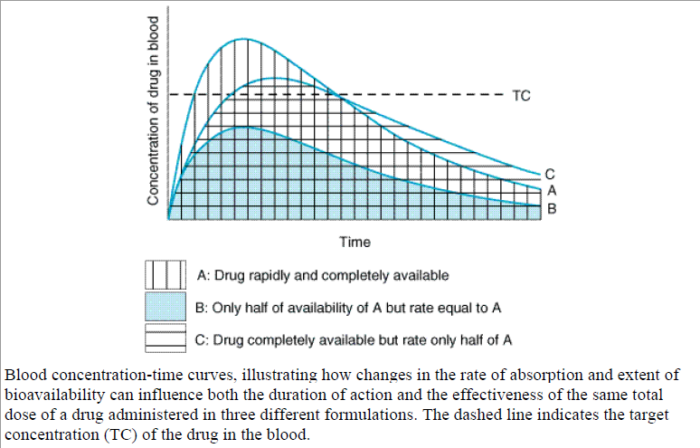
(Diagrams in Rang and Dale;Katzung Figure 3-4)

Slide 29
Duration of Drug Action
It is proportional to the half life of elimination and to the log of the dose provided the absorption and distribution are rapid in comparison with elimination and that these are 1st order processes
Can be extended by one half life when the dose is doubled

Slide 30
Extension of Drug Duration
Administer the drug as an intravenous infusion or as sustained release tablets/capsules
Repeated drug administration – dosage regiments
If initial dose equals the maintenance doses, the desired concentration is reached after several dose intervals
To attain desired concentration immediately give loading or priming dose
If a drug is given by oral route, then each term is multiplied by F

Slide 31
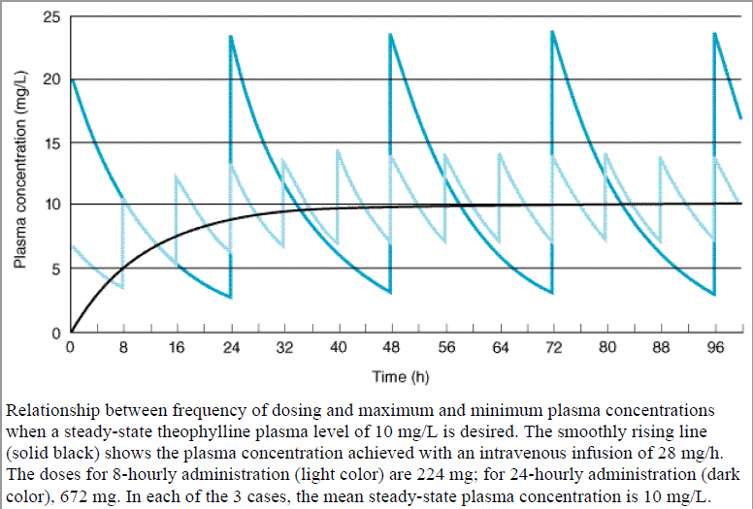
Rang and Dale-Pharmacokinetics and Katzung Figure 3-6)

Slide 32
Multiple Dose Regimens
For prolonged therapeutic activity
Established to provide the correct plasma levels without excess fluctuation and drug accumulation
For some drugs e.g. antibiotics, a desirable minimum effective concentration can be determined
For drugs with narrow therapeutic indices (e.g. digoxin, phenytoin) require definition of the therapeutic minimum and maximum non toxic plasma concentrations
The desired Cp (plasma drug concentration) must be related to the therapeutic response
Main parameters that can be adjusted in developing a dosage regimen are the sise of the dose and dosage interval

Slide 33
Rates and Orders of Reactions
Rate of a chemical reaction is the velocity with which it occurs. Consider the following chemical reaction;
Drug A B
If the amount of drug A is decreasing with respect to the time the rate of reaction can be expressed as - ^{Da}/_{dt}
Since the amount of drug B is increasing with respect to time, the rate of the reaction can also be expressed as + ^{Db}/_{dt}
The rate of reaction is determined by measuring the disappearance of drug A at given time intervals
Drug A Drug B
(^{Da}/_{dt} ) +(^{Db}/_{dt} )

Slide 34
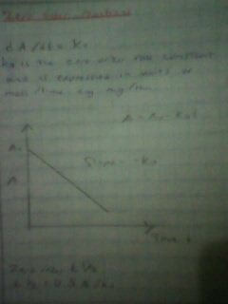
Zero order reactions

Slide 35
NON-LINEAR PHARMACOKINETICS
Theoretically occurs when you give an enormous amount of drug (overdose)
Is also termed as;
Saturation kinetics, concentration or dose-dependent kinetics
Capacity limited
Some drugs exhibit non-linear (behavior) kinetics at therapeutic doses in healthy adults e.g.
Phenytoin
Alcohol
ASA in high dose used for mx of rheumatoid conditions

Slide 36
Many processes of ADME
Drugs may also demonstrate non-linear p’kinetics due to pathologic alteration in drug ADME e.g.
Liver disease
Kidney disease
Obstruction of the bile duct due to formation of gallstones will alter billiary drug excretion
In most cases the main observation is a change in apparent (k) elimination rate constant. CL is variable and depends on the concentration of the drug
NB: Changes in p’kinetic parameters, Clearance, volume of distribution, half life as a function of dose or drug concentration is usually due to saturation of protein binding, hepatic metabolism or active renal transport of the drug

Slide 37
GRAPH OF RATE ABSORPTION VS CONCENTRATION OF DRUG
Absorption
A – Absorption by passive diffusion
B – Absorption by carrier mediated system e.g. Vit B₁₂
In passive diffusion rate of drug, drug absorption increases in a linear relationship to drug concentration
Distribution
Binding to plasma proteins (saturable) e.g. phenylbutazone
Saturable transport into or out of tissue e.g. methotrexate
Effect is however difficult to predict.

Slide 38
Metabolism
Capacity limited metabolism has been demonstrated in;
Glycine conjugation of salicylate
SO₄ conjugation of salicylamide
Acetylation of PABA and the elimination of phenytoin, theophylline etc
Biliary excretion is also saturable

Slide 39
Excretion
Nephritic effect of high doses of aminiglycosides
Active tubular secretion e.g.
Probenecid/Penicillin
Probenecid/methotrexate
In saturated elimination you get zero order elimination with high doses which reverts to 1st order when plasma level sufficiently falls
Once (V_{max}) maximum elimination capacity is reached the rate of metabolism is constant i.e. absolute constant amount is metabolized per unit time
Saturation due to competition

Slide 40
Characteristics of Drugs which demonstrate saturation kinetics
Elimination of drug does not follow 1st order kinetics i.e. elimination kinetics are non-linear
The elimination half life becomes greater as dose increases. At high doses you get a shoulder (zero order) because of saturation of elimination system then the graphs become parallel as Cp (drug plasma concentration) decreases (1st order or linear kinetics)
The AUC is not proportional to amount of bioavailable drug
Plasma concentration curves observed after giving different doses are not super imposable after normalization i.e. ³/₃ > 1
Hence the curve with a higher dome has 3 times the normal elimination curve
Twice the dose divided by two then a single dose for one

Slide 41
Metabolism
X
S0₄ (70%)
D
Salicylamide
Met Saturable
Y
Glucoromide (30%)
S0­₄ (30%)
Increase Dose of Salicylamide
Glucoromide (70%)

Slide 42
The saturation of capacity-limited processes may be affected by other drugs that require the same enzyme or carrier mediated system
When a dosage is increased, the concentration of the drug increases as a substitute with a sulphate group and this may lead to poisoning

Slide 43
Therapeutic Drug Level Monitoring
Doses appropriate for one patient may not be so for another
Clinical assessment is the best way to knowing what the patient requires e.g.
For analgesics: Ask the patient if he or she is feeling pain
Hypertensiveness: Take Bp and adjust dose
Diuretics: Check the weight
Hypnotics: Ask if the patient slept well
Insulin: Take blood glucose levels

Slide 44
With clinical assessment (wide) variable amounts of doses are administered.
With drugs such as phenytoin where there is no simple clinical assessment, it is difficult to adjust the dose for a particular patient therefore drug monitoring is essential
A study showed that when patients were given same dose of phytoin, the blood levels of patients were very variable. Therapeutic range is important in analyzing the right dosage because different people will need different concentrations of the same drug to reach a therapeutic level
Phenytoin is an anti-epileptic drug that does not need clinical assessment to know whether the drug is working because waiting for the fitz to occur may result to more damage than assessing in other ways; Epilepsy is thus a stigma to many families but is manageable and the drugs are free in Kenya

Slide 45
Drug level monitoring should not be used without considering;
It is intensive; taking blood from patients, analysis, instruments etc and is thus expensive
Results may be ambiguous
Patients do not like it (being injected all the time)

Slide 46
Criteria before initiation
Do not monitor drug level if there is clinical assessment
Start monitoring when there is sensitive assay procedure available
There should be a relationship between plasma drug level and clinical effect
Only done for drugs with low therapeutic index. If it is wide, i.e. the index, you may end up poisoning the patient therefore need to monitor
Only for drugs where a wide range of plasma drug levels can occur in different patients after the same dose
To confirm the adequacy of treatment
When the patient exhibits toxicity on a normal dose regimen or the usual dose does not give expected results
To establish a baseline value after a patient exhibits a satisfactory response to drug therapy. When adjusting dosage regimen or changing dose formulations
When the patients condition is refractory to a dosage regimen

Slide 47
Special Circumstances for Plasma Drug Level Monitoring
The patient is receiving more than one drug and there might be interactions
When patient has concomitant disease that may alter drug disposition/physiological factors are present which may affect drug p’kinetics e.g. liver, heart or kidney disease (changes in BF or RF)
When non compliance is suspected
If the physician is not going to take notice of the trouble taken by the pharmacist, then he should not monitor it

Slide 48
Drugs which require plasma drug level monitoring
Digoxin/digitoxin
Artiarrhythmics – procainamide, lignocaine, quinidine
Antiepileptics – phenytoin, carbamazepine, primidone/phenobarbitone
Theophylline
Lithium salts
Cytotoxics – methotrexate, cisplatin, 5FU
Some antibiotics – aminoglycosides, gentamycin/amikacin, chloramphenical
Anti inflammatory drugs – salicylates
Therapeutic drug monitoring relates p’kinetic and p’dynamic to get target concentration or to refine the dosing rate/regimen

Slide 49
Timing of Sample Collection
Collection time should be based on;
The p’kinetic properties of the drug, is the dosage form IV, IM injections or oral tablets
Dosing protocol and clinical reasons for assaying the sample
Concurrently administered drugs
The patients clinical status, age, weight and sex
When specimen is being collected during infusion, the sample should be taken from the opposite limb

Slide 50
Various Stages
Choose target concentration (desired Cp)
Vd and CL in normal individuals known
Adjust for weight if drug distributes in fat or lean body mass (KF value obtained from CL creatinine)
LD (Loading Dose) given = Vd x Target Cp
Revise CL based on the measured concentration
Adjust dose depending on Cp achieved

Slide 51
Notes
Absorption – Cp after absn depends on amount of drug taken, rate and extent of absn
Cp – can tell in case of overdose or non-compliance. Varies if disease (abnormality) in the small bowel or first pass metabolism in the GIT
CL – abnormal CL if kidney impairment, liver or heart (malfunction) disease
Kidney impairment hence abnormal clearance of creatinine that tells the extent of kidney damage
Long half life for drugs predominantly cleared by the kidneys will be observed
Hepatic disease reduces clearance of drugs biotransformed in the liver leading to long half life

Slide 52
If intermittent dosing, (D) measured in a sample taken at virtually any time during the dosing interval will provide information that may aid in assessment of drug toxicity
Samples taken before the next planned dose the C_{min} (Concentration minimum) may also reveal accumulation
Sample should be taken after 4.5 t_{0.5} when steady state has been reached
For drugs following 1st order kinetics the min (C_{min}) average (C_{ave}) and maximum (C_{max}) concentration are linearly related to dose and dosing rate and the ratio between the measured concentration and the desired concentration can be used to adjust dose
NB: Computer programs available whereby you enter patients factors and get appropriate regimen for that patient

Slide 53
Interpretation and Value of Results
If assay is to be fully utilized, results must be interpreted in light of the complete clinical situation, using information which include;
Patients age, weight and sex
List of all drugs patient is receiving
Dosage regimen and dosage form of each drug
Time of sample collection
Time elapsed since the last administered dose (of drug being measured)
Whether the level represents a steady state concentration
Whether the level represents free or total drug concentration
Clinical status of the patient
What therapeutic information can be derived from the test
What is the specificity of the assay

