Slide 1
LOG – DOSE RESPONSES AND ADVERSE DRUG REACTIONS
KIMAIGA H.O
MBChB (University of Nairobi)

Slide 2
LOG – DOSE RESPONSES
Introduction
The relation between the dose of a drug and the clinically observed response may be complex
However, in carefully controlled in vitro systems, the relation between concentration of drug and its effect can be described with mathematical precision
This idealized relation underlies the increased complex relations between dose and effect that occurs when drugs are given to patients

Slide 3
Concentration Effect Curves and Receptor Binding of Agonists
Responses to low doses of a drug usually increase in direct proportion to dose
As doses increase however, the response increment diminishes
Finally doses may be reached at which no further increase in response can be achieved
In idealized or in vitro systems, the relation between drug concentration and effect is described by a hyperbolic curve

Slide 5
The hyperbolic curve is according to the following equation;
Where;
E – Effect observed at concentration C
E_{max} is the maximal response that can be produced by the drug and
EC_{50­} is the concentration of the drug that produces 50% of the maximal response

Slide 6
Dose response data are often presented as a plot of the drug effect (y – axis) against the logarithm of the dose or concentration (x – axis)
Logarithm = The exponent required to produce a given number
Exponent = A mathematical notation indicating the number of times a quantity is multiplied by itself
This mathematical maneuver transforms the hyperbolic curve of figure 2-1 into a sigmoid curve with a linear midportion

Slide 7
Figure 2-2.

Slide 8
Figure 2-2. Logarithmic transformation of the dose axis and experimental demonstration of spare receptors, using different concentrations of an irreversible antagonist. Curve A shows agonist response in the absence of antagonist. After treatment with a low concentration of antagonist (curve B), the curve is shifted to the right; maximal responsiveness is preserved, however, because the remaining available receptors are still in excess of the number required. In curve C, produced after treatment with a larger concentration of antagonist, the available receptors are no longer "spare"; instead, they are just sufficient to mediate an undiminished maximal response. Still higher concentrations of antagonist (curves D and E) reduce the number of available receptors to the point that maximal response is diminished. The apparent EC₅₀ of the agonist in curves D and E may approximate the K_{d} that characterizes the binding affinity of the agonist for the receptor.
This expands the scale of the concentration at low concentrations where the effect is changing rapidly and compresses it at high concentrations where the effect is changing slowly, but has no special biologic or pharmacologic significance

Slide 9
Relationship between drug dose and clinical response in patients
Graded dose response relations
Shape of the dose response curves
Quantal dose effects curves

Slide 10
1. Graded Dose-Response Relations
To choose among drugs and to determine appropriate doses of a drug for a patient, the prescriber must know the relative pharmacological potency and maximal efficacy of the drugs in relation to the desired therapeutic effect.
These two terms can be explained using the next graph which depicts graded dose-response curves that relate dose of 4 different drugs to the magnitude of a particular therapeutic effect

Slide 11
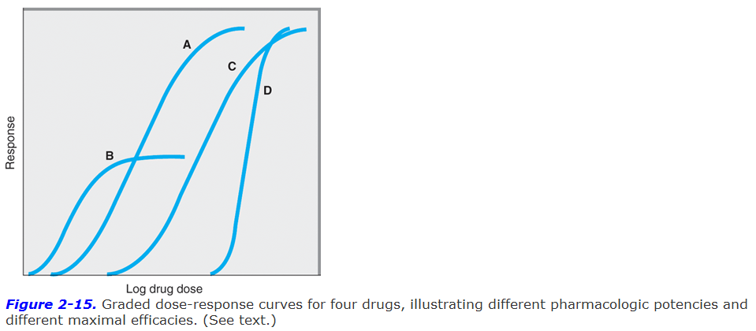

Slide 12
Potency
Drugs A and B are said to be more potent than drugs C and D because of the relative positions of their dose-response curves along the dose axis of the figure above. Few doses are required to get a response
Potency refers to the concentration (EC₅₀) or dose (ED_{50­}) of a drug required to produce 50% of the drugs maximal effect
Hence the pharmacologic potency of drug A in figure 2-15 is less than that of drug B, a partial antagonist, because the EC₅₀ of A (concentration required to produce 50% of its maximal effect) is greater than that of B
Potency of a drug depends in part on the affinity (K_{d}) of receptors for binding the drug and in part on the efficiency with which drug receptor interaction is coupled to response

Slide 13
NB: Some doses of drug A can produce larger effects than any dose of drug B, despite drug B being pharmacologically more potent.
This is because drug A has a larger maximal efficacy as described below
For clinical use, it is important to distinguish between drug potency and drug efficacy
The clinical effectiveness of a drug depends not on its potency (EC₅₀) but on its maximal efficacy (described below) and its ability to reach the relevant receptors
This ability can depend on its route of administration, absorption, distribution through the body and clearance from the blood or site of action
In deciding which of the two drugs to administer to a patient, the doctor should consider their relative effectiveness rather than their relative potency
Pharmacologic potency can largely determine the administered dose of the chosen drug
For therapeutic purposes, the potency of a drug should be stated in dosage units, usually in terms of a particular therapeutic end point (e.g. 50mg for mild sedation or 1mcg/kg/min for an increase in heart rate of 25 beats/min)
Relative potency i.e. the ratio of equi-effective (same effect) doses (0.2, 10, etc), may be used in comparing one drug with another

Slide 14
Maximal Efficacy
This parameter reflects the limit of the dose response relation on the response axis
Drugs A, C and D in figure 2-15 have equal maximal efficacy while all have greater maximal efficacy than drug B
The maximal efficacy is at times referred to as efficacy and is crucial in making clinical decisions when a large response is needed i.e. in severe cases of hypertension
It may be determined by the drug’s mode of interactions with receptors or by characteristics of the receptor – effector system involved

Slide 15
Illustration
Mode of interaction with receptors;
Partial agonists produce a lower response at full receptor occupancy, than do full agonists
In figure 2-15, drug B is a partial agonist while drug A is a full agonist
Characteristics of the receptor-effector system involved
Diuretics that act on one portion of the nephron may produce much greater excretion of fluid and electrolytes than diuretics that act elsewhere
In addition, the practical efficacy of a drug for achieving a therapeutic endpoint e.g. increased cardiac contractility may be limited by the drug’s propensity to cause a toxic effect e.g. fatal cardiac arrhythmia even if the drug could otherwise produce a greater therapeutic effect

Slide 16
2. Shape of Dose Response Curves
While the response depicted in curves A, B and C of figure 2-15 approximate the shape of a simple Michaelis – Menten relation (transformed to a logarithmic plot), some clinical responses do not
Extremely steep dose response curves e.g. curve D in figure 2 – 15 may have important clinical consequences if the upper portion of the curve represents an undesirable extent of response e.g. coma caused by a sedative – hypnotic. For every small increment in the dosage, the response is much higher due to the steep gradient of the drug. It is more dangerous to administer such a drug because a slight increase in the dosage may be lethal.
Steep dose response curves in patients can result from interactions of several different actions of a drug e.g. effect on brain, heart and peripheral vessels, all contributing to lowering of blood pressure.

Slide 17
Quantal Dose Effect Curves
Graded dose response curves of the sort described above have certain limitations in their application to clinical decision making
For example, such curves may be impossible to construct if the pharmacologic response is an either or (quantal) even such as prevention of convulsions, arrhythmia or death
In addition, the clinical relevance of a quantitative dose response relationship in a single patient may be limited in application to other patients owing to the great potential variability among patients in severity of disease and responsiveness to drugs.
Some of these difficulties may be avoided by determining the dose of a drug required to produce a specified magnitude of effect in a large number of individual patients or experimental animals and plotting the cumulative frequency distribution of responders versus the log dose

Slide 18
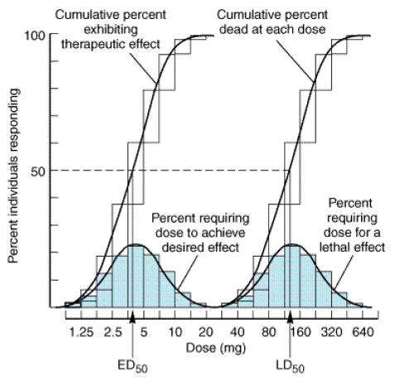
(fig 2 – 16)
Shaded boxes and the accompanying black curves indicate the frequency distribution of doses of drug required to produce a specified effect i.e. the % of animals that required a particular dose to exhibit the effect
The open boxes are the corresponding colored curves indicating the cumulative frequency distribution of responses, which are log normally distributed

Slide 19
The specified quantal effect may be chosen on the basis of;
Clinical relevance e.g. relief of headache
Preservation of safety of experimental subjects e.g. using low doses of a cardiac stimulant and specifying an increase in heart rate of 20 beats per minute as the quantal effect
Inherently quantal event e.g. death of an experimental animal
For most drugs, the doses required to produce a specified quantal effect in individuals are lognormally distributed i.e.
A frequency distribution of such responses plotted against the log of the dose produces a Gaussian normal curve of variation (fig 2 – 16)

Slide 20
When these responses are summated, the resulting cumulative frequency distribution constitutes a quantal dose effect curve (or dose-percent curve) of the proportion or % of individuals who exhibit the effect plotted as a function of log dose
The quantal effect dose effect curve is often characterized by stating the median effective dose (ED₅₀) of individuals exhibit the specified quantal effect
The abbreviation ED₅₀ has a different meaning in this context from its meaning in relation to graded dose effect curves as described above
Similarly, the dose required to produce a particular toxic effect in 50% of animals is called the median toxic dose (TD₅₀). If the toxic effect is death of the animal, a medial lethal dose (LD₅₀) may be approximately defined

Slide 21
Such values provide a convenient way of comparing the potencies of drugs in experimental and clinical settings e.g.
If the ED₅₀ of two drugs for producing a specified quantal effect are 5 and 500mg respectively, then the 1st drug can be said to be 100 x more potent than the 2nd for that particular effect
Similarly, one can obtain a valuable index of the selectivity of a drug’s action by comparing its ED₅₀ for two different quantal effects in a population e.g. cough suppression versus sedation for opioid drugs
Quantal dose-effect curves may also be used to generate information regarding the margin of safety to be expected from a particular drug used to produce a specified effect

Slide 22
Therapeutic index
This is a measure which relates the dose of a drug required to produce a desired effect to that which produces an undesired effect
In animal studies, the therapeutic index (TI) is usually defined as the ratio of the TD₅₀ to the ED₅₀ for some therapeutically relevant effect
Such a TI may be used to estimate the potential benefit of a drug in humans
The TI of a drug is almost never known with precision
Instead, drug trials and accumulated clinical experience often reveal a range of usually effective doses and a different (but sometimes overlapping) range of possibly
The clinically acceptable risk of toxicity depends critically on the severity of the disease being treated e.g. the dose range that provides relief from an ordinary headache in the great majority of patients should be very much lower than the dose range that produces serious toxicity
However, for reaction of a lethal disease, e.g. cancer, the acceptable difference

Slide 23
ADVERSE DRUG EFFECTS
ADR A response to a drug which is noxious and unintended, and which occurs at doses normally used in man for the prophylaxis, diagnosis, or therapy of disease, or for the modifications of physiological function
A side effect is an effect, whether therapeutic or adverse, that is secondary to the one intended
Antichonergec effects of
Side effect may be beneficial or not
Drugs can be divided into two groups namely;
Idiosyncratic
Dose related
Notes:
Physiological function
E.G contraceptives to interupt ovulation
GIT

Slide 24
The following are the factors that determine drug response;
Tolerance/Tachyphylatics: This is the lack of response to a drug by some patients e.g. Ethanol and all drugs of abuse, one needs more and more with time to get the same effect. Tachyphylatics refers to immediate tolerance after taking a drug
Age: Children have immature body development and ability to handle drugs is not optimal hence sensitive. Old age on the other hand, everything is wearing out, glands, enzyme systems, muscle fat water ratio and the ability to handle drugs recedes
Sex: Different genders handle drugs differently due to the difference in the anatomy of the body. Some drugs get better effect in women with low doses as compared to men e.g. alcohol and other drugs
Body size: This determines how drugs are handled. The small bodied deal with drugs better than the fat e.g digoxin
Disease state: Kidney disease and cardiac disease will lead to poor excretion of drugs and so does the liver. When these organs are diseased, there is poor drug potency and reduced drug response
Genetics: The peculiarity of different people results in difference in drug handling. Exposure to the same pathogen may cause mixed reactions among different people and so will drugs
Other drugs: In some disease states like TB combined with AIDS, the drugs taken may interfere with each other’s pharmacokinetics and the pharmacodynamics causing toxicity and reduced responses or magnified responses

Slide 25
Wrong diagnosis
Prescription wrong drug
Undetected medical, genetic or allergic condition that may cause reaction
Self prescription for prescription drugs
Not following instruction
Reaction with other drugs e.g Traditional drugs and also foods
Use of substandard medicine whose composition and ingredients do not meet scientific requirements e.g counterfeits

Slide 26
Adverse/Toxic Drug Effects
Is also termed as side effect
They are determined by how the body responds to a drug. No drug causes only one specific effect. Every drug causes more than one effect on the body
This is because drugs bind to different receptors that may be coupled to other biochemical actions. Hence specificity is not as crucial as selectivity.
The drug is of use if it is of high selectivity meaning the other effects are minimal e.g. ganglion blockers are non-selective while a neuromuscular junction blocker is more selective.

Slide 27
Types of Adverse Effects
Idiosyncratic Drug Effects
This refers to the general genetics of a person
Some drugs require acetylation for metabolism hence some people are fast acetylators while others are slow acetylators. For fast acetylators, the normal dose may be too small because metabolism will get rid of the drug too fast while slow acetylators may get toxicity due to prolonged drug effects by the body
1 in every 40,000 pneumonia patients will have adverse effects from the drug administered.
Dose Related
Type A
These fall into three groups;

Slide 28
Pharmaceutical variation
E.g formulation of phenotoin
Pharmacodynamic variation
Pharmacokinetic varion
Effects from metabolites

Slide 29
Types of Effects
The beneficial effect of the drug and the toxic effect are produced by the same receptor-effector mechanism. The drug binds on the same receptor and produces adverse effects. These effects are an extension of the therapeutic effects of the drug e.g. Anticoagulants like Wofarin and Heparin stop clotting. If excess is given, clotting mechanism is so impaired that one gets increased amounts of bleeding. Antidiabetics like insulin and oral hypoglycemic agents reduce blood sugar levels. If excess is given, one overshoots the normal and the blood sugar reduces leading to hypoglycemic coma and even death – very low blood sugar.

Slide 30
Management of Adverse Effects
Judicious management/careful monitoring of the effects e.g. repeated blood sugar tests after drug administration, calculating bleeding time and physical observation.
Taking care of ancillary measures e.g. when taking anticoagulants, one has to avoid trauma or injections or anything that may cause bleeding. In diabetics, avoiding carbohydrate diets to avoid hyperglycemia
Give drugs only when very necessary or give a safer alternative if available e.g. Digoxin has a very low therapeutic index but there is no better alternative in heart failure treatment.
Adjunctive treatment; if a drug has adverse effects, another drug can be added to reduce the effect of the other drug that may cause adverse drug effects. By addition of a second drug, the 1st drug’s effects are reduced.

Slide 31
Beneficial/Toxic Effects
Are mediated by identical receptors but in different tissues or by a different effector pathways e.g. glucocorticoids like hydrocortisol; excess of this drug will cause Cushing’s syndrome resulting to obesity, stria with loss of fat in the limbs taking a pyramid shape. Hydrocortisol breaks down proteins resulting to muscle wasting or break down of free fatty acids. In other tissues, the drug deposits fats especially in the upper trunk
Methotrexate will treat cancer but will destroy the bone marrow as an adverse side effect

Slide 32
Management of the Effects
Use the lowest effective dose
Use adjunctive (additional) drugs acting through different receptor mechanisms therefore producing different toxicities hence avoiding lowering of the dose. The adjunctive drug that will lead to the least adverse effect is used
Manipulate concentration in different compartments e.g. treatment of asthma, the inhalation route is used but the amount absorbed is less than that if the drug was administered orally

Slide 33
Beneficial/Toxic Effects
In this category, the receptors are different and the effector mechanisms are also different
Examples include; antihistamines having H₁ and H₂ receptors, one may need the receptor blockers like piriton to stop allergic reactions but one gets sedation due to action on a different receptor. Atropine as well, a muscarinic binding drug is given to reduce respiratory secretions during respiratory system surgery but in the GIT, one may get constipation, urine retention etc due to different receptors of atropine in the body.
The drug’s tendency to bind to different receptors has remained a big challenge but it has led to discovery of new more specific drugs. Others are discovered by mistake e.g. a drug designed for psychotic treatment turning out to be a better depressant

Slide 34
Drugs commonly causing ADR
Aspirin and other NSAIDS
Analgesics
Digoxin
Diuretics
Anticoagulants
Antimicrobials
Glucocotocoids
Antineoplastic drugs
Hypoglycemic drugs for diabetics

Slide 35
ND LIST ADVERS REACTIONS IN SYTEMS
E.G GIT not nausea
DI

