Slide 1
MEMRANE POTENTIALS
Prof Kihumbu Thairu
MB ChB (EA)
PhD (Lon)
FRCP (Glasg)
FRSM (Lon)

Slide 2
ELECTRICAL PROPERTIES OF CELLS
All cells +ve on outside and –ve on inside
All body cells are polarized
There is a potential difference between the outside and the inside of cells up to -90mV
Some cells e.g. nerve and muscle cells experience waves of depolarization and re-polarization
Changes in polarization also associated with function of
  Glandular cells(secretion)
  Ciliated cells (motility of cilia)

Slide 3
IONIC DIFFUSION POTENTIALS
The cell membrane is semi-permeable to ions
Imbalance of ions across the cell membrane
Xs Na+, Ca++ on the outside
Xs K+ on the inside
Xs indifussible negative ions inside cells e.g.
  Proteins
  Phosphates
  Sulphates

Slide 4
STRUCTURE OF CELL MEMBRANE
Phospholipid bi-layer
Phosphate end is hydrophilic and lipid (fatty acid) end is hydrophobic
Large membrane protein molecules
  Channels
  Pumps
  Carriers
Some channels allow leakage of diffusible ions across the membrane down their concentration gradients
Such Leakage of K+, Na+ and Cl- is main cause of the membrane potential
Relative permeability of each of these ions differ
Membrane bi-layered but very thin; only up to ten (10) nanometres thick

Slide 5
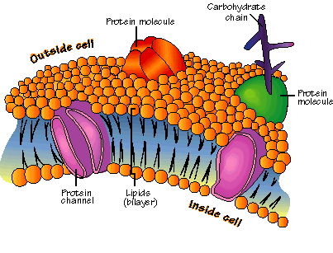

Slide 6
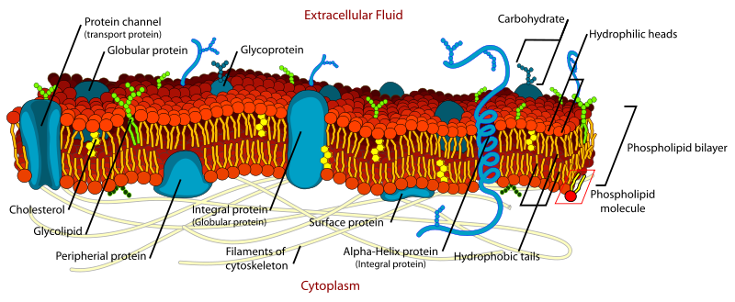

Slide 7
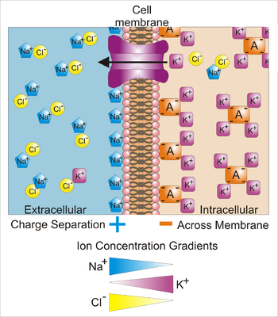
POTASSIUM DIFFUSION

Slide 8
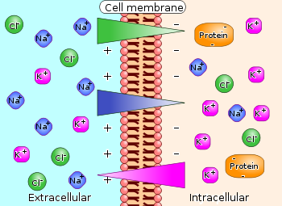
POTASSIUM DIFFUSION

Slide 9
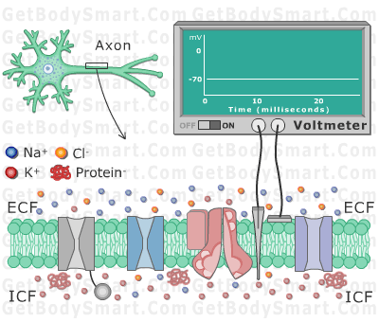
MEASUREMENT OF MEMBRANE POTENTIALS

Slide 10
DIFFUSION POTENTIALS OF IONS
K+ is x35 more conc inside the cell
Na+ is x 10 more conc outside the cell
K+ ions diffuse from inside to outside down their concentration gradient
BUT large indiffusible negative ions (mentioned above) remain behind
Cell loses net +ve charge to outside of membrane
Cell membrane becomes +ve on outside and –ve on inside
The opposite can also happen in case of Na+ ions

Slide 11
K+ DIFFUSION POTENTIAL
K+ diffusion makes membrane more positive on outside
Unlike pole attract and like poles repel
Eventually membrane becomes so positive on outside that it stops any more K+ ions leaving the cell
The value of this membrane potential is minus 94mV measured from the inside
At this potential, the diffusion force pushing K+ out reaches equilibrium with the electrical force opposing any further ions leaving the cell
-94 mV is therefore the EQUILIBRIUM POTENTIAL for K+

Slide 12
DIFFUSION POTENTIAL FOR Na+
X 10 more Na+ on outside cell membrane
Diffusion to inside would make inside +ve
If positivity reached +61mV it would stop the diffusion forces from pushing Na+ in
+61mV is therefore the EQUILIBRIUM POTENTIAL for Na+

Slide 13
NERNST POTENTIALS FOR DIFFUSIBLE IONS-1
Equilibrium potential (EMF) also known as the NERNST POTENTIAL and it can be calculated using a constant x the concentration gradient across the membrane thus
Nernst potential (EMF)=+ 61x log [Conc in ] i.e. NERNST equation.
[Conc out]
Potential is +ve if it arises from –ve oins leaving the cell e.g. Cl-
Potential is –ve if it arises from +ve ions e.g.K+ leaving the cell
Na+ conc = 1/10 and log = minus One so EMF= +61
K+ conc = x 35, Log 35= 1.54 = -61x+1-54 = Minus 94 (-94).
Cl- conc higher outside cell and= x 14. log 14= 1.15 , -61x 1.15=about minus 70mV (-70mV)
NB:Walther Hermann Nernst : German Physical Chemist 1864-1941.

Slide 14
NERNST POTENTIALS FOR DIFFUSIBLE IONS-2
But permeability for K+ = x 100 that of Na+ therefore resting membrane potential due mainly to K+.
Cl- permeability also a minor contributor
Constant = RT
FZ
Where R=gas const; T= absolute temp; F=Faraday; Z=valence ( + )
ESTIMATED RELATIVE CONCENTRATIONS OF MAJOR IONS INVOLVED:
[Na+] in =15mEq ; out = 150mEq
[K+] in = 150mEq,; out = 4.3mEq
{CL-} in =9mEq,; out = 125mEq

Slide 15
NB: SLIDES 15-19 (GAS CONSTSNT -2) NOT ESSENTIAL. :
FROM WIKIPEDIA
The gas constant (also known as the molar, universal, or ideal gas constant, denoted by the symbol R or R) is a physical constant which is featured in many fundamental equations in the physical sciences, such as the ideal gas law and the Nernst equation.
It is equivalent to the Boltzmann constant, but expressed in units of energy (i.e. the pressure-volume product) per temperature increment per mole (rather than energy per temperature increment per particle). The constant is also a combination of the constants from Boyle's law, Charles's law, Avogadro's law, and Gay-Lussac's law.
Physically, the gas constant is the constant of proportionality that happens to relate the energy scale in physics to the temperature scale, when a mole of particles at the stated temperature is being considered. Thus, the value of the gas constant ultimately derives from historical decisions and accidents in the setting of the energy and temperature scales, plus similar historical setting of the value of the molar scale used for the counting of particles constant by the letter R is elusive.^{[2][3}

Slide 16
GAS CONSTANT -2
. The last factor is not a consideration in the value of the Boltzmann constant, which does a similar job of equating linear energy and temperature scales.
The gas constant value is
8.3144598(48) J mol⁻¹ K^{−1[1]}
The two digits in parentheses are the uncertainty (standard deviation) in the last two digits of the value. The relative uncertainty is 9.1×10⁻⁷. Some have suggested that it might be appropriate to name the symbol R the Regnault constant in honour of the Frenchchemist Henri Victor Regnault, whose accurate experimental data was used to calculate the early value of the constant; however, the exact reason for the original representation of the

Slide 17
GAS CONSTANT-3
The gas constant occurs in the ideal gas law, as follows:
where P is the absolute pressure (SI unit pascals), V is the volume of gas (SI unit cubic metres), N is the amount of gas (SI unit moles), m is the mass (SI unit kilograms) contained in V, and T is the thermodynamic temperature (SI unit kelvins). The gas constant is expressed in the same physical units as molar entropy and molar heat capacity.
Contents
[hide]
1 Dimensions of R
2 Relationship with the Boltzmann constant
3 Measurement
4 Specific gas constant
5 U.S. Standard Atmosphere
6 References
7 External links

Slide 18
A FARADY
A unit of electric charge, symbol, F. This entry also treats the Faraday constant, symbol F. Their magnitudes are numerically identical and are determined experimentally. According to the 2006 CODATAvalues, F= 96 485.3399 ± 0.0024 coulombs; F = 96 485.3399 ± 0.0024 coulombs per mole.
Shortly after Volta invented the battery, it was found that when an electric current passes through water, the water decomposes into oxygen and hydrogen.
Michael Faraday investigated electrochemistry using a solution of copper sulfate. The electric current plated out the copper ions on the electrode, and through before and after weighings of the electrode Faraday discovered that the mass of copper plated out depended solely on the strength of the current and the length of time it flowed. This principle leads naturally to the idea that the quantity of matter liberated can be used as a measure of the quantity of charge.
One faraday was defined as the quantity of electricity flowing through an electrolyte that will liberate one gram-equivalent of any substance at each electrode.
“When 96,494 coulombs are passed through a solution, 1 gram-equivalent weight of any ion is liberated. Hence, 96,494 coulombs, called a FARADAY, are associated with the charge on one equivalent of an ionic substance.”¹

Slide 19
GRAM EQUIVALENT AND EQUIVALENT WEIGHT
GRAM EQUIVALENT
The quantity of an element, group, or compound that has a mass in grams equal to the equivalent weight
EQUIVQLENT WEIGHT
The weight of a substance that will combine with or replace one mole of hydrogen or one-half mole of oxygen. THEREFORE, The EQUIVALENT WEIGHT is equal to the atomic weight divided by the valence.

Slide 20
OVERALL DIFFUSION POTENTIAL
Combination of the diffusion potentials of Na+, K+ and Cl- determine value of membrane diffusion potential (mVolts) i.e. the resting membrane potential
But this value depends on :
Concentration gradient of each individual ion’s [C]across membrane
Membrane permeability for each ion [P]
The constant used for the Nernst Equation

Slide 21
GOLDMAN HODGKIN KATZ EQUATION
Considering all the above the value of the calculated resting membrane potential is:-
EMF= -61x log {CNa+i x PNa+}+{CK+i x PK+}+{CCl-o x PCl-}
{CNa+o x PNa+}+{CK+o xPK+}+{CCl-i x PCl-}
Calculated EMF = minus 86 milli volts (-86 mV)
NB: Nernst potentials for K+; Na+; Cl- = -94mV; +61mV; -70mV; respectively
Therefore value of calculated resting membrane potential is nearest the Nernst potential of K+

Slide 22
THE SODIUM- POTASSIUM ATPase PUMP
Pump is membrane protein with alpha(carrier channel) and beta(anchor) units
It is responsible for keeping K+ inside cells and Na+ outside cells thus setting op their respective concentration gradients
Has 3 receptor sites for Na+ on inside and 2 for K+ on outside
Once these are attached, carrier breaks ATP to ADP and uses energy for pumping action
Pump electrogenic: pumps out 3Na+ for each 2K+ ions i.e. makes membrane more +ve on outside by additional 4mV
True measured Resting Membrane potential = -90mV
Na+/K+ pump

Slide 23
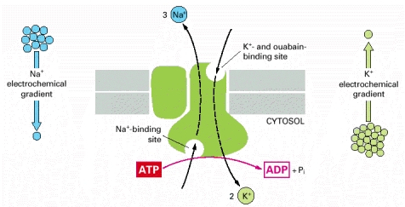
SODIUM-POTASSIUM ATPase PUMP

Slide 24
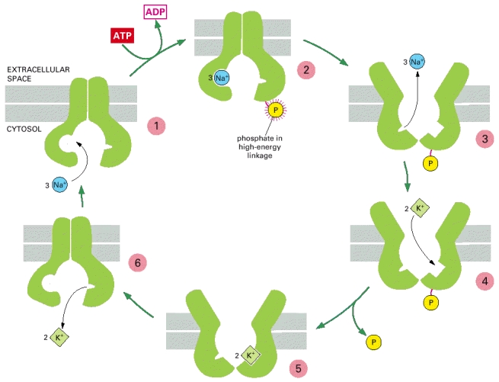
FIVE STAGES OF SODIUM-POTASSIUM ATPase PUMP MECHANISM

Slide 25
FUNCTIONS OF Na+/K+ PUMP
Maintaining Na+/K+ gradient across cell membrane
Maintaining normal cell volume
  Indiffusible –ve ions in cell attract diffusible +ve ions
  These ionic flows attract water into cells osmotically
  The more the water that seeps in the harder the pump works
  Normal cellular volume is maintained
Without the pump the cells would swell and burst (and die)

Slide 26
EXTRA INFORMATION ON MEMBRANE TRANSPORT SYSTEMS
PRIMARY ACTIVE TRANSPORT
SECONDARY ACTIVE TRANSPORT
CO-TRANSPORT
COUNTER-TRANSPORT
ACTIVE TRANSPORT THROUGH CELLULAR SHEETS LINING SPECIAL ORGANS

Slide 27
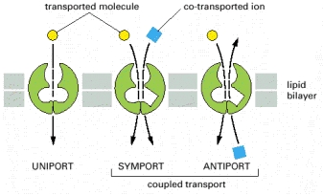

Slide 28
PRIMARY ACTIVE TRANSPORT
Na+ /K+ pump
Other Active energy consuming pumps for:
    Ca++
    H+
    Cl-
Diagram of Na+/K+ pump (insert)
Reversibility of Na+/K+ pump
If concentration gradients artificially changed to make N+ and K+ flow in the same direction as by pump action through diffusion, pump would stop and ADP would be turned into ATP thus storing energy in high energy ATP bond.

Slide 29
ACTIVE TRANSPORT OF Ca++
The pump is a carrier protein
Has specific binding sites for Ca++ similar to other pumps
Splits ATP just as ATPase does in the N+/K+ pump
2 active transport systems
  Cell membrane pump
  Pumps Ca++ out of cells maintaining a gradient of 1:10,000
Intracellular pump e.g. in muscle
  Pumps Ca++ from cytoplasm into the sarcoplasmic reticulum

Slide 30
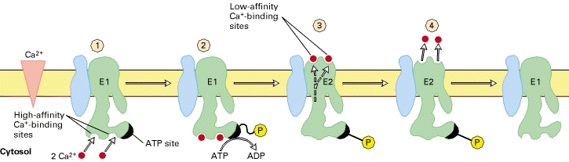
CALCIUM PUMP

Slide 31
H+ PUMP
Its function essential in
Gastric HCl secreting parietal cell in gastric glands where it achieves a gradient of up to 1:1million
Kidney in
lower DCT
Cortical collecting ducts (in intercalated cells)
Enable H+ excretion into urine
Can maintain a 1:900 gradient

Slide 32
ENERGY CONSUMPTION BY CELLULAR PUMPS
Energy consumption is proportional to the log of gradient i.e.
  Increasing gradient from x10 to x100 DOUBLES the energy consumption (log 10=1, while log 100=2)
  Increasing gradient from x10 to x1000 TREBLES the energy consumption (log 1000=3)
Energy consumption equation:
  En (Calories) = const(1400) x log [conc1]
  [conc2]
Up to 90% of energy consumed by
  secretory cells and
  excretory cells
Is used for powering their pumping mechanisms

Slide 33
SECONDARY ACTIVE TRANSPORT
The Na+/K+ pump sets up and maintains the N+/K+ gradient across the cell membrane
In CO-TRANSPORT, the concentration gradient can pull in substances along the Na+ gradient or pull in substances along the K+ gradient
In COUNTER-TRANSPORT, the opposite happens

Slide 34
CO-TRANSPORT
A membrane carrier protein provides a coupling mechanism
The carrier protein lets N+ leak into cell down its concentration gradient
BUT the carrier protein couples another substance near the N+ site and the two move in together into the cell
Co- transport with sodium carries glucose into cells in
  GIT
  Kidneys

Slide 35
COUNTER -TRANSPORT
The cell membrane counter transport carrier protein
  binds Na+ onto a receptor site on the outside of the cell and
  Binds the other substance onto a receptor site on the inside of the cell membrane
As Na+ moves in down its concentration gradient the other substance is transported to the outside of the cell
Na+ linked counter-transport occurs for amino acids transport
Up to 5 different amino acid carrier proteins
Each carrier protein transports a specific group of amino acids

Slide 36
ACTIVE TRANSPORT THROUGH SHEETS OF CELLS LINING SPECIAL ORGANS
Sheets of cells found in lining of
  GIT
  Kidney Tubules
  Exocrine Glands
  Gall Bladder
  Choroid plexus epithelium in the brain
Mechanism involves a combination of both
  simple diffusion needing no energy e.g.
    in gut for ions and nutrients from lumen into epithelial cells and
  active transport that consumes energy i.e.
    as these substances are actively pumped from the epithelial cell into baso-lateral spaces and the intercellular fluid

Slide 37
COMPARISON OF RESTING MEMBTANE POTENTIALS OF DIFFERENT CELLS
Summary of resting potential values in different types of cells
The resting membrane potential in different cell types are approximately:
Skeletal muscle cells: −95 mV
Smooth muscle cells: –6OmV
Astroglia: –80 to –90mV
Neurons: -60 to –70mV

Slide 38
END

