Slide 1
CLASSIFICATION OF PERIPHERAL NERVES
INTRODUCTION
METHODOLOGY
MOTOR CUTANEOUS SENSORY AND AUTONOMIC SYSTEM (Erlanger and Gaser)
MUSCLE AFFERENTS SYSTEM (Lloyd)
GENERAL SYSTEM
SENSORY PHYSIOLOGY SYSTEM
MODALITY, MYELINATION AND CONDUCTION SYSTEMS
HARMONIZATION OF DIFFERENT SYSTEMS

Slide 2
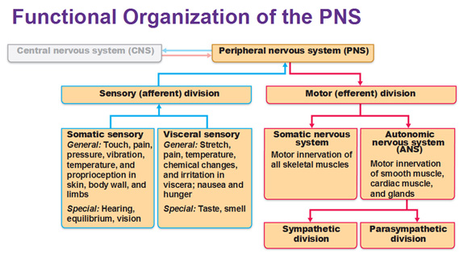
THE PERIPHERAL NERVOUS SYSTEM (PNS)

Slide 3
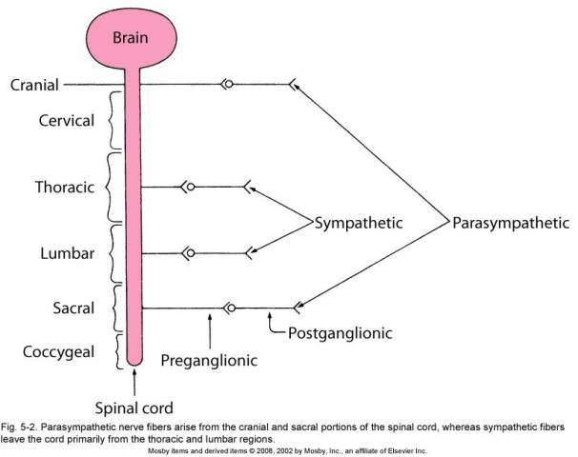
SCHEMATIC DIAGRAM OF THE ANS

Slide 4
METHODOLOGY
Compound action potential of peripheral nerves
These have both motor and sensory nerves
Careful electrical recording
Cutting specific nerves
Anatomical studies of degenerating nerves
NB: ALL THE ABOVE LED TO SCIENTIFIC CLASSIFICATION OF PERIPHERAL NERVES

Slide 5
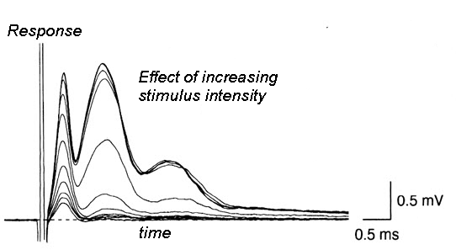
COMPOUND ACTION POTENTIALS ELICITED USING DIFFERENT STIMULUS STRENGTHS

Slide 6
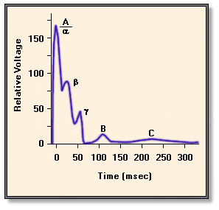
COMPOUND ACTION POTENTIAL SHOWING VOLTAGE AND CONDUCTION VELOCITIES OF DIFFERENT FIBRE CLASSES

Slide 7
A: ERLANGER AND GASER’S’ CLASSIFICATION-1
USED FOR CLASSIFYING MOTOR, AUTONOMIC AND CUTANEOUS AFFERENTS NERVES
Most motor nerve fibres are:-
  Group A alpha – voluntary muscles
    Alpha fibres from alpha motor neurons
  Group A gamma - Muscle spindles motor nerves
    Gama efferents from gamma motor neurons

Slide 8
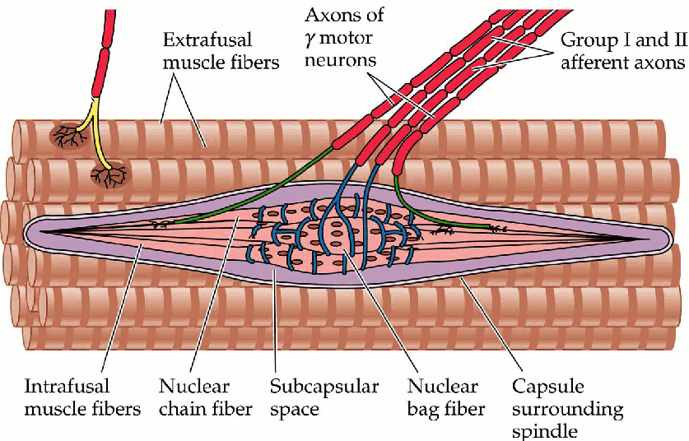
MUSCLE FIBRES- INTRA FUSAL AND EXTRA FUSAL

Slide 9
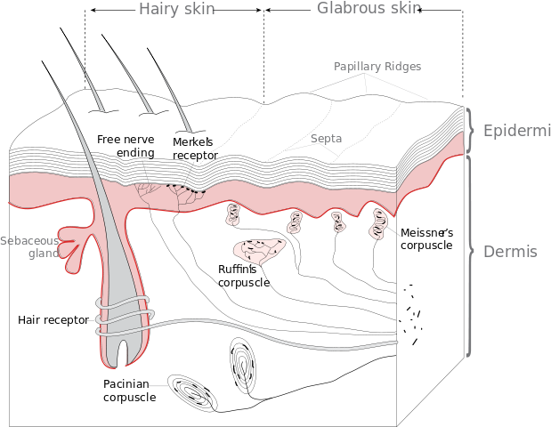

Slide 10
ERLANGER AND GASER’S CLASSIFICATION-2
FOR CLASSIFYING SKIN AFFERENTS AND AUTONOMIC NERVES:-
Skin afferents (cutaneous sensory fibres) are classified as groups A,B and C as follows:-
  A-beta (touch and pressure)
  A – delta (fast pain temperature and fine touch)
Autonomic nerves classified as:
  B – pre-ganglionoc autonomic nerve fibres
  C- post ganglionic sympathetic nerve fibres
Pain and temperature fibres DETAILS:
  A- delta thinly myelinated
    For transmitting “fast pain” and cold (cold also carried by C)
  C –Unmyelinated
    Most pain fibres are group C. They transmit “slow pain”
    C fibres also carry warmth sensation
  NB: “C” FIBRES ARE ALL UNMYELINATED. Information regarding cooling of the skin apparently more urgent than warming the skin.

Slide 11
TABLE SHOWING ERLANGER AND GASER’S SYSTEM
GROUP | DIAMETER (microM) | VELOCITY (m/sec
A–alpha | 8-20 | 50-120
A- Beta | 5-12 | 30-70
A- gamma | 2-8 | 10-50
A- Delta | 1-5 | 3-30
B | 1-3 | 3-5
C | <1 | <2 (unmyelinated)

Slide 12
B: LLOYD’S CLASSIFICATION
FOR CLASSIFYING MUSCLE AFFERENTS
The system is used for classifying receptors afferents from muscle
Muscle receptors arise from:-
  Muscle spindles - group I and II
  Golgi tendon organs- group II (equivalent to sensory group IB)

Slide 13
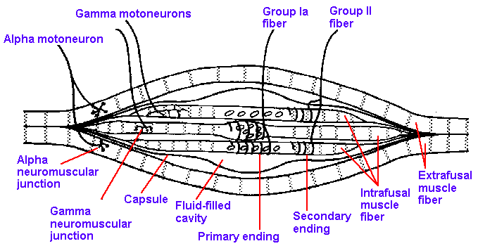
MUSCLE SPINDLE-1

Slide 14
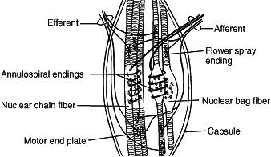
MUSCLE SPINDLE-2

Slide 15
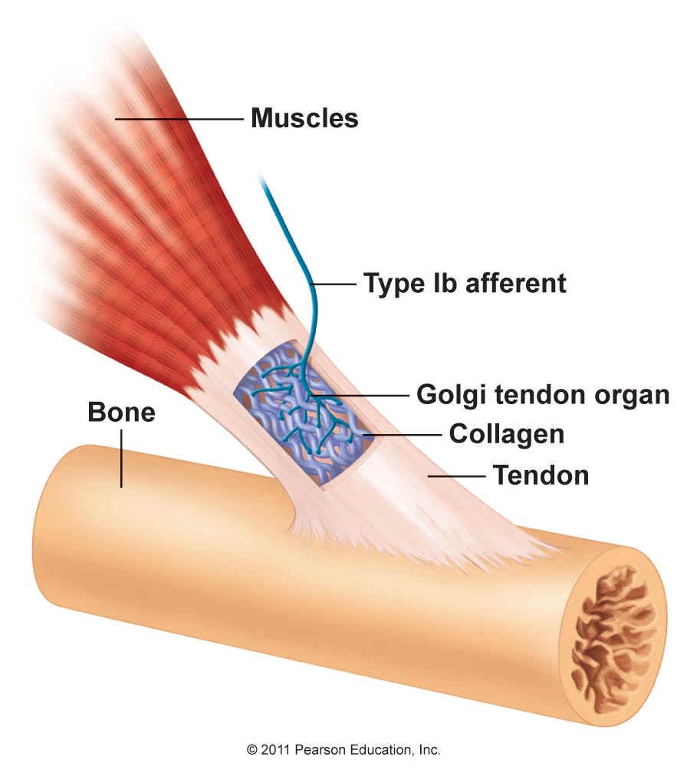
GOLGI TENDON ORGAN – group II

Slide 16
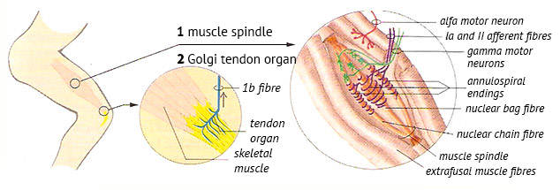
FUNCTION OF GOLGI TENDON ORGAN

Slide 17
TABLE OF LLOYD’S SYSTEM
GROUP | DIAMETER (microM) | VELOCITY (m/sec
I | 12-20 | 70-120
II | 4-12 | 24-70
III | 1-4 | 3-24
IV | <1 | <2 (unmyelinated)

Slide 18
GENERAL CLASSIFICATION-1
MAIN CLASSES, ARE “A” AND “C”:
Group A is subdivided into:-
  Alpha
  Beta
  Gamma
  Delta
TYPE A:
  Myelinated large and medium sized SPINAL NERVES

Slide 19
GENERAL CLASSIFICATION-2
C FIBRES
Ummyelinated
Slow conducting
Make up
  over 50% of SENSORY FIBRES otherwise nerves would be too thick
  All post-ganglionic autonomic fibres
Refer to table 46-6 Guyton and Hall – 12th Edition for a comprehensive classification table .

Slide 20
SENSORY PHYSIOLOGY SYSYTEM-1:
This system uses 4 classes labled according to ROMAN NUMERALS AND ALPHABETICAL “GROUP” notation :
i.e. Groups I-A; I-B ; and Groups II, III and IV as folows:-
1.GROUP IA
From muscle spindles annulospiral endings
Diameter 17 microMetres
Equivalent to type A – alpha (general classification)
2.GROUP IB
From golgi tendon organs
Diameter 16 microMetres
Equivalent to type A-alpha (general classification)

Slide 21
SENSORY PHYSIOLOGY SYSYTEM-2
2.GROUP II
From specific discreet skin touch receptors e.g Pacinian corpuscles
From flower spray endings of muscle spindles
Diameter 8 microMetres
Equivalent to general classification types “Beta” and “Delta
4.GROUP III
Afferents carrying
Temp
Sharp pain
Crude touch
Diameter 3 microMetres
Equivalent to general classification “A- Delta”

Slide 22
SENSORY PHYSIOLOGY SYSYTEM-3
GROUP IV
Unmyelinated fibres
Transmit sensations of
  Temperature
  Itch
  Crude touch
  Pain
Diameter 0.5 to 2 microMetres
General classification “Type C”
NB; TABLE 18 BELOW ON RELATIVE SUSCEPTILITY OF MAMALIAN NERVES TO DIFFERENT AGENTS IS FROM GANONG , 23RD EDITION PAGE 90

Slide 23
EFFECT OF HYPOXIA, PRESSURE AND LOCAL ANAESTHESIA ON FIBRE TYPES NB: THE TABLE 18 BELOW ON RELATIVE SUSCEPTILITY OF MAMALIAN NERVES TO DIFFERENT AGENTS IS FROM GANONG , 23RD EDITION PAGE 90
SUSCEPTIBI-LITY TO DIFFERENT AGENTS | MOST SUSCEPTIBLE GROUP | INTERMEDIATE GROUP | LEAST SUSCEPTIBLE GROUP
HYPOXIA | B | A | C
PRESSURE | A | B | C
LOCAL ANAESTHESIA | C | B | A

Slide 24
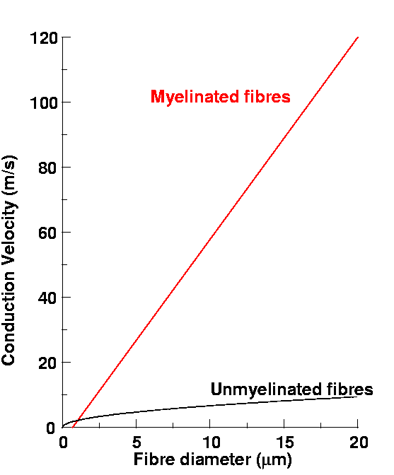
MYELINATION DIAMETER AND CONDUCTION VELOCITY

Slide 25
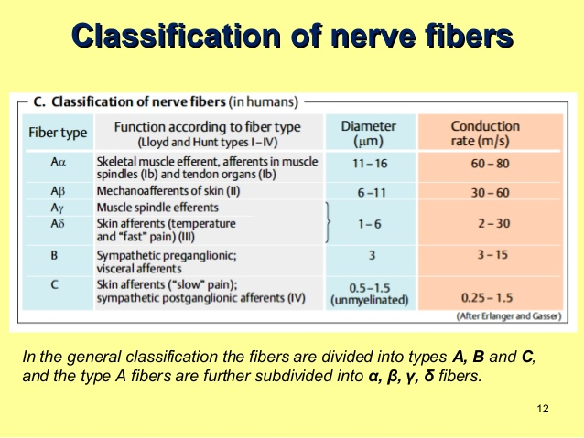
GENERAL CLASSIFICATION BASED ON FUNCTION AND FIBRE SIZE-1

Slide 26
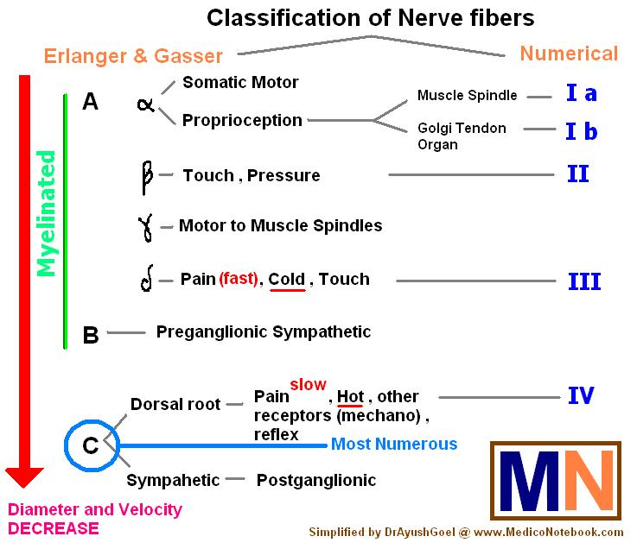
SUMMARY -2

Slide 27
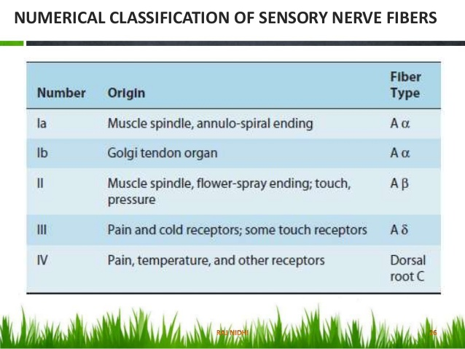
RECEPTOR-BASED CLASSIFICATION: ROMAN NUMERALS AND APHABETICAL SYSTEM

Slide 28
SENSORY FIBRE, MYELINATION, RECEPTOR AND MODALITY BASED SYSTEM
SEE NEXT SLIDE

Slide 29
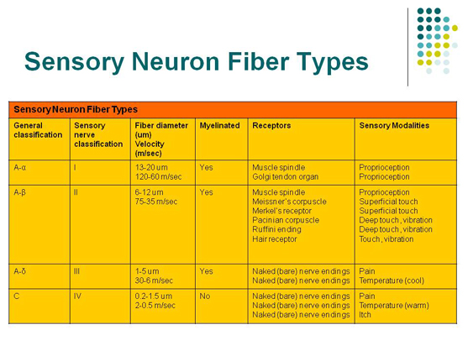

Slide 30
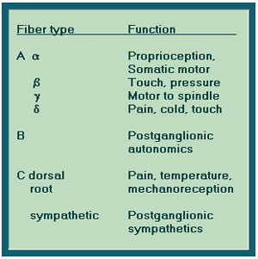
ALPHABETICAL FIBRE TYPE AND FUNCTION-BASED SYSYTEM (correction group “B” are pre-ganglionic autonomics)

Slide 31
NETTER’S ATLAS (P.8) SUMMARY OF COMBINED MYELINATION, MOTOR AND SENSORY CLASSIFICATION

Slide 32
END

