Slide 1
ENDOCRINE SYSTEM
OVERVIEW PHYSIOLOGY

Slide 2
Hormones are messengers that convey information signal relevant for cell function.
Endocrine hormones are transported via the blood steam and are produced by the endocrine glands (ductless glands) to include:
Hypothalamas, pituitary,thyroid, adrenal gland, islets in the pancreas, ovaries and testes.

Slide 4
CHEMICAL CATEGORIES OF HOEMONRES
POLYPEPTIDES
STEROIDS
AMINES
GLYCOPROTEINS

Slide 5
AMINES
These are hormones derived from the amino acids tyrosine and tryptophan. They include the hormones secreted by the adrenal medulla, thyroid, and pineal glands

Slide 6
POLYPEPTIDES AND PROTEINS
Proteins are large polypeptides
Antidiuretic hormone is a polypeptide with nine amino acids it is too small to accurately be called a protein.
If a polypeptide chain is larger than about 100 amino acids, such as growth hormone with 191 amino acids, it can be called a protein. Insulin blurs the two categories, because it is composed of two polypeptide chains derived from a single,larger molecule

Slide 7
GLYCOPROTEINS
These molecules consist of a protein bound to one or more carbohydrate groups.
Examples are follicle stimulating hormone (FSH) and luteinizing hormone (LH).

Slide 8
STEROID HORMONES
Steroid hormones are derived from cholesterol after an enzyme cleaves off the side chain attached to the five-carbon “D” ring
Steroid hormones include testosterone, estradiol, progesterone, and cortisol.

Slide 9
MECHANISM OF HORMONE RELEASE

Slide 10
Hormones can also be classifies as water soluble and lipid soluble

Slide 11
Water soluble hormones
Water soluble hormones (ie, peptides and biogenic amines) attach to receptors on the plasma membrane of the target cell.
Receptors for water-soluble hormones stimulate the production of intracellular second messengers (eg, cAMP, diacylglycerol, inositol 1,4,5- triphosphate, increased Ca2+), which modify intracellular proteins (often enzymes) and bring about the hormone’s biologic response.
Water-soluble hormones circulate free (unbound) in the plasma and are continually available for degradation, thus accounting for their short plasma half-lives (generally 1–30 min).

Slide 12
Lipid soluble hormones
These include steroids and thyroid hormones which cross the plasma and nuclear membranes of their target cells readily and attach to receptorson the nuclear chromatin.
The hormone receptor complex activates RNA polymerase, which transcribes aspecific portion of the genome.
Lipid-soluble hormones circulate bound to plasma proteins that serve as carriers. These carriers make the lipid-soluble hormones less available for degradation, thus accounting for their longer half-lives (usually hours for the steroid hormones and days for the thyroid hormones).
Only unbound hormones can enter the target cell and initiate hormoneaction.

Slide 13
Endocrine organs in the brain
Hypothalamus___________
Pituitary__________

Slide 14
Hypothalamas
Has Releasing hormones (releasing factors) of hypothalamus
Secreted like neurotransmitters from neuronal axons into capillaries and veins to anterior pituitary (adenohypophysis)
TRH (thyroid releasing hormone) -----turns on* TSH
CRH (corticotropin releasing hormone) -----turns on ACTH
GnRH (gonadotropin releasing hormone) ---turns on FSH and LH
PRF (prolactin releasing hormone) -----turns on PRL
GHRH (growth hormone releasing hormone) ----turns on GH
Inhibiting hormones of hypothalmus
PIF (prolactin inhibiting factor) -----turns off PRL
GH (growth hormone) inhibiting hormone ---turns off GH
The hypothalamus controls secretion of hormones which in their turn control the secretion of hormones by the thyroid gland, the adrenal cortex and gonads: in this way the brain controls these endocrine glands

Slide 15
Structure of pituitary
Infundibulum

Slide 16
The pituitary gland is structurally and functionally divided into an anterior lobe, or adenohypophysis, and a posterior lobe called the neurohypophysis.
These two parts have different embryonic origins. The adenohypophysis is derived from a pouch of epithelial tissue (Rathke’s pouch) that migrates upward from the embryonic mouth, whereas the neurohypophysis is formed as a downgrowth of the brain.
The adenohypophysis consists of two parts in adults: (1) the pars distalis, also known as the anterior pituitary, is the rounded portion and the major endocrine part of the gland, and (2) the pars tuberalis is a sheath of tissue that partially wraps around the infundibulum.

Slide 17
Pituitary gland
The anterior pituitary, is regulated by hormones secreted by the hypothalamus, as well as by feedback from the target gland hormones.
The anterior pituitary is responsible for releasing and inhibiting hormones. Some of the hormones released include ACTH, GH, TSH, FSH, LH and Prolactin

Slide 18
The posterior pituitary stores and releases hormones that are actually produced by the hypothalamus like ADH (vasopressin) and oxytocin

Slide 19
Anterior hormones
Growth hormone (GH, or somatotropin). GH promotes the movement of amino acids into cells and the incorporation of these amino acids into proteins, thus promoting overall tissue and organ growth.
Some of growth hormone’s actions, including growth of cartilage and bones and protein synthesis in muscles, result from a group of molecules (the somatomedins) produced by the liver undergrowth hormone stimulation

Slide 20
Thyroid-stimulating hormone (TSH, or thyrotropin). TSH stimulates the thyroid gland to produce and secrete thyroxine (tetraiodothyronine, or T 4 ) and triiodothyronine (T 3 ).
Adrenocorticotropic hormone (ACTH, or corticotropin). ACTH stimulates the adrenal cortex to secrete the glucocorticoids, such as cortisol (hydrocortisone).

Slide 21
Follicle-stimulating hormone (FSH, or folliculotropin) stimulates the growth of ovarian follicles in females and the production of sperm cells in the testes of males.
Luteinizing hormone (LH, or luteotropin). This hormone and FSH are collectively called gonadotropic hormones.
In females, LH stimulates ovulation and the conversion of the ovulated ovarian follicle into an endocrine structure called a corpus luteum. In males, LH is sometimes called interstitial cell stimulating hormone, or ICSH; it stimulates the secretion of male sex hormones (mainly testosterone from the interstitial cells (Leydig cells) in the testes.

Slide 22
Prolactin which aids in milk production. It is also essential in male

Slide 23
Posterior pituitary hormones
Antidiuretic hormone (ADH). The human form of this hormone is also chemically known as arginine vasopressin(AVP), its stimulation of water retention by the kidneys, so that less water is excreted in the urine.

Slide 24
Oxytocin- In females, oxytocin stimulates contractions of the uterus during labor and for this reason is needed for childbirth.
Oxytocin also stimulates contractions of the mammary gland alveoli and ducts, which result in the milk-ejection reflex in a lactating woman.
In men, a rise in oxytocin secretion at the time of ejaculation has been measured, but the physiological significance of this hormone in males remains unclear.

Slide 25
Thyroid gland

Slide 26
The thyroid glands are found in the anterior neck on trachea just inferior to larynx
It comprises of two lateral lobes and an isthmus
Produces two hormones
Thyroid hormone: tyrosine based with 3 or 4 iodine molecules
T4 (thyroxine) and T3
Calcitonin involved with calcium and phosphorus metabolism

Slide 27
Production of thyroid hormones
The thyroid follicles actively accumulate iodide (I 2 ) from the blood and secrete it into the colloid. Once the iodide has entered the colloid, it is oxidized and attached to a specific amino acid (tyrosine) within the polypeptide chain of a protein called thyroglobulin.
The attachment of one iodine to tyrosine produces monoiodotyrosine (MIT); the attachment of two iodines produces diiodotyrosine (DIT).
Within the colloid, enzymes modify the structure of MIT and DIT and couple them together. When two DIT molecules that are appropriately modified are coupled together, a molecule of tetraiodothyronine ( T 4 ), or thyroxine, is produced
The combination of one MIT with one DIT forms triiodothyronine (T 3 ).

Slide 28
Mechanism of action
Decrease in circulating thyroxine stimulates the hypothalamus to releases TRF which in turn stimulates the anterior pituitary gland to release TSH which further stimulates the thyroid gland to produce Thyroxine (TSH has caused cleavage of thryroglobulin into thyroxine).

Slide 29
EFFECTS OF THYROXINE HORMONE
Some of the widespread effects of thyroid hormones in the body are secondary to stimulation of O2 consumption (calorigenic action),
Growth and development in mammals,
Help regulate lipid metabolism
Increase the absorption of carbohydrates from the intestine
They also increase the dissociation of oxygen from hemoglobin by increasing red cell 2,3-diphosphoglycerate(DPG)

Slide 30
Calcitonin is secreted by the parafollicular cells, or C cells, of the thyroid.
It inhibits the activity of osteoclasts, the bone cells that promote dissolution of the calcium phosphate crystals of bone.
It also stimulates the urinary excretion of Ca 2+ by the kidneys.
These actions would lower the blood Ca 2+ concentrations and thus antagonize the effects of parathyroid hormone

Slide 31
Parathyroid glands

Slide 32
Most people have four
On posterior surface of thyroid gland
(sometimes embedded)

Slide 33
Functions of parathyroid hormone
Increases blood Ca++ (calcium) concentration when it gets too low
Mechanism of raising blood calcium
Stimulates osteoclasts to release more Ca++ from bone
Decreases secretion of Ca++ by kidney
Activates Vitamin D, which stimulates the uptake of Ca++ from the intestine
Has opposite effect on calcium as calcitonin (which lowers Ca++ levels)

Slide 34
Adrenal glands
These are paired glands located above each the kidneys.
The adrenal gland is composed of two layers: the adrenal cortex and adrenal medulla.
These two parts are really two functionally different glands with different embryonic origins, different hormones, and different regulatory mechanisms.
The adrenal cortex secretes steroid hormones; the adrenal medulla secretes the hormone epinephrine (adrenaline) and, to a lesser degree, norepinephrine, when it is stimulated by the sympathetic system

Slide 35
Adrenal Gland
Adrenal cortex
Secretes lipid-based steroid hormones, called “corticosteroids” – “cortico” as in “cortex”
MINERALOCORTICOIDS
Aldosterone is the main one
GLUCOCORTICOIDS
Cortisol (hydrocortisone) is the main one
Adrenal medulla
Secretes epinephrine and norepinephrine

Slide 36
Aldosterone, the main mineralocorticoid
Secreted by adrenal cortex in response to a decline in either blood volume or blood pressure (e.g. severe hemorrhage)
Is terminal hormone in renin-angiotensin mechanism
Prompts distal and collecting tubules in kidney to reabsorb more sodium
Water passively follows
Blood volume thus increases.
Excess will cause SIADH

Slide 37
Cortisol, the most important glucocorticoid (Glucocorticoid receptors are found in the cells of most vertebrate tissues)
It is essential for life
Helps the body deal with stressful situations within minutes
Physical: trauma, surgery, exercise
Psychological: anxiety, depression, crowding
Physiological: fasting, hypoglycemia, fever, infection
Regulates or supports a variety of important cardiovascular, metabolic, immunologic, and homeostatic functions including water balance
People with adrenal insufficiency( addison disease): these stresses can cause hypotension, shock and death: must give glucocorticoids, eg for surgery or if have infection, etc.

Slide 38
Cortisol, continued
Keeps blood glucose levels high enough to support brain’s activity
Forces other body cells to switch to fats and amino acids as energy sources
Catabolic: break down protein
Redirects circulating lymphocytes to lymphoid and peripheral tissues where pathogens usually are
In large quantities, depresses immune and inflammatory response
Used therapeutically
Responsible for some of its side effects

Slide 39
Hormonal stimulation of glucocorticoids
With stress, hypothalamus sends CRH to anterior pituitary (adenohypophysis)
Pituitary secretes ACTH
ACTH goes to adrenal cortex where stimulates glucocorticoid secretion
Sympathetic nervous system can also stimulate it
Adrenal cortex also secretes DHEA (dehydroepiandrosterone)
Converted in peripheral tissues to testosterone and estrogen (also steroid hormones)
Unclear function in relation to stress

Slide 40
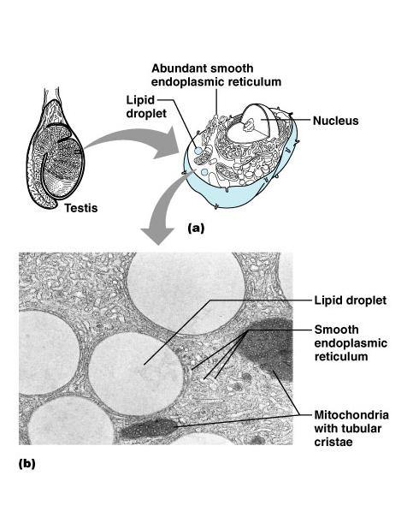
In general:
Steroid-secreting cells have abundant smooth ER
As opposed to rough ER in protein-secreting cells
Steroids directly diffuse across plasma membrane
Not exocytosis
Abundant lipid droplets
Raw material from which steroids made

Slide 41
Adrenal medulla
Part of autonomic nervous system
Spherical chromaffin cells are modified postganglionic sympathetic neurons
Secrete epinephrine and norepinephrine
Amine hormones
Fight, flight, fright
Vesicles store the hormones

Slide 42
The Pancreas
Exocrine and endocrine cells
Acinar cells (forming most of the pancreas)
Exocrine function
Secrete digestive enzymes
Islet cells (of Langerhans)
Endocrine function

Slide 43
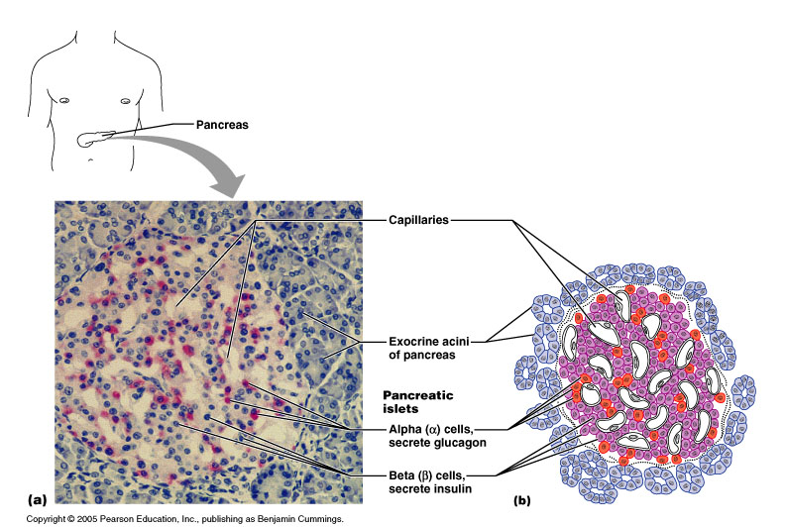
Pancreatic islet endocrine cells
Alpha cells: secrete glucagon
raises blood sugar
mostly in periphery
Beta cells: secrete insulin
lowers blood sugar
central part (are more abundant)
Also rare Delta cells:secrete somatostatin
inhibits glucagon

Slide 44
The Gonads (testes and ovaries) main source of the steroid sex hormones
Testes
Interstitial cells secrete androgens
Primary androgen is testosterone
Maintains secondary sex characteristics
Helps promote sperm formation
Ovaries
Androgens secreted by the folliculi
Directly converted to estrogens by follicular granulosa cells
Granulosa cells also produce progesterone
Corpus luteum also secretes estrogen and progesterone

Slide 45
Endocrine cells in various organs
The heart: atrial natriuretic peptide (ANP)
Stimulates kidney to secrete more salt
Thereby decreases excess blood volume, high BP and high blood sodium concentration

Slide 46
Endocrine cells in various organs continued
The heart: atrial natriuretic peptide (ANP)
Stimulates kidney to secrete more salt
Thereby decreases excess blood volume, high BP and high blood sodium concentration
GI tract & derivatives: Diffuse neuroendocrine system (DNES)
The placenta secretes steroid and protein hormones
Estrogens, progesterone
CRH
HCG
The kidneys
Juxtaglomerular cells secrete renin
Renin indirectly signals adrenal cortex to secrete aldosterone
Erythropoietin: signals bone marrow to increase RBC production
The skin
Modified cholesterol with uv exposure becomes Vitamin D precursor
Vitamin D necessary for calcium metabolism: signals intestine to absorb CA++

Slide 47
REFERENCES
Barret al(2010) Ganong’s review of Medical Physiology
Pasley J.N(2003) Usmile Road map physiology
Stuart Ira Fox (2016) Human Physiology 14th ed

