Slide 1
HAEMOPHILUS
KIMAIGA H.O
MBChB (University of Nairobi)

Slide 2
HAEMOPHILUS
Family Pasteurellaceae
Gram -ve bacilli coccobacilli
Non motile, non spore formers
Facultative anaerobes
Oxidase positive
Require accessory factors X and V present in RBC for growth and viability
No growth on MacConkey agar

Slide 3
X factor
Component of the iron containing part of hb
Utilized in the synthesis of haem containing enzymes – catalases, peroxidases
Heat resistant
V factor
Nicotinamide adenine nucleotide or nicotinamide adenine dinucleotide
H2 acceptor during metabolism
Heat labile- destroyed by heating at 1200c
Present in blood known as co-enzyme I. It is necessary with the enzyme dehydrogenase for the oxidation-reduction system.
Also produced by some microorganisms e.g staph aureas

Slide 4
Classification
Numerous spp found in humans and other animals
Classification and differentiation is based on factor requirement .
Species | Factor requirement
H. influenzae | x and v
K. decreyi | x
H. aegyptius | x and v
H. haemolyticus | x and v
H. parainfluenzae | v
H. aphrophilus

Slide 5
Haemophilus influenzae
Main pathogenic spp in humans
Belong to family Pasteurellaceae, on the level with the Vibrionaceae and the Enterobacteriaceae
Also present as part of normal flora in upper respiratory tract
Gram-negative bacterium in the
Pleomorphic – bacilli – coccobacillary or filamentous forms
Non motile

Slide 6
Capsulated strains and non capsulated strains
Encapsulated strains isolated from CSF are coccobacilli, 0.2 to 0.3 to 0.5 to 0.8 um, similar in morphology to Bordetella pertussis, the agent of whooping cough.
Non capsulated organisms from sputum are pleomorphic and often exhibit long threads and filaments

Slide 7
Antigenic properties
Polysaccharide capsule contains distinct polysacch caspular antigens
Six different antigens identified designated a -f each stimulates production of a specific antibody
Corresponding with the antigen are six different serotypes a-f.

Slide 8
Virulence
Capsule – a significant virulence factor
Enables the organism to resist phagocytosis by host's phagocytic cells
Capsulated strains of serotype b are more virulent than other serotypes and the non capsulated
IgA protease – degrades mucosa; IgA is a mucosal colonizing factor
Neuraminidase – Aid in mucosal colonozation
Fimbriae increase the adherence of bacteria to human mucosal cells in vitro and colonization of the nasopharynx

Slide 9
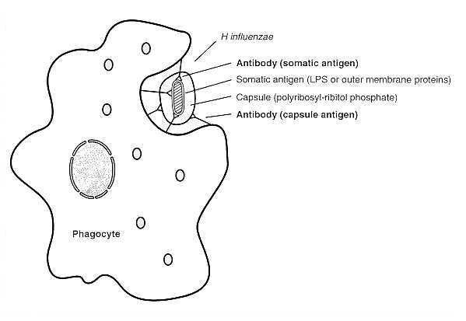

Slide 10
Immunity.
The age incidence of H. influenzae meningitis is inversely proportional to the titer of bactericidal antibody in the blood, whether passively acquired from the mother or actively formed.
Without artificial immunization, in children aged 2 months to 3 years, antibody levels are minimal; thereafter antibody levels increase and the disease becomes much less common.
From this active immunization should begin at 2 months of age, when nearly all passive immunity has waned, and the child enters a vulnerable non immune period of life.

Slide 11
Pathogenesis
Presence of the type b polysaccharide capsule is known to be the major factor in virulence.
Encapsulated organisms can penetrate the epithelium of the nasopharynx and invade the blood capillaries directly. Their capsule allows them to resist phagocytosis and complement-mediated lysis in the the nonimmune host.
Nontypable (non encapsulated) strains are less invasive, but they are apparently able to induce an inflammatory response that causes disease.
Outbreaks of H. influenzae type b infection may occur in nurseries and child care centers, and prophylactic administration of antibiotics is warranted.

Slide 12
Vaccination with type b polysaccharide (in the form of Hib conjgate vaccines) is effective in preventing infection, and several vaccines are now available for routine use.
In infants and young children (under 5 years of age), H. influenzae type b causes bacteremia and acute bacterial meningitis.
Occasionally, it causes epiglottitis (obstructive laryngitis), cellulitis, osteomyelitis, and joint infections.
Nontypable H. influenzae causes ear infections (otitis media) and sinusitis in children, and is associated with respiratory tract infections (pneumonia) in infants, children and adults.

Slide 13
Clinical manifestations
CAPSULATED STRAINS OF SEROTYPE B
Responsible for a majority of human dx caused by H. influenzae
Most frequent age group affected – 2 months to 5 yrs
Dxs tends to be complicated by invasion of the organism into the blood circulatory system – may result in further spread

Slide 14
May cause:-
Pyogenic mengingitis
Manifestations similar to those of meningitis due to other pyogenic bacteria
Fever, headache and stiff neck
Encountered in children – majority btw 2 months and 3 yrs
Epiglottitis
Swelling of epiglottis
Severe inflammatory process in the upper respiratory tract causing airway obstruction
Associated with fever and bacteremia
Encountered in children (they hunch in order to breath)
Less common compared to meningitis
Other pyogenic dx – suppurative arthritis, osteomyelitis
Other infections of the respiratory tract – acute pharyngitis, lower respiratory tract infections.
Likely to be a secondary invader in the lower respiratory tract after infections with other organisms.

Slide 15
NON- CAPSULATED STRAINS AND OTHER CAPSULATED SEROTYPES OTHER THAN SEROTYPE B
Mostly occur as part of the normal flora of the upper respiratory tract – non capsulated strains dominated
Possibility causing opportunistic infections.
Causes otitis media, conjuctivitis and sinusitis in children and associated with pneumonia

Slide 16
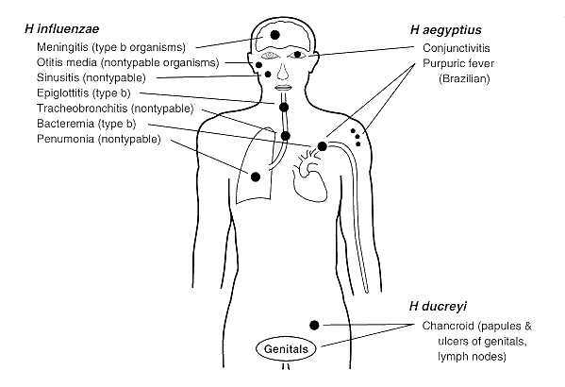

Slide 17
Laboratory diagnosis
Does not retain viability for long time in specimens left at room temperatures.
Is sensitive to cold temperatures
Easily becomes non viable if kept at 00c – 40c
laboratory examinations is performed as soon as possible after collecting the specimen for meaningful results.
Specimens
CSF, blood for culture, pus swabs, sputum
Gram stain of smears of various specimen – where applicable and microscopic examinations for the gram -ve bacilli
Culture – all specimens including blood.

Slide 18
Media:
SBA alone does not yield good growth – only x factor is readily available
Heated blood agar/ chocolate blood agar prepared by adding blood to an agar base at 80 degrees. The heat releases X(Haematin) and V(NAD) factors from the RBCs and turns the medium a chocolate brown color. Suitable and used for the isolation of H. influenzae from specimens. Smells like semen
Atmosphere - aerobic or facultative anaerobes growth enhanced by additional 5-20% co2
Temperatures – for incubation 36-37 0c; 18 -24 hrs.
Colonies
Pinpoint to 1-3 mm diameter – translucent
Gram's stain to confirm gram -ve bacilli

Slide 19
Further identification
Demonstration of growth factor requirement
Based on commercially prepared factors on Nutrient agar
Satellitism (satellite test)- S. aureus produces factor v if culture on a blood agar with H. influenzae , the factor V and haemin released by staphylococcus haemolysins help the growth of H. influenzae.
Biochemical tests
API systems
Catalase and oxidase tests are positive
Serotyping
Immunological detection of specific polysaccharide H. influenzae antigen – latex agglutination
Serotyping for capsulated strains – Quellung reaction
Porphyrin production tests to differentiate between H influenzae and H parainfluenzae

Slide 21
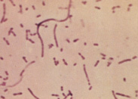
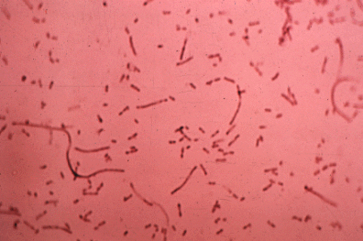
Gram stain of Haemophilus influenzae from sputum

Slide 22
Antimicrobial susceptibility
Susceptibility tests for the isolated organisms necessary for proper treatment of the infections
Ampicillin – resistance due to plasmid mediated beta – lactamase production noted
Effective antimicobials include amoxycillin-clavulanic acid combination, Chloramphenicol, ceftriaxone and cefotaxime.

Slide 23
PREVENTION
Vaccine – Polyribosyl ribitol phosphate (PRP vaccine) consisting of the serotype b capsular polysaccharide, making it a T-Cell dependent vaccine.
For protection of children as part of routine immunization other predisposed individuals.WHO recommends a pentavalent vaccine, combining vaccines against diphteria, tetanus, pertussis, hepatits B and Hib
Rifampin given to reduce respiratory carriage.

Slide 24
Haemophilus ducreyi
Fastidious gram- negative coccobacillus
The organism is more fastidious than H. influenzae but can grow on CBA, supplemented with X factor in 5%-10% CO₂ atmosphere.
A causative organism of sexually transmissible genital ulcer dx. - chancroid or soft sore or soft chancre
Clinically a painful ulcer or multiple ulcers on the external genital organs – associated with enlarged inguinal lymph nodes (You do cry with ducreyi)

Slide 25
Virulence factors
Peptidoglycan-associated lipoprotein
Adhesive pilli
Cytolethal toxin – damages host cells

Slide 27
Pathogenesis & clinical findings
Incubation is generally 3-14 days
H. ducreyi breaks in the skin or epidermis
Inflammation then takes place as the area of infxn
This pyogenic inflammation causes regional lymphadenitis (bubo)
Chancroid on the genitalia starts as an erythematous popular lesion that breaks down into a painful bleeding ulcer with a necrotic base and ragged edge

Slide 28
Lab diagnosis
Specimen: the ulcerative chancroid exudate. In case of delay, place the swab in Amies transport medium
G-stain: G-ve short rods or coccobacilli
Culture
CBA containing 1% Isovitalex (X factor) and vancomycin (3 μ g/ml) to suppress G+ve contaminants
Incubate in a moist atm & additional 5-10% CO2, 36-37 deg c, 48hrs
The organism grows slowly, producing small grey-yellow or brown colonies
G-stain: pleomophilc short gram –ve coccobacilli
Biochemical test
Slowly oxidase +ve (15-20 sec)
Catalase, urease & indole –ve)

Slide 30
LAB XTICS
Smears from the surfaces of the ulcer are innoculated onto the medium immediately after collection
X factors and other special nutrients – vitamins to be incorporated in the medium
Incubation = atmosphere with moisture and additional 5-10% co2 – 36-370c – 48 hrs
Microscopic appearance – pleomorphic short gram -ve bacilli

Slide 31
Antimicrobial susceptibility
Shows susceptibility to - erythromycin, ceftriaxone, azithromycin, ciprofloxacin hence treated with them
Many strains of H. ducreyi are beta lactamase producers
Multi-drug resistant strains especially to sulphur containing antimicrobial agents have been reported – sulphonamides, streptomycin, chloramphenicol, tetracycline, and ampicillin.

Slide 32
OTHER SPECIES
Not regularly from specimens
H. aegyptius (Koch's – week's bacillus)
Isolated in association with some cases of acute purulent conjuctivitis

Slide 33
Differentiation of H. spp
Species | X (Heme/hemin) | V (NAD) | Hemolysis
h. influenza | + | + | -
H. parainfluenzae | - | + | -
H. ducreyi | + | - | -
H. haemolytics | + | + | +
H. parahaemolytics | - | + | +
H. aphrophilus | - | - | -

