Slide 1
BORDETELLA
KIMAIGA H.O
MBChB (University of Nairobi)

Slide 2
Bordetella Species
Bordetella pertussis – causative agent of respiratory tract infections in humans
Bordetella prapertussis – causative agent of mild respiratory tract infections
Bordetellaus– Occasionally causes respiratory in deaseases immunocompromised

Slide 3
BORDETELLA PERTUSSIS
Small gram -ve coccobacilli
Capsulated – especially freshly isolated
Pilliated
Non motile, do not form endospores

Slide 4
Virulence
Pili or fimbria – for adherence to the epithelium of the trachea and bronchi
Filamentous hemagglutin – Enable adhesion to ciliated cells of URT
Pertussis toxin – an exotoxin – responsible for clinical signs and symptoms of illness – lymphocytosis – stimulation of the immune responses
Tracheal cytotoxin
Causes damage of the ciliated epithelial cells
Also interferes with DNA synthesis
It produces a highly lethal toxin which causes inflammation and local necrosis
Dermonecrotic toxin
Lipopolysaccharide – activates the complement sysytem and stimulates cytokine release

Slide 5
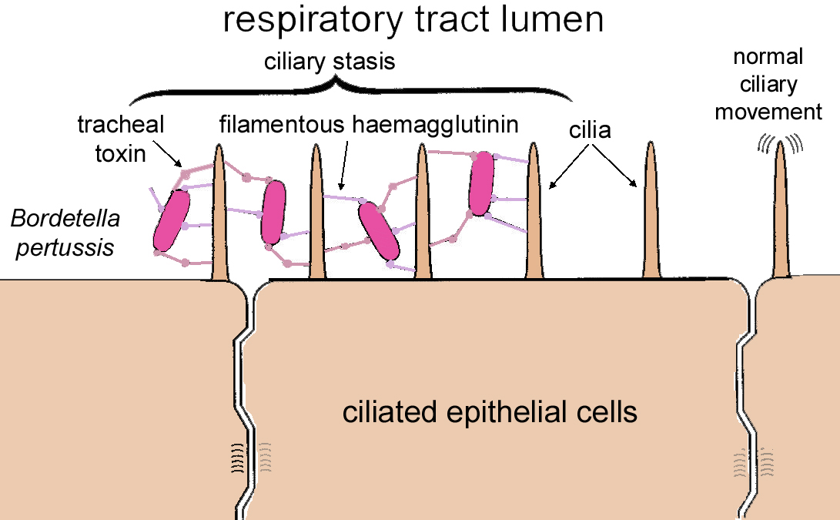

Slide 6
Pertussigen: (an AB-toxin, oligopeptide)
Increases histamine and LPS sensitivity
Increases IgE levels
T-cell lymphocytosis
Impairs phagocyte functions
ADP-ribosylates the Gi protein (results in increased cAMP)

Slide 7
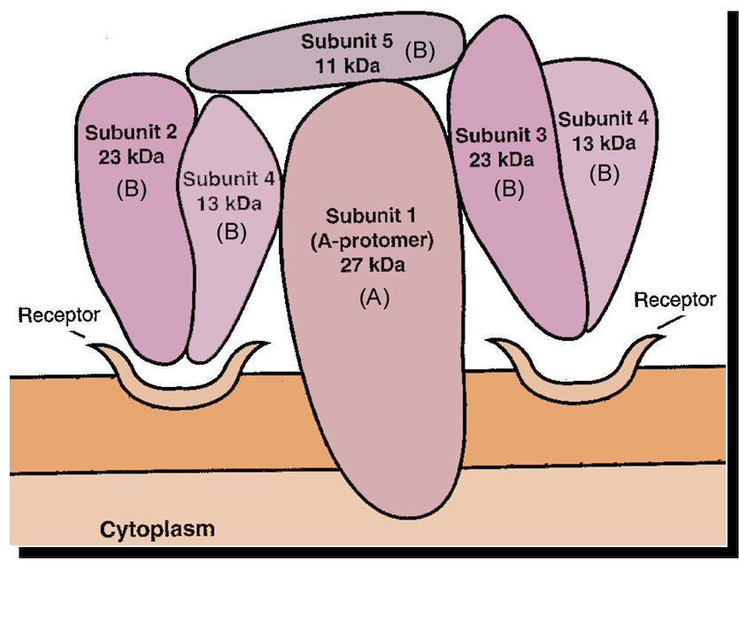
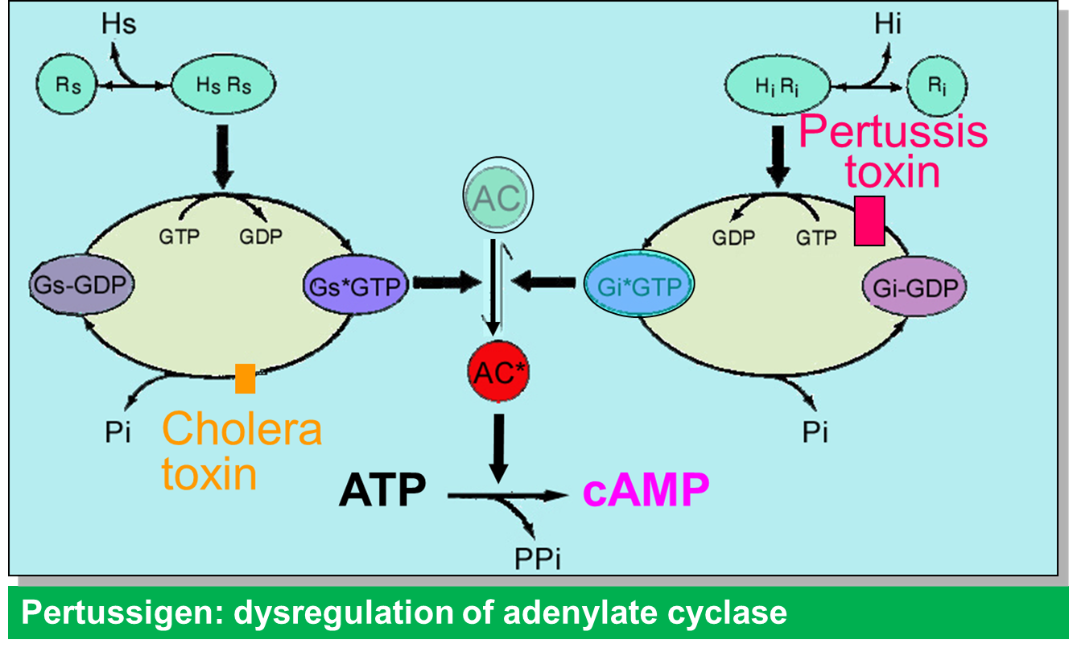

Slide 8
Pertussis tracheal Toxin
A peptidoglycan-like molecule
Binds to ciliary epithelial cells
Inhibits ciliary movement
Kills ciliary ciliary epithelial cells
Causes pertussis

Slide 9
Dermonecrotic toxin
Strong vasoconstrictor
Causes ischemia
Synergizes with tracheal toxin to causes tracheal necrosis
Filamentous haemagglutinin
Causes binding of bacteria to ciliated epithelial cells
Lipopolysaccharide
Activates inflammatory cytokines
Activates complement
In larger quantities, causes shock and cardiac arrest

Slide 10
Virulence factors of B pertussis.
Pertussis Toxin
It produces the pertussis toxin, PTx, a protein that mediates both the colonization and toxemic stages of the disease.
PTx is a two component, A+B bacterial exotoxin.
Secretes its own invasive adenylate cyclase
which enters mammalian cells The adenylate cyclase toxin is a single polypeptide with an enzymatic domain (i.e., adenylate cyclase activity) and a binding domain that will attach to host cell surfaces.
The adenylate cyclase was originally identified as a hemolysin because it will lyse red blood cells.
In fact, it is responsible for hemolytic zones around colonies of Bordetella pertussis growing on blood agar.
Adenylate cyclase toxin is a protein toxin that penetrates the host cell, is activated by host cell calmodulin, and increases intracellular CAMP massively. The increase of CAMP, which is rather short-lived as in contrast to the action of pertussis toxin, is associated with the inhibition of phagocytic cell oxidative responses and natural killer cell (NK) activity.

Slide 11
It also produces a substance called the tracheal cytotoxin which is toxic for ciliated respiratory epithelium and which will stop the ciliated cells from beating.
The toxin kills ciliated cells and causes their extrusion from the mucosa.
It also stimulates release of cytokine IL-1, and so causes fever.
It produces a highly lethal toxin (formerly called dermonecrotic toxin) which causes inflammation and local necrosis adjacent to sites where B. pertussis is located.

Slide 12
Pathogenesis
B. pertussis pili and filamentous hemagglutinis adheres to cliliated epithelial cells of the upper resp tract
Procures tracheal cytotoxin – paralyses cilia leading to paroxysms of cough to remove excess mucus
Produces pertussis toxin – promotes lymphocytosis and secretion of mucus leading to irritation and spasms of coughing

Slide 13
Pathogenesis
The disease pertussis has two stages.
The first stage, colonization, is an upper respiratory disease with fever, malaise and coughing, which increases in intensity over about a 10-day period.
During this stage the organism can be recovered in large numbers from pharyngeal cultures, and the severity and duration of the disease can be reduced by antimicrobial treatment.
Adherence mechanisms of B. pertussis involve a "filamentous hemagglutinin" (FHA), which is a fimbrial-like structure on the bacterial surface, and cell-bound pertussis toxin (PTx).
Short range effects of soluble toxins play a role as well in invasion during the colonization stage.

Slide 14
The second or toxemic stage of pertussis follows relatively nonspecific symptoms of the colonizaton stage.
It begins gradually with prolonged and paroxysmal coughing that often ends in a characteristic inspiratory gasp (whoop).
During the second stage, B. pertussis can rarely be recovered, and antimicrobial agents have no effect on the progress of the disease

Slide 15
Transmission
– via contaminated droplets – inhaled from pts during the early stages of the dx or form carriers – ether directly or indirectly
– do not survive for long time outside the hosts
– after inhalation – adhere to and multiply on the epithelial surface of the hosts trachea and brochi
– inflammatory response follows and together with products of the organisms causes tissue damage and interfere with the cilliary action
– bacilli....

Slide 16
Clinical features
Catarrhal phase
Low grade fever (), catarrhal symptoms (blocked, runny nose, irritating and persistent cough, h/ache facial pain caused by a blocked nose and blocked sinuses, a loss of smell and taste)
Paroxysmal phase
Cough increases in intensity – continuous coughing
Long intake of air producing a long high-pitched whoop
Fluids steam from eyes, nose and mouth
Sometimes vomiting & convulsions may result
Convalescent phase
Cough intensity reduces gradually
Complications: encephalitis, bronchopneumonia & mental retardation

Slide 17
It is a respiratory tract infection. Characterize by three stages: catarrhal, paroxysmal, and convalescent stages.
Catarrhal stage: resembles a common cold. First symptoms appear after 7 to 10 day incubation period after exposure and inhalation to infectious aerosols. This is the most contagious stage and lasts 1 to 2 weeks.
Paroxysmal stage: is marked by a series of repetitive coughs followed by an inspiratory whoop. These paroxysms are often ended with vomiting and exhaustion. It lasts about 2 to 4 weeks.
Convalescent stage: the number of paroxysms diminishes, but complications can appear.

Slide 19
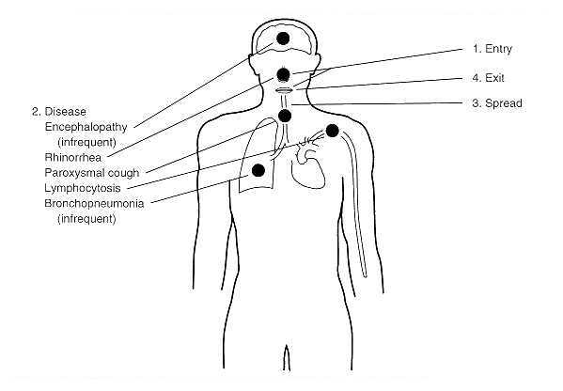

Slide 20
MANIFESTATIONS
-A respiratory tract infection associated with cough specifically whooping cough
– affects children mainly.
– Illness is xtrized by stages
– incubation period
– stage xtrized by mild cough, sneezing, nasals secretion, numerous bacilli in the secretions- infections transferred at this stage.
– tpypical whooping cough.
– damage to the respirator epithelium and the exudation of the fluid predisposes to secondary infection by pyogenic bacteria – staph aureaus and H. influenzae – most often encountered as causal agents of pneumonia.

Slide 21
Lab diagnosis
Better isolation can be achieved in the 1st or 2nd weeks of the illness
Specimens
Nasophargyngeal swap- Collected form the posterior nasopharynx by passing a swab on the long flexible wire thro the nostril
Nasopharyngeal aspirates- Collected by passing a tube to the posterior nasopharynx
Droplets from coughs- Use of cough plate – droplets are collected using petri-dish containing the medium held in front of the pts mouth while coughing then incubated – not preferred – can be used together with above methods.

Slide 22
Gram stain
Small gram -ve cocco-bacilli
Culture
Bacilli do not grow easily on artificial culture medium
Strict aerobes
Incubate 35-37⁰C for 2-6 days in a moist aerobic condition
Modified Bordet-Gengou/BG medium(contains nutrients –starch.glycerol and blood) – also penicillin
Slow growth-colonies appear after 2-4 days:Smooth shiny grayish which– reflect light comparable to bisect or split pearl(Mercury drop pearl appearance)
Charcoal cephalexin blood agar
Colonial morphology-Small, mercury-like or rain drop like and mucoid, Capsulated and piliated(non motile)

Slide 23
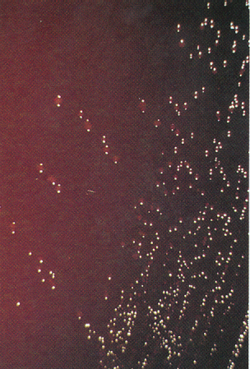

Slide 24
Biochemical tests
Urease negative
Does not produce nitrate
Oxidase positive
Do not ferment carbohydrates
Catalase positive
(B. parapertussis: oxidase⁻, urease⁺; B. brochosepticus: +/+)

Slide 25
Other methods of lab diagnosis
Serology test
To identify the different serovars
Increase in antibody
Detection of bordetella pertussis in nasopharyngeal specimens based on fluorescent antibody to detect the antigen – immunofluorescent staining methods sensitivity low – can be combined with culture
DNA amplification techniques such as PCR for detection in nasopharyngeal specimens
Negative results from the above tests do not necessarily exclude bordetella pertussis infections

Slide 26
Bordetella pertussis, the agent of pertussis or whooping cough. Gram stain.

Slide 27
Antimicrobial agents
Susceptible to erthromycin, chloramphenicols, ampicilin, amoxycilin, kanamycin.
Resistant to tetracycline

Slide 28
Prevention
– early recognition and isolation of the pts to limit the spread of the organisms
– rx of pts with antibiotics
– vaccination – pertussis vaccine.
P on DPT vaccine and Pertusis is a whole-cell component of the vaccine.

Slide 29
BORDETELLA PARAPERTUSSIS
– Non motile, non sporing, not capsulated
– similarities with bordetella pertussis morphologically and antigenically
– causes a milder form of whooping cough than that due to bordetella pertussis
– growth is relatively rapid on BA, CBA can support growth – does not grow on MAC
Produces larger colonies than B. pertusissis which are pigmented (brown)

Slide 30
BORDETELLA BRONCHISEPTICA
– mainly animal pathogen (dogs)
– non spore former, non capsulated, motile
– found in the respiratory tract of domestic and wild animals – associated with respiratory tract infections in humans – pertussis – like or pneumonia
– rapid growth on BA and MAC
Produces small beta haemolytic colonies on blood agar after 2-3 days of incubation at 35-37⁰C

Slide 31
A 2-year-old male is presented to you with a 10-day history of persistent cough. The long cough spells are followed by a deep breath. The cough often leads to choking, vomiting, gasping and cyanosis. His pulse rate is 190 (n: 100-160) and respiratory rate is 72 (n: 10-20). Chest x-ray is normal. WBC counts are16,000/cm2 with 70% lymphocytes.
What is the organism and what are its physiologic characteristics?
What are the pathogenic factors of this organism?
Why is there a preponderance of lymphocytes?
What is the epidemiology of and prophylaxis for the disease?

