Slide 1
BRUCELLA
KIMAIGA H.O
MBChB (University of Nairobi)

Slide 2
Brucella
Gram -ve bacilli with variation in shape and seize- pleomorphic, short bacilli or cocco-bacilli
Nonmotile non-capsular, nonspore forming
Strict aerobes and grow very slowly (fastidious) on blood agar
Live as facultative intracellular pathogens

Slide 3
Physical properties
Susceptible to heat – rendered non viable within 10 minutes at 600c
Destroyed by heat methods of processing items – pasteurization
Sensitive to direct sunlinght
Sensitive to acid – non viable in sour milk
Can remain viable after refrigeration for several weeks

Slide 4
Species
– numerous- primarily animal pathogens
– transmissible to humans from animals
– 3 major species which are associated with dx in humans and cause brucellosis(undulating fever)
1. Brucella melitensis – sheep and goats
2. brucella abortus – cattle
3. b. suis – swine
B. canis- dogs
– hosts – parasite relationship is not absolutely specific
B. abortus, suis, melitensis are major pathogens of humans causing zoonotic dx – brucellosis (undulating fever – wavy form)

Slide 5
Transmission
– humans get exposed thro contact with infected animals or products of infected animals –
untreated milk, cheese, pork, meat or infected droplets
entry can be thro:
– mucous membranes
– broken skin
– ingestion – via untreated contaminated
Inhaled in infected aerosols

Slide 6
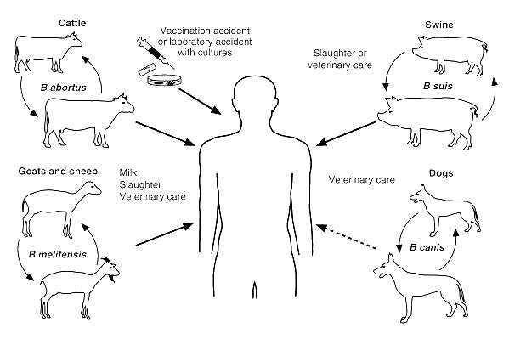

Slide 7
Virulence and pathogenesis
– in humans virulence is attributed partly to:
– occurrence as intracellular organisms inside the host's phagocytic cells
– ability to evade host defense mechanisms
Has lipopolysacharide surface antigen that has endotoxin activity
– organisms are spread in the humans host via the blood circulatory system
– localize in tissue such as lymph nodes, liver, spleen and bone marrow as intracellular organisms in the reticuloendothelial cells – macrophages
– inflammatory response occurs in the tissues , chronic type, responsible for tissue damage associated with dx.

Slide 8
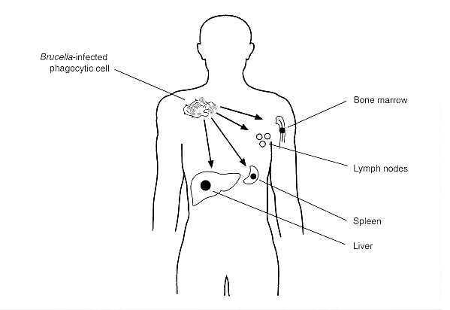
Spread of Brucella in the body

Slide 9
Clinical implications
– dx caused is brucellosis or undulant fever/ relapsing fever
– a zoonosis or zoonotic dx

Slide 10
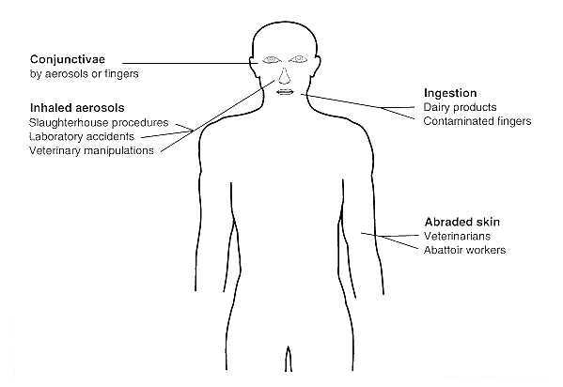

Slide 11
Clinical features
Acute brucellosis 0characteriseed by h/ache, undulating fever, septicemia, muscular pain, sweating (esp at night), chills, anorexia, irritability & enlargement of lymph nodes
Urogenital symptoms may occur in some px and rarely neurological symptoms
Untreated infxns can become chronic with musculoskeletal symptoms (back pain, arthritis, arthralgia)
Complications: osteomyelitis

Slide 12
Lab diagnosis
Specimen- Blood, infected tissue, CSF, urine, swabs from abscess, biopsy materials
Blood for culture; infected tissues – suspension in sterile saline
Gram stain- Small Gram negative coccobacilli or pleomorphic, short rods
Culture
Difficult to isolate from culture
Nutritional specific – requires a medium enriched with serum and other nutrients – vitamins,amono acids , glucose
Can be in liquid form (broth), semi solid, CBA or biphasic (liquid and semi solid phase)
Castaneda's medium in castaneda's technique
A biphasic medium in a sealed bottle together with a suitable mixture of gases
Sampling and sub cultures on CBA for confirmatory tests in identification:
Aerobic incubation
Brucella abortus yields better growth in additional 5-10%CO2

Slide 13
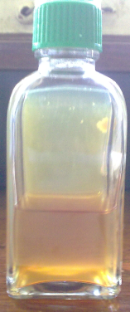
Castenada’s Medium for blood culture
Used for isolation of athogens from blood e.g Brucella ssp
5 ml of blood is added to the both and the mixture allowed to flow on the agar surface.
CO₂ may be introduced using a needle to support growth.
The agar surface is then examined for growth after 48 hours.
If no growth the agar surface is flooded again followed by further incubation.

Slide 14
Biochemical tests
Carbon dioxide requirement for growth
H2S production
Oxidase, catalase, urease positive
Ability to grow in the presence certain chemicals
Don not ferment carbohydrates
Serology
Brucella antigens used to test for antibodies in pts blood
Can be performed quantitatively -can differentiate active infection from past exposure depending on the antibody levels
Brucella skin tests

Slide 15
Brucella antibody tests
Serum Dilutions: 1/20, 1/40, 1/80, 1/160, 1/320
Titre of serum is the highest final dilution of serum to show agglutination
Brucella melitensis
Brucella abortus

Slide 16
Antimicrobial susceptibility
Susceptible to a number of antimicrobial agent – tetracycline, ofloxacin, gentamicin
Reserved agents – streptomycin and rifampicin
Antimicrobial agents may be administered as a combination in sever infections – tetracycline and gentamicin

Slide 17
Prevention and control
In animals – prevention will reduce human infections
Avoid contact with infected animals
Vaccination of animals
Testing susceptible animals and separating the infected from the healthy for proper rx
In human
Proper rx of animal products before rx such as pasteurization of milk before consumption
Education of farmers and the public to avoid ingestions of animal products.

