Slide 1
YERSINIA, PASTEURELLA, FRANCISELLA
KIMAIGA H.O
MBChB (University of Nairobi)

Slide 2
Yersinia, pasturella, francisella
Similar microscopic appearance
Small gram negative bacilli or coccobacilli
Stain more deeply at the ends: characteristic described as Bipolar staining or safety-pin appearance
Essencially animal pathogens but acccidentaly transmitted to human in Zoonotic infection
All belong to the genus pasturella: reclassified into 3 seperate genera

Slide 3
Yersinia
Belongs to family of Enterobacteriaceae
Pathogenic species to man include
Y. Pestis
Y. Pseudotuberculosis
Y. Enterocolitica
Pasteurella
Example of species: Pasteurella multocida
Francisella
Example of species: Francisella Tularensis

Slide 4
Yersinia pestis
Also called plague bacillus
MICROSCOPIC MORPHOLOGY AND DESCRIPTION
Pleomorphic gram –ve bacilli or coccobcilli
Stainable by gram’s stain as well as Giesma and Wyson’s stains:
Better display densely staining poles of bacilli
Safety pin or bipolar appearance
Capsulated in tissue
Non motile, non spore former
Facultative anaerobic

Slide 5
Habitat/ Occurence
Wild rodents: including Rats and squirrels in which y.pestis is a primary pathogens
Other wild animals: also become chronic carriers and resoirvoirs
Fleas acquire bacteria when they feed on the blood of infected animals and carry the organism

Slide 6
Pathogenic properties
Main virulence factors which enable organism to
Survive and multiply within phagocytes
Spread within infected human
Cause tissue damage

Slide 7
Virulence factors include
Capsule – carbohydrate protein envelope that is antiphagocytic
Somatic antigen complex – contains somatic antigen V and W – resist phagocytosis and cause rapid proliferation and septicemia
Lipopolysaccharide – with endotoxin activity
Aggressive factors like fibrino-lysins that enhance spreading
Ability to absorb Iron
Low calcium response (lcr) : This is a plasmid-coded gene that enables growth in a low Ca++ (intracellular) environment.

Slide 8
Yops: Responsible for cytotoxicity, inhibition of phagocyte migration and engulfment and platelet aggregation.
Envelope (F-1) antigen: is anti-phagocytic.
Coagulase and Plasminogen activator: Both of these are plasmid-coded proteins. Coagulase is responsible for micro thrombi formation and plasminogen activator promotes the dissemination of the organism.
It also destroys C3b on the bacterial surface, thus attenuating phagocytosis.

Slide 9
Transmission
Occurs in the forest and in human habitat
Primarily through fleas’ bites as they feed on the animal’s blood: Fleas transmit Y.petis from infected rodents and other animals to susceptible animals including humans
1. In the forest among
Wild rodentsl
Man
Fleas

Slide 10
2. In human habitats
Involves rats and fleas to man
Infected black and brown rats which gain access to human together with their fleas constitute the most important source of human infection
Human to human transmission
From respiratory tract of patients with pneumonic plague through droplets of secretions which contain Y. pestis
From infected individuals with bacilli in blood circulation to susceptible individual by human fleas

Slide 11
Clinical implications
Causative agent for plague
Disease of Rats transmitted to man resulting in human plague
An ancient disease 1st described in parts of Asia and Africa
Prevailed extensively throught Europe in the middle ages

Slide 12
Manifestations
Incubation period: after exposure
Initial clinical manifestation
Approx 10 days after exposure
Fever accompanied by non specific symptoms like headache and body aches
Leads to gangrene and blackening of various parts of the body hence plague is also called the black death.
Capillary fragility results in hemorrhages in the skin which also result in black patches.

Slide 13
Bubonic plague
Glandular form of plague
Results from a bite by infected flea
Non-specific manifestations are followed by enlargement of lymph nodes draining the part of the flea bite
Enlarged lymph nodes are: painful and referred to as buboes (inguinal and femoral buboes are more common)
May occur as an epidemic among humans in association with human to human transmission by the human flea
Varies in severity from mild to severe: severe illness is characterised by invasion of blood circulation and septicaemia

Slide 14
Pneumonic plague
Encountered as:
A complication of the glandular form through septicaemia spread
A result of inhalation of y.pestis in respiratory droplets
Clinically severe bronchopneumonia with blood stained sputum which contains numerous y.pestis
Septicaemic plague
Occurs primarily or as a complication of either bubonic or pneumonic plague

Slide 15
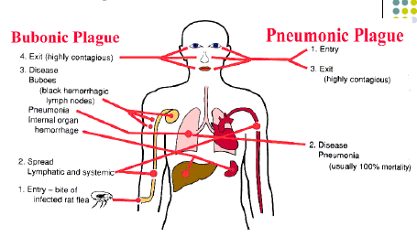

Slide 16
Antimicrobial susceptibility:
Shows susceptibility to several agents:
Gentamycin
Chloramphenicol
Tetracycline

Slide 17
Prevention
Control of fleas and rats
Control of rodent population in wild and domestic
Construction of houses which are inaccessible to rats
Rat proofing warehouses and dock areas with ship fumigation
Application of insecticides against fleas in human habitats
Periodic surveys of endemic areas

Slide 18
Prevention of spread of infection from patients
Management of suspected patietns or confirmed patients of pneumonic plague to treatment in their own separate rooms
Applying necessary prevention and controlling measures
Vaccination
Not widely available
Provide protection for a short duration so not an effective meeasure

Slide 19
Y.pseudotuberculosis and Y.enterocolitica
Microscopic morphology similar to pestis
Y.Pseudotuberculosis is slightly acid fast
Both species are motile when grown at 22oC
OCURENCE
Y.Pseudotuberculosis is a primary pathogen of animals and fowl
Y.enterocolitica is a primary pathogen of swine, goats, cattle, horses, rodents and household pets

Slide 20
Clinical significance
Infections mostly acquired from ingestion of contaminated food
Manifestation are related to inflammatory processes in GIT
Difficulty in differentiation of the causative agent between the two
Infection associated with bactereamia

Slide 21
Y. pseudotuberculosis
Causative agent enterocolitis and acute mesenteric lymphadenitis
Mostly encountered in:
Older children
Adolescents
Young adults
Y. enterocolitica
Manifests in:
Gastroenteritis
Fever
Blood and mucus in stool
Majority of infection in young children and adolescence

Slide 22
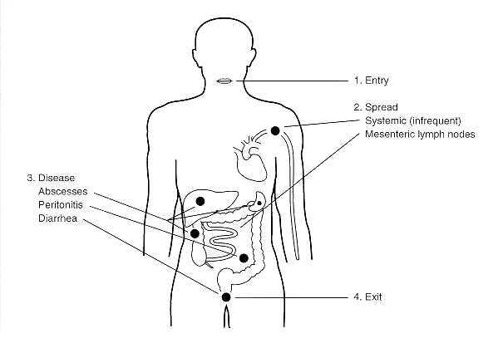
Pathogenesis of Y enterocolitica.

Slide 23
Antimicrobial susceptibility
Susceptible to Agents eg:
Chloromphenical
Cotrimoxasole
Ciprofloxacin
Tetracyclin
Mild infections don’t require antibiotics

Slide 24
Lab investigations of Yersinia
Specimens:
Contain numerous bacilli
Transported and handled with necessary precautions
Include; Fluid aspirates from bulboes, Sputum, Blood culture, Infected tissue aspirates, Stool, Lymph nodes aspirate.
Gram stain and microscopic investigations:
Stain and morphology to demonstrate coccobacilli with bipolar staining

Slide 25
Culture
SBA or MAC(NLF)
Incubation – in air , better growth in 27 – 38 degrees for 24 – 48hrs
Colonies – small transparent initially enlarge to 3 – 4 mm with prolonged incubation
Facultative anaerobe
Wayson’s stain for Y.pestis -hairpin appearance i.e. both ends are stained.
Motility tests
Y pestis immotile at 18-22ºC
Y.enterocolitica and Y.Pseudotuberculosis are motile at 18-22oC
Y enterocolitica isolation from fecal specimen can be facilitated by keeping specimen at 4ºC for 3 weeks and culturing from time to time.This cold temp favours their growth-not other bacteria that may be present in the specimen.
Biochemical tests
Oxidase negative

Slide 26
Y.pestis Wayson's stain

Slide 27
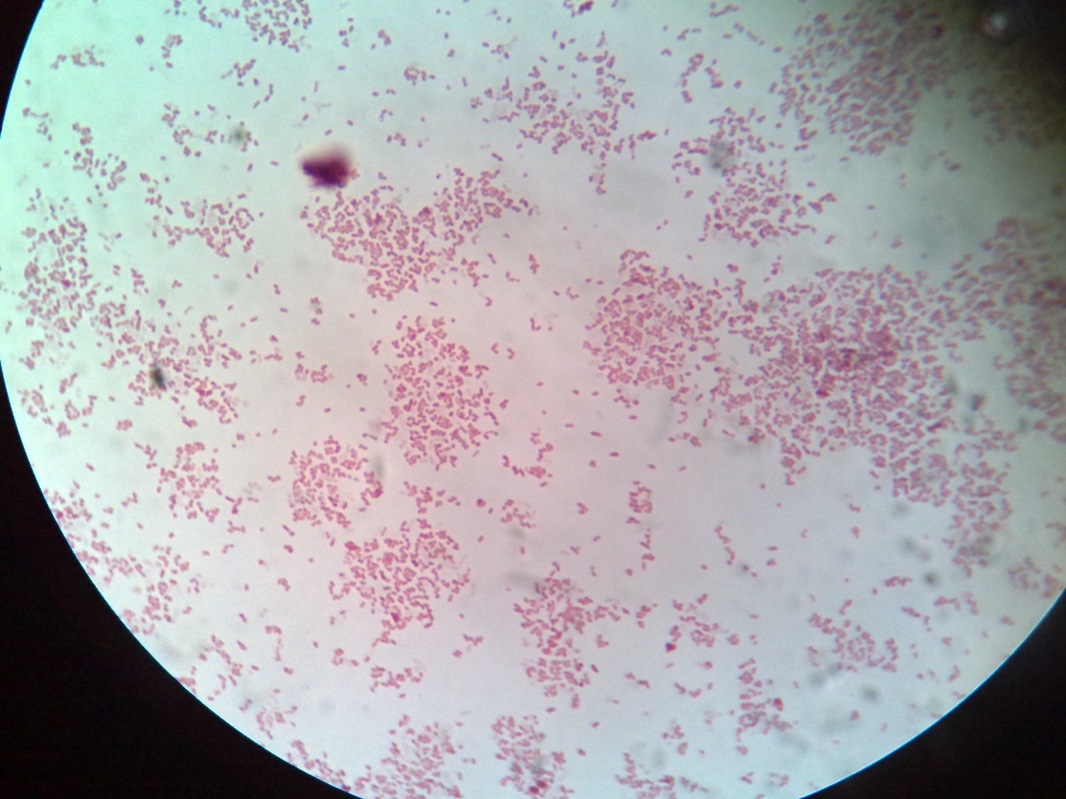
Y. enterocolitica

Slide 28
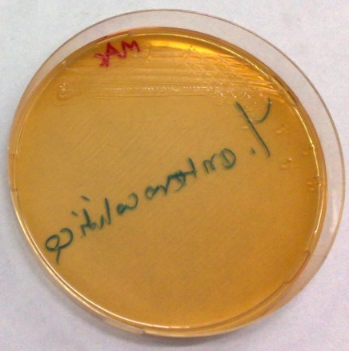
Y.enterocolitica on MAC
Y.enterocolitica on BA

Slide 29
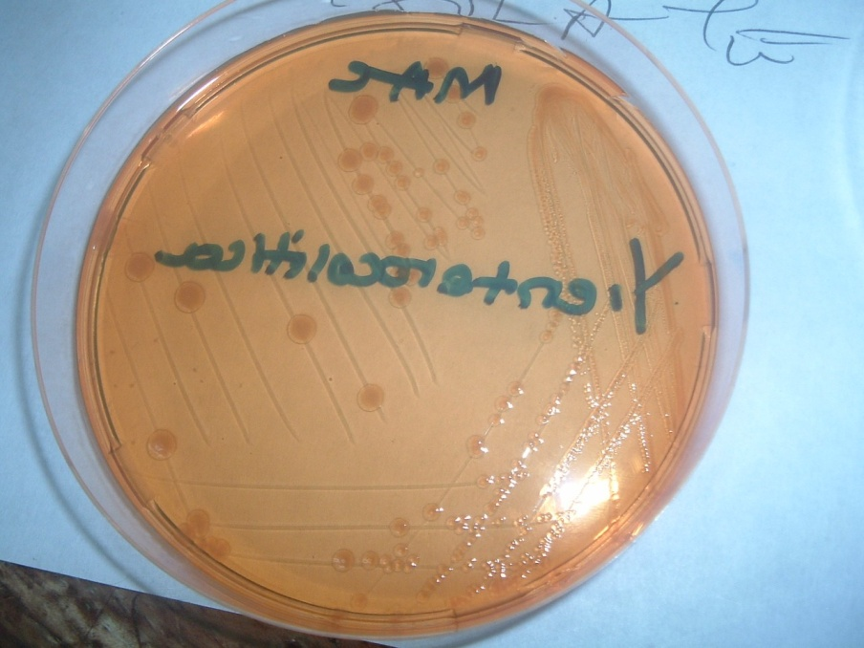
Yersinia Cultures

Slide 30
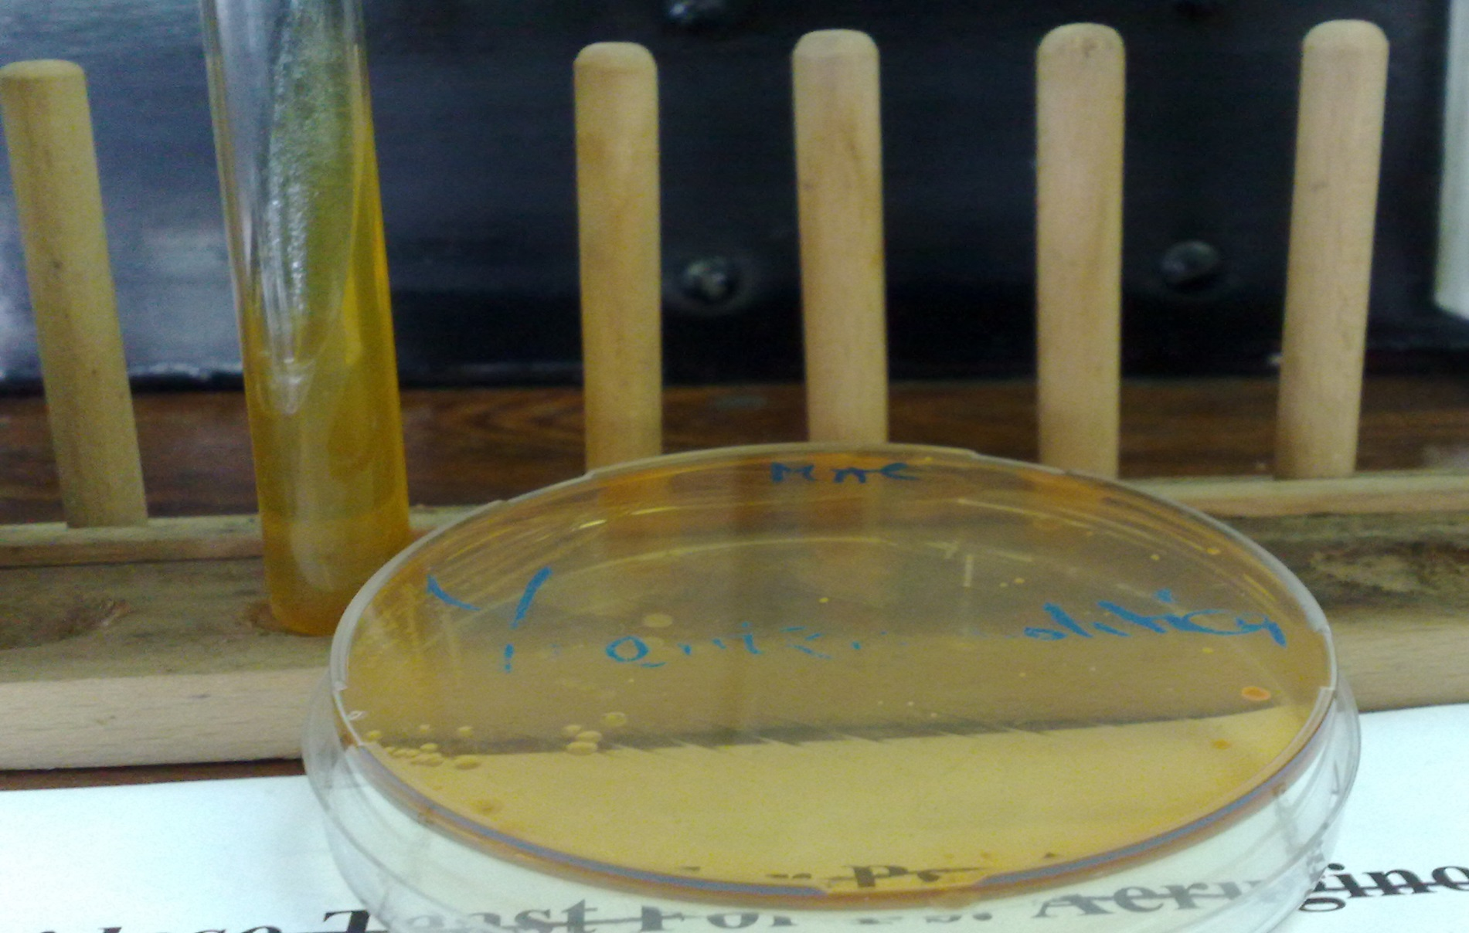
Y.enterolitica on MAC & TSI

Slide 31
Y.enterocolitica on KIA
Slant = Red
Butt = Yellow

Slide 32
Yersinia enterocolitica on TSI
Slant = yellow
Butt = yellow
No gas *test done late hence red bottom

Slide 33
Pasterilla multicoda
Normal flora of Upper respiratory tract of dogs and cats
Similar microscopic characteristics to Yersinia
Capsulated and non-motile
Transmission to man through
Animal bite(mainly)
Contamination related to other forms of trauma
Main clinical manifestation is due to wound infection and spread to adjacent tissue
Lab investigations: involves isolation from pus obtained from the wound and identification
Susceptible to penicillin and tetracycline

Slide 34
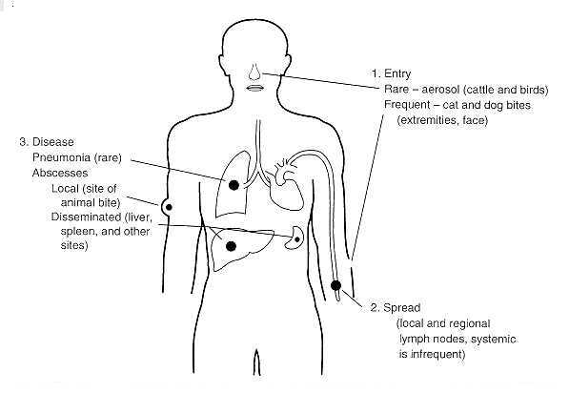
Pathogenesis of p Multocida

Slide 35
Francela tularensis
Primarily Animal pathogen
Human infection from
Bite scratch from infected animal
Contact with tissue of diseased animal tissue
Contaminated animal products

Slide 36
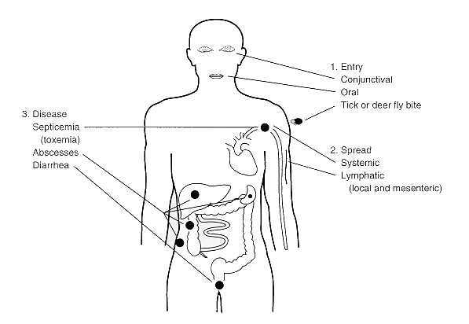
Pathogenesis of F tularensis.

Slide 37
Clinical manifestations
Variable including
fever, illness with enlarged lymph nodes
Skin ulcer
Lower respiratory tract infections
Lab investigation involves
Isolation from specimens
Serology
Susceptible to
CLORAMPHENICAL
GENTAMYCIN
ERYTHROMYCIN

