Slide 1
MYCOBACTERIA
KIMAIGA H.O
MBChB (University of Nairobi)

Slide 2
Introduction
Order: Actinomycetales
Family: Mycobacteriaceae
Genus: Mycobacterium
More than 80 species of mycobacteria
2 are major pathogens
Mycobacterium tuberculosis (Koch’s bacillus)
Mycobacterium leprae (Hansen’s bacillus)
The rest are environmental organisms - collectively known as MOTTs (Mycobacteria other than Tuberculosis) or NTM (Non-Tuberculosis Mycobacteria)
Cause opportunistic infections

Slide 3
Classification
Runyon group | Species | Disease
A. Obligate parasites (non-cultivable) | M.leprae M.lepraemurium | Human leprosy In rats
B. Cultivable (4-6/52) | M.tuberculosis M.bovis M.ulcerans (grows best at 30°C) | TB in man TB in man and cattle Buruli ulcer
Atypical : Group I: photochromogens | M.kansasii M.marinum (30°C) M.simiae | TB-like Swimming pool granulomas TB-like

Slide 4
Group II: scotochromogens | M.scrofulaceum M.szulgai,M.gordonae M.flavescence,M.xenopi | Granulomatous cervical adenitis Not associated with disease in humans
Group III: non-pigmented | M.avium-intracellulare complex M.gastrii, M.malmoense, | TB-like , pulmonary dx in pt with bronchitis, emphysema
Group IV: Rapid growers (2-5/7) | M.fortuitum-chelonei complex M.smegmatis M.abscessus M.phlei, M.vaccae | Skin and soft tissue infections in immunosuppressed pts, prosthetic hip joints, indwelling catheters Normal flora of smegma Chronic lung infxn, skin, bone

Slide 5
General characteristics
Slim, rod-like and Acid fast i.e Retains carbolfuchsin and do not decolorize with acid & alcohol once stained with aryl methane dyes. Has a modified Gram positive cell wall
Non-motile, Non-sporing, Non-capsulated
Obligate/ Strict aerobes
M.bovis - reduced O₂ tension

Slide 6
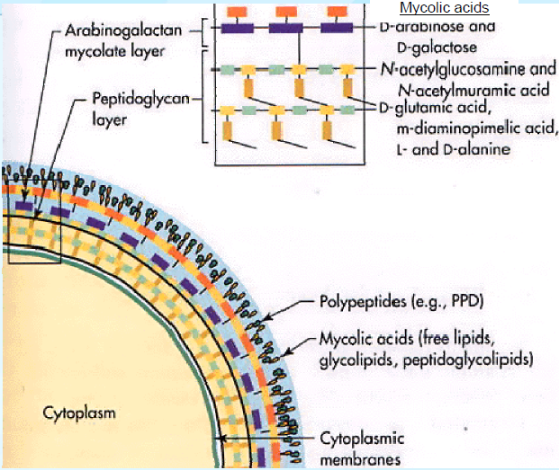

Slide 7
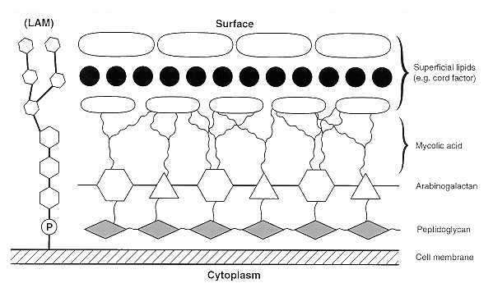

Slide 8
Sensitive to UV-light, sunlight, heat at 60-80°C for 30 min, boiling
Cell wall has peptidoglycan but 60% is lipids
Cell wall has N-glycolylmuramic acid instead of NAM and contains;
Mycolic acid
Cord factor
Wax-D
Do not produce exotoxins or endotoxins
Disease process largely a result of delayed type hypersensitivity reaction to mycobacterial proteins
Elicit a granulomatous response
Chronic course of disease

Slide 9
Human strains show heavy growth on culture (eugonic) while bovine strains show poor growth (dysgonic) on glycerol containing media. M.bovis better on pyruvate enriched media
Properties conferred by high lipid content (60%)
Impermeability to stains and dyes
Resistance to many antibiotics
Resistance to killing by acidic and alkaline compounds
Resistance to osmotic lysis via compliment deposition
Resistance to lethal oxidations and survival inside of macrophages

Slide 10
M.tuberculosis
Statistics
8.8 million incident cases of TB globally
1.45 million deaths
1.1 million incident cases in this year were in HIVpositive patients
1.1 million deaths were from TB among HIVnegative patient.
Asia contributed 59% of TB cases
African region came second contributing 26%
Kenya is one of the 22 countries most affected by TB in the world
WHO Global TB Control report

Slide 11
Causes tuberculosis
M.tuberculosis is a member of the M.tuberculosis complex
Closely related species; all cause TB
M.tuberculosis - Human TB
M.bovis - TB in cattle
M.africanum - Human TB
M.canetti - Rare variant with smooth colonies
M.microti - Voles and other small mammals
M.caprae - Goats
M.pinnipedii - Sealions, seals

Slide 12
Characteristics of M.Tuberculosis
Slim, acid-alcohol fast rod (straight or bit curved bacilli)
Non motile, non sporing, non capsulated
Strict/Obligate aerobic
Grows at 35-37°C and 5-10% CO2.
Facultative intracellular bacteria
Heat sensitive; destroyed by pasteurization
Sensitive to UV-light
Susceptible to alcohol, formaldehyde, gluteraldehyde
Less susceptible to hypochlorites & phenolic disinfectants

Slide 13
Resistant to alkalis, acids and quaternary ammonium compounds
Able to survive in dried expectorated sputum
Cell wall has complex lipids
Mycolic acid
Wax D - used to enhance immune responses to many antigens in vaccines
Phosphatides - role in caseation necrosis
Lipids confer:
Hydrophobic nature
Acid fastness (resistant to decolorization by acid or alcohol after staining with carbol fucshin or other aryl methane dyes)
Proteins which combined with waxes elicit delayed hypersensitivity (PPD)

Slide 14
Contributors to virulence
Intracellular growth
Detoxification of oxygen radicals
Slow generation time (15-20 hrs)
High lipid content in cell wall
Cord factor (trehalose 6, 6’ dimycolate) thought to induce growth in serpentine cords on artificial medium)

Slide 15
PATHOGENESIS
Modes of transmission
Droplet infection (Primary infection)
Person to person by inhalation aerosols
Coughing, sneezing, talking
M. tuberculosis(Pulmonary tuberculosis)
Ingestions of milk
Infected cattle
M bovis (Intestinal tuberculosis)
Contamination by abrasion
Laboratory workers (Skin infection)

Slide 17
The bacilli are deposited in the alveoli of the lungs, where they are engulfed by alveolar macrophages.
A portion of the infectious inoculum resists intracellular destruction and persists, eventually multiplying and killing the macrophage.
The ability of virulent mycobacteria to survive within phagocytes justifies their designation as facultative intracellular pathogens.
In addition, some of the components of the mycobacterial cell wall (e.g., cord factor) may be directly cytotoxic to macrophages.
Most of the tissue destruction associated with tuberculosis results from cell-mediated hypersensitivity.

Slide 18
Eventually, the accumulating mycobacteria stimulate an inflammatory focus which matures into a granulomatous lesion characterized by a mononuclear cell infiltrate surrounding a core of degenerating epithelioid and multinucleated giant (Langhans) cells.
This lesion (called a tubercle) may become enveloped by fibroblasts, and its center often progresses to caseous necrosis.
Liquefaction of the caseous material and erosion of the tubercle into an adjacent airway may result in cavitation and the release of massive numbers of bacilli into the sputum.
In the resistant host, the tubercle eventually becomes calcified.

Slide 19
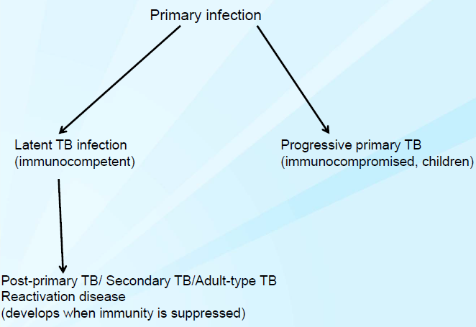

Slide 20
Primary infection
M.tuberulosis is transmitted by aerosols (produced by coughing, sneezing or talking)
It reaches the terminal airways and is engulfed by alveolar macrophages
The bacteria inhibit phagolysosome formation & multiply, alkalinize intra lysosomal enzymes; resistant to oxidative killing
The macrophages are destroyed, release the bacteria which infect other macrophages
Circulating macrophages are attracted to the infection site and engulf M.tuberculosis cells

Slide 21
Infected macrophages may spread the bacteria throughout the body e.g bone marrow, spleen, kidneys, CNS
Adaptive immune system
Localization in lungs:
Tubercles - granulomas that heal but still contain viable Mycobacterium tuberculosis in calcified areas
Ghon focus - a calcified tubercle in the middle and lower lung
Some bacilli are carried to hilar lymph nodes causing granulomatous lymphadenitis
Ghon focus + enlarged hilar LNs = primary complex
M.bovis
Drinking milk - primary complex in tonsils & cervical LNs (scrofula) or in the intestines and mesenteric LNs
Inhalation - PTB (pulmonary TB)

Slide 22
Complications of primary disease
Airway obstruction by hilar LN
Segmental TB
Bacteremia & miliary TB
Pulmonary haemorrhage

Slide 23
Secondary infections
Bacilli may remain dormant for years; controlled but not eradicated by host
Any change in host immune defenses especially in CMI (cell mediated immunity) → secondary infection e.g due to age, degenerative disease (diabetes), immunosuppressive conditions &/or therapy, alcoholism, malnutrition e.t.c
Increased numbers of bacilli lead to an increase in the host immune response: complement, TNF, damage from enzymes released by macrophages

Slide 24
M.tuberculosis may infect many organs: kidney, bones, brain, bowel
Lungs are most commonly infected. The bacteria spread through the lungs, causing local necrosis and damage of blood vessels
Symptoms include night sweats and cough producing sputum with M.tuberculosis
Progressive primary TB & post-primary TB

Slide 25
Progressive primary TB
Develops directly form primary lesion without a latent phase
In immunocompromised and young children
Usually lower lobes
Disseminated disease

Slide 26
Post-primary TB
Due to either reactivation of latent foci of infection or exogenous reinfection
Reactivation may be kept under control with intact immune system
Immunocompromise will cause infection: diabetes, cancers, and other disease that would render immunocompromisation: alcoholism, malnutrition
Increase numbers of bacili lead to an increase kin the host immune response: complement tumour necrossi factor, damage form enzymes
Often occur in upper lobes of the lungs and other well oxygenated sites - kidney, brain, bone

Slide 27
Granuloma formation, but with tissue destruction and caseation - tuberculoma
Enlarge and may erode into bronchus discharging its material & leaving a cavity
Spread of bacilli from cavities:
Through bronchus - other parts of lungs
In sputum to larynx
Swallowed SPUTUM- intestinal tract ulcers, anal fistulas
Raptured blood vessels & lymphatics could spread infection to other areas of lungs, other LN through blood stream to other organs

Slide 28
IMMUNITY
After infection, resistance by host is through CMI
Macrophages - directly phagocytose bacilli and act as APCs, production of cytokines
CD4+ T-cells - production of cytokines
Tuberculin testing - Mantoux test, Heaf test (PPD)
Positive - induration not erythema
Indicates exposure, false positive in NTM infection
Negative - excludes infection, but false negative in severe TB infection, malnutrition, AIDS, corticosteroid use e.t.c

Slide 29
TB & HIV
HIV/Tb infection - TB can occur at any stage of HIV infection; TB presentation varies with stage
Reactivation rates much higher in HIV +ve
TB more aggressive in HIV +ve
EPTB (extra pulmonary TB) - more common in HIV patients
Diagnostic problems in patients with co-infection
Increased frequency of smear negative
Atypical radiographic findings
Lack of granuloma formation in late stages
Negative results on PPD skin tests

Slide 30
Latent TB infection (LTBI)
LTBI is the presence of M. tuberculosis organisms (tubercle bacilli) without signs and symptoms or radiographic or bacteriologic evidence of TB disease
The annual risk of developing active disease is 5-15%
Lifetime risk increases to approximately 50% in HIV-co infected individuals

Slide 31
Pulmonary TB-Like disease is commonly associated with
M. kansasii
M. avium-intracellulare
M. simiae

Slide 32
Extrapulmonary TB
Bone and joint TB
Tuberculosis meningitis (TBM)
Tuberculomas
Abdominal TB
Tuberculous lymphadenitis
Urinary TB
Genital tract TB
Skin TB- scrofuloderma
TB pericarditis
TB laryngitis
Ocular TB
Adrenal gland TB- hypoadrenalism of Addison’s disease

Slide 33
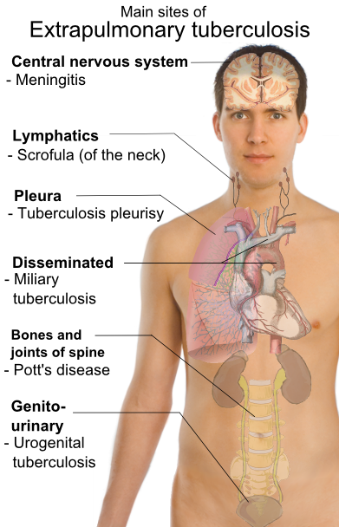

Slide 34
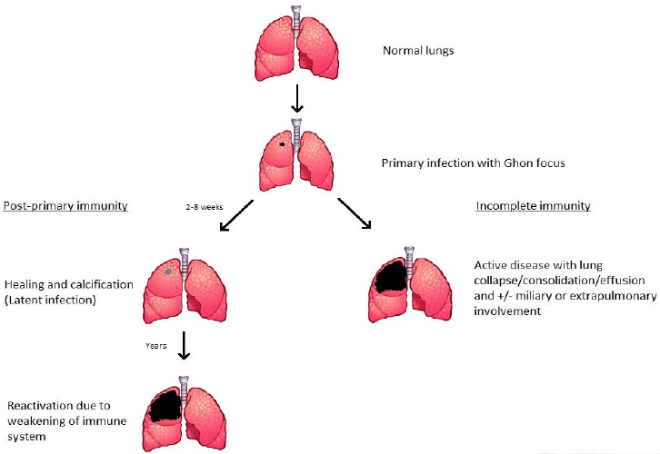

Slide 35
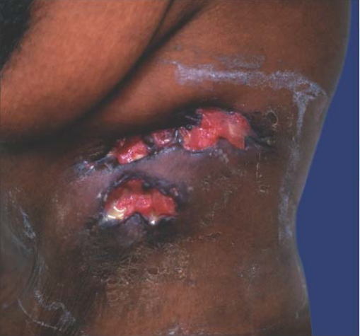
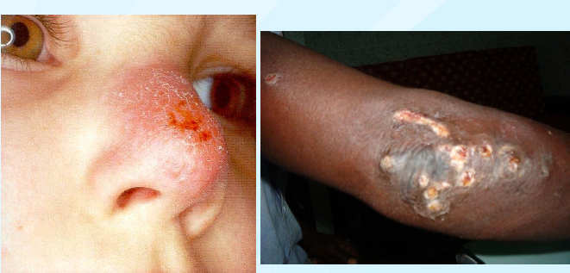
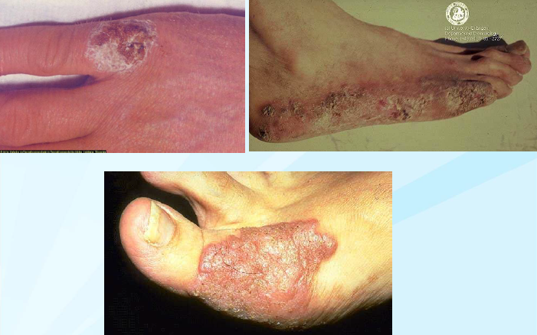

Slide 36
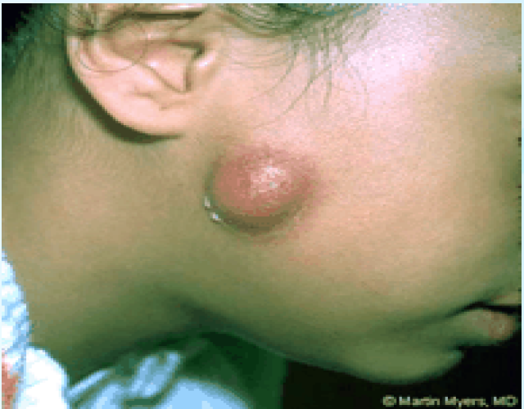
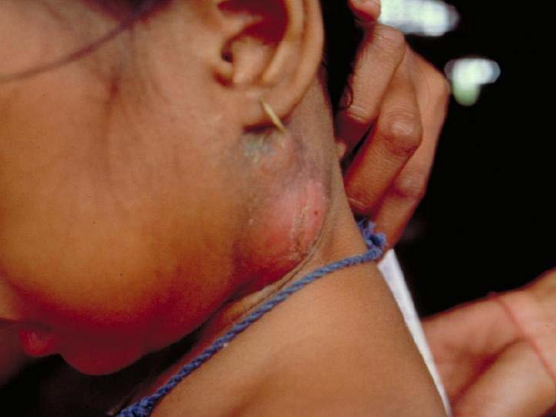
Scrofula
A cervical lymphadenitis
Source: Environmental, water sources, human respiratory tract
Chronic painless mass in the neck - known as cold abscess
In children agent M.scrofulaceum
Surgery, usually resistant to antibiotics
In adults agent is M.tuberculosis
antiTB drugs, surgery may spread disease

Slide 37
Clinical manifestations
Weight loss ≥10%
PTB - low grade fever, malaise, night sweats, chest pain, chronic cough (>2/52), hemoptysis
EPTB - fever; the rest depend on the site - skeletal TB, genital tract TB, urinary tract TB, CNS TB, GIT TB, adrenal TB, cardiac TB

Slide 38
Lab diagnosis
Specimen
Sputum
Pleural fluid
Gastric washings
Urine (remember to neutralise),
Aspirates
CSF
Tissue biopsies
Pathological material

Slide 39
Staining of specimen using
Ziehl-Neelsen (ZN) stain - acid fast bacilli (AFBs) - red bacilli on a blue (methylene blue counter stain) or green (malachite green counter stain) background
Kinyoun staining
Fluorescence microscopy using auramine O or rhodamine stain - fluorescent microscope

Slide 40
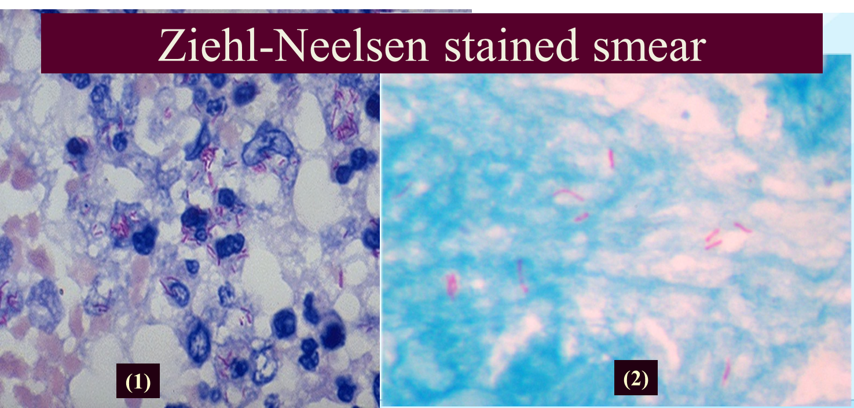
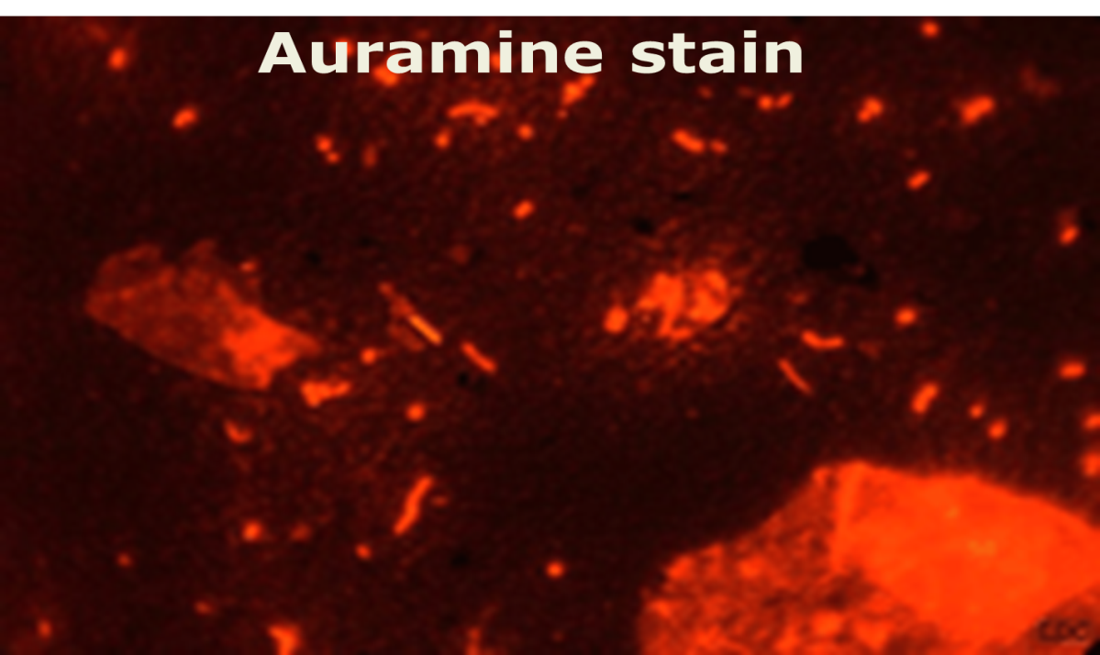
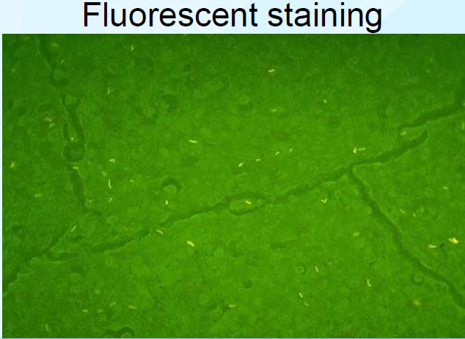

Slide 41
CULTURE MEDIA
Requires enriched culture media
Lowenstein-Jensen (LJ) medium; selective media for Mycobactria tuberculosis. Contains
Malachite green - inhibits growth of contaminants
Glycerol (source of carbon)
Egg yolk, serum, tissue extracts, citrate, potato starch
Aspergin (nitrogen source)
Agar based media or broth - enriched with bovine serum albumin - automated culture system
Gold standard in TB diagnosis/ Primary isolation on a solid culture medium may take 6-8 weeks incubation
Obligate aerobe

Slide 42
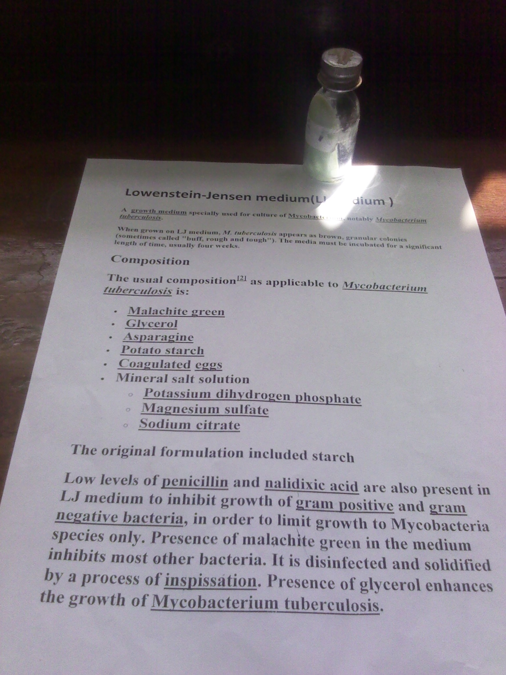

Slide 43
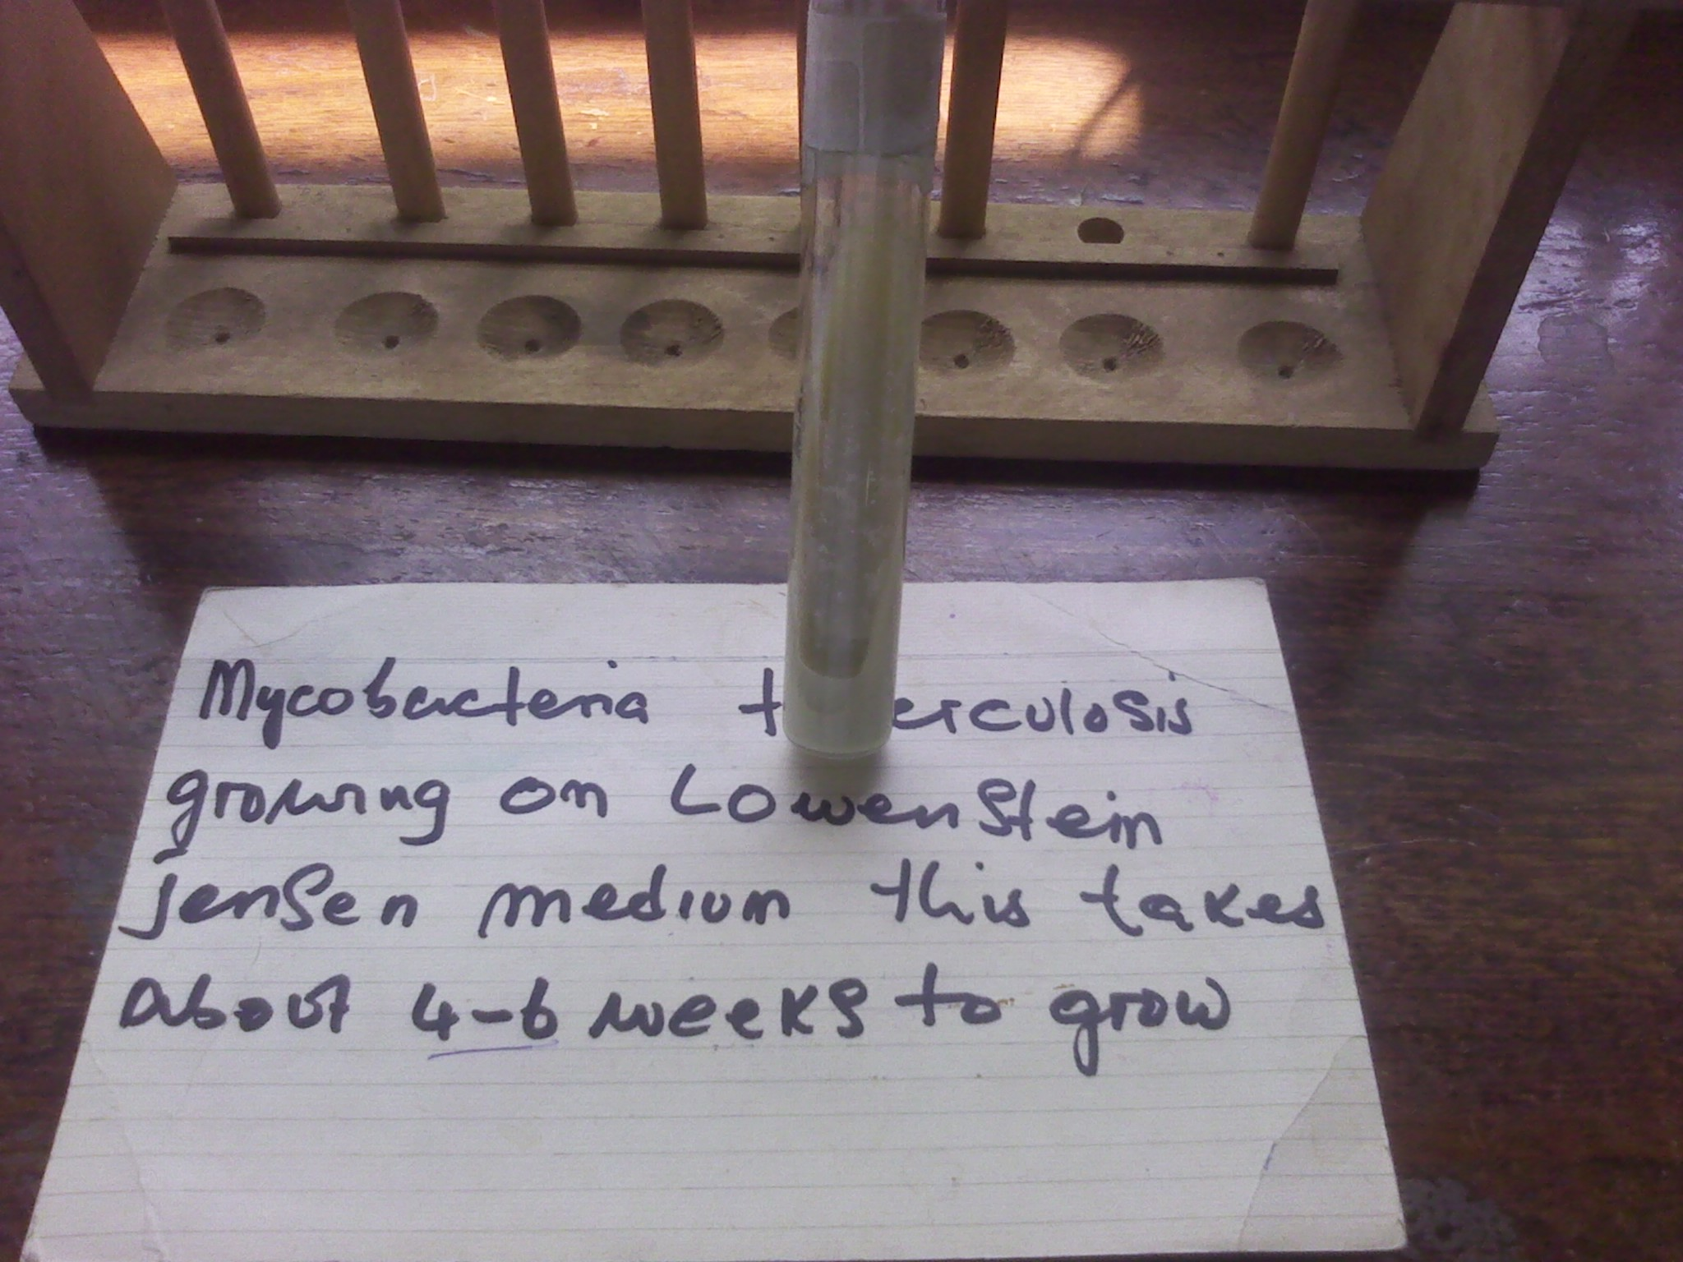
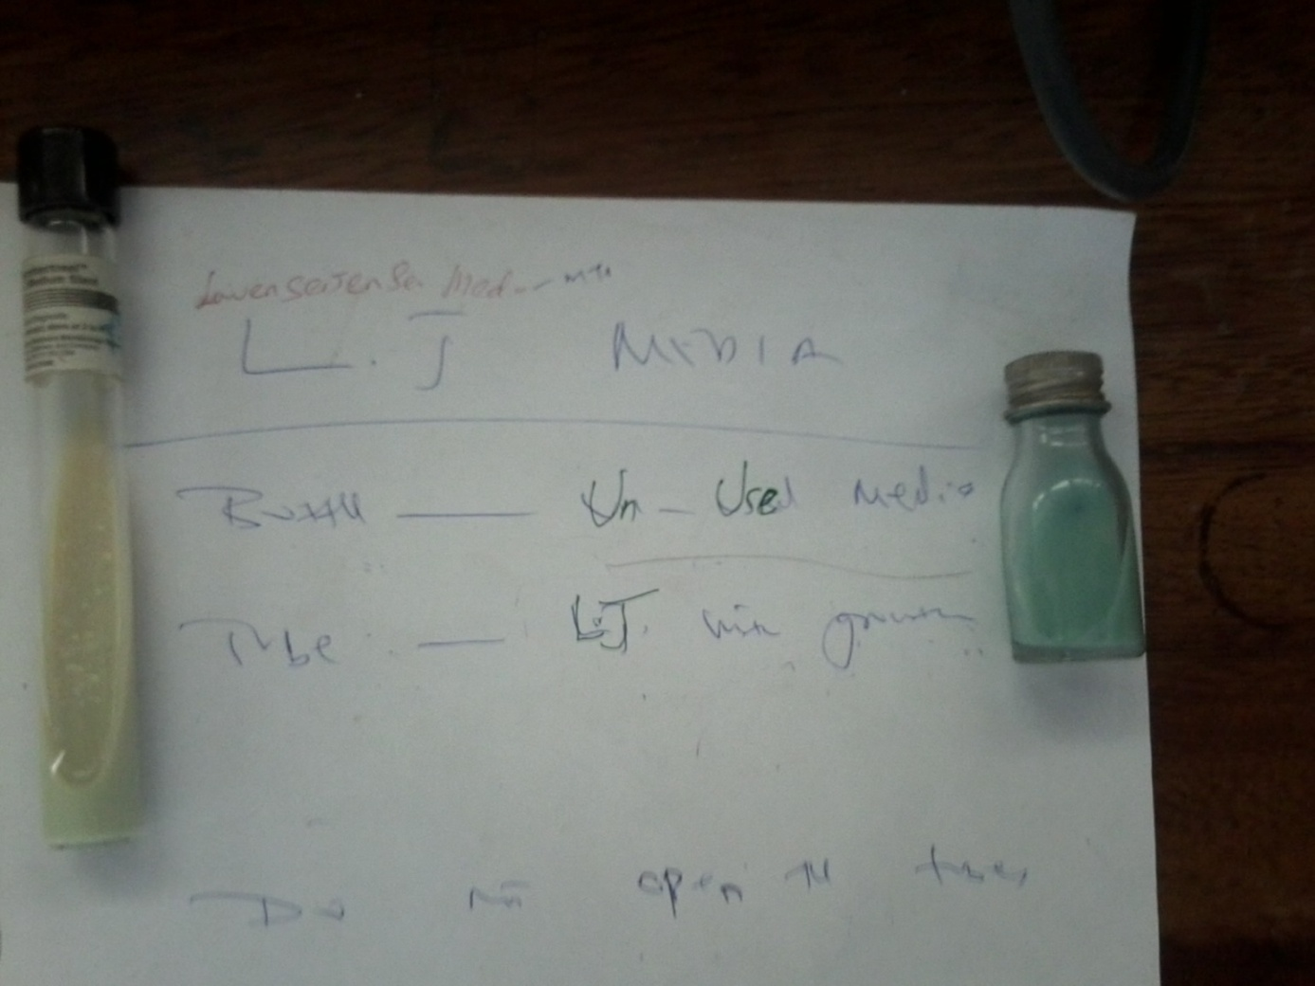

Slide 44
Culture
Conventional media – LJ, Middlebrook media (7H10 and 7H11), liquid media (Dubos oleic-albumin medium)
Modern
Automated radiometric culture – BACTEC
Non-radiometric, biphasic broth-based system –SEPTICHEK
Automated liquid systems MGITs (Mycobacterial growth indicator tubes)
Liquid cuulture: (Middle brook 7H12)
Semi automated liquid culture (Bactc 460)
No gold standard for diagnosis of LTBI

Slide 46
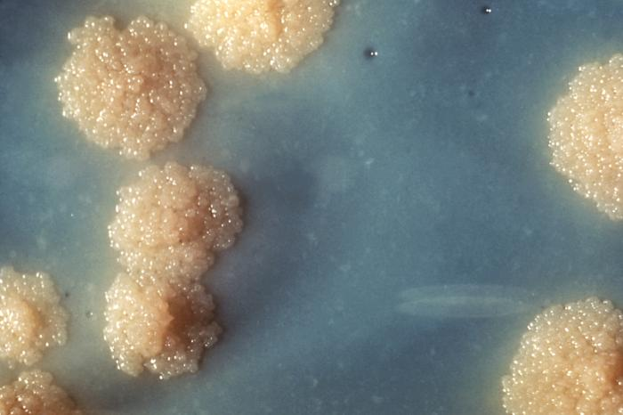
Colony appearance
M.Tuberculosis are rough, thick, wrinkled have an irregular margin and are faintly buff-colored
M.canetti - smooth, white, glassy colonies

Slide 47
To confirm M.tuberculosis from culture
Growth rate, Slow growth → solid
Colonial morphology → solid
Ziehl Neelsen staining results
Nitrate reductase test - +ve → -ve for M.bovis
Niacin test, +ve → -ve for M.bovis
Catalase at 68⁰ C – Negative
Aryl sulfate test
Addition of NAP (p-nitro-acetyl-amino-hydroxy-propiophenone) inhibits growth of M.tb complex – M.tb, M.bovis & M.africanum
DNA probes
Chromatographic analysis (cell wall lipids)
Colonies from conventional solid media
Thin-layer chromatography
Gas-liquid chromatography
High-performance liquid chromatography

Slide 48
Molecular techniques
PCR - from culture; some direct from sputum
Immunological diagnostic tests
Tuberculin skin test (TST) - does not distinguish between vaccination & disease. Usually negative in patients with advanced AIDS
QuantiFERON, T-SPOT TB - Detect Interferon γ. For active and latent TB

Slide 49
Treatment
1st line - isoniazid, rifampicin/rifabutin, ethambutol, pyrazinamide, streptomycin
2nd line - para-amino salicylic acid, cycloserine, quinolones (ofloxacin/ciprofloxacin/levofloxacin e.t.c), amikacin, kanamycin, capreomycin, ethionamide

Slide 50
Drug susceptibility testing (DST)
Conventional methods
Resistance ratio method
Absolute concentration method
Proportion method
BACTEC 460® radiometric method
Molecular methods
Genotypic- Identify gene mutations associated with resistance to individual drugs e.g katG (catalase peroxidase gene)& inhA genes - isoniazid; rpoB gene - rifampicin; pncA - pyrazinamide; embA & embB for ethambutol

Slide 51
Microscopy observation drug susceptability assay (MCIS)
Interferon-γ release assays
QuantiFERON- TB Gold
T-SPOT TB (ELISPOT)
Hexagon TB

Slide 52
Challenges with TB
HIV
↑ susceptibility to infection
Clinical presentation and dx
Diagnosis
HIV
Children
LTBI
Dug resistance
Multi-drug resistant TB (MDR TB): resistant to at least rifampicin & isoniazid
Extensively drug resistant TB (XDR TB): MDR strains that are also resistant to a fluoroquinalone & at least one of the three 2nd line injectable agent (amikacin, kanamycin or capreomycin)

Slide 53
Prevention and control
Vaccination with BCG (Viable, attenuated strain of M bovis, called Bacille Calmette-Guérin)- variable results
Contraindicated in patients with AIDS
Prompt detection of cases and effective Rx
Isolation of persons with suspected TB until non-infectious
Follow up or trace contacts of cases
Ventilation of household
Nutrition
Chemoprophylaxis
Reducing overcrowding

