Slide 1
NONTUBERCULOUS MYCOBACTERIA
KIMAIGA H.O
MBChB (University of Nairobi)

Slide 2
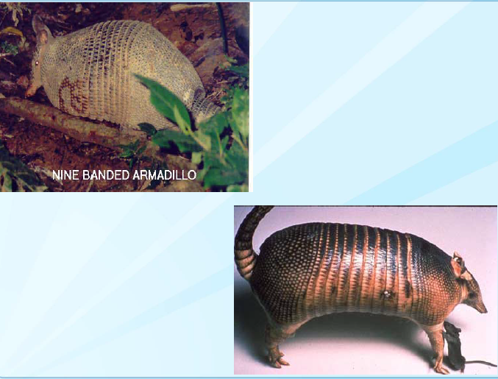
Mycobacterium leprae
Obligate intracellular organism
Causes leprosy (Hansen’s disease -1894)
Not affected by HIV
Not grown in artificial culture but can be grown in the mouse pad or in the armadillo
Reservoir - infected humans, low infectivity
Transmission: skin-to-skin contact
Bacteria grow best and infect cooler areas of the body (skin, peripheral nerves, anterior chamber of eye, upper respiratory tract,ears, nose, eyebrows, fingers, toes, testes)
Incubation period - years to decadesM leprae-Diagnosis is clinical-cannot be cultured.

Slide 3
Classification
Ridley-Jopling classification:
Depending on host response
Tuberculoid leprosy (TL)
Borderline tuberculoid (BT)
Mid borderline (BB)
Borderline lepromatous (BL)
Lepromaotus leprosy (LL)

Slide 4
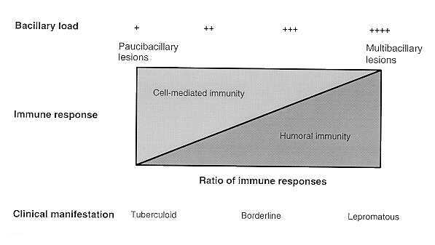

Slide 5
Tuberculoid leprosy
Relatively few or no bacilli because of adequate cell mediated immunity
One or a few anesthetic hypopigmented macules or plaques with well defined borders
Devoid of normal skin organs(sweat glands and hair follicles)-are dry, scaly
Flattened plaques on skin are observed - few well defined lesions
Nerves may be destroyed with loss of sensation and perspiration (Arthur’s phenomenon)
Lepromine test positive

Slide 6
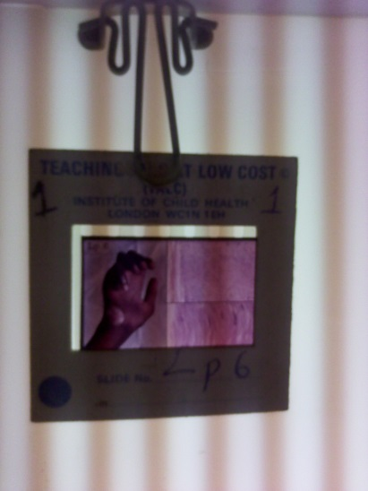

Slide 8
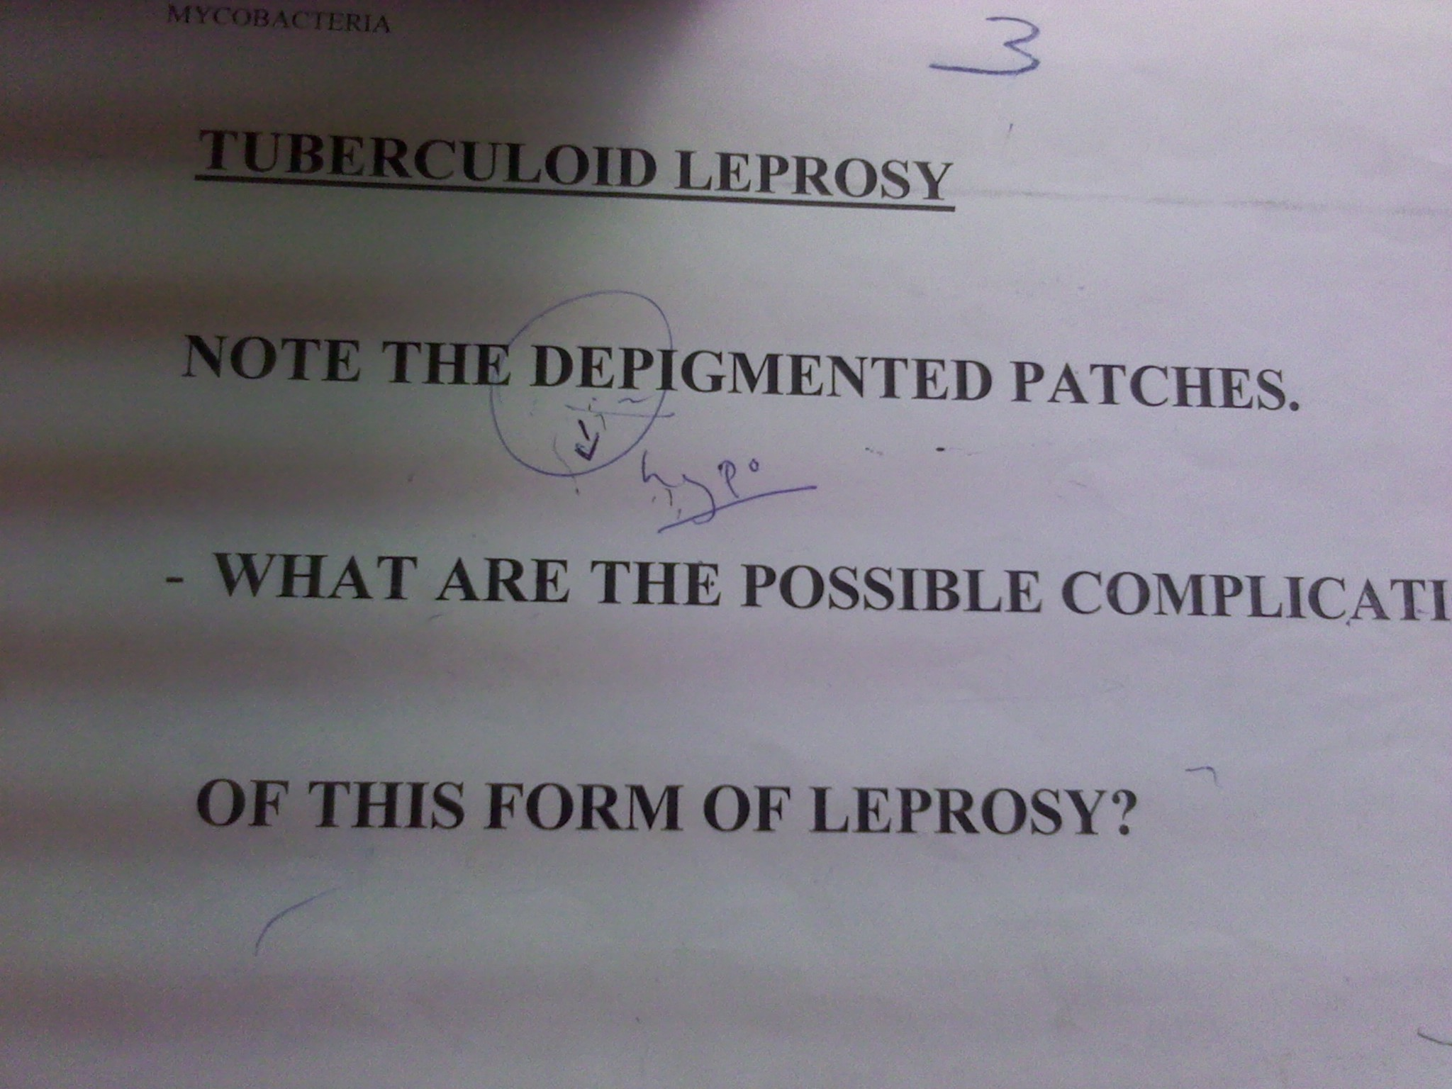
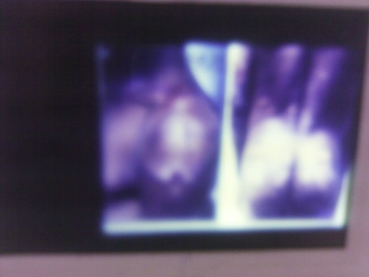

Slide 9
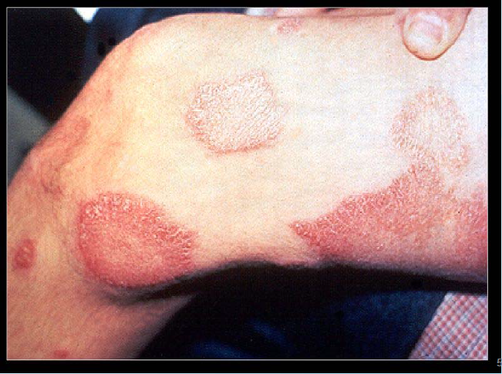
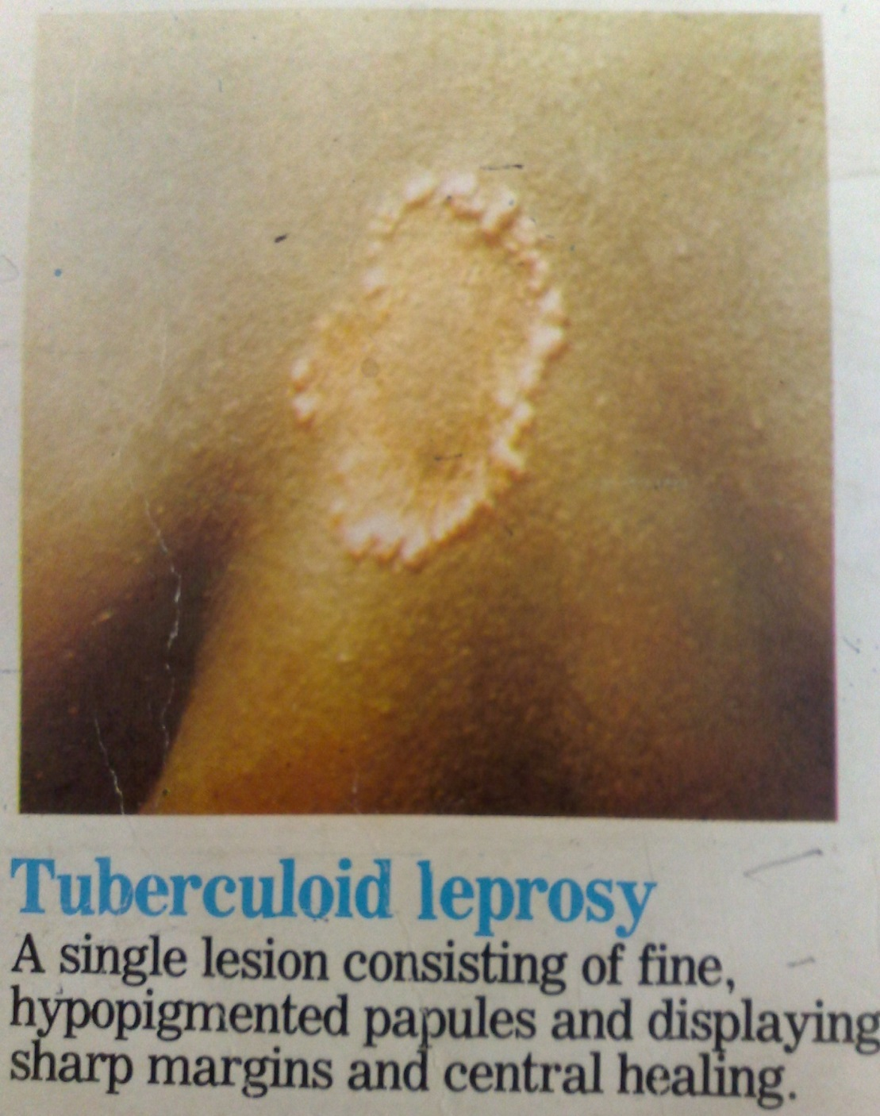
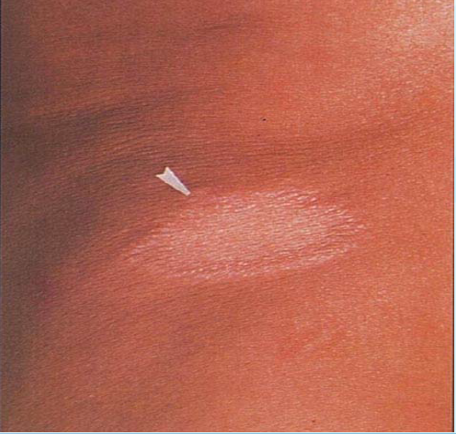

Slide 10
Lepromatous leprosy
Lesions have large number of bacilli even on skin that appears normal - poor CMI
Symmetrically distributed skin lesions/ nodules with poorly defined margins
Nerve damage leads to loss of digits
Late manifestations include loss eyebrows (initially the lateral margins only) and eyelashes and dry scaling skin, particularly on the feet, Leonine facies and testicular damage
Lepromine test negative
Baciliary density – high

Slide 11
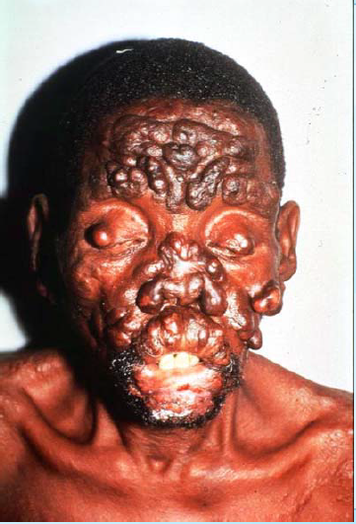
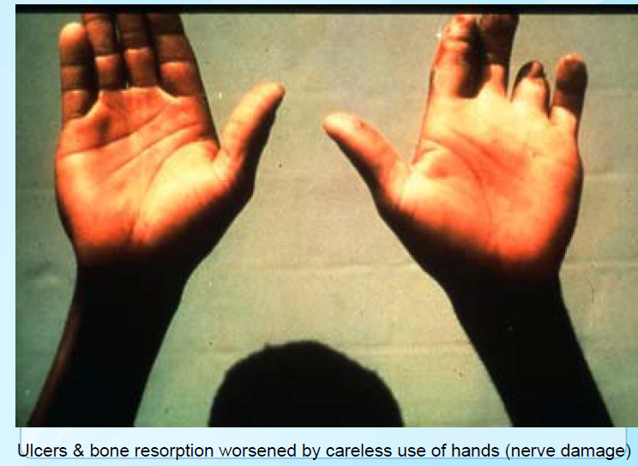

Slide 12
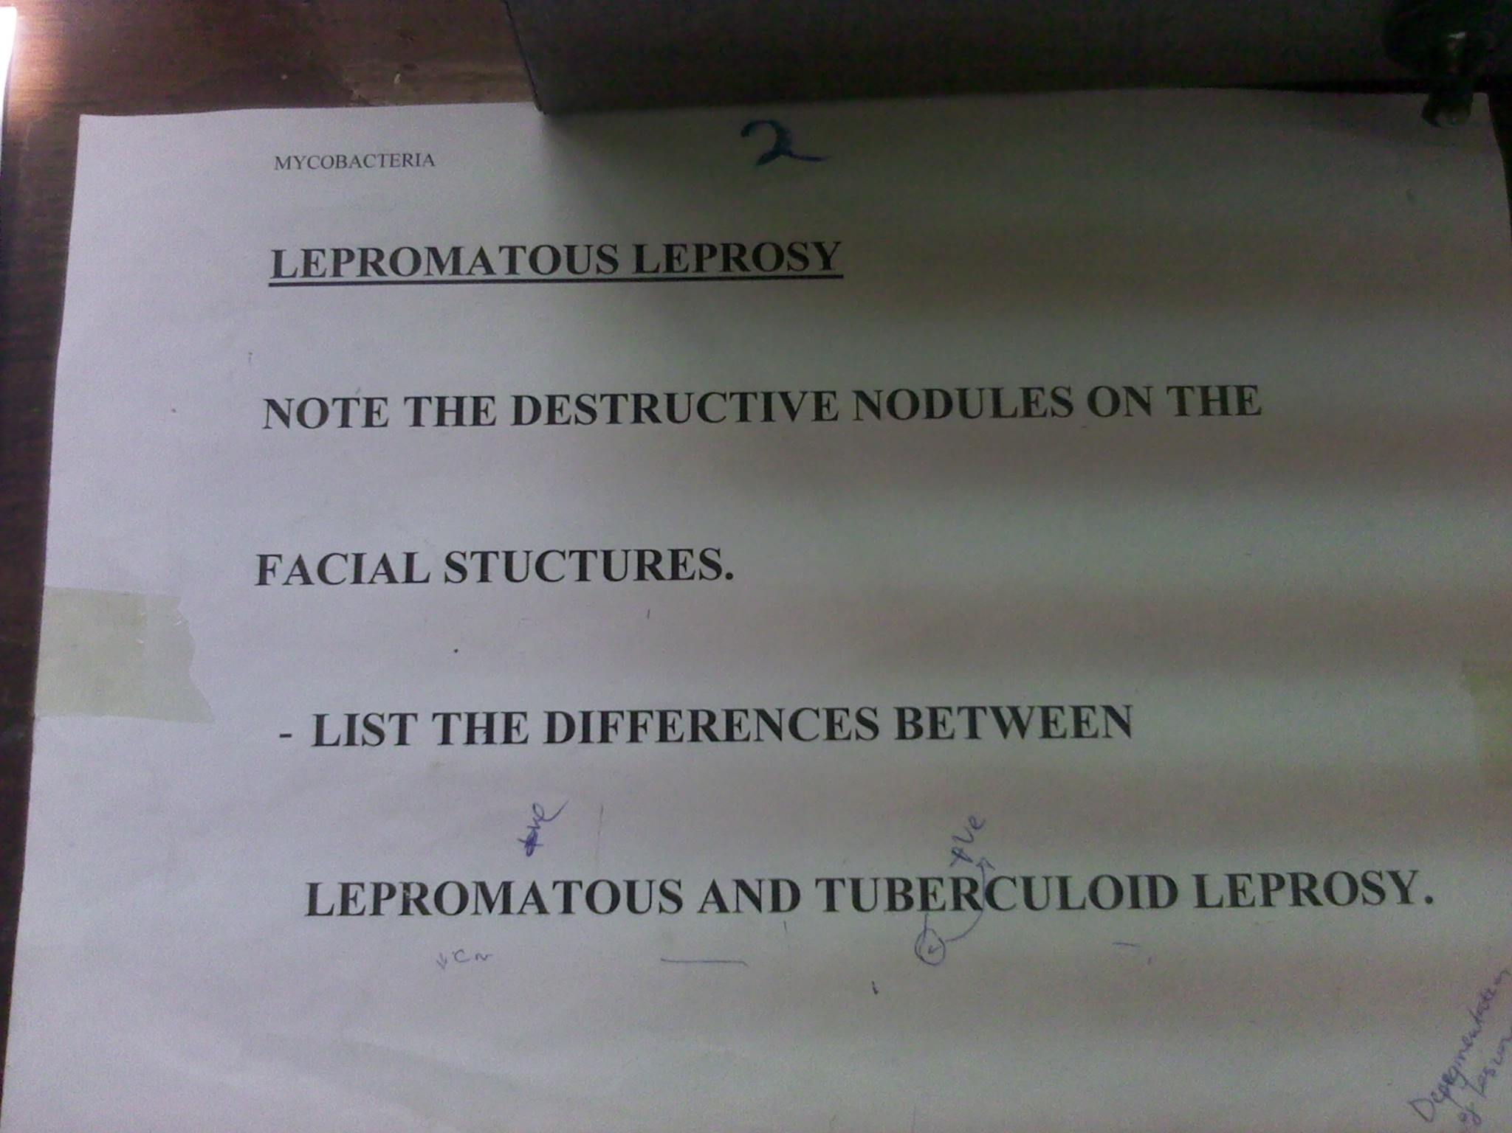
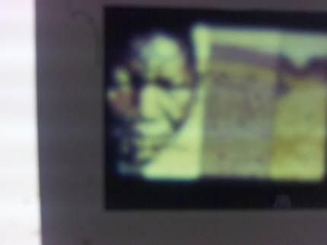

Slide 13
Diagnosis
Specimen - nasal discharge, scrapings from nasal mucosa & slit-skin smears
2 or 3 clinical criteria,Anesthesia of the skin, Thickned peripheral nerves,Typical skin lesions
Slit-skin smear
Tissue fluid exudate examined with Fite stain to determine bacterial index
Punch biopsy of skin
Fitz stain reveals intracellularr bacilli
PCR
ZN II
Histology

Slide 14
Treatment
Dapsone -Mainstay of therapy, but due to resistance use combination therapy with rifampicin, clofazamine in dapsone-resistance
Prothionamide, ofloxacin, clarithromycinor microcycline are options
Treatment is long - at least 3 years

Slide 15
Control
Detection and treatment of infectious cases
Early detection of disease in close contacts
Chemoprophylaxis for exposed children - dapsone
Vaccination with BCG - varying results

Slide 16
M.avium - intracellulare complex
Species are difficult to differentiate
Transmission - inhalation, ingestion
Environmental - soil, water
Causes disseminated infection in immunocompromised hosts
In patients without HIV - main risk factor is underlying lung disease
Presents with pulmonary disease patterns similar to TB
Children - cervical lymphadenitis

Slide 17
Resistant to many antibiotics and antiTB drugs
Combination therapy used
Fairly susceptible to:
Macrolides (clarithromycin, azithromycin)
Rifamycins (rifampin, rifabutin)
Ethambutol, clofazamine, fluoroquinolones, amikacin & streptomycin
Red = 1st line

Slide 18
M.fortuitum - chelonei complex
Post injection and post traumatic abscess
Post surgery - insertion of prosthesis (e.g heart valves); corneal infection after ocular injury
Treatment: amikacin + doxycyclin + surgical excision

Slide 19
M.marinum
Causes swimming pool or fish tank granuloma
Enters through cuts and abrassions aquired while swimming or handling of tropical fish tanks
Development of warty skin lessions
Lesions usually localized but may form secondary lesions along dermal lymphatics - sporotrichoid spread
Self limiting - can use minocycline, cotrimoxazole, or rifampicin with ethambutol

Slide 20
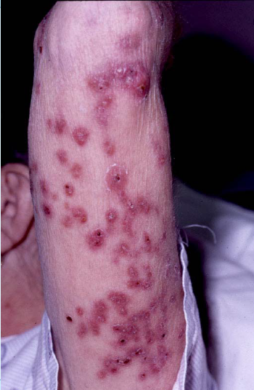
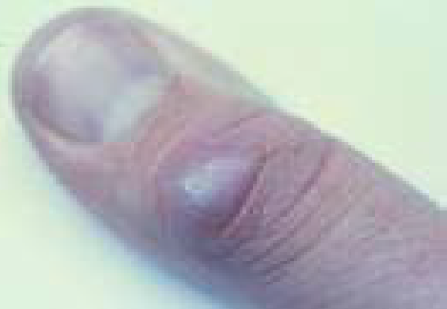

Slide 21
M.ulcerans
Causes Buruli ulcer
Found in low-lying marshy areas, subject to periodic flooding
Pathogenesis
1 subcutaneous nodule
2 vasculities & spreadign celluties
Treatment:
Early, pre-ulcerative lesion - excision and primary closure
Ulcerated lesions - excision & grafting
Antimicrobial agents - variable results
Tissue necrosis due to toxin

