Slide 1
TREPONEMA
KIMAIGA H.O
MBChB (University of Nairobi)

Slide 2
Treponema
Pathogenic & non-pathogenic species
Pathogenic species are:
T. denticola associated with mouth infections
All are similar morphologically and antigenically so they give cross reactions in serological tests
Differentiated by geographical location and clinical manifestations
Organism | Disease
T.pallidum pallidum | Syphilis
T.pallidum endemicum | Bejel & non-venereal or endemic syphilis
T.pallidum pertenue | Yaws
T.carateum | Pinta

Slide 3
Some of the non-pathogenic are normal flora or saprophytes in humans and include:
In the oral cavity
Treponema microdentium
Treponema macrodentium
In the genital tract
Treponema calligyrum
Treponema genitalis
Reiter’s strain – saprophytes
Antigenically related to Treponema pallidum
Growth on artificial medium
require anaerobic incubation
Nichol’s T. pallidum
Used in labs for studies

Slide 4
Growth in the lab
Does not grow on artificial culture media
Propagated by inoculating living microorganisms from lesions into the – testis, skin or eye of a rabbit
Causes no disease in the rabbit

Slide 5
Physical properties
Organisms is rendered non-viable rapidly by drying
Can be preserved in suitable suspending fluids under anaerobic conditions
Susceptible to heat, cold temps (0-4ºC)
Susceptible to some chemicals and penicillin

Slide 6
Antigens
Exact antigenic components are not clearly demonstrated but three distinct antibodies are formed as a result of human infection by T. pallidum
An antibody which reacts with cardiolipin – a lipid compound that can be extracted from beef heart muscle
Also referred to as Wasserman's antibody
Reagin- lipoidophil – anticardiolipin antibody
An antibody which is formed in response to specific antigen contained solely within the treponemes – antitreponemal antibody
An antibody which is formed in response to a specific antigen present in Treponema pallidium and in non pathogenic organism Reiter's treponeme antigen

Slide 7
Clinical significance
Causative agent of disease syphilis in humans
Natural infection is limited to humans
Has become relatively rare but is severe and has long term complications if not adequately treated
Transmission
Mainly sexually transmitted/ venereal disease /STD
Not highly contagious – transmission rate dependent upon stage of disease
Other methods
Infected pregnant female to the foetus
Blood transfusion

Slide 8
Clinical manifestation
Sexually transmitted infection. Organisms enter the new host through broken skin
Multiply at the site of entry
Long incubation period – a time when the individual is non infectious
Manifestations are grouped into four clinical stages:
Primary
Secondary
Tertiary
Late (quaternary)

Slide 9
Primary syphilis
Characterized by
Invasion of mucus membranes
Relatively rapid multiplication of the organism
Dissemination through lymphatics and systemic circulation
Manifests within 2-3 weeks or 10-90 days after exposure
Initial lesion is primary sore or hard chancre
Starts as a papule and commonest site is external genitalia then ulcerates to form a chancre(a painless ulcer with clearly defined margin)
Single lesion – occasionally multiple
Associated with painless enlarged lymph nodes in most cases – some bilateral
Chancre heals spontaneously in 3-8 weeks if untreated although the organisms may not be eliminated.

Slide 10
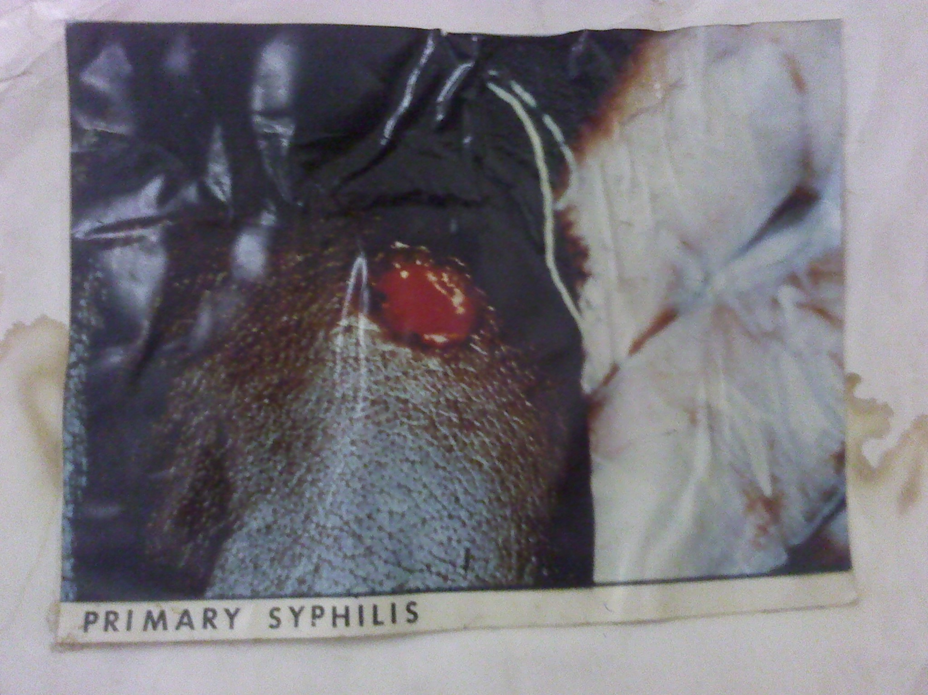

Slide 11
Secondary syphilis
Invasion of the blood circulatory system
Generalized infection – skin rash – lesion on the mucous membranes – ulcers in the oral cavity
Lymph node enlargement
Whitish plaques – possible sites – axilla, groin, perianal region
Coalesce to form wart-like lesions referred to as condylomata lata
Uncommon manifestation – inflammatory processes involving bones, joints and eyes
Lesions contain numerous spirochaetes
Possible outcome
Healing in the absence of treatment
Development of asymptomatic state (latent syphilis)
Development of tertiary or late stage syphilis

Slide 12
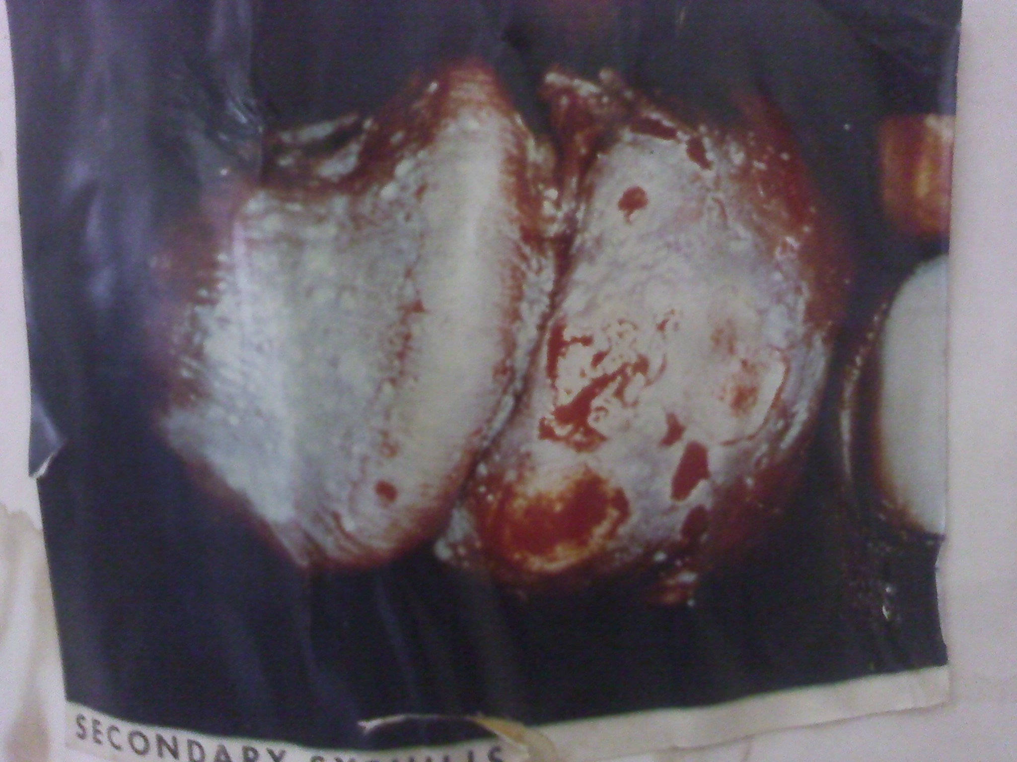

Slide 13
Tertiary syphilis
Develops approximately 3-10 yrs after the primary lesion
Organisms are rare in the lesion
Presence of nodules due to chronic inflammatory process (Gummas) on the skin, mucous membranes, bone or other organisms
Tend to undergo ulceration

Slide 14
Late syphilis
Can develop 10-20 yrs after primary disease
Mainly affects;
Cardiovascular system – inflammation of the aorta including the aortic valve
CNS; Neurosyphilis – manifestation include
Abnormal gait – trophic changes of joints
Abnormalities of optic nerve function
Abnormal mental capacity and others
Meninges, blood vessels causing more complications
Latent syphilis
Dormant disease without symptoms – detectable by serology
Can eventually develop into CVS or neurosyphilis

Slide 15
Congenital syphilis
Transplacental transmission
Can take place as early as the 10th week of pregnancy and any time throughout the pregnancy
Associated with septicemia in the fetus and widespread dissemination
Can result in death of fetus – miscarriage or still born at term
Others fetus are born alive with different manifestation
Latent infections
Signs and symptoms which develop shortly after birth or by the end of second year after birth- Failure to thrive , Skin rash, Nasal deformities, Deafness, Internal organ involvement, Eyes, joints, teeth

Slide 16
Laboratory diagnosis
Specimen
Fluid or scrapings from chancre or ulcerated lesions of secondary syphilis
Freshly collected
Dark field microscopy
Perfomed promptly and possibly repeatedly
Provides useful information if organisms are present
Slender, elongated spiral organisms with tight spirals and tapered ends
Too narrow for Gram staining and light microscopy ‘Gram indeterminate’
Immunofluorescent staining of exudates
Using Treponema pallidum fluorescent antibody – and microscopy – sensitive
Staining of infected tissues by techniques which utilize silver and microscopic examination
Serological tests – most effective method of laboratory diagnosis; do not distinguish syphilis from other treponemal infection. Two types of serological tests are done; Non-treponemal (Screening) tests and Treponomal (confirmatory) tests and

Slide 17
1. Non-treponemal tests
Detect reagin antibody that react against cardiolipin antigen derived from beef heart muscle
In most cases test becomes positive approximately 10-14 days after appearance of a chancre
Associated with false positive reaction and false negative results for primary syphilis hence require confirmation
Applied mostly as screening tests
Positive in all patients with secondary syphilis
May be negative in patients with late syphilis, cardiovascular or neurosyphilis
Approximately 25% of pts with primary syphilis who test positive become negative within 3 months of treatment and all become negative in 24 months

Slide 18
Include
VDRL (venereal disease reference laboratory)
Wasserman's test
Kahn test
RPR (rapid plasma reagent) or rapid plasma reagin card test
Suitable for quick screening
Used more frequently
A positive test can be quantified.

Slide 19
2. Treponemal tests
Detect antibody against T pallidum antigen
Associated with fewer false positive and remain positive after completion of treatment
Include
Fluorescent treponemal antibody – absorption test (FTA- ABS)
T. pallidum haemaglutinin assay (TPHA)
T. pallidum immobilisation test (TPI) – has several disadvantages – used less frequently
ELISA – associated with false positives
PCR

Slide 20
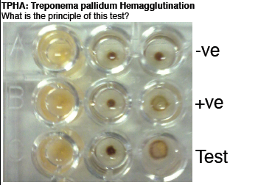

Slide 21
Antibiotic susceptibility
Benzathine penicillin (long-acting form) for primary and secondary syphilis (no resistance to penicillin)
Tetracycline, Erythromycin
Treatment – dose , duration and method of administration depend on the stage of the disease
Jarisch-Herxheimer Reaction
Starts generally during the first 24 hours of antibiotic treatment
Increase in temperature, decrease in blood pressure; rigors, leukopenia
May occur during treatment of any of the spirochete diseases

Slide 22
Prevention
Sexually transmitted infections
Similar to preventive measures against sexually transmitted infections
Screening tests
Congenital syphilis
Antenatal screening, prompt diagnosis and treatment of expectant females
Blood transfusion
Screening blood before transfusion

Slide 23
NON VENEREAL DISEASES DUE TO TREPONEMA SPP
Bejel /Non-Venereal/endemic syphilis
Causative agent Treponema pallidum endemicum
Transmitted from person to person by contaminated articles
Begins in childhood in mucous membranes as a small patch which starts in the mouth
Manifestation include – lesions in the oral cavity
Papules and mucosal patches initially
later gummas of skin, bones, nasopharynx
Common in tropical and subtropical areas of Africa, Asia and Australia

Slide 24
Yaws
Causative agent ; T. pallidum pertenue
Transmitted by direct contact with lesions containing abundant spirochetes
Characterized by
Initially painless nodules widely distributed
Later inflammatory lesions of skin lymph nodes and bones
Other destructive lesions on soft tissues
Detected in some areas of South America, Central Africa, South East Asia

Slide 25
Pinta
Causative agent – T. carateum
Transmitted by direct contact with skin lesions
Primarly restricted to skin
Incubation period
Initial lesions are small pruritic papules
Followed by enlarged plaques which persists for months to years
Later – disseminated, recurrent
Hypopigmentation or depigmentation leading to scarring and disfigurement of skin lesions associated with scarring

