Slide 1
BORRELIA
KIMAIGA H.O
MBChB (University of Nairobi)

Slide 2
Species of borrelia which infect humans, Transmission and clinical implications
Borrelia recurrentis
  Cause louse borne relapsing fever or louse borne borreliosis or epidemic relapsing fever.
  Transmitted by the body louse from person to person; disease can occur as an epidemic
  Over crowding favors transmission
  Louse ingests the organism while feeding on the blood of an individual with the organism
  Humans form the reservoir
  Human infection occur through rubbing or crushing infected lice onto broken skin introducing fluid which contains the organisms

Slide 3
Borrelia duttoni and related tick borne species
  Responsible for tick-borne relapsing fever or tick borne borreliosis or endemic relapsing fever Transmission occur between animals and from animals to humans
  Humans get infected either from a tick bite or crushing the infected tick on broken skin
  Ticks get infected as they feed on blood from animals with the organisms in the circulation
    infected rodents, pigs, armadillos, porcupines constitute the reservoir
  Infected ticks also provide a reservoir as the infection persists through out the life of the tick and is passed on
  Human infections are endemic

Slide 4
Borrelia vincentii – normal flora in the oral cavity – potential pathogenic
Borrelia burgdorferi – isolated in temperate countries – parts of USA and Europe
  Transmitted by hard ticks
  Mammals such as rodents are involved in the transmission
  Causative agent of febrile illness: Lyme disease

Slide 5
Clinical manifestation of relapsing fever
Louse-borne or tick borne – similar manifestation
Fever – febrile and afebrile periods
febrile episodeis characterized by
  numerous spirochetes in blood
  during the febrile period the organisms are abundant in the blood circulation
  hosts's immune system is stimulated resulting in production of antibodies which act against organisms
  due to the immune response the quantity of organisms reduces before fever subsides
  fever recurs after 4-10 days and borreliae reappear in the blood- relapse
  febrile episodes and disappearance of organisms (recurrence or relapse) are repeated several times
  lasts 3-5 days then subsides

Slide 6
When the organisms are present in the blood a few undergo mutation – acquire antigenic determinants which differ structurally form the original antigenic determinants – are not recognized by antibodies and form new strains because of antigenic variation
Antibodies produced during each febrile episode are effective in destroying the infecting strains at that particular episode as they recognize their antigenic strains
The few that have undergone mutation are not recognized – multiply and cause the next relapse

Slide 7
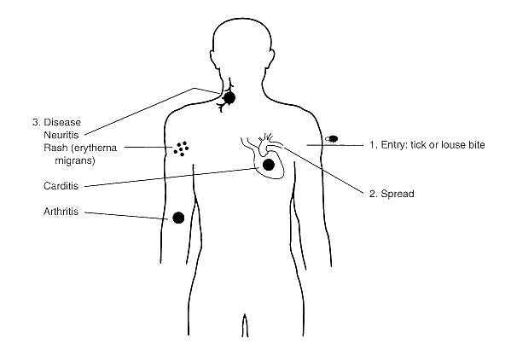

Slide 8
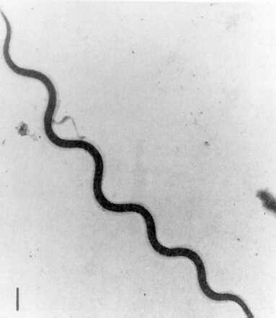
Lab diagnosis
Direct microscopy examination
  Detection of borreliae in peripheral blood film especially during the febrile episode
  Stained peripheral blood smears – Giemsa or Wright's stain
  Relatively broader – have a larger diameter compared to other spirochaetes
Dark field or phase contrast microscopic examination of peripheral blood for motile spiral organisms – more reliable

Slide 9
Culture in the laboratory
Does not grow easily on cultures
Some species have been grown successfully using specially formulated culture media containing suitable nutrients
Incubation under micro- aerophillic conditions is a requirement for growth

Slide 10
Antimicrobial susceptibility
Penicillin
Chloramphenicol
Erythromycin
Tetracycline

Slide 11
Borrelia vincentii
Normal flora in the oral cavity in small numbers
relatively longer and broader – actively motile
  gram -ve
difficult to grow in the lab – fastidious nutritional requirements – a medium enriched with serum and anaerobic incubation
clinically contributes to the causation of ulcerative gingivostomatitis and ulcerative oropharyngitis
other abnormalities- trauma, vitamin deficiencies, other organisms
sporadic – occurred as an outbreak during the 1st world war as trench mouth

