Slide 1
LEPTOSPIRA
KIMAIGA H.O
MBChB (University of Nairobi)

Slide 2
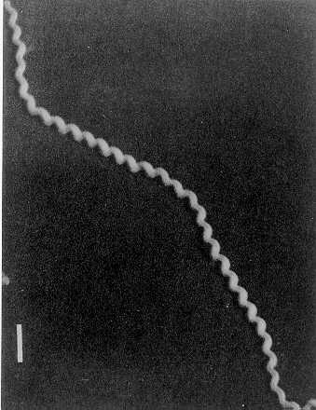
Leptospira
Slender spiral cells with hooked ends motile with periplasmic flagella
Numerous closely set coils
Can be visualized using- dark field, phase contrast or electron microscopes
Stainable by silver impregnation and fluorescent antibody methods

Slide 3
Species
Consists saprophytic organisms and potential pathogens
Two species – morphologically indistinguishable – each has numerous serotypes
L. interrogans – potential human pathogens, approximately 200 serotypes
L.interrogans icterohaemorrhagiae – associated with rats
L.interrogans canicola — associated with cats and dogs
L. biflexa – saprophytes in the environment, approximately 60 serotypes

Slide 4
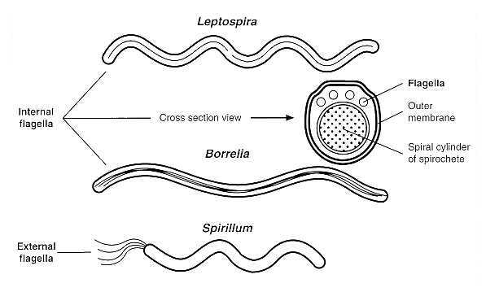

Slide 5
Transmission & clinical significance
Spirochetes live in the kidneys of infected animals particularly rodents, rats - are passed out in urine
No signs or symptoms of disease in animals
Accidental transmission to humans occurs through broken skin or mucous membranes by contact with infected urine of the animal carriers directly or through contaminated soil or water
Increased risk due to the occupation for workers in:
Rice field, sugar cane plantations, miners, sewer workers- as zoonotic infections
No lesions develops at the site of site of entry
The infected individual develops bacteremia
Organisms are spread to internal organs via blood circulation
In the kidneys the organisms multiply in the convoluted tubules and are shed in urine

Slide 6
Manifestations
Disease caused, leptospirosis, can be asymptomatic - severe
An initial septicemic phase characterized by mild non specific signs and symptoms – headache, chills, fever
Some cases progress and develop manifestations related to the internal organ involved
Most severe form of the disease is characterized by jaundice, bleeding tendency, other signs and symptoms caused by serotype L.interrogans icterohaemorrhagiae
Mechanisms not clear
No toxin produced
Most likely caused by the host’s immune reaction

Slide 7
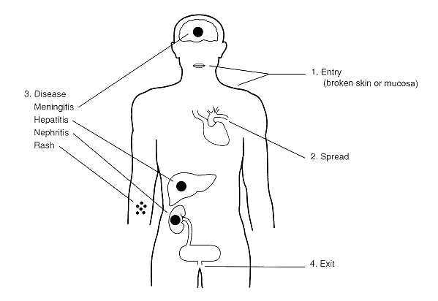

Slide 8
Lab diagnosis
Specimens include – blood, CSF, urine, infected tissue
Blood
Culture, confirmatory if positive
Dark field microscopy – organisms are not easily detected therefore not done routinely. Very efficient if done during the septicaemic phase of the disease.
Detected if performed during septicemic phase
Urine
Deposit examined after centrifugation by microscopy and culture
Spirochetes are likely to be found in urine form the first week of the illness and may persist intermittently for 2-3 months
Serology-Demonstration of rising antibody titre

Slide 9
Culture
Difficult to grow in the lab – fastidious nutritional demands – medium enriched with animal serum supports growth – also requires other nutrients including fatty acids and vitamins
Fletcher semisolid culture medium – enriched with proteins and other nutrients.
Obligate aerobes
Slow growth especially during the primary isolation – 6-14 days or longer
Can also be grown on chorioallantoic membranes of embyronated eggs

Slide 10
Serology
Detection of specific antibodies in the blood by various immunological techniques
demonstration of rising antibody titre of the infecting serotype
antibodies may persist for years therefore indicate past exposure
DNA detection in – serum, urine, CSF – by amplification techniques – PCR

Slide 11
Antimicrobial susceptibility
Penicillin
Tetracycline
Best if given in the first week of illness when organisms are numerous in blood

Slide 12
Control
Reducing the infection in wild and domestic animals – if and where possible
Vaccination of domestic animals where vaccine is available
No vaccine available for human use

