Slide 1
CHLAMYDIA
KIMAIGA H.O
MBChB (University of Nairobi)

Slide 2
Introduction
Currently 2 genera:
Chlamydia
Chlamydophila
Small, obligate intracellular parasites of humans, animals and birds.
Resemble bacteria except cannot multiply outside living cells/tissues (live viruses)
Non-motile.

Slide 3
Share some characteristics with viruses-
Very small not easily visualized with a microscope
Do not synthesize ATP (get ATP and nutrients from host cell- energy parasites)
Do not replicate extracellularly.
Unlike viruses-
Contain both DNA and RNA
Cell wall similar to gram negative - Have LPS, peptidoglycan layer but lack muramic acid.
Have ribosomes and make their own proteins and nucleic acids
Binary fission
Respond to antibacterial antimicrobial agents.

Slide 4
Classification
The family Chlamydiaceae consists of one genus Chlamydia with three species that cause human disease:
C. trachomatis, which can cause urogenital infections, trachoma, conjunctivitis, pneumonia and lymphogranuloma venereum (LGV)
C. pneumoniae, which can cause bronchitis, sinusitis, pneumonia and possibly atherosclerosis
C. psittaci, which can cause pneumonia (psittacosis/ parrot fever).

Slide 5
Differences
C. trachomatis | C. psittaci
Affects humans | Affects birds and other animals
Sensitive to sulphonamides | Resistant to sulphonamides
Form inclusions that displace the nucleus | Inclusions around the nucleus is not displaced.
Inclusion contain glycogen | Glycogen negative

Slide 6
Life Cycle.
2 forms.
Elementary form/body | Reticulate form/body (RB)
Larger (0.8-1µm) Extracellular survival Does not replicate Metabolically inactive Infectious form- Direct contact, droplets, mechanical vectors. Not affected by antibiotics. | Small (0.3-0-4µm) Intracellular survival. Replicates Metabolically active Non infectious Susceptible to antibiotics.

Slide 7
REPLICATIVE CYCLE
Elementary body attaches to the surface of the cell.
Endocytosis of the elementary body occurs.
Elementary body is the endosome which doesn’t fuse with lysosome. Elementary body possess a rigid outer membrane that is extensively cross-linked by disulfide bonds.
Elementary body reorganizes into reticulate body in endosome.
Reticulate body replicates by binary fission.
Reticulate bodies are reorganized into elementary bodies.
They possess a fragile membrane lacking the extensive disulfide bonds characteristic of the EB
Formed elementary bodies are released from the cell.
C. pneumonia and C. trachomatis reverse endocytosis.
C.psittaci – lysis of cells and inclusions.

Slide 8
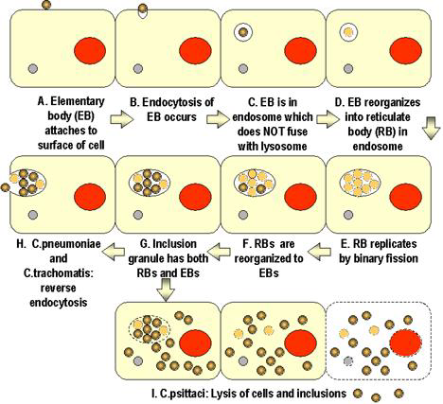

Slide 9
C. trachomatis
C. trachomatis is the causative agent of;
Trachoma
Oculogenitial disease- Inclusion conjunctivitis
Neonatal pneumonia
Lymphogranuloma venereum (LGV)
Epididmytis, Salpingitis, Cervicitis
Pathogenesis and Immunity
C. trachomatis infects non-ciliated columnar epithelial cells.
The organisms stimulate the infiltration of polymorphonuclear cells and lymphocytes which leads to lymphoid follicle formation and fibrotic changes.
The clinical manifestations result from destruction of the cells and the host inflammatory response.
Infection does not stimulate long lasting immunity and reinfection results in a inflammatory response and subsequent tissue damage.

Slide 10
1. Trachoma
First infection usually in childhood i.e. infections result in scarring and corneal damage
Leading cause of preventable blindness in the developing world.
Eye disease of conjunctiva and cornea – blindness if untreated.
Caused by sero-types A, B1, B2 and C
First infection usually in childhood
Spread by transferof infected discharge from eye of infected person by hands, clothing, towels or flies.
Poverty, overcrowding, poor personal hygiene, inadequate water enhance spread.

Slide 11
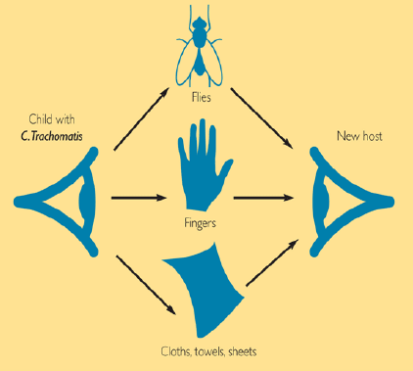

Slide 12
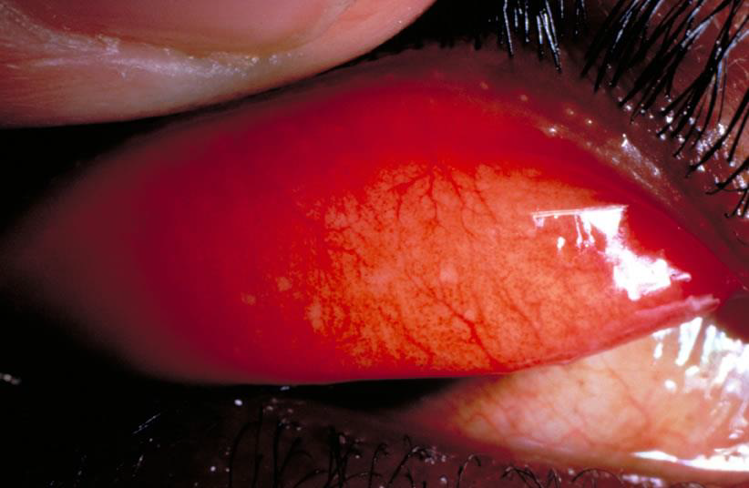
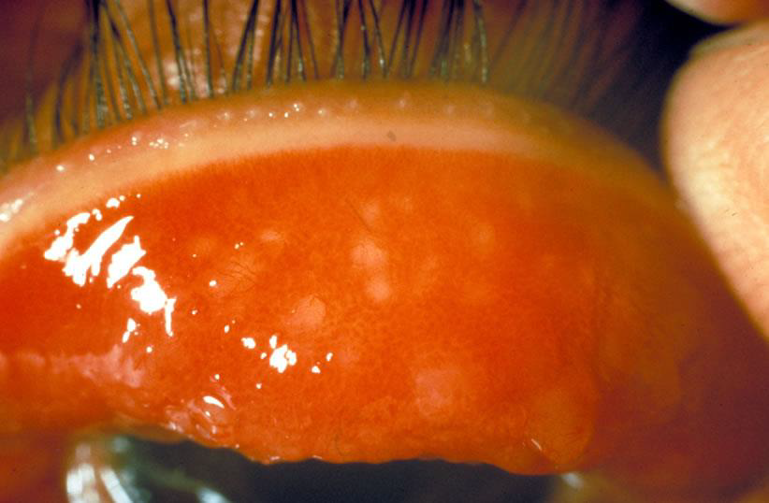
Stages of Trachoma Disease
Stage 1: Trachoma infection: Small bumps/ follicles under the eye lid
Stage 2: Follicles, inflammation,

Slide 13
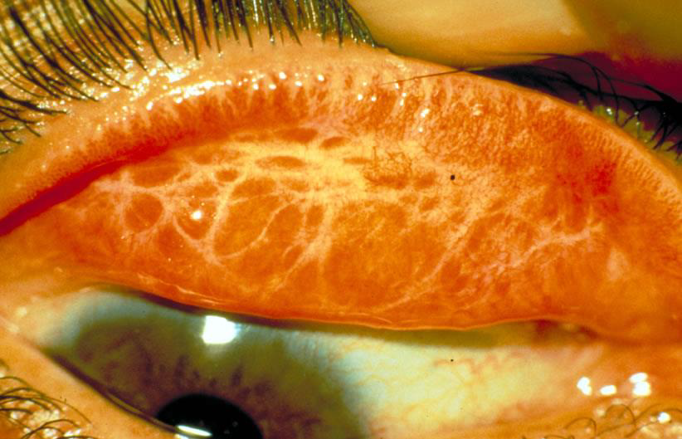
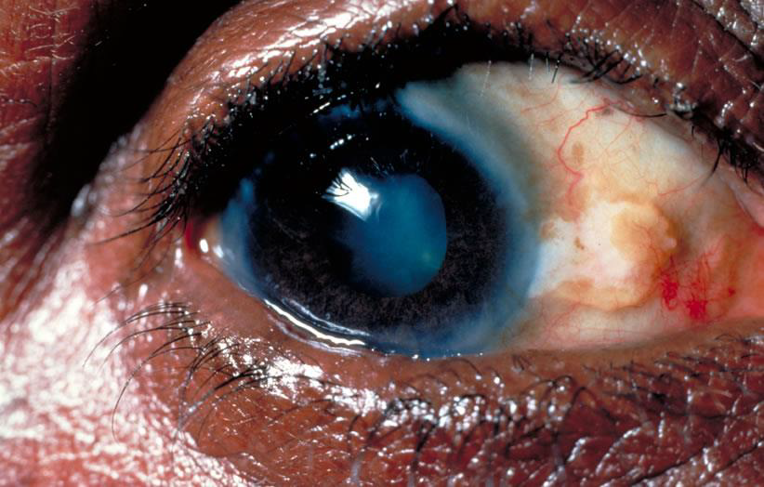
Stage 3: Trachoma with scarring
Scar tissue forms.
Eyelid is difficult to turn for examination
Stage 4: Trachoma with trichiasis
Eyelids turn in towards the cornea

Slide 14
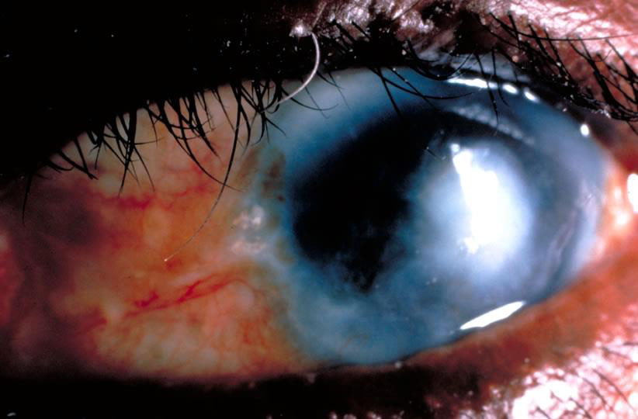
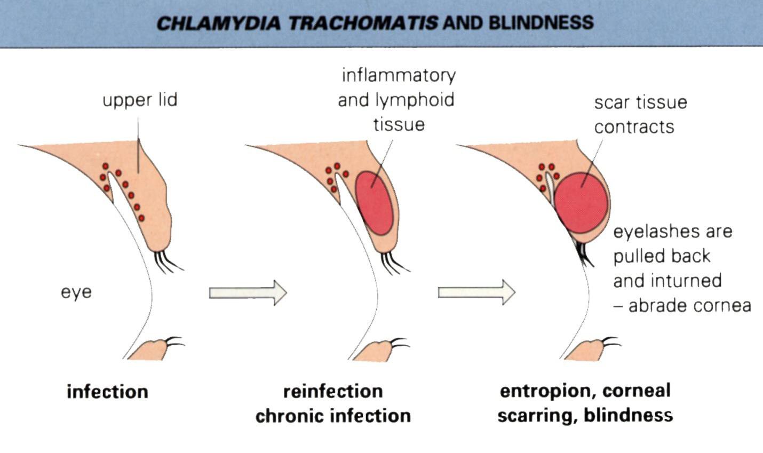
Stage 5: Corneal Opacity
Trichiasis rubs on cornea
Corneal Scarring
Bacteria/Virus enters damaged cornea

Slide 15
2. Inclusion conjunctivitis:
Serotypes D2, K
Associated with genital Chlamydia
Can affect neonates born of mothers with the organism
Presents with mucopurulent discharge -Ophthalmia neonatarum,
Adults- sexually transmitted infection of the eye

Slide 16
3. Neonatal pneumonia
Serotypes D-K
Acquired from the mother’s genital.
Often preceded by inclusion conjunctivitis
Presents with cough, wheezing and there is no fever.

Slide 17
4. Lymphogranuloma venereum (LGV)
Serotypes L1, L2 and L3
Primary lesion is a small painless papule or ulcer or ulcer at injection site heals rapidly.
Lymphdenopathy ( may coalesce to form abscesses and buboes)
Fever, headache, proctitis.
Chronic- scarring, lymphatic obstruction- may resemble elephantiasis.

Slide 18
5. Epididmytis, Salpingitis, Cervicitis
Sexually transmitted infections- Similar to N. gonorrhea can occur as a co-infection.
Serotypes D-K
Can result in pelvic inflammatory disease.
Reactive arthritis and Reiter’s syndrome may follow.

Slide 19
C. psittaci
Wild and domestic animals and birds.
Human infection- inhalational of organism in dried infected bird droppings is rare.
Influenza like illness pneumonitis
Diagnosis – serology: ELISA
Treatment- Tetracycline, doxycycline and erythromycin.

Slide 20
C. pneumonia
Inflammatory process in respiratory tract- atypical pneumonia, bronchitis and sinusitis
Person to person spread via respiratory droplets.
Diagnosis- serology, PCR, cell cultures.
Treatment- Doxycycline and erythromycin.

Slide 21
Lab Diagnosis
Specimens- infected tissues
Microscopy
Immunofluorescense- Fluorescent antibody stains detect species specific and immunotype specific antigens.
Giemsa stain- Direct visualization of inclusion bodies.
C. trachomitis inclusion bodies contain glycogen, can visualize by staining with iodine.
Culture
Not on artificial medium.
On cell cultures treated with cycloheximidine.( Inhibits host cell but not Chlamydial protein synthesis). Such cultures include Chicken embryo yolk sac and Mccoy cell lines.

Slide 22
Antigen detection - Direct immunofluorescence and ELISA kits that detect the group specific LPS or strain-specific outer membrane proteins are available for diagnosis.
ELISA antigen detection in respiratory or genital secretions.
Serology - Serological tests for diagnosis are of limited value in adults, since the tests do not distinguish between current and past infections. Detection of high titer IgM antibodies is indicative of a recent infection. Detection of IgM antibodies in neonatal infection is useful.
Delayed type skin reaction ( type IV hypersensitivity) to killed organisms. Frei test for LGV.
Molecular tests e.g. PCR and ligase chain reaction for Chlamydial DNA.

Slide 23
Treatment
Trachoma – erythromycin, doxcycline
LGV – doxycycline, aspirate buboes
Genital and ocular – azithromycin, doxycycline

Slide 24
Prevention
Trachoma
Mass treatment with oral azithromycin – contacts of trachoma patient’s.
Hygiene
Education and face washing campaigns
Tracing and treating partners in genital tract infections.
C. psittaci
Proper control of importation or handling of psittacine birds e.g. birds

