Slide 1
MYCOPLASMAS
KIMAIGA H.O
MBChB (University of Nairobi)

Slide 2
Basic characteristics
Family Mycoplasmaceatea
Genera: Mycoplasma, Ureaplsama.
Smallest and can grow in cell free culture media.
Lack cell wall- highly pleomorphic
Only bacteria that contain cholesterol in the cell membrane
Non motile
Replicates by binary fission
Require a rich medium containing a sterol and serum proteins for growth.

Slide 3
Antigenic Properties
Mycoplasmas have glycolipids- can account for the neurological manifestations of M. pneumoniae infection.
Alter the I antigens on RBCs: stimulate anti-I antibodies (cold agglutinins)- autoimmune response and damage to erythrocytes.
Variable membrane lipoproteins form an antigenic variation system - escaping the host immune response.

Slide 4
Species
M. pneumonia
Normal habitat - Respiratory tract
Commonest cause of atypical pneumonia (walking pneumonia)
Resolves in 10-14 days
Complications- Hemolytic anaemia, Gullain Barre syndrome, pneumothorax, arthritis, lung abscesses.
M. hominis and Ureaplasma urealyticum
Normal habitat- Lower genital tract, mouth, throat
Sexually transmitted
M. hominis causes pelvic inflammatory disease
U. urealyticum causes non- gonococcal urethritis in men. Implicated in endometritis and chorioamnionitis.
Differences
M. pneumonia and M.hominis do not hydrolyze urea, U. urealyticum hydrolyses urea.

Slide 5
Pathogenesis and epidemiology
Respiratory Infections
M. pneumoniae
Common cause of atypical pneumonia.
Transmitted by respiratory droplets.
Ciliary motion is inhibited and necrosis of the epithelium occurs.
It produces hydrogen peroxide which contributes to damage by respiratory tract cells.

Slide 6
Pathogenicity
Mycoplasma pneumoniae attaches to sialoglycoproteins or sialoglycolipid receptors on the tracheal epithelium via protein adhesins on the attachment organelle.
The major adhesin is a 170-kilodalton (kDa) protein, named P1.
Hydrogen peroxide and superoxide radicals (O2-) excreted by the attached organisms cause oxidative tissue damage.
Pneumonia is induced largely by local immunologic and phagocytic responses to the parasites. Sequelae of M pneumoniae infection (mainly hematologic and neurologic) apparently have an autoimmune etiology.
Several fastidious mycoplasmas may act as cofactors in activation of the aquired immunodeficiency syndrome (AIDS).
Macrophage activation, cytokine induction, and superantigen properties of some mycoplasmal cell components can be considered as pathogenicity factors.

Slide 7
M. hominis and Ureaplasmas- respiratory disease in newborns
M. fermentans –throat, associated with adult respiratory distress syndrome.
Extrapulmonary- due to production of autoantibodies.
Include: meningitis, hemolytic anaemia, mycarditis, pericarditis.

Slide 8
Urogenital Infections
M. hominis: pelvic inflammatory disease, acute pyelonephritis.
Ureaplasma urealyticum: nongonoccocal urethritis.

Slide 9
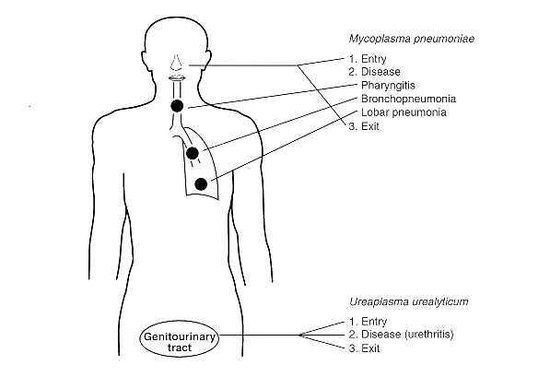

Slide 10
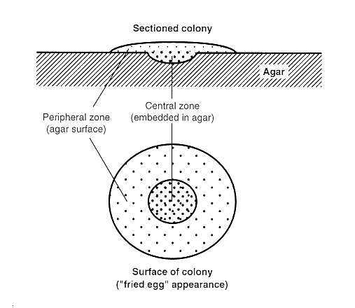
Laboratory Diagnosis
Serology for M. pneumaniae - mainstay of diagnosis
Cold agglutinins – IgM autoantibodies against type O red blood cells that agglutinate these cells at 4⁰C but not at 370C
Complement fixation test – 4 fold or greater rise in specific antibody titre.
Culture on selective enriched media
Slow growing small colonies
“Fried egg” appearance – raised centre with thinner edges
Indirect fluorescent antibody tests for M. hominis.
Molecular – PCR and DNA probes.

Slide 11
Treatment
Resistant to antibiotics which interfere with bacterial cell wall synthesis
M. pneumonia – tetracycline/ quinolones/ macrolides e.g.erythromycin
M. hominis – usually resistant to erythromycin. Some genital strains also resistant to tetracycline. Use azithromycin instead.
U. urealyticum – less susceptible to quinilones. Use erythromycin

Slide 12
Prevention
No vaccine or specific preventive measures.

