Slide 1
RICKETTSIAE
KIMAIGA H.O
MBChB (University of Nairobi)

Slide 2
Family Rickettsiaceae
Consists of Gram negative bacteria
Some organisms in family not associated with disease in humans
Those that cause disease in humans are maintained in nature through cycles involving:
Reservoir mammals - wild rodents, mice, domestic animals - dogs, humans
Arthropod vectors - ticks, mites, body louse, fleas
Humans are incidental hosts for the majority
Most human infection acquired through transmission by arthropods

Slide 3
Classification into genera species
Classification based on various characteristics comparable to other bacteria
Five genera in this class cause human diseases:
Rickettsia
Coxiella
Ehrlichia
Bartonella
Orientia

Slide 4
Genus | Species
Rickettsia | Rickettsia prowazekii (Epidemic typhus) Rickettsia typhi (Endemic typhus) Rickettsia rickettsii (Spotted fever) Rochalimaea quintana (trench fever) R.sennetsu, R.conorii, R.sibrica, R.australis, R.akari, R.tsutsugamushi (orienta tsutsugamushi)
Coxiella | Coxiella burnetii (Q fever)
Rochalimaea (Bartonella) | R.quintana (B.quintana)

Slide 5
Biological and morphological characteristics
Relatively small prokaryotic cells, comparable to viruses
Pleomorphic bacilli, cocco bacilli, occasionally filamentous, capsulated except Coxiella burnetii
Multiply by binary fission
Exist and multiply as obligate intracellular organisms - except R.quinitana

Slide 6
Posses both DNA and RNA within the cell\posses enzyme systems for biosynthetic processes and energy production
LPS present in cell wall - except R.tsutsugamushi
Lipopolysaccharide have weak endotoxic activity (absent in Ehrlichia)
Easily destroyed by heat, drying & bactericidal agents EXCEPT Q fever due to the formation of endospore-like structure by C. burnetti

Slide 7
Organisms not readily stained with Gram’s stain - when stained are gram negative
C.burnetti can also stain as gram positive with modified reagents
Organisms stain better with other stains - immunofluorescent staining techniques especially in tissues
Also stainable with Giemsa
Rickettsia replicate in the cytoplasm and nucleus of their host cell; Coxiella replicate only in the phagolysosome.

Slide 8
Epidemiology
All rickettsial diseases are zoonoses
Humans are accidental host except for epidemic typhus which occurs only in humans because the causative agent is transmitted by human body louse.
Transmission:
Via arthropod vectors such as fleas, lice, fleas and mites
Coxiella burnetti the cause of Q fever is transmitted by aeroso inhalation or ingestion of contaminated milk or food.

Slide 9
Virulence factors
Release of endotoxin
Phospholipase A may help in penetration.
Production of immune complexes

Slide 10
PATHOGENESIS:
Typhus, spotted fever and trench fever are transmitted via arthropod vectors;
Q fever is acquired via inhalation or ingestion of contaminated milk or food.
Upon attaching to the host cell membrane, rickettsiae enter host endothelial cells via an induced phagocytosis.
The enzyme phospholipase A may help penetration.
Once phagocytosed by the host cell, rickettsiae are observed to quickly escape from the phagosome membrane and enter the cytoplasm.

Slide 11
Replication of the bacteria causes lysis of the host cell and consequent spread to other cells through the bloodstream
Initial replication occurs at the site of entry producing a local lesion. This is followed by dissemination via the vascular system producing vasculitis and a skin rash. These lesions may become necrotic.
Virulence is probably due to many factors including release of endotoxin, the production of immune complexes and hypersensitivity reactions.
A characteristic triad of symptoms include fever, headache and rash (no rash with Q fever).

Slide 12
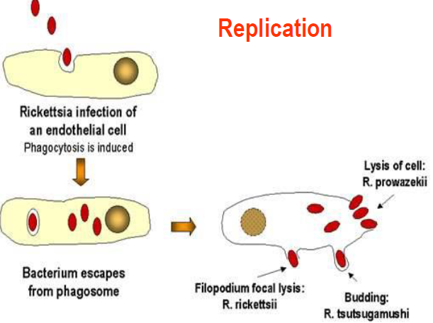

Slide 13
Human diseases caused by genus rickettsia
Relatively uncommon
Majority are a result of inoculation from arthropods. Multiply at site of inoculation before dissemination via blood circulation
From blood organisms infect the vascular endothelial cells - basic lesion - vasculitis associated with:
Proliferation of microorganisms in endothelial lining of small blood vessels causing direct cell injury
Abnormal function characterized by ↑ vascular permeability & thrombosis
Signs & symptoms - variable severity - depend on damaged organ - skin and brain most frequently involved

Slide 14
Clinical manifestations
Fever associated with other signs and symptoms - broadly similar - some more sililar than others
Based on similarities and geographical distribution diseases and their causative agents are classified into groups
Spotted fever
Typhus group
Others - Q-fever; trench fever

Slide 15
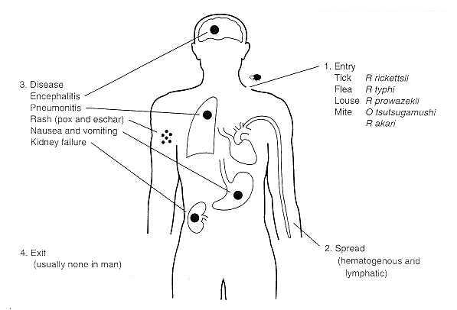
.

Slide 16
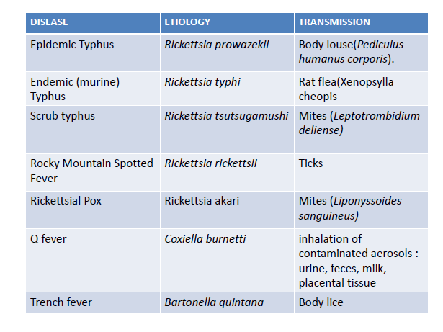

Slide 17
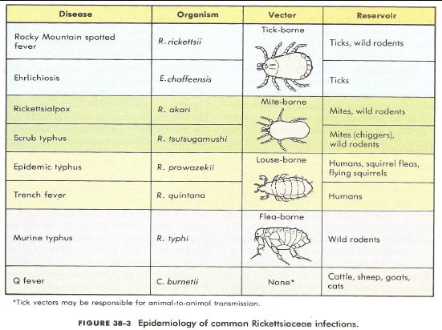

Slide 18
1. Spotted fever group
Disease | Organism | Vector | Host
Rocky mountain spotted fever | R.rickettsii | Ticks | Wild rodents & dogs
Boutonneuse fever | R.conorii | Ticks | Wild rodents & dogs
African tick bite fever | R.africae | Ticks | Rodents
Rickettsial pox | R.akari | Mites | Mice
Zoonotic infection transmitted by ticks and mice
Organisms closely related genetically - differences in their:
Surface antigens
Geographical distribution
Severity of clinical infection
Ticks provide reservoir for majority of those those transmitted by ticks - pass organisms on from generation to generation by eggs

Slide 19
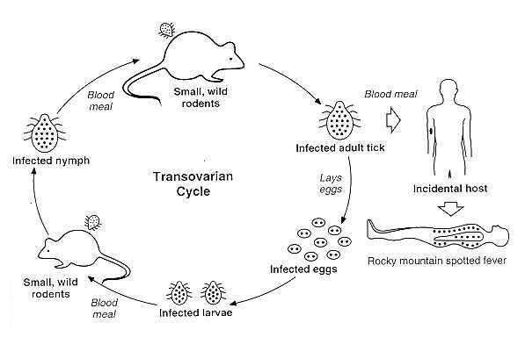

Slide 20
Rocky mountain spotted fever
Occurs in the western hemisphere
Most sever illness in this group
Uninfected ticks acquire the organisms when they feed on blood of infected small mammals such as rodents
Human infected accidentally after bite
Manifestations - skin rash, thrombocytopenia, hemorrhage
Boutonneuse fever
Reported in Africa and parts of Mediterranean
Synonyms: Mediterranean fever/ Kenya tick typhus/ South African tick bite fever
Manifestations - cutaneous rash with central necrosis (eschar) at site of bite & enlarged lymph nodes

Slide 21
2. Typhus group
Epidemic typhus
Encountered in S.America, Africa and Asia
Etiology: Rickettsia prowazekii
The disease often causes epidemics following wars and natural disasters
Transmitted from human to human via the human body louse (Pediculus humanus corporis). Restricted to humans
Transmission in a cycle involving humans and body louse
Transmission favored by overcrowding and low standards of cleanliness
Rickettsiae deposited on skin of new host via louse feces or by crushing louse on skin
Scratching facilitates entry

Slide 22
Epidemic typhus
Encountered in S.America, Africa and Asia
Etiology: Rickettsia prowazekii
The disease often causes epidemics following wars and natural disasters
Transmitted from human to human via the human body louse (Pediculus humanus corporis). Restricted to humans
Transmission in a cycle involving humans and body louse
Transmission favored by overcrowding and low standards of cleanliness
Rickettsiae deposited on skin of new host via louse feces or by crushing louse on skin
Scratching facilitates entry

Slide 23
Symptoms include severe headache, a sustained high fever, maculopapular rash, cough, severe muscle pain, chills, sensitivity to light. A rash begins on the chest about five days after the fever appears, and spreads to the trunk and extremities.
More fatal if not treated
Recurrent form is called Brill-Zinsser Disease which is less severe and rarely fatal. recurrence often occurs in times of relative immunosuppression
R.powerzekii can persist as latent infection
Mild sporadic cases occur as recurrences
Can initiate epidemics in susceptible populations

Slide 24
Endemic (murine) typhus
Widespread. Commonly in southern California, Texas and Hawaii.
Etiology: Rickettsia typhi
Primarily a disease of rats - transmitted by rat flea (Xenopsylla cheopis). Humans are accidental host
Flea acquires organisms by trans-ovarian transmission or by feeding on infected blood
Organisms shed in flea feces
Enter humans through broken skin
Possibly respiratory tract or conjunctiva
Human infection sporadic
Less severe than epidemic typhus

Slide 25
Scrub typhus
Etiology: Rickettsia tsutsugamushi (Orientia tsutsugamushi)
Cell wall differs structurally from that of other bacteria - lacks LPS & peptidoglycan - consists of proteins linked by diffuse bonds
Transmitted by some species of trombiculid mites (chiggers mites, particularly Leptotrombidium deliense) which are found in areas of heavy scrub vegetation
Female adult mites pass infection to offspring
Organisms introduced to humans during feeding and spread via blood circulation

Slide 26
Scrub typhus is endemic to a part of the world known as the tsutsugamushi triangle. This extends from northern Japan and far-eastern Russia in the north, into northern Australia in the south, and to Pakistan and Afghanistan in the west
Resembles Epidemic typhus ; Maculopapular rash, eschar, splenomegaly and lymphadenopathies are typical signs
More virulent strains of O. tsutsugamushi can cause hemorrhaging and intravascular coagulation.
Cardiac & cerebral involvement occur in the late phase of illness

Slide 27
3. BQ Fever (Query fever)
Causative agent; Coxiella burnetii
Genetically different form genus Rickettsia
Physically different from other bacteria
Highly resistant to chemicals including those used as disinfectants
Resistant to dessication
Not easily killed by heat treatment and sunlight
Hardy organism
Obligate intracellular organism

Slide 28
Reservoirs: domestic animals - cattle, sheep, goats; wild animals & infected ticks
Most infected animals asymptomatic
Shed organisms in urine, feces, milk
Also in placental tissue and amniotic fluid of the animals
From these sites the animal gets contaminated with C.burnetti
Humans acquire disease primarily by inhalation of contaminated aerosols of the above materials
Consumption of infected milk - less common source of infection
Individuals at risk: food handlers, sherpherds, abattoir employees, farm workers & veterinarians

Slide 29
May be asymptomatic acute or chronic
After inhalation multiply in lungs
Atypical pneumonia or asymptomatic
Acute disease associated with septicemia
Other manifestation related to organ affected
Invasion of blood circulatory system → invasion of other organs
Invasion of small blood vessels not as clear as in Rickettsia
It begins with fever, severe headache, cough and other influenza-like symptoms
The disease can progress to an atypical pneumonia
Rash is rare unlike other rickettsial diseases
Chronic Q fever can present as
Endocarditis - with damage to heart valves especially where there is pre-existing valvular heart disease
Osteomyelitis, hepatitis, encephalitis, meningitis
Complications- myocarditis, arthritis, guillain-Barre syndrome and glomerulonephritis

Slide 30
4. Trench fever
Five day fever
Etiology: Bartonella quintana (older name; Rickettsia quintana)
Transmitted by body lice
Manifestations: headache, exhaustion, pain, sweating, & a five-day fever of the relapsing type fever
The persistent fever might lead to heart failure

Slide 31
Lab confirmation of Rickettsial infection
Specimens: blood, infected tissue, grown over 4-7 days
Giemsa stain: bluish purple organisms.
Culture of blood or infected tissues
Performed in reference labs
Require living cells for growth- Tissue culture, Yolk sac of embryonated eggs, Cell lines
Lab animals - guinea pigs
R.quintana can be grown on a cell free medium

Slide 32
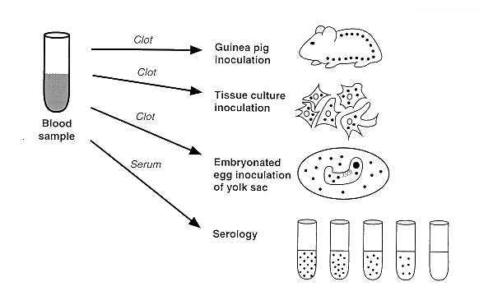

Slide 33
Antigen detection using immunofluorescent staining and PCR assays for detection and identification
Both performed on cutaneous infection specimen
Limited availability
Serology
Detection of antibodies to specific antigens - more useful if both acute & convalescence stage sera are considered
Demonstration of rising antibody titer - for confirmation of disease
Serology useful for diagnosis of most infections
Cross reactions common - limits specificity
Methods: immunofluorescence, ELISA

Slide 34
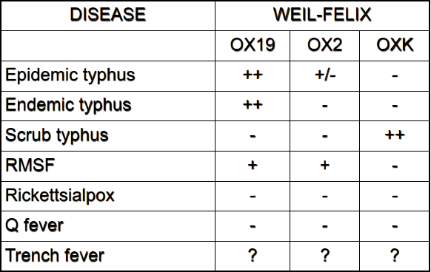
Weil-Felix test
Based on ability of anti-rickettsia antibodies to cross react with proteus mirabilis or Proteus vulgaris antigens
The reactive proteus antigen is part of somatic O antigen complex
Proteus strains used: OX-19, OX-2, OX-k
Low specificity, low sensitivity

Slide 35
Treatment/Antibiotic susceptibility
Organisms differ in susceptibility
Doxycycline is the drug of choice for the treatment of infections caused by Rickettsia except in cases of pregnancy
Chloramphenicol and tetracycline are alternatives
C.burnetti - tetracycline, ciprofloxacin

Slide 36
Control & prevention
Effective vaccines
Limited use - indicated for lab workers or those living in known endemic areas
Control of arthropod vectors - delousing the susceptible population - control of rodents - insecticides
Improve sanitation

Slide 37
Rochalimaea quintana
Reclassified as Bartonella quintana
Differ from Rickettsiae - ability to grow on cell free medium ∴ not obligate intracellular organisms
Transmitted by lice
Humans with latent infection act as source of infection
Etiological agent of trench fever

Slide 38
Manifestations
Fever, headache, general aches, skin rash
Associated with bacteremia
Lab confirmation
Culture of infected tissues - blood on artificial medium formulated for it
Serology in reference lab - comparable to rickettsia
Antibiotic susceptibility
Tetracyclin

Slide 39
Other species:
B.henselae
B.bacilliformis

