Slide 1
CORYNOBACTERIUM
KIMAIGA H.O
MBChB (University of Nairobi)

Slide 2
CORYNEBACTERIA
Morphology
Are gram positive bacilli
Have some swellings/ club shaped at the end
Polymorphic show variation in shape and size. Some are so short, others large
Stain irregularly due to the nature of their cell wall
They do not form spores
Do not have capsules
Are non motile
Facultative anaerobes
Several species

Slide 3
Corynebacteria diphtheria
This is the main pathogenic species in human.
Collectively known as diptheroids or coryneform
Typical corynebacteria morphologically (see traits above)
It easily gets decolorized during gram staining and can be confused to be gram negative
They contain metachromatic granules/volutin in their cytoplasm to store metabolites.
The organisms arrange themselves in pairs attached at one end and look like a bean
Others arrange themselves in a parallel arrangement known as palisade arrangement. They tend to look like Chinese alphabets but this is seen in the critical stage.

Slide 4
Physical properties
Are resistant to drying
Susceptible to heat
Susceptible to disinfectant

Slide 5
Pathogenicity
Causes the disease called diphtheria
Causes disease by invasion and is local not deeply
It attaches itself on the affected area
It attaches itself to virulence factors by producing an exotoxin, the diphtheria toxin
This toxin is responsible for the illness caused; severity depends on the extent of toxic production.

Slide 6
The toxin released is the one that determines the extent of disease
There are three types;
  Severe toxin- Severe manifestations
  Mild toxin- Mild manifestations
  Moderate toxin effect- Intermediate manifestations
However not all members of the species are capable of producing the toxin hence can be grouped into two categories;
  Toxigenic
  Non toxigenic- But can acquire new genetic information and synthesis and release the toxin and this is mediated by special bacterial phages and is known as lysogeny

Slide 7
Clinical Manifestation
Wound infections
  Organism can be isolated from infected wounds
  Infection mainly by contamination and evasion
  Toxin production not significant
Diphtheria
  Occurs mainly in epidemics/outbreaks
  Affects children mainly
  The carrier releases the bacteria from the upper respiratory tract and enters the next host and causes invasion of mucous membrane of upper respiratory tract and the body results by an inflammatory process

Slide 8
  Inflammation in the upper respiratory tract
  Grayish membrane (pseudomembrane)
  From the outside one looks like he or she has a swollen neck due to enlraged cervical lymph nodes
  Difficulty in breathing when the pseudomembrane is extensive covering the tonsils and tonsilar area up to the nostril
  Toxins circulate in the blood stream and can cause myocarditis, can reach the peripheral nerves and can damage the adrenal glands; the organism itself is confined to the upper respiratory tract
  Fever

Slide 9
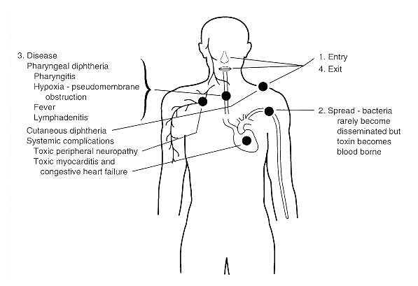

Slide 10
Lab diagnosis
Specimens
    From the upper respiratory area using a sterile swab e.g. cotton wool, Consist of exudate from the pseudomembrane
Microscopy
  Gram stain and observe for gram
  Pallisade arrangement or Chinese character arrangement

Slide 11
Culture
  Blood agar
  Are facultative anaerobes
  Grows best at 37ºC
  Selective media is recommended for primary isolation. The media include;
    Potassium Tellurite: Suppresses growth of other bacteria-black colonies due to reduction of tellurite
    Size and color vary according to the strain present
    Tinsdale medium also contains potassium tellurite
  Loeffler’s serum agar; it is useful during identification after primary isolation. It contains serum and glucose and provides a lot of nutrients and organisms grow rapidly in it
  Albert’s stain and Neisser’s stain are used to demonstrate volutin granule

Slide 12
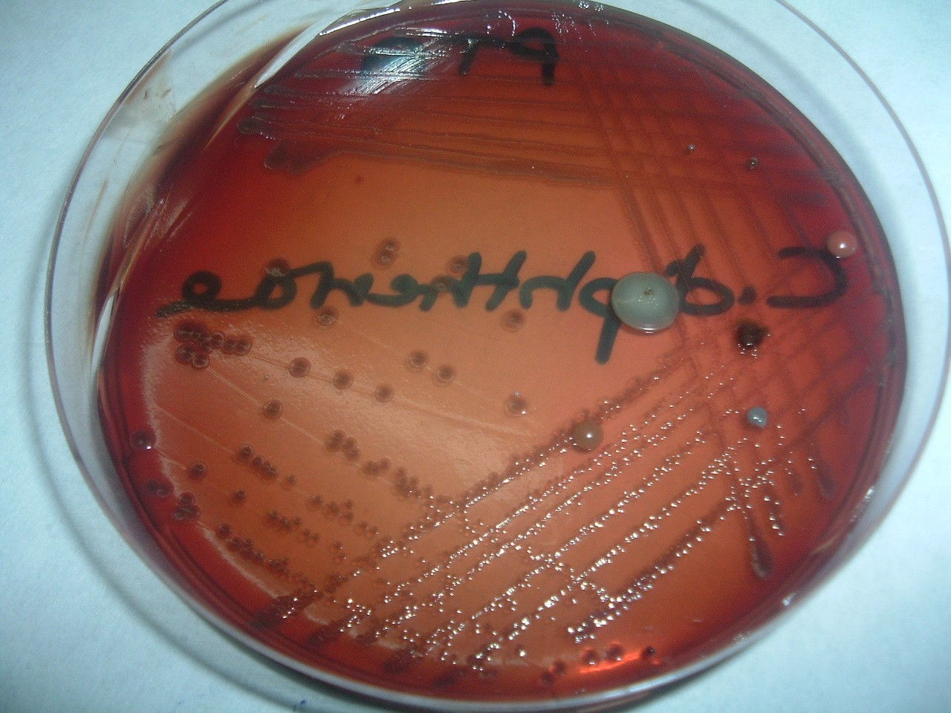
C diphtheriae on Tellurite agar-Black colonies

Slide 13
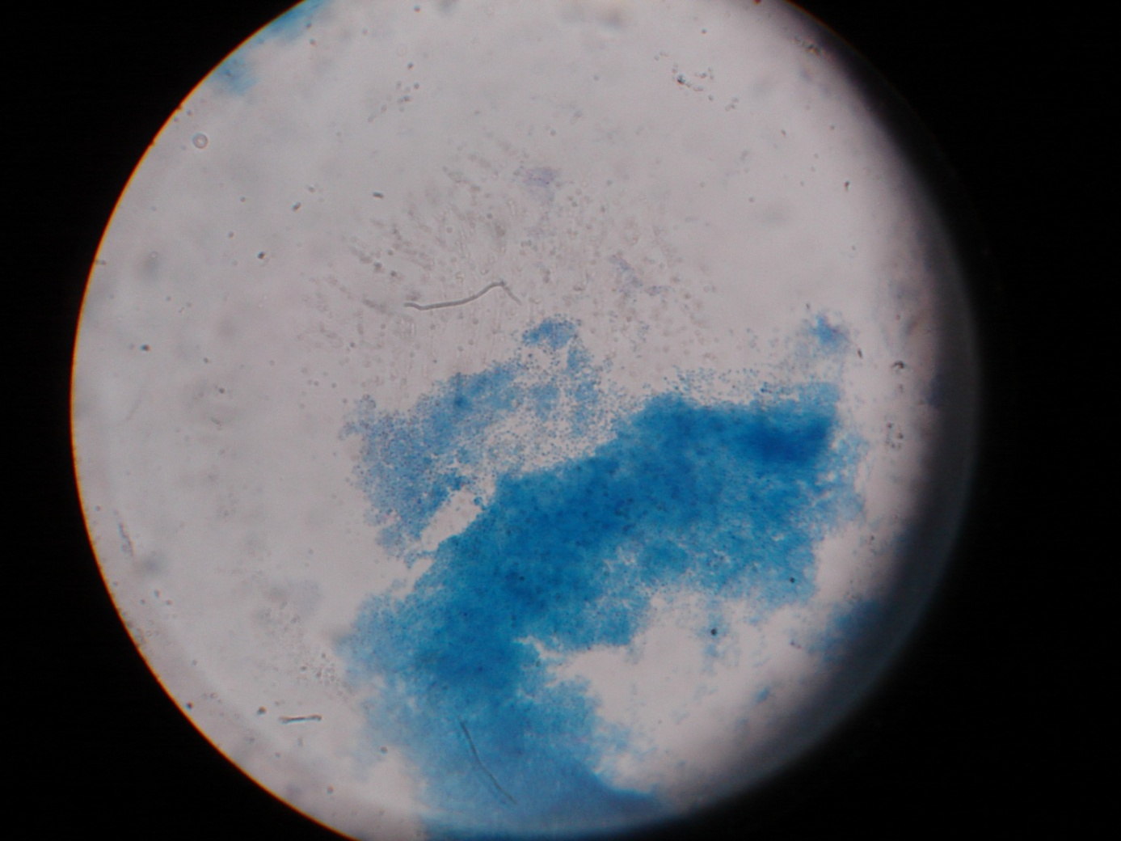
Albert's Stain

Slide 14
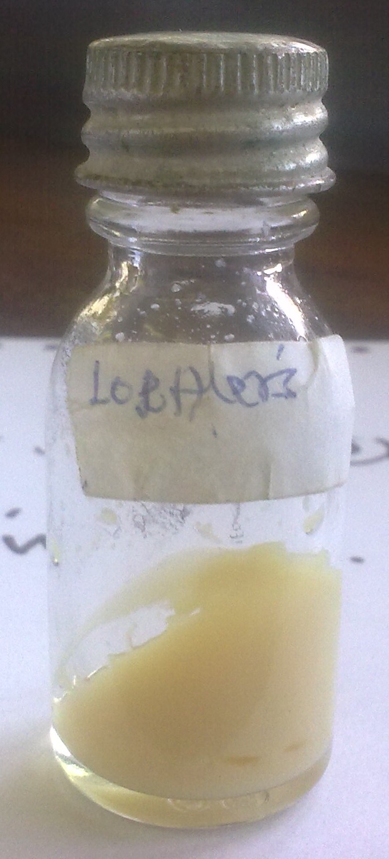
Loeffler’s Medium/ Slope
For culturing C. diphtheriae

Slide 15
Biochemical tests
  Carbohydrate oxygenation test to differentiate the toxic strains
  Elek immunodiffusion test. Sterile filter paper impregnated with diphtheria antitoxin is imbedded in agar culture medium. Isolates of C diphtheriae are then streaked across the plate at an angle of 90° to the antitoxin strip. Toxigenic C diphtheriae is detected because secreted toxin diffuses from the area of growth and reacts with antitoxin to form lines of precipitin. If positive, a precipitate forms if negative, no precipitate line is formed
  Use of laboratory animals like rats; observation of toxicity on the animals can also be utilized to know the toxic strains
  Sheep test; performed for epidemiological survey to know the susceptibility of the population to diphtheria.
  In Vivo tests e.g. Schick test-Ag injected into one arm and a control on the opposite arm . Rubor indicates non immunity.

Slide 16
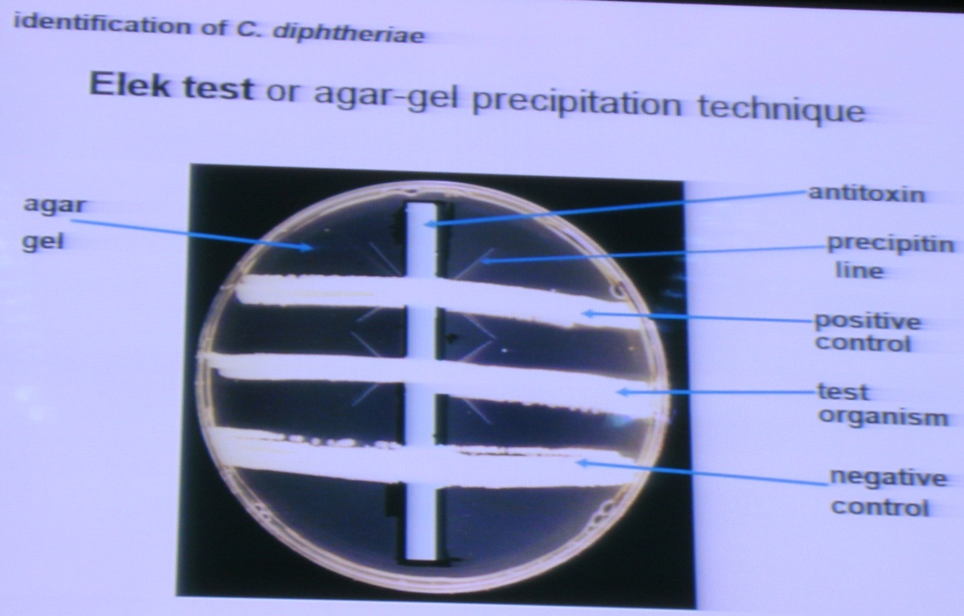
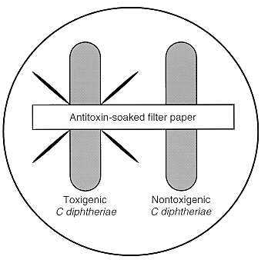
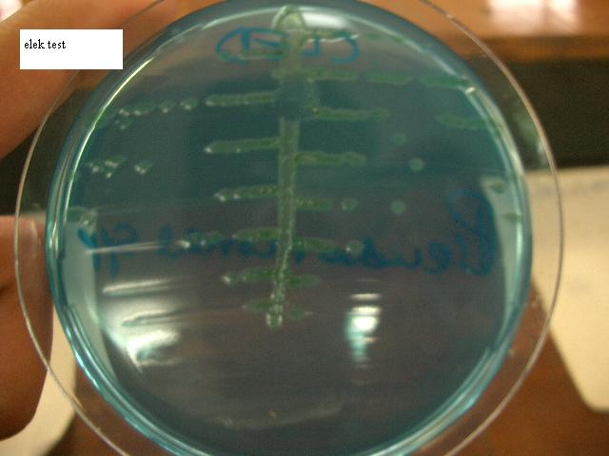

Slide 17
Management
Allowing air to flow during infection
Giving antitoxin as early as possible based on clinical investigations
Antimicrobioloins, it is susceptible to penicillin and erythromycin that eliminate the toxin
Detection and treatment of carriers
Vaccination; DPT is given as part of child immunization

Slide 18
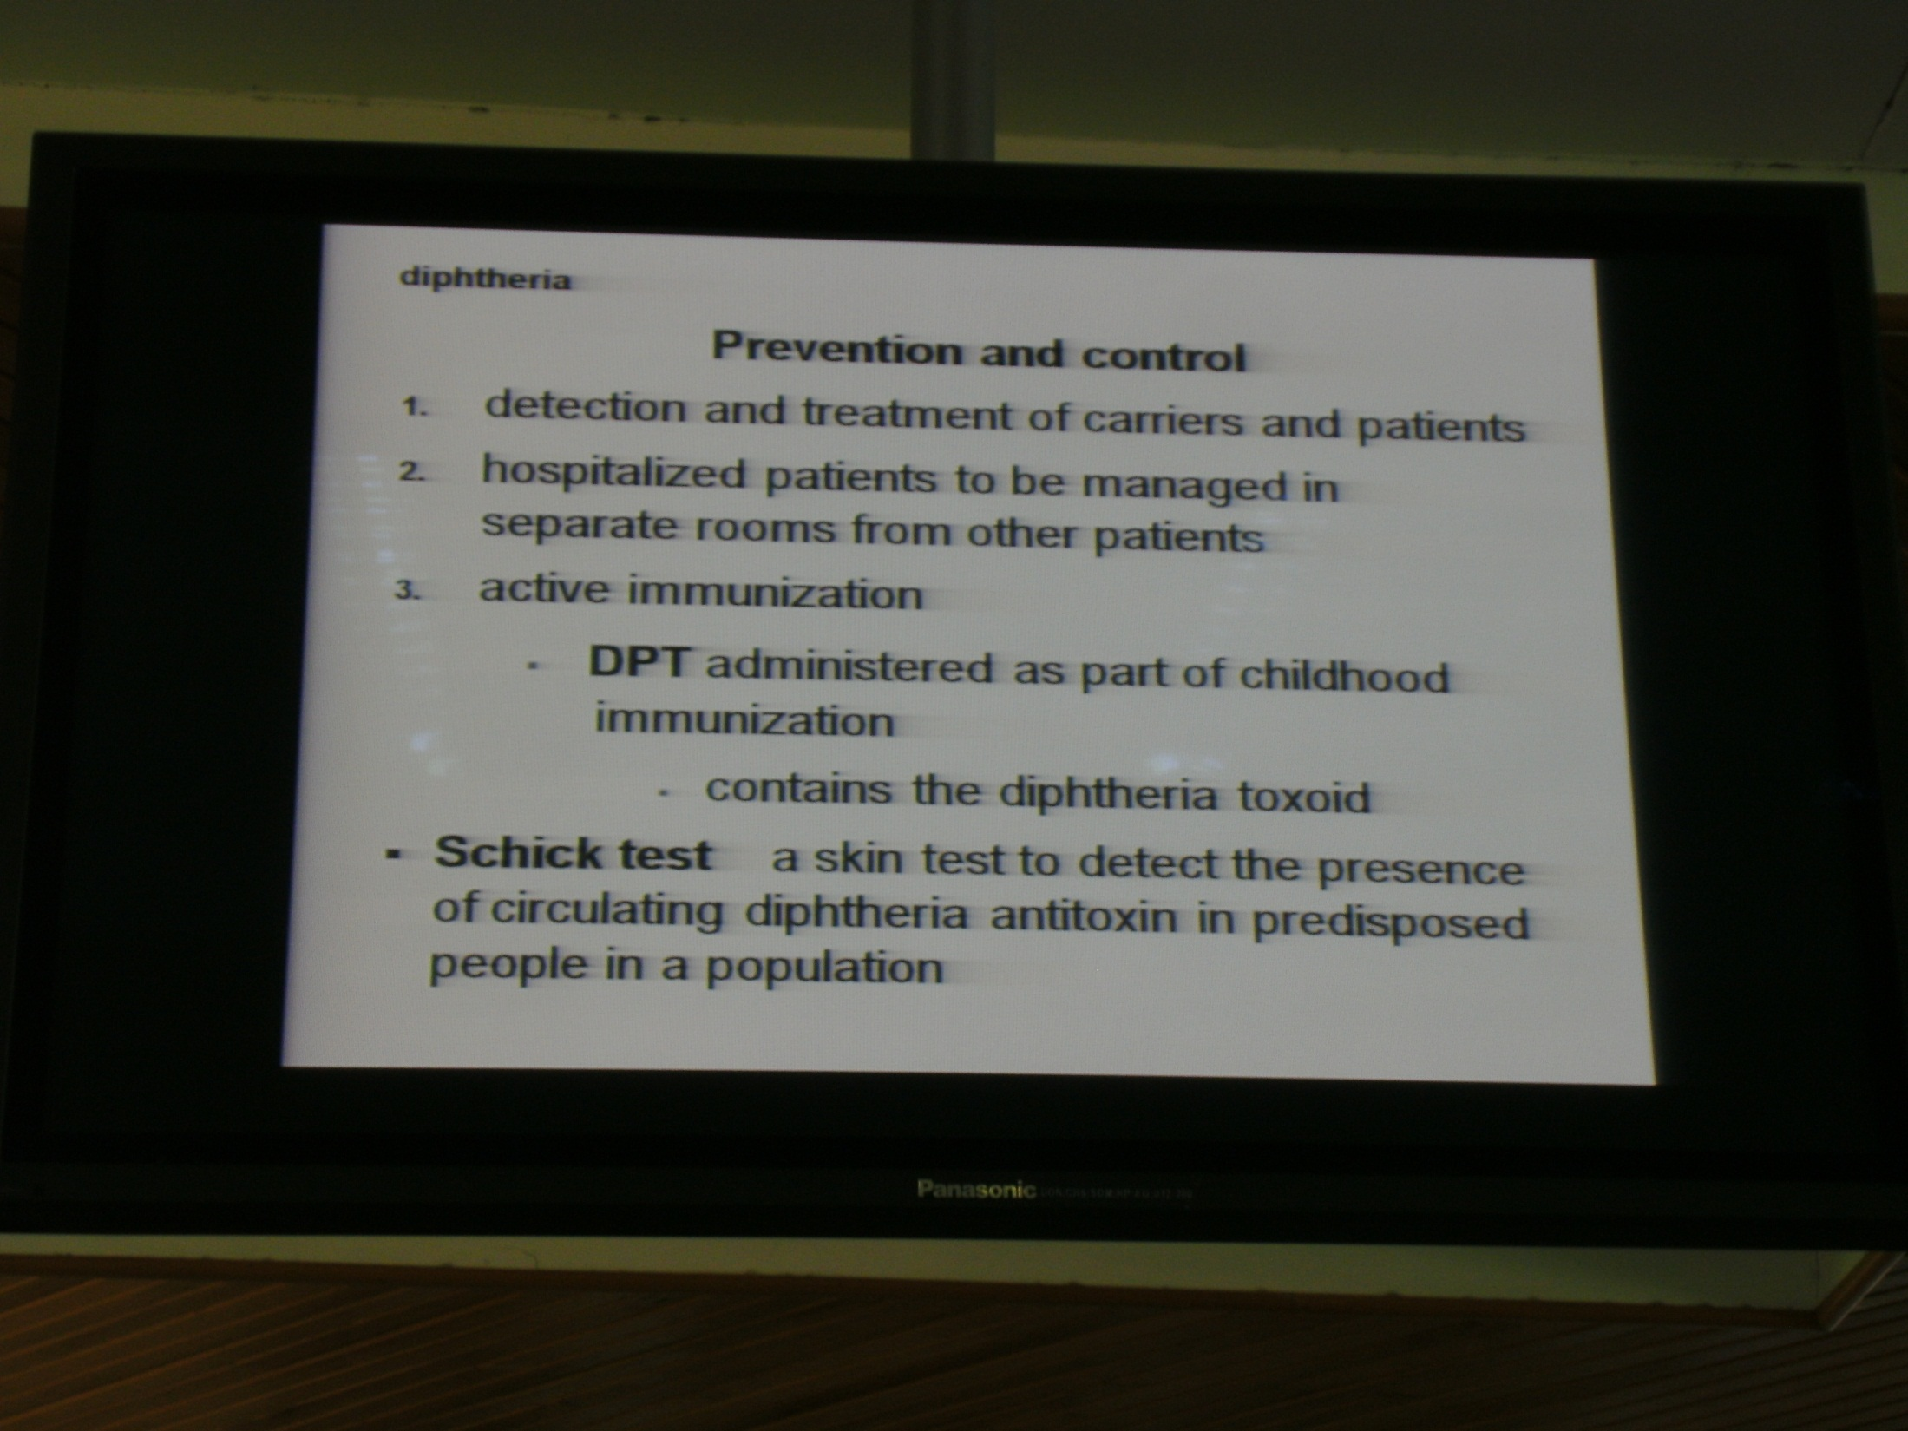

Slide 19
Diphtheroids
Are rarely associated with diseases but rather opportunistic infections
Are microscopically indistinguishable from the C. diptheriae

